Slide 1
Joint Unsupervised and Supervised Training for Multilingual ASR
Junwen Bai, Cornell University
Joint work with: Bo Li, Yu Zhang, Ankur Bapna, Nikhil Siddhartha, Khe Chai Sim, Tara N. Sainath

Slide 2
Multilingual ASR
Concerned with dealing with multiple languages with one model
In a production setting
Training, deploying and maintaining one model per language, especially on long tail of low-resource languages, can quickly become cumbersome as the number of languages increases
A single model for all languages can simplify the production pipeline significantly
Training multilingual ASR models on a small set of similar languages can improve recognition performance
Support the use case of code-switching
Goal: A single E2E model for multiple languages
Improve automatic speech recognition (ASR) performance on low-resource languages
Overall simplify deployment of ASR systems to support diverse languages

Slide 3
Existing Multilingual ASR corpus
IARPA Babel Program
24 languages, from conversational telephone speech
labeled data range from 25 to 65 hours per language
not released
(public) VoxForge
15 different languages
remains low-scale (300h in total)
(public) CommonVoice
more than 30 languages
In total with 4500h so far
(In-house) VoiceSearch
15 languages from 9 distinct language families
360k hours in total
Even the smallest language, Malay, has 7.6k hours

Slide 4
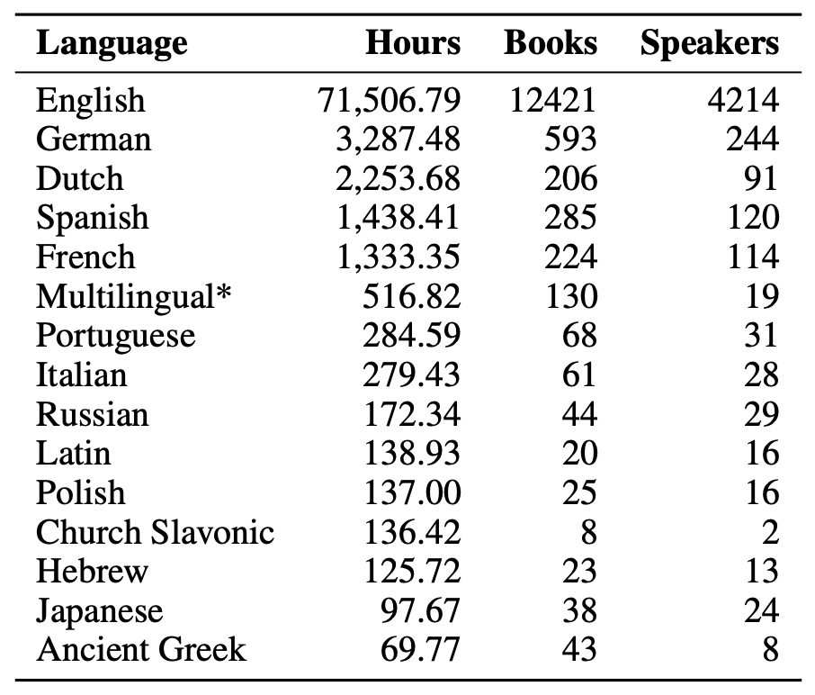
Multilingual LibriSpeech (MLS)
Monolingual LibriSpeech
derived from the LibriVox data
ships with about 1000 hours of labeled audio, obtained by leveraging alignments between textbooks and their read (audio) counterpart
A great success as a standard, freely available ASR benchmark
LibriVox top 15 languages

Slide 5
Multilingual LibriSpeech (MLS)
While English is the most dominant language in LibriVox, there is a significant amount of audio hours present for other languages
MLS selects English(en), German(de), Dutch(nl), Spanish(es), French(fr), Portuguese(pt), Italian(it), Polish(pl)
Based on the number of audiobook hours and the availability of the corresponding text sources
All the audio data is downsampled from 48kHz to 16kHz for further processing

Slide 6
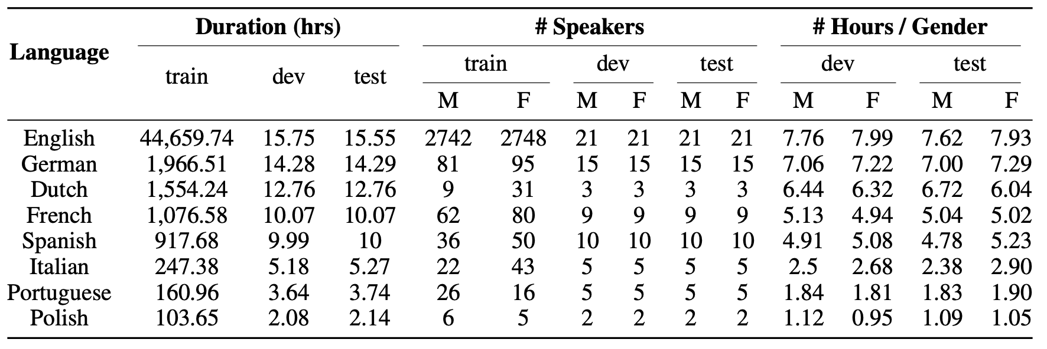
Multilingual LibriSpeech (MLS)
English has up to 44.6k hrs
Portuguese and Polish only have as low as ~100 hrs

Slide 7
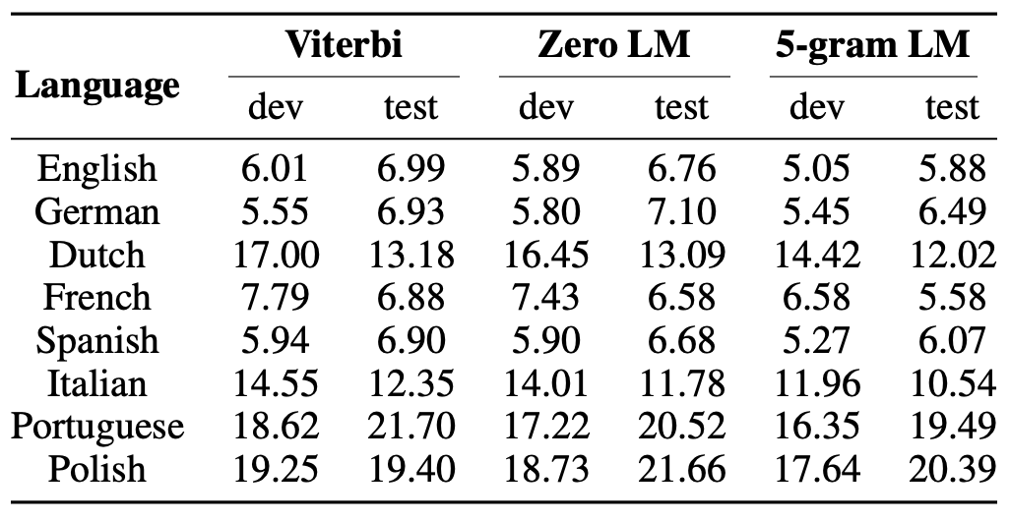
Prior works
Train an ASR model for each language
Monolingual Baseline WER with different decoding strategies using wav2letter++ *
Low-resource languages have very bad WERs
* Pratap et al., “MLS: A Large-Scale Multilingual Dataset for Speech Research”, InterSpeech, 2020

Slide 8
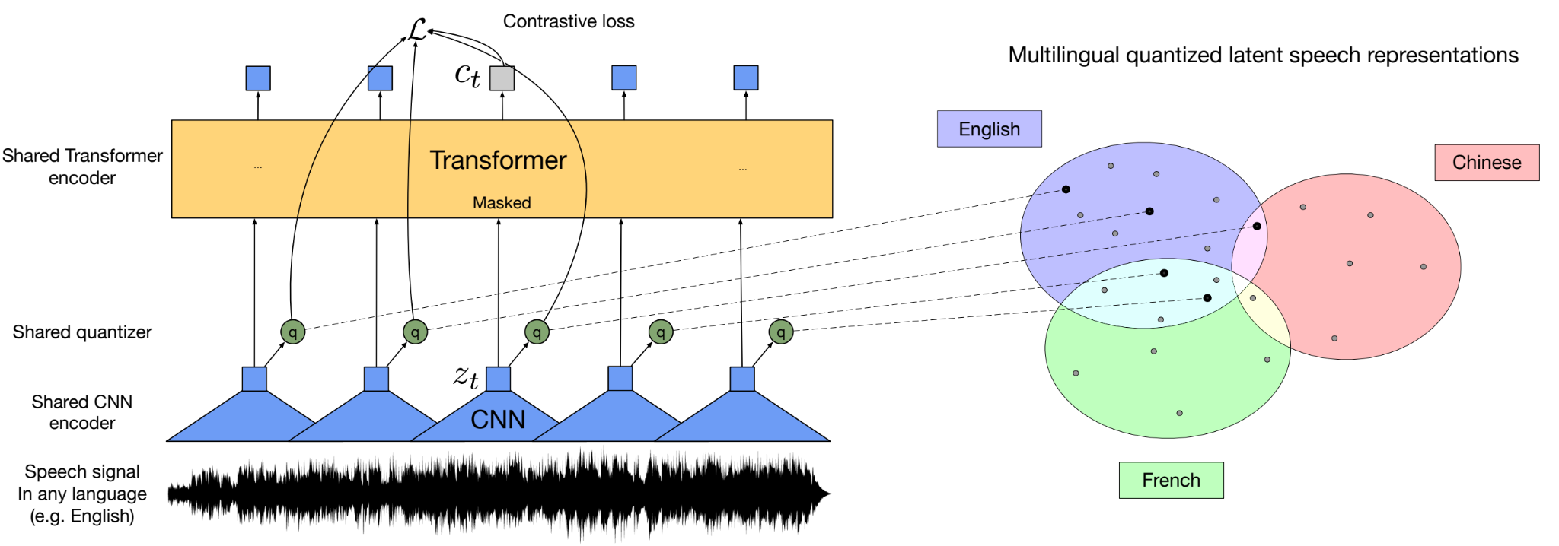
Prior works
Cross-Lingual Speech Recognition (XLSR)*
2-stage pretrain+finetune framework based on wav2vec2
A shared quantization module over feature encoder representations produces multilingual quantized speech units/tokens
embeddings are then used as targets in contrastive learning
* Conneau et al., “Unsupervised cross-lingual representation learning for speech recognition”, 2020

Slide 9
Prior works
Decoder
Transfer learning
Trained on VoiceSearch and then transferred to MLS
An attention-based encoder-decoder model
Using GShard, an elegant way to express a wide range of parallel computation patterns with minimal changes
Block 3
Conformer Layer
xN
projection
Block 2
Conformer Layer
Time stacking layer
Block 1
Conformer Layer
x4
Position embedding
Input projection
Input Features
* Li et al., “Scaling end-to-end models for large-scale multilingual ASR”, ASRU, 2021

Slide 10
Joint Unsupervised and Supervised Training
Concerns for pretrain+finetune
catastrophic forgetting
The model might forget the previously learnt knowledge
pretrained checkpoint selection
The downstream performance varies from one checkpoint to another
The one pretrained longer is not necessarily the best one
Different languages are often heterogeneous and the corpus is often imbalanced
We propose to train the model with both supervised and self-supervised losses jointly
Reconcile the gradients provided by both types of losses
Mutually regularize each other
Unsupervised losses
Contrastive loss
Masked language model (MLM) loss
Supervised loss
RNN-T

Slide 11
JUST
Feature encoder
Conv downsample
2 Convolutional layers
Extract latent representations from the surface features (log-mel filter bank)
Quantization
Encoded features are passed to a quantizer without masking
Quantizer “summarizes" all the latent speech representations to a finite set (codebook) of representative discriminative speech tokens
Output both the quantized token + token ID
Target Context Vectors
Discretized IDs
Linear
Masking
Quantization
Feature Encoder
Convolutional subsampling
Encoded Features
Input Features

Slide 12
JUST
Contrastive Module
A stack of Conformer blocks
Read the encoded features with masking
Extract context vectors from feature encoder output for computing the w2v2 contrastive loss
Decoder
objective
Context Vectors
RNN-T loss
MLM Module
Conformer Block
...
MLM Loss
Conformer Block
MLM Module
From w2v-bert*
Continue to extract context vectors (from the contrastive module’s output) for computing the MLM loss
Cross-entropy with ground-truth token IDs
Context Vectors
Contrastive Loss
Contrastive Module
Conformer Block
...
Target Context Vectors
Conformer Block
Discretized IDs
Linear
Masking
Quantization
Decoder Module
2-layer LSTM
RNN-T loss
Feature Encoder
Convolutional subsampling
Encoded Features
Diversity Loss
* Chung et al., “W2v-bert: Combining contrastive learning and masked language modeling for self-supervised speech pre-training”, 2021
Input Features
Final JUST loss = $L_{s}+β⋅(L_{c}+L_{m}+0.1⋅L_{d})$

Slide 13
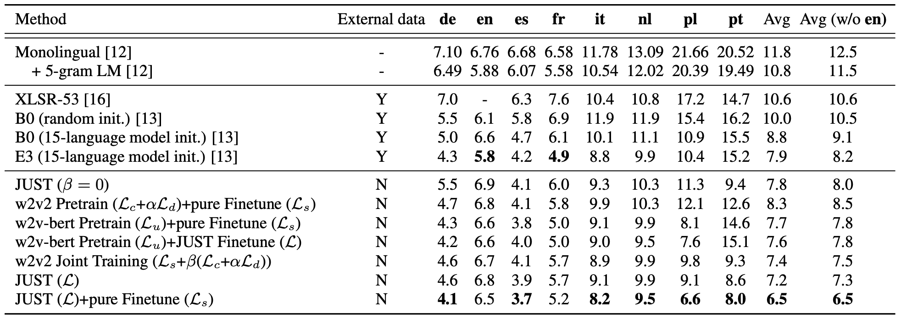
Multilingual LibriSpeech (MLS)
On average WER of all 8 languages, all JUST-based methods outperform previous works. In particular, JUST (with β=0.07) outperforms the monolingual baseline with 5-gram LM by 33.3%, XLSR-53 by 32.0%, B0 by 18.2%, E3 by 8.8%

Slide 14
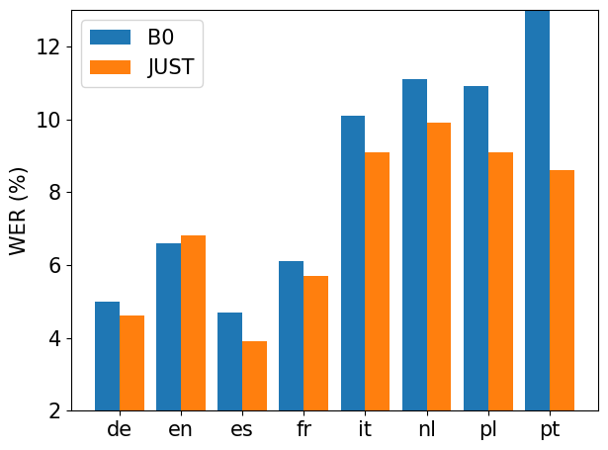
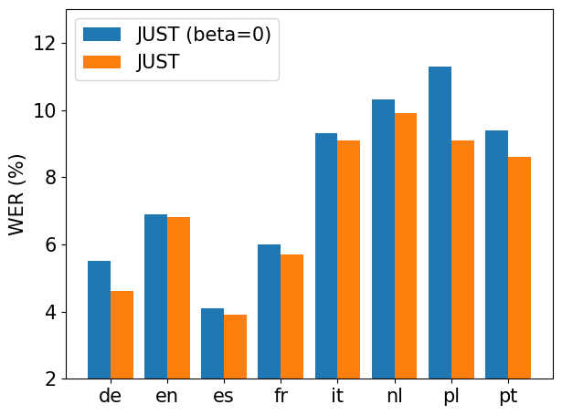
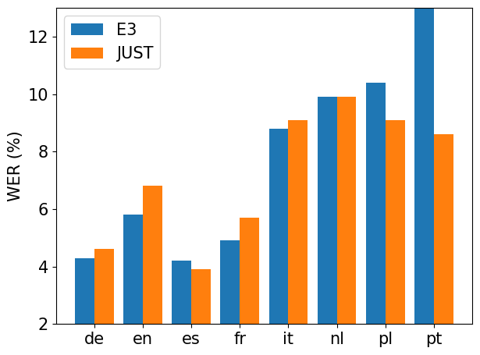
Per Language
B0 vs JUST
JUST (β=0) vs JUST
E3 vs JUST

Slide 15
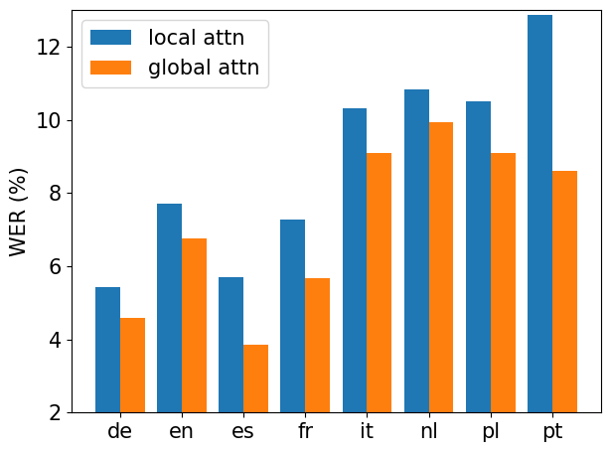
Attention
We compare two attention mechanisms for JUST from scratch:
a local attention mechanism with both left and right context 128
a global attention mechanism with full context
Global attention clearly outperforms local attention on all languages

Slide 16
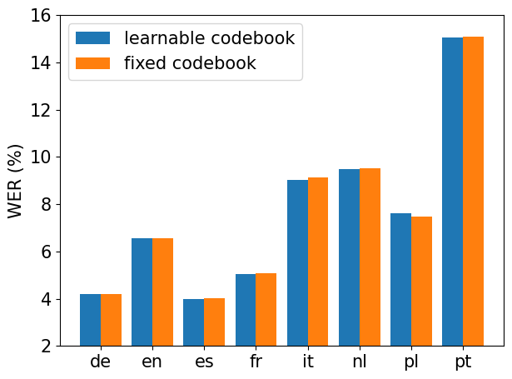
Codebook
Original w2v2 doesn't update codebook in the finetuning phase. JUST finetuning, however, keeps the unsupervised loss and could further update the codebook
We compare the performance with learnable or fixed codebook during JUST finetuning
Their results are close
This implies that fixing codebook in JUST finetuning would not degrade the performance

Slide 17
Take-aways
When the task is known, self-supervision can still further boost the performance when combined with supervision
Joint training can reconcile the self-supervised signals and supervised signals, especially in the complex task like multilingual ASR

Slide 18
Q & A
Thanks for listening!

