Slide 1
Complex Ratio Masking for Singing Voice Separation
Yixuan Zhang¹, Yuzhou Liu¹, DeLiang Wang^{1,2}
1. Department of Computer Science & Engineering, The Ohio State University
2. Center of Cognitive and Brain Sciences, The Ohio State University
ICASSP 2021

Slide 2
Outline
Motivation
Proposed methods
Complex SA-DenseUNet
Multi-context Averaging
Experimental results
Comparisons of different training targets
Multi-context Averaging
Comparison with other methods
Concluding Remarks

Slide 3
Outline
Motivation
Proposed methods
Complex SA-DenseUNet
Multi-context Averaging
Experimental results
Comparisons of different training targets
Multi-context Averaging
Comparison with other methods
Concluding Remarks

Slide 4
Singing Voice Separation
Fundamental and popular topic in music information retrieval
Aims to separate singing voice and accompaniment from music mixture
Commercial applications:
Karaoke industry
Lyrics generation
Singer identification

Slide 5
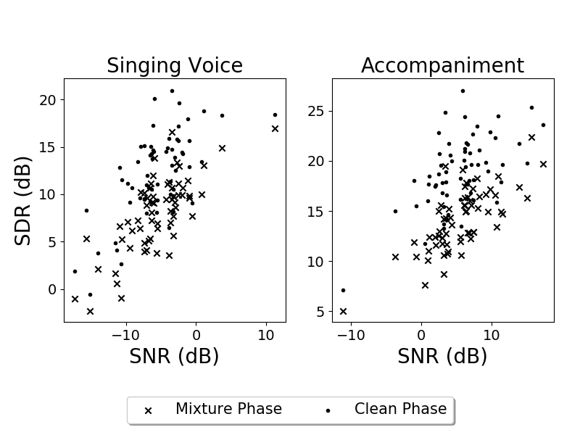
Importance of phase in singing voice separation
We use SA-DenseUNet [1] to estimate magnitude spectrograms of singing voice and accompaniment for 63 songs with different signal-to-noise ratios
We compare the signal-to-distortion ratio (SDR) of output audios re-synthesized with clean phase versus mixture phase
For both singing voice and accompaniment, the use of clean phase leads to considerable improvement, about 4 to 5 dB on average
Y. Liu, B. Thoshkahna, A. Milani, and T. Kristjansson, “Voice and accompaniment separation in music using self-attention convolutional neural network,” arXiv preprint arXiv:2003.08954, 2020.

Slide 6
Outline
Motivation
Proposed methods
Complex SA-DenseUNet
Multi-context Averaging
Experimental results
Comparisons of different training targets
Multi-context Averaging
Comparison with other methods
Concluding Remarks

Slide 7
Complex SA-DenseUNet
Extended from SA-DenseUNet [1]
Input has three dimensions: frequency, time and channel, with the real and imaginary components treated as two separate channels
Estimate the real and imaginary components of the complex ideal ratio mask (cIRM) of each source
The estimated complex ratio masks are then multiplied with the complex STFT of the mixture audio to get the estimated complex STFT of each source
Loss function
$$L=\sum_{j=1,2}{[\left|Re(S_{j}−{cRM}_{j}⊙Y)\right|+\left|Im(S_{j}−{cRM}_{j}⊙Y)\right|]}$$
where ${cRM}_{j}$ is an estimate of the cIRM for source $j$, and $⊙$ denotes element-wise multiplication. $Y$ denotes the complex STFT of the input mixture, and $S_{1}$ and $S_{2}$ represent the complex STFT of singing voice and accompaniment, respectively.
Y. Liu, B. Thoshkahna, A. Milani, and T. Kristjansson, “Voice and accompaniment separation in music using self-attention convolutional neural network,” arXiv preprint arXiv:2003.08954, 2020.

Slide 8
Multi-context Averaging
We exploit different contexts of the input by using different window lengths.
P DNNs are used form a DNN ensemble and every DNN has a different window length.
Given the mixture Y and the corresponding clean singing voice S₁ and accompaniment S₂, the $p$th DNN is trained to estimate the real and imaginary components of the STFT of S₁ and S₂ with window length set to $w_{p}$.
In the test stage, for the $p$th DNN, the corresponding complex STFT is also computed with window length $w_{p}$. The outputs of all P DNNs are transformed to the time domain by inverse STFT. After that, we calculate the average of waveform outputs by
$$\hat{s_{j}}=\frac{1}{P}∙\sum_{p=1}^{P}{\hat{s_{j,p}}}$$
where $\hat{s_{j}}$corresponds to the final estimated singing voice for j = 1 and accompaniment for j = 2. $\hat{s_{j,p}}$corresponds to the estimated sound waveform from the $p$th DNN.

Slide 9
Outline
Motivation
Proposed methods
Complex SA-DenseUNet
Multi-context Averaging
Experimental results
Comparisons of different training targets
Multi-context Averaging
Comparison with other methods
Concluding Remarks

Slide 10
Experimental Setup
Training Set
Contains 450 songs, in which 50 are from DSD100’s Dev Set and 400 songs are generated by randomly scaling, shifting, remixing different music sources from these 50 songs for data augmentation
Validation Set
Contains one third of tracks from MedleyDB and CCMixter and half of tracks from DSD100’s Test Set.
Test Set
Contains another third of tracks from MedleyDB and CCMixter, and the remaining half of DSD100’s Test Set
Evaluation
Use mir_eval [2] to calculate the average SDR, SIR, SAR of each song.
[2] C. Raffel, B. McFee, E. J. Humphrey, J. Salamon, O. Nieto, D. Liang, D. P. Ellis, and C. C. Raffel, “mir eval: A transparent implementation of common mir metrics,” in Proc. of ISMIR, 2014.

Slide 11
Comparison of different training targets
Table 1 Comparisons of different training targets
 | Singing Voice |  |  | Accompaniment
Metric (dB) | SDR | SIR | SAR | SDR | SIR | SAR
TMS | 8.08 | 15.44 | 9.34 | 14.10 | 18.42 | 16.50
TCS | 8.40 | 18.74 | 9.07 | 14.50 | 22.29 | 15.70
cIRM-CS | 8.92 | 20.04 | 9.54 | 14.99 | 23.06 | 16.12
We compare a magnitude-domain and two complex-domain objectives
TMS refers to target magnitude spectrum
TCS refers to target complex spectrum
cIRM-CS refers to cIRM with loss function defined in complex spectrum
Complex-domain training targets achieve better SDR and SIR performances compared with the target magnitude spectrum (TMS)
The proposed cIRM-CS performs uniformly better than the TCS, and achieves the best SDR score.

Slide 12
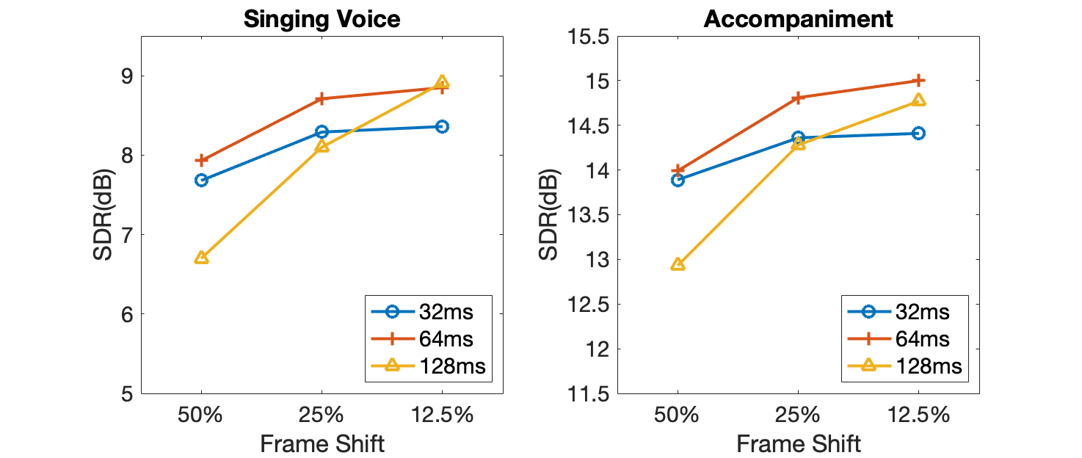
Multi-context averaging
To create input with different contexts, we first train our complex SA-DenseUNet with different window lengths and shifts.
We test three window lengths, i.e. 32 ms, 64 ms, 128 ms and for each window length, three frame shifts: 12.5%, 25%, 50%.
With the same window length, the performance improves with reduced frame shift for both singing voice and accompaniment.

Slide 13
Multi-context averaging
Table 2 Average test results on the test sets
 | Singing Voice |  |  | Accompaniment
Metric (dB) | SDR | SIR | SAR | SDR | SIR | SAR
Complex SA-DenseUNet | 9.09 | 20.15 | 9.76 | 15.21 | 22.77 | 16.45
Multi-context Averaging | 9.73 | 20.76 | 10.36 | 15.57 | 21.78 | 17.28
Three complex SA-DenseUNets whose window lengths of 32 ms, 64 ms, 128 ms to create a multi-context averaging (MCA) ensemble, all with 12.5% frame shift.
We compare the MCA ensemble and the single best window length of 64 ms with 12.5% frame shift.
The MCA network improves the mean SDRs of singing voice and accompaniment by 0.64 dB and 0.36 dB respectively.

Slide 14
Overall evaluation and comparison with other methods
Table 2 Comparison of median SDR values on DSD100 datasets
Metric (dB) | Singing Voice | Accompaniment
MMDenseNet [3] | 6.00 | 12.10
MMDenseLSTM [4] | 6.31 | 12.73
SA-SHN-4 [5] | 6.44 | 12.60
SA-DenseUNet [1] | 7.72 | 13.90
Proposed | 9.78 | 15.20
Compare with four state-of-the-arts methods
The comparisons are conducted on DSD100 Test Set
Our method outperforms SA-DenseUNet by 2.06 dB for singing voice and 1.3 dB for accompaniment

Slide 15
Outline
Motivation
Proposed methods
Complex SA-DenseUNet
Multi-context Averaging
Experimental results
Comparisons of different training targets
Multi-context Averaging
Comparison with other methods
Concluding Remarks

Slide 16
Concluding Remarks
This study addresses complex-domain deep learning for singing voice separation.
We observe that phase is important for singing voice separation. We find the cIRM to be an effective training target when the loss is defined in terms of complex spectrogram.
A simple ensemble technique is introduced to further improve separation performance.
Systematic evaluation results show that the proposed method produces outstanding separation results, outperforming current state-of-the-art methods.

Slide 17
Reference
Y. Liu, B. Thoshkahna, A. Milani, and T. Kristjansson, “Voice and accompaniment separation in music using self-attention convolutional neural network,” arXiv preprint arXiv:2003.08954, 2020.
C. Raffel, B. McFee, E. J. Humphrey, J. Salamon, O. Nieto, D. Liang, D. P. Ellis, and C. C. Raffel, “mir eval: A transparent implementation of common mir metrics,” in Proc. of ISMIR, 2014.
N. Takahashi and Y. Mitsufuji, “Multi-scale multi-band densenets for audio source separation,” in Proc. WASPAA, 2017, pp. 21–25.
N. Takahashi, N. Goswami, and Y. Mitsufuji, “MMDenseLSTM: An efficient combination of convolutional and recurrent neural networks for audio source separation,” in Proc. 16th IEEE International Workshop on Acoustic Signal Enhancement, 2018, pp. 106–110.
W. Yuan, S. Wang, X. Li, M. Unoki, and W. Wang, “A skip attention mechanism for monaural singing voice separation,” IEEE Signal Processing Letters, vol. 26, pp. 1481–1485, 2019.

