Slide 1
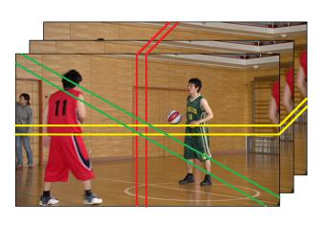
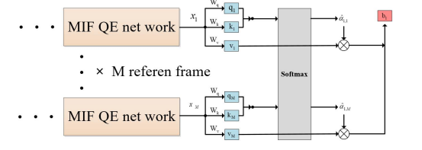
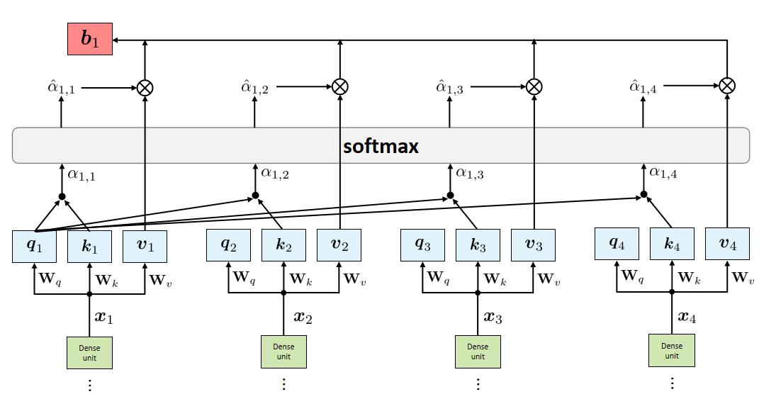
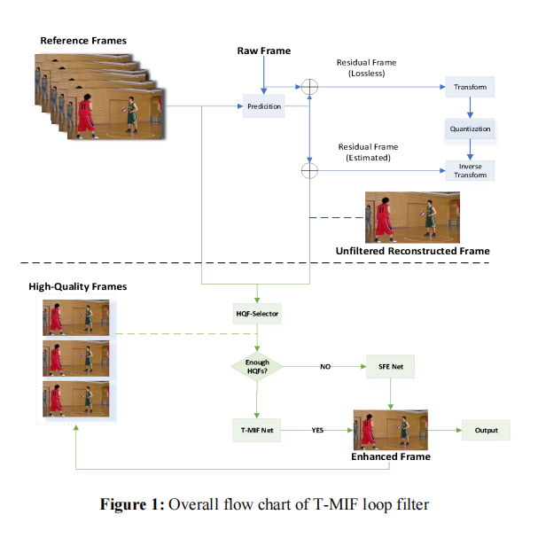
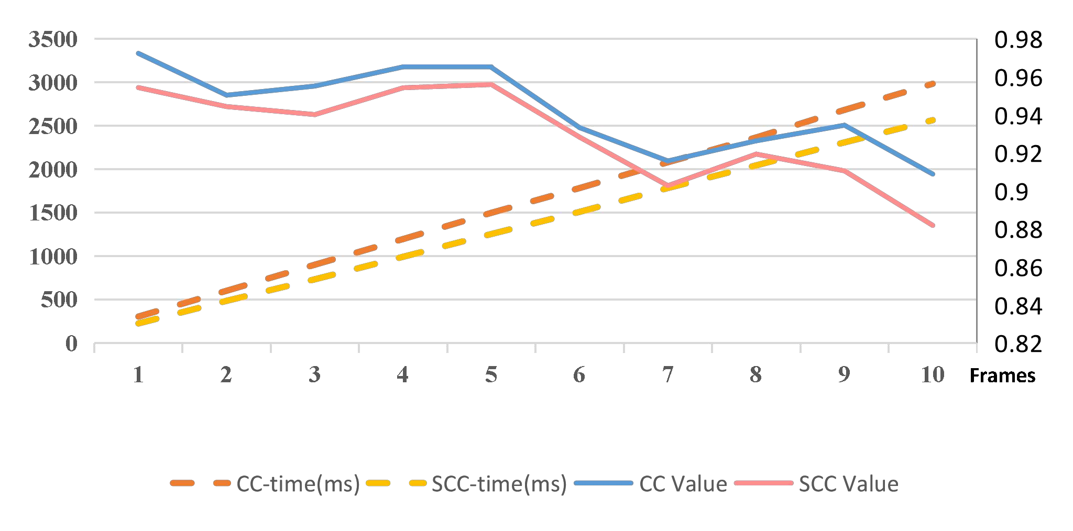
An Improved Multi-reference Frame Loop Filter Algorithm Based on Transformer for VVC Zhi Liu*, Yunpeng Duan+ and Mengmeng Zhang* North China University of Technology, BeiJing, China lzliu@ncut.edu.cn,838011080@qq.com,muchmeng@126.com
Abstract
Figure 2: Schematic diagram of SCC
Figure 3: T-MIF structure overview
Figure 4: Transformer structure for quality enhanced network
Deep learning methods have been achieving good results at the in-loop filtering stage in Versatile Video Coding(VVC). The Multi-Frame In-Loop Filter of HEVC (MIF) algorithm is one of the networks that effectively utilizes the multiple reference frames to enhance the quality of reconstruction. However, it has the disadvantages of low efficiency of the reference frame selection, and its quality enhancement network does not fully utilize the inter-frame correlations of the video sequence and has large redundancy. To address these problems, an improved multi-reference frame loop filter algorithm based on transformer optimization (T-MIF) is proposed.
The Proposed Strategy
Experimental Results
To improve the efficiency of the reference frame selection and quality enhancement network, this paper made two improvements based on MIF, which include a high-efficiency reference frame selector and a Quality enhancement network with an additional transformer module.
First, this algorithm improves the original MIF high-quality reference frame selector with slice correlation coefficient(SCC) to reduce the computational complexity. Based on the characteristics of strong inter-frame continuity of video sequences, this algorithm replaces CC(correlation coefficient) with SCC, taking pixels of appropriate width in each of the three directions: diagonal, vertical, and horizontal, the rest of the areas are not involved in the SCC calculation to reduce the computational boost caused by the computation of CC. In addition to SCC and PSNR, SSIM is added as additional filtering conditions to make better use of inter-frame continuity.
Then, to utilize the inter-frame correlations of a video sequence and reduce network redundancy, this algorithm designs the T-MIF network. The feature maps of multiple reference frames obtained through the original MIF quality enhancement (QE) network enter the transformer structure after feature exchange, and the video quality is improved by weighting the features of multiple reference frames.
To ensure the fairness and scientificity of the experiment, the MIF algorithm is reproduced on VTM and named VTM-based MIF. The operating system used for this experiment is ubuntu 18.04, the graphics card is 2080 Ti, and the CPU is E5 2678 V3. The experimental data used in this paper are the average values of a total of 18 video sequences from Class C to Class F of standard video sequences, tested at four different QPs (22, 27, 32, 37).
From Figure 5, it can be found that the error of SCC value relative to CC value is always kept below 3%, and the time is reduced by about 15% on average. The effect of SCC cannot be measured only by the numerical error rate, but also by the misselection rate. The case that CC is judged the frame to meet the minimum threshold and the slice CC is judged the frame not meet the minimum threshold due to the error is regarded as misselection, and a total of 40 unfiltered reconstructed frames are counted in this paper, of the total 400 interval frames corresponding to it, 17 frames were misselected, with a misselection rate of 4.25%.
Experimental results show that compared with VTM13.0 and MIF respectively, the proposed T-MIF algorithm can achieve on average 7.469%, 1.306% saving of the BD-BR and 0.192dB, 0.101 dB of BD-PSNR increase on the standard test set.
Class | Sequence | Random Access
 |  | VTM 13.0 |  | MIF |  | T-MIF
 |  | BD-BR | BD-psnr (dB) | BD-BR (%) | BD-psnr (dB) | BD-BR (%) | BD-psnr (dB)
C | BasketballDrill | -5.011% | 0.335 | -10.256% | 0.411 | -11.923% | 0.515
 | BQMall | -3.942% | 0.289 | -9.323% | 0.367 | -10.871% | 0.421
 | PartyScene | -1.031% | 0.162 | -4.161% | 0.182 | -5.847% | 0.311
 | RaceHorses | -6.181% | 0.331 | -12.875% | 0.479 | -14.519% | 0.586
D | BasketballPass | -3.835% | 0.265 | -9.996% | 0.480 | -11.232% | 0.589
 | BlowingBubbles | -0.799% | 0.211 | -3.989% | 0.163 | -4.879% | 0.291
 | BQSquare | -0.061% | 0.269 | -4.391% | 0.166 | -5.311% | 0.263
 | RaceHorses | -4.451% | 0.351 | -10.979% | 0.511 | -12.196% | 0.652
E | FourPeople | -7.031% | 0.383 | -16.471% | 0.639 | -17.601% | 0.721
 | Johnny | -5.631% | 0.282 | -14.392% | 0.383 | -15.436% | 0.447
 | KristenAndSara | -6.423% | 0.414 | -15.352% | 0.518 | -16.735% | 0.611
Average |  | -4.036% | 0.299 | -10.199% | 0.391 | -11.505% | 0.492
The Flowchart of Proposed Strategy
Table 2. Experimental results of the proposed algorithm
Figure 5:Values and times between SCC and CC
Figure 1: Overall flow chart of T-MIF loop filter
Figure 2: flow chart of High Quality frame selector
2022 Data Compression Conference

