Slide 1
Emotion Neural Transducer for Fine-Grained Speech Emotion Recognition
Siyuan Shen^{1,2}, Yu Gao², Feng Liu¹, Hanyang Wang¹, Aimin Zhou¹
1 East China Normal University, Shanghai, China
2 Midea Group, Shanghai, China
PRESENTED BY: SIYUAN SHEN

Slide 2
Background
Speech Emotion Recognition (SER) aims to recognize the emotional states expressed in spoken language.
Mainstream SER paradigm is identifying the single emotion label of the entire utterance.
Sequence-to-label
Input: “Shh…If we are really quiet, the fish might come… I've got a bite !!”
Output: <excited>

Slide 3
Motivation – Fine-grained SER
Emotional states inherently exhibit diverse temporal dynamics.
We aim to recognize emotions at a fine temporal granularity.
Sequence-to-sequence
Input: “Shh…If we are really quiet , the fish might come… I've got a bite !!!”
Output: <neutral>…<neutral> … <excited> …<excited>

Slide 4
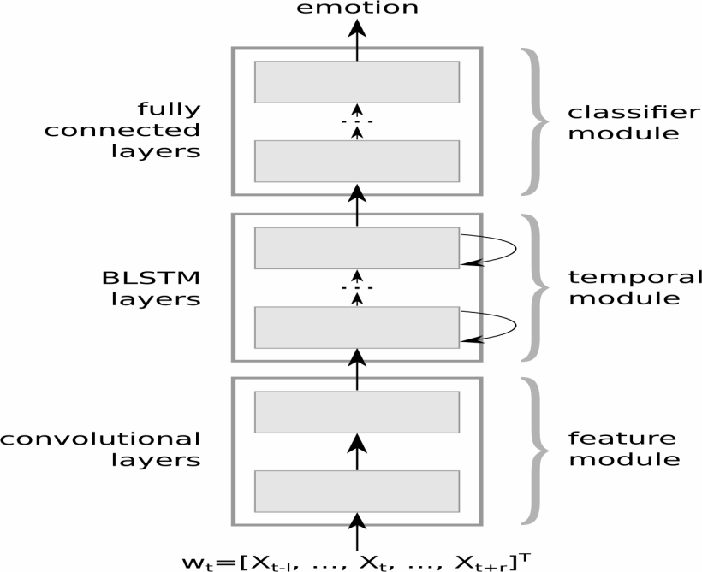
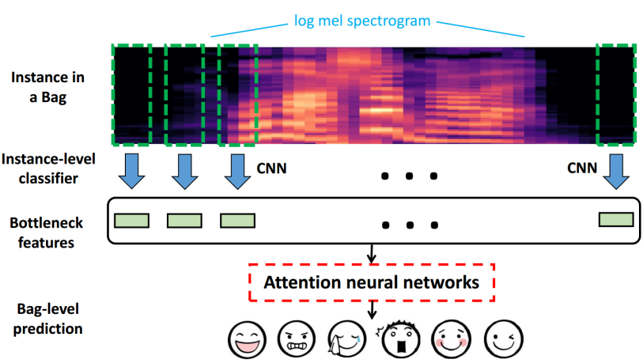
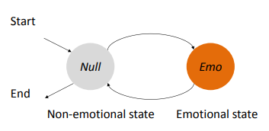
Related Works – Fine-grained SER
Aligning frames and emotional labels in a weakly supervised manner
Limitations
Acoustic only
Evaluated on utterance-level dataset
Frame-wise
Segment-wise
CTC
Huang, Che-Wei, and Shrikanth Shri Narayanan. "Deep convolutional recurrent neural network with attention mechanism for robust speech emotion recognition." 2017 IEEE international conference on multimedia and expo (ICME). IEEE, 2017.
Mao, Shuiyang, et al. "Advancing Multiple Instance Learning with Attention Modeling for Categorical Speech Emotion Recognition." Interspeech 2020 (2020).
Han, Wenjing, et al. "Towards Temporal Modelling of Categorical Speech Emotion Recognition." Interspeech 2018 (2018).

Slide 5
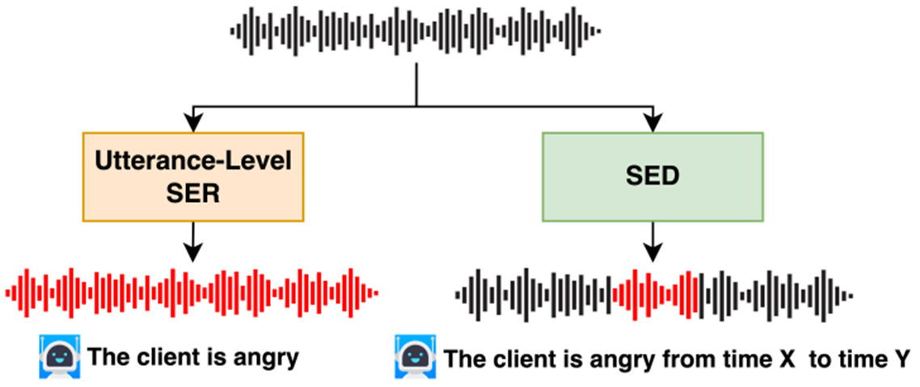
Related Works – Speech Emotion Diarization
Benchmark for Speech Emotion Diarization task (SED)
Zaion Emotion Dataset (ZED) for evaluation only
Wang, Yingzhi, Mirco Ravanelli, and Alya Yacoubi. "Speech emotion diarization: Which emotion appears when?." 2023 IEEE Automatic Speech Recognition and Understanding Workshop (ASRU). IEEE, 2023.

Slide 6
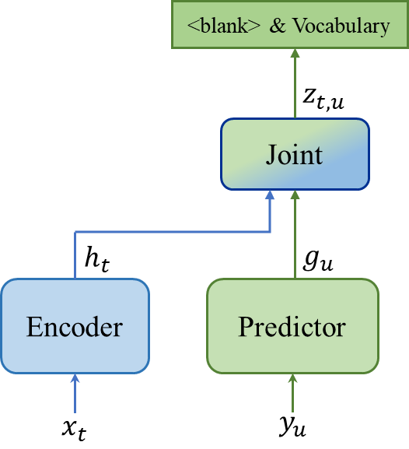
Extending Neural Transducer for Fine-grained SER
Inspiration from Neural transducer for sequence alignment
Automatic Speech Recognition
Input: “Shh…If we are really quiet , the fish might come… I've got a bite !!!”
Output: Shh…<blank> If we are <blank> really <blank> quiet <blank>, the fish <blank> might come <blank>… I've got <blank> a bite !!! <blank>
<blank> as accumulation of text and speech
Make <blank> as emotion indicator
Automatic Speech Recognition with fine-grained SER
Input: “Shh…If we are really quiet , the fish might come… I've got a bite !!!”
Output: Shh…<neutral> If we are <neutral> really <neutral> quiet <neutral>, the fish <neutral> might come <neutral>… I’ve got <excited> a bite!!! <excited>

Slide 7
Proposed Method
Emotion Neural Transducer for fine-grained SER with ASR joint training
Lattice max-pooling for distinguishing emotional and non-emotional frames in a weak supervision manner
Factorized Emotion Neural Transducer biased to transducer inference manner
Perform frame-level emotion recognition
Leverage both acoustic and linguistic information
Generate transcripts along with emotion synchronously

Slide 8
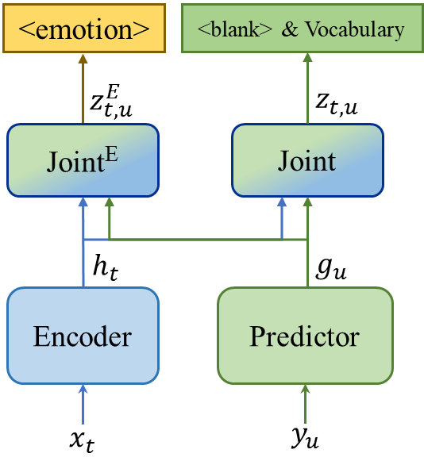
Emotion Neural Transducer (ENT)
Joint network for emotion
Standard Neural Transducer
Emotion Neural Transducer

Slide 9
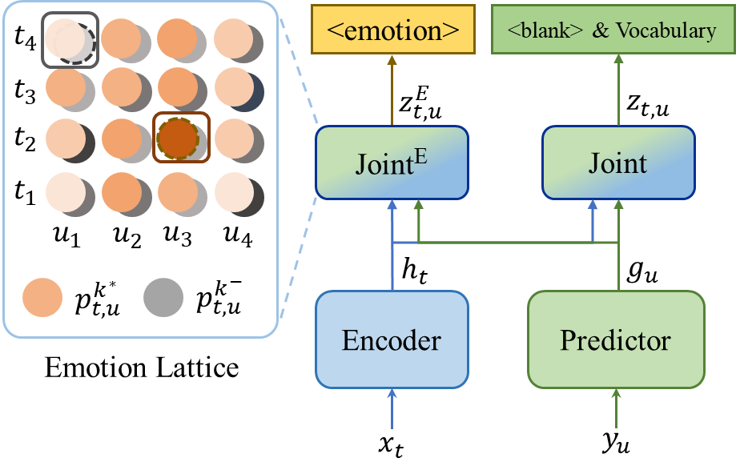
Lattice Max Pooling Loss
Each node $p_{t,u}$denotes the emotion probability distribution having output $u$tokens by frame $t$.
Apply loss to the most and least significant node.
$$ℒ_{lattice}=−\log{\max_{t,u}{(p_{t,u}^{k^{∗}})} } − \log{\min_{t,u}{{(p}_{t,u}^{k^{−}})}}$$
highest target emotion probability
minimum neutral probability

Slide 10
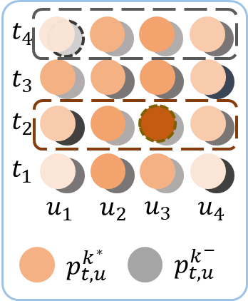
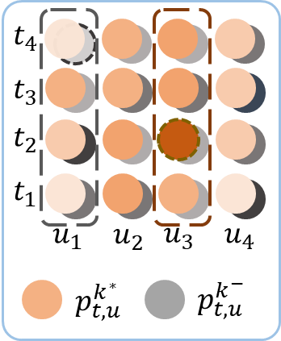
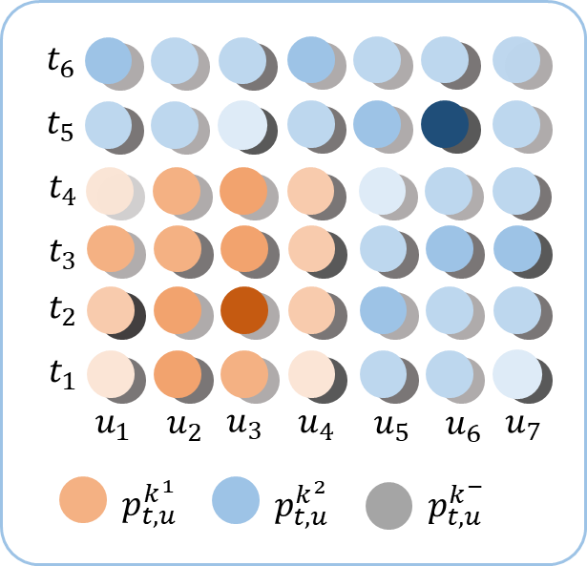
Lattice Max Pooling Loss – Some Variants
$$ℒ_{lattice}^{T}$$
$$ℒ_{lattice}^{U}$$
Mixing

Slide 11
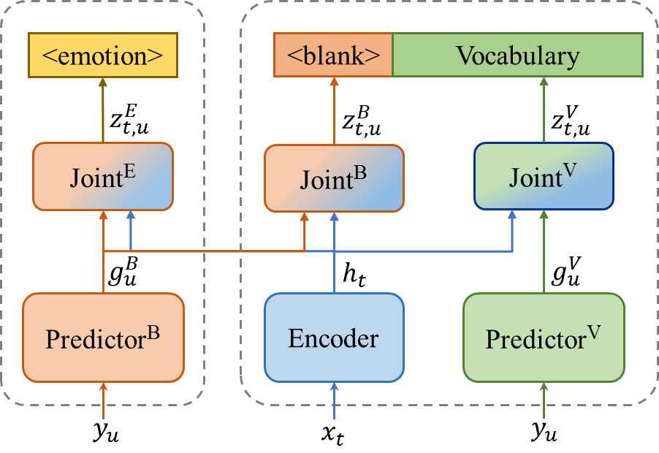
Factorized Emotion Neural Transducer
Bias the <blank> symbol towards emotion prediction:
Disentangle <blank> from vocabulary prediction.
Use separate blank predictor and blank joint network.
Share the predictor for both emotion and blank prediction.

Slide 12
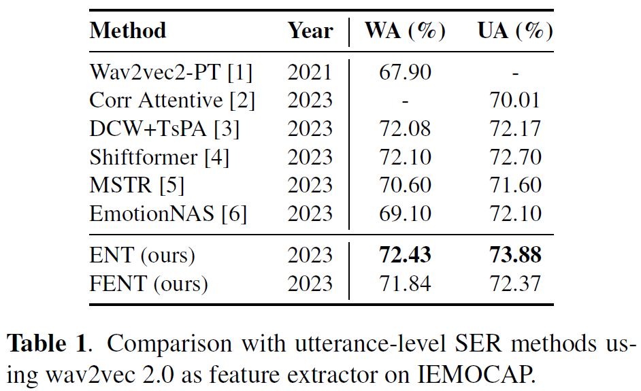
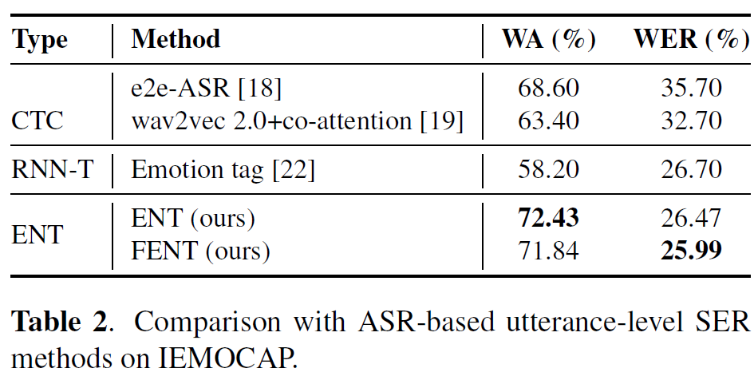
Experiments – Utterance-level SER on IEMOCAP
Leave-One-Session-Out 5-fold Cross-Validation

Slide 13
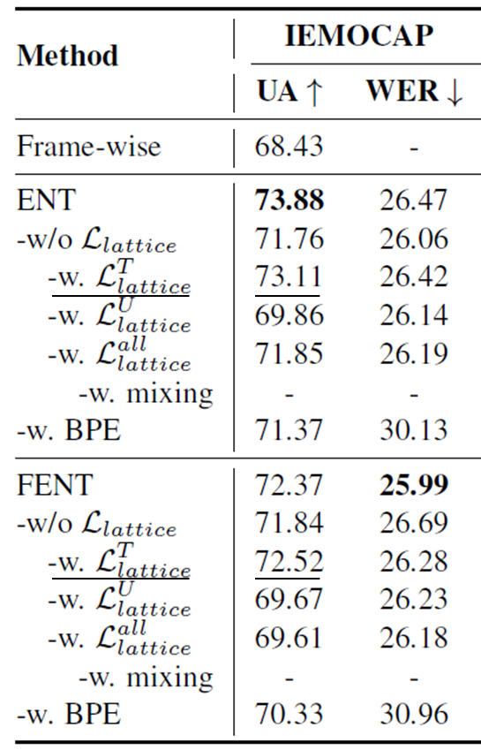
Experiments – Utterance-level SER on IEMOCAP
Performance of both ENT and FENT drops when removing the lattice max pooling loss.
FENT/ENT with $ℒ_{lattice}^{T}$ produces comparable performance.

Slide 14
Experiments – Frame-level SER on ZED
Configuration:
IEMOCAP for training
ZED for evaluation
(180 utterances)
EDER as metrics for fine-grained SER
(lower is better)
$$EDER=\frac{FA+ME+CF+OL}{Utterance Duration}$$
Wang, Yingzhi, Mirco Ravanelli, and Alya Yacoubi. "Speech emotion diarization: Which emotion appears when?." 2023 IEEE Automatic Speech Recognition and Understanding Workshop (ASRU). IEEE, 2023.

Slide 15
Experiments – Frame-level SER on ZED
FENT achieves lowest EDER by only providing utterance label for training.
Among all variants, except for the mixing approach, FENT consistently outperforms its ENT counterparts.
ENT achieves lowest EDER by concatenating emotional segments.

Slide 16
Summary
Motivation
Recognize emotions at a fine temporal granularity
Methods
Emotion Neural Transducer with ASR joint training
Lattice Max Pooling
Factorized Emotion Neural Transducer
Future Works
More diverse training dataset
Decoding and postprocessing method
Temporal granularity
Code
Paper

Slide 17
Thanks for Your Attention

