Slide 1
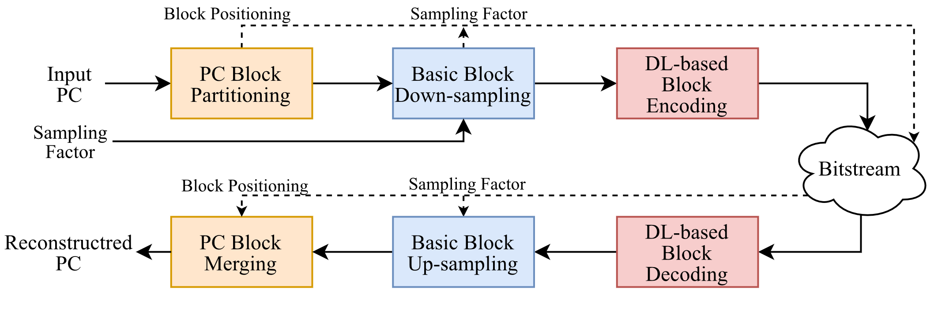
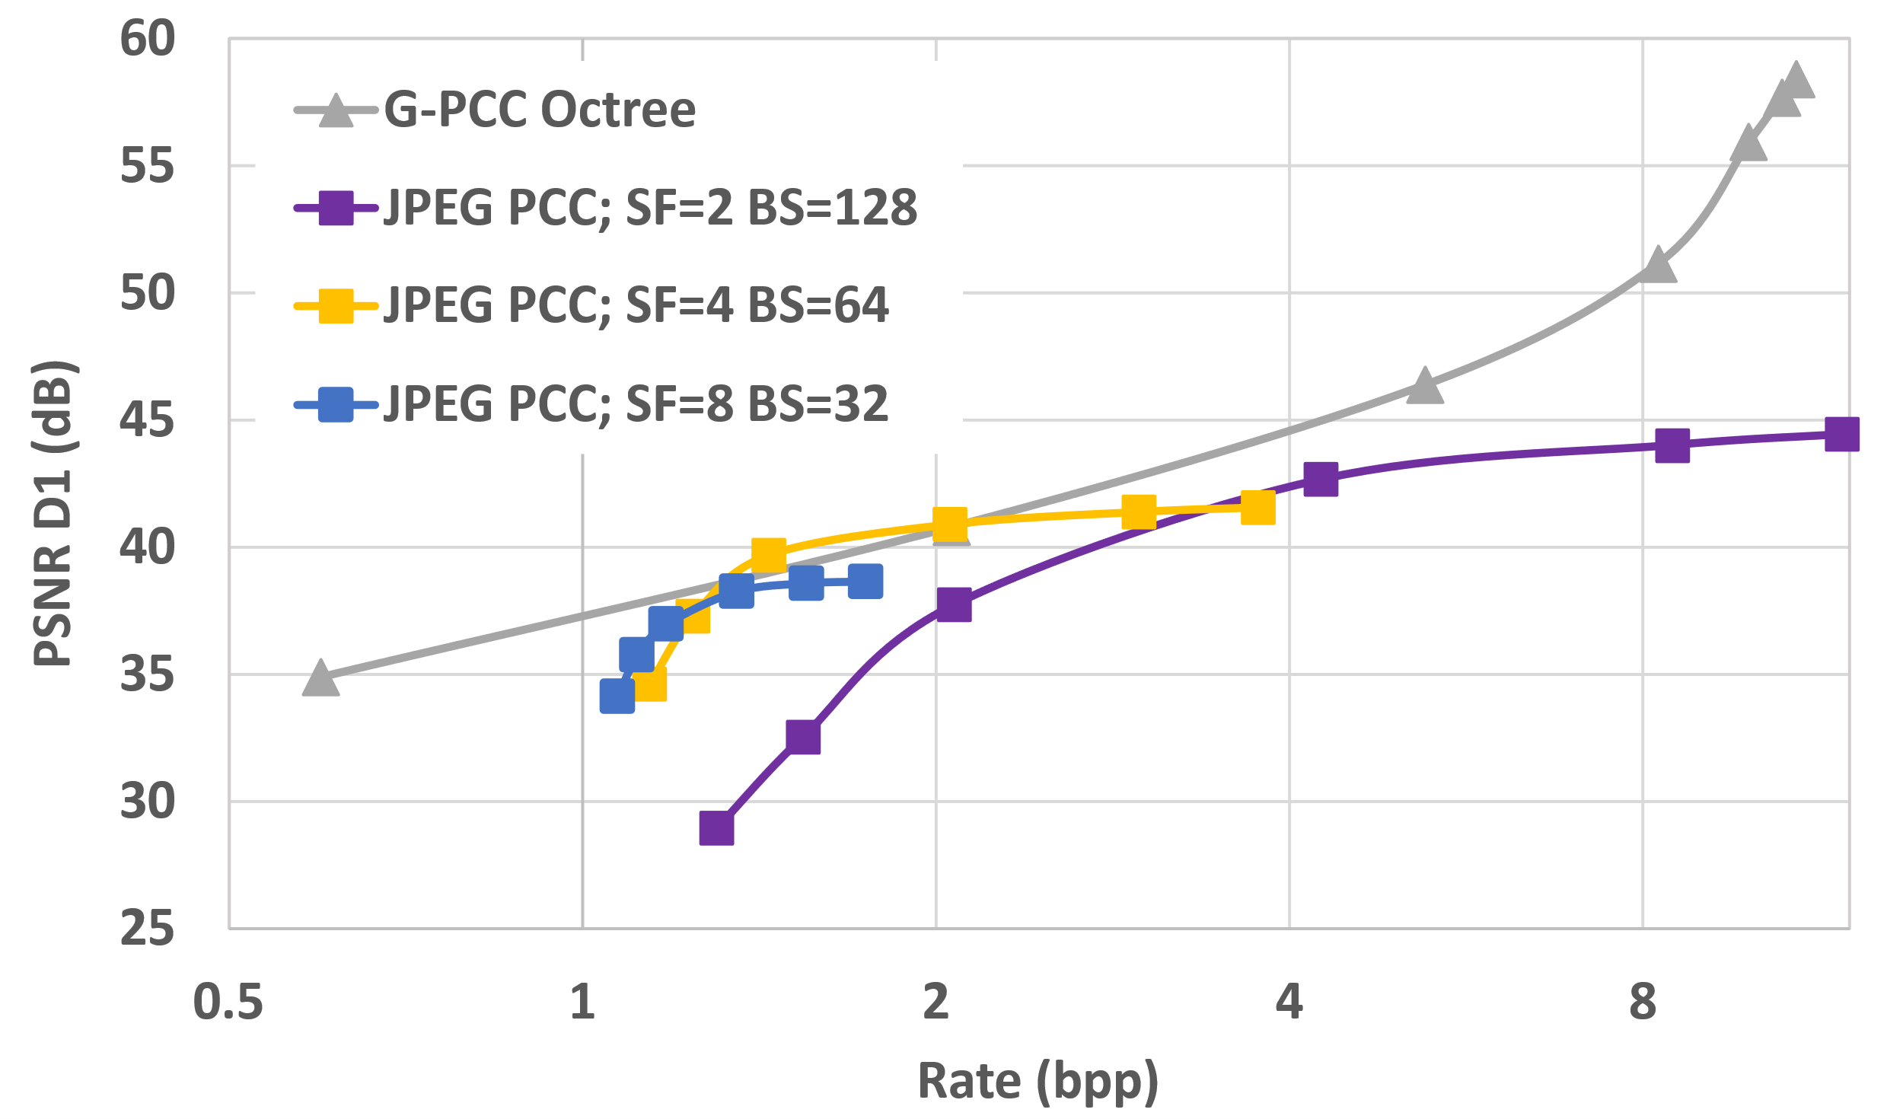
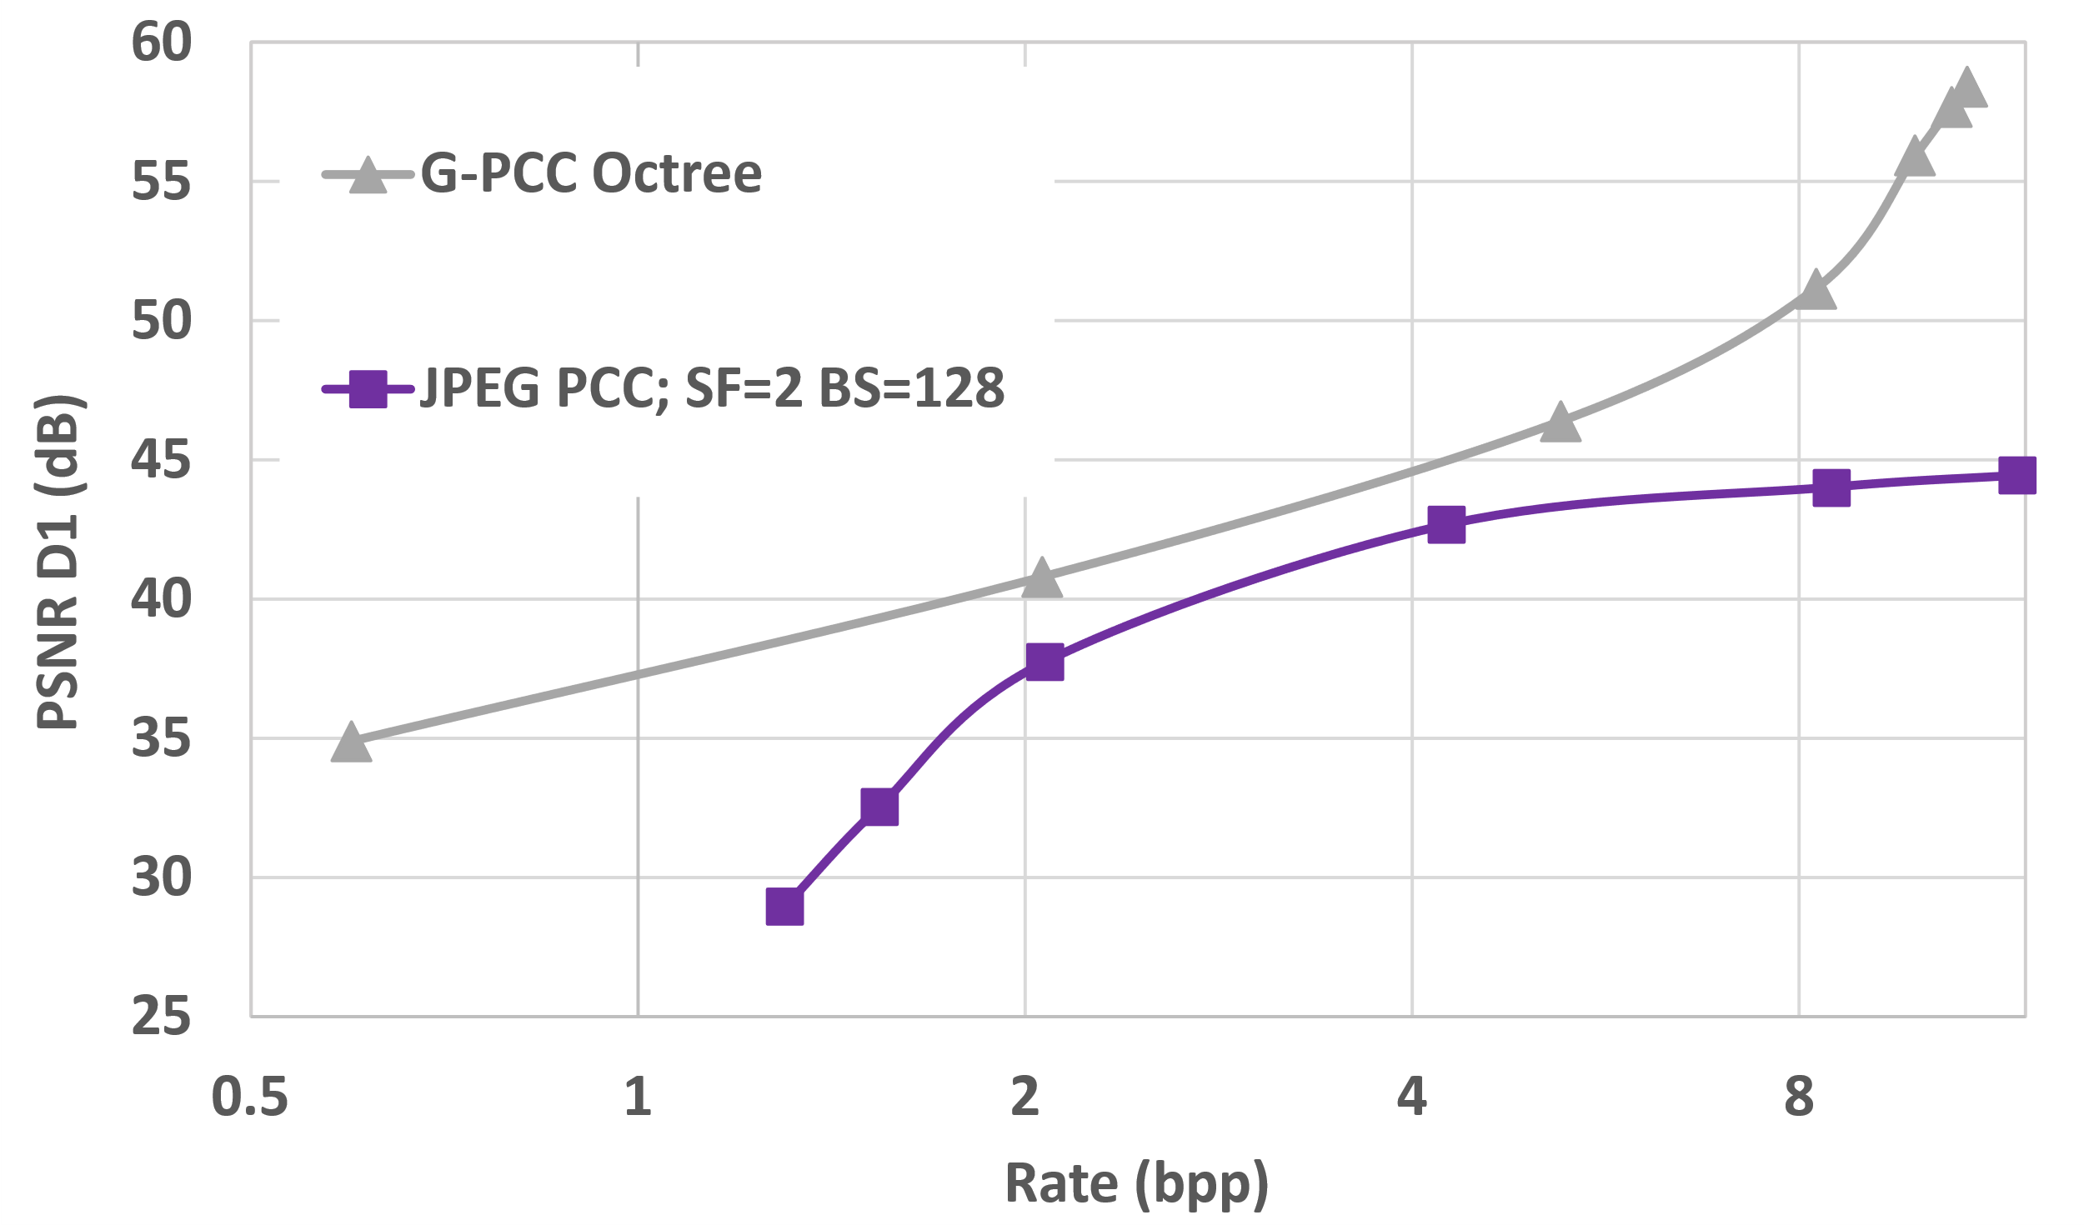
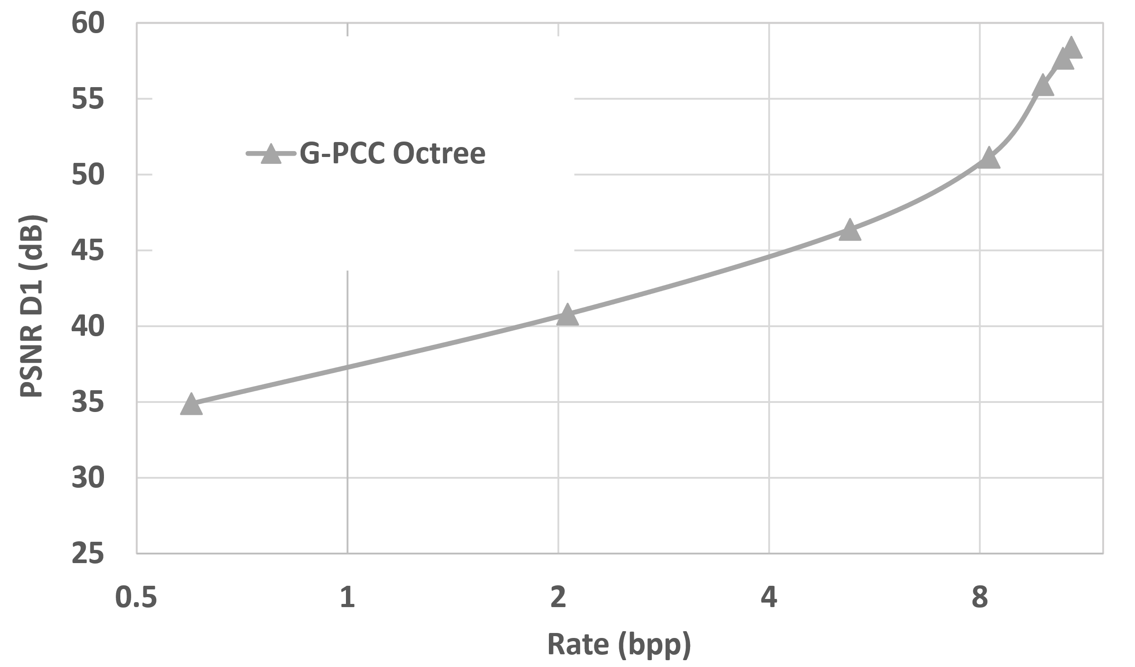
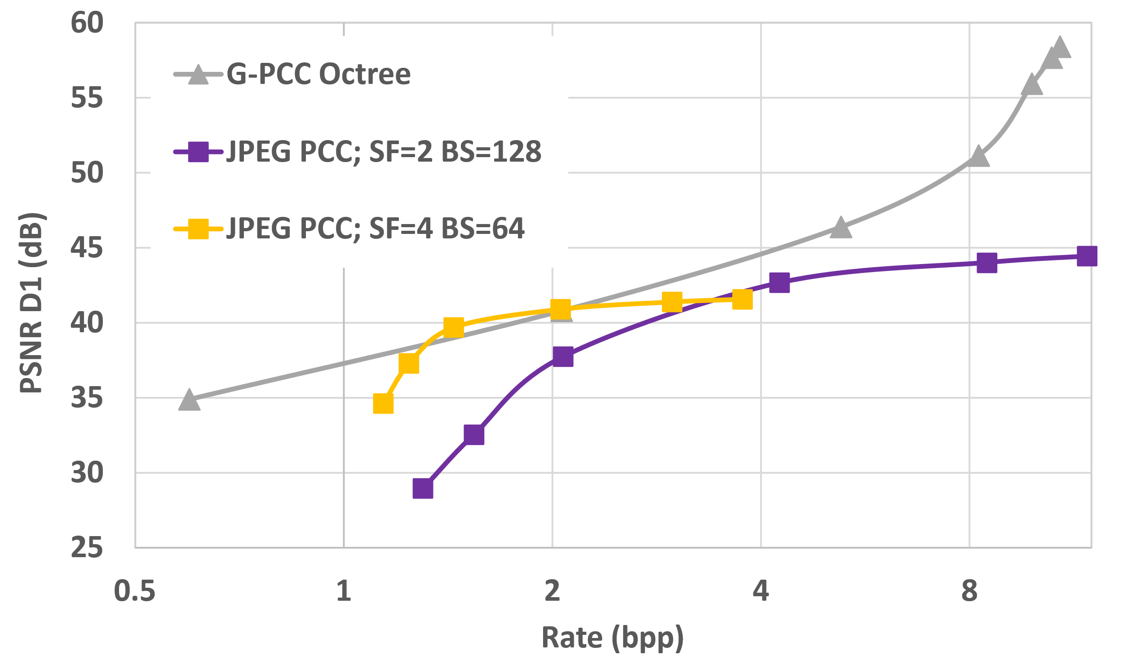
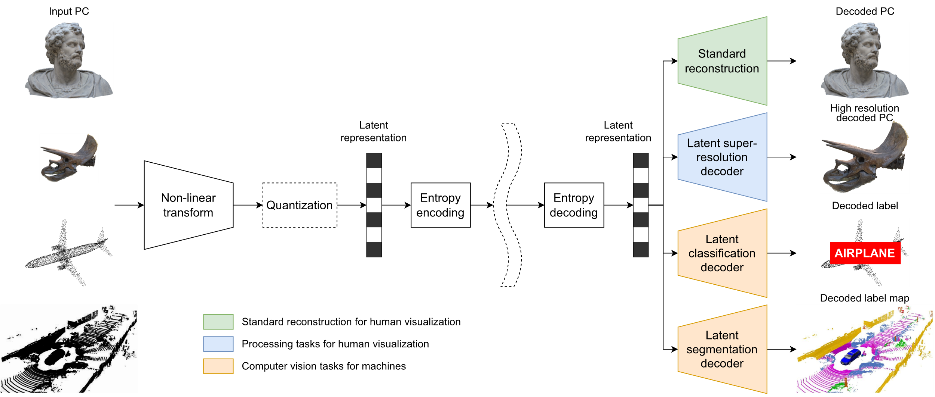
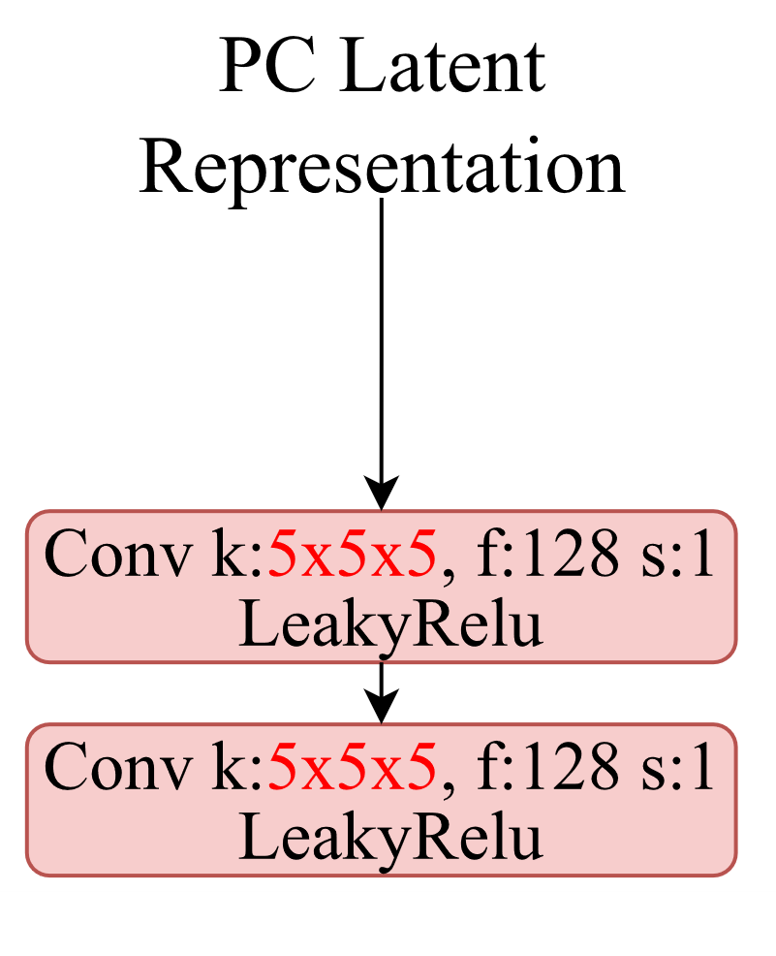
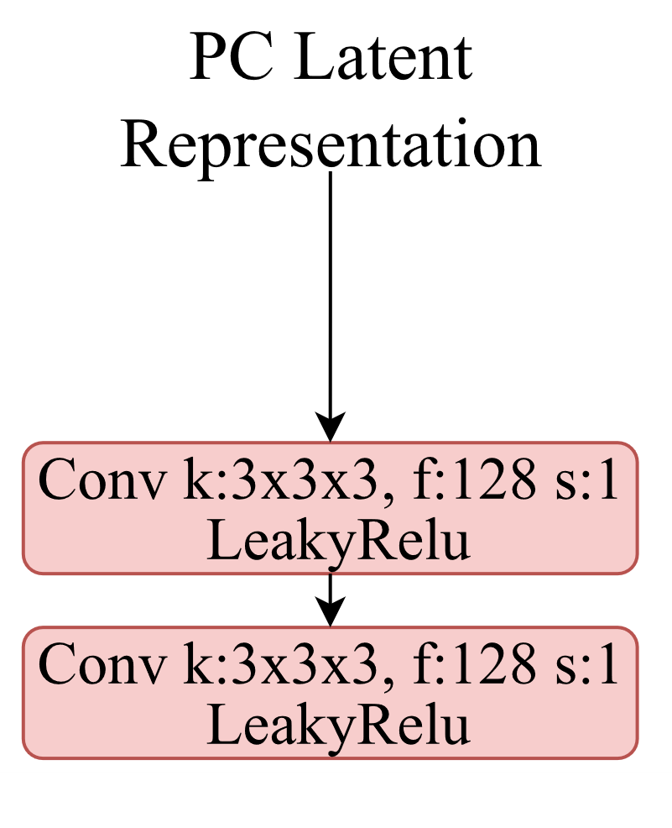
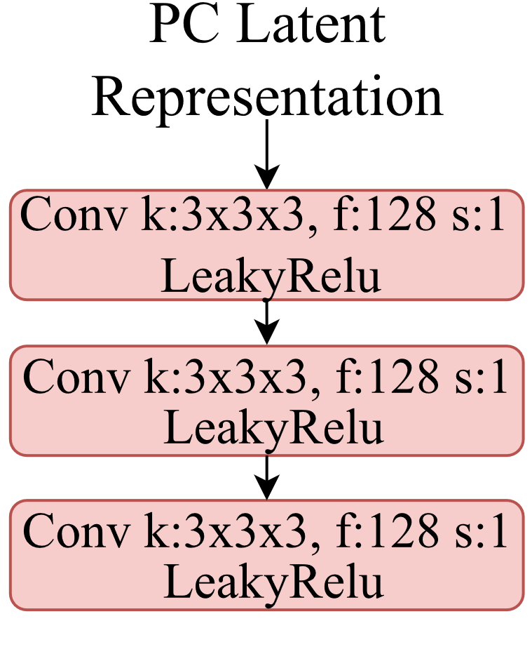
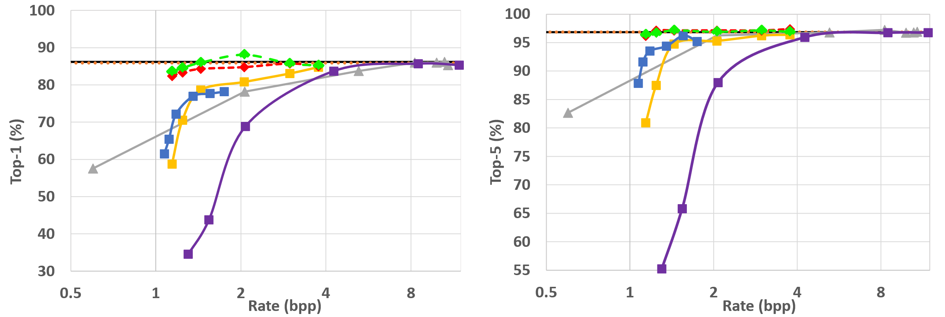
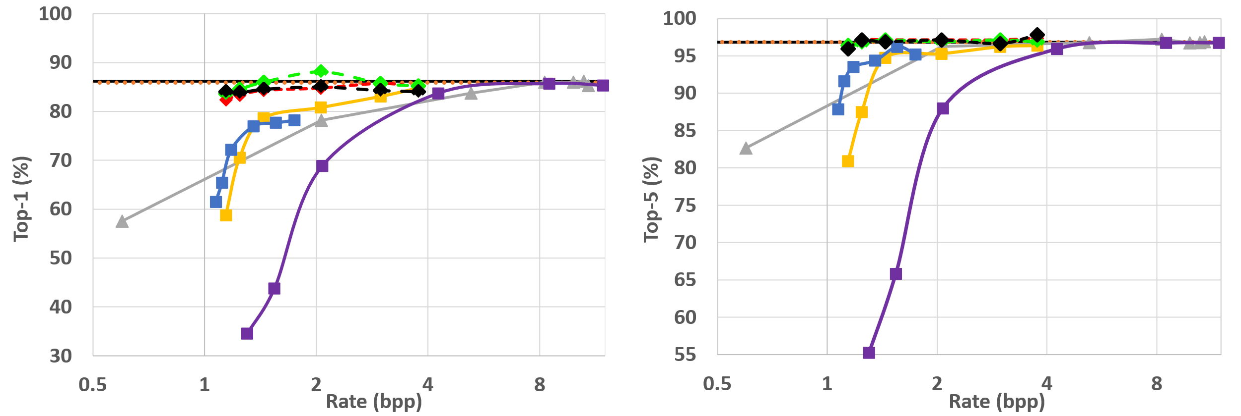
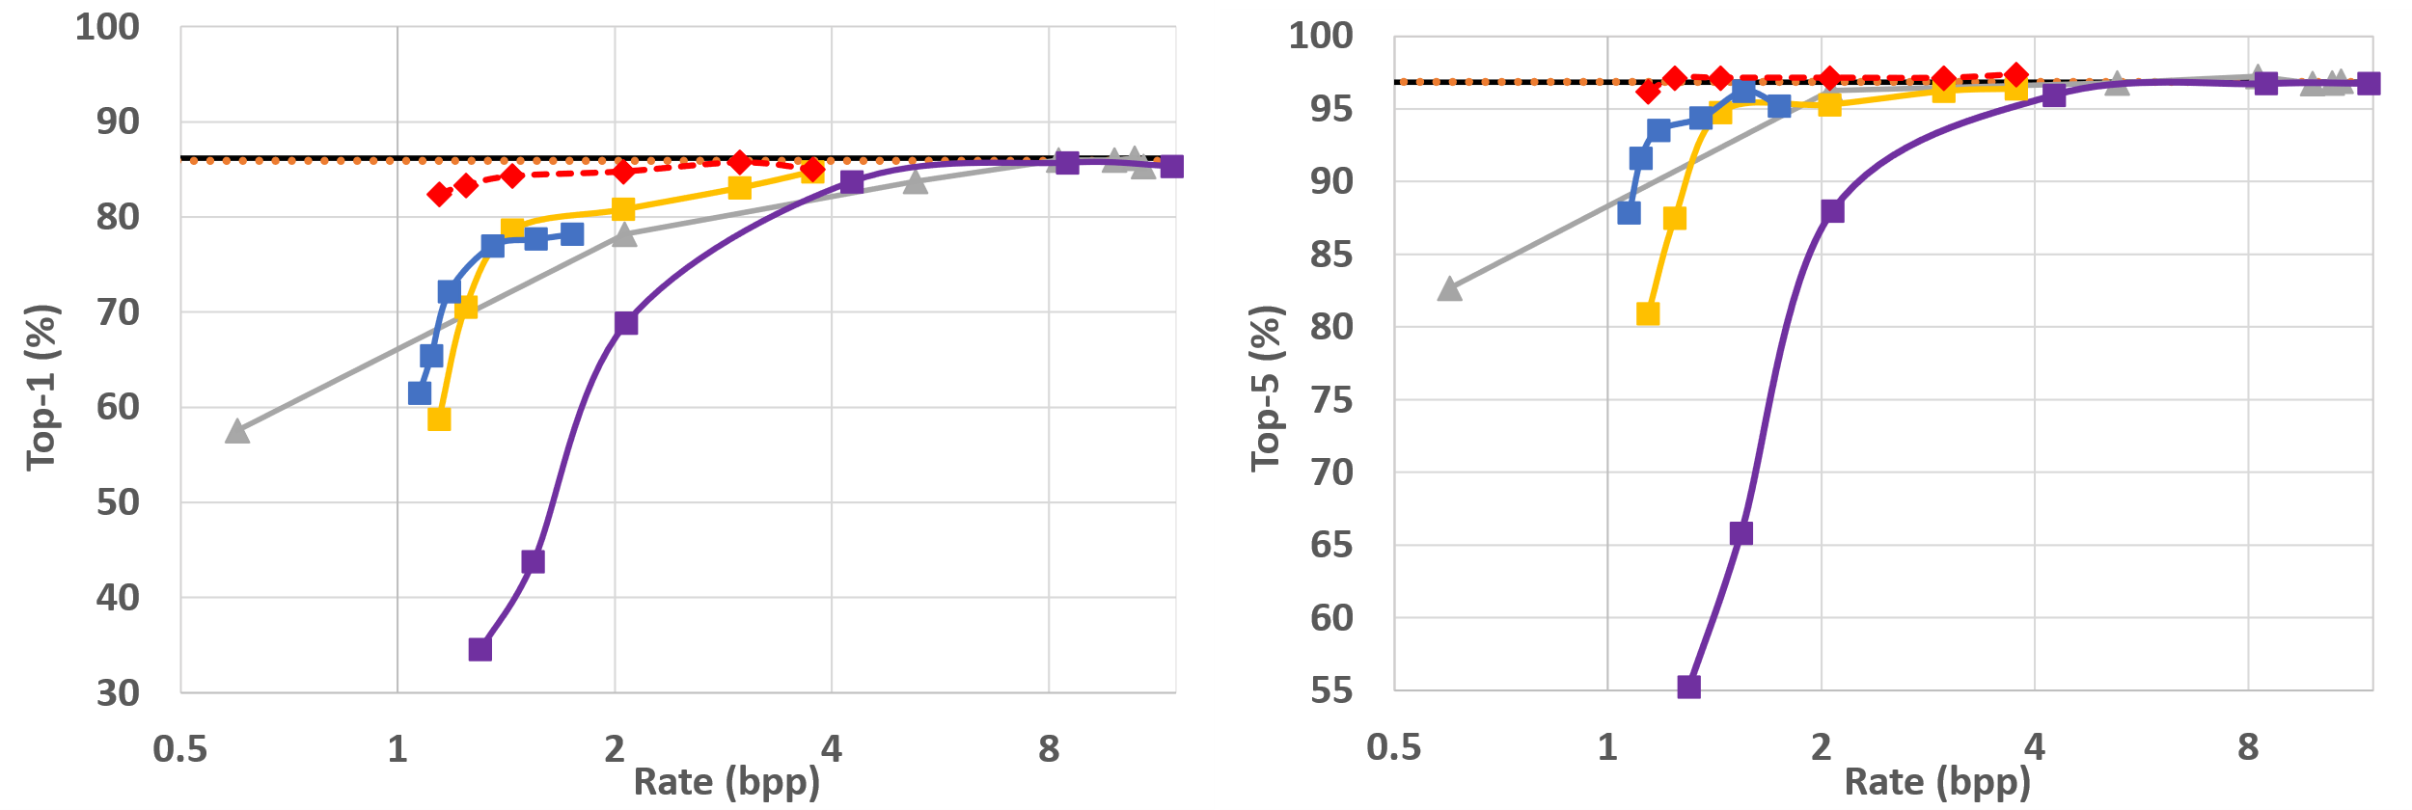
Deep Learning-based Compressed Domain Point Cloud Classification
Abdelrahman Seleem ^{1,3} André F. R. Guarda ³ Nuno M. M. Rodrigues ^{2,3} Fernando Pereira ^{1,3}
¹ IST – Universidade de Lisboa; ² ESTG – Politécnico de Leiria; ³ Instituto de Telecomunicações, Portugal
1. Context & Objectives
3. Proposed cd-pccl Solutions
4. Performance Assessment
Emerging learning-based codecs offer a single, efficient compressed domain representation for man and machine, thus unifying the visual representation language.
Propose novel DL-based compressed domain PC classification (CD-PCCL) solutions based on JPEG PCC codec and PointGrid classifier, targeting:
Unified learning-based representation for man and machine.
Better classification performance than decompressed domain classification with lower complexity.
JPEG PCC codec
Compression Performance
PC coding benchmark: G-PCC
G-PCC is the MPEG standard for static PC coding.
G-PCC codes PC geometry using an octree structure.
Spatial domain PointGrid classifier
Proposed CD-PCCL
Bridge: Adapts the JPEG PCC latent dimension to the Partial Classifier input (requires training).
Partial Classifier: Corresponds to the bottom part of the PointGrid classifier after pruning the first 5 layers (does not require training).
Compressed vs Spatial Domain Classification Performance
2. PC Coding and Classification Pipelines
Bridge | Total # weights | Variation
PointGrid (baseline) | 10,492,072 | 0%
CD-PCCL: 2L, k=3 | 9,584,168 | -8.7%
CD-PCCL: 3L, k=3 | 10,026,664 | -4.4%
CD-PCCL: 2L, k=5 | 12,795,432 | +22.0%
5. Conclusions
DL-based compressed domain PC classification has a clear advantage over decompressed domain PC classification in terms of classification accuracy.
Proposed CD-PCCL validates the JPEG Pleno PCC vision of having a unified learning-based representation for both man and machine.
Future work will design an adaptive Bridge to accept JPEG PCC latent representations for different coding block sizes.
Original 2.Voxelized 3. Decompressed 4. Compressed
1
2
3
ModelNet40 dataset is used in all classification pipelines.
ModelNet40 dataset is divided into training (9840 PCs), validation (2048 PCs), and test (420 PCs) sets.
4
This work was funded by the Fundação para a Ciência e Tecnologia (FCT, Portugal) through the research project PTDC/EEI-COM/1125/2021, entitled “Deep Learning-based Point Cloud Representation.”

