Slide 1
ICIP 2020
ATTENTION-ENHANCED AND MORE BALANCED R-CNN FOR OBJECT DETECTION
Presenter: Ruohong Mei
Tutor: Haiying Wang

Slide 2
Background
Attention Mechanism Used in Object Detection:
Spatial Attention
Channel Attention
Spatial & Channel Attention
…
Fig 1. The Overview of CBAM. The module has two
sequential sub-modules:channel and spatial.

Slide 3
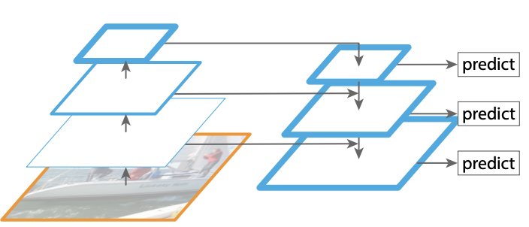
Background
Imbalance Problems in Object Detection:
Class Imbalance
Scale Imbalance
Spatial Imbalance
Objective Imbalance
…
Fig 2. The overview of FPN, which is widely used to handle multi-scale problems
Therefore, we adopted Libra R-CNN as our baseline and made it an attention-enhanced and more balanced R-CNN for object detection.

Slide 4
Network Architecture
Fig 3. The overall architecture.
Backbone: ResNet.
“TAM” and “DCM” denote Transform attention module and deformable convolution module respectively. They compose “attended residual module”.
We use Cascade RPN to gain more balanced anchors.
“BFP with CC” means balanced feature pyramid with criss-cross module to reduce GPU consumption.

Slide 5
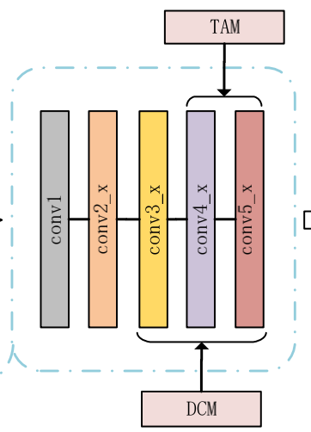
Attended Residual Module
Fig 4. Attended residual module
We incorporate it in the residual block of ResNet.
For Transformer attention, there are four attention factors, and we take “0010” configuration for less computation flops and GPU consumption.
For deformable convolution, it serves as a relative position attention factor which works well with “0010” configuration.

Slide 6
Cascade RPN
Fig 5. Cascade RPN. “I” means Images. “DilConv” and “AdaConv” denote dilated and adaptive convolution respectively
The cascade architecture refines anchors step by step, while it will mismatch source feature maps and regressed anchors gradually. Therefore, it gains little average recall.
Adaptive convolution will learn an offset of feature maps, which leads feature maps correspond to anchors.

Slide 7
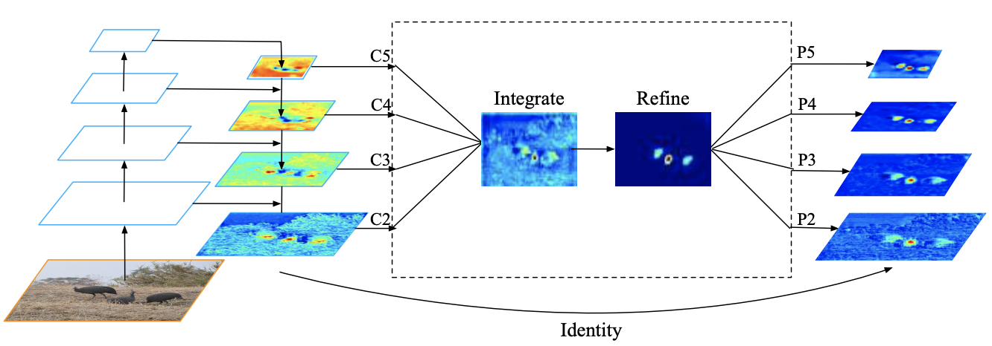
Balanced FPN with Criss-cross Module
Non-local
Fig 6. Pipline and heatmap visualization of blanced feature pyramid.
Libra R-CNN uses non-local module to refine integrated features, while it will cost too much GPU memory.

Slide 8
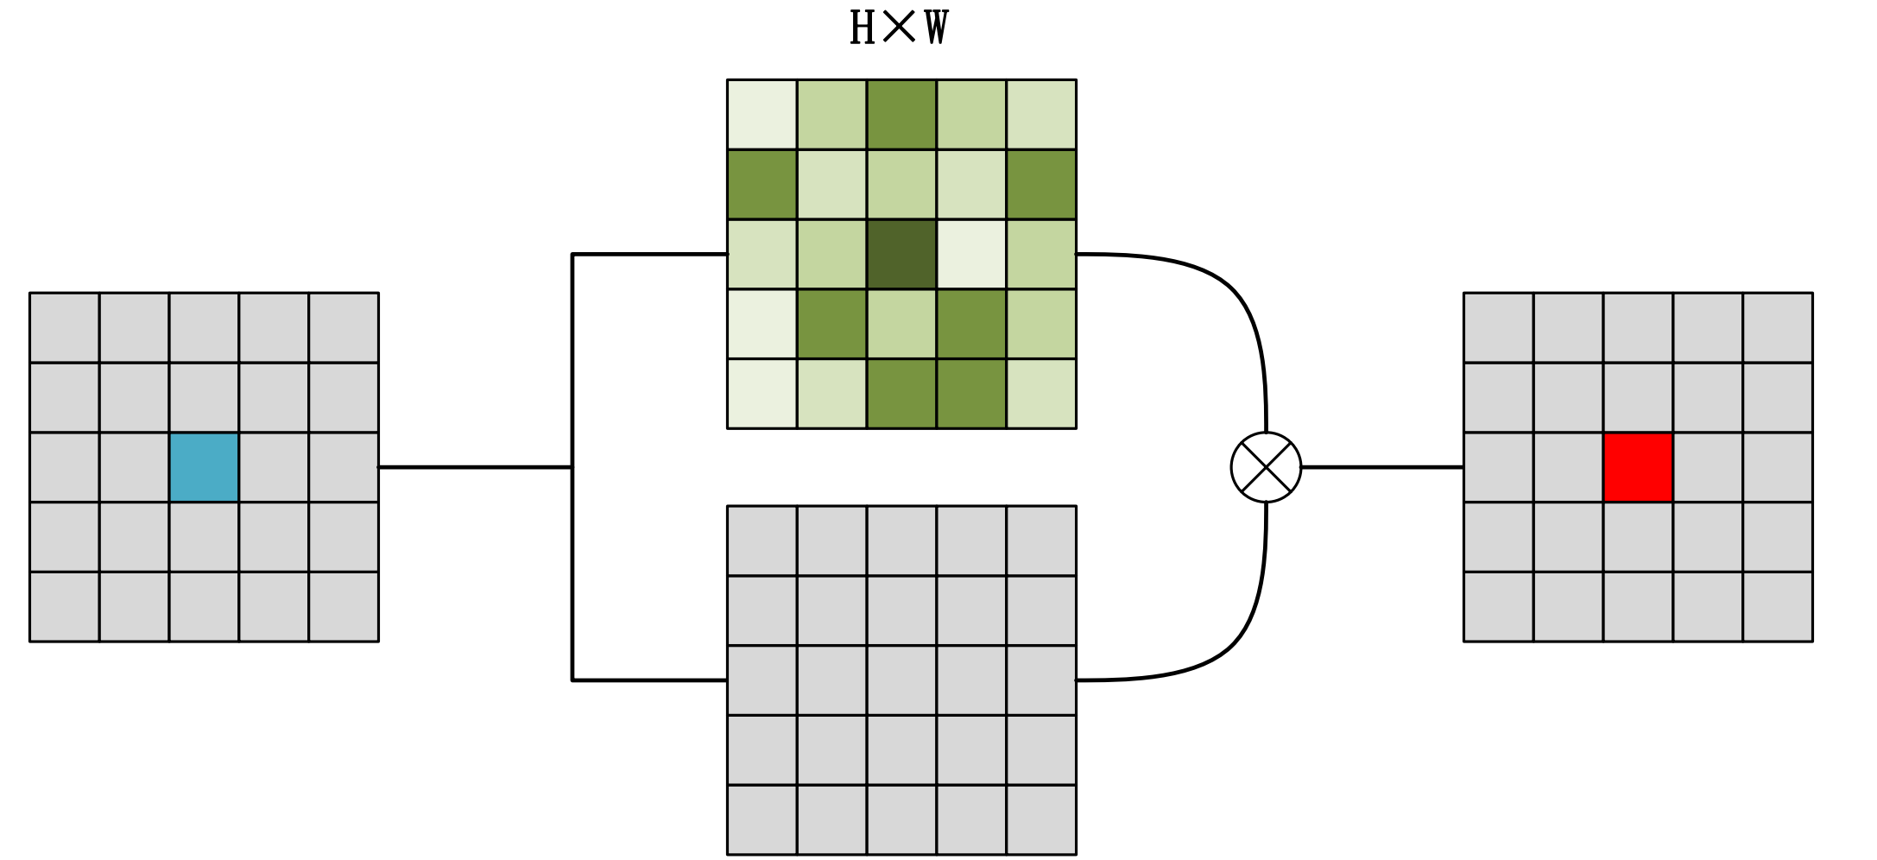
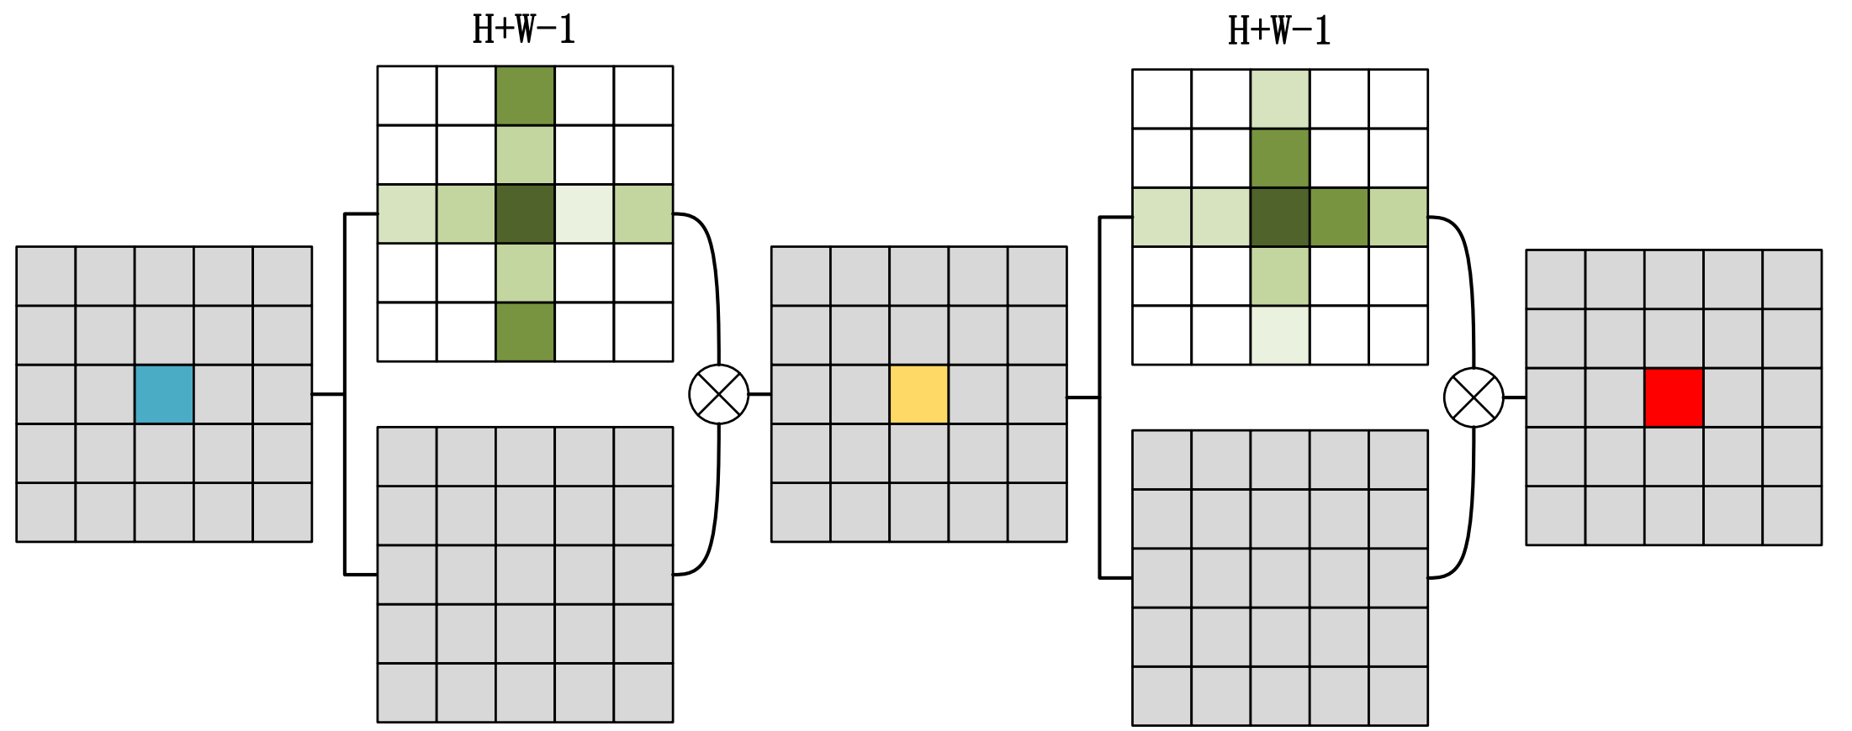
Balanced FPN with Criss-cross Module
(a) Non-local module
(b) Criss-cross module
Fig 7. Comparison between the non-local module and the criss-cross module
By stacking these two criss-cross modules sequentially, we can reduce complexity in space from O((H*W)*(H*W)) to O((H*W)*(H+W-1)) .

Slide 9
Experiment
Implementation
Baseline:
Libra R-CNN
Training:
Dataset: MS COCO dataset.
Train 12 epochs using SGD to optimize.
Initial learing rate is set to 0.02, and is decreased by 0.1 after 8 and 11 epochs.
A single RTX 2080Ti.
Val
MS COCO val-2017
Testing
MS COCO test-dev 2019

Slide 10
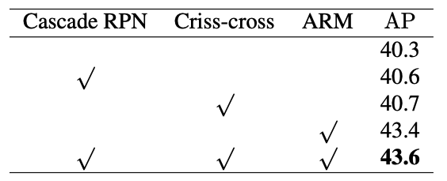
Ablation Study
Table 1. Overall ablation study on COCO val-2017. Backbone is ResNet101 with FPN. “ARM” denotes the attended residual module.

Slide 11
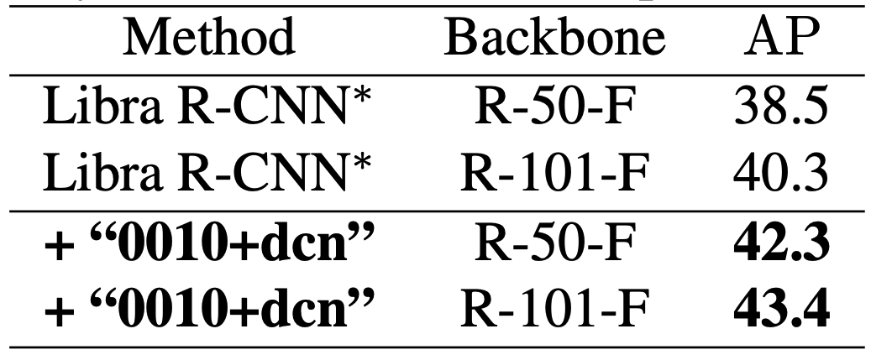
Ablation Study
Table 2. Ablation study for “0010+dcn” attended residual module. The symbol * means our re-implement.

Slide 12
Ablation Study
Table 4. Abation study for cascade RPN. The symbol * means our re-implement.

Slide 13
Ablation Study
Table 4. Ablation study for criss-cross module. The symbol * means our re-implement.

Slide 14
Overall Results
Table 4. Comparison with Libra R-CNN and other state-of-the-art methods on COCO test-dev. The symbol * meas our re-implemented methods. The 1x training schedule follows the configurations detailed in Detectron.

Slide 15
Summary&Thanks
Summary:
Attended residual module
Cascade RPN
Balance FPN with criss-cross attention module
Thanks!

