Slide 1
MULTI-QUERY MULTI-HEAD ATTENTION POOLING AND INTER-TOPK PENALTY FOR SPEAKER VERIFICATION
Miao Zhao¹, Yufeng Ma¹, Yiwei Ding^{1,2}, Yu Zheng¹, Min Liu¹, Minqiang Xu^{1*}
¹SpeakIn Technologies Co. Ltd., ShangHai, China
²Fudan University

Slide 2
Overview
Abstract
Datasets And Results
Baseline System
Proposed Methods

Slide 3
Abstract
performance
By adopting both the MQMHA and inter-topK penalty, we achieved state-of-the-art performance in all of the public VoxCeleb test sets.
pooling mechanism
loss function
Most multi-head attention pooling mechanisms either attend to the whole feature through multiple heads or attend to several split parts of the whole feature. Our proposed MQMHA combines both these two mechanisms and gain more diversified information.
The margin-based softmax loss functions are commonly adopted to obtain discriminative speaker representations. To further enhance the inter-class discriminability, we propose a method that adds an extra inter-topK penalty on some confused speakers.

Slide 4
Datasets And Results
Training set
Test sets
RAW DATA
The VoxCele2-dev dataset was used as our training set.
spk: 5,994
utt:1,092,009
VoxCeleb1-O
VoxCeleb1-E
VoxCeleb1-H
VoxSRC20-dev(out of domain)
VoxSRC21-val(multi-lingual)
A 3-fold speed augmentation to generate extra twice speakers. Each segment was perturbed by 0.9 or 1.1 factor.
+SPEED AUG
spk: 17,982
utt:3,276,027
It is worth mentioning that the VoxSRC20-dev and VoxSRC21-val are much harder to recognize as the VoxSRC20-dev contains some out-of-domain utterances and the VoxSRC21-val focuses on multi-lingual verification.
+KALDI AUG
Use RIRs and MUSAN to create extra four augmented copies of the above training utterances.
spk: 17,982
utt:16,380,135

Slide 5
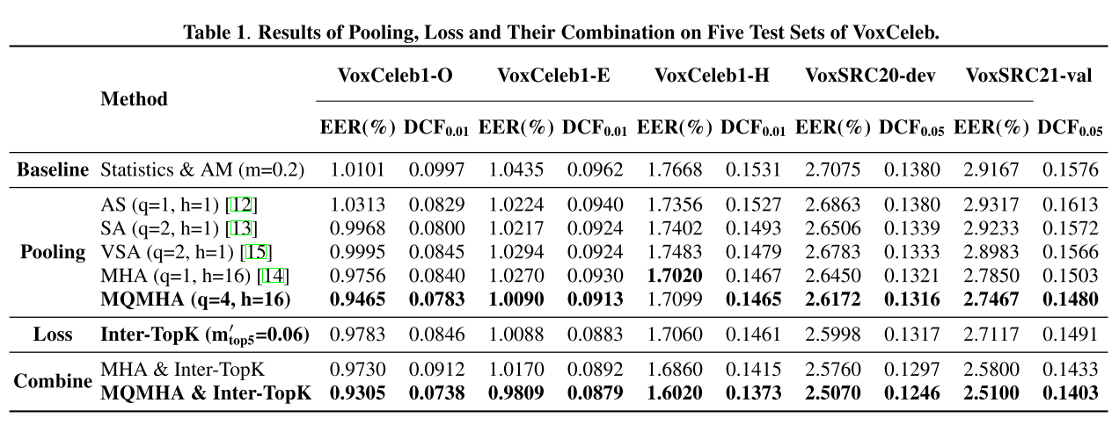
Datasets And Results
Overall Results
Take the performance of VoxSRC21-val as our benchmark, :
MQMHA pooling：5.83% and 6.09% relative improvement;
Inter-topK penalty：7.03% and 5.39% relative improvement;
MQMHA pooling with inter-topK loss：13.94% and 10.98% relative improvement.

Slide 6
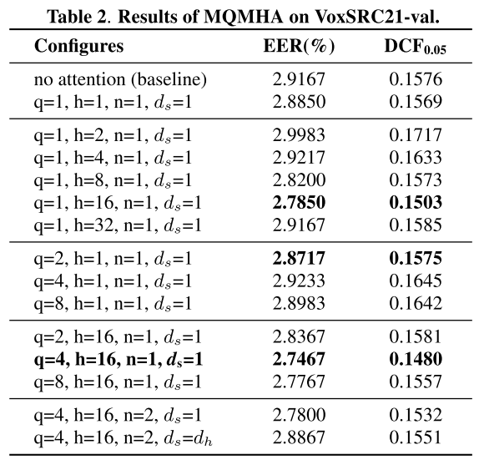
Datasets And Results
Ablation Study of MQMHA Pooling
When h=16, the best results are obtained；
When h=1, the results are unstable when increasing the number of queries；
When h=16,q=4, the improvements of multi-query are significant；
Increasing n, we do not observe better results

Slide 7
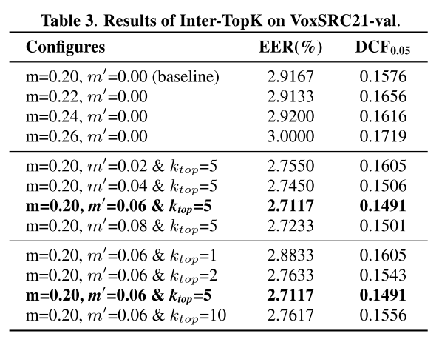
Datasets And Results
Ablation Study of Inter-topk Penalty
Both the extra inter margin penalty $m^{′}$ and the number of top nearest negative speakers k have an important effect on the performance：
Our proposed intertopK outperforms baseline by 7.03% in EER and 5.39% in DCF when m0 = 0.06 and ktop = 5；
the $k_{top}$is a more important hyperparameter than $m^{′}$；

Slide 8
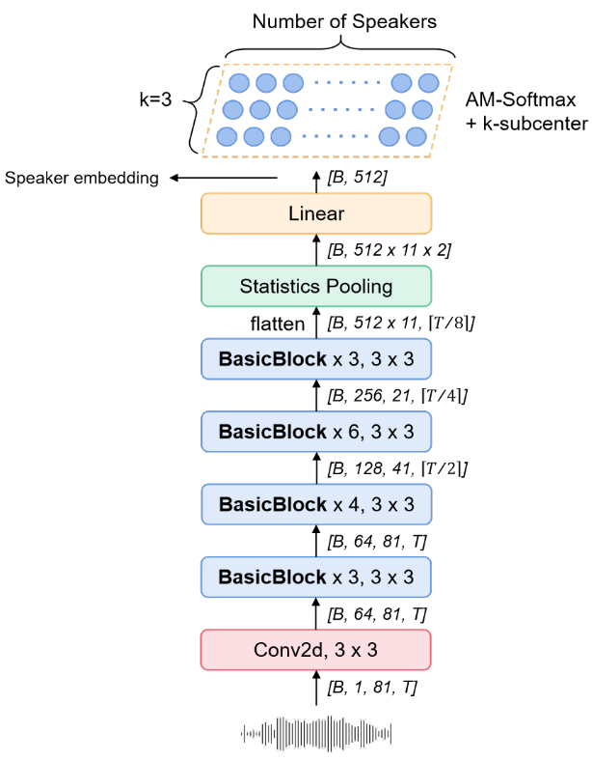
Baseline System
Architecture
Acoustic Feature: 81-dimensional log Mel filter fbank
Backbone: a modified 34-layer ResNet
Pooling: statistics pooling with concatenating mean and stddev
Loss: AM-Softmax with 3 sub-centers
He, Kaiming, et al. "Deep residual learning for image recognition." Proceedings of the IEEE conference on computer vision and pattern recognition. 2016.

Slide 9
Proposed Methods
Multi-query Multi-head Attention Pooling
…
Attention 3
Utterance Level Representation
W₁₃
W₂₃
W₃₃
W₄₃
W₅₃
W₆₃
W_{N3}
C = | C
…
Attention 2
Attention
c3
c2
c1
W₁₂
W₂₂
W₃₂
W₄₂
W₅₂
W₆₂
W_{N2}
…
C=
W₁
W₂
W₃
W₄
W₅
W₆
W_{N}
…
Attention 1
Utterance Level Representation
W₁₁
W₂₁
W₃₁
W₄₁
W₅₁
W₆₁
W_{N1}
…
h₁
h₂
h₃
h₄
h₅
h₆
h_{N}
h₁₃
Head 3
h₁₂
…
Head 2
Sequence of Encoded Representations
h₁₁
Head 1
Head=1,query=1
h₁
h₂
h₃
h₄
h₅
h₆
h_{N}
Sequence of Encoded Representations
Head=3,query=1
Miquel India, Pooyan Safari, and Javier Hernando, “Self multi-head attention for speaker recognition,” arXiv preprint arXiv:1906.09890, 2019.

Slide 10
Proposed Methods
Multi-query Multi-head Attention Pooling
Utterance Level Representation：concat the representation of every query
C = | C₁ | C₂ | C₃
Query1
Query2
Query3
Attention1
…
Attention2
…
Attention 3
…
…
W₁
W₂
W₃
W₄
W₅
W₆
W_{N}
W₁
W₂
W₃
W₄
W₅
W₆
W_{N}
W₁
W₂
W₃
W₄
W₅
W₆
W_{N}
…
…
…
h₁
h₂
h₃
h₄
h₅
h₆
h_{N}
h₁
h₂
h₃
h₄
h₅
h₆
h_{N}
h₁
h₂
h₃
h₄
h₅
h₆
h_{N}
Sequence of Encoded Representations
Sequence of Encoded Representations
Sequence of Encoded Representations
Head=1,query=3
Yingke Zhu, Tom Ko, David Snyder, Brian Mak, and Daniel Povey, “Self-attentive speaker embeddings for text independent speaker verification.,” in Interspeech, 2018, vol. 2018, pp. 3573–3577.

Slide 11
Proposed Methods
Multi-query Multi-head Attention Pooling
C = | C₁₁ | C₂₂ | C₃₃
Utterance Level Representation：concat the representation of every query
…
Attention 3
…
Attention 3
…
Attention 3
W₁₃
W₁₃
W₂₃
W₃₃
W₄₃
W₅₃
W₆₃
W_{N3}
W₁₃
W₂₃
W₃₃
W₄₃
W₅₃
W₆₃
W_{N3}
W₂₃
W₃₃
W₄₃
W₅₃
W₆₃
W_{N3}
W₁₃
…
Attention 2
…
Attention 2
…
Attention 2
c3
c2
c1
c3
c2
c1
c3
c2
C1
W₁₂
W₂₂
W₃₂
W₄₂
W₅₂
W₆₂
W_{N2}
W₁₂
W₂₂
W₃₂
W₄₂
W₅₂
W₆₂
W_{N2}
W₁₂
W₂₂
W₃₂
W₄₂
W₅₂
W₆₂
W_{N2}
C11=
C22=
C33=
…
Attention 1
…
Attention 1
…
Attention 1
W₁₁
W₂₁
W₃₁
W₄₁
W₅₁
W₆₁
W_{N1}
W₁₁
W₂₁
W₃₁
W₄₁
W₅₁
W₆₁
W_{N1}
W₁₁
W₂₁
W₃₁
W₄₁
W₅₁
W₆₁
W_{N1}
h₁₃
Head 3
h₁₃
Head 3
h₁₃
Head 3
h₁₂
…
Head 2
h₁₂
…
Head 2
h₁₂
…
Head 2
h₁₁
Head 1
h₁₁
Head 1
h₁₁
Head 1
h₁
h₂
h₃
h₄
h₅
h₆
h_{N}
h₁
h₂
h₃
h₄
h₅
h₆
h_{N}
h₁
h₂
h₃
h₄
h₅
h₆
h_{N}
Sequence of Encoded Representations
Sequence of Encoded Representations
Sequence of Encoded Representations
Head=3,query=3

Slide 12
Proposed Methods
Multi-query Multi-head Attention Pooling
Sequence of Encoded Representation: $O=\left[o1,o2,…,oT\right], ot ∈Rd$
Split each $ot$ into H parts: $ot=[o_{t}^{1},o_{t}^{2},…,o_{t}^{H}]$, $o_{t}^{h}$ $∈Rd/H$
For each head, it has Q trainable queries. Then
w$t,h,q$ = $\frac{exp⁡(F(o_{t}^{h}))}{\sum_{t=1}^{T}{exp⁡(F(o_{t}^{h}))}}$
the function F(·) is an attention mechanism to calculate weights and it can be composed of one linear layer or two linear layers with a nonlinearity：$F(o_{t}^{h} )=\left\{\begin{aligned}{{(o}_{t}^{h})}^{T}w_{a}, n=1 \\ relu\left({{(o}_{t}^{h})}^{T}w_{b}\right)w_{c}, n=2\end{aligned}\right.$
超参数说明：
H：the number of heads
Q：the number of queries
n：the number of linear layers
$d_{s}$：the number of weights for a frame
AS (H = 1, Q = 1, n = 2, ds = 1)
MHA (H > 1, Q = 1, n = 1, ds = 1)
SA (H = 1, Q > 1, n = 2, ds = 1)
VSA (H = 1, Q > 1, n = 2, ds = dh)
w_{a} is a matrix of size d_{h} $×$d_{s}；
w_{b} is a matrix of size d_{h} $×$d_{k};
w_{c} is a matrix of size d_{k} $×$ d_{s}.
d_{k}: hidden size of the two linear layers

Slide 13
Proposed Methods
Extra Inter-TopK Penalty for AM-Softmax Loss
$$ℒ_{AM}=−\frac{1}{N}\sum_{i=1}^{N}{log\frac{e^{s∗\left(cosθ_{i,y_{i}} −m\right)}}{e^{s∗\left(cosθ_{i,y_{i}} −m\right)}+\sum_{j=1,j≠y_{i}}^{C}{e^{s∗cosθ_{i,j}}} }}$$
Top-K: pay more attention to the confused pairs
A hard prototype mining method
but without extra sampling requirements.
$$ℒ_{{AM}^{′}}=−\frac{1}{N}\sum_{i=1}^{N}{log\frac{e^{s∗\left(cosθ_{i,y_{i}} −m\right)}}{e^{s∗\left(cosθ_{i,y_{i}} −m\right)}+\sum_{j=1,j≠y_{i}}^{C}{e^{s∗∅\left(θ_{i,j}\right)}} }}$$
$$φ\left(θ_{i,j}\right) = \left\{\begin{aligned}&cosθ_{i,j} + m^{′}, j∈argtopK\left(cosθ_{i,n}\right), 1≤n≤C,n≠y_{i} \\ &cosθ_{i,j}, Others\end{aligned}\right.$$

Slide 14
Datasets And Results
Ablation Study of MQMHA Pooling
When h=16, the best results are obtained；
When h=1, the results are unstable when increasing the number of queries；
When h=16,q=4, the improvements of multi-query are significant；
Increasing n, we do not observe better results

Slide 15
Datasets And Results
Ablation Study of Inter-topk Penalty
Both the extra inter margin penalty $m^{′}$ and the number of top nearest negative speakers k have an important effect on the performance：
Our proposed intertopK outperforms baseline by 7.03% in EER and 5.39% in DCF when m0 = 0.06 and ktop = 5；
the $k_{top}$is a more important hyperparameter than $m^{′}$；

Slide 16
Datasets And Results
Overall Results
Take the performance of VoxSRC21-val as our benchmark, :
MQMHA pooling：5.83% and 6.09% relative improvement;
Inter-topK penalty：7.03% and 5.39% relative improvement;
MQMHA pooling with inter-topK loss：13.94% and 10.98% relative improvement.

Slide 17
Q&A

