Slide 1
Combining TF-IDF with symptom features to differentiate between lymphoma and tuberculosis case reports
Put here an image of reference for the project described in the paper
Moanda Diana PHOLO

Slide 2
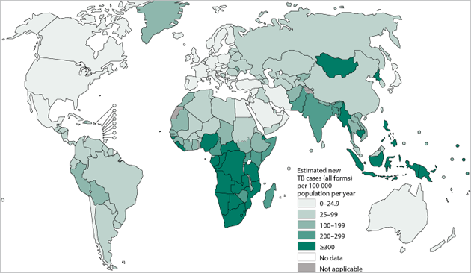
Background
Tuberculosis (TB) = infectious disease with highest mortality
High burden countries -> empirical treatment for TB suspects

Slide 3
Problem
Tuberculosis (TB) = infectious disease with highest mortality
High burden countries -> empirical treatment for TB suspects
BUT… TB symptoms NOT specific to TB

Slide 4
Problem (cont.)
With rise of HIV/AIDS -> TB is a more complex
HIV-infected patients present with atypical TB symptoms
Tend to develop TB outside lungs
-> Greater chances of a misdiagnosis

Slide 5
Problem (cont.)
Many cases of lymphoma misdiagnosed as TB
Same symptoms as TB
lymphadenopathy, fatigue, fever or night sweats, radiological features, etc.
-> Cancer treatment delayed for up to two years

Slide 6
Our Solution
Use Machine Learning + Natural Language Processing + Symptoms to differentiate between TB and Lymphoma
Goal: Provide support tool for accurate and timely diagnosis of TB and lymphoma,
especially in low­-income, endemic TB regions

Slide 7
Methodology
Data Collection
TB and lymphoma case reports collected from ScienDirect using web scraping
Feature extraction
Tokenization → Stopwords removal → Lemmatization → Conversion into word vector
Symptoms extraction
Symptoms extracted using Comprehend Medical API

Slide 8
Methodology (cont.)
Algorithms
Algorithms trained and tuned: kNN, Decision Trees, Perceptron, Naïve Bayes, SVM, Logistic Regression
Models training
Models trained on word vector only
Evaluation
Best models tested on unseen data
Then trained on word vector + symptoms

Slide 9
Results
Data collection
505 lymphoma
Feature extraction
15538 vocabulary features
215 TB case reports
+ Patient’s age group & gender
207 “other” case reports
+ Symptoms

Slide 10
Results (cont.)

Slide 11
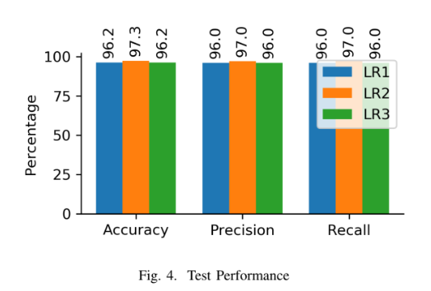
Results (cont.)
Results on test set

Slide 12
Conclusion
Misdiagnosis between TB and lymphoma = serious health problem
Our solution successfully categorises patient as having TB, lymphoma or neither based on case report
Future research will aim to:
test system using real-life clinical reports
test against human experts

