Slide 1
Scalable light field coding
using weighted binary images
Koji Komatsu, Keita Takahashi, Toshiaki Fujii
Graduate School of Engineering, Nagoya University, Japan
Notes:
Thank you for your introduction.
I’m Koji Komatsu from Nagoya University in Japan.
Today, I’d like to talk about “Scalable light field coding using weighted binary images”.

Slide 2
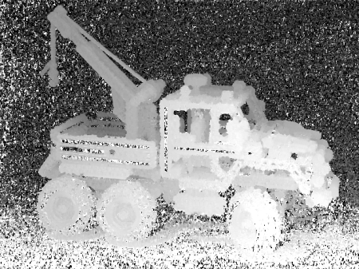
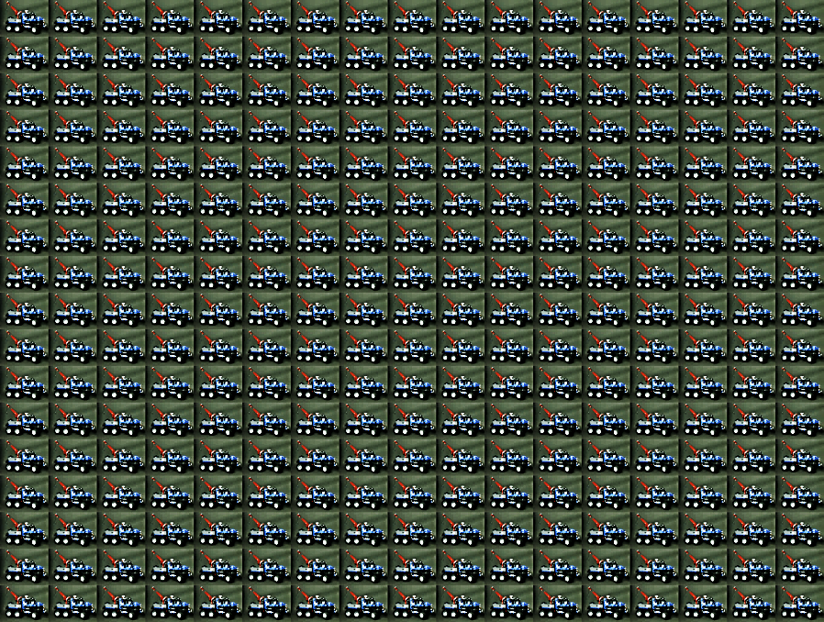
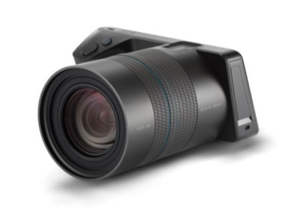
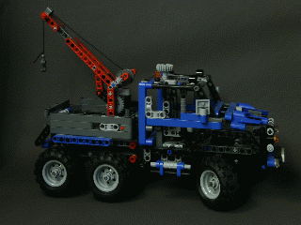
Multi-view image
shoot
Camera array
Depth estimation
shoot
Light Field Camera
(Lytro ILLUM)
Multi-view image
Free viewpoint video
・ Interval between view and view is large.
・ Shooting cost is very high.
Notes:
So first of all, I mention multi-view images for my research.
Multi-view image is a lot of images taken from multiple different view-points, and used for several purposes.
For example, depth-estimation, free viewpoint video, and so on.
To obtain this multi-view image, camera array is often used previously.
As the Characteristic of multi-view image obtained from this camera , interval between view and view is large.
And, shooting cost is very high.

Slide 3
Multi-view image
shoot
Camera array
Depth estimation
shoot
Light Field Camera
(Lytro ILLUM)
Multi-view image
Free viewpoint video
・ Interval between view and view is very small.
・ Shooting cost is very low.
Notes:
On the other hand, recently Light Field Camera has been developed.
Thanks to this camera, it is very easy to obtain multi-view images, because we can obtain them with just only one shooting.
The images obtained from this camera, interval between view and view is very small.
And shooting cost is very low.

Slide 4
Purpose of our research
shoot
Camera array
Depth estimation
shoot
Light Field Camera
(Lytro ILLUM)
Multi-view image
Free viewpoint video
We propose a new scheme which efficiently compresses such dense multi-view images.
Notes:
You know that multi-view images have a lot of amount of data, so they need to be compressed.
So, in our research, we proposed a new scheme which efficiently compresses such dense multi-view images.

Slide 5
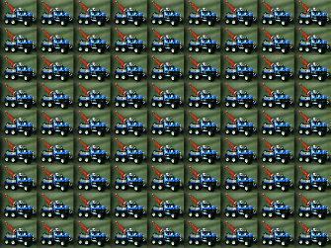
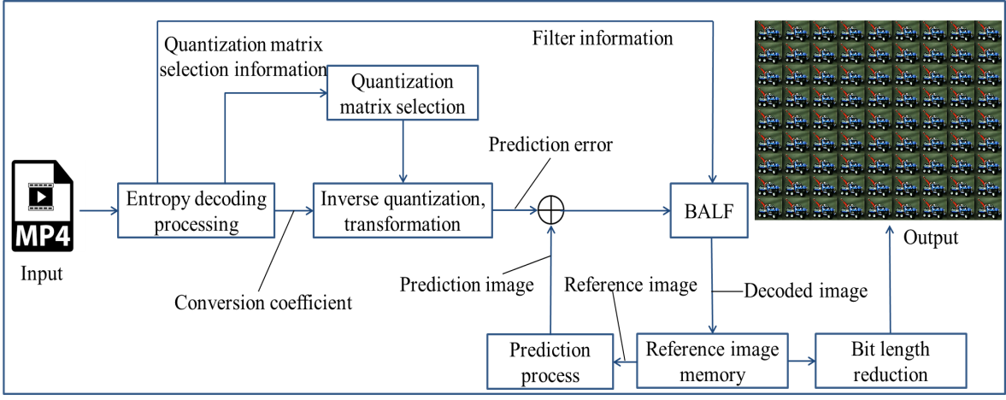
Modern video codecs
Modern video codec
Decode figure
inverse quantization, IDCT, predictive coding, etc…
Notes:
To compress multi-view image, most people use modern video codecs, such as HEVC.
These codecs are composed of inverse quantization, IDCT, predictive coding, and so on.
And you can see the decode figure at top right.
As shown in this figure, you know that decoding process is very complex.

Slide 6
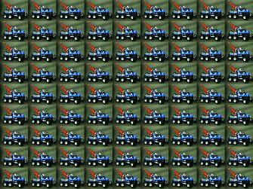
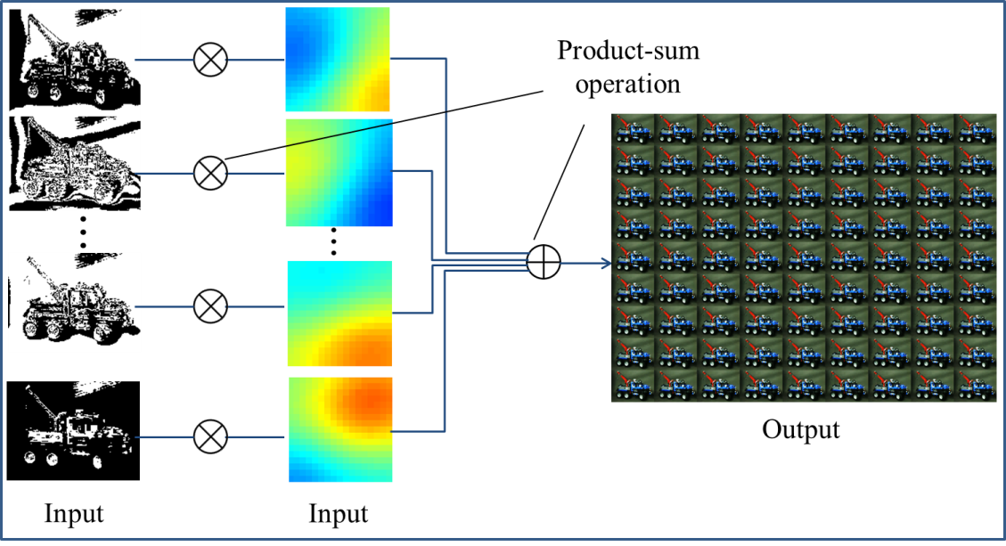
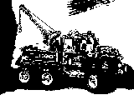
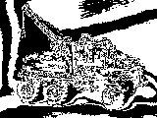
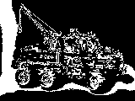
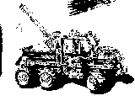
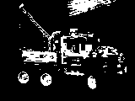
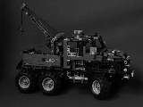
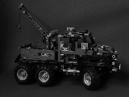
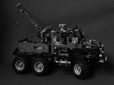
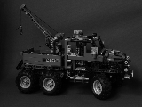
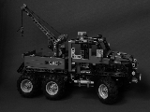
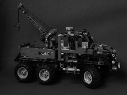
Modern video codec and our proposed method
Modern video codec
Decode figure
inverse quantization, IDCT, predictive coding, etc…
Our proposed method
Decode figure
common binary images
weight per viewpoint
…
Notes:
On the other hand, our proposed method is composed of some binary images and corresponding weights.
You can see the decode figure at bottom right.
Comparing modern video codecs and our proposed method, the principle of decoding is completely different and our proposed method is much simpler than modern video codecs.

Slide 7
Achievements of our proposed method
Modern video codec
Decode figure
・ Decoding process is extremely simple.
・ Rate-distortion performances are comparable
to that of modern video codecs.
inverse quantization, IDCT, predictive coding, etc…
Our proposed method
Decode figure
common binary images
weight per viewpoint
…
Notes:
As main achievements of our proposed method, we can mainly raise two points as follows.
First, decoding process is extremely simple.
Second, rate-distortion performances are comparable to that of modern video codecs.
So, I will explain our proposed method.

Slide 8
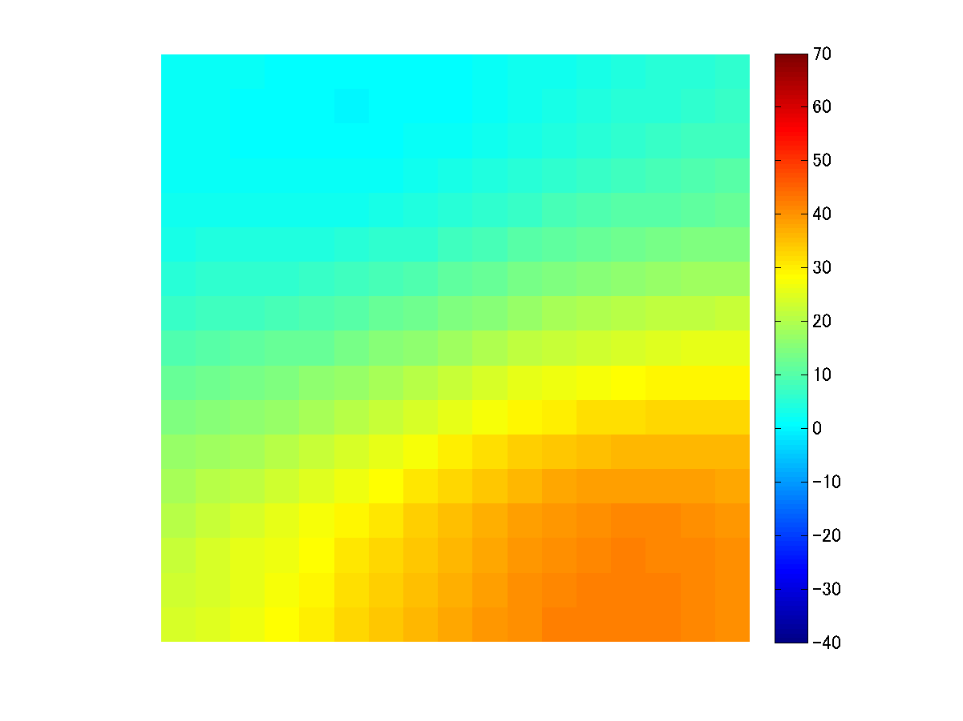
Proposed method (gray scale)
$$×$$
$$B_{1}^{}(x,y)$$
$$r_{1}^{}(s,t)$$
corresponding
$$×$$
T
$$B_{2}^{}(x,y)$$
h
$$r_{2}^{}(s,t)$$
$$⋯$$
$$⋯$$
w
$$×$$
$$B_{n}^{}(x,y)$$
$$r_{n}^{}(s,t)$$
S
$$⋯$$
$$⋯$$
$$L(s,t,x,y)$$
$$×$$
$$B_{N}^{}(x,y)$$
$$r_{N}^{}(s,t)$$
Binary images
weights
Notes:
For simplicity, we treat gray-scale multi-view image.
In order to reconstruct multi-view images, we only use common N binary images and weights.
The color graphs indicate weights corresponding to the view points.

Slide 9
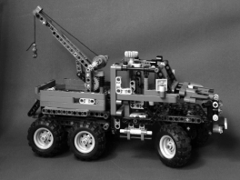
Proposed method (gray scale)
$$×$$
$$B_{1}^{}(x,y)$$
$$r_{1}^{}(s,t)$$
$$L(1,1,x,y)$$
$$×$$
$$B_{2}^{}(x,y)$$
$$r_{2}^{}(s,t)$$
$$⋯$$
$$⋯$$
$$×$$
$$B_{n}^{}(x,y)$$
$$r_{n}^{}(s,t)$$
$$⋯$$
$$⋯$$
$$L(s,t,x,y)$$
$$×$$
$$B_{N}^{}(x,y)$$
$$r_{N}^{}(s,t)$$
（example）
-22×
+28×
$$⋯$$
+7×
+18×
=
$$×$$
$$⋯$$
$$+$$
$$×$$
$$+$$
$$×$$
$$+$$
$$×$$
$$r_{1}^{}(1,1)$$
$$B_{1}^{}$$
$$r_{2}^{}(1,1)$$
$$B_{2}^{}$$
$$r_{n}^{}(1,1)$$
$$B_{n}^{}$$
$$r_{N}^{}(1,1)$$
$$B_{N}^{}$$
=
$$L(1,1,x,y)$$
Notes:
Firstly, when we reconstruct the top left view, (1, 1) view, we multiply the weights corresponding to the viewpoint to N binary images.

Slide 10
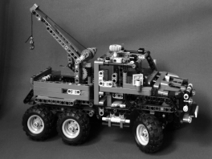
Proposed method (gray scale)
$$×$$
$$B_{1}^{}(x,y)$$
$$r_{1}^{}(s,t)$$
$$×$$
$$B_{2}^{}(x,y)$$
$$r_{2}^{}(s,t)$$
$$⋯$$
$$⋯$$
$$×$$
$$L(17,17,x,y)$$
$$B_{n}^{}(x,y)$$
$$r_{n}^{}(s,t)$$
$$⋯$$
$$⋯$$
$$L(s,t,x,y)$$
Change only weight values
$$×$$
$$B_{N}^{}(x,y)$$
$$r_{N}^{}(s,t)$$
（example）
35×
-37×
$$⋯$$
+45×
+7×
=
$$×$$
$$⋯$$
$$+$$
$$×$$
$$r_{1}^{}(17,17)$$
$$+$$
$$×$$
$$+$$
$$×$$
$$B_{1}^{}$$
$$r_{2}^{}\left(17,17\right)$$
$$B_{2}^{}$$
$$r_{n}^{}(17,17)$$
$$B_{n}^{}$$
$$r_{N}^{}(17,17)$$
$$B_{N}^{}$$
=
$$L(17,17,x,y)$$
Notes:
Next, when we reconstruct bottom right view, (17, 17) view, , we multiply the different weights corresponding to the viewpoint to the same N binary images.
Here, please note that we use the same binary images and only change weight values.

Slide 11
Proposed method (gray scale)
$$×$$
$$B_{1}^{}(x,y)$$
$$r_{1}^{}(s,t)$$
$$×$$
$$B_{2}^{}(x,y)$$
$$r_{2}^{}(s,t)$$
$$⋯$$
$$⋯$$
$$×$$
$$B_{n}^{}(x,y)$$
$$r_{n}^{}(s,t)$$
$$⋯$$
$$⋯$$
$$L(s,t,x,y)$$
$$×$$
$$B_{N}^{}(x,y)$$
$$r_{N}^{}(s,t)$$
We can reconstruct multi-view images using only common binary images and corresponding weights.
Notes:
So, we can reconstruct whole multi view images using only common binary images and corresponding weights, just by changing the weight values.
This is our core proposal.

Slide 12
Optimization problem
Multi-view images
Binary images
weights
$$r_{n}^{}(s,t)$$
Notes:
Next, I explain how binary images and corresponding weights are generated from input multi-view images.

Slide 13
Optimization problem
Least squares method
(computational cost is low）
Multi-view images
Binary images
weights
$$r_{n}^{}(s,t)$$
fix
Notes:
To obtain these optimum solution, we need to solve the following least square problem.
This equation include two unknown pairs, binary images and weights.
So, first of all, I appropriately initialize binary images and fix them, and then calculate the weights using least square method.
This computational cost is not so high.

Slide 14
Optimization problem
Multi-view images
Binary images
weights
$$r_{n}^{}(s,t)$$
fix
01 combinatorial optimization problem
(computational cost is very high）
Notes:
And then, fix the weights and obtain the binary images by solving 01 combinatorial optimization problem.
This computational cost is very high, so this is a bottleneck of our proposed method.
So I will mention this problem in detail later.

Slide 15
Optimization problem
Least squares method
(computational cost is low）
Multi-view images
Binary images
weights
$$r_{n}^{}(s,t)$$
Alternate optimization
01 combinatorial optimization problem
Notes:
And we alternately optimize these problems until convergence, we can obtain the optimum solutions, binary images and weights.

Slide 16
01 combinatorial optimization problem
ST
0
0
$$N$$
0
0
$$≅$$
0
0
h
w
Multi-view images
weights
Binary images
$$r_{n}^{}(s,t)$$
Column vector of
multi-view images’ pixel values
cost function$E={\left|L−RB\right|}^{2}$
Search for the combination
when the cost function is minimum
Column vector of
binary images’ pixel values
matrix of weights
Notes:
Next, I explain the difficulty of solving 01 combinatorial optimization problem.
We change the binary images’ pixel value 0 or 1, and search for the optimum combination when the following cost function is minimum.

Slide 17
01 combinatorial optimization problem
ST
0
0
$$N$$
0
0
$$≅$$
0
1
h
w
Multi-view images
weights
Binary images
$$r_{n}^{}(s,t)$$
Column vector of
multi-view images’ pixel values
cost function$E={\left|L−RB\right|}^{2}$
Search for the combination
when the cost function is minimum
Column vector of
binary images’ pixel values
matrix of weights
Notes:
Like this, we apply 0 or 1, from 00000 to 11111.
And we will find the optimum solution.

Slide 18
01 combinatorial optimization problem
ST
0
0
$$N$$
0
0
$$≅$$
1
0
h
w
Multi-view images
weights
Binary images
$$r_{n}^{}(s,t)$$
Column vector of
multi-view images’ pixel values
cost function$E={\left|L−RB\right|}^{2}$
Search for the combination
when the cost function is minimum
Column vector of
binary images’ pixel values
matrix of weights
Notes:
Like this, we apply 0 or 1, from 00000 to 11111.
And we will find the optimum solution.

Slide 19
01 combinatorial optimization problem
ST
0
0
$$N$$
0
0
$$≅$$
1
1
h
w
Multi-view images
weights
Binary images
$$r_{n}^{}(s,t)$$
Column vector of
multi-view images’ pixel values
cost function$E={\left|L−RB\right|}^{2}$
Search for the combination
when the cost function is minimum
Column vector of
binary images’ pixel values
matrix of weights
Notes:
Like this, we apply 0 or 1, from 00000 to 11111.
And we will find the optimum solution.

Slide 20
01 combinatorial optimization problem
ST
1
0
$$N$$
1
0
$$≅$$
0
1
h
optimum
w
Multi-view images
weights
Binary images
$$r_{n}^{}(s,t)$$
Column vector of
multi-view images’ pixel values
cost function$E={\left|L−RB\right|}^{2}$
Search for the combination
when the cost function is minimum
Column vector of
binary images’ pixel values
matrix of weights
Notes:
Like this, we apply 0 or 1, from 00000 to 11111.
And we will find the optimum solution.

Slide 21
01 combinatorial optimization problem
ST
1
1
$$N$$
0
0
$$≅$$
1
0
h
optimum
w
Multi-view images
weights
Binary images
$$r_{n}^{}(s,t)$$
Column vector of
multi-view images’ pixel values
cost function$E={\left|L−RB\right|}^{2}$
Search for the combination
when the cost function is minimum
Column vector of
binary images’ pixel values
matrix of weights
Notes:
And we repeat this process for all pixel.

Slide 22
01 combinatorial optimization problem
ST
0
0
$$N$$
1
0
$$≅$$
0
0
h
optimum
w
Multi-view images
weights
Binary images
$$r_{n}^{}(s,t)$$
Column vector of
multi-view images’ pixel values
cost function$E={\left|L−RB\right|}^{2}$
Search for the combination
when the cost function is minimum
Column vector of
binary images’ pixel values
matrix of weights
Notes:
And we repeat this process for all pixel.

Slide 23
01 combinatorial optimization problem
ST
$$N$$
$$≅$$
Multi-view images
weights
Binary images
$$r_{n}^{}(s,t)$$
Column vector of
multi-view images’ pixel values
cost function$E={\left|L−RB\right|}^{2}$
Search for the combination
when the cost function is minimum
Column vector of
binary images’ pixel values
matrix of weights
Notes:
And we can obtain the optimum N binary images.

Slide 24
01 combinatorial optimization problem
ST
$$N$$
$$≅$$
Multi-view images
weights
Binary images
$$r_{n}^{}(s,t)$$
calculation = $2^{N} ×w×h$
As the number of binary images (N) increases, computational cost explosively increases.
Implement scalable coding
Notes:
From this process, the amount of calculation is like this.
So you know that as the number of binary images N increases, the computational cost increases explosively.
This is the bottleneck of our proposed method.
So, in order to solve this problem, we applied scalable coding to our method.

Slide 25
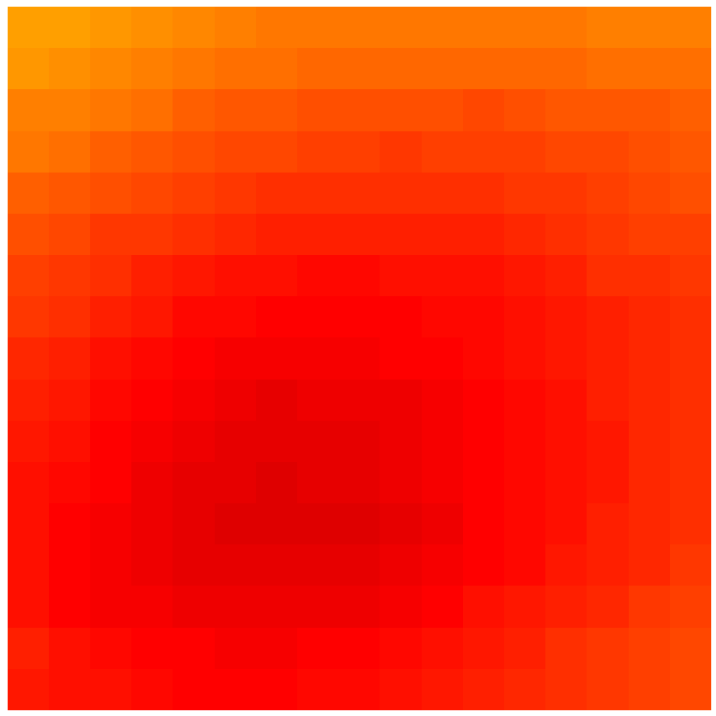
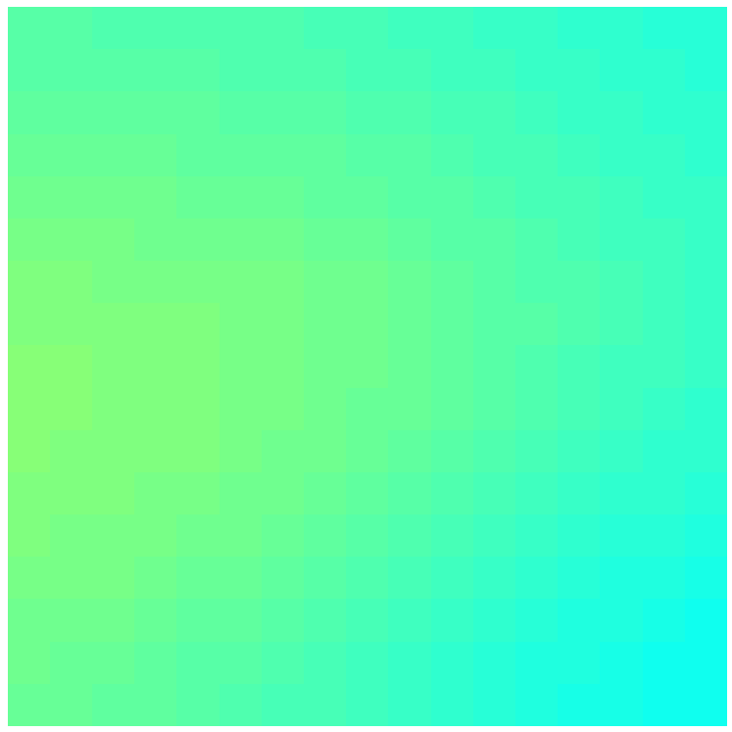
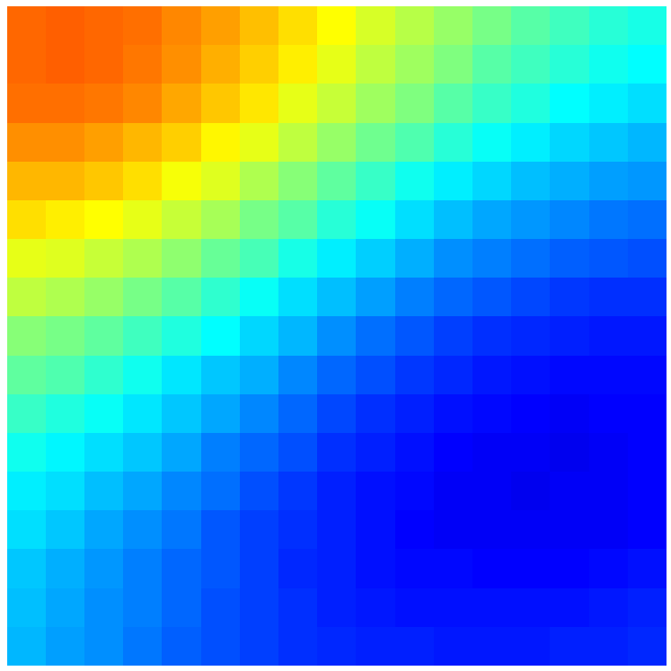
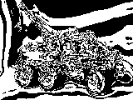
Scalable coding
—
= input
difference
Reconstruct multi-view images with $\left|N_{1}\right|(1\sim 3)$ binary images.
Notes:
Next, I’d like to explain the scalable coding.
Firstly, we express the multi-view images using very few binary images, for example 1 to 3.
Of course, the reconstructed multi-view images are not expressed well.
And, we obtain the difference between the original multi-view images and the reconstructed images.

Slide 26
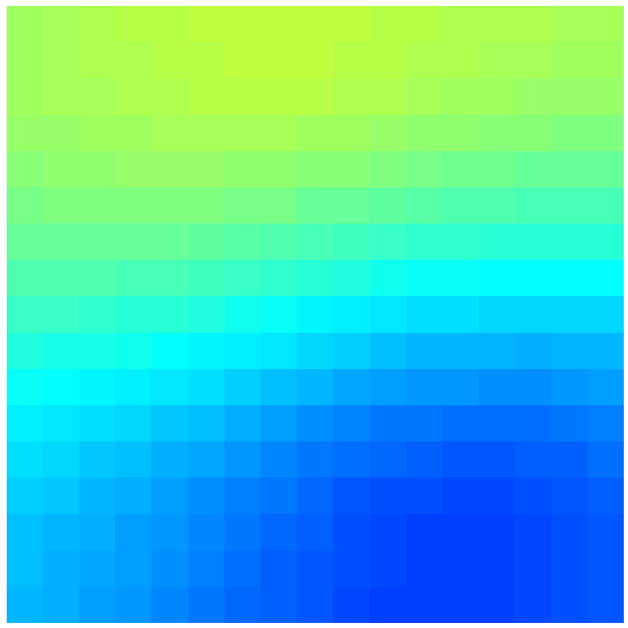
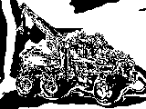
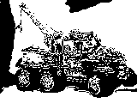
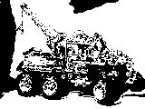
Scalable coding
—
difference
Reconstruct multi-view images with $\left|N_{2}\right|(1\sim 3)$ binary images.
Notes:
After that, in the same way we express the difference of multi-view images using very few binary images.
And we obtain the difference between the previous difference and current reconstructed images.

Slide 27
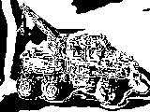
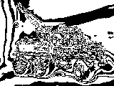
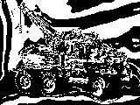
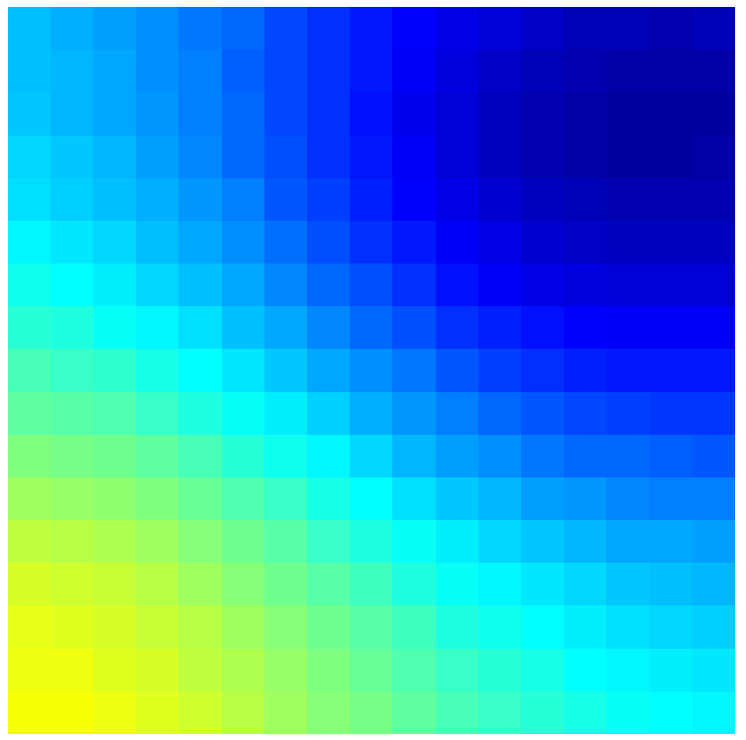
Scalable coding
Calculation cost is very low for each layer
because the number of binary images $N_{m}$ is small
$$⋮$$
$$⋮$$
$$⋮$$
M layer
Notes:
And repeat this process for M times.
The residuals obviously decrease.
Here, because we just optimize very few binary images for each layer, we can drastically reduce the computational cost.

Slide 28
Scalable coding
Add from top layer to any layer. 1~M’ (M’<M)
$$⋮$$
$$⋮$$
$$⋮$$
Notes:
And by adding from the top layer to any layer M’, we can control the bit rate.
As the number of M’ increases, multi-view images can be expressed clearly.

Slide 29
Comparison of computational cost
Non-scalable
$$\frac{2×M}{2^{N}}$$
Scalable
：number of binary images for m-th layer
suppose that
When N=15, about 820 times
When N=30, about 13.4million times
Notes:
And this is the comparison of computational cost between the non-scalable coding and scalable coding.
As mentioned in the previous slide, the calculation amount is like this, and N_m denotes the number of binary images for m-th layer.
When we suppose that N = N_m times M, N_m = 3, these amount of calculations in each condition can be reduced like this.

Slide 30
Summary so far
Multi-view images can be expressed using common binary images and corresponding weights.
It has high computational cost in optimization.
By dividing into multiple hierarchies,
the calculation cost is drastically reduced.
Notes:
Here, I summarize our proposed method so far.
We proposed an efficient scheme which compress dense light fields using common binary images and corresponding weights.
However, It needs high computational cost as we use many binary images.
So we applied scalable coding to our method.
By dividing into multiple hierarchies, we can drastically reduce the computational cost.

Slide 31
Experiments
Performance comparisons between non-scalable method and scalable method.
- PSNR
- encoding time
Performance comparisons between modern video codecs and our proposed method.
Notes:
Next, I will show you some experimental results.
We have mainly conducted following experiments.

Slide 32
Experiments
Performance comparisons between non-scalable method and scalable method.
- PSNR
- encoding time
Performance comparisons between modern video codecs and our proposed method.
Notes:
Firstly, I will show you the performance comparisons between non-scalable coding and scalable coding.
We evaluated PSNR and encoding time.

Slide 33
Experiments
Multi-view image
17×17=289 views, 160×120 pixels, gray-scale
Non-scalable
Scalable
binary image : = 1 ~ 3
$M$layer （ ）
binary image : N = 1 ~ 15
Experiment Ⅰ: comparison of PSNR.
Experiment Ⅱ: comparison of encoding time.
Notes:
This is the experimental condition.
We compressed this multi-view images, which have 17 times 17 views and 160 times 120 pixels.
Both methods use from 1 to 15 binary images and in scalable coding, the number of binary images for each layer N_m is set from 1 to 3.

Slide 34
Experimental result（PSNR）
[dB]
Non-scalable
= 3 (scalable)
Compare encoding time
PSNR
= 1 (scalable)
= 2 (scalable)
Total number of binary images
Notes:
This is the experimental results of PSNR.
The horizontal axis indicates the total number of binary images and the vertical axis indicates PSNR.
The black graph shows the result of non-scalable coding and red graphs show the results of scalable coding.
We confirm that the best performance can be achieved when N_m is 3.
The performance of scalable coding is inferior to that of non-scalable coding, because it is not whole optimal solutions.
But the performances are not declined so much.
Next, I’d like to show you the encoding time when we use 12 binary images.

Slide 35
Experimental results（encoding time）
$$≈$$
(non-scalable)
(scalable)
about 1/100
(scalable)
(scalable)
$$≈$$
8000
10000
[s]
Notes:
This is the results of encoding time.
Non-scalable coding takes over 8000 seconds, but each scalable coding takes only about 80 seconds.

Slide 36
Experimental results（encoding time）
$$≈$$
(non-scalable)
(scalable)
High speed encoding can be achieved
without declining in rate-distortion performances so much.
about 1/100
(scalable)
(scalable)
$$≈$$
8000
10000
[s]
Notes:
From these results, we have achieved high speed encoding without declining in rate-distortion performances so much.

Slide 37
Experiments
Performance comparisons between non-scalable method and scalable method.
- PSNR
- encoding time
Performance comparisons between modern video codecs and our proposed method.
Notes:
Finally, I will show you the performance comparisons between modern video codecs and our proposed method.

Slide 38
Experiments
Multi-view images: 17×17=289 views, gray-scale
Proposed method
Modern video codecs
Video file
$$⋮$$
output
Video frame
・binary image： 6 ~ 15
・weight ： short int (16bit)
・initialize ： threshold left top image （average pixel value）
・implement with gzip
・non-scalable
・implemented with ffmpeg
・video codec： HEVC, H.264(w/ all_intra)
・bit rate ： 6 ~ 30kbps
・frame rate : 30fps
Notes:
This is the experimental conditions.
In proposed method, we use from 6 to 15 binary images and with non-scalable coding.
And I also evaluated with gzip.
Modern video codecs are implemented with ffmpeg, and the video codecs are HEVC, H.264, and with all intra frame mode.

Slide 39
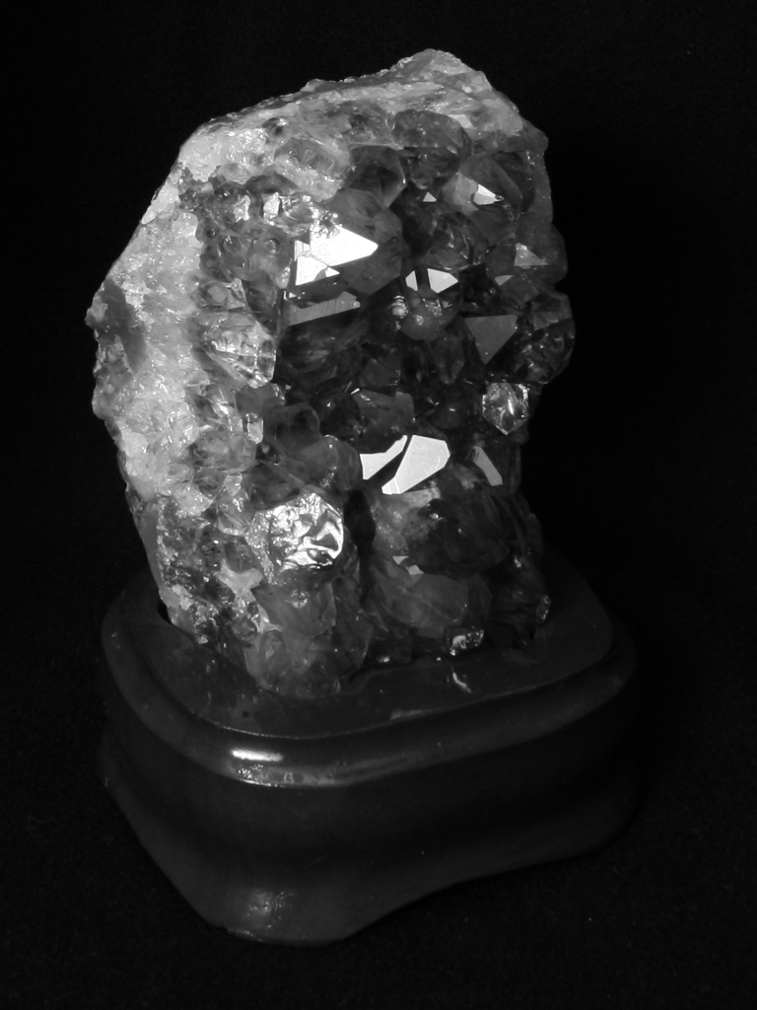
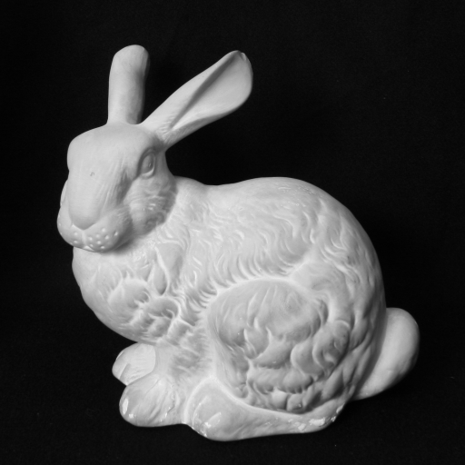
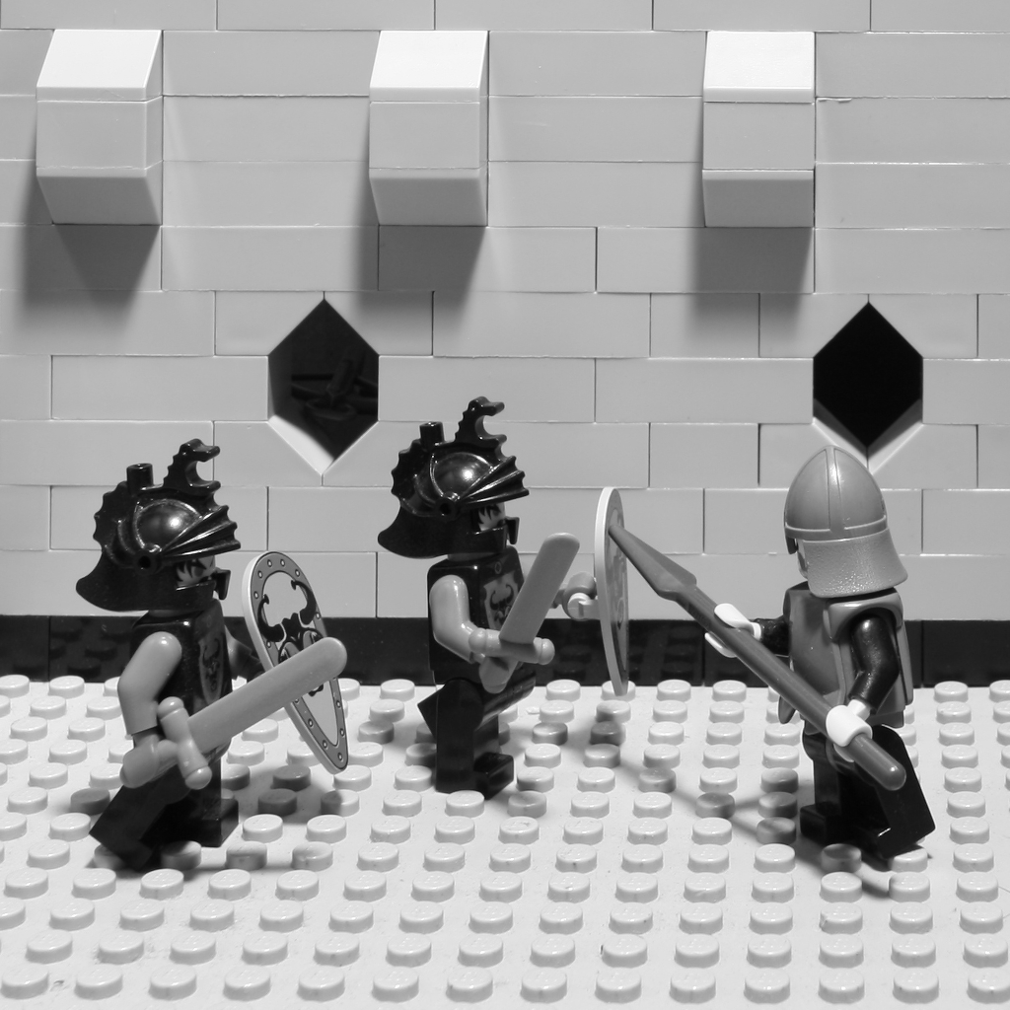
Experimental datasets
Amethyst (96×128)
Bunny (128×128)
Knight (128×128)
Truck (160×120)
Notes:
This is the datasets for experiments.

Slide 40
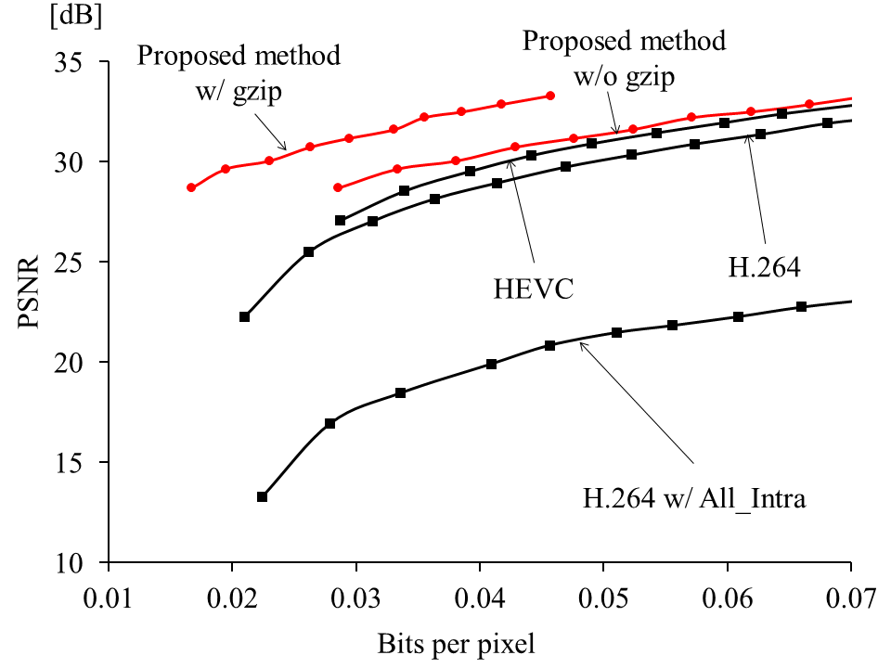
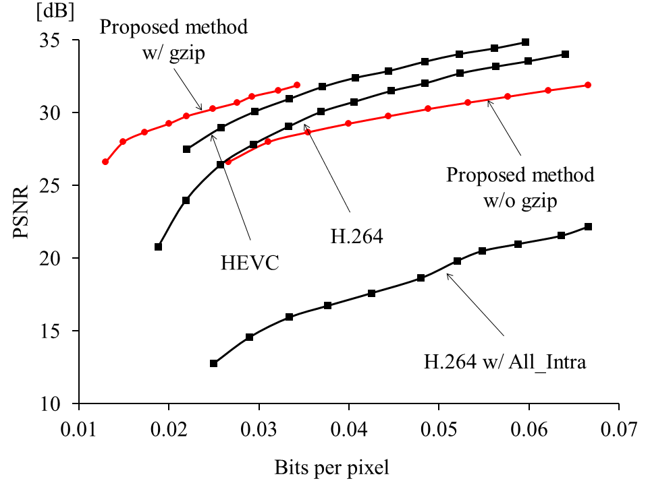
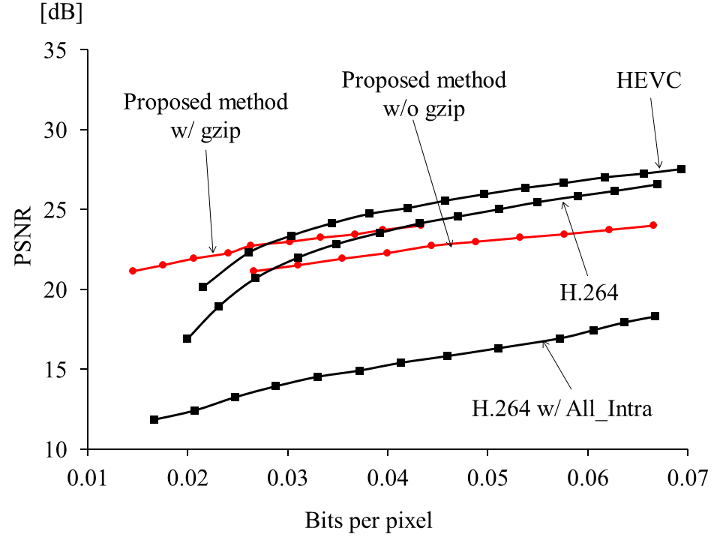
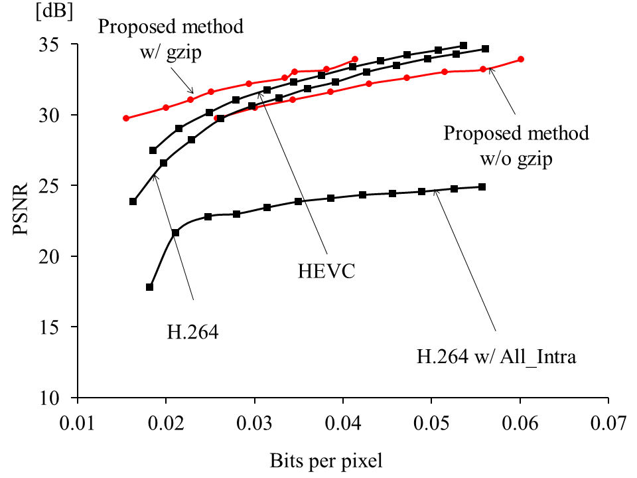
Experimental results
Notes:
This is the experimental results.
The horizontal axis indicates the bit per pixel and the vertical axis indicates PSNR.
Red graph shows the result of our method and each black graph shows the results of modern video codecs.
It is better when graph positions on the top left corner because it means that it achieves high PSNR with small data.

Slide 41
Experimental results
Our proposed method with gzip can achieve
comparable rate-distortion performances to
that of modern video codecs.
Notes:
As you can see, the rate-distortion performance of our proposed method with gzip is comparable to that of modern video codecs.

Slide 42
Conclusion
Efficient coding scheme for dense light fields.
(using only common binary images and weights)
Decoding process is extremely simple.
Rate-distortion performances are comparable to that of modern video codecs.
Scalable coding
Reduce computational costs drastically without declining in rate-distortion performances so much.
Notes:
Finally, I’d like to summarize my presentation.
We proposed an efficient coding scheme for dense light fields, which use only common binary images and corresponding weights.
This is completely different from modern video codecs and the decoding process of our method is extremely simple.
And, rate-distortion performances of our method are comparable to that of modern video codecs.
Moreover I applied scalable coding to our proposed method because it needs high computational cost when using many binary images.
Thanks to this approach, we can drastically reduce the computational cost without declining in rate-distortion performances so much.
Thank you for listening to my presentation.

