Slide 1
Unsupervised Relapse Detection using Wearable-Based Digital Phenotyping The 2nd e-Prevention Challenge
Samsung Research China-Beijing (SRC-B)
Jinting Wu
Notes:
Hello, everyone. I’m XXX from Samsung Research China-Beijing. Today, I would like to introduce our solution submitted to the second e-prevention challenge.

Slide 2
CONTENTS
1. Challenge Introduction
2. Method
2-1 Data processing
2-2 Statistical feature extraction
2-3 Model training
3. Results
3-1 Results on the validation set
3-2 Results on the test set
Notes:
This is the outline of my presentation.

Slide 3
1. Challenge Introduction
The 2nd e-Prevention challenge: Psychotic and Non-Psychotic Relapse Detection using Wearable-Based Digital Phenotyping
The objective of this challenge is to stimulate innovative research on the prediction and identification of mental health relapses via the analysis and processing of the digital phenotype of patients in the psychotic spectrum.
Track 1: Detection of non-psychotic relapses (rank 4th)
Track 2: Detection of psychotic relapses (rank 3rd)
Dataset:
Signals: Accelerometers (ACC), Gyroscopes (GYR) and Heart rate (HR) monitors, as well as information about the daily step count and sleep.
Track 1 -- 9 patients, Track 2 -- 8 patients.
The training sets of these tasks do not contain relapses, which means they are unsupervised tasks.
Notes:
First, I’ll introduce the challenge. The second E-prevention challenge uses continuous recordings of biosignals for relapse detection. We participated in both 2 tracks. We ranks fourth at track 1 and ranks third at track 2. ACC, GYR, HR and R-R interval signals are provided. Both tasks are unsupervised.

Slide 4
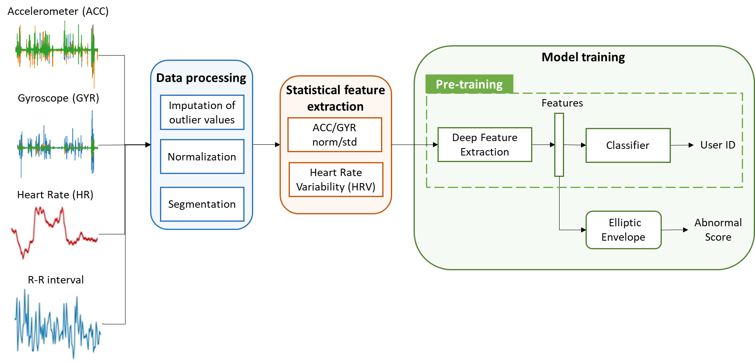
2. Method
Overview
Eight-channel signals are used (3-axis ACC, 3-axis GYR, HR, and R-R interval). Sleep and step data are not been used.
Data processing: imputation of outliers, normalization, segmentation
Statistical feature extraction: ACC/GYR norm/std, Heart Rate Variability (HRV)
Model training: 3 deep networks for feature extraction
Notes:
Then, I’ll introduce our solutions. The methods used for the two tracks are the same, and the model parameters are selected separately.
Eight channel signals are used including ACC, GYR, HR, and r-r intervals. Sleep and step data are not used.
First, the signals are pre-processed to deal with outliers and missing values. We divide the data into 5-minute segments, and extract statistical features such as Heart Rate Variability. Then, 3 deep networks are used for high-level feature extraction with User ID labels. Finally, the features are fed into a outlier detector to get the final abnormal scores.
We will introduce each module in detail.

Slide 5
2. Method
Data processing
Outliers and missing values are replaced by the average value of the same day. Valid ranges are as follows:
ACC: [-19.6, 19,6]
GYR: [-573, 573]
HR: [40,180]
R-R interval: [200, 2000]
Normalization
Segmentation: 5 minutes
Notes:
During data processing, the average value of the same day is used for imputation. The valid ranges for each channel are as follows. At the moment of abnormal heart rate values, the values of r-r interval are also replaced. Then, the data of each channel are normalized and split into 5-minute segments.

Slide 6
2. Method
Statistical feature extraction
Same as baseline, we extract the 6 features from the raw data using a 5-minute window:
Accelerometer norm, Gyroscope norm
HeartRate Mean
RR-Interval RMSSD, RR-Interval SDNN, RR-Interval Mean, RR-Interval Lomb-Scargle Power in High Frequency Band
Time encoding of the corresponding time of the day using cosine and sine functions is added.
In addition to the above features, 9 features are also extracted:
Accelerometer std, Gyroscope std
RR-Interval NN50, RR-Interval NN20, RR-Interval SDSD, RR-Interval SD1, RR-Interval SD2, RR-Interval SD-ratio, RR-Interval SD-area
Notes:
Then, the processed data are used to calculate statistical features. At first, the same features and time encoding as the baseline are extracted. In addition, we also add 9 features, including standard deviation of ACC and GYR signals and other indicators of heart rate variability.

Slide 7
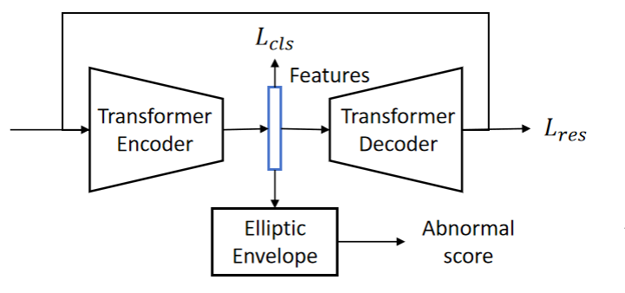
2. Method
Model training
We use person identification as an auxiliary task to train Transformer-based networks on above features. Then, we use the output of the last hidden layer of the Transformer encoder to train an Elliptic Envelope outlier detector for each patient and get abnormal scores.
Three Transformer-based networks are designed.
Model A: A Transformer encoder (baseline)
Model B: A Transformer encoder-decoder.
In addition to calculating the classification loss, we also use the reconstruction of the decoder to retain the most original information of the input.
Fig. 1. Framework of model A
Fig. 2. Framework of model B
Notes:
After extracting the above time-series statistical features, we further use deep networks to extract higher-level features. Because there is no relapse data in the training set, we use user IDs as training labels of the deep network to distinguish different behavior patterns. The high-level features are used to train an Elliptic Envelope outlier detector for each patient. The output of the outlier detector is abnormal score of relapse. This framework is the same as baseline.
Then, we focus on three Transformer-based feature extraction networks. The model A is a Transformer encoder which is given by baseline. The framework of model A is shown in Fig.1.
Next, in the Model B, we add a Transformer decoder. By adding the reconstruction loss of the encoder-decoder, the features output by the encoder can retain sufficient information from original input. The framework of model B is shown in Fig.2.

Slide 8
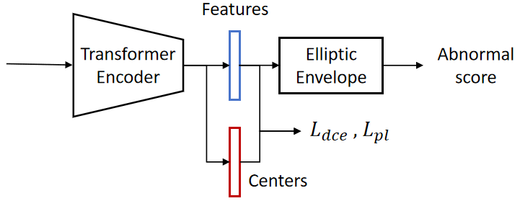
2. Method
Model training
Model C: A Transformer encoder based on prototype learning.
Some prototype-based methods learn a prototype representation of each class to improve the robustness of classification, so we train centers for each patient using the features which are output by the Transformer encoder.
Distance-based Cross Entropy loss (DCE) is used to measure the similarity between the samples and the prototypes.
Prototype Loss (PL) is used as a regularization.
Output of Transformer encoder
Prototype of corresponding category (user ID)
Fig. 3. Framework of model C
Notes:
In Model A and Model B, the traditional softmax-based classification loss tends to misclassify unseen classes as seen classes. To solve this problem, we propose Transformer encoder based on prototype learning called Modal C. The prototype representation of each class is trained to improve the robustness of classification.
Two loss functions are used for patient identification. The first loss is Distance-based Cross Entropy loss which can be used to measure the similarity between the samples and the prototypes. The second loss is Prototype Loss which is used as a regularization. Pi is the output of the last layer of transformer encoder, and m is the prototype of the sample’s category.
The loss function and structure of Model C is shown below.

Slide 9
3. Results
Results on the validation set
Performance on different feature sets
 | Track 1 |  |  | Track 2
Feature set | ROC-AUC | PR-AUC | AVG-AUC | ROC-AUC | PR-AUC | AVG-AUC
8 features | 0.6741 | 0.5074 | 0.5908 | 0.6778 | 0.5279 | 0.6028
17 features | 0.6477 | 0.5171 | 0.5824 | 0.6668 | 0.4966 | 0.5817
Performance on different models
 | Track 1 |  |  | Track 2
Model | ROC-AUC | PR-AUC | AVG-AUC | ROC-AUC | PR-AUC | AVG-AUC
Model A | 0.6362 | 0.4764 | 0.5563 | 0.6430 | 0.4724 | 0.5577
Model B | 0.6741 | 0.5074 | 0.5908 | 0.6636 | 0.4866 | 0.5751
Model C | 0.6658 | 0.4922 | 0.5790 | 0.6778 | 0.5279 | 0.6028
After choosing different models for each user, the best AVG-AUC on validation set of track 1 is 0.6292, and the best AVG-AUC of track 2 is 0.6506.
Notes:
Finally, we show the experimental results.
We compare the performance of different feature sets. After adding 9 features, most metrics are decreasing. This may be because some features, especially those related to R-R interval, are much more sensitive and easily affected by noise and errors.
The performance on different models is shown in the second table. On the validation set of track 1, the best performance comes from model B, which is Transformer encoder-decoder. But on the validation set of track 1, model C is the best. This result illustrates that although the two tasks seem similar, the differences between the two different relapse types need to be further explored. Finally, we select the best-performing model for each user, and average AUC are 0.6292 and 0.6506 respectively.

Slide 10
3. Results
Results on the test set
Track 1
Team | ROC-AUC | PR-AUC | AVG-AUC
Samsung R&D Institute Poland | 0.711 | 0.6202 | 0.6656
MagCIL | 0.6512 | 0.6416 | 0.6464
Jackalope | 0.5949 | 0.574 | 0.5844
SCRB-LUL | 0.6102 | 0.5255 | 0.5678
CHI-EIHW | 0.5796 | 0.5549 | 0.5673
Track 2
Team | ROC-AUC | PR-AUC | AVG-AUC
Jackalope | 0.5632 | 0.4443 | 0.5037
CHI-EIHW | 0.493 | 0.5053 | 0.4991
SCRB-LUL(Ours) | 0.569 | 0.4237 | 0.4964
Samsung R&D Institute Poland | 0.511 | 0.4775 | 0.4943
ABCDZ | 0.548 | 0.4111 | 0.4795
Notes:
Finally, on the test set, we rank fourth at Track 1 and rank third at Track 2. The average AUC are 0.5678 and 0.4964 respectively.

Slide 11
4. Conclusion
Performance on the test set is much lower in that on the validation set.
The generalization of the model is still not enough.
The behaviors of relapse are complex and a user may have multiple states in a single relapse type.
Advantageous methods in Track1 are not advantageous in Track2.
Although the data format and annotation of the two tasks are similar, the features of the psychotic and non-psychotic relapse states may be very different.
Adjustments to model parameters may not be sufficient. In the future work, features and model structures that are more suitable for the two types of relapse respectively need to be explored.
Notes:
From the experiment results of the both two tracks, some problems need to be solved in the future.
The first problem is that performance on the test set is much lower in that on the validation set. We need to solve the problem of overfitting and explore complex relapse states in a single type.
The second problem is that advantageous methods in Track1 may not be advantageous in Track2. The difference in the characteristics of psychotic and non-psychotic relapse states may be greater than we assume. Only adjusting parameters is not enough. More features and model structures needs to be explored.

Slide 12
Thank You
If you have any questions, please contact jinting01.wu@samsung.com
Notes:
Thanks for watching my presentation. If you have any questions, please feel free to contact the lead author.

