Slide 1
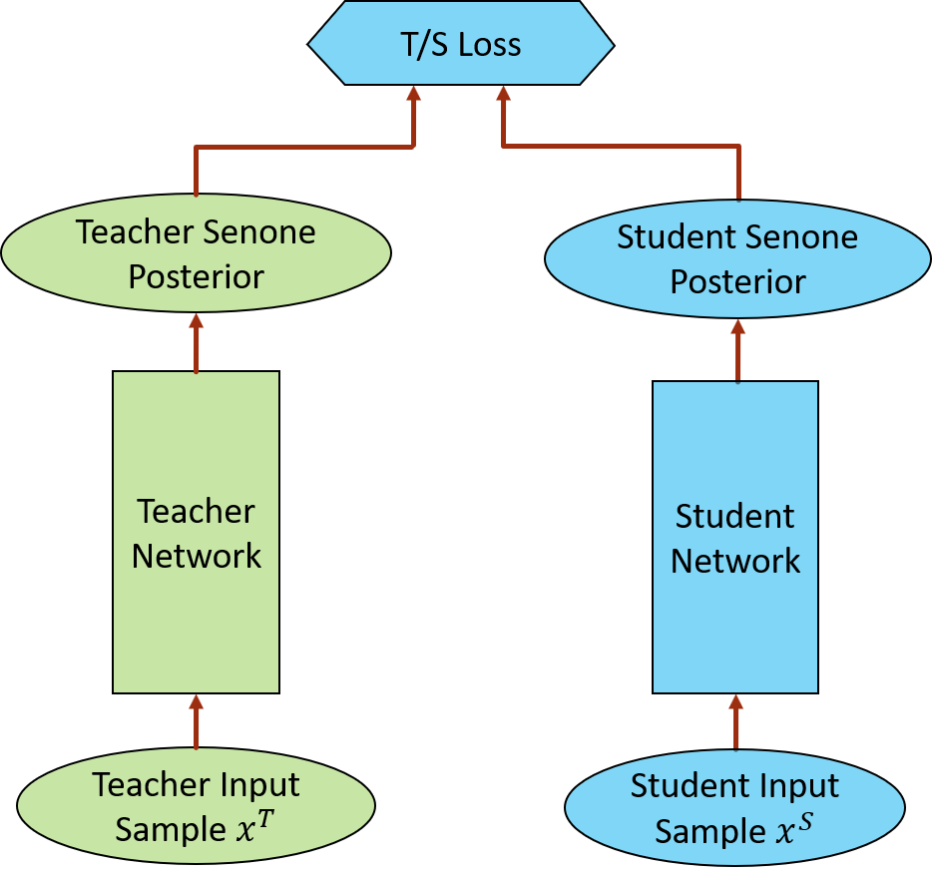
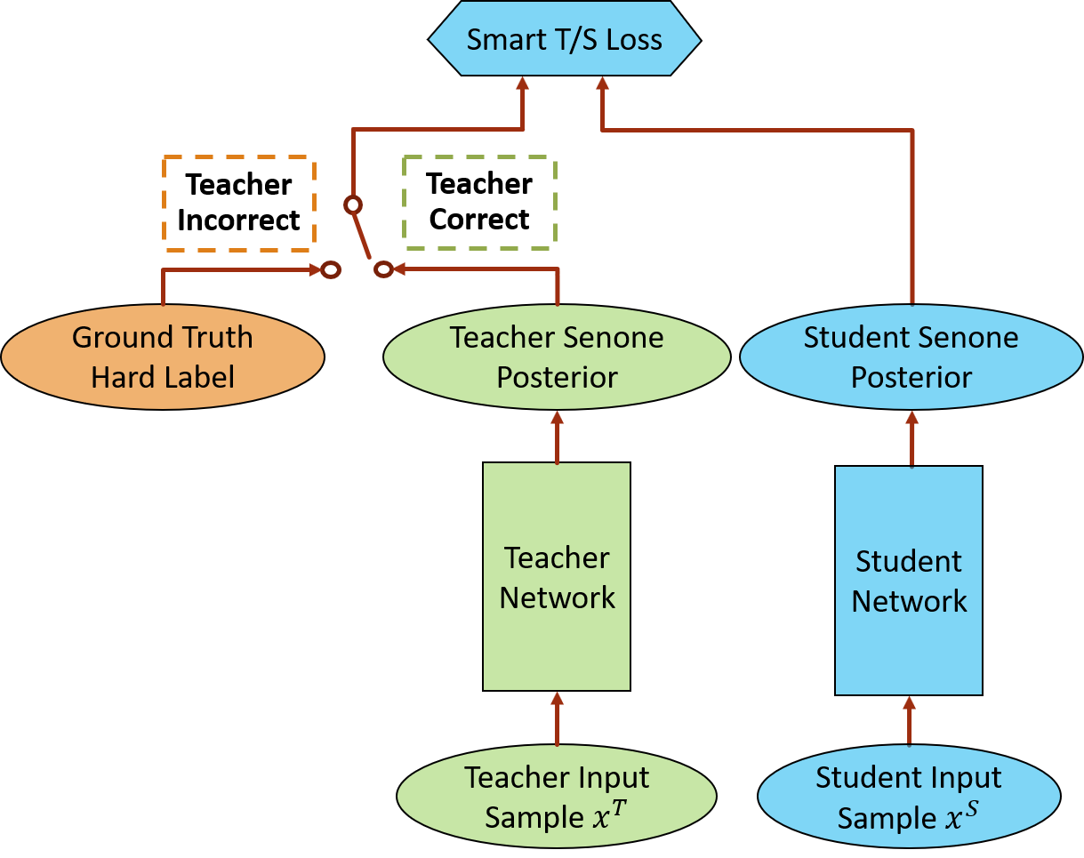
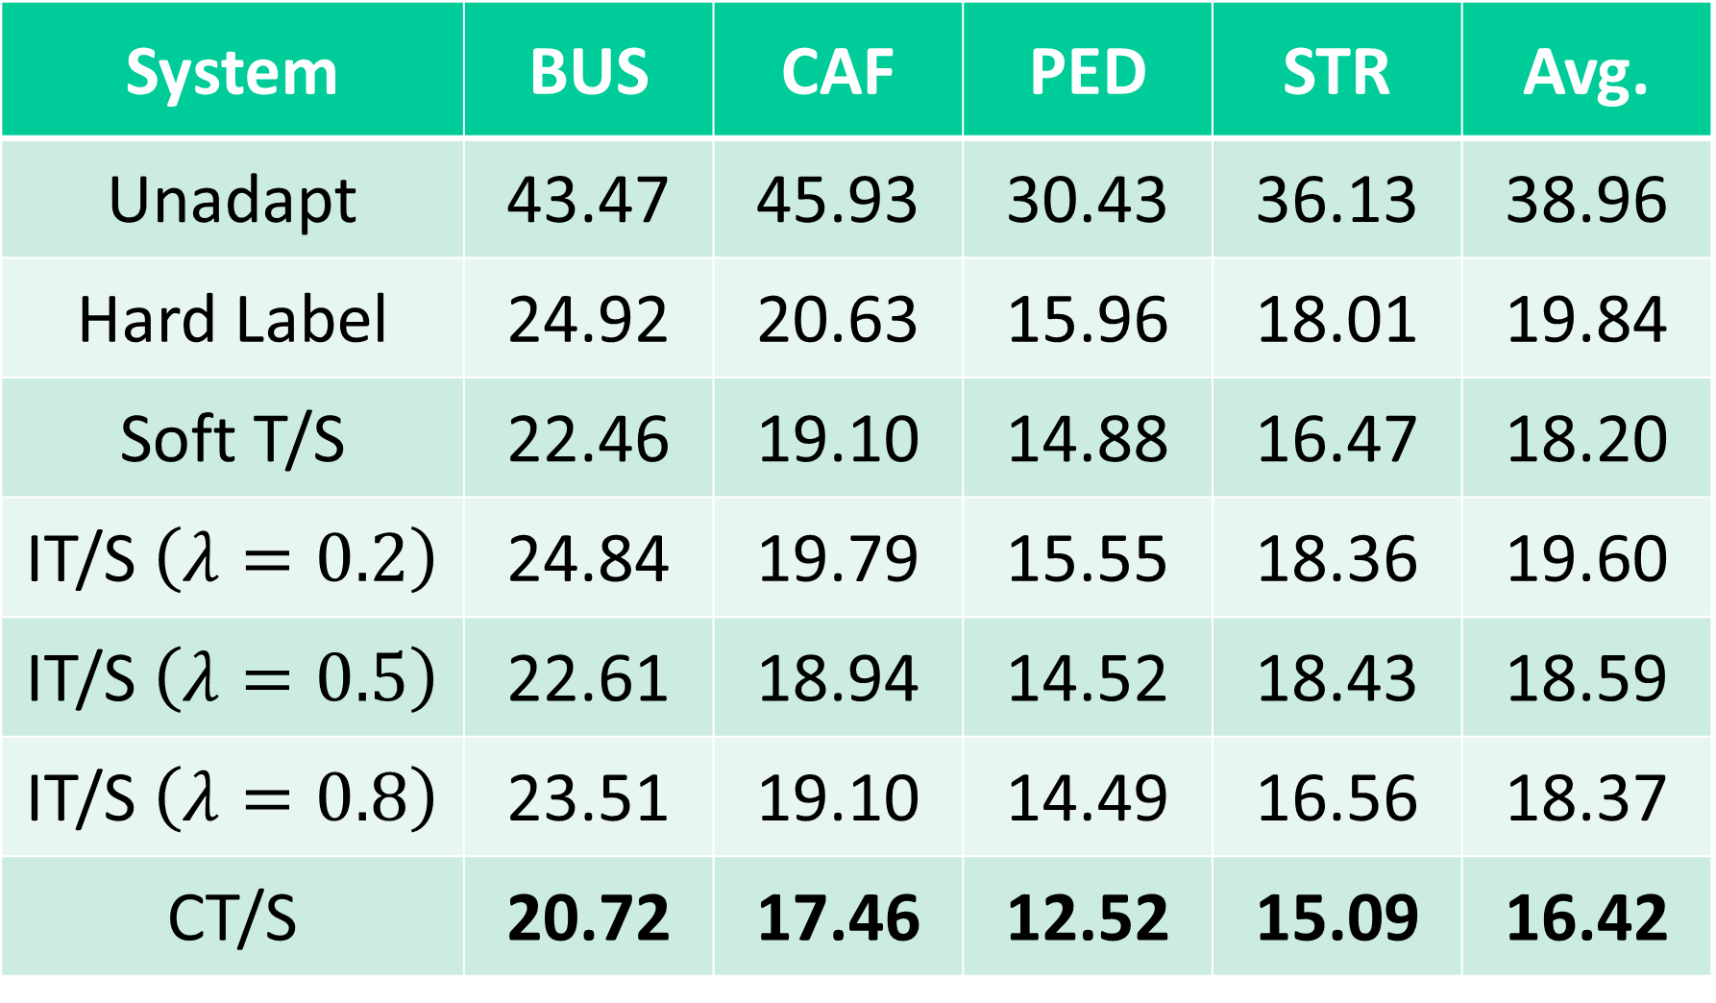
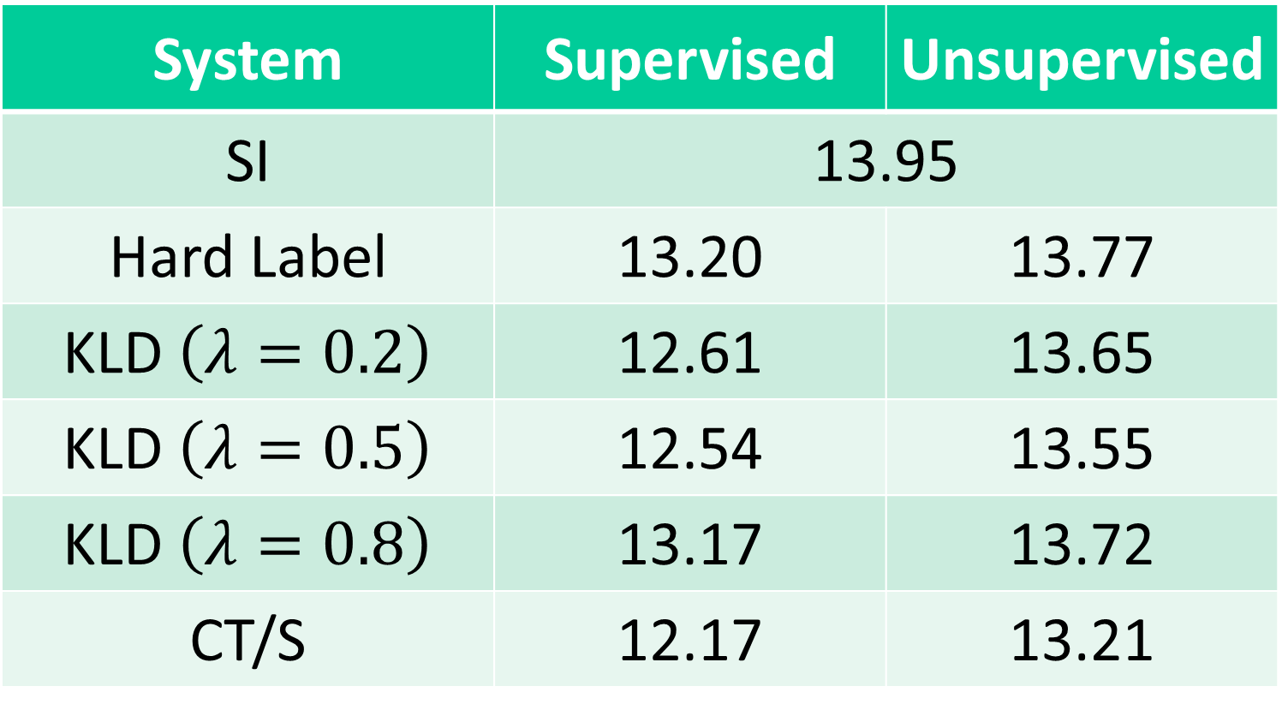
Conditional Teacher-Student Learning
Zhong Meng, Jinyu Li, Yong Zhao, Yifan Gong
Microsoft Corporation, Redmond, WA, USA
Introduction
Teacher-student (T/S) learning shortcoming: the teacher model may produce wrong guidance that misleads the student model
Propose conditional teacher-student (CT/S) learning
When teacher is correct, the student model learns from the teacher’s soft posteriors.
When teacher is wrong, the student learns from the hard labels.
CT/S for domain adaptation: 9.8% relative WER reduction (WERR) over T/S
CT/S for speaker adaptation: 12.8% WERR over T/S
3. Teacher-Student (T/S) Learning
5. Experiments
Domain Adaptation
Adaptation data: 9137 parallel clean and noisy training utterances in CHiME-3 dataset
Test data: real single-channel (5th microphone) far-field noisy speech in CHiME-3 dev set.
LSTM AM: 4 hidden layers, 512 hidden units, 87 input units, 3012 output units.
ASR WER (%) Results
CT/S achieves 9.8% and 11.7% WERRs over soft T/S and IT/S for domain adaptation.
Speaker Adaptation
KLD adaptation can be formulated as a special case of IT/S [Asami et al, 2017]
SI training data: 2600 hours Microsoft Cortana
Adaptation data: 7 speakers, 200 utt. for each
Test data: 20,203 words from 7 speakers.
LSTM AM: 4 hidden layers, 512 hidden units, 80 input units, 5980 output units.
ASR WER (%) Results
Supervised: CT/S achieves 12.8% and 3.0% WERRs over SI and KLD.
Unsupervised: CT/S achieves 5.3% and 2.5% WERR over SI and KLD.
Student input $X^{S}$ is parallel or identical to teacher input $X^{T}$.
Minimize the KL divergence between the output distributions of the teacher and student model
$KL\left(p_{T}||p_{S}\right)=p\left(c|x_{i}^{T};θ_{T}\right)\log\left(\frac{p\left(c|x_{i}^{T};θ_{T}\right)}{p\left(c|x_{i}^{S};θ_{S}\right)}\right)$
T/S with soft labels [Li et al, 2014]
Teacher class posteriors as training target
$ℒ_{TS}\left(θ_{S}\right)=−\sum_{i}{\sum_{c=1}^{D_{c}}{p\left(c|x_{i}^{T};θ_{T}\right)\log{p\left(c|x_{i}^{S};θ_{S}\right)}}}$
$c$ is one of the classes in the set $\left\{1, …,D_{c}\right\}$
T/S with interpolated labels (IT/S) [Hinton et al, 2015]
Interpolation of teacher class posteriors and hard label as training target
$ℒ_{ITS}=−\sum_{i}{\sum_{c=1}^{D_{c}}{\left[\left(1−λ\right)δ\left(c=c_{i}\right)+λp\left(c|x_{i}^{T};θ_{T}\right)\right]\log{p\left(c|x_{i}^{S};θ_{S}\right)}}}$
System | BUS | CAF | PED | STR | Avg.
Unadapt | 43.47 | 45.93 | 30.43 | 36.13 | 38.96
Hard Label | 24.92 | 20.63 | 15.96 | 18.01 | 19.84
Soft T/S | 22.46 | 19.10 | 14.88 | 16.47 | 18.20
IT/S $\left(λ=0.2\right)$ | 24.84 | 19.79 | 15.55 | 18.36 | 19.60
IT/S $\left(λ=0.5\right)$ | 22.61 | 18.94 | 14.52 | 18.43 | 18.59
IT/S $\left(λ=0.8\right)$ | 23.51 | 19.10 | 14.49 | 16.56 | 18.37
CT/S | 20.72 | 17.46 | 12.52 | 15.09 | 16.42
2. Related Work
T/S Learning for model compression [Li et al, 2014] [Hinton et al, 2015]
Same training data to the input of teacher and student models.
Small-footprint student model learns from a large strong teacher model.
T/S Learning for domain adaptation [Li et al, 2017] [Watanabe et al, 2017]
Parallel training data to the input of teacher and student models.
Noisy student model learns from a well-trained clean teacher model.
Small-footprint neural machine translation [Kim et al, 2016]
Low-resource neural machine translation [Chen et al., 2017]
4. Conditional Teacher-Student (CT/S) Learning
Student input $X^{S}$ is parallel or identical to teacher input $X^{T}$.
When teacher makes correct prediction
Teacher’s class prediction equals to ground truth
Student uses teacher class posteriors as training target
When teacher makes incorrect prediction
Teacher’s class prediction does not equal to ground truth
Student uses hard label (ground truth) as training target
System | Supervised | Unsupervised
SI | 13.95
Hard Label | 13.20 | 13.77
KLD $\left(λ=0.2\right)$ | 12.61 | 13.65
KLD $\left(λ=0.5\right)$ | 12.54 | 13.55
KLD $\left(λ=0.8\right)$ | 13.17 | 13.72
CT/S | 12.17 | 13.21

