Slide 1
Reverse Multi-Delimiter Compression Codes
Igor Zavadskyi, Anatoly Anisimov
Taras Shevchenko National University of Kyiv, Ukraine Computer science department

Slide 2
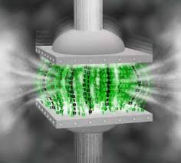
Data compression codes key features: compression rate
Arithmetic
Asymmetric numeration systems
Huffman
Multi-delimiter
Fibonacci
Byte-aligned RPBC
Byte-aligned SCDC
Codes with delimiters

Slide 3
Key features: synchronization
Arithmetic code, ANS and Huffman codes are not synchronizable
error
Codes with delimiters are synchronizable
error

Slide 4
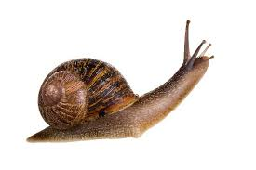
Key features: decoding speed
1
RPBC
2
Byte-aligned algorithms for multi-delimiter codes
3
SCDC
4
Byte-aligned algorithms for Fibonacci codes
5
Huffman codes, ANS
6
Arithmetic encoding

Slide 5
Key features: search in compressed file
We have developed a new class of variable length prefix codes, so called (; k)-codes, which can be used for efficient data compression.
efficient
Huffman, arithmetic, ANS, RPBC
–
SCDC, Fibonacci, multi-delimiter
+

Slide 6
Natural language text compression: Fibonacci codes
Fib3
?
Fib3
Fib2
Fib4
Fib4
Fib2
Fibm is the pattern code with delimiter 1…1
m

Slide 7
Delimiters
Fibonacci codes
Delimiter Strings
–
–
–
111
1111 11111 11111
Multi-delimiter codes
Delimiter Strings
s
+
+
+
0110
01110
011110
0111110
,
D_{2,3}

Slide 8
Multi-delimiter code: definition
Let m₁ ,… , m_{t} be a sequence of integers, 0 < m₁ <…< m_{t}
The code contains:
- codewords of a form 1…10, … , 1…10
- codewords of a form α01…10, … , α01…10
(type 1)
m₁
m_{t}
(type 2)
m₁
m_{t}
A type 2 codeword contains the delimiter only as a suffix and does not contain any of type 1 codewords as a prefix.

Slide 9
Multi-delimiter codes properties
Completeness
Universality
Synchronizability with the delay 1
Direct search in compressed file
etc.

Slide 10
Code D_{2,3} (delimiters 0110, 01110) – example
codewords
1101110010110110
delimiters

Slide 11
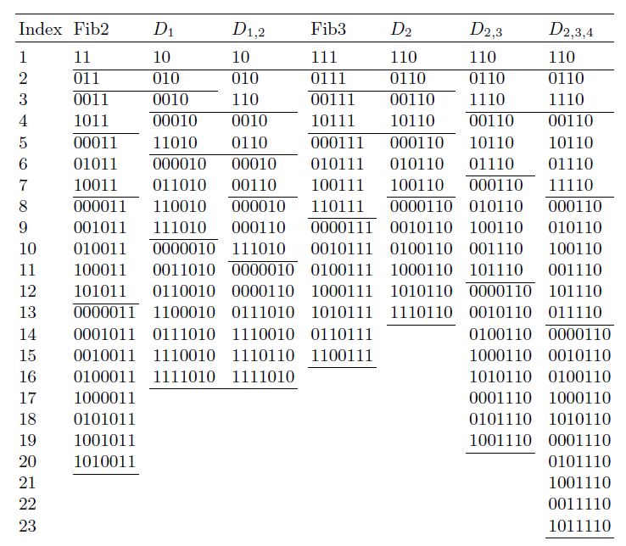
Codewords of length ≤7

Slide 12
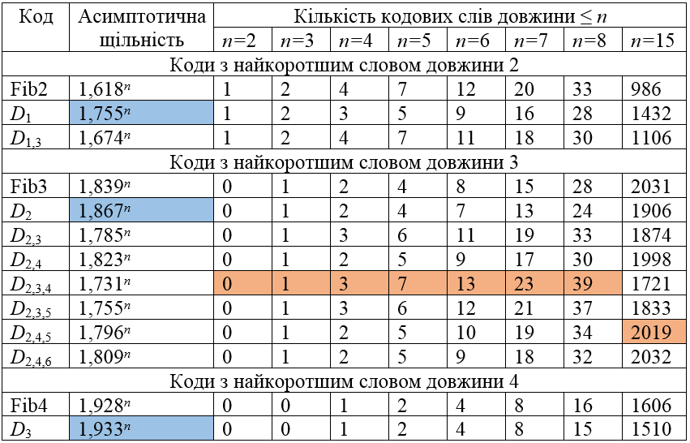
Multi-delimiter codes vs Fibonacci codes
Asymptotic density
Number of codewords of length ≤ n
Code
The codes with the shortest codeword of length 2
The codes with the shortest codeword of length 3
The codes with the shortest codeword of length 4

Slide 13
The flexible family of codes
 | Number of short codewords | Asymptotic density
Longer delimiters
More delimiters

Slide 14
Publication
A.V. Anisimov, I.O. Zavadskyi, “Variable-Length Prefix Codes With Multiple Delimiters,”
IEEE Transactions on Information Theory, vol. 63, no. 5, pp. 2885–2895, 2017.

Slide 15
Main problem: non-monotonousness
110
0110
00110
10110
000110
010110
1
2
4
3
8
5
Dict[1] = the
Dict[2] = and
Dict[4] = of
Dict[3] = to
Dict[8] = that
Dict[5] = in
…
NULL
00001110110
92784
Dict[92784] = Abhor
NULL
…

Slide 16
The reverse codes – key idea
Write all codewords from right to left.
Direct code:
011
0101110
0101000110
0101000110
011
0101110
0110001010
Reverse code:
110
0111010
This way we obtain a non-prefix but uniquely decodable code
with a simple principle of monotonous codeword set construction.

Slide 17
Codeword set construction — R_{2,4} , K={ 0, 1, 3, 5 }
L=3
L=4
L=5
L=6
L=7
1. Replicate the sets of codewords of lengths L−k−1 and append the sequences of the form 01^{k}, k ∈ K.
2. Replicate the set of words of the length L−1 with a suﬃx 01^{r}, r > m_{t} , and append a single “1” bit to all elements of this set.
3. If L = m + 1, m ∈ {m₁,...,m_{t}}, append the word 01^{m} to the codeword set.
011
0110
011
0
011
011
0110
0
011000
011010
011110
011001
01100
01101
01111
0
0
0
0
0
0
0
01100
01101
01111
01
01111
01
01
01
01
0111
L=9
L=10
011011111
011011111
1

Slide 18
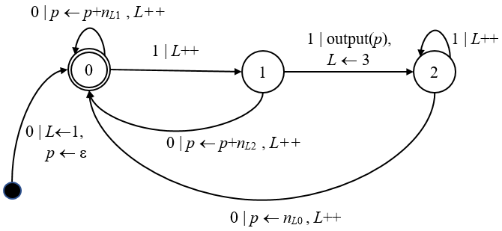
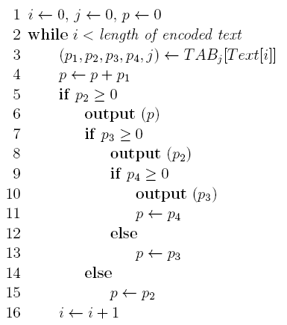
R_{2–∞} decoding
Automaton
Algorithm
input: encoded Text
output: dictionary indices

Slide 19
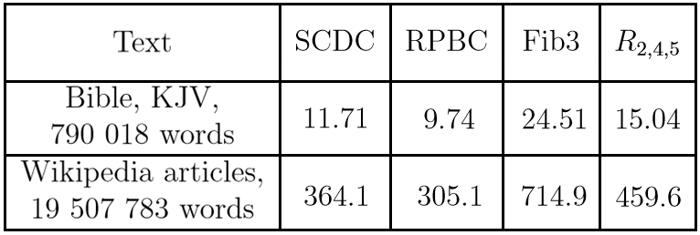
Decoding time comparison, milliseconds

Slide 20
R_{2–∞} improved decoding algorithm (idea)
Pack TAB_{j}[Text[i]] into 32-bit word
Get p1,…,p4 via bit-level operations

Slide 21
Improved decoding timing, milliseconds

Slide 22
Empirical comparison of codes compression rate

Slide 23
Conclusions
The reverse multi-delimiter codes are the first compression codes that have all the following properties:
Operate quite close to entropy (2–3% away)
Allow us to search the data in a compressed file without its decompression
Provide fast decoding on a level with byte-aligned codes
Are synchronizable with the delay 1
These codes point the way towards information retrieval systems of a new type, which can operate with compressed data directly, performing the decompression only on the fly.

Slide 24
Thank You!
Igor Zavadskyi
ihorza@gmail.com
Anatoly Anisimov
ava.lectures@gmail.com

