Slide 1
RENet: A Time-Frequency Domain General Speech Restoration Network for ICASSP 2024 Speech Signal Improvement Challenge
Fengyuan Hao, Huiyong Zhang, Lingling Dai, Xiaoxue Luo, Xiaodong Li, Chengshi Zheng
{haofengyuan, cszheng}@mail.ioa.ac.cn
Institute of Acoustics, Chinese Academy of Sciences
April 19, 2024
Notes:
下午好各位，我今天带来的汇报的题目是“RENet: A Time-Frequency Domain General Speech Restoration Network for ICASSP 2024 Speech Signal Improvement Challenge”。
Good afternoon, everyone. It is a pleasure to have the opportunity to present my research today. The topic of this presentation is “RENet: A Time-Frequency Domain General Speech Restoration Network for ICASSP 2024 Speech Signal Improvement Challenge”.

Slide 2
1. Introduction
2. Related Works
3. Methodology
4. Results and Discussions
5. Conclusions
Notes:
我的报告主要分为以下5个部分。
My share mainly consists of the following five sections.

Slide 3
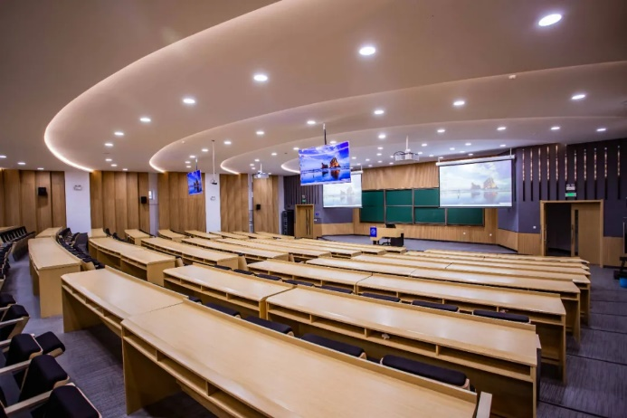
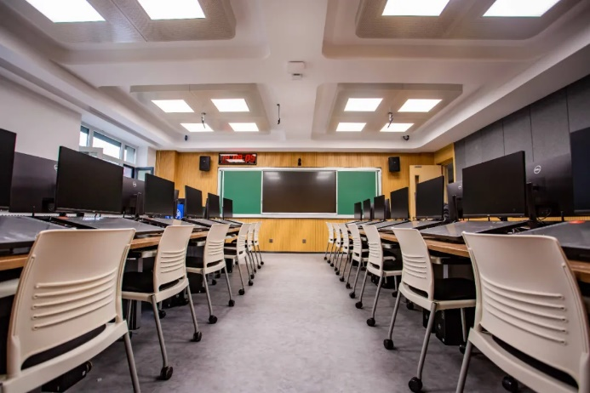
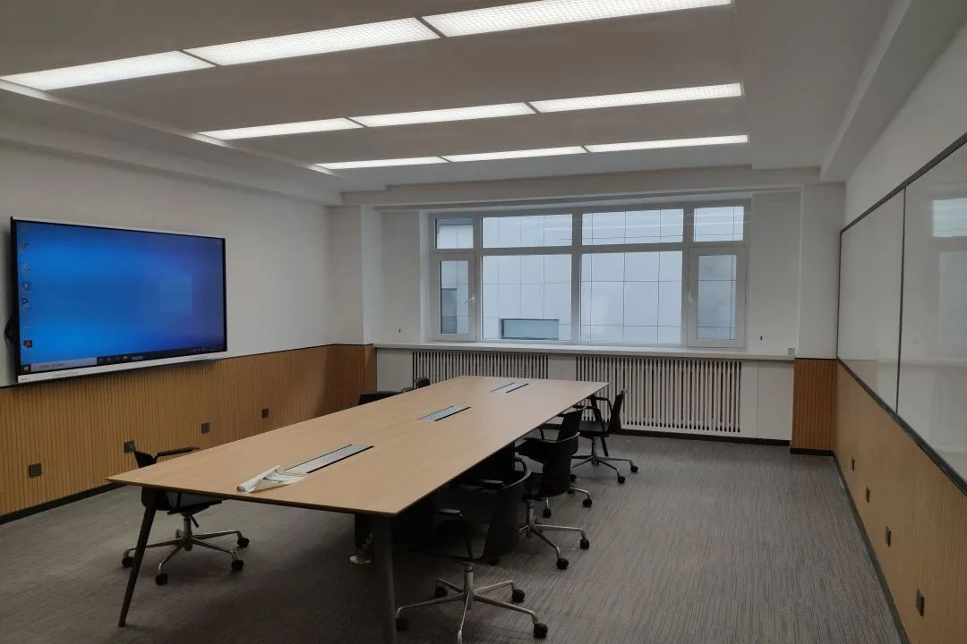
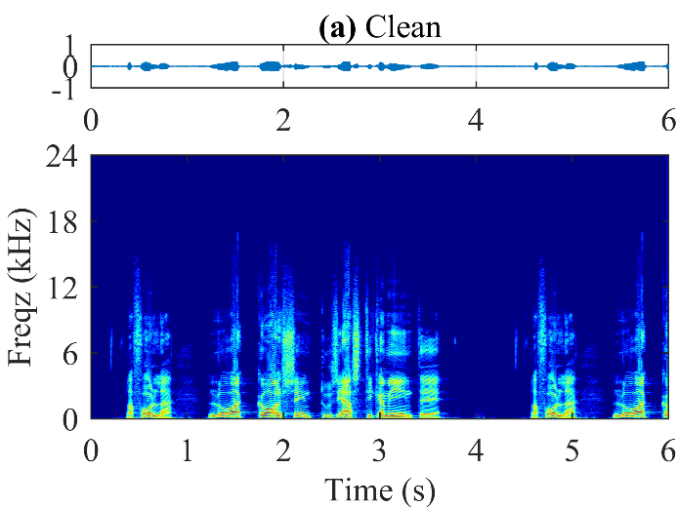
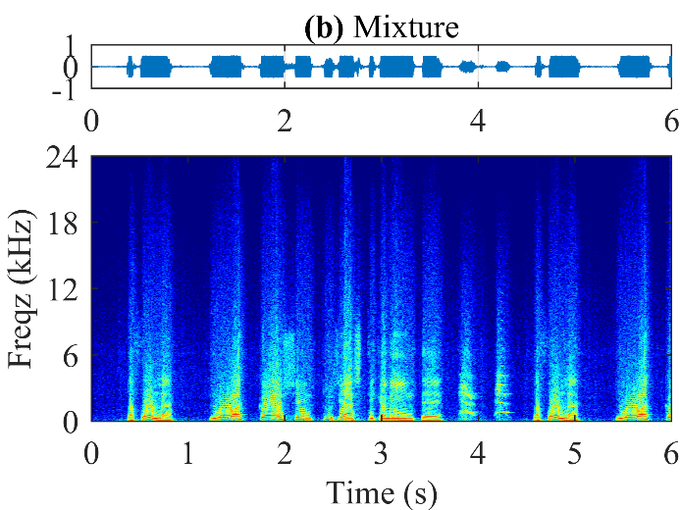
1. Introduction
(a) Assembly hall
(b) Multimedia classroom
(c) Conference room
Coloration, Noise, Reverberation
Reduce speech quality and intelligibility;
Disable ASR system.
Notes:
在现如今的会议室、礼堂和多媒体教室中存在各种拾音设备，除了常见的噪声和混响之外，这些设备可能存在缺陷导致出现频谱泄露、丢帧等等失真，从而严重降低了语音的质量和可懂度，同时阻碍了许多下游任务如语音识别的实现。
Nowadays, in conference rooms, multimedia classrooms, and assembly halls, a variety of microphones are employed. Apart from typical noise and reverberation, these devices can introduce many distortions such as spectrum leakage, pocket loss, which significantly degrade the speech quality and intelligibility and hinder the implementation of many downstream tasks such as ASR.

Slide 4
1. Introduction
ITU-T P.804 Subjective Evaluation Framework
Quality scores of speech signal (SIG), background noise (BAK), and overall quality (OVRL);
BAK and SIG are orthogonal metrics;
OVRL ~ BAK + SIG.
Improvements in BAK and OVRL were impressive on ICASSP 2023 DNS Challenge;
Declines in SIG and WAcc.
Track 1-Headset
IDs | SIG | BAK | OVRL | WAcc
Mixture | 3.76 | 1.22 | 1.22 | 0.843
1 | 3.52 | 2.88 | 2.71 | 0.761
2 | 3.58 | 2.87 | 2.69 | 0.758
3 | 3.58 | 2.82 | 2.65 | 0.725
4 | 3.52 | 2.81 | 2.60 | 0.734
5 | 3.48 | 2.67 | 2.48 | 0.725
Track 2-Speakerphone
IDs | SIG | BAK | OVRL | WAcc
Mixture | 3.83 | 1.22 | 1.24 | 0.857
1 | 3.64 | 2.92 | 2.72 | 0.768
2 | 3.60 | 2.78 | 2.58 | 0.769
3 | 3.60 | 2.84 | 2.65 | 0.735
4 | 3.64 | 2.88 | 2.66 | 0.724
5 | 3.61 | 2.86 | 2.64 | 0.728
How to enhance SIG scores?
Notes:
为了评价拾取到声信号的质量，最好的方法就是进行主观测听，ITU-T P.804将评估分为3个部分，即信号的质量SIG，噪声的去除质量BAK和整体的质量OVRL，在这里SIG和BAK是两个相互独立的指标，他们两个一起决定了整体质量OVRL。
尽管现如今有许多出色的语音增强的方法，但如果我们列举出最新DNS Challenge不同赛道的结果，我们可以发现尽管BAK和OVRL得到了显著的提升，但SIG指标却出现了下降，也就是说大部分的方法只能去噪去混响，却没有办法消除语音中存在的各种失真，以提升语音质量。
To evaluate speech quality, the most effective approach is to conduct subjective listening tests. According to ITU-T P.804, the evaluation is based on three dimensions: the quality of speech signal (SIG), background noise (BAK), and overall quality (OVRL). SIG and BAK are considered independent factors that together determine the overall quality.
While numerous SOTA speech enhancement methods exist today, a review of the latest DNS Challenge results indicates an interesting trend. Despite notable improvements in BAK and OVRL, SIG has seen a decrease. This suggests that while many methods excel at removing noise and reverberation, they struggle to eliminate various distortions presented in degraded speeches, thereby limiting improvements in final quality.

Slide 5
1. Introduction
ICASSP 2024 Speech Signal Improvement (SSI) Challenge
The ICASSP 2024 Speech Signal Improvement (SSI) Challenge is dedicated to enhancing the speech quality of mainstream telecommunication systems, directly addressing the prevalent issue of unsatisfactory speech quality in practical applications.
Based on ITU-T P.804, the following dimensions of SIG should be improved:
Coloration: bandwidth extension (BWE), equalization, declipping;
Discontinuity: packet loss concealment (PLC);
Loudness: automatic gain control (AGC);
Reverberation: dereverberation;
Noise: denoising
Universal speech enhancement/General speech restoration
Notes:
为此，我们参加了ICASSP 2024 Speech Signal Improvement Challenge，这个比赛用于提升现如今主流的电子通信设备拾取语音信号的质量，以消除其中存在的各种失真。
基于现有的标准，我们需要从以下五个维度提升语音的质量：Coloration、Discontinuity、Loudness、Reverberation、Noise，虽然有许多方法针对某一方面的失真，如丢帧补偿和频带扩展，但我们需要的是一个能够同时处理所有失真的框架，也就是“广义的语音修复”。
The ICASSP 2024 Speech Signal Improvement (SSI) Challenge is dedicated to enhancing the speech quality of mainstream telecommunication systems, directly addressing the prevalent issue of unsatisfactory speech quality in practical applications.
Based on ITU-T P.804, the following dimensions of SIG should be improved: coloration, discontinuity, loudness, reverberation, noise.
Despite the availability of methods designed to address specific dimensions of distortion, such as pocket loss concealment and bandwidth extension, what is truly needed is a unified framework that can effectively handle all types of distortions simultaneously, known as "general speech restoration".

Slide 6
2. Related Works
Single-task Speech Restoration (SSR)
Previous researches primarily center on single-task speech restoration (SSR), which tackle only one dimensional of SIG at a time.
Method | Class | Distortion
 |  | Noise | Reverb. | BW | Clip | PL | Other
SEGAN (Pascual et al., 2019) | GAN |  |  | √ | √ |  | √
MetricGAN+ (Fu et al., 2021) | GAN | √
CTSNet (Li et al., 2021a) | Regression | √
HiFiGAN-2 (Su et al., 2021) | GAN | √ | √
SEANet (Li et al., 2021b) | GAN |  |  | √
TMGAN-PLC (Guan et al., 2021) | GAN |  |  |  |  | √
T-UNet+TF-UNet (Nair & Koishida, 2021) | Regression |  |  |  | √ | √ | √
HD-DEMUCS (Kim et al., 2023) | Regression | √ | √ | √ |  |  | √
SGMES+M (Lemercier et al., 2023) | Diffusion | √ | √ | √
Notes:
早期的方法基本都专注于SIG的某一个维度，只针对于部分任务进行恢复。我们的表格中列举了近年来常见的方法。可以看到，大部分的方法针对在噪声和混响场景下的频带扩展，很少有方法考虑丢帧的存在；此外，由于涉及到扩展和补偿，生成式方法如GAN和扩散模型占据了主流。
Early approaches primarily target a single dimension of SIG and are limited to addressing a subset of tasks. This table outlines the methods that have become prevalent in recent years. It is evident that the majority of these methods focus on BWE in noise and reverberation condition, with limited consideration for pocket loss. Additionally, generative methods, such as GAN and diffusion models, are predominant, owing to their capabilities in expansion and concealment.

Slide 7
2. Related Works
General Speech Restoration (GSR)
VoiceFixer (Liu et al., 2021):
A multi-stage GAN framework to tackle noise, reverberation, clipping, and limited bandwidth distortions concurrently, with analysis stage to predict mel spectrograms and synthesis stage to produce clean waveforms.
UNIVERSE (Serra et al., 2022):
A score-based diffusion model employed to simultaneously address 55 distinct distortions, including noise, reverberation, clipping, limited bandwidth, or inconsistent loudness, and more.
Considerable computational complexity and parameter number unsuitable for practical application;
Absence of PLC.
Notes:
目前很少有方法涉及到适用于各种任务的广义语音恢复，VoiceFixer采用了一个多阶段的GAN网络来处理以上四种失真，其中分析阶段用来生成梅尔谱，之后在生成纯净音频，UNIVERSE基于扩散模型据称能够处理多达55种失真。但是，这些方法的参数量和计算复杂度都过大了，不适合于实际应用，此外，他们并没有很好的考虑到丢帧补偿这个问题。
Currently, there are few methods focusing on general speech recovery. VoiceFixer utilizes a multi-stage GAN to tackle four distortions, incorporating an analysis stage for predicting mel spectrograms and a synthesis stage for generating clean waveforms. Conversely, UNIVERSE employed a score-based diffusion model employed to simultaneously handle 55 different distortions. However, both approaches suffer from substantial computational complexity and a high parameter number, rendering them unsuitable for practical applications. Furthermore, they do not effectively handle PLC.

Slide 8
2. Related Works
ICASSP 2023 SSI Challenge
IDs | Track | Param. (M) | RTF | Training Set | Total hour (h) | Stage | Domain | SIG | OVRL
1 | Real-time | 12.1 | 0.37 | DNS, private | 1500 | 3 | T & T-F | 0.610 | 0.610
2 | Real-time | 5.2 | 0.36 | DNS | 1500 | 2 | T & T-F | 0.589 | 0.589
3 | Real-time | 9.2 | 0.36 | DNS | 1500 | 1 | T-F | 0.531 | 0.531
4 | Non-real-time | 10.0 | 1.48 | DNS | 421 | 2 | T-F | 0.446 | 0.446
5 | Non-real-time | 55.7 | 30.1 | VCTK | 28.2 | 1 | T-F | 0.445 | 0.445
Absence of networks tailored specifically for the non-real-time track hinders performance enhancement beyond that of the real-time track.
There lacks a standardized pipeline for SSI Challenge.
Accurately simulating degraded speeches is crucial for achieving optimal performance.
Notes:
为此，回到第一届SSI Challenge，我们对前五的方法进行了一个总结，并给出了最终的结果。我们发现并没有一个队伍为非实时赛道设计一个很好的网络使其超过实时赛道的结果，这也是与非实时赛道设计的初衷相违背的；此外，我们还发现并没有一个标准的处理流程来分解任务，最简单的思路就是每个网络串联处理不同的失真，但大部分方法都是遵循与“先修复再增强” 的思路，而这其中如何模拟失真的语音就至关重要了。
为此，我们设计了一个三阶段的时频域网络，专门适用于非实时赛道，并取得了第二名的成绩。
Upon reviewing the first SSI Challenge, we compile a summary of the top five methods and their final results. Surprisingly, none of the participating teams manage to devise effective networks for non-real-time tracks that surpass the performance of real-time tracks, a departure from the original objective of non-real-time track design. Additionally, A notable absence of standardized processes for task decomposition is observed, with the simplest approach being to address different distortions sequentially within each network. However, the prevailing strategy followed the “Restoration and Enhancement" pipeline, underscoring the critical importance of accurately simulating degraded speeches.
In response, we develop a three-stage time-frequency domain network tailored specifically for non-real-time tracks, ultimately achieving the second-place position.

Slide 9
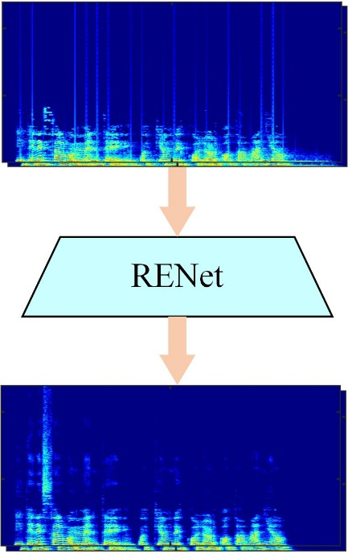
3. Methodology
Problem Formulations
Clean speech:
Degraded speech:
Distortion modeling:
Noise and reverberation:
Limited-bandwidth:
Clipping:
RENet framework:
Notes:
为了讲述我们的网络，我们首先对语音的失真进行建模，传声器接收到的语音信号中存在有各种失真，如噪声混响、频带受限或者存在裁剪，我们可以以一种串行的方式模拟这些失真，而我们的方法就是从失真的语音中直接估计纯净音频。
To introduce our network, we initially model the distortion of speech received by the microphone, which includes various types such as noise, reverberation, band limitation, or clipping. These distortions can be simulated sequentially. Our approach focuses on estimating the real and imaginary components of clean speech directly from the degraded speech.

Slide 10
3. Methodology
RENet
Building on the “Restoration and Enhancement” pipeline, RENet employed complex spectrum mapping to address diverse speech degradation problems simultaneously.
TF-GridGAN: initially perform speech recovery and execute preliminary noise and reverberation reduction;
FB-ENet: address residual noises and artifacts;
BWE: generate high-resolution speeches.
Notes:
基于“先修复然后增强的思路”，我们提出了RENet在时频域利用复数谱映射来同时处理各种失真。
如图所示，我们的网络可以分为三个阶段：第一阶段是TF-GridGAN，用于进行语音修复，同时进行初步的去噪去混响，第二阶段是一个全带的语音增强FB-ENet用于去除残留的噪声和混响，最后是BWE用于再进行频带扩展。
Building on the “Restoration and Enhancement” pipeline, we propose RENet, which employ complex spectrum mapping to address diverse speech degradation problems simultaneously. RENet comprises three stages: TF-GridGAN for initial speech recovery and preliminary noise and reverberation reduction, a full-band speech enhancement module (FB-ENet) to address residual noises and artifacts existed in the output of the restoration module, and a BWE module to generate the high-resolution speech from wide-band speech.

Slide 11
3. Methodology
First Stage: TF-GridGAN
TF-GridGAN was designed to serve as the speech restoration module, employing a generative adversarial network (GAN) to initially perform speech recovery and execute preliminary noise and reverberation reduction.
Notes:
第一阶段的TF-GridGAN是基于GAN网络的，他的生成器利用的是TF-GridNet模块，他主要包括三个子层：一个是帧内的谱建模，一个是子带的时间建模，最后是一个全带的注意力模块，在这里为了减小参数量和计算复杂度，我们将输入语音的频谱划分为三个子带，并沿特征维度进行拼接。鉴别器采用的是一个多尺度的时频域鉴别器，每个鉴别器包含五个一维卷积层，同时我们还利用PQMF对得到的信号进行分解，再将分解后的信号输入到鉴别器中，以覆盖不同子带和分辨率。
The proposed TF-GridGAN incorporates a GAN, with its generator integrating the latest TF-GridNet block. This block comprises an intra-frame spectral module, a sub-band temporal module, and a cross-frame self-attention module. To manage the number of parameters and computational overhead, full-band complex spectrograms are divided into three sub-bands and concatenated along the channel dimension for simultaneous processing. Additionally, we utilize a multi-resolution T-F domain discriminator, each consisting of five one-dimensional convolution layers. Furthermore, we employ PQMF to decompose the obtained signal, which is then input into the discriminator to cover various bands and resolutions.

Slide 12
3. Methodology
First Stage: TF-GridGAN
The generator loss function incorporated several elements, including a reconstruction loss term, an adversarial loss term, and a feature match loss term.
Reconstruction loss: multi-resolution spectral convergence loss and logarithmic magnitude spectral L1 loss;
Adversarial loss:
Feature match loss:
Total loss:
The discriminator loss function incorporated an adversarial loss term.
Notes:
最终，生成器的损失主要包括三部分，一个是信号重构的损失，一个是对抗损失，最后是特征匹配损失，我们信号重构损失包括多尺度的L1的对数谱距离和谱收敛损失，同时还对信号进行PQMF分解求解重构损失，最终的损失是这四项的加权和。
鉴别器的失只包含一个对抗损失。
The final generator loss function incorporates several elements, including a reconstruction loss term, an adversarial loss term, and a feature match loss term. The reconstruction loss includes multi-resolution spectral convergence loss and logarithmic magnitude spectral loss, and the PQMF decomposition of the signal is also performed to calculate the reconstruction loss, and the final loss is the weighted sum of these four terms. The discriminator loss function incorporates an adversarial loss term.

Slide 13
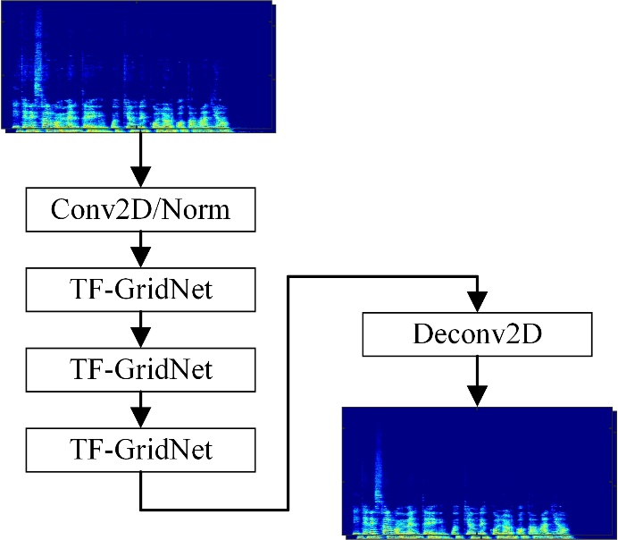
3. Methodology
Second Stage: FB-ENet
FB-ENet was sequentially integrated to address residual noises and artifacts existed in the output of TF-GridGAN, leveraging the relatively high-quality speech produced by the restoration module.
The total loss function included a SI-SDR loss, a complex spectrum loss, and a magnitude spectrum loss.
SI-SDR loss:
Complex spectrum loss:
Magnitude spectrum loss:
Total loss:
Notes:
第二阶段的全带的语音增强网络FB-ENet用于处理第一阶段网络输出中可能存在的残留的噪声和失真，他也采用TF-GridNet模块，只不过此时我们输入的是经过谱压缩的全带信号，同时减小了模型的维度。
第二阶段的网络并没有采用生成式的方法，其损失函数包括时域的SI-SDR损失和时频域的幅度谱和复数谱的损失的加权。
The second stage, full-band speech enhancement (FB-ENet) is utilized to address residual noises and artifacts existed in the output of TF-GridGAN, leveraging the relatively high-quality speech produced by the restoration module. FB-ENet also employs the TF-GridNet block, but in this case, the processed speech is inputted with a magnitude compression strategy, while simultaneously reducing the model's dimension.
Unlike the generative approach of TF-GridGAN, the total loss function of the second stage includes a SI-SDR loss in the time domain, a complex spectrum loss, and a magnitude spectrum loss in the T-F domain.

Slide 14
3. Methodology
Third Stage: BWE
Considering the potential presence of band-limited speeches, to further improve the quality of the output speech, a light-weight BWE network (BAE-Net-lite) was implemented to generate the high-resolution speech from the wide-band speech.
Notes:
最后，考虑到前两阶段的网络可能没办法很好的恢复全带语音丢失的高频信息，为了进一步提升输出语音的质量，我们采用了一个预训练的轻量级的BWE网络BAE-Net-lite，来进一步的扩宽频带。
Our preliminary experiments reveal that the above-mentioned two modules only have limited capability in reconstructing the missing super-resolution band. Consequently, the final step incorporates the utilization of BAE-Net-lite, a very recent SOTA lightweight BWE network. It is employed for generating the high-resolution speech with the wide-band speech as the input, further enhancing the naturalness and clarity of the final speech.

Slide 15
4. Results and Discussions
Degraded Speech Simulation
Clean speech (48 kHz): DNS Challenge dataset filtered out by DNSMOS;
Noise: DNS Challenge dataset;
RIR: DNS Challenge dataset or simulated by based on image method;
Distortion type: coloration, discontinuity, loudness, noise, and reverberation;
Total hour: about 1,000 h;
Simulation protocol:
Evaluation Metrics
SIGMOS, NISQA, DNSMOS (16 kHz), ITU-T P.804 subjective listening test
Notes:
为了更好的进行数据模拟，我们分析了验证集和去年盲测集的示例，从Coloration、Discontinuity、Loudness、Reverberation、Noise这五个方面失真进行模拟。
我们的纯净语音、噪声和混响都来自于DNS Challenge dataset数据集，需要注意的是，我们使用了DNSMOS滤除掉了低信号质量的部分，同时我们还添加了基于镜像法模拟的模拟RIR。
具体的仿真流程如图所示，相较于之前的方法，让纯净音频以一定概率依次通过各种失真，我们发现部分失真种类一般会同时出现，如存在频带受限的带噪带混响音频，而多说话人时可能会出现响度不一致的问题，因此在实际造数据集时，我们选取了常见的几种失真组合进行模拟。
总共生成了约1000小时的训练数据。
我们最终采取的评价指标包括SIGMOS、NISQA和DNSMOS，在这里我们要指出DNSMOS基于16 kHz的音频的，剩下两个都是48 kHz的，而最终的比赛结果则是基于主观测听。
After a detailed analysis of speech clips in the previous SSI Challenge blind set, we simulate degraded speeches with various distortions, such as coloration, discontinuity, loudness, noise, and reverberation. To construct this dataset, we carefully select clean speech signals, noises and RIRs from the DNS Challenge dataset, all sampled at 48 kHz. Subsequently, we employ DNSMOS to filter out clean speeches with poor quality, and simulate RIRs based on the image method.
The specific simulation process depicted in the figure. In contrast to previous methods, where clean speech sequentially passes through various distortions with a certain probability, we observe that certain distortion types often appear together. For instance, limited bandwidth is often accompanied by noise and reverberation, and inconsistent loudness may arise in scenarios with multiple speakers. Hence, during the simulation phase, we select several common distortion combinations for simulation, reaching a total of 1,000 h.
The final metrics employed include SIGMOS, NISQA, and DNSMOS. DNSMOS is based on 16 kHz speech, while the remaining two are based on 48 kHz. The final result is determined based on subjective listening tests.

Slide 16
4. Results and Discussions
Ablation Studies
SIGMOS (48 kHz)
Method | Col | Disc | Loud | Noise | Reverb | SIG | OVRL | Param. (M) | MACs (G/s)
Mixture | 3.09 | 2.89 | 3.55 | 3.44 | 3.70 | 3.04 | 2.54 | - | -
TF-GridGAN | 3.36 | 3.99 | 3.95 | 4.10 | 4.12 | 3.40 | 2.94 | 14.41 | 80.0
+FB-ENet | 3.23 | 4.00 | 3.93 | 4.28 | 4.07 | 3.35 | 2.92 | 21.75 | 172.3
+BWE | 3.38 | 4.03 | 3.91 | 4.26 | 4.16 | 3.48 | 3.03 | 21.32 | 172.4
NISQA (48 kHz)
Method | Col | Disc | Loud | Noise | MOS
Mixture | 2.73 | 3.18 | 3.28 | 3.14 | 2.52
TF-GridGAN | 3.22 | 3.78 | 3.66 | 3.91 | 3.25
+FB-ENet | 3.04 | 3.63 | 3.60 | 4.01 | 3.16
+BWE | 3.14 | 3.56 | 3.63 | 4.00 | 3.16
DNSMOS (16 kHz)
Method | SIG | BAK | OVRL | P.808 MOS
Mixture | 3.00 | 3.58 | 2.62 | 3.24
TF-GridGAN | 3.31 | 3.99 | 3.00 | 3.61
+FB-ENet | 3.33 | 4.08 | 3.05 | 3.63
+BWE | 3.33 | 4.08 | 3.05 | 3.63
Notes:
我们首先进行了消融实验，观察SIGMOS和NISQA，我们发现第一阶段的网络能够显著提升各种指标，而FB-Enet进一步去除了其中残留的噪声和失真，在BWE之后我们的SIG和OVRL分数分别为3.48和3.03。
而由于DNSMOS输入的是16 kHz的音频，因此第二三阶段指标没有变化， 这证明BWE模块主要是用于进一步增加输入语音的高频信息。
Initially, we conduct ablation studies, which reveal significant improvements in SIGMOS and NISQA scores. Notably, the first stage TF-GridGAN exhibit substantial enhancement across various dimensions. Subsequently, FB-ENet effectively mitigate residual noises and artifacts, resulting in SIG and OVRL scores of 3.48 and 3.03, respectively, after BWE.
Given that DNSMOS relies on 16 kHz speech, there were no changes in the metric scores of the second and third stages. This underscores the primary role of the BWE module in enhancing the high-frequency information of the final speech.

Slide 17
4. Results and Discussions
ITU-T P.804 Subjective Results
The challenge metric score is based on both the c listening test and the word accuracy (WAcc) rate, given by:
Non-real-time Track
ID | Col | Disc | Loud | Noise | Reverb | SIG | OVRL | WAcc | Score
Mixture | 3.34 | 3.70 | 3.78 | 3.21 | 3.40 | 3.05 | 2.58 | 0.83 | 0.65
1 | 4.00 | 3.89 | 4.34 | 4.28 | 4.24 | 3.74 | 3.43 | 0.77 | 0.74
2 (ours) | 3.68 | 4.00 | 4.21 | 4.07 | 3.90 | 3.56 | 3.18 | 0.81 | 0.72
3 | 3.77 | 3.82 | 4.23 | 4.05 | 3.89 | 3.51 | 3.16 | 0.77 | 0.70
4 | 3.53 | 3.81 | 4.09 | 3.92 | 3.55 | 3.31 | 2.95 | 0.79 | 0.68
A substantial improvement in all subjective assessments, highlighting its remarkable robustness under diverse challenging distortions;
A final WAcc of 0.81, closely aligning with unprocessed degraded speech signals.
Notes:
我们还附上了基于ITU-T P.804主观测听的结果，最终比赛的评价指标是基于主管测听的SIG与OVRL和语音识别的正确率。
可以看到，我们的方法在各个维度都取得了显著的提升，同时在不连续这个维度上显著高于其他方法，这证明了其在面对各种失真尤其是丢帧补偿上的有效性；此外，我们的方法最终的识别正确率为0.81，仅略低于未处理的音频，这说明它相较于其他方法只引入很小的失真。
我们的RENet最终在非实时赛道取得了第二名的好结果。
Additionally, we include the results of the final subjective listening tests based on the ITU-T P.804. The ultimate challenge metric score combines both the subjective listening test and the word accuracy (WAcc) rate.
Remarkably, our proposed method exhibits substantial enhancements in all subjective assessments, notably surpassing other methods in addressing discontinuity. This underscores its exceptional robustness across diverse challenging distortions, particularly PLC. Moreover, the proposed method achieves a final WAcc of 0.81, closely resembling unprocessed degraded speech signals. This indicates its minimal introduction of artifacts when compared with other existing SOTA methods.
The proposed RENet method ranks the 2nd place in the non-real-time track of this Challenge.

Slide 18
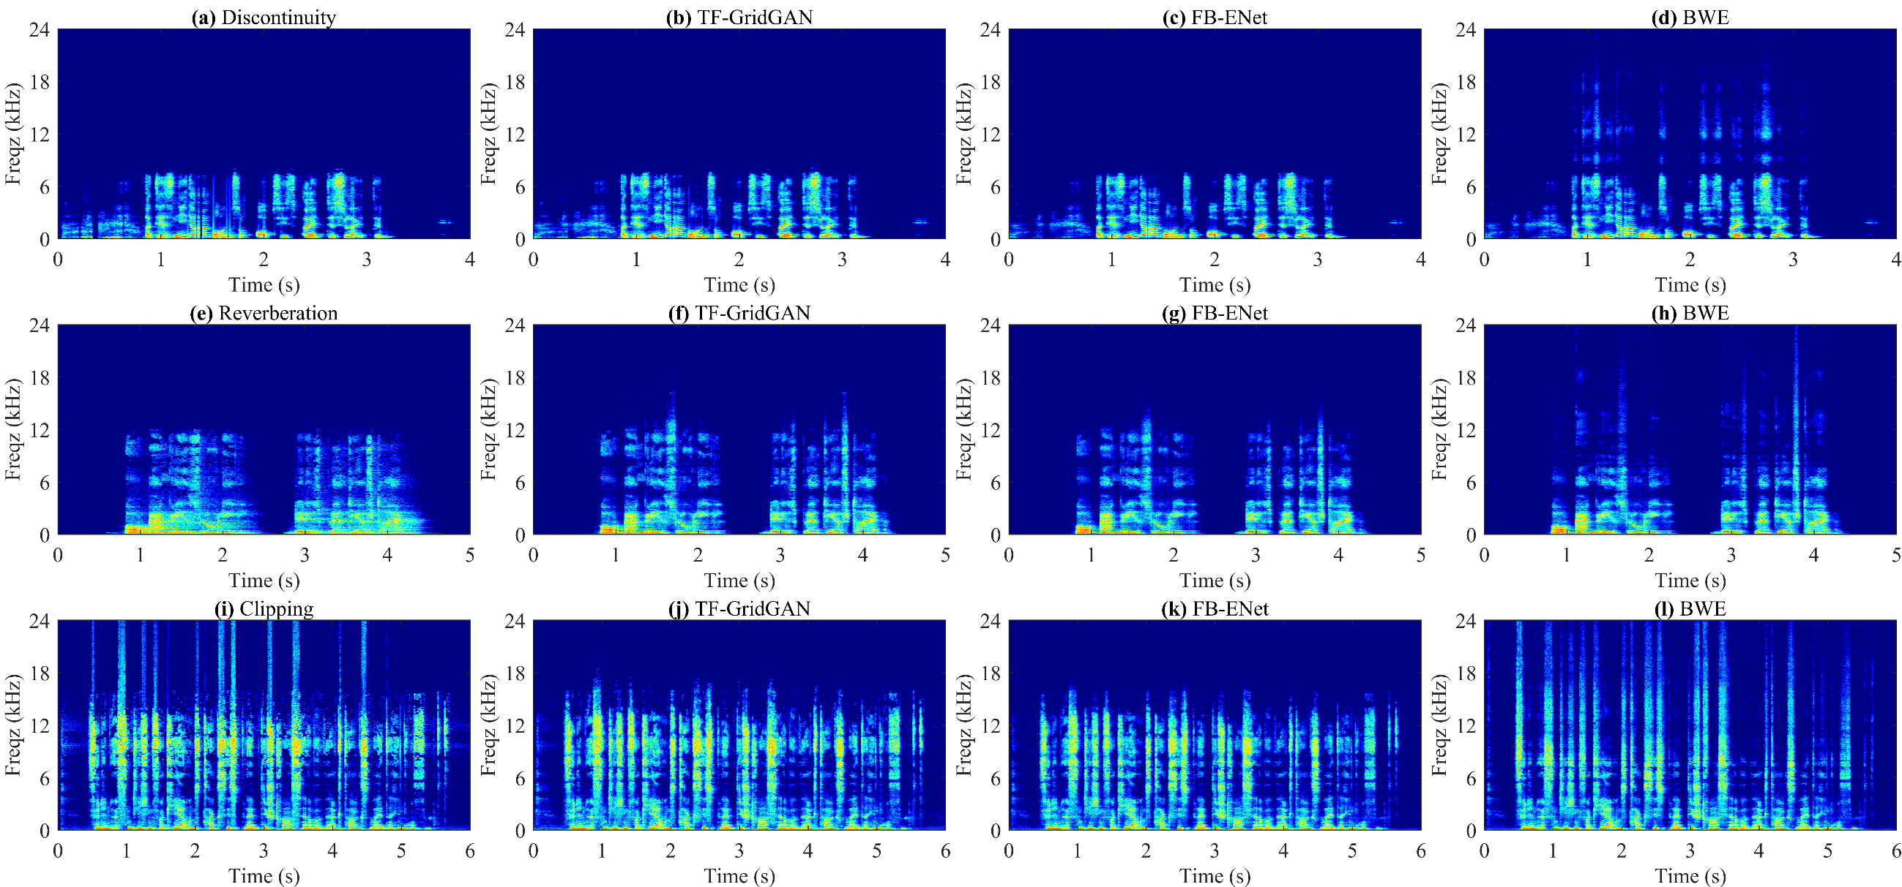
4. Results and Discussions
Spectrum Visualization
Notes:
最后，我们选取了部分盲测集的结果进行了可视化，每一行表示一种失真，后面三个列表示三个阶段的输出。在这里，第一行的音频表示存在丢帧，第二行是混响，第三行存在裁剪，可以发现我们的每个阶段都对最终的SIG的提升有着贡献。
In our final presentation, we showcase selected results from the blind set for visualization. Each row corresponds to a specific distortion, while the subsequent three columns illustrate the output of the three stages. Specifically, the first row denotes pocket loss, the second row represents reverberation, and the third row showcases clipping. Our analysis reveals the contribution of each stage to the final SIG enhancement.

Slide 19
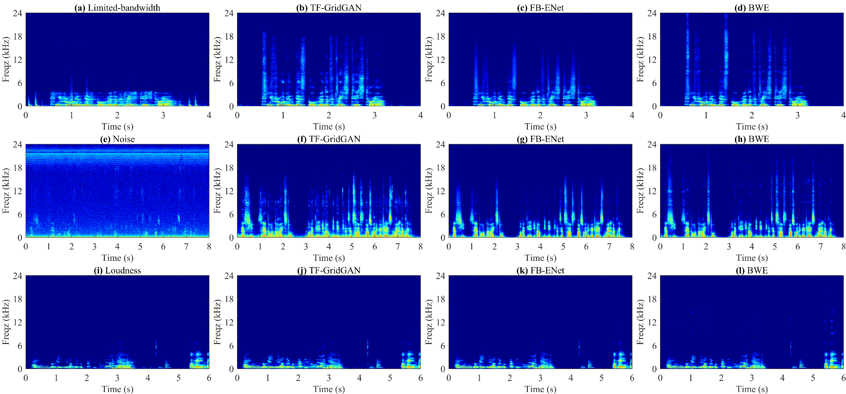
4. Results and Discussions
Spectrum Visualization
Notes:
后面三行给出的是在频带受限、噪声、响度不均衡场景下的输出。可以发现我们的发现我们的方法在很低的信噪比下都能显著的降低背景噪声，同时提升输出语音的质量。最后，在复杂的多说话人场景，我们的方法也能够均衡不同说话人的响度。
The last three rows depict the output in scenarios characterized by limited bandwidth, noise, and inconsistent loudness conditions. Notably, our proposed method demonstrates an impressive ability to mitigate background noise and enhance the quality of the output speech, even under very low SNR conditions. Moreover, in complex multi-speaker scenarios, our proposed method adeptly manages the loudness levels of different speakers.

Slide 20
5. Conclusions
Conclusions
In this paper, we introduced RENet, a novel T-F domain method tailored for general speech restoration in the ICASSP 2024 SSI Challenge. RENet is a multi-stage network, consisting of a speech restoration module, a speech enhancement module, and a BWE module. The proposed method ranked the 2nd place in the non-real-time track of this Challenge.
Future Works
Reduce both the number of parameters and computational complexity while maintaining the performance of the proposed method;
Explore new frameworks for achieving real-time implementations.
Notes:
最后，对我们的方法进行一个总结，在本文中，我们引入了RENet，它是一个多阶段的时频域广义语音恢复方法用于参加ICASSP 2024 SSI 挑战赛。其由语音恢复模块、语音增强模块和BWE模块组成。所提出的方法在本次挑战赛的非实时赛道上排名第二。
下一步，我们将在保持性能的同时进一步降低模型的参数量和计算复杂度，同时设计一款适用于实时任务的新框架。
To summarize our approach, we introduce RENet, a novel T-F domain method tailored for general speech restoration in the ICASSP 2024 SSI Challenge. RENet is a multi-stage network, consisting of a speech restoration module, a speech enhancement module, and a BWE module. The proposed method ranks the 2nd place in the non-real-time track of this Challenge.
Looking ahead, future research directions may involve efforts to reduce both the number of parameters and computational complexity while maintaining the performance of the proposed method. Moreover, exploring new frameworks for facilitating real-time implementations holds promise for advancing this field.

Slide 21
中国科学院声学研究所
Institute of Acoustics, Chinese Academy of Sciences
Thank you for your attention!

