Slide 1
DCC 2023
A Parallel ANS Coder with Reduced
Decoding Error Diffusion
${Na Wang}^{1}$, ${Zhengrui Li}^{2}$, ${Sian−Jheng Lin}^{3}$
1 University of Shanghai for Science and Technology, Shanghai, China
2 Hong Kong University of Science and Technology, Hong Kong, China
3 Huawei Technology Co., Ltd, Hong Kong, China

Slide 2
CONTENTS
Background
Algorithms
Experimental results
Conclusion

Slide 3
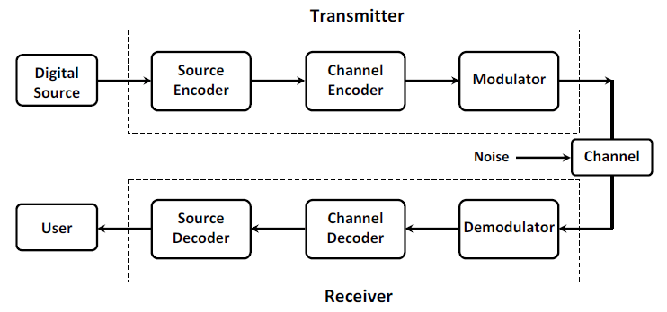
Background
Digital Communications System

Slide 4
Background
Decoding Error Diffusion
What is bit error?
Transmitted Bits: 0 1 1 1 0 0 1 0 0 0 1 0 1 0 1 1 1 0
Received Bits: 0 1 1 0 0 0 1 0 0 0 1 1 1 0 1 1 1 0
Bits errors
What is decoding error diffusion?
When a symbol at a certain position is decoded incorrectly, some subsequent symbols are also decoded incorrectly, this is called error diffusion.

Slide 5
Background
Asymmetric numeral systems (ANS)
Encoding
Decoding
(symbol, state) $→$(new state)
(new state) $→$(symbol, state)
12
a
23
23
a,
12
When a symbol is encoded, the state becomes larger.
As more and more symbols get encoded, the value of state will eventually grow to infinity.

Slide 6
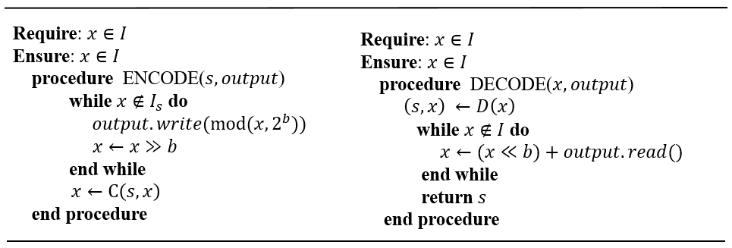
Background
Streaming ANS--solve this problem by keeping state $x$ within an interval
$I$:=$\left\{L,L+1,⋯2^{b}L−1\right\}$.
When 𝑥 gets too large in the encoder, the encoder has an output.
When $x$ gets too small in the decoder, the decoder reads this output.

Slide 7
Background
Interleaved ANS Coders (IAC)-- a fast implementation of streaming ANS by interleaving multiple encoders.
encoder2
encoder2
encoder2
Input symbol sequence:
$$s_{1}$$
$$s_{2}$$
$$s_{3}$$
$$s_{4}$$
$$s_{5}$$
$$s_{6}$$
$$s_{7}$$
$$⋯⋯$$
encoder1
encoder1
encoder1
encoder1
Output:
encoder2.output
encoder1.output
encoder1.output
encoder2.output
encoder1.output
$$⋯⋯$$

Slide 8
Algorithm
Discuss error diffusion in IAC
If a few errors happen, decoder1 may read encoder2.output, and decoder2 may read encoder1.output.
The main reason for error diffusion in IAC is that the decoders are not completely independent.

Slide 9
CONTENTS
Background
Algorithms
Experimental results
Conclusion

Slide 10
Algorithm
Error-Reduced ANS (erANS)--behavior of its decoders is completely independent, each decoder knows in advance the location of the data it needs to read.
decoder1
decoder2
decoder1
decoder2
decoder1
decoder2
Output:
encoder1.output
encoder2.output
encoder1.output
encoder2.output
encoder1.output
encoder2.output
$$⋯⋯$$
Input symbol sequence:
$$s_{1}$$
$$s_{2}$$
$$s_{3}$$
$$s_{4}$$
$$s_{5}$$
$$s_{6}$$
$$⋯⋯$$
$$s_{m}$$
encoder1
encoder2
When an encoder has output, it doesn't output it directly, but waits for another encoder to have output as well.
When both encoders have outputs, we output them together.

Slide 11
Algorithm
Input symbol sequence:
$$s_{1}$$
$$s_{2}$$
$$s_{3}$$
$$s_{4}$$
$$s_{5}$$
$$s_{6}$$
$$⋯⋯$$
$$s_{m}$$
encoder1
encoder2
In a single iteration, there are four cases:
Case1. Both encoder1 and encoder2 have an output; Output directly in order
Case2. Encoder1 has an output but encoder2 has no output; Encoder1 waits encoder2
Case3. Encoder2 has an output but encoder1 has no output; Encoder2 waits encoder1
Case4. Neither encoder1 nor encoder2 has an output; Both continues

Slide 12
Algorithm
Discuss error diffusion in erANS
If a few errors happen, decoder1 only reads encoder1.output, and decoder2 only reads encoder2.output.

Slide 13
CONTENTS
Background
Algorithms
Experimental results
Conclusion

Slide 14
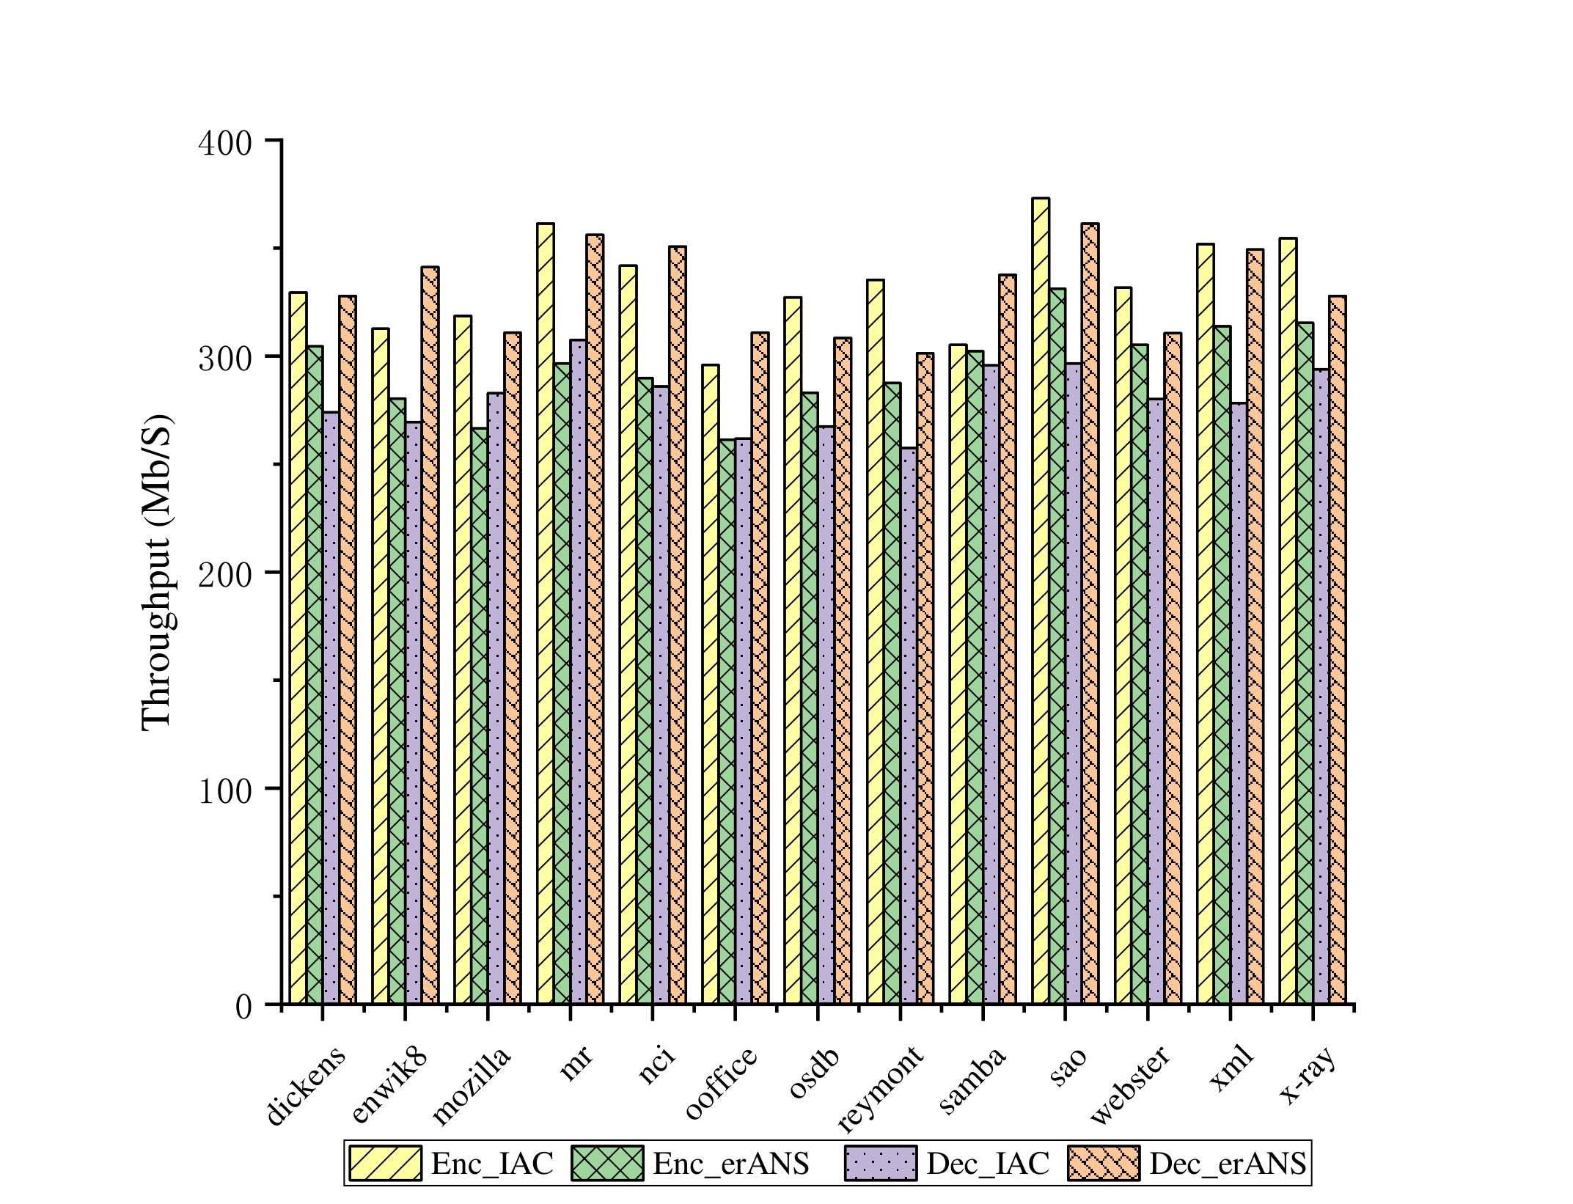
Results
The throughput is defined as
erANS has approximately 13.1% lower encoding throughput than IAC due to the pause mode.
erANS has about 17.6% higher decoding throughput than IAC
Figure 1: Throughput tests

Slide 15
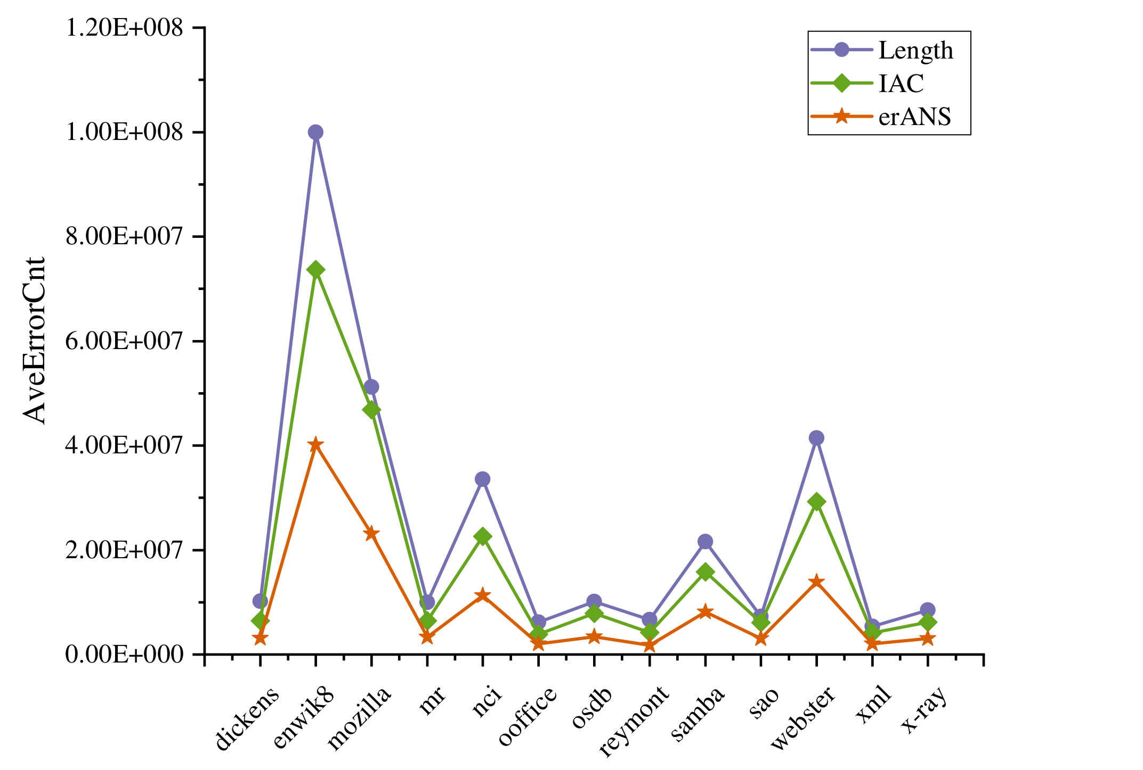
Results
The average number of symbols decoded incorrectly (AveErrorCnt) in IAC is quite high.
erANS can reduce this number by approximately 50%.
Figure 2: Decoding error diffusion tests

Slide 16
CONTENTS
Background
Algorithms
Experimental results
Conclusion

Slide 17
Conclusion
Propose a parallel ANS method to mitigate the diffusion for a class of error patterns.
The errors are limited to affect only a single decoder in the proposal.
The simulation results show that the method has a certain inhibitory effect on decoding error diffusion.

Slide 18
CONTACT US
wna@usst.edu.cn
zligt@connect.ust.hk
lin.sian.jheng1@huawei.com
Thanks!

