Slide 1
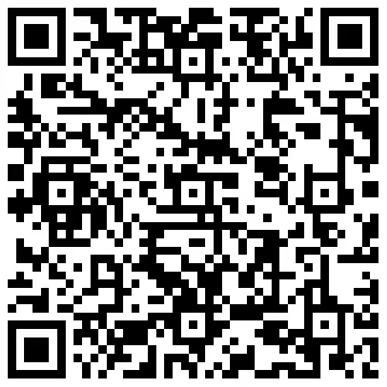
Paper
MTIDNET：A Multimodal Temporal Interest Detection Network for Video Summarization
Xiaoyan Tian, Ye Jin*, Zhao Zhang, Peng Liu, Xianglong Tang
Harbin Institute of Technology, Harbin, Heilongjiang, 150001, China
Speaker: Xiaoyan Tian
Time: 2024.4.16

Slide 2
01
Background
02
Motivation
Contents
032
Methods
042
Experiments
052
Conclusion

Slide 3
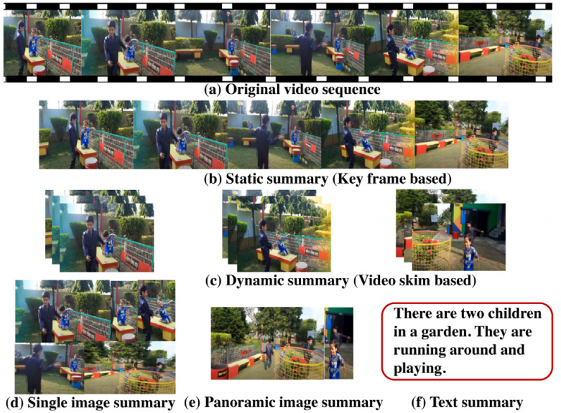
Background
Fig. 1 Illustration of task of video summarization
Fig. 2 Different types of video summarization

Slide 4
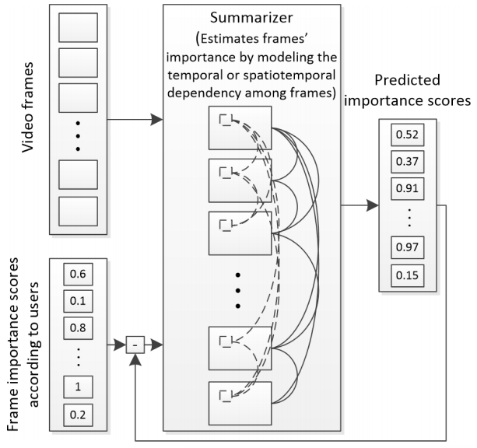
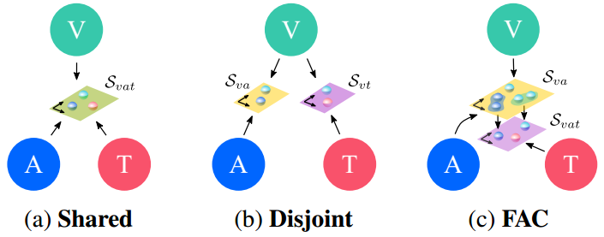
Motivation
The inter-relations between various configuration of modality spaces should be considered.
Shot-level video summarization approaches place excessive emphasis on the significance of individual shots, thus losing the ability to capture global and local features within shots.
Fig. 4 Pipeline of shot-level VS approaches
Fig. 3 Modality embedding spaces

Slide 5
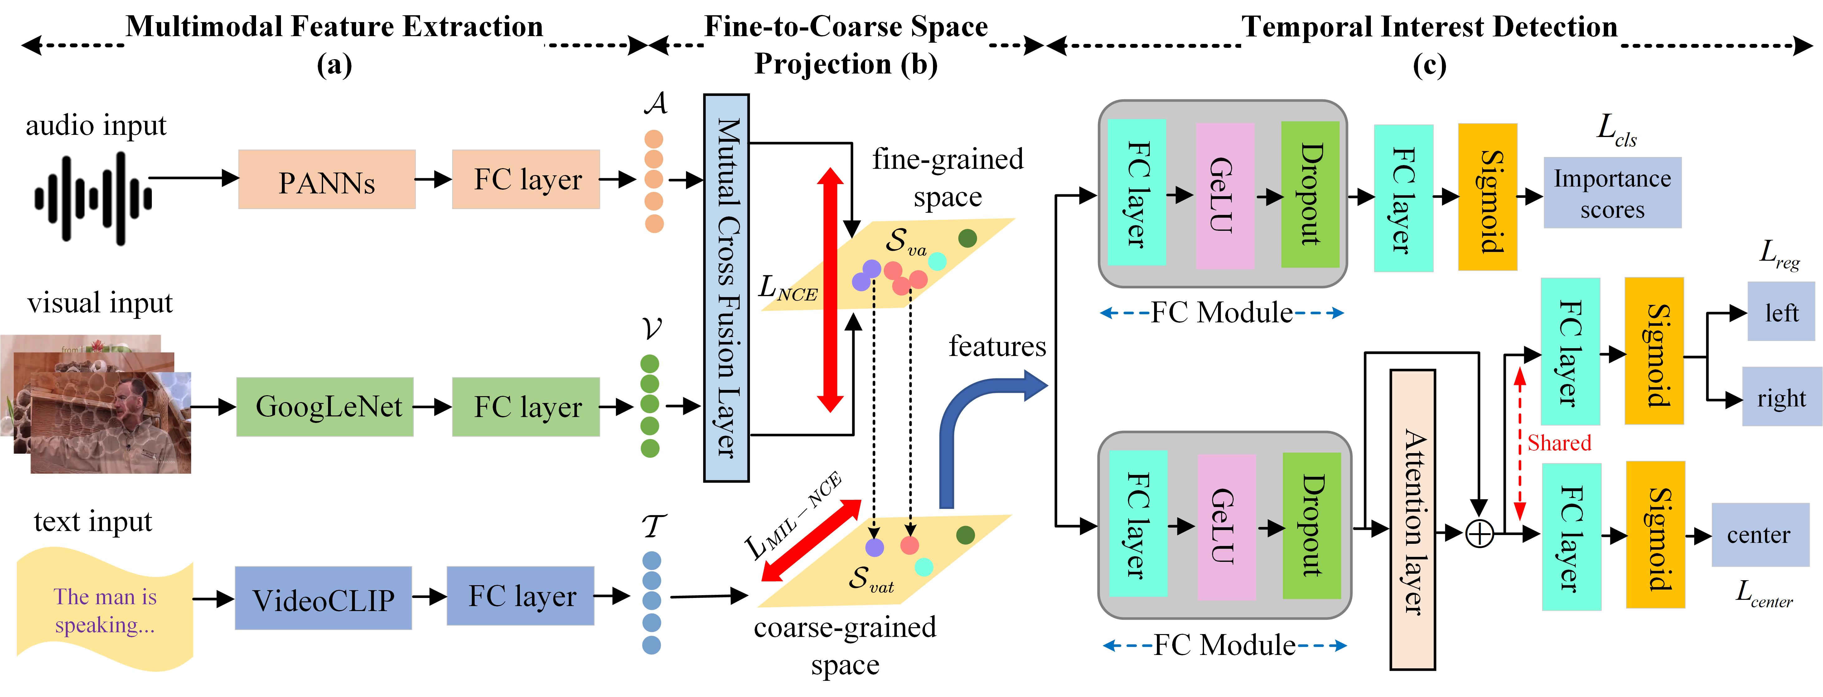
Methods
Fig. 5 Overview structure of the proposed Multimodal Temporal Interest Network (MTIDNet)

Slide 6
Methods--Contribution
MTIDNet is a novel video summary network and the first one to explore both fine- and coarse-grained representations by investigating different modality embedding spaces.
We propose an innovative technique for detecting temporal interest regions to improve the intergrity of the semantics with the same segment. The algorithm applies temporal regression scoring on the extracted features to obtain both local and global features across shots.
We conduct extensive experiments on two benchmark datasets, SumMe and TVSum. Results show that our MTIDNet achieves state-of-the-art performance.

Slide 7
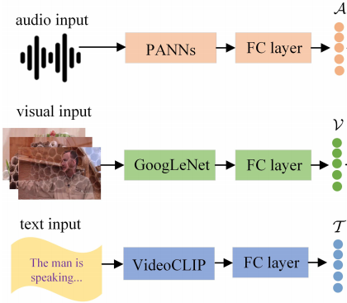
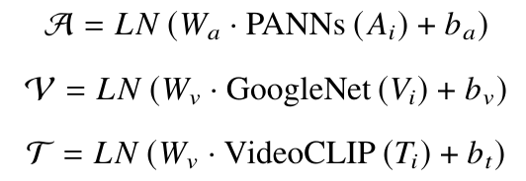
Methods
Multimodal Feature Extraction
Formula Expression
Fig. 6 Overview of Multimodal Feature Extraction

Slide 8
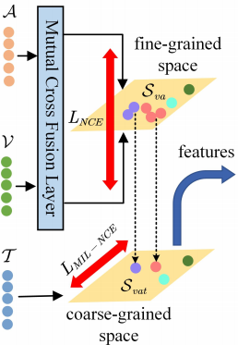
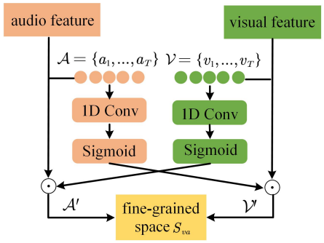
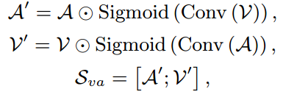
Methods
Fine-to-Coarse Space Projection
Mutual Cross Fusion Layer
Formula Expression
Fig. 7 Overview of Fine-to-Coarse Space Projection

Slide 9
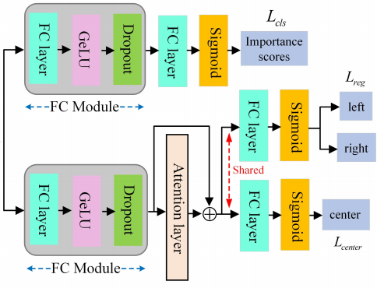
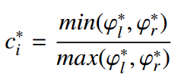
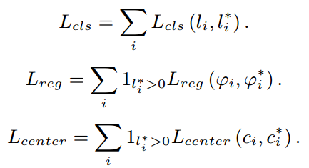
Methods
Temporal Interest Detection
Formula Expression
2D boundary information
Centrality parameter
Importance scores
Loss function
Fig. 9 Overview of Temporal Interest Detection Network

Slide 10
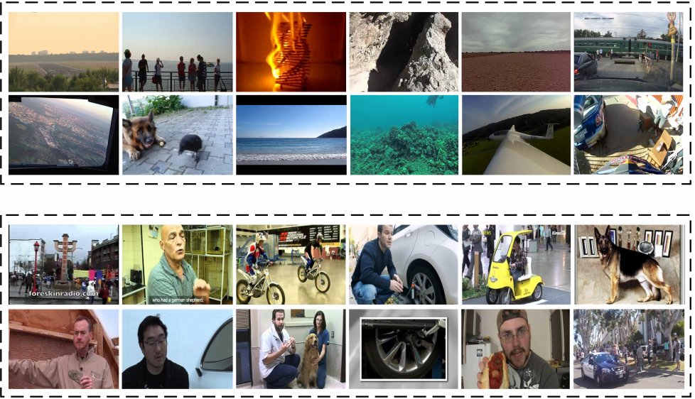
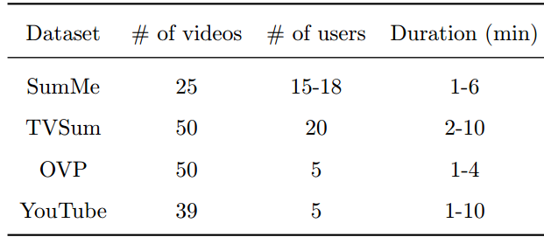
Experiments
Datasets
Evaluation metrics
F-score (%)
Fig. 10 Sample image classes from SumMe and TVSum datasets

Slide 11
Experiments
Comparision with SOTA methods

Slide 12
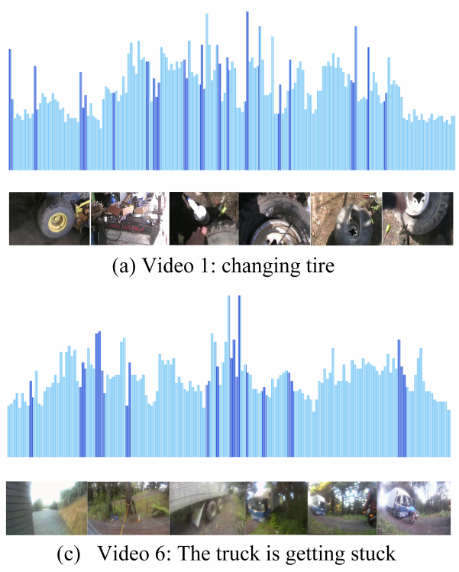
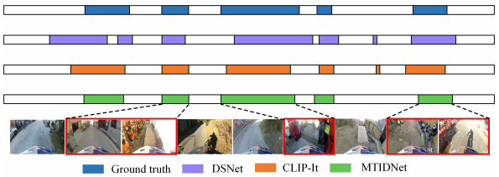
Experiments--Qualitative Evaluation
Fig. 11 Qualitative results of different VS methods, including GT, DSNet, CLIP-It, and our MTIDnet
Fig. 12 Qualitative results generated from different video samples of MTIDNet

Slide 13
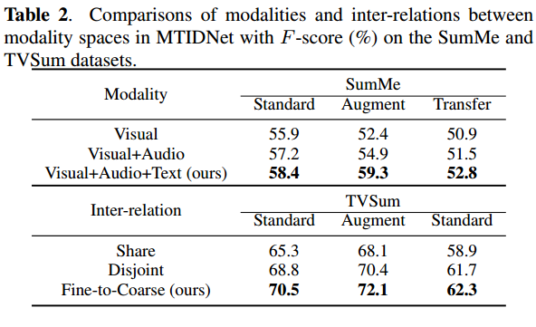
Experiments
Ablation study on modalities and inter-relations
Ablation study on different losses
Runtime analysis

Slide 14
Conclusion
We can see the experimental results prove that:
MTIDNet learns the audio-visual modality in the fine-grained embedding space, and then projects the embedding into the coarse-grained space compared to the text modality based on modality fusion.
Temporal Interest Detection Network is to maintain the integrity across shots with the same semantics by regressing boundary locations and importance scores.

Slide 15
Thanks for your attention
Email: tianxy@stu.hit.edu.cn
Speaker: Xiaoyan Tian
Time: 2024.4.16

