Slide 1
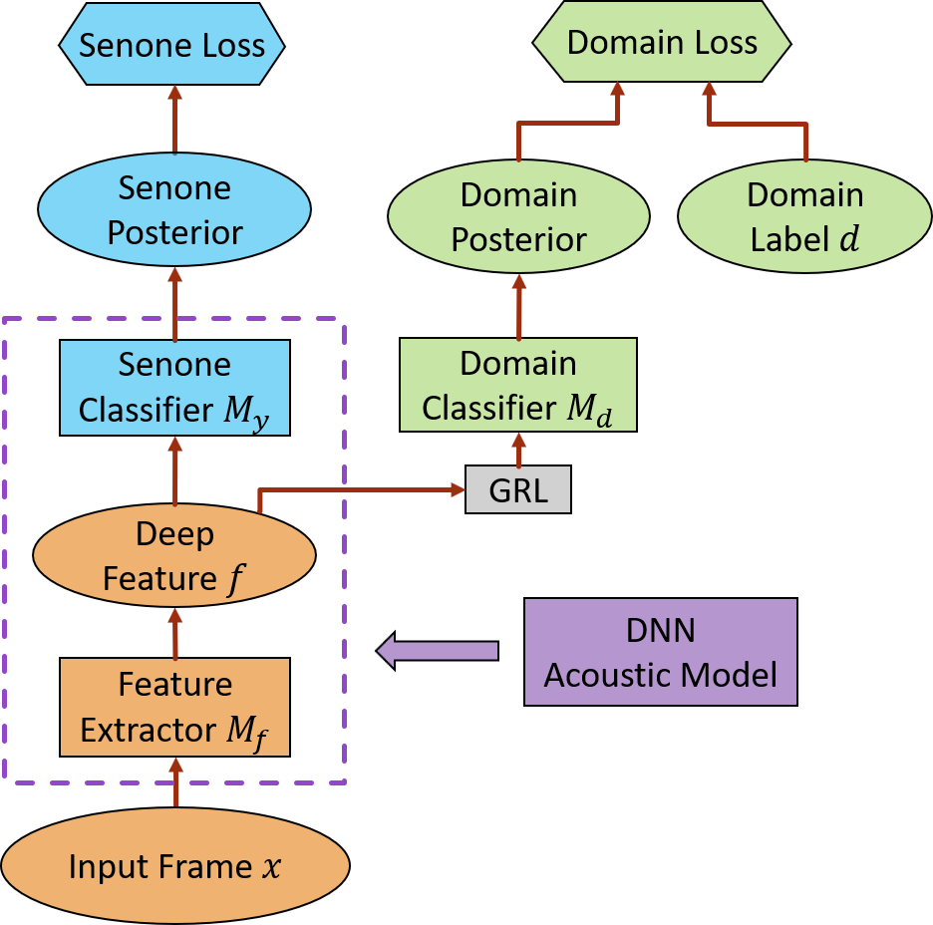
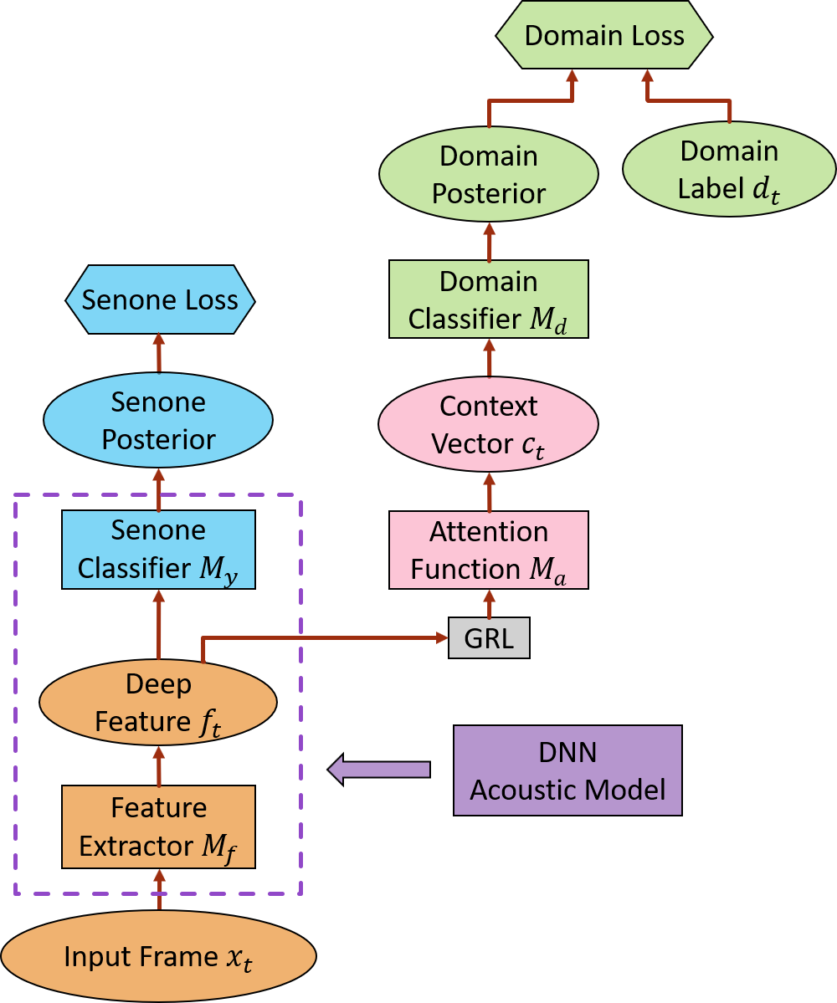
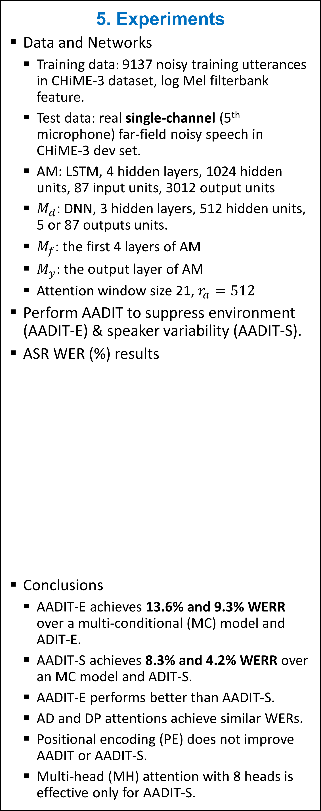

Attentive Adversarial Learning for Domain-Invariant Training
Zhong Meng, Jinyu Li, Yifan Gong
Microsoft Corporation, Redmond, WA, USA
Introduction
Adversarial domain-invariant training (ADIT)
Use adversarial learning to suppress the effects of domain variability (e.g., environment, speaker, language, dialect variability) in acoustic modeling (AM).
Deficiency: domain classifier treats deep features uniformly without discrimination.
Propose attentive adversarial learning (AADIT) to improve ADIT
Use attention mechanism to re-weight the deep features according to their importance in domain classification.
Focus on the domain normalization of phonetic components that are more susceptible to domain variability .
Achieves 13.6% and 9.3% relative WER reduction (WERR) over multi-conditional model and ADIT for ASR.
Can improve acoustic modeling with any DNN architectures.
Can enhance the discriminators in any generative adversarial network or gradient reversal layer network.
3. Adversarial Domain-Invariant Training (ADIT)
5. Experiments
Data and Networks
Training data: 9137 noisy training utterances in CHiME-3 dataset, log Mel filterbank feature.
Test data: real single-channel (5th microphone) far-field noisy speech in CHiME-3 dev set.
AM: LSTM, 4 hidden layers, 1024 hidden units, 87 input units, 3012 output units
$M_{d}$: DNN, 3 hidden layers, 512 hidden units, 5 or 87 outputs units.
$M_{f}$: the first 4 layers of AM
$M_{y}$: the output layer of AM
Attention window size 21, $r_{a}=512$
Perform AADIT to suppress environment (AADIT-E) & speaker variability (AADIT-S).
ASR WER (%) results
Conclusions
AADIT-E achieves 13.6% and 9.3% WERR over a multi-conditional (MC) model and ADIT-E.
AADIT-S achieves 8.3% and 4.2% WERR over an MC model and ADIT-S.
AADIT-E performs better than AADIT-S.
AD and DP attentions achieve similar WERs.
Positional encoding (PE) does not improve AADIT or AADIT-S.
Multi-head (MH) attention with 8 heads is effective only for AADIT-S.
Learn a domain-invariant and senone-discriminative deep feature
Only ADIT acoustic model ($M_{f}$,$M_{y}$) used in decoding.
Feature extractor $M_{f}\left(x_{t}\right)=f_{t}$
Senone classifier $M_{y}(M_{f}\left(x_{t}\right))=p\left(\hat{y} | x_{t};θ_{f},θ_{y}\right)$
Domain classifier $M_{d}(M_{f}\left(x_{t}\right))=p\left(\hat{d} | x_{t};θ_{f},θ_{d}\right)$
Senone loss
$ℒ_{y}\left({θ_{f}, θ}_{y}\right)=−\sum_{t=1}^{N}{\log{p\left(y_{t} | x_{t};θ_{f}, θ_{y}\right)}}$
Domain loss
$ℒ_{d}\left(θ_{f}, θ_{d}\right)=−\sum_{t=1}^{N}{\log{p\left(d_{t} | x_{t};θ_{f}, θ_{d}\right)}}$
Adversarial Multi-Task Learning
Senone-discriminative:$\min_{θ_{y},θ_{f}}{ℒ_{y}\left(θ_{y},θ_{f}\right)}$
Domain-invariant: $\max_{θ_{f}}{\min_{{ θ}_{d}}{ℒ_{d}\left(θ_{d},θ_{f}\right)}}$
4. Attentive Adversarial Domain-Invariant Training (AADIT)
Learn a deep feature with improved domain-invariance over ADIT.
Use self-attention to determine the weights of deep features for domain classification.
Attention block is external to the AM and only AM is used in decoding.
Deep feature $f_{t}$, Key $k_{t}=W_{k}f_{t}$, Query $q_{t}=W_{k}f_{t}$
Dot-product attention (DP)
$e_{t,τ}=k_{τ}^{⊺}q_{t}/\sqrt{r_{a}}$ , $τ=t−L, …, t, …, t+R$
Additive attention (AD)
$e_{t,τ}=g^{⊺}\tanh\left(k_{τ}+q_{t}+b\right)$
Attention probabilities: $a_{t}=softmax(e_{t})$
Context vector
$c_{t}=\sum_{τ=t−L}^{t+R}{a_{t,τ}f_{τ}}$
Attentive Domain Classifier
$M_{d}(M_{a}(M_{f}\left(x_{t}\right)))=p\left(\hat{d} | x_{t};θ_{f},θ_{a},θ_{d}\right)$
Attentive Domain Loss
$ℒ_{d}\left(θ_{f},θ_{a}, θ_{d}\right)=−\sum_{t=1}^{N}{\log{p\left(d_{t} | x_{t};θ_{f},θ_{a}, θ_{d}\right)}}$
Attentive Adversarial Multi-Task Learning
Senone-discriminative:$\min_{θ_{y},θ_{f}}{ℒ_{y}\left(θ_{y},θ_{f}\right)}$
Domain-invariant: $\max_{θ_{f}}{\min_{{{ θ}_{a}, θ}_{d}}{ℒ_{d}\left(θ_{f},θ_{a},θ_{d}\right)}}$
System | Attention Type | Domain
 |  | Speaker (87) | Environment (5)
MC | - | 19.23
ADIT | - | 18.40 | 18.31
AADIT | AD | 17.63 | 16.82
 | DP | 17.67 | 16.61
AADIT +PE | AD | 17.57 | 16.68
 | DP | 17.37 | 16.94
AADIT +MH | AD | 17.33 | 17.10
 | DP | 17.25 | 16.97
2. Related Work
Adversarial multitask learning [Ganin et al., 2015]
Propose gradient reversal layer (GRL) network with domain classifier to learn domain-invariant deep feature.
Adversarial environment-invariant training for ASR [Shinohara, 2016]
Auxiliary environment classifier to predict noisy types.
Adversarial speaker-invariant training for ASR [Meng et al, 2018]
Auxiliary speaker classifier to predict speaker identity.

