Slide 1
Music Source Separation With Band-Split RoPE Transformer
Wei-Tsung Lu, Ju-Chiang Wang, Qiuqiang Kong
and Yun-Ning Hung
Speech, Audio, and Music Intelligence (SAMI) team, ByteDance

Slide 2
Main Contribution
Propose Band-Split RoPE Tansformer (BS-RoFormer), a novel Transformer based architecture for music source separation, which achieved state-of-the-art performance, with and without external training data.
Notes:
the music separation track of the sound demixing challenge is specifically for this task with the 4-stem setting.

Slide 3
Outlines
01
Introduction
02
Model: BS-RoFormer
03
Implementation & Experiments

Slide 4
Introduction

Slide 5
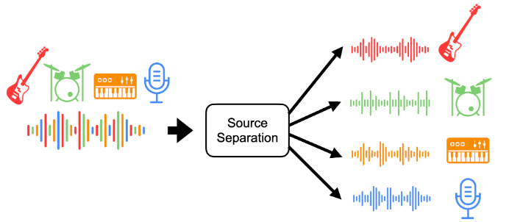
Music Source Separation (MSS)
4-Stem setting
Vocals
Bass
Drums
Other
Figure from Ethan Manilow, Prem Seetharaman, Justin Salamon, “Open Source Tools & Data for Music Source Separation”, Tutorial website.
Notes:
The task of music source separation is to demix the input mixture into tracks that contain only the predefined instrument classes. We followed the classis 4-stem setting, to separate input mixtures into vocal, bass, drums and other stems.

Slide 6
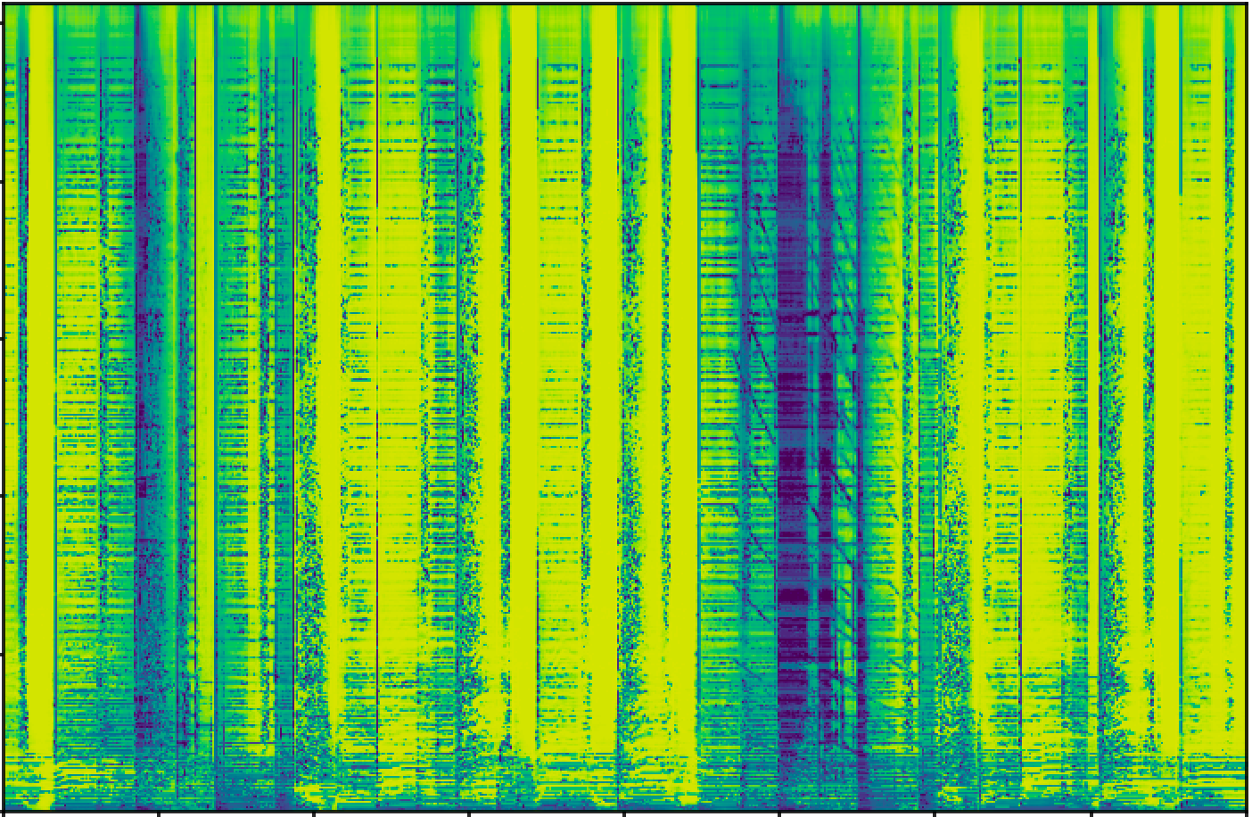
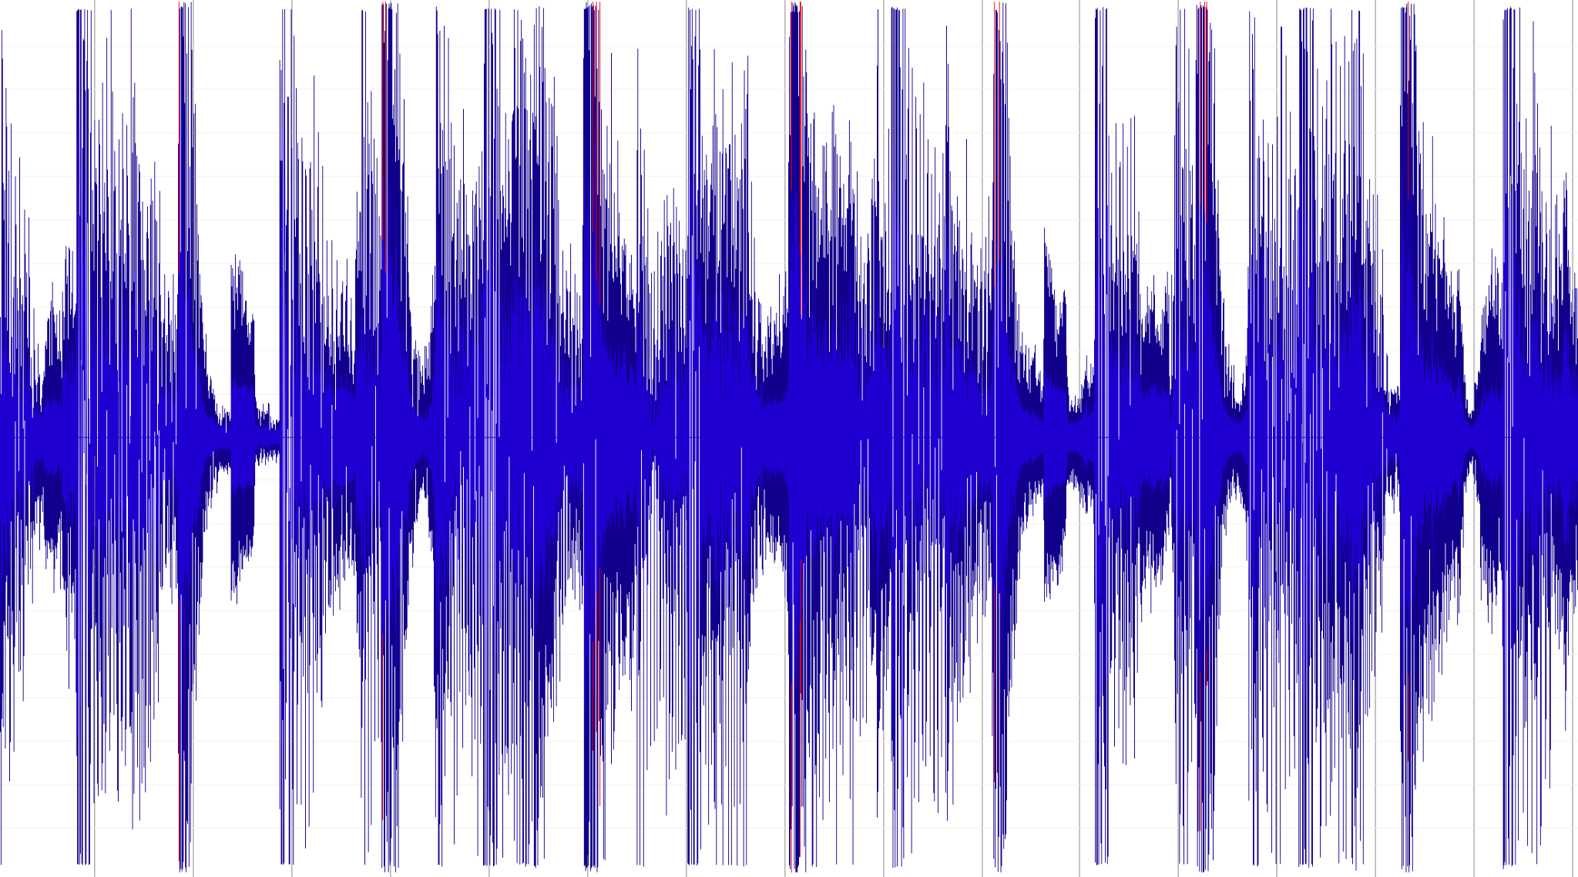
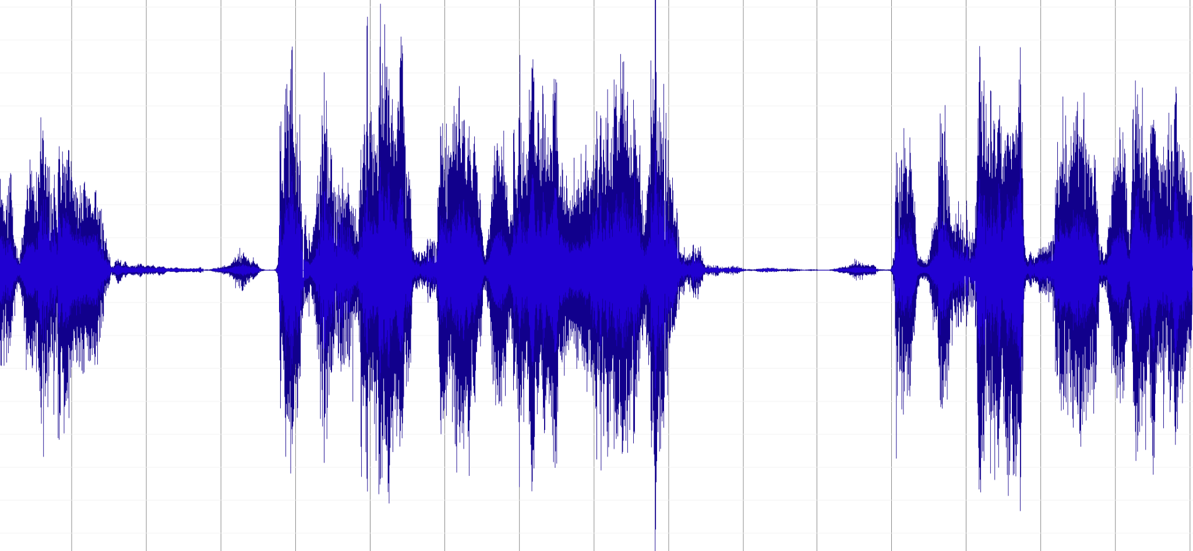
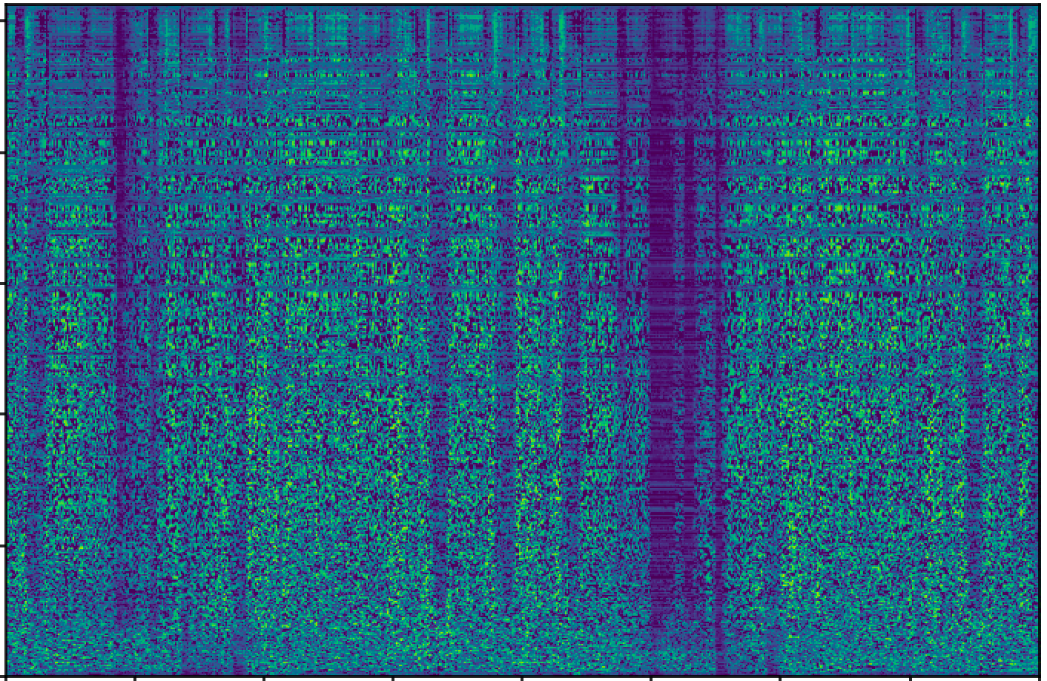
Spectrogram-based Approach
Goal: Predict the Mask for Complex Spectrogram
Real
Real
STFT
iSTFT
X
Imaginary
Imaginary
Music Mixture
Complex Spectrogam
Estimated Mask
cIRMs
Notes:
We adopt the spectrogram-based approach and train BS-Roformer to predict the ideal complex ratio mask. Here is a diagram for the system:
It first applies STFT to get the complex spectrogram including the real and imaginary parts. Then the model predicts the complex masks which also contain the real and imaginary parts. The estimated mask will be applied to the input by complex domain mutlpication before iSTFT.

Slide 7
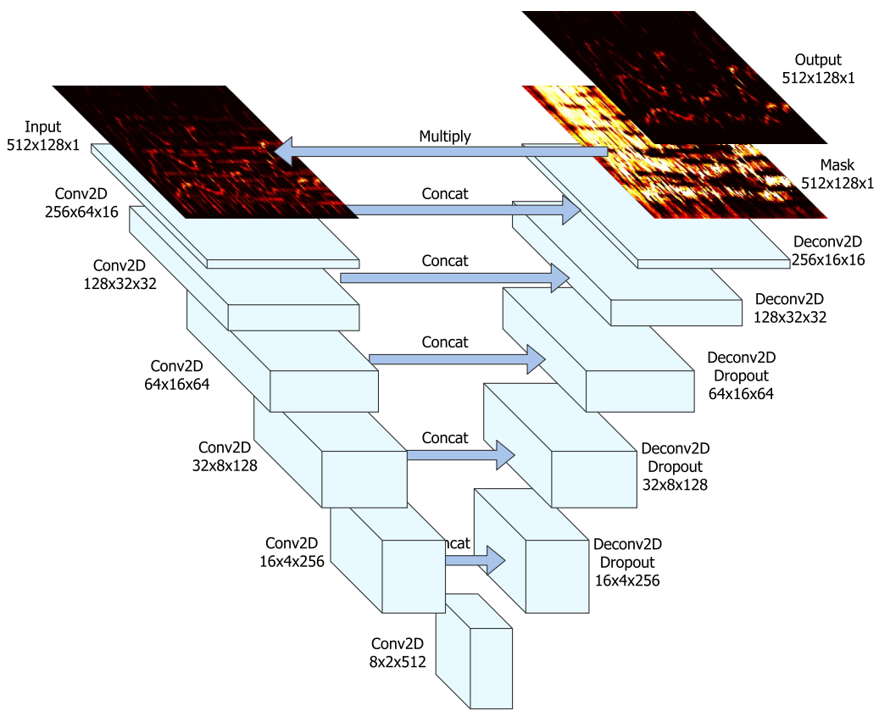
A Representative Conventional Approach
U-shape Auto-encoder (U-Net)
CONV modules
Jansson et al. “Singing voice separation with deep U-net” in ISMIR 2017.
Notes:
To get an estimation for the mask, a representative model for MSS is U-net. It is basically a u-shape structured auto-encoder with the bottle neck in the middle, and it completely relys on convoluational modules to extract the features.
Convolutional layers has been an important module employed in many previous MSS models, but our prelimniary study shows that it may introduce uniform noises that make the output spectrogram look foggy.

Slide 8
Model: BS-RoFormer

Slide 9
Band-Split Approach
Let the model process pre-defined sub-band spectrograms, not full-band
MSS
Mask-6
Estimated Mask
Band-6
Mask-5
combine
Band-5
Band-4
Mask-4
Band-3
Mask-3
Band-2
Mask-2
Band-1
Mask-1
Band-0
Mask-0
• Takahashi et al., 2018, MMDenseLSTM
• Luo et al, 2023, Band-Split RNN
Notes:
As the name suggest, one of the major components in our model is the band-split module, Instead of applying convolution that learns to filter local features along the full-band freuqncies, band-split approach processes the sub-band spectrograms according to a pre-defined frequency grouping scheme. Then the MSS model estimates the mask for each band and combines them into a final estimated mask. In the example here, the spectrogram is devided into 7 bands, and the model output 7 masks before combining them together.
The Band-split RNN model adopts this approach and achieves very promising results.

Slide 10
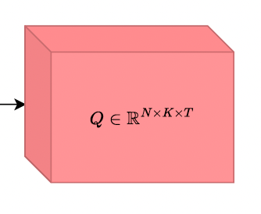
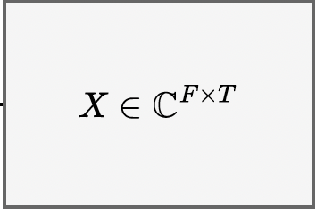
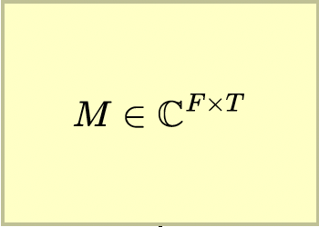
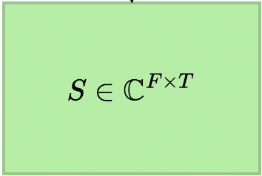
Band-Split RNN
MLP
Layer-Norm + FC
MLP
Layer-Norm + FC
Tanh + FC
GLU
…
…
MLP
MLP
Luo et al, 2023, Music Source Separation with Band-split RNN
Notes:
The model is straightforward. It uses an MLP with layer-norm plus fully connected layers to extract the features for each band instead of using convolution layers as in U-net models. Then, it models the time-wise and band-wise representations as two sequences respectively. So two corresponding RNNs are applied, where the first one models across time and the second one models across bands. They call this interleaved RNNs. After several repeats of the interleaved RNNs, it applies another MLP for each band to predict the mask.

Slide 11
BS-RoFormer Framework and Training Loss
Major Contribution: the middle part & how to train it successfully
MLP: RMS-Norm + FC
MLP: RMS-Norm + FC Tanh + FC
GLU
F : # freq bins
C : # channel
T : time
D : # features
N : # subbands
T : time
Notes:
Our model is inspired by BSRNN, it contains three major modules, Band-split module, rope transformer blocks, and multi-band mask estimation. Our main contribution is using Transformers to model the time-wise and band-wise sequences and train it successfully.

Slide 12
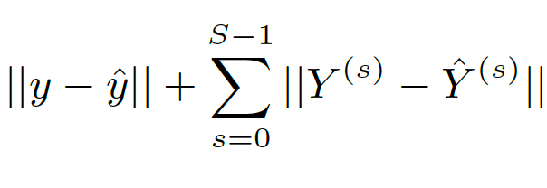
BS-RoFormer Framework and Training Loss
Major Contribution: the middle part & how to train it successfully
Mean Absolute Error (MAE) Loss:
Time-domain MAE
Multi-resolution spectrogram MAE
Notes:
For loss function, we use a combination of mean absolute errors which includes the time-domain MAE and multi-resolution spectrogram MAE. It should be noted that the loss is computed on the output signal instead of the mask.

Slide 13
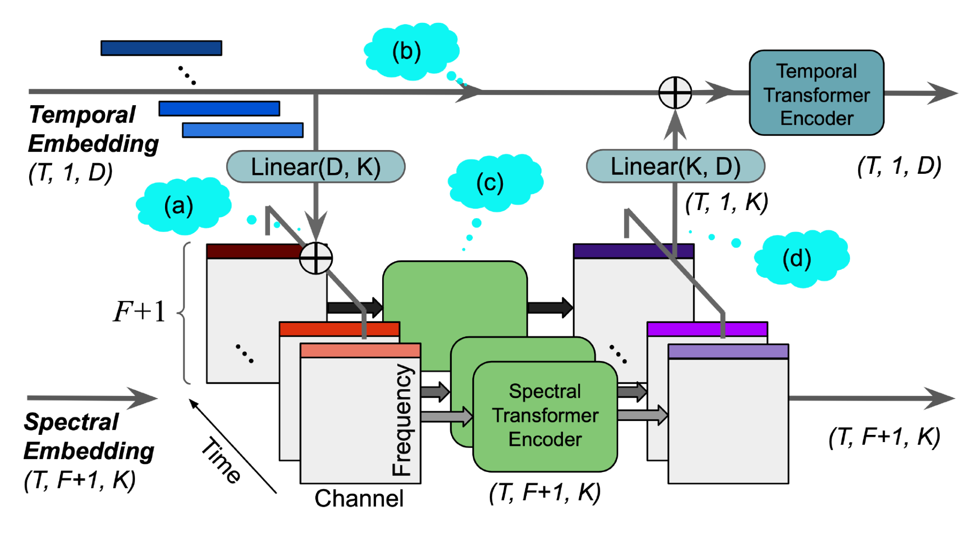
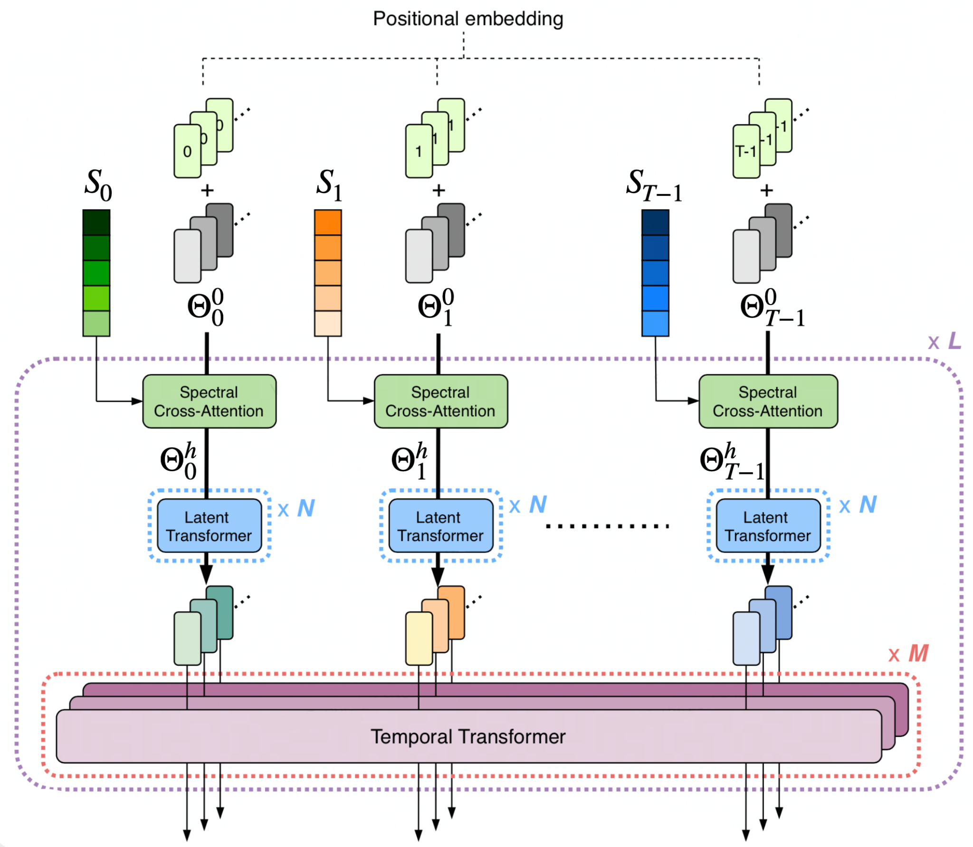
Hierarchical Transformer Encoder Architecture
Modeling the frequency and time axis from T-F representations
Time-level Transformer: inner-band sequence, along time.
Frequency-level Transformer: inter-band sequence, along band.
Its siblings have proven effective in modeling Time-Frequency representation of music
SpecTNT: SOTA in vocal melody, beat/downbeats, chords, music structure
Perceiver TF: SOTA in multi-instrument audio-to-midi transcription
W.-T. Lu, et al., “SpecTNT: A Time-Trequency Transformer for music audio,” in ISMIR, 2021.
W.-T. Lu, et al., “Multitrack Music Transcription with a Time-Frequency Perceiver,” in ICASSP, 2023.
Notes:
Given the Time frequency representation of music signal, it’s intuitively to consider the dependency within both the time and frequency dimensions. To model this relation explicitly, we introduce a hierarchical Transformer structure, where each time-level Transformer is responsible for modeling the inner-band sequence along the time dimension, and the frequency-level Transformer is responsible for the inter-band sequence along band dimension.
This idea has been proven effective through its sliblings in our previous works, SpecTNT has shown SOTA performance in different MIR tasks. Another variant called Perceiver TF has demonstrated SOTA in multi-instrument audio-to-midi transcription.

Slide 14
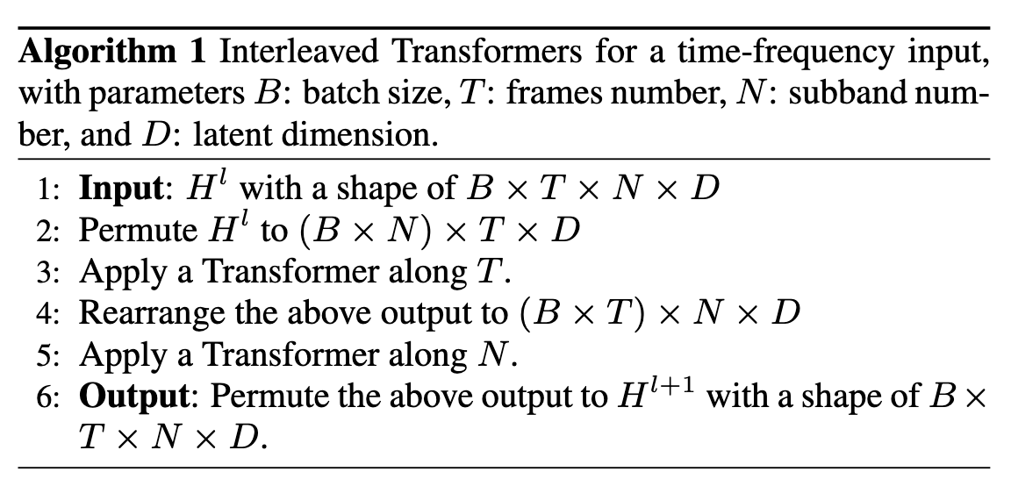
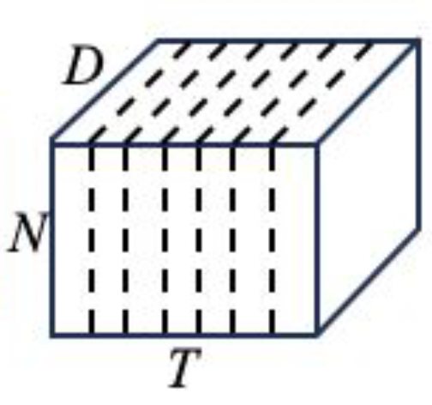
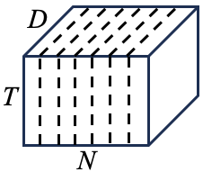
Interleaved RoPE Transformer
Proposed to use Rotary Position Embedding (RoPE)
J. Su, et al. “RoFormer: Enhanced transformer with rotary position embedding”
L ✕ layers
transpose
time sequence
band sequence
Notes:
The actual implementation is shown in this algorithm. Within a Rope transformer block, we alternatively fold the tensors’s time and band dimension into the batch dimension, to achieve the goal of applying attention mechanism on the time axis and band axis interleavely, and this process is repeated for L times based on the predefined numbers of Transformer blocks. We also propose to use the rotary position embedding in order to better preserve the scale of latent even with the constant changing direction of attention, which is shown to be one of the key decision for the success of the model.

Slide 15
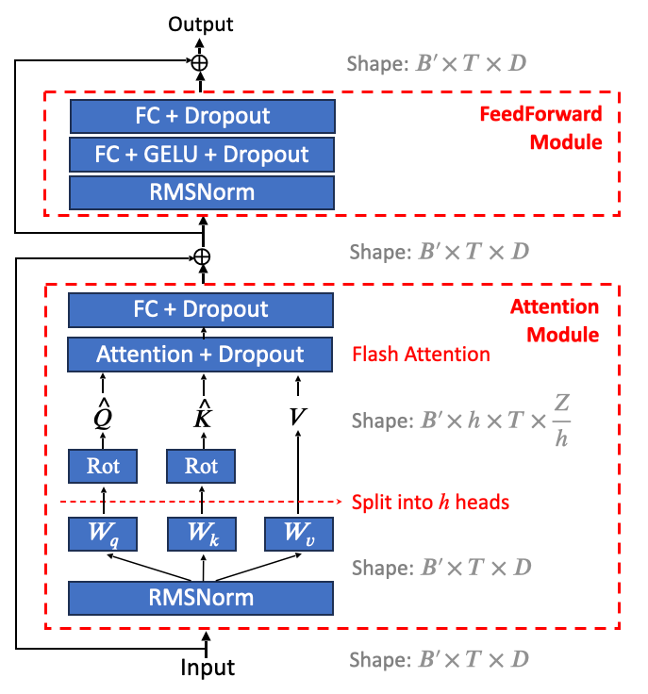
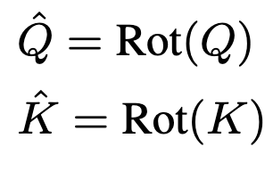
RoPE Transformer Block
instead of absolute position encoding
Notes:
This slide shows an example of RoPE Transformer block applying to the time axis, and it’s pretty much identical to a standard transformer. The differences are the use of rotary positional embedding, which applies rotation matrics to query and key, so when they multiply, each token will be aware of there relative position in the sequence. We also use the of RMS-Norm inspired by design of LLaMA.

Slide 16
Implementation & Experiments

Slide 17
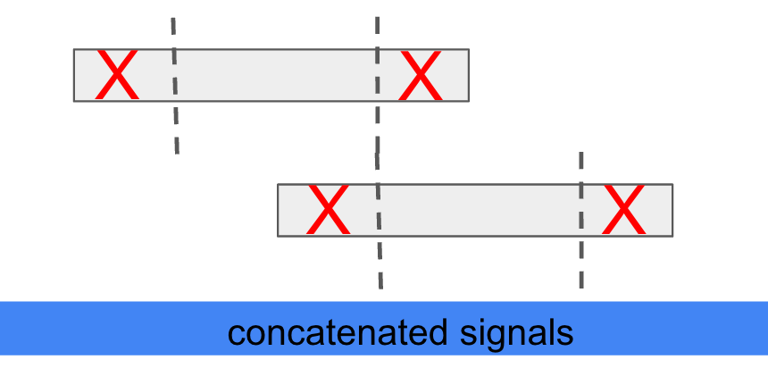
Implementation Details
We trained 3 models using the same configurations: Vocal, Bass and Drums.
Band-split Module
8-second long input; Hann window; length=2048; hop size=10ms
<1kHz: 2 bins/band; 1kHz ~ 2kHz: 4 bins/band; 2kHz ~ 4kHz: 12 bins/band; 4kHz ~ 8kHz: 24 bins/band; 8kHz ~ 16kHz: 48 bins/band; >16kHz: evenly divided into 2 bands.
Data: 4-stem, 100 songs from MUSDB18HQ, 500 songs internal; random mix and gain.
Configurations
RoFormer blocks L = 12; # features D = 384;
AdamW with LR = 0.0005, decay 10% every 50k steps
EMA (Exponential Moving Averaging) with decay 0.999
Deframing: “truncate & concat” the output chunks with a hop of 4 seconds
Notes:
For the full size model, we train for vocal, bass and drums only, using the same training configuration. The other stems is obtained by substracting the separate output from the original mixture. The models accept 8 second long input, and for the STFT we use Hann window with length equals to 2048 and a hop size of 10 milliseconds.
We employ a non overlapping band split strategy and the configuration is listed here. It should be noted that we didnt optimize for the band split strategy and slightly modify it doesn’t affect the final results based on preliminary tests.
For the data, all songs are in the format of 4-stems. We use 150 songs from the MUSDBHQ dataset, we also have an in house dataset which contains 500 songs. durning training, we apply random mixing and random gain augmentaioon without considering the musicality of the resulting mixture.
We set the number of roformer blocks to be 12 with a feature dimension 384. Adamw was used as optimizer, weight decay, EMA are also used.
Due to the fact that our model is operating on fixed length segments, we use a truncate and concate methods to combine the small chunks together into the final separated tracks.

Slide 18
Implementation Details - Scaling up
Scaling-Up is the key (BSRNN as reference)
Input length: 3s → 8s, frame rate is 100Hz
Increase the number of bands: ~25 → 62
Number of parameters: 20M → 93.4M
Large batch size: 16 → 128
Comsume significantly more memory in GPUs, how to train it succesfully?
Mixed precision: FP16 (AMP), but STFT uses FP32
Checkpointing: redo forward pass durning backward pass (from OOM to batch size=2 on single V100 32GB)
Flash attention: T. Dao et al. “FlashAttention: Fast and Memory-Efficient Exact Attention with IO-Awareness”
Notes:
One of the keys to the success of BS-RoFormer is scaling up. But to accommodate such changes, we need to incorporate some large scale model training techniques in order to fit the model into GPU. First is mixed precision training, the model was trained with FP16, except for the STFT parts. Gradient checkpoints is also used to free the GPU memory from forward state caching. Finally is the Flash attention which largely reduce the computational need for the attention module.

Slide 19
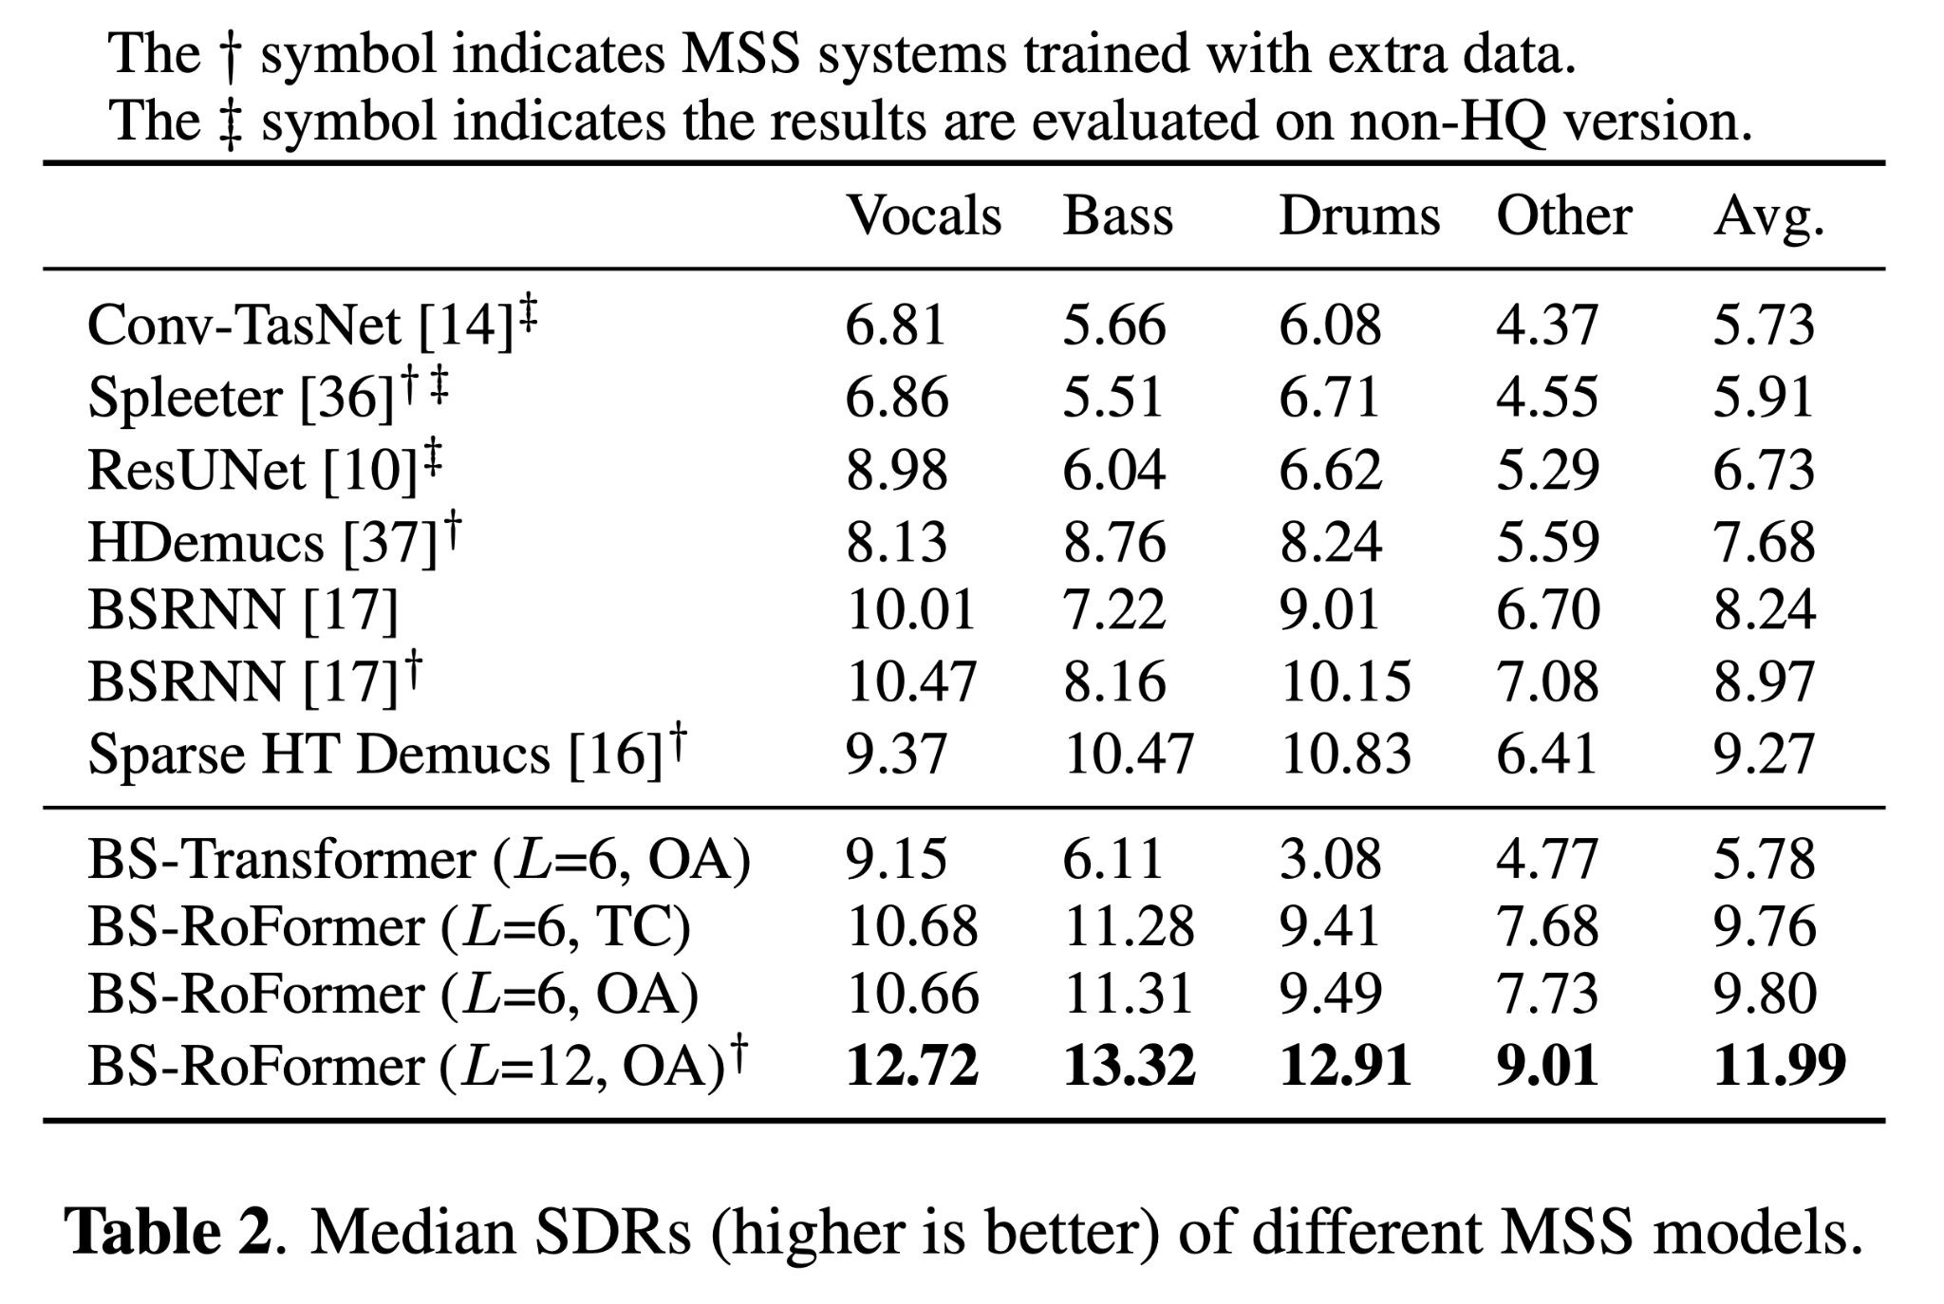
Results
Notes:
Here is the results, the BS-RoFormer at the bottom is our full size model which achieved 11.99 avg SDR, outperformed previous works by a large margin.

Slide 20
Results - Ablation Studies
Why do we choose to use Rotary Positional Embedding (RoPE)?
When using absolute position encoding, the training progress became very slow and the performance drops significantly. .
Notes:
To validate the importance of rotary positional embedding, we replaceed it with traditional learnble absolution positional embedding and train a model called BS-Transformer. The performance drops a lot and the training became very slow.

Slide 21
Results - Ablation Studies
Is the model data-hungry?
No, training the model solely on MUSDB18HQ still outperform existing models trained with extra data, except for drums separation.
Notes:
Next, to compare with models trained without external data, we trained a set of smaller models by setting the number of roformer blocks to 6 and using only MUSDBHQ as the training data. We can see our model still outperform existing models in terms of average SDR. This shows that the proposed model is not data-hungry and can still works under a reduced model size.

Slide 22
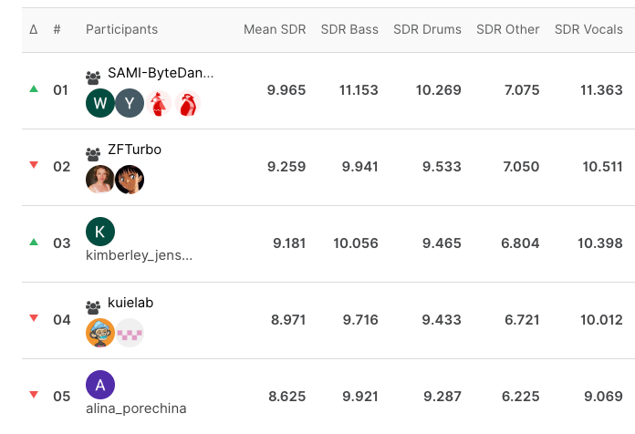
Results - Sound Demixing Challenge 2023
Leaderboard C, Standard Music Source Separation Track
Our team (SAMI-ByteDance) used the BS-RoFormer, ranked the first place
https://www.aicrowd.com/challenges/sound-demixing-challenge-2023/problems/music-demixing-track-mdx-23/leaderboards
Notes:
Last year, we also participated in the sound demixing challenge 2023, we submitted the results from BS-Roformer to the Leaderboard C of standard music separation track. It allows the submitted system to be trained on any dataset that could maximize the performance. The proposed model ended up ranking the first place.

Slide 23
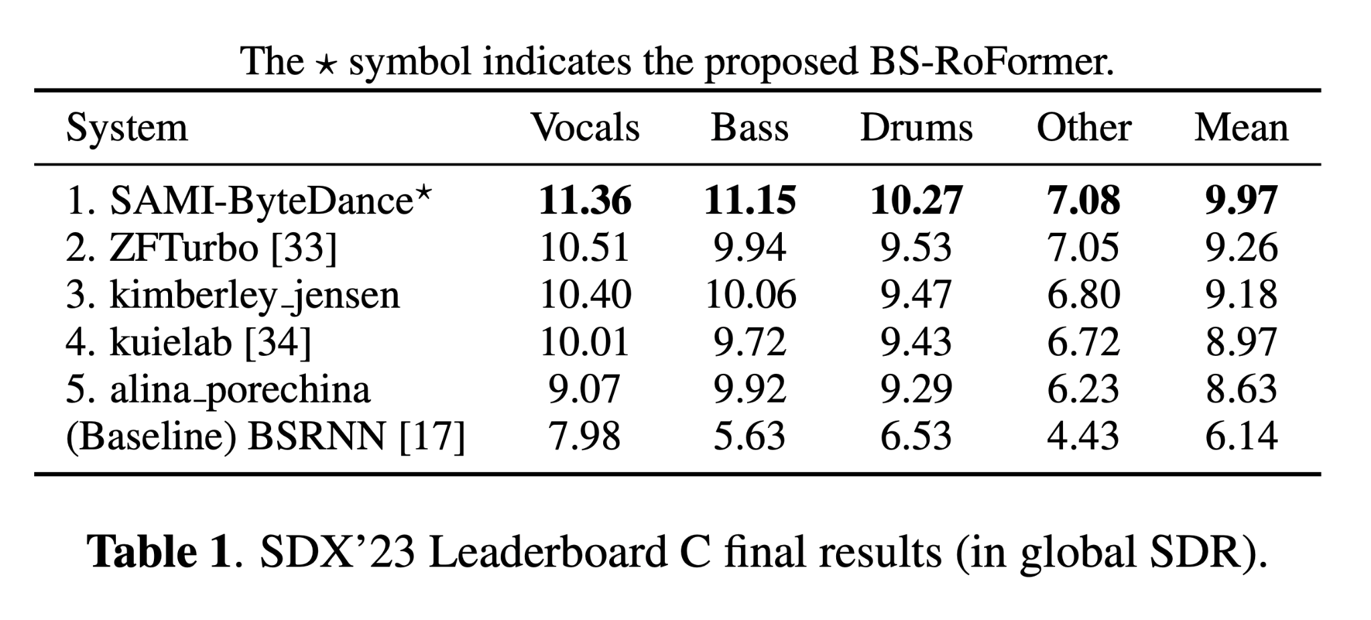
Results - Leaderboard C of Music Seperation of SDX23
BS-RoFormer outperforms the second by a large margin (0.71dB Mean SDR)
Considering vocals, bass and drums: mean SDR difference is 0.93dB
Qualitative: highly accurate, less bleed; less foggy, sharp on spectrogram
Subjective study in SDX23 paper:
Musicians & educators 👍
Music producers 👎
G. Fabbro et al., “The sound demixing challenge 2023 – music demixing track”
Notes:
It outperforms the second place by .71db in mean sdr. Qualitatively, we feel the results are highly accurate, meaning it’s less bleeding. The signals are clearer and less foggy, but sharp on spectrogram. From the subjective review done by the orgranizer of the challenge, our model is more preferred by musicians and educators instead of music producers.

Slide 24
Demo
Notes:
Before jumping into details, let me first introduce what’s music structure analysis.

Slide 25
Demo

Slide 26
Demo

Slide 27
Thanks!
Test the model on our product:
Implementation from the open source community:

