Slide 1
Remixing Music for Hearing Aids Using Ensemble of Fine-Tuned Source Separators
Matthew Daly

Slide 2
Approach
Fine-tuned separators on challenge data
Incorporated residual signal into “other” track
Used audio compressor to mitigate clipping distortion

Slide 3
System Overview

Slide 4
System Overview
Music Source Separation (MSS)

Slide 5
Music Source Separators
Model | Average SDR (MUSDB18-HQ) | Number of Parameters
HDemucs | 7.68 dB | 83.6 million
KUIELab-MDX-Net | 7.47 dB | 4 x 7.4 million
DTTNet | 8.15 dB | 4 x 5 million

Slide 6
Fine Tuning
Original hyperparameters, decayed learning rate
Source activity detection to choose salient training examples
Chose checkpoints with highest SDR on validation set

Slide 7
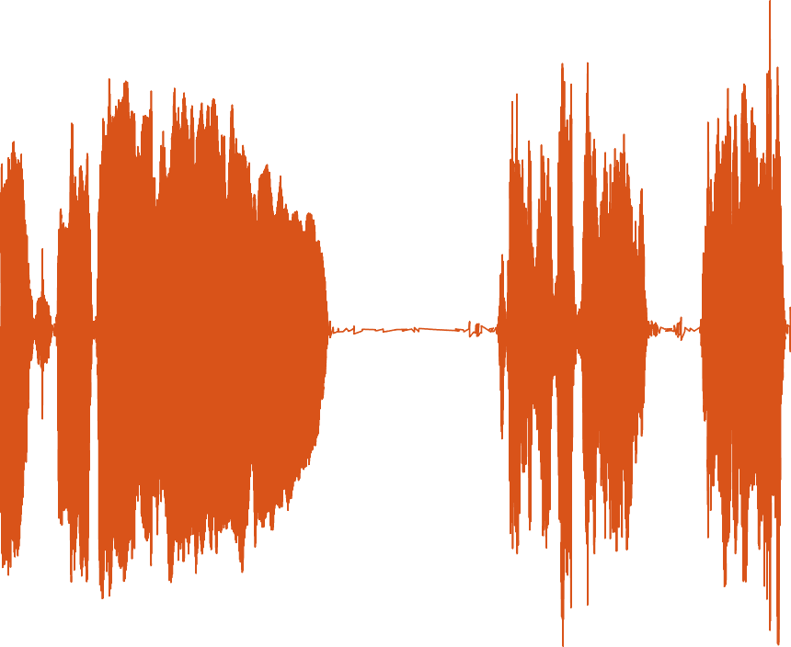
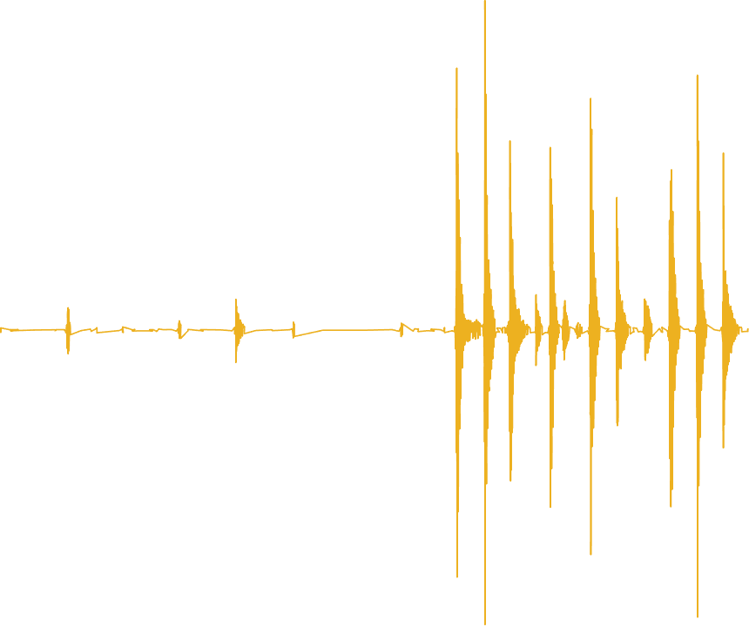
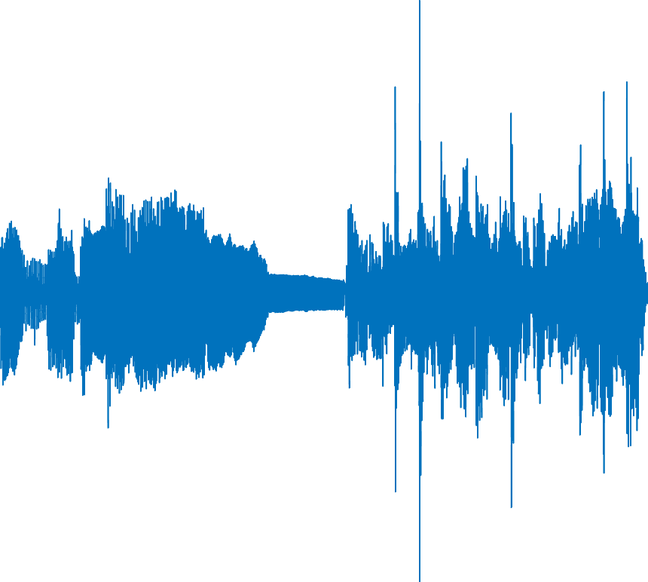
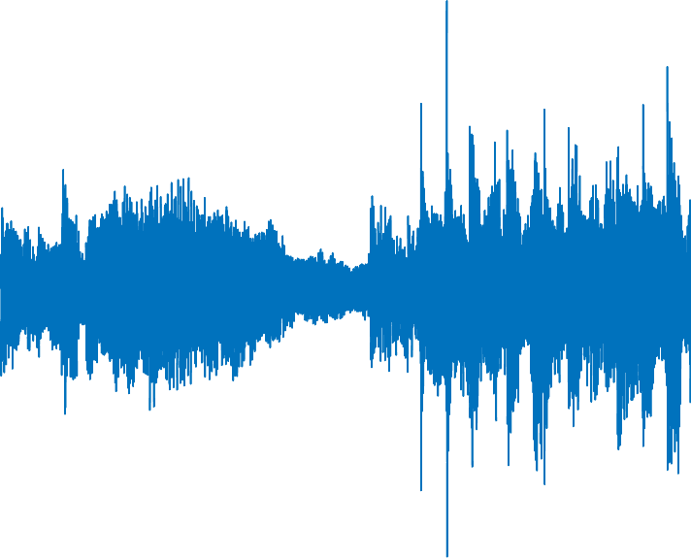
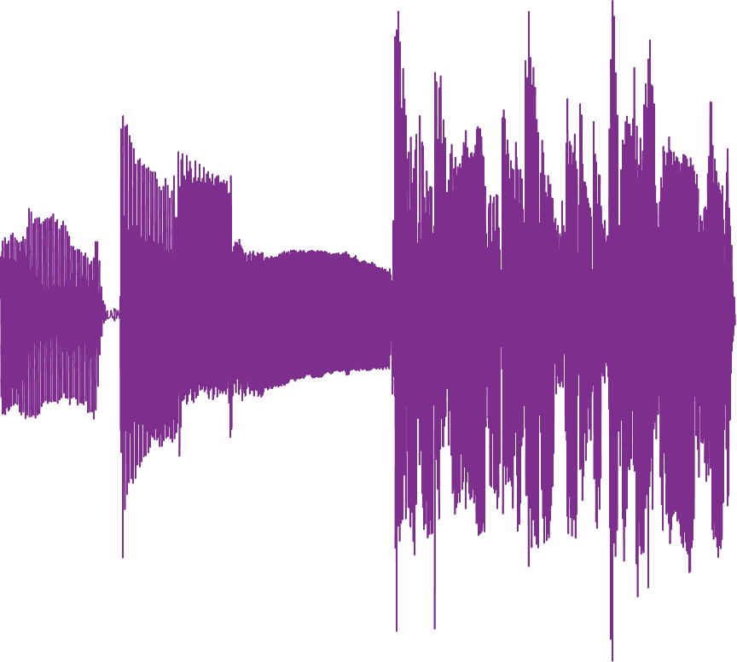
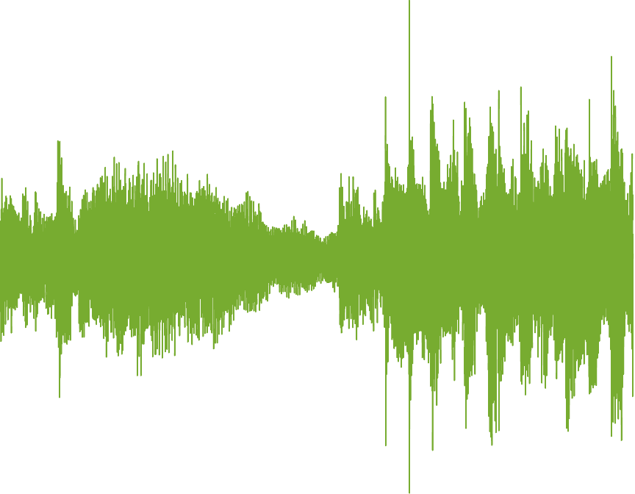
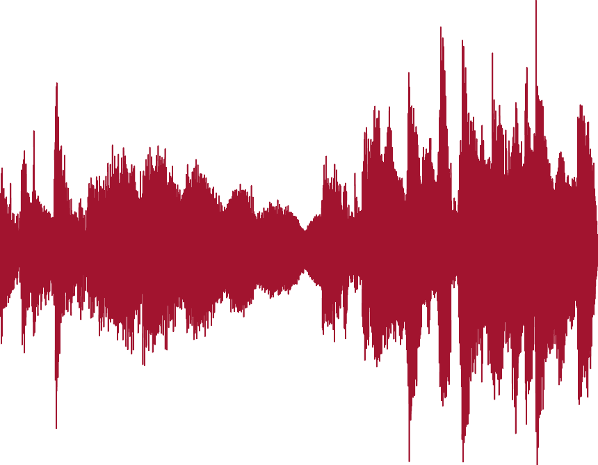
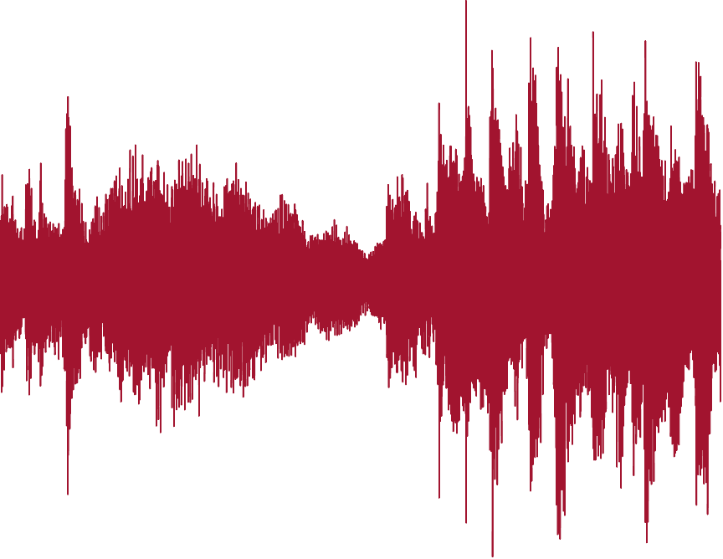
Incorporating Residual
MSS
Vocals
Drums
−
Music Mixture
Bass
Residual
AVG
Other
Other

Slide 8
Clipping
Severe hearing loss → NAL-R amplification → clipping & distortion
HAAQI affected by a lot of clipping
Applied audio compressor when clipping was “bad” according to heuristic

Slide 9
Results
System | HAAQI Score
Baseline (HDemucs) | 0.5697
Fine-tuned HDemucs | 0.6027
Fine-tuned KUIELab-MDX-Net | 0.6001
Fine-tuned DTTNet | 0.6166
Ensemble | 0.6317
Ablations | HAAQI Score
Remove use of residual | 0.6081
Remove audio compressor | 0.6053

Slide 10
Working with HAAQI
Slowness of HAAQI was bottleneck during experimentation
Approximated HAAQI score with fewer gammatone bands for faster validation
Sped up MATLAB implementation of HAAQI using parallelization (parfor loops)
Evaluating 10s signal: ~7s → ~3s

