Slide 1
Evaluating the Throughput of Video Transcoding in Cloud Services
Yangang Cai, Xufengli, Zhenyu Wang and Ronggang Wang
caiyangang@pku.edu.cn
IEEE DCC 2022
Notes:
I'm Cai Yangang, the speaker of this article

Slide 2
ABSTRACT
In current cloud services, they transcode the videos in parallel in the cluster.Transcoding units in a cluster may transcode multiple videos simultaneously. In each transcoding unit, the more transcoding tasks, the longer each video transcoding time is consumed. So we need to schedule an appropriate number of videos in the transcoding unit to minimize the total transcoding time. In this paper, we propose a method to evaluate the throughput of video transcoding in cloud services. This method can quickly estimate the maximum number of transcoding video concurrence on the current transcoding unit.

Slide 3
Proposed Method
Mathematical Definitions
Extremum Point
Maximum Throughput
Notes:
we design a mathematical model to estimate the maximum video transcoding throughput of the current transcoding unit. First of all, we present the basic mathematical definitions of our mathematical model. Then, we discuss whether there is an extreme point in the current model. Finally, the extremum point of maximum throughput is obtained through the mathematical formula.

Slide 4
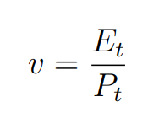
Proposed Method
Mathematical Definitions
We define v as the ratio of video encoding time to video playback time, Et as video encoding time, and Pt as video playback time. When v is greater than 1, the current transcoding speed is not enough to support live broadcasting and when v is less than 1, the current transcoding speed can support live broadcasting. So, the larger the v, the slower the transcoding speed.

Slide 5
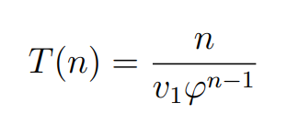
Proposed Method
Mathematical Definitions
Then we define the speed ratio of the transcoder with only one video transcoding task as v1. As the transcoder processes more videos, the transcoding speed of individual videos tends to decrease. In other words, the transcoding speed ratio v will rise. Therefore, we define the rate of rising of speed ratio as ϕ, which means the rate of rising of the speed ratio of each task for each additional transcoding task. When the transcoder processes n videos simultaneously in parallel, the speed ratio of each video is v₁ϕ _{n−1} .

Slide 6
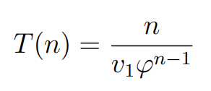
Proposed Method
Mathematical Definitions
Finally, we define the total length of transcoded videos in one hour as throughput T. When the transcoder processes n videos simultaneously in parallel, the throughput T(n) is .

Slide 7
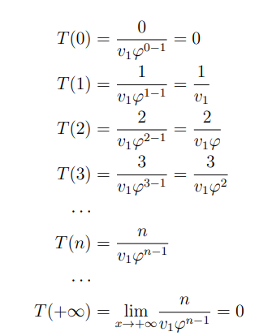
Proposed Method
Extremum Point
We try to find an optimal n that maximizes T. First of all, we analyze whether there is a maximum point for T(n). We list the distribution of the throughput T values for different n videos simultaneously in parallel. Due to T(0) = 0, T(+∞) = 0 and T(n) ≥ 0, there must be an n value in T(n) that makes T(n) get the maximum value.

Slide 8
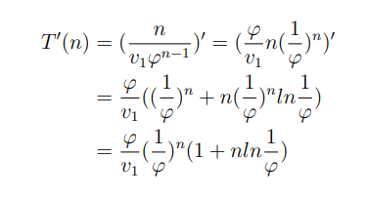
Proposed Method
Maximum Throughput
We get an optimal n value by derivation. We take the derivative of the T(n) function

Slide 9
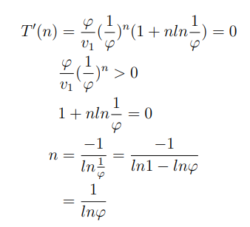
Proposed Method
Maximum Throughput
We can take T’(n) to be zero. Then we can obtain all extremum points of T(n).

Slide 10
Proposed Method
Maximum Throughput
The function T(n) has only one maximum point. Therefore, when n= 1/lnϕ, T(n) gets its maximum value T(1/lnϕ). Through the above mathematical model analysis, we can get the maximum throughput of the transcoder. If the current transcoder process videos at the same time, the transcoder can obtain the maximum throughput

Slide 11
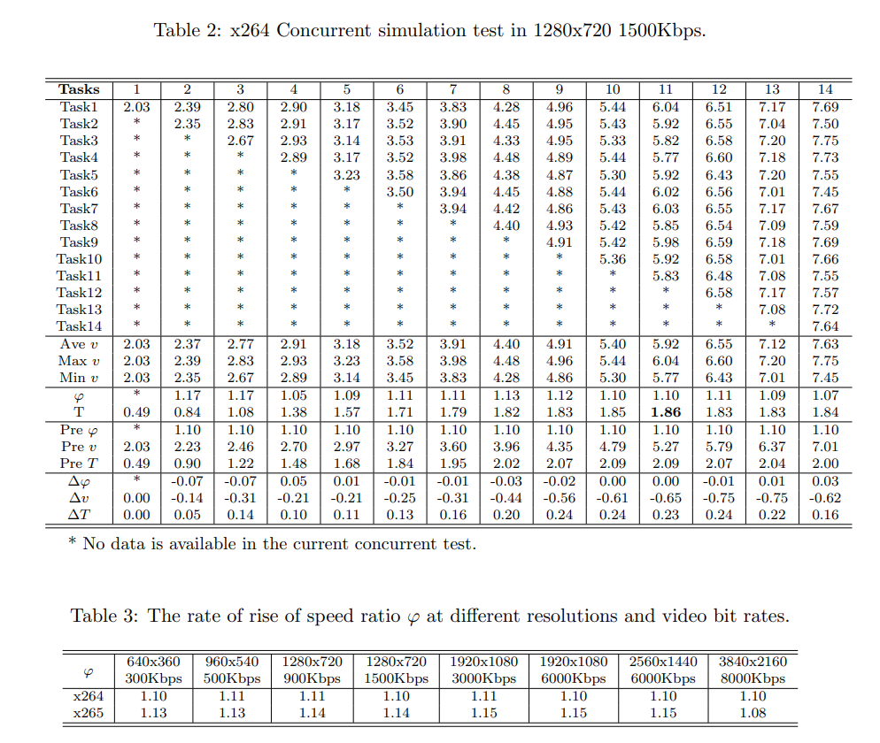
Simulation Results
Notes:
To verify our proposed method, we performed simultaneous execution of the X264 encoder from 1 task to 14 tasks in a transcoding unit. In addition, the resolution of our transcoding video is 1280x720, the target bit rate is 1500Kbps and the transcoding command line is shown in Table 1. Table 2 presents the detailed data for each task. We can observe that the higher the number of concurrent tasks, the higher the speed ratio v, in other words, the slower the transcoding speed. And under a specific number of concurrent tasks, the transcoding speed ratio of each task has little difference. Therefore, we can evaluate the speed ratio of these tasks in a uniform speed ratio. In Table 2, ϕ represents the average of the rate of rising of the speed ratio for each test case and T represents the average of the throughput for each test case. In this simulation test, we choose the average value of ϕ as our prediction P reϕ. Based on P reϕ, we can get the predicted speed ratio P rev and predicted throughput P reT for each case.∆ϕ, ∆v and ∆T represent the predicted errors of the rate of rising ……

Slide 12
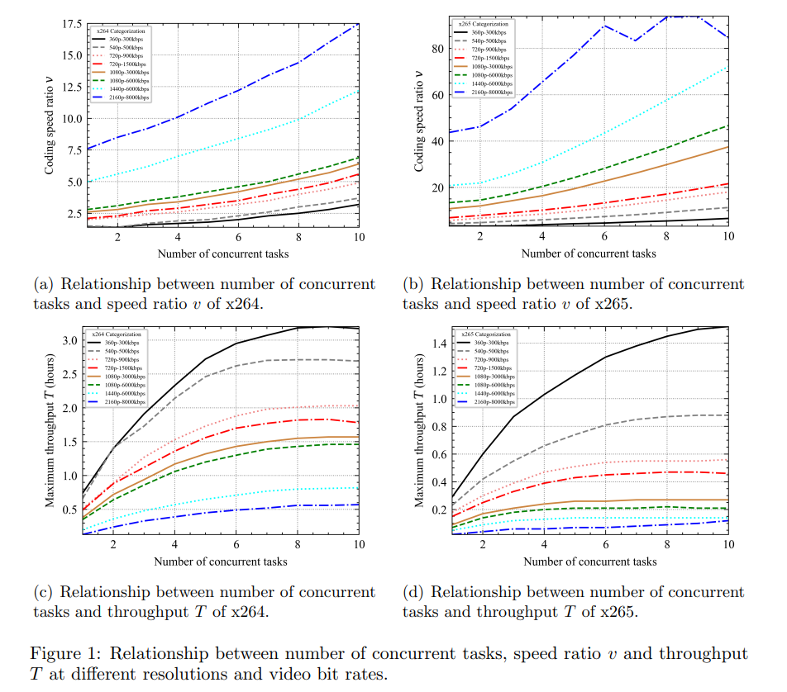
Simulation Results
Notes:
To verify our proposed method, we performed simultaneous execution of the X264 encoder from 1 task to 14 tasks in a transcoding unit. In addition, the resolution of our transcoding video is 1280x720, the target bit rate is 1500Kbps and the transcoding command line is shown in Table 1. Table 2 presents the detailed data for each task. We can observe that the higher the number of concurrent tasks, the higher the speed ratio v, in other words, the slower the transcoding speed. And under a specific number of concurrent tasks, the transcoding speed ratio of each task has little difference. Therefore, we can evaluate the speed ratio of these tasks in a uniform speed ratio. In Table 2, ϕ represents the average of the rate of rising of the speed ratio for each test case and T represents the average of the throughput for each test case. In this simulation test, we choose the average value of ϕ as our prediction P reϕ. Based on P reϕ, we can get the predicted speed ratio P rev and predicted throughput P reT for each case.∆ϕ, ∆v and ∆T represent the predicted errors of the rate of rising ……

Slide 13
Simulation Results
Table 4 shows the average error of ∆ϕ, ∆v and ∆T between the actual and predicted. We can observe that the average speed ratio error is only −0.34, and the average throughput prediction error is only 0.13
Notes:
To verify our proposed method, we performed simultaneous execution of the X264 encoder from 1 task to 14 tasks in a transcoding unit. In addition, the resolution of our transcoding video is 1280x720, the target bit rate is 1500Kbps and the transcoding command line is shown in Table 1. Table 2 presents the detailed data for each task. We can observe that the higher the number of concurrent tasks, the higher the speed ratio v, in other words, the slower the transcoding speed. And under a specific number of concurrent tasks, the transcoding speed ratio of each task has little difference. Therefore, we can evaluate the speed ratio of these tasks in a uniform speed ratio. In Table 2, ϕ represents the average of the rate of rising of the speed ratio for each test case and T represents the average of the throughput for each test case. In this simulation test, we choose the average value of ϕ as our prediction P reϕ. Based on P reϕ, we can get the predicted speed ratio P rev and predicted throughput P reT for each case.∆ϕ, ∆v and ∆T represent the predicted errors of the rate of rising ……

Slide 14
Thank you!

