Slide 1
Hierarchical Privacy-Preserving and Communication-
Efficient Compression via Compressed Sensing
Hui Huang* , Di Xiao*, Mengdi Wang
* College of Computer Science
Chongqing University
Chongqing 400044, China
Email: dixiao@cqu.edu.com
Notes:
更多精品素材：http://shop248912786.taobao.com （下拉可隐藏）

Slide 2
Motivation
A great number of data are captured by sensors every day, and the dramatically increasing number has raised concerns about data privacy and communication.
Privacy: The attack wants to obtain the useful information when the transmitting terminal sends the secret to the receiving terminal.
Communication: The secret is transmitted from the transmitting terminal to the receiving terminal, which occupies a great deal of communication resources.

Slide 3
The proposed scheme
A hierarchical privacy-preserving and communication-efficient compression scheme is presented to address these two issues.
In the encoding stage, the obfuscated sensitive regions and non-sensitive regions are compressed and encrypted simultaneously.
In the decoding stage, two hierarchical authorized users, i.e., the semi-authorized users and authorized users, are considered.
Additionally, the left annihilator matrices provide various kinds of recovery qualities for real-world requirements, which further achieves communication-efficient compression.
Notes:
Cryptographic attack models should be considered in our reseach. The first type of attack is COA, which means that the adversary only knows the ciphertext and attempts to find the corresponding key and plaintext. The second attack is KPA, which refers to the adversary can access the plaintext/ciphertext pairs and infer the secret measurement matrix. The third kind of attack is CPA, which means that the adversary can select the identity matrix as a plaintext to infer the measurement matrix.

Slide 4
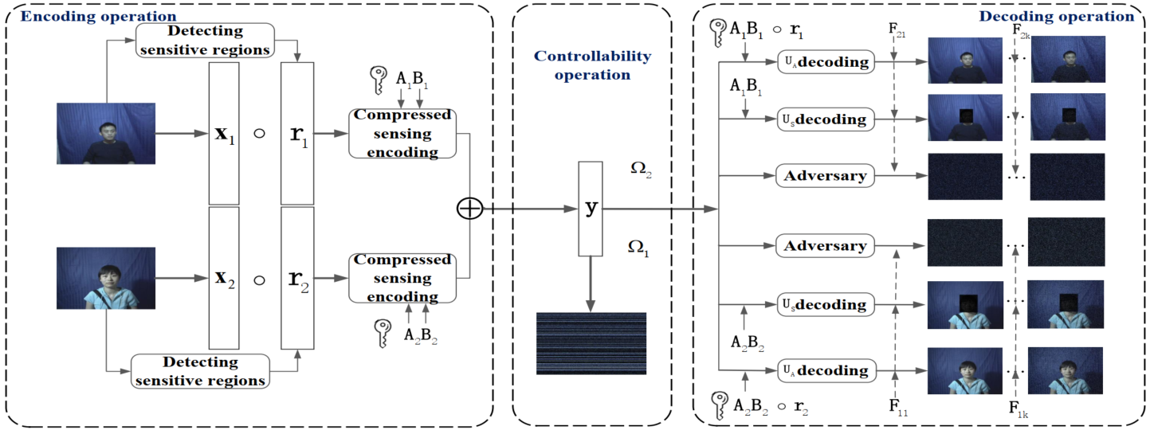
Framework
Figure 1: The overall architecture of the proposed scheme.
Notes:
CS encoding includes Image permutation-diffusion encryption and diffused image compression, and CS recovery is mainly dedicated to multi-prior regularization image recovery. This is the overall architecture of the proposed scheme.

Slide 5
Encoding operation

Slide 6
Controllability operation

Slide 7
Decoding operation

Slide 8
Conclusion
Sensitive regions are obfuscated and non-sensitive regions are preserved before performing CS. Thus, hierarchical authorized users are considered, i.e., the semi-authorized users and authorized users.
The left annihilator matrices are helpful to achieve communication-efficient compression. Meanwhile, both semi-authorized users and authorized users can recover signals with different qualities separately for two signals.
Notes:
we design a privacy-assured and multi-prior recovered CS strategy for image compression-encryption applications. The privacy-assured CS and multiprior regularization recovery can address the problems of low-security and low-quality recovery, respectively. For the low-security challenge, the permutation-diffusion structure is embedded to the CS encoding process, which can resist cryptographic attacks and increase key space. For the low-quality recovery challenge, we employ the multiprior regularization recovery to enhance the recovery performance. The simulation results and analyses show the effectiveness and feasibility of the proposed scheme.

Slide 9
Thanks

