Slide 1
Semi-Supervised Contrastive Learning of Global and Local Representation for 3D Medical Image Segmentation
Chuang Jia* Jian Xue* Ke Lu*† Zhongqi Wu*
*University of Chinese Academy of Sciences, Beijing 100049, China
†Peng Cheng Laboratory, Shenzhen 518055, China

Slide 2
CONTENTS
PART ONE
PART TWO
Background & Related Work
Proposed Methods
PART THREE
PART FOUR
Experiment & Result
Conclusion & Future Work

Slide 3
Background & Related Work
PART ONE

Slide 4
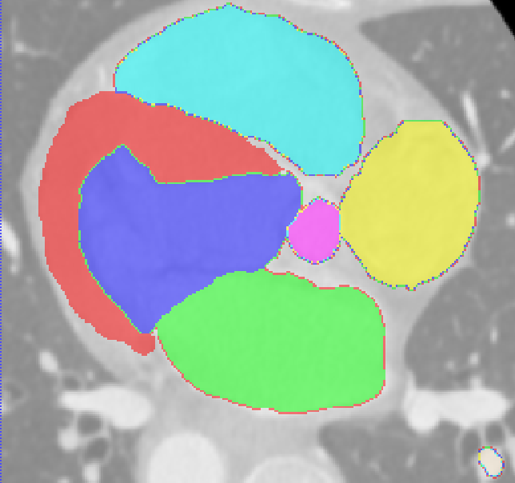
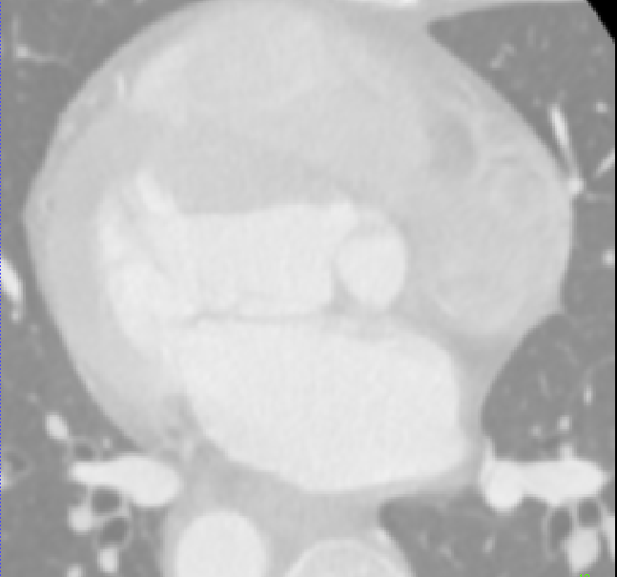
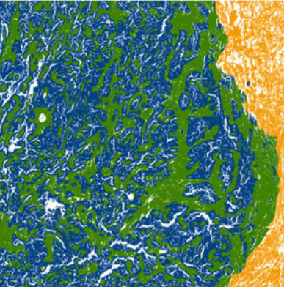
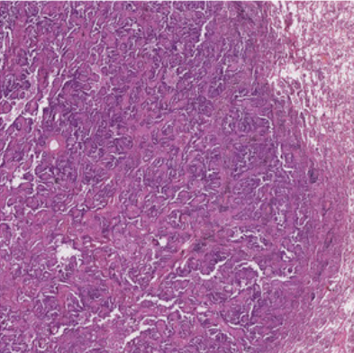
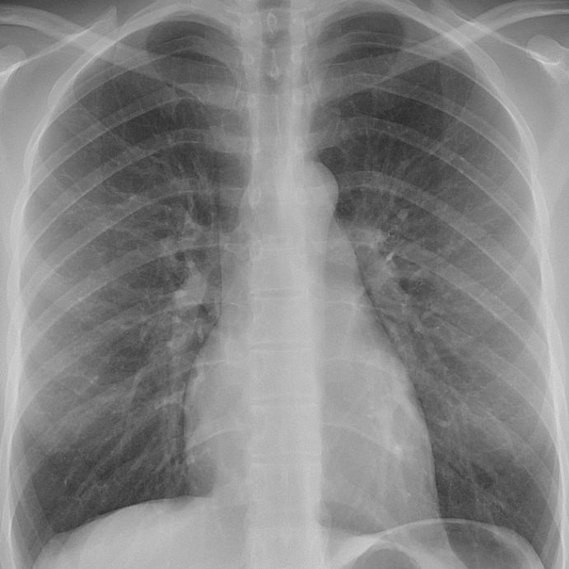
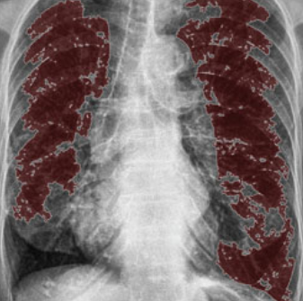
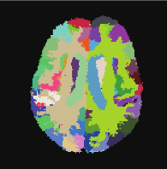
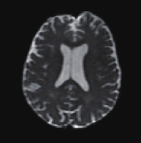
Background
Accurate medical image segmentation is essential for developing modern medical systems, especially in disease diagnosis and postoperative planning. With the advantages of convolutional neural networks, supervised deep learning has achieved state-of-the-art performance in medical image segmentation for various modalities and organs.
However, the success of these methods relies heavily on good annotations of medical images by experienced experts. Obtaining annotations for medical images is labor-intensive and time-consuming, and it is challenging to build a large public medical image dataset due to patient privacy.

Slide 5
Related Work
Methods | Limitations
MoCo[1], SimCLR[2], and BYOL[3] | Limited improvement for downstream tasks that require pixel-level accuracy.
Contrastive learning of global and local features for medical image segmentation with limited annotations[4] | Data must be meticulously recorded and presented in a two-dimensional format.
Semi-supervised contrastive learning for label-efficient medical image segmentation[5] | Focused on 2D analysis, with limited utilization of spatial information from 3D medical images.
Mixup[6] | Sensitivity to noise and outlier samples.
First to apply a two-stage pre-training and fine-tuning approach to volumetric medical image segmentation.

Slide 6
Proposed Methods
PART TWO

Slide 7
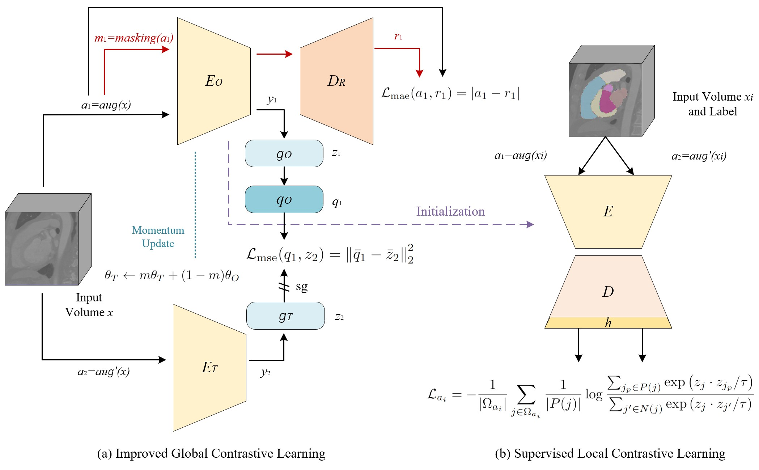
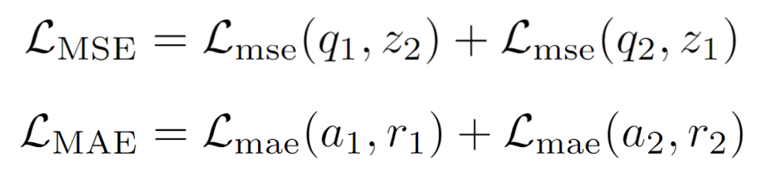
Proposed Methods

Slide 8
Experiment & Result
PART THREE

Slide 9
Datasets
Hippocampus
From the MICCAI 2018 medical segmentation decathlon challenge. There are 260 3D volumes of mono-modal MRI scans with the annotation of anterior and posterior hippocampus body.
MMWHS
From the MICCAI 2017 challenge, which consists of 20 3D cardiac CT volumes. The annotations include seven structures of heart: left ventricle, left atrium, right ventricle, right atrium, myocardium, ascending aorta, and pulmonary artery.
We divided the data into three parts, the training set $X_{tr}$, validation set $X_{vl}$, and test set $X_{ts}$.
The ratio $\left|X_{tr}\right|:\left|X_{vl}\right|:\left|X_{ts}\right|$ is 3:1:1 for Hippocampus and 2:1:1 for MMWHS.

Slide 10
Pre-processing
Hippocampus
Apply max-min normalization to each volumetric image;
Crop and pad the im-ages and corresponding labels to the size of $64 ×64×32$.
MMWHS
Re-sample each volumetric image and corresponding labels to a fixed spacing of $1.0 mm×1.0 mm×1.0 mm$;
Apply max-min normalization to each volumetric image;
Resize the length and width of the volumetric image and corresponding labels to $256 ×256$;
Cropping several sub-volumes of $256 ×256×16$from the volumetric image and corresponding annotations.

Slide 11
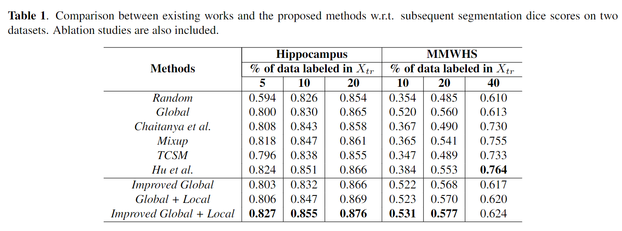
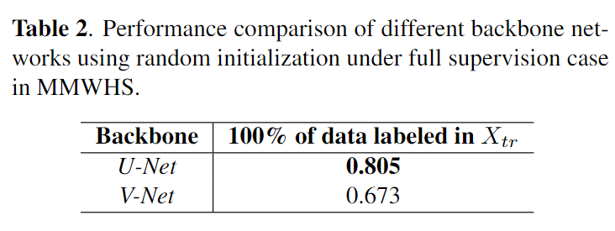
Result Analysis
[3]
[4]
[6]
[7]
[5]
[8]
[9]

Slide 12
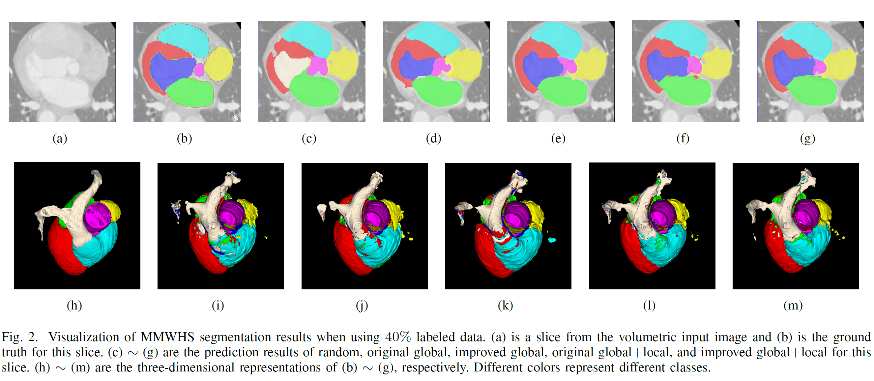
Result Visualization

Slide 13
Conclusion & Future Work
PART FOUR

Slide 14
Conclusion
In this work, we propose improved global contrastive learning and voxel-level supervised local contrastive learning, a semi-supervised contrastive learning of global and local features that learns the representation of volumetric medical image segmentation by exploiting image-level and voxel-level information.
Experiments on two public medical image datasets with limited annotations show that when extending this pre-training approach of the global-local contrastive learning to volumetric images, competitive results are achieved compared to state-of-the-art methods.

Slide 15
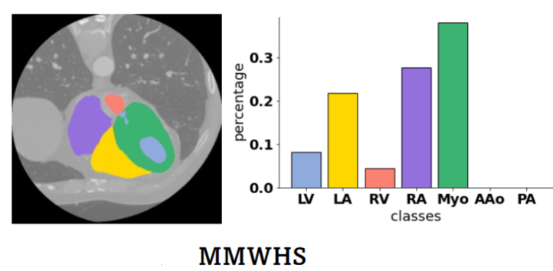
Future Work
New Backbone：Vision Transformer, Swin Transformer or hybrid architecture etc.
Class Imbalance：The most significant challenge affecting semi-supervised learning is the issue arising from the inherent physiological structure of human organs, leading to an uneven distribution of classes in medical data.
Examples of MMWHS with long-tail class distributions

Slide 16
References
[1] Kaiming He, Haoqi Fan, Yuxin Wu, Saining Xie, and Ross Girshick, “Momentum contrast for unsupervised visual representation learning,” in Proceedings of the IEEE/CVF conference on computer vision and pattern recognition, 2020, pp. 9729–9738.
[2] Chen T, Kornblith S, Norouzi M, et al. A simple framework for contrastive learning of visual representations[C]//International conference on machine learning. PMLR, 2020: 1597-1607.
[3] Jean-Bastien Grill, Florian Strub, Florent Altch´e, Corentin Tallec, Pierre Richemond, Elena Buchatskaya, Carl Doersch, Bernardo Avila Pires, Zhaohan Guo, Mohammad Gheshlaghi Azar, et al., “Bootstrap your own latent-a new approach to self-supervised learning,” Advances in neural information processing systems, vol. 33, pp. 21271–21284, 2020.
[4] Krishna Chaitanya, Ertunc Erdil, Neerav Karani, and Ender Konukoglu, “Contrastive learning of global and local features for medical image segmentation with limited annotations,” Advances in Neural Information Processing Systems, vol. 33, pp. 12546–12558, 2020.
[5] Xinrong Hu, Dewen Zeng, Xiaowei Xu, and Yiyu Shi,“Semi-supervised contrastive learning for label-efficient
medical image segmentation,” in International Conference on Medical Image Computing and Computer- Assisted Intervention. Springer, 2021, pp. 481–490.
[6] Hongyi Zhang, Moustapha Cisse, Yann N Dauphin, and David Lopez-Paz, “mixup: Beyond empirical risk minimization,” International Conference on Learning Representations, 2018.
[7] Xiaomeng Li, Lequan Yu, Hao Chen, Chi-Wing Fu, Lei Xing, and Pheng-Ann Heng, “Transformation consistent self-ensembling model for semi-supervised medical image segmentation,” IEEE Transactions on Neural Networks and Learning Systems, vol. 32, no. 2, pp. 523–534, 2020.
[8] Ronneberger O, Fischer P, Brox T. U-net: Convolutional networks for biomedical image segmentation[C]//Medical Image Computing and Computer-Assisted Intervention–MICCAI 2015: 18th International Conference, Munich, Germany, October 5-9, 2015, Proceedings, Part III 18. Springer International Publishing, 2015: 234-241.
[9] Milletari F, Navab N, Ahmadi S A. V-net: Fully convolutional neural networks for volumetric medical image segmentation[C]//2016 fourth international conference on 3D vision (3DV). Ieee, 2016: 565-571.

Slide 17
THANKS FOR YOUR ATTENTION

