Slide 1
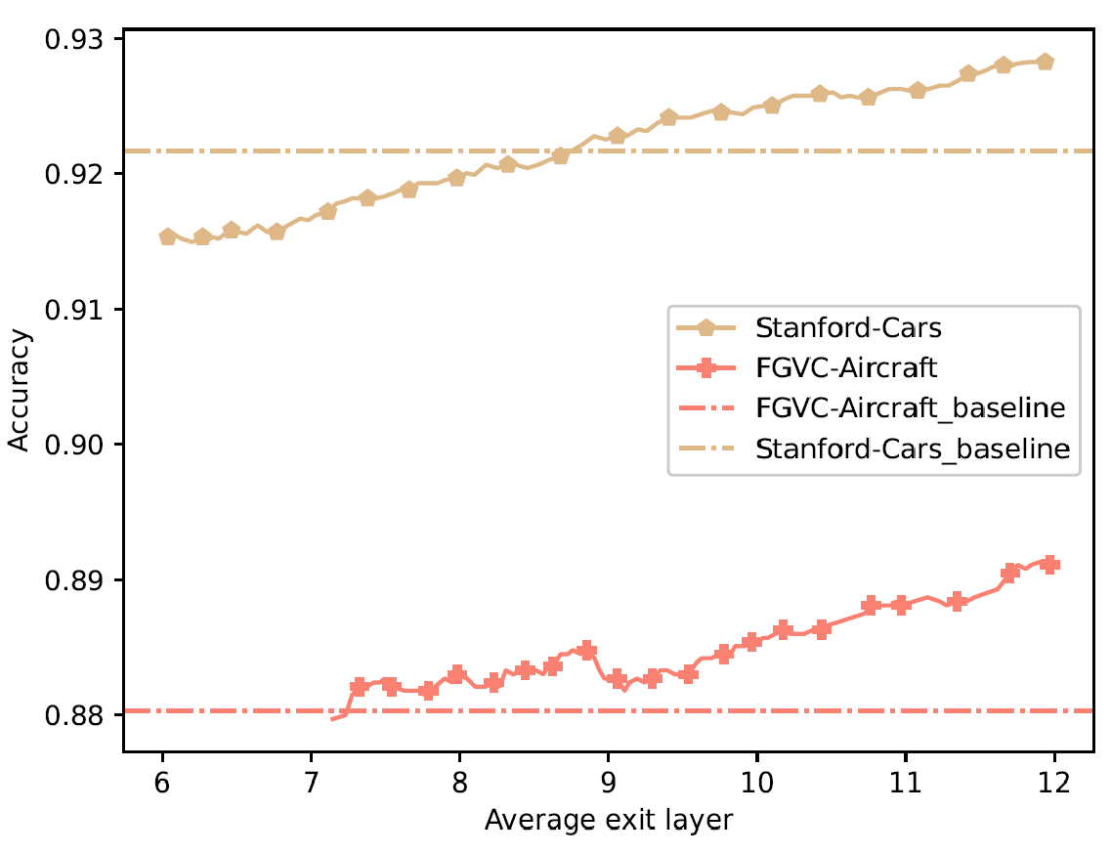
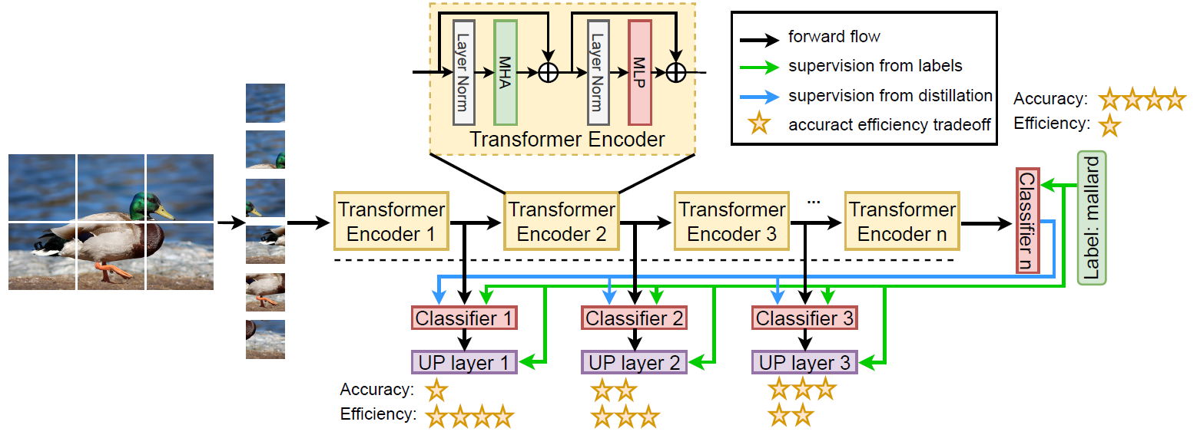
MULTI-EXIT VISION TRANSFORMER WITH CUSTOM FINE-TUNING FOR FINE-GRAINED IMAGE RECOGNITION
Paper ID: 2852
Tianyi Shen, Chonghan Lee, Vijaykrishnan Narayanan
The Pennsylvania State University, Dept. of Electrical Engineering and Computer Science
Introduction
Proposed Method
The sandwich rule:
After the normal backward pass of the model, we do the distillation step with order:
last encoder -> random middle encoder -> earliest exiting encoder
to “sandwich” the weight for all the exiting encoder towards the last encoder (Fig. 2.)
Table 1. Result on Stanford Car dataset
Table 2. Result on FGVC Aircraft dataset
Fig. 3. Layer-wise trade-off curve with acc.
vs. average num. of layer
Conclusion:
We propose MEViT for efficient inference on FGVC tasks
The uncertainty score predictor module enables the early-exit functionality
Extensive experiments are conducted, and the results show the superior accuracy-efficiency trade-offs
MEViT drastically reduces the overall compute cost and memory usage on various systems with different computational budgets.
Task:
Fine-grained Visual Classification (FGVC)
Accurately identify discriminative local parts and features from visually similar subcategories. (bird species, car model)
Harder than general-level visual classification.
Problem Statement:
Vision transformers (ViT) dominate the FGVC tasks
ViT-based models achieve better performance than CNN due to its self-attention mechanism that maintains the global context.
Vision transformers (ViT) are expensive during inferencing
ViT-based models generally take $O(n^{2})$ time complexity for self-attention calculation, which makes it unrealistic to be implemented to edge devices with real-time application. (monitoring camera, mobile-phone app etc.)
Our Approach:
In this work
We introduce a Multi-Exit Vision Transformer architecture (MEViT) with and uncertainty score predictor module.
We apply a layer-wise in-place distillation strategy along with the sandwich rule during training to address the knowledge degradation problem.
Architecture Overview:
Fig. 1 Overview of MEViT
Early-exit branches:
We attach a single layer classifier to do the projection from encoder dimension to class dimension for each selected encoders. (6th to 12th encoder in our case)
Uncertainty score predictor:
Independent block used to evaluate the prediction quality.
Will be updated during the training with the MSE loss $L_{MSE_{i}}={\left\|u_{i}−\tilde{u}\right\|}_{2}^{2}$
Where $u_{i}$ is the predicted uncertainty level at encoder i
$u_{i} =σ(w^{T}f_{i}(h_{i})+b)$
and $\tilde{u}$is the true uncertainty level.
$\tilde{u}=tanh(\left|f_{i}\left(h_{i}\right)−y\right|)$
Loss for i^{th} layer:
$L_{i}=L_{CE_{i}}+L_{MSE_{i}}$
Layer-Wise In-Place Distillation:
Fig. 2. Visualized attention distribution
Encoder similarity evaluation:
Kullback-Leibler divergence loss with the last layer
$L_{{KLDiv}_{i}}=f_{n}\left(h_{n}\right)ln⁡(\frac{f_{n}(h_{n})}{f_{i}(h_{i})})$
Experiment and Results
Compared with baseline model ViT-B…
$MEViT_{12}$ (latest exit point)
0.6 % accuracy increase in Stanford Car dataset
1.1 accuracy inscrease in FGVC Aircraft dataset
Almost no latency increase
$MEViT_{6}$ (earliest exit point)
0.7 accuracy reduction in Stanford Car dataset
0.8 accuracy inscrease in FGVC Aircraft dataset
Half the latency of ViT-B
This work was supported in part by Semiconductor Research Corporation (SRC), Center for Brain-inspired Computing (C-BRIC), and Processing with Intelligent Storage and Memory (PRISM).

