Slide 1
Weighted Median-Shift on Graphs for Geometric Model Fitting Xiong Zhou, Hanzi Wang, Guobao Xiao, Xin Wang, Yan Yan, Liming Zhang
ICIP’17
Presented by:
Xiong Zhou
Xiamen University, China

Slide 2
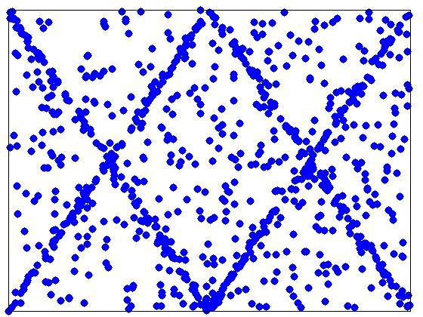
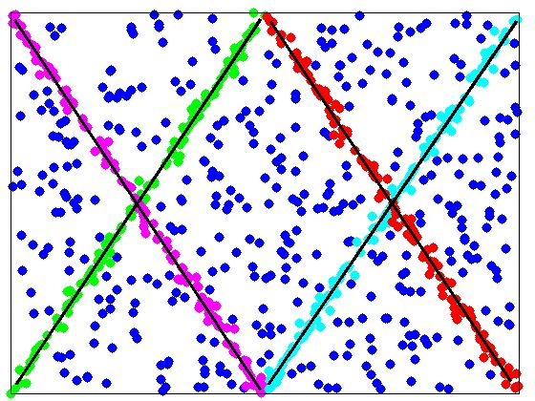
Geometric Model Fitting
Objective
The number of structures
The parameters of each structure
The inliers of each structure
2 /27

Slide 3
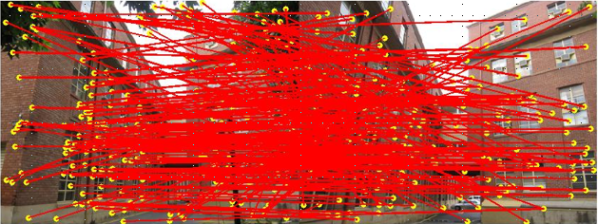
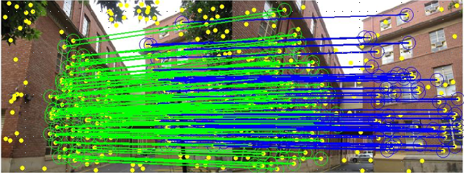
Geometric Model Fitting
Applications
Homography estimation
3 /27

Slide 4
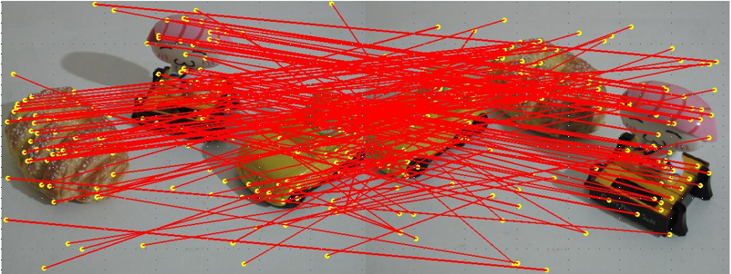
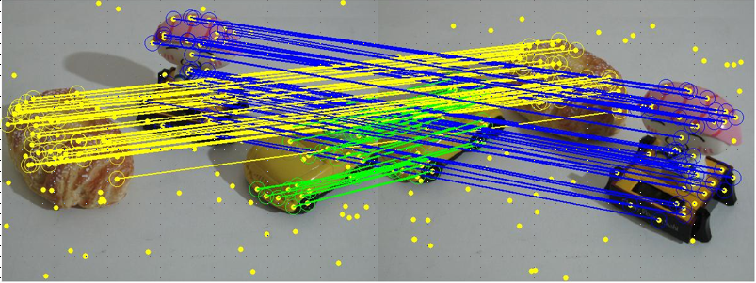
Geometric Model Fitting
Applications
Two-view based
motion segmentation
4 /27

Slide 5
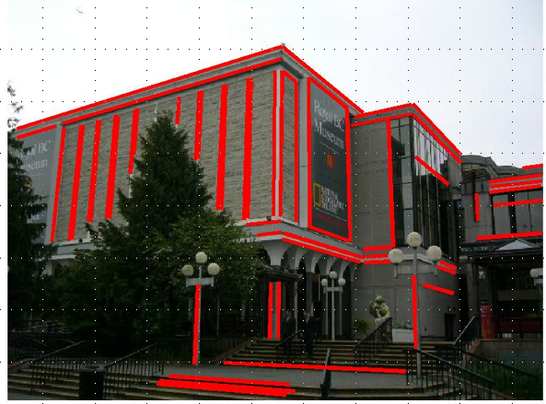
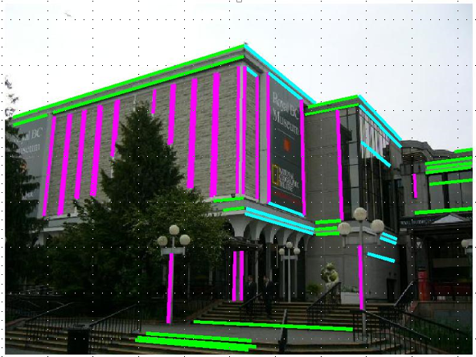
Geometric Model Fitting
Applications
Vanishing point detection
5 /27

Slide 6
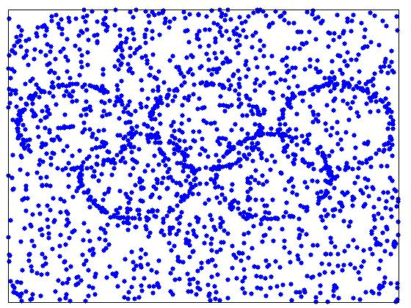
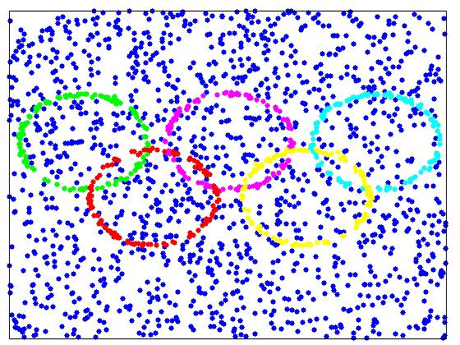
Geometric Model Fitting
Difficulties
95%
Data with a large number of outliers
6 /27

Slide 7
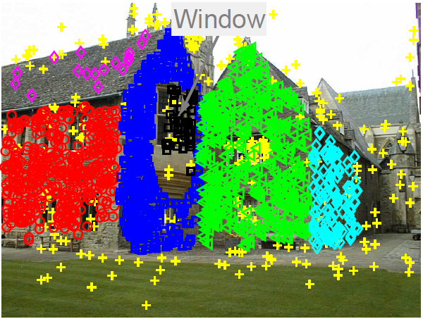
Geometric Model Fitting
Difficulties
The number of structures
Automatically estimating the
number of structures
is a great challenge.
The ground truth number of structures may be ambiguous.
7 /27

Slide 8
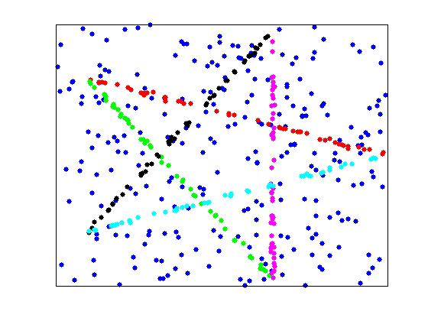
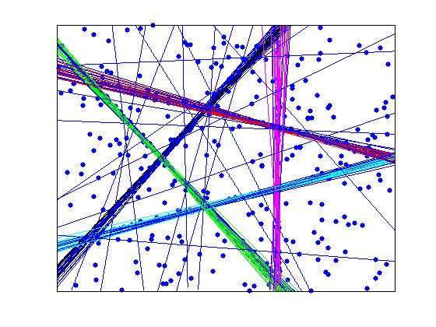
Geometric Model Fitting
Related works
Cluster data points in the data space
Cluster model hypotheses in the parameter space
OR
8 /27

Slide 9
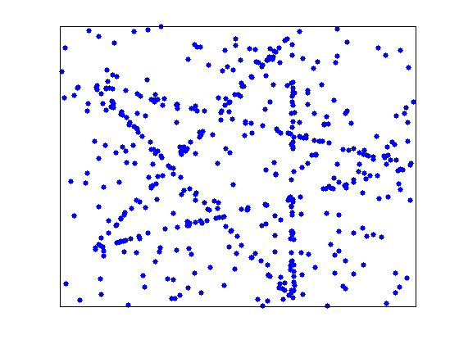
Geometric Model Fitting
Related works
Cluster data points in the data space
J-Linkage
(Toldo and Fusiello, ECCV 2008)
Kernel Fitting
(Chin, et al, ICCV 2009)
T-Linkage
(Magri and Fusiello, CVPR 2014)
Hypergraph Fitting
(Xiao, et al, PR 2016)
9 /27

Slide 10
Geometric Model Fitting
Drawbacks
Which cluster should it belong to?
10 /27

Slide 11
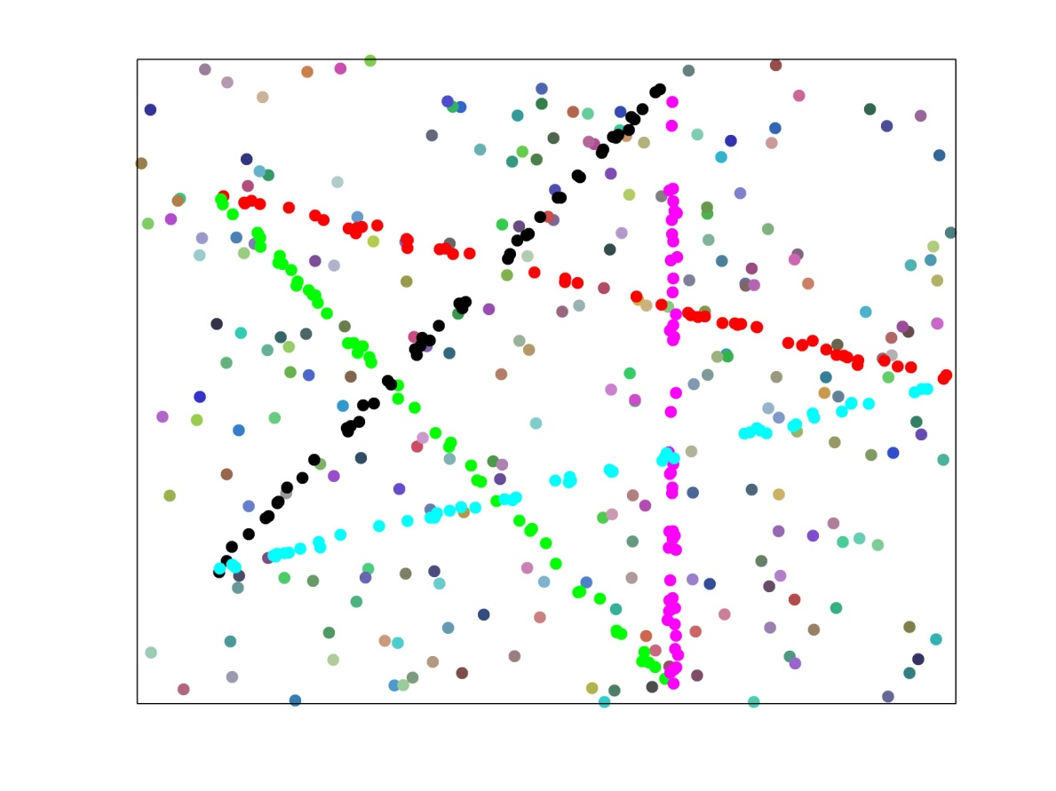
Geometric Model Fitting
Drawbacks
Ideal clustering result Obtained clustering result
11 /27

Slide 12
Geometric Model Fitting
Related works
Cluster model hypotheses in the parameter space
Randomized Hough Transform
(Xu, et al, PRL 1990)
Adaptive Kernel-Scale Weighted Hypotheses
(Wang, et al, PAMI 2012)
Mode-Seeking on Hypergraphs
(Wang, et al, ICCV 2015)
Graph-based Mode-Seeking Fitting
(Xiao, et al, PRL 2016)
12 /27

Slide 13
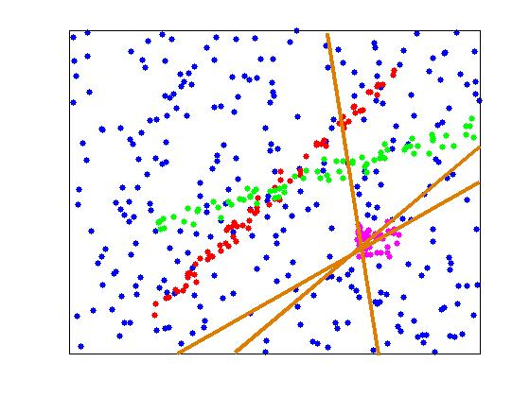
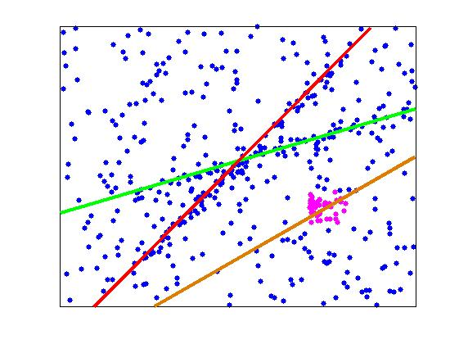
Geometric Model Fitting
Drawback
Model fitting
Clustered outliers
13 /27

Slide 14
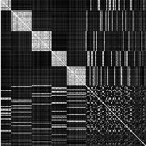
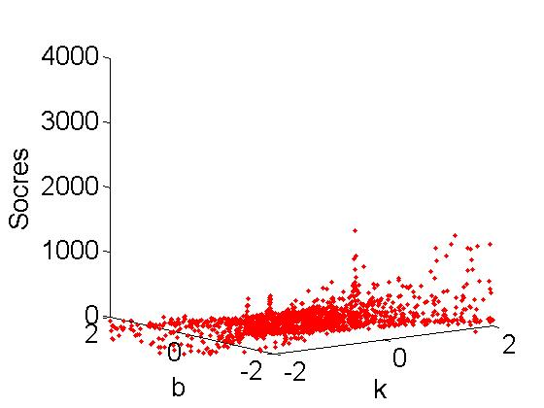
Motivation
Model hypotheses
Similarities
Combine
Weighting scores
14 /27

Slide 15
Weighted Median-Shift on Graphs (WMSG)
The first stage of WMSG
Generate model hypotheses and compute the similarities
2. The second stage of WMSG
Calculate the weighting scores of the model hypotheses
The third stage of WMSG
Perform the weighted median-shift method
15 /27

Slide 16
The first stage of WMSG
Generate some model hypotheses θ₁,θ₂,…,θ_{M} to construct a graph G = (V, E).
The similarities between vertices:
is highly similar to
is not very similar to
16 /27

Slide 17
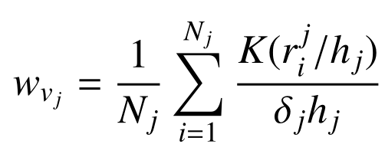
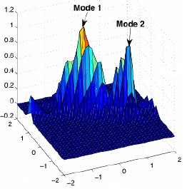
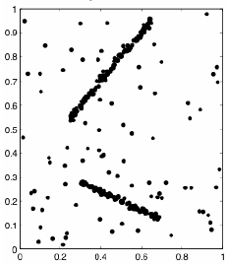
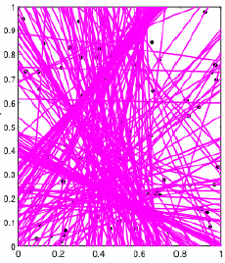
The second stage of WMSG
Calculate the weighting scores of the corresponding vertices
v₁,v₂,…,v_{M} by the kernel density estimation technique:
Data points Model hypotheses Weighting scores
17 /27

Slide 18
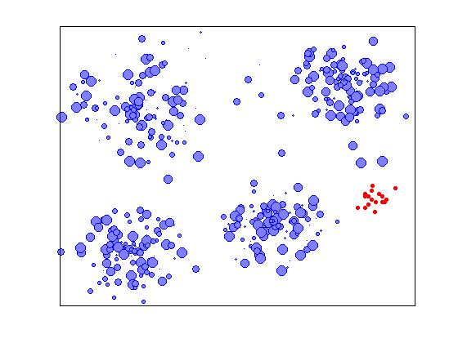
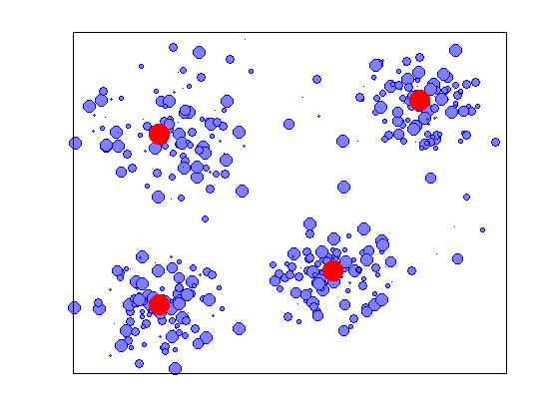
The third stage of WMSG
Shift vertex towards the weighted median
vertex :
Iterately perform the above process until each
vertex converges to a stable vertex (each vertex
represents a model hypothesis).
18 /27

Slide 19
The third stage of WMSG
Weighted median-shift on graphs
Vertices in parameter space
Fitting result
19 /27

Slide 20
Experimental results
Line Fitting
The first row is the original data, and the second row is the fitting result obtained by the proposed method.
20 /27

Slide 21
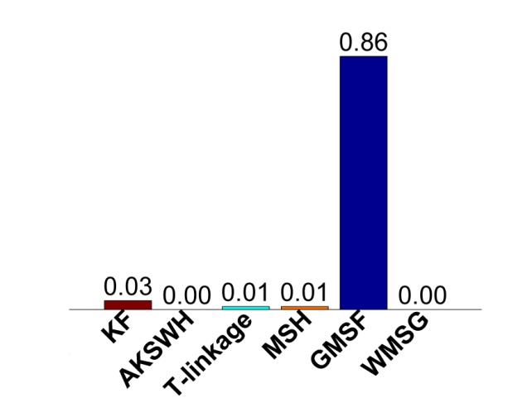
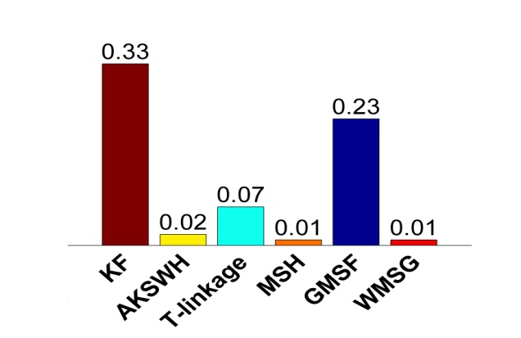
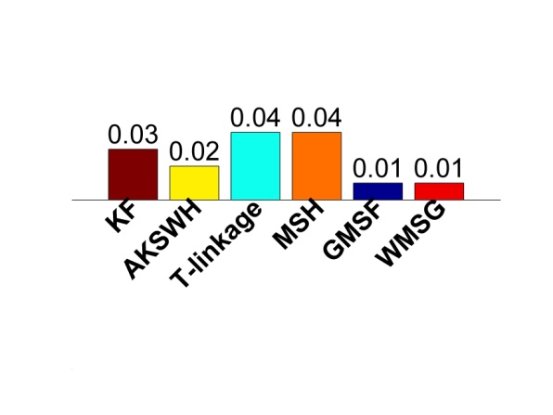
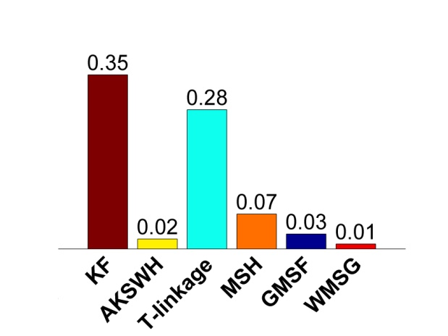
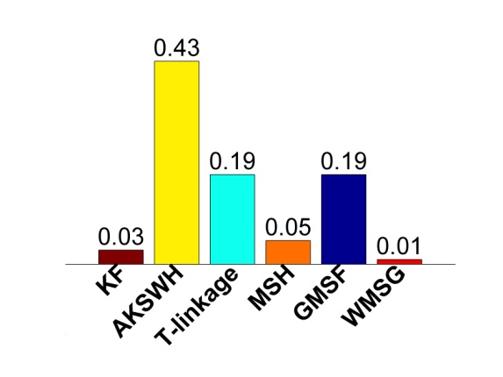
Experimental results
Line Fitting (average errors)
Two lines Three lines Four lines
Five lines Six lines
21 /27

Slide 22
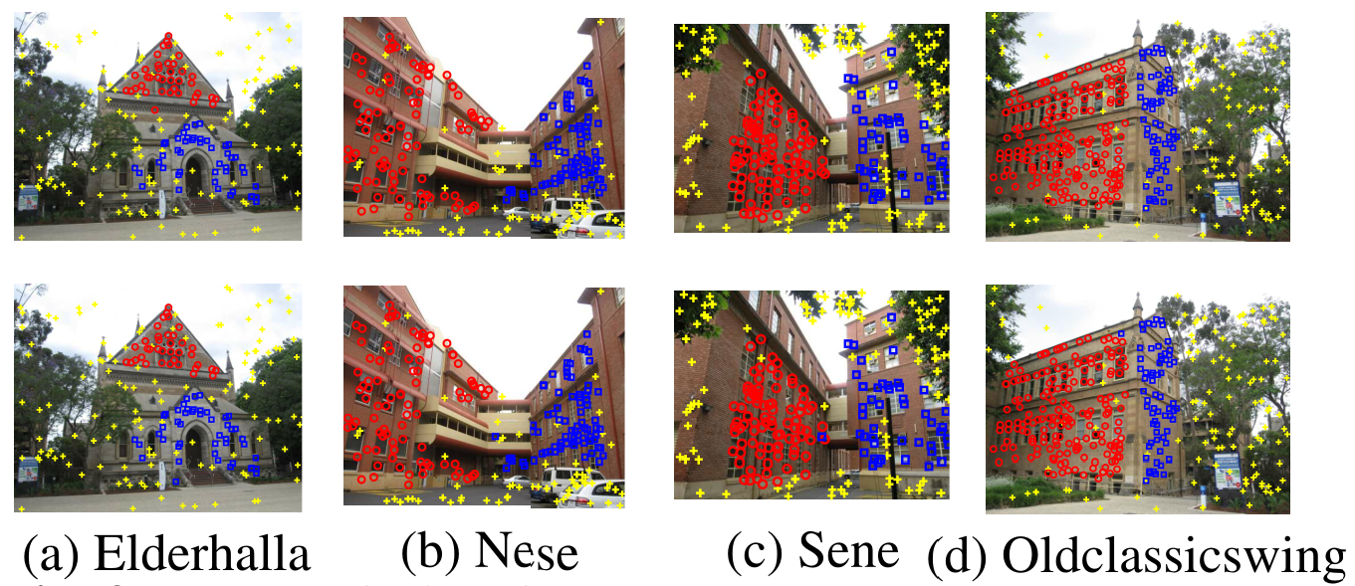
Experimental results
Homography Based Segmentation
The first row is the original images, and the second row is the fitting result obtained by the proposed method.
22 /27

Slide 23
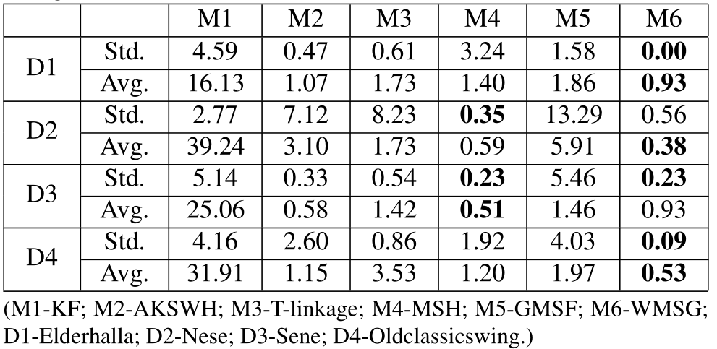
Experimental results
Homography Based Segmentation
23 /27

Slide 24
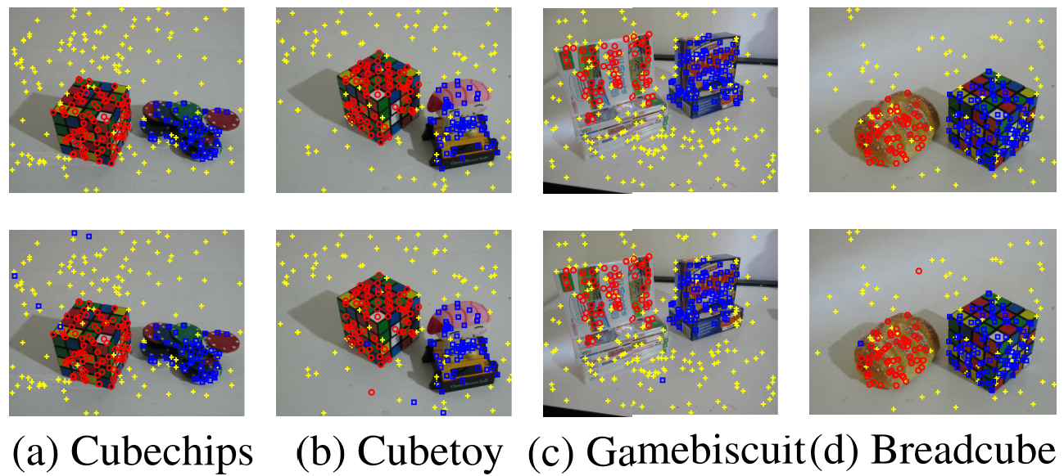
Experimental results
Two-view Based Motion Segmentation
The first row is the original images, and the second row is the fitting result obtained by the proposed method.
24 /27

Slide 25
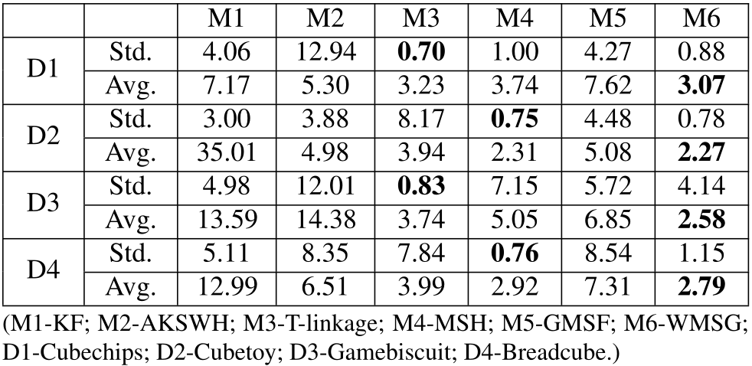
Experimental results
Two-view Based Motion Segmentation
25 /27

Slide 26
Conclusions
We proposed a weighted median-shift on graphs algorithm
Deal with the cases when outliers cluster together.
Accurately detect multiple structures in data without specifying the number of structures.
Handle data with a large proportion of outliers.
26 /27

Slide 27
Thank you !

