Slide 1
A Self-Supervised Learning Approach for Detecting Non-Psychotic Relapses using Wearable-based Digital Phenotyping
Panagiotis Kaliosis, Sofia Eleftheriou, Christos Nikou and Theodoros Giannakopoulos
MagCIL, National Center for Scientific Research “DEMOKRITOS”, Greece
Notes:
G’evening I am Sofia Eleftheriou and I am a PhD Student in the multimodal machine learning group of the national center for scientific research demokritos in athens greece
This is a collaborative work with my collegues ….

Slide 2
Outline
Focus
1st track of the "2nd e-Prevention challenge: Psychotic and Non-Psychotic Relapse Detection using Wearable-Based Digital Phenotyping".
Contents
Preprocessing and Feature Extraction.
A Transformer model for learning self-supervised representations from augmented features.
2 unsupervised methods for detecting relapse days as outliers.
One model for each patient.
Method ranked 2nd with
ROC_AUC = 0.651
PR_AUC = 0.642
Code available at https://github.com/magcil/e-prevention-challenge

Slide 3
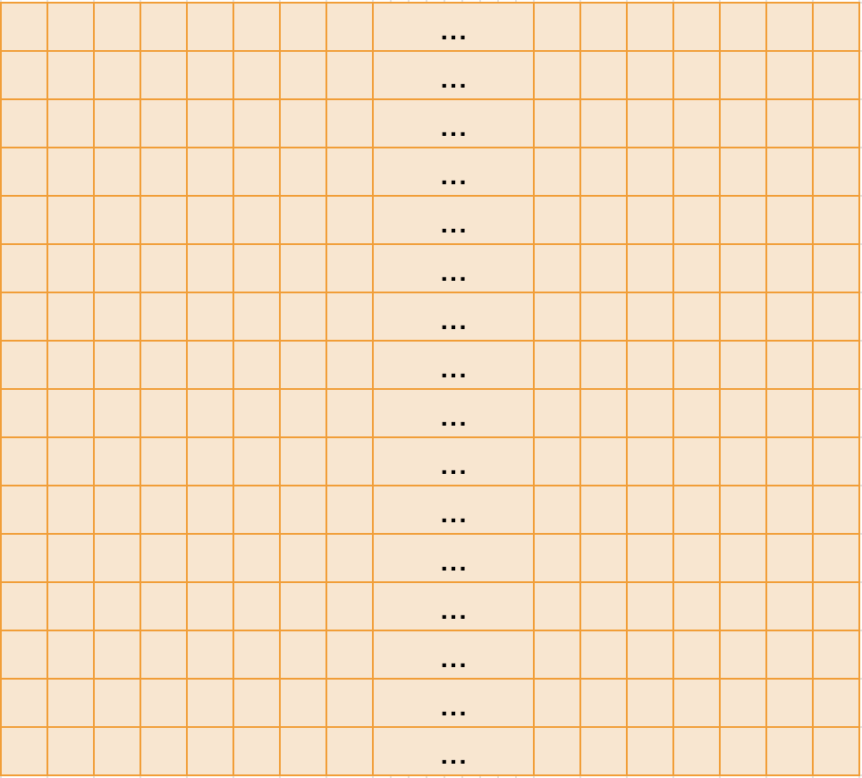
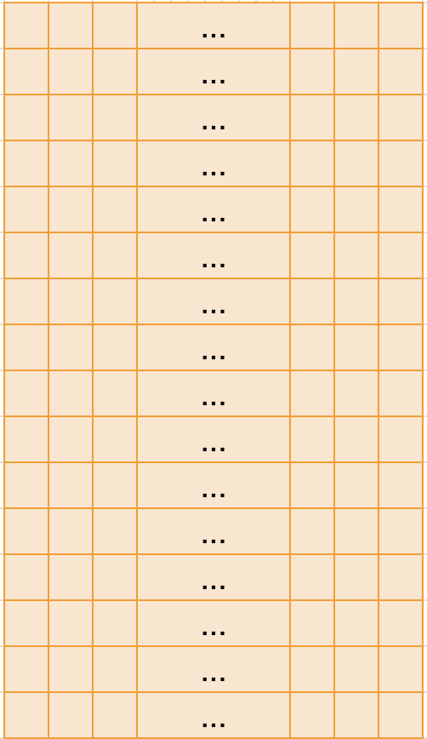
Method: Conceptual Diagram
Raw Data
Feature extraction
Augmentation
features
time
f₁
…
f₇₆₈
…
Outlier Detection
Self-supervised ViT
Normal/Relapse
Self-trained representations
Notes:
This is a conceptual diagram of our methodology. At first, from the data of a particular day of a particular user, we extract features for every 5-minute time interval, leading to a wide feature matrix. Then, we randomly sample feature submatrices in an attempt to achieve augmentation and reduce the representation size. Then we train a self-supervised model that extracts the final representations which is finally fed as input to the outlier detection method that recognizes if the respective day is relapse or not.

Slide 4
Data Description and Problem Formulation
Goal: Detect non-psychotic relapses
Constraint: no supervised information in the training data (training data from the non-relapse class alone)
Data
Long-term continuous recordings of raw biosignals from wearable sensors
Accelerometers
Gyroscopes
Heart rate
Supplemental data
Sleep schedules
Daily step count
Demographics
9 patients
Training data: P1: 172, P2: 211, P3: 232, P4: 185, P5: 196, P6: 201, P7: 178, P8: 178, P9: 160 non-relapse days

Slide 5
Method: Feature Extraction
Types of features:
Linear/angular acceleration:
Accelerometer
Gyroscope
Heart rate / RR-intervals
Daily activity
Sleep hours
Walking/running steps not used
To preprocess the data we adopt a similar approach [1] wrt the value ranges:
acceleration_X, Y, Z: (-19.6, 19.6)
gyroscope_X, Y, Z: (-573, 573)
HeartRate: (0, 255)
rRinterval: (0, 2000)
We implement a 5-minutes windowing process.
[1] P. P. Filntisis, N. Efthymiou, G. Retsinas, A. Zlatintsi, C. Garoufis, T. Sounapoglou, P. Tsanakas, N. Smyrnis, and P. Maragos, “The 2nd e-prevention challenge: Psychotic and non-psychotic relapse detection using wearable-based digital phenotyping,” in Proc. International Conference on Acoustics, Speech and Signal Processing. IEEE, 2024

Slide 6
Method: Feature Extraction: 3-D Acceleration
For both accelerometer and gyroscope coordinates (x, y, z) we compute the euclidean norm (||(x, y, z)|| = (x^2+y^2+z^2)^(1/2)) to produce one scalar value for each (2 scalar values in total).
For each norm (accelerometer and gyroscope) we compute the mean and standard deviation (4 values).
Also compute the deltas.
Deltas are calculated using a 30 sec window on the initial features.
8 total values in each 5-minutes window.

Slide 7
Method: Feature Extraction: 3-D Acceleration
5 mins mean + std of deltas
delta
…
delta
30s mean of
euclidean norm
30s mean of
euclidean norm
30s mean of
euclidean norm
30s mean of
euclidean norm
x |  | … |  |  | … |  | … |  | … |  |  | …
y |  | … |  |  | … |  | … |  | … |  |  | …
z |  | … |  |  | … |  | … |  | … |  |  | …
5 mins mean + std of
euclidean norm
Notes:
In both cases, a 5-min window is adopted for the final statistics (mean and std), however the deltas are first extracted using a shorter, 30sec window.

Slide 8
Method: Feature Extraction: Heart-rate
5 features as in [1] (per 5 minutes window)
heartRate_nanmean
rRInterval_nanmean
RInterval_rmssd
rRInterval_sdnn
rRInterval_lombscargle_power_high

Slide 9
Method: Feature Extraction: Sleep
3 features (per 5 minutes window) for each time interval starting at t of the L_{p, d} available 5-min intervals of patient p on day d:
the number of sleep intervals up to t
the total amount of sleep (in secs) up to t
the difference t-a_{t*} (secs), if (a_{t*}, b_{t*}) is a sleeping interval and t belongs in the (a_{t*}, b_{t*}) range (this is the time elapsed since the patient was in sleep at time t)
start_time: 16:35
end_time: 17:05
start_time: 17:05
end_time: 23:15
start_time: 23:15
end_time: 07:20
…
…
5-min internal (t)
n_sleep = 2
aggr_sleep = 1800 s
interval_sleep = 300 s
Notes:
We then extract 3 features from the provided sleep intervals. For each window t we extract the following 3 features (1) the number of sleep intervals in the day up to that point (2) the total time the user has slept in that day, up to that point and (3) the time distance between each point t and the begining of the current sleep interval (if t belongs to a sleep interval).
In this example the first feature for the window t (noted in red here) is equal to 2, because the user has slept two times in the current day until that point. In addition, the second feature is 1800seconds because this is how much time the user has slept up to that point. Finally, t belongs to a sleep interval, therefore the third feature has a non zero value (equal to 300 sec in particular).

Slide 10
Method: Feature Extraction: Final
2 time features as described in [1]
2 features discarded due to low significance
rRInterval_lombscargle_power_high and acc_delta_mean
For each patient, features are standardized with mean and std from the training data
1 | gyr_mean | 9 | rRInterval_nanmean
2 | gyr_std | 10 | rRInterval_rmssd
3 | gyr_delta_mean | 11 | rRInterval_sdnn
4 | gyr_delta_std | 12 | interval_sleep
5 | acc_mean | 13 | aggr_sleep
6 | acc_std | 14 | n_sleep
7 | acc_delta_std | 15 | cos_t
8 | heartRate_nanmean | 16 | sin_t

Slide 11
Method: Initial Features - Augmentation
L_{p,d} 5-min intervals
Representation F_{p,d} for each patient p and day d (size 16 x L_{p,d})
L_{p,d:} : Available 5-min intervals
From each day d randomly sample 120 feature submatrices from F_{p,d}
Each submatrix is of size 16 x T (T = 32)
16 Features
Notes:
The aforementioned 16 features are extracted for each 5-minute interval. Therefore, each day d of patient p is represented by a 2-dimensional matrix, where rows represent features and columns represent time intervals. Note that there are mising time intervals in the data, so the width of that matrix is varying (denoted by L here).
The next step is to sample this feature matrix to a predefined width several times. In particular, we sample the initial matrix to a width of 32 time intervals and we do this 120 times.

Slide 12
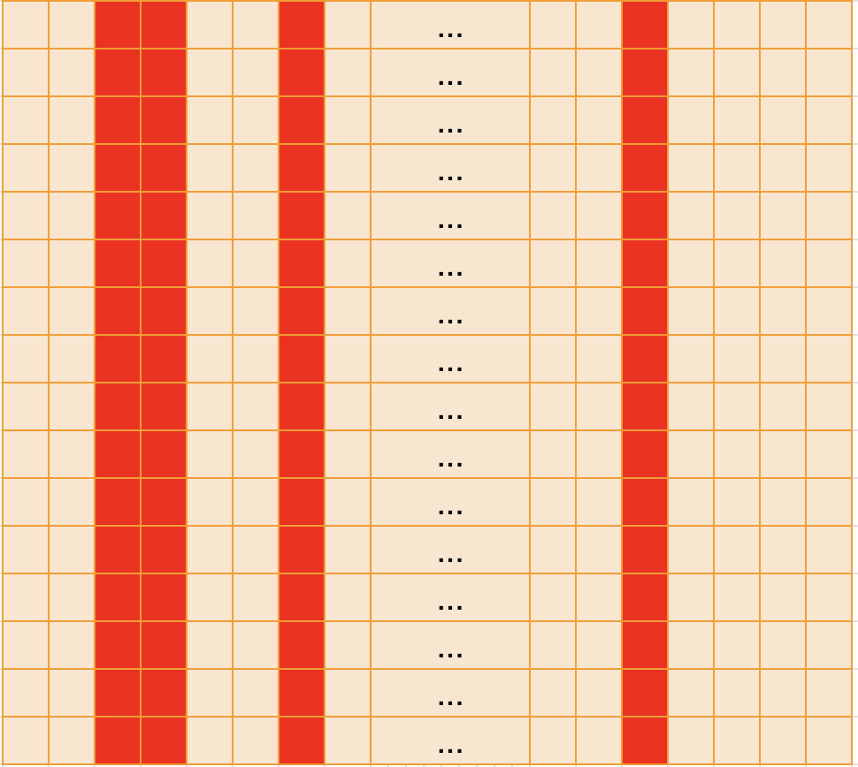
Method: Initial Features - Augmentation
L_{p,d} 5-min intervals
Representation F_{p,d} for each patient p and day d (size 16 x L_{p,d})
L_{p,d:} : Available 5-min intervals
From each day d randomly sample 120 feature submatrices from F_{p,d}
Each submatrix is of size 16 x T (T = 32)
16 Features
Submatrix 1
16 Features
T(=32) 5-min intervals
Notes:
Each time the resulting submatrix is therefore of size 16 x 32. Here we can see that the first submatrix is sampled from the 5-min intervals shown in red color.

Slide 13
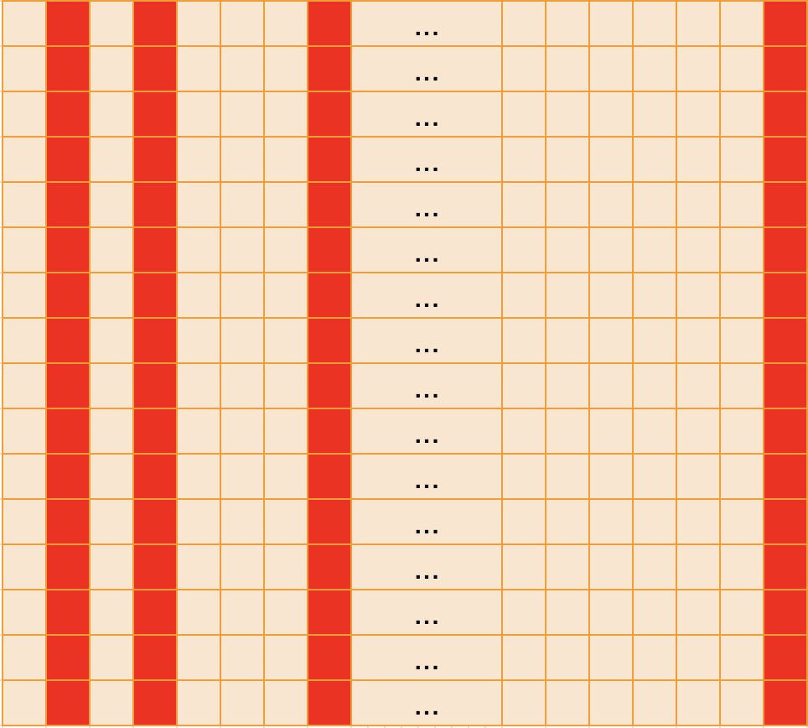
Method: Initial Features - Augmentation
L_{p,d} 5-min intervals
Representation F_{p,d} for each patient p and day d (size 16 x L_{p,d})
L_{p,d:} : Available 5-min intervals
From each day d randomly sample 120 feature submatrices from F_{p,d}
Each submatrix is of size 16 x T (T = 32)
16 Features
Submatrix 1
Submatrix 2
16 Features
16 Features
T(=32) 5-min intervals
T(=32) 5-min intervals
Notes:
… and this process …

Slide 14
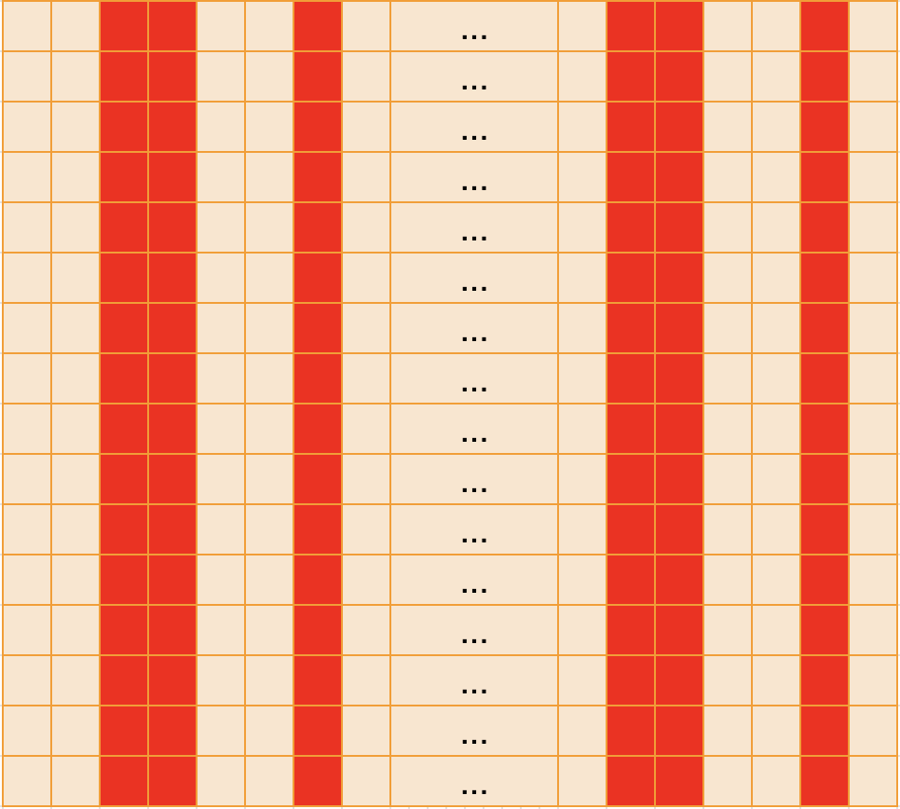
Method: Initial Features - Augmentation
L_{p,d} 5-min intervals
Representation F_{p,d} for each patient p and day d (size 16 x L_{p,d})
L_{p,d:} : Available 5-min intervals
From each day d randomly sample 120 feature submatrices from F_{p,d}
Each submatrix is of size 16 x T (T = 32)
16 Features
Submatrix 1
Submatrix 2
Submatrix 120
16 Features
16 Features
…
16 Features
T(=32) 5-min intervals
T(=32) 5-min intervals
T(=32) 5-min intervals
Notes:
… is repeated 120 times to produce 120 feature submatrices of fix width.
The intuition behind this process is to produce fix-sized representations and most importantly to achieve data augmentation for the next stage.

Slide 15
Method: Self-supervised models
2 methods:
Self-supervised Vision Transformers trained on the input reconstruction task using augmented features + positional embeddings.
Also implemented and trained Convolutional Autoencoders (CAEs) on the initial representations (same input as in the Transformers method), for comparison purposes
Notes:
The aforementioned 2-D augmented representations are then fed as input to a self-supervised model to extract more meaningful representations. To this end, we tried two methods: BLA BLA
Flatened patches
+MLP to reconstruct the input
Since time-series data, being inherently 2d can be effectively represented and model as images

Slide 16
Method: Outlier Detection: MSE-Based
Compute the MSE loss across all augmented samples for a day
Fit a Gaussian distribution of the MSE loss with mean μ and standard deviation σ on the training data
Compute a normalized value signifying the deviation from the training distribution (non-relapse cases)
The closer the MSE loss of a test sample (x) is to the average MSE loss of the training (non-relapse) data, the more probable is that the sample is non-relapse
Notes:
As soon as the self-supervised models have extracted the repsective representations, we proceed to the outlier detection step, which is responsible for detecting the relapses. The first method we implemented is based on modeling the MSE loss of all augmented instances using a simple Gaussian distribution. In particular, we compute the mean and std of the MSE loss of the represantations from the training data which are non-relapsed. Then, during inference, we compute the MSE loss of the test instance and we then compute the following score which is obviously low if the MSE loss is close to the average MSE of the non-relapsed training data and high if the instance is an outlier (relapsed)

Slide 17
Method: Outlier Detection: SVM-Based
Train a one-class-SVM on the self-learnt representations of a patient
Compute Score as:

Slide 18
Method: Outlier Detection: SVM-Based
Train a one-class-SVM on the self-learnt representations of a patient
Compute Score as:
s: number of (augmented) instances predicted as outliers (relapses) by the one-class-svm
n: total number of augmented instances of the day
OutDHP: the set of absolute distances of all the s outliers (relapses)
In other words to calculate S:
predict outliers from the one-class svm
calculate all distances of the s (augmented) instances predicted as replaces by the SVM
compute the median value of the distances and min-max normalize it
linearly shift by a α (tuned param)
weight using the above the hard decision ratio (s/n)
hard-decision ratio (#outliers / #total instances)

Slide 19
Method: Outlier Detection: SVM-Based
Train a one-class-SVM on the self-learnt representations of a patient
Compute Score as:
s: number of (augmented) instances predicted as outliers (relapses) by the one-class-svm
n: total number of augmented instances of the day
OutDHP: the set of absolute distances of all the s outliers (relapses)
In other words to calculate S:
predict outliers from the one-class svm
calculate all distances of the s (augmented) instances predicted as relpses by the SVM
compute the median value of the distances and min-max normalize it
linearly shift by a α (tuned param)
weight using the above the hard decision ratio (s/n)
hard-decision ratio (#outliers / #total instances)
Distance-based weight factor
Notes:
In this way, the score of a day is increased when the detected outliers lie further from the hyperplane, enhancing certainty in relapse indication.

Slide 20
Method: Outlier Detection: Hybrid
Note: for each patient we train a separate self-supervised model based on his/her non-relapse (normal) data
As for the outlier detection method we have two options:
Use the 2nd approach for all patients (one-class-svm)
Use the best outlier method for each patient (either MSE-based or one-class-svm).
Selection is done using the validation data
We call this “hybrid”

Slide 21
Post-processing
Applied median filtering for smoothing the predictions from the outlier detection stage (between successive days). 2 sequential medial filters with windows 5 and 13 applied. This added +9.3% on average in our evaluation experiments for the selected method.
Linear interpolation is used for the days with missing data.

Slide 22
Results
Metrics:
ROC_AUC
PR_AUC
Methods:
Random
Baseline
Convolutional Autoencoder + one-class SVM
Convolutional Autoencoder + one-class SVM or Gaussian outlier Detection (Hybrid)
Transformer + one-class SVM
Transformer + one-class SVM or Gaussian outlier Detection (Hybrid)
Hyperparams:
Submatrix width = 32 (number of 5-min windows sampled)
Instances per day (using the sampling method we described): T = 120
Encoding blocks: 12
Median filtering: 5 + 13
lr : loguniform(1e-6, 1e-3)

Slide 23
Results - Discussion
Hybrid outlier detection adds
+8% on validation data (for both models)
+4% on the test data (for the Transformer model)
Transformers-based model is
+4% better than CAE svm-based outlier detection
+1.5% better than CAE for hybrid outlier detection

Slide 24
Discussion and Future Work
A method that
Augments feature matrices from each day
Encodes feature matrices using Transformers (or CAEs)
Detects outliers using either one-class-svms or hybrid (one-class-svms and Gaussian-based outlier detection)
Ranked 2nd in terms of ROC_AUC and PR_AUC
Future work
Hybrid, patient-specific outlier detection significantly boosts the performance so we need to explore other patient adaptation techniques for outlier detection?
Currently there is no modeling of the daily temporal evolution (temporal information is modelled only between the 5-min intervals). We will explore this using both sequential self-supervised approaches
More sophisticated method for aggregating the augmented decisions
Notes:
TODO

Slide 25
Thank you!
Questions?

