Slide 1
Towards privacy-enhancing
provenance annotation for images
Nikolaos Fotos, Jaime Delgado
Universitat Politècnica de Catalunya (UPC) Barcelona (Spain)
http://dmag.ac.upc.edu
nikolaos.fotos@upc.edu
ICIP 2024
27-31 October 2024, Abu Dhabi – UAE

Slide 2
Contents
Introduction
Provenance as a graph
Privacy-sensitive cases in provenance data
Implementation
Demonstration
Conclusions

Slide 3
Introduction
Excessive consumption of media in social networks
US MEDIA CONSUMPTION, Oberlo, January 24
Spread of misinformation and disinformation
Excessive and easy access to AI tools
Meta’s Adversarial Threat Report, August 2024
Robustness of Generative AI models

Slide 4
Introduction
Excessive consumption of media in social networks
Spread of misinformation and disinformation
Excessive and easy access to AI tools
Robustness of Generative AI models
Need to ensure trustworthiness of media
Need for reactive and proactive measures

Slide 5
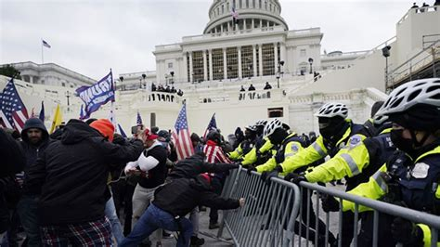
Introduction
Who,
When,
Where,
What type of device?

Slide 6
Introduction
Who,
When,
Where,
What type of device?
N. Fotos and J. Delgado, "Ensuring privacy in provenance information for images," 2023 24th International Conference on Digital Signal Processing (DSP)

Slide 7
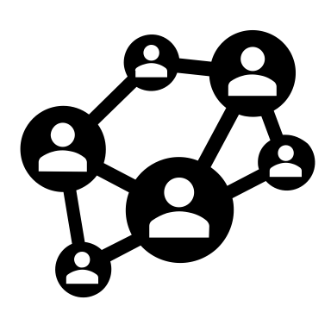
Introduction
Who,
When,
Where,
What type of device?
Crop
Filter
Transcode,
Convert image
N. Fotos and J. Delgado, "Ensuring privacy in provenance information for images," 2023 24th International Conference on Digital Signal Processing (DSP)

Slide 8
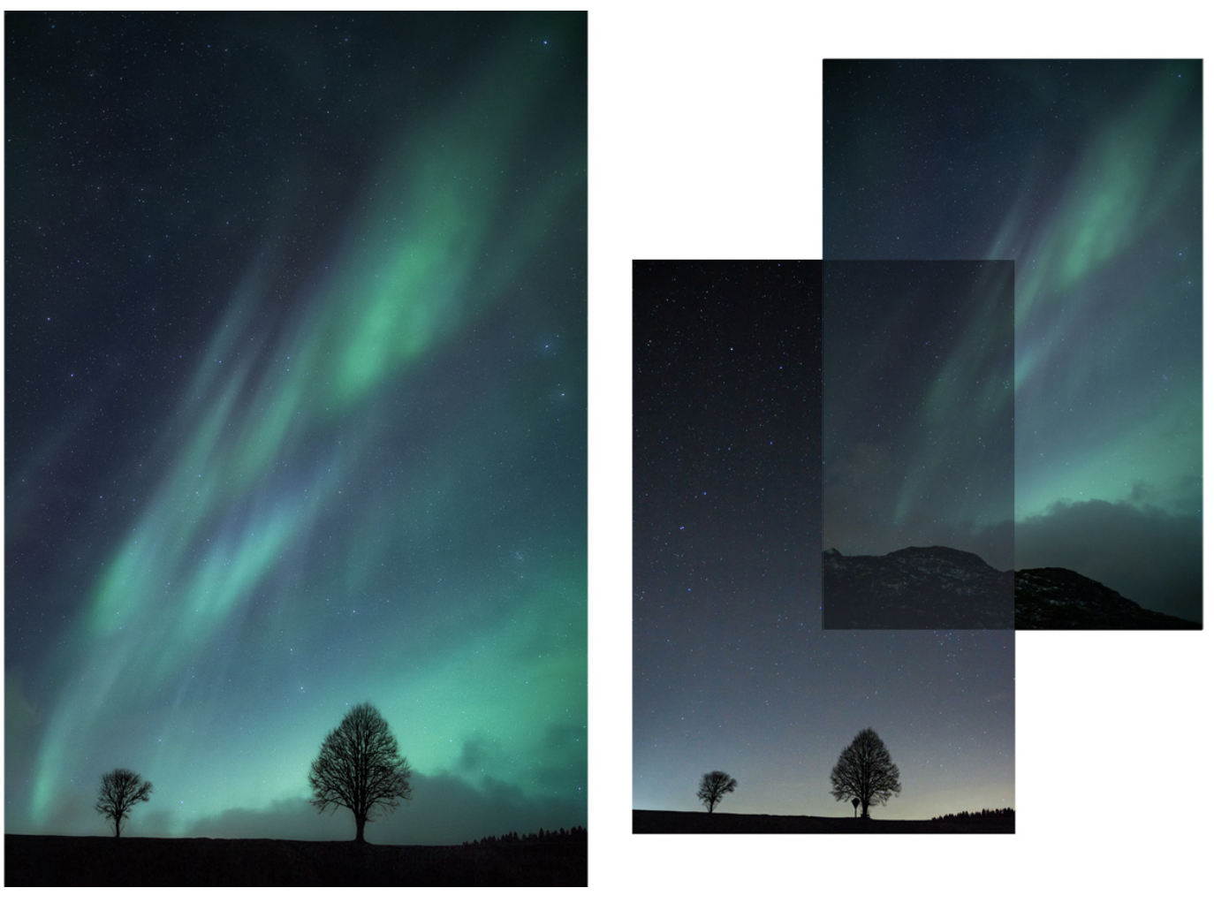
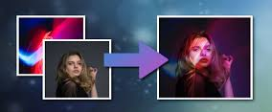
Introduction
Composite images?
Image overlay?

Slide 9
Provenance as a graph
Composite images?
Image overlay?
Composite
Image A
Source Image A
Source Image B

Slide 10
Contributions of this paper
Identify privacy-related use cases beyond the protection of a provenance event
Design a privacy framework, agnostic to provenance data models
Protection and access control enforcement to safeguard privacy in provenance graphs
Demonstrate the feasibility of the framework with the JPEG Trust data model

Slide 11
Use case 1: Protect then commit
First encrypt the sensitive provenance events (protect), then link the latest provenance events with them (commit)
Protect the processing steps between the origin and the final edition
Protection need to take place during the creation of the provenance event.

Slide 12
Use case 2: Commit then protect
First build the provenance graph (commit), then encrypt the sensitive provenance events (protect).
Authorized entities may reconstruct the entire provenance graph.
References may be invalid for unauthorized users

Slide 13
Use case 3: Conditional access
Access policies accompanying a protection operation
Different encryptions may have different access control policies

Slide 14
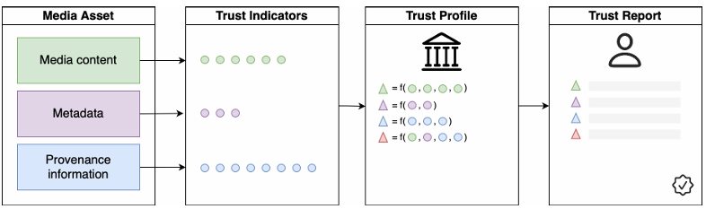
JPEG Trust Part 1: Core Foundation
Provides mechanisms to enable trustworthy evaluation of a media asset throughout its lifecycle.
Provides a data model and a serialization format

Slide 15
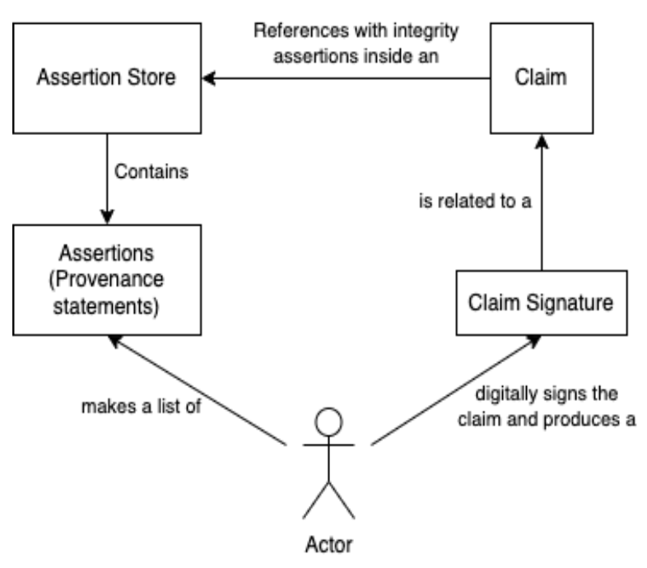
JPEG Trust Part 1: Core Foundation
Actor A wants to record a set of assertions
All data are recorded in a Claim.
Actor A digitally signs the Claim to prove authenticity.

Slide 16
Serializing JPEG Trust data
Use of JPEG Universal Metadata Box Format (JUMBF)
JUMBF supports the definition of application-specific boxes
JUMBF supports URI reference schema
Signal protection operations over JUMBF data through JPEG Privacy & Security
Trust Record
Trust Manifest
Assertion Store
Claim
Claim signature
…

Slide 17
Graph of manifests
JPEG Trust Record may contain multiple Manifests
JPEG Privacy and Security allows the expression of encrypted Manifests into “Protection” Boxes
Manifest A
Manifest B
Manifest D
Manifest C

Slide 18
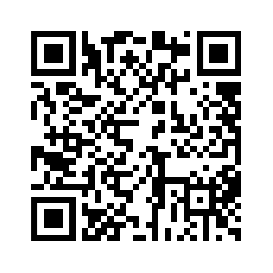
Implementation
Develop a JAVA library to process provenance data following to the JPEG Trust data model
Use JUMBF reference implementation to define all the JPEG Trust boxes (e.g., Record, Manifest)
Support encryption of Manifest boxes and enforcement of access policies
Showcase functionality through
a demo GUI application

Slide 19
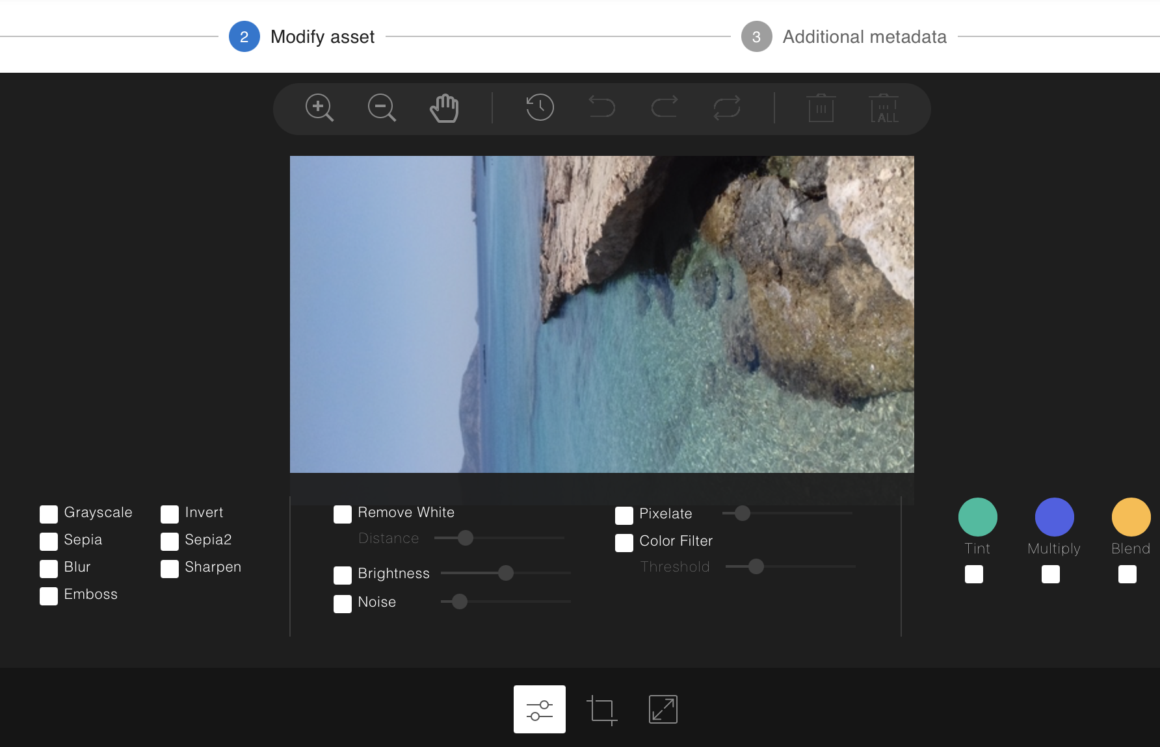
Demonstration: Creating Trust Records
Configure Provenance events through a wizard

Slide 20
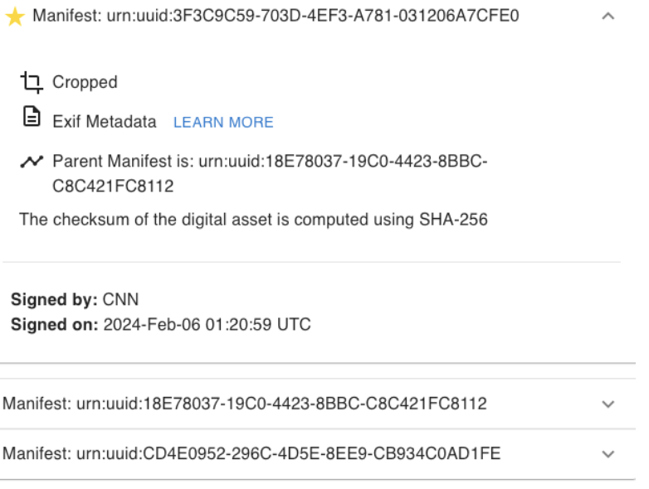
Demonstration: Accessing provenance data
Authorized user

Slide 21
Demonstration: Accessing provenance data
Authorized user
Link to previous manifest
Manifest A
Manifest B

Slide 22
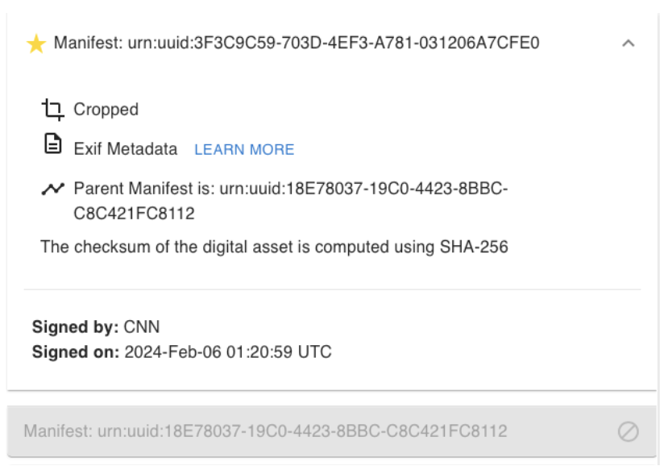
Demonstration: Accessing provenance data
Unauthorized user

Slide 23
Demonstration: Accessing provenance data
Unauthorized user
End-user has access to the latest provenance event
Rest of the provenance events are encrypted.
Inside the Trust Record the end-user sees:
The latest Manifest box
A Protection box
The access control policy, as an XML box

Slide 24
Conclusions
Identify privacy-related use cases beyond the protection of a provenance event
Design a privacy framework, agnostic to provenance data models
Protection and access control enforcement to safeguard privacy in provenance graphs
Demonstrate the feasibility of the framework with the JPEG Trust data model

Slide 25
Future steps
Contribute to the enhancement of privacy-related use cases in JPEG Trust standard
Reach to a fully compliant JPEG Trust software
Evaluate the overhead of the privacy features different provenance data models
Trade-off between privacy and trust
Anonymized signatures, ZK proofs

Slide 26
References
JPEG Trust – Part 1: Core Foundation
C2PA Technical Specification
JPEG Systems – Part 5: JPEG Universal Metadata Box Format
JPEG Systems – Part 4: Privacy and security
JPEG Systems - Part 10: Reference Software

Slide 27
Towards privacy-enhancing
provenance annotation for images
Nikolaos Fotos, Jaime Delgado
Universitat Politècnica de Catalunya (UPC) Barcelona (Spain)
http://dmag.ac.upc.edu
nikolaos.fotos@upc.edu
ICIP 2024
27-31 October 2024, Abu Dhabi – UAE

