Slide 1
Sub-band and Full-band Interactive U-Net with DPRNN
For Demixing Cross-talk Stereo Music
Han Yin¹, Mou Wang², Jisheng Bai^{1,3}, Dongyuan Shi³ ,
Woon-Seng Gan³, Jianfeng Chen¹
¹ School of Marine Science and Technology, Northwestern Polytechnical University, Xi’an, China
² Institute of Acoustics, Chinese Academy of Sciences, Beijing, China
³ School of Electrical & Electronic Engineering, Nanyang Technological University, Singapore

Slide 2
Outline
Background
Our Approaches
Experiment Details
Results & Discussions

Slide 3
Background: Neural Network-based Source Separation
Waveform-based [1], [2], [3]
Neural Network
waveform
Target waveform
Spectrogram-based [4], [5], [6]
Mask
iSTFT
STFT
Neural Network
Target waveform
or
waveform
iSTFT
Target waveform
[1] Stoller D, Ewert S, Dixon S. Wave-u-net: A multi-scale neural network for end-to-end audio source separation[J]. arXiv preprint arXiv:1806.03185, 2018. (Wave-U-Net)
[2] Luo Y, Mesgarani N. Conv-tasnet: Surpassing ideal time–frequency magnitude masking for speech separation[J]. IEEE/ACM transactions on audio, speech, and language processing, 2019, 27(8): 1256-1266. (Conv-TasNet)
[3] Défossez A, Usunier N, Bottou L, et al. Music source separation in the waveform domain[J]. arXiv preprint arXiv:1911.13254, 2019. (Demucs v2)
[4] Stöter F R, Uhlich S, Liutkus A, et al. Open-unmix-a reference implementation for music source separation[J]. Journal of Open Source Software, 2019, 4(41): 1667. (Open-Unmix)
[5] Kong Q, Cao Y, Liu H, et al. Decoupling magnitude and phase estimation with deep resunet for music source separation[J]. arXiv preprint arXiv:2109.05418, 2021. (ResUNet)
[6] Takahashi N, Mitsufuji Y. D3net: Densely connected multidilated densenet for music source separation[J]. arXiv preprint arXiv:2010.01733, 2020. (D3Net)
[7] Luo Y, Yu J. Music source separation with band-split RNN[J]. IEEE/ACM Transactions on Audio, Speech, and Language Processing, 2023. (Band-Split RNN)

Slide 4
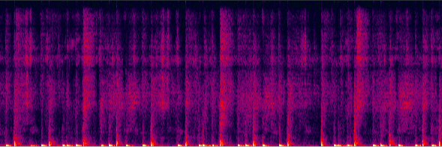
Background: characteristics about music
vocal
drum
bass
other

Slide 5
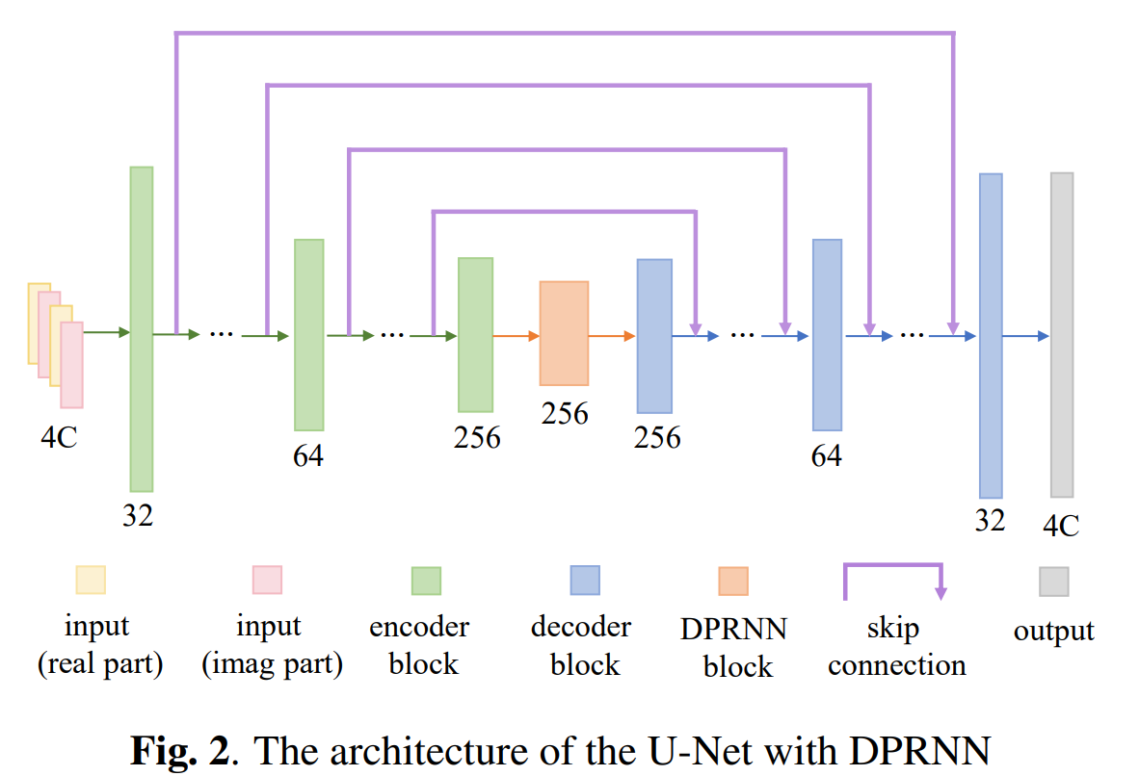
Our Approaches
1. Band Split Processing (Sub-bans & Full-band)
2. U-Net with DPRNN

Slide 6
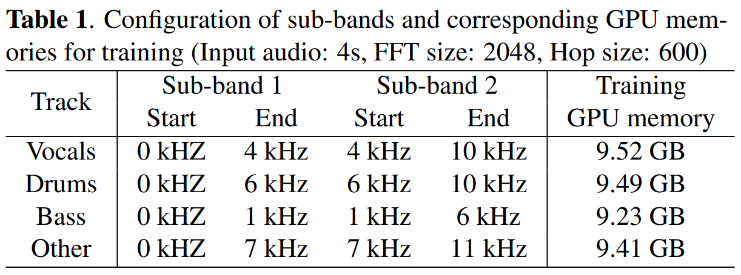
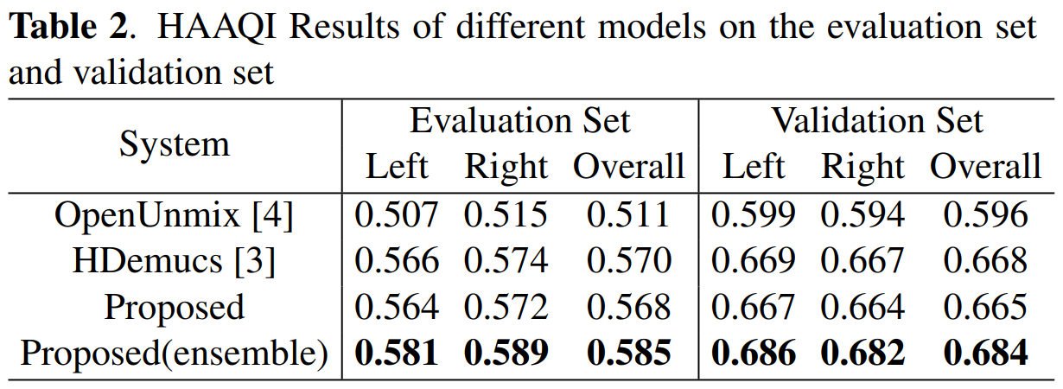
Results and Discussions
Demo: Triviul feat. The Fiend - Widow-hlp_0105.wav
Vocal:
HDemucs
Proposed
Proposed (ensemble)
Drum:
HDemucs
Proposed
Proposed (ensemble)

Slide 7
Thank you

