Slide 1
Detecting Check-Worthy Claims in Political Debates, Speeches, and Interviews Using Audio Data
Petar Ivanov,¹ Ivan Koychev,¹ Momchil Hardalov,^{2*} Preslav Nakov,³
¹Sofia University "St. Kliment Ohridski" ²AWS AI Labs ³Mohamed bin Zayed University of Artificial Intelligence
*Work done while Momchil Hardalov was at the Sofia University, prior to joining Amazon

Slide 2
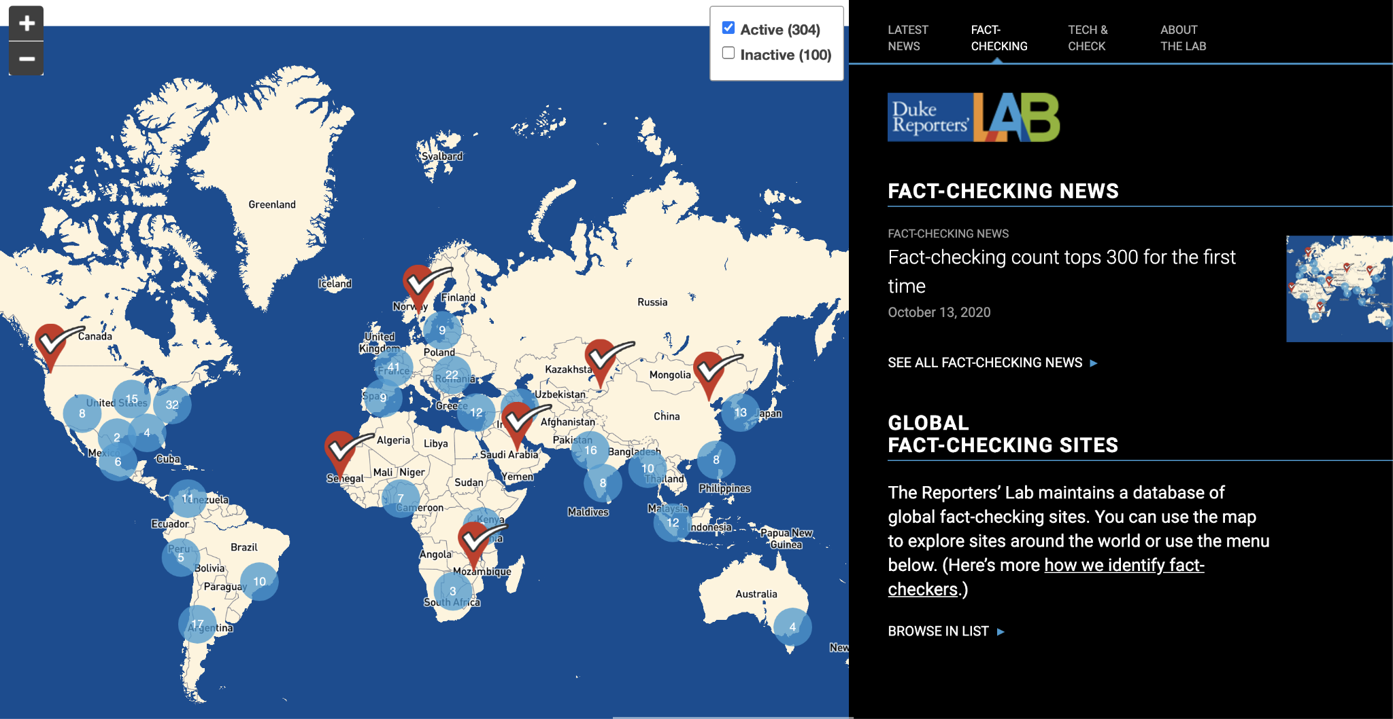
Motivation
The fact-checking landscape
https://reporterslab.org/fact-checking/

Slide 3
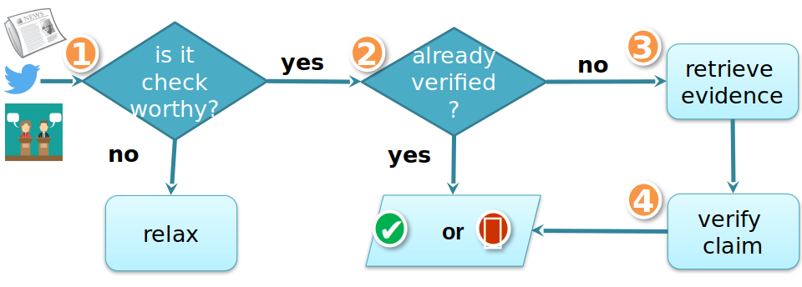
Motivation
The fact-checking flow

Slide 4
Motivation
Manual fact-checking is the most important and credible way to fight mis/disinformation. Yet, it is very tedious and time-consuming, and thus it is important to prioritize what to fact-check, i.e., to estimate the check-worthiness of the claims.

Slide 7
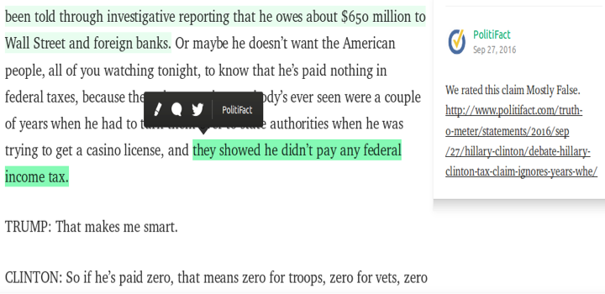
Motivation
US Presidential Debates 2016

Slide 8
Objective
Prioritize what to fact-check by ranking the sentences in political debates, speeches, and interviews according to their check-worthiness.

Slide 9
Objective
Line # | Speaker | Sentence | Check-worthy?
146 | Pence | But Hillary Clinton and Tim Kaine want to build on Obamacare. | No
147 | Pence | They want to expand it into a single-payer program. | Yes
842 | Kaine | The Clinton Foundation is one of the highest-rated charities in the world. | No
843 | Kaine | It provides AIDS drugs to about 11.5 million people. | Yes
Prioritize what to fact-check by ranking the sentences according to their check-worthiness.
Line # | Speaker | Sentence | Check-worthy?
843 | Kaine | It provides AIDS drugs to about 11.5 million people. | Yes
147 | Pence | They want to expand it into a single-payer program. | Yes
842 | Kaine | The Clinton Foundation is one of the highest-rated charities in the world. | No
146 | Pence | But Hillary Clinton and Tim Kaine want to build on Obamacare. | No

Slide 10
Objective
Line # | Speaker | Sentence | Check-worthy?
146 | Pence | But Hillary Clinton and Tim Kaine want to build on Obamacare. | No
147 | Pence | They want to expand it into a single-payer program. | Yes
842 | Kaine | The Clinton Foundation is one of the highest-rated charities in the world. | No
843 | Kaine | It provides AIDS drugs to about 11.5 million people. | Yes
Prioritize what to fact-check by ranking the sentences according to their check-worthiness.
Using audio data
Line # | Speaker | Sentence | Check-worthy?
843 | Kaine | It provides AIDS drugs to about 11.5 million people. | Yes
147 | Pence | They want to expand it into a single-payer program. | Yes
842 | Kaine | The Clinton Foundation is one of the highest-rated charities in the world. | No
146 | Pence | But Hillary Clinton and Tim Kaine want to build on Obamacare. | No

Slide 11
Motivation
Previous work on this problem has focused exclusively on
the text modality; here, we explore the utility of the audio
modality as an additional input.

Slide 12
Contributions
Dataset: multimodal dataset (text and audio) for detecting check-worthy claims.
A novel framework that combines the text and the speech modalities.
Evaluation and comparison of current state-of-the-art textual and audio models on our multimodal dataset.
Positive results
Multiple speakers: adding the audio modality yields sizable improvements over using the text modality alone.
Single speaker: an audio-only model could outperform a text-only one.

Slide 13
Dataset
Multimodal dataset (text and audio in English) containing 48 hours of speech in English, 34,489 sentences.
Sentence 1
Sentence 2
Sentence 3
Alignment to build sentence-level text and audio pairs

Slide 14
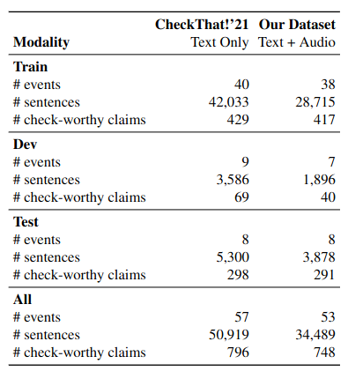
Dataset
Augmentation of the dataset for the 2021 CheckThat! lab, Task 1b. events = debates, speeches, interviews

Slide 15
Utterances Variants
Original audio: no additional processing.
Reduced noise: with brought down background noise.

Slide 16
Training Dataset Variants
As the check-worthy claims are around 2% of all sentences, we prepared several variants of the training set using oversampling and undersampling.
x15 - duplicating check-worthy 15 times
x30 - duplicating check-worthy 30 times
1:1 - removing non-check-worthy until ratio is 1:1

Slide 17
Single-Speaker Setup
We propose a single-speaker setup, leaving aside the speech specifics of the different speakers.

Slide 18
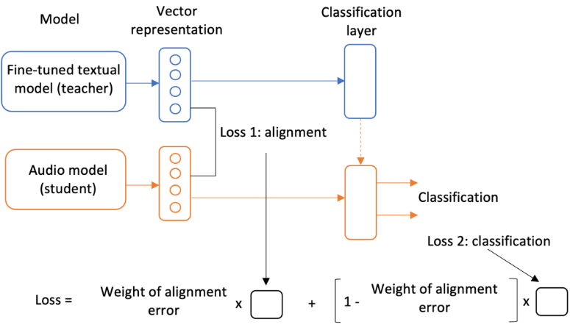
Knowledge Alignment from Text to Audio
We take a fine-tuned text model and train an audio model on two tasks:
Classification
Representing the audio input the same way the fine-tuned textual model represents its input (teacher-student mode).

Slide 19
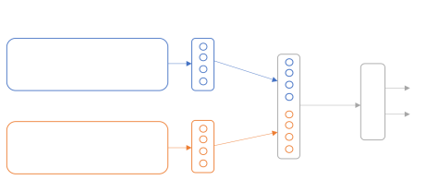
Ensembles
Comprising fine-tuned textual and audio models: early fusion
Vector representations
Model
Fusion
Classification
Fine-tuned textual
Fine-tuned audio

Slide 20
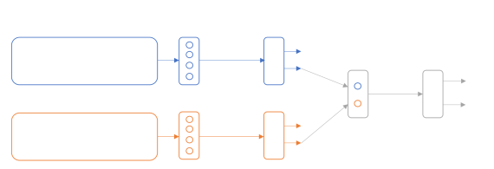
Ensembles
Comprising fine-tuned textual and audio models: late fusion
Vector representations
Model
Predictions
Fusion
Classification
Fine-tuned textual
Fine-tuned audio

Slide 21
Models
Text:
BERT-base uncased
SVM using TF.IDF
Feedforward network focusing on named entities
Audio (base variants):
HuBERT
wav2vec 2.0
data2vec-audio

Slide 22
Metric
We use Mean Average Precision (MAP)
D is the number of events
d is the current event
AveP(d) is the Average Precision for the current event
K is the number of sentences in the event
P(k) is the precision at rank k
δ(k) is 0 if the sentence at rank k is not check-worthy and 1 if it is
#checkworthy is the number of check-worthy sentences in the event

Slide 23
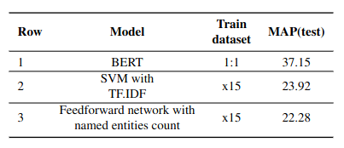
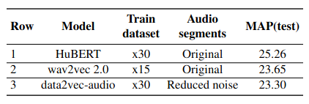
Results
Multiple speakers
Textual models
Audio models

Slide 24
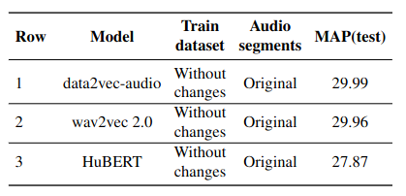
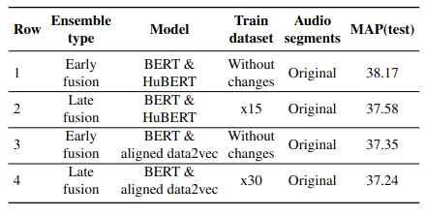
Results
Multiple speakers
Audio models with knowledge alignment
Ensembles

Slide 25
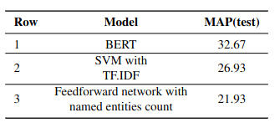
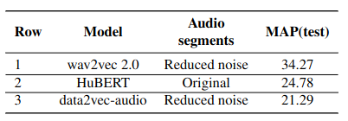
Results
Single speakers
Textual models
Audio models

Slide 26
Summary
combined text and audio for detecting check-worthy claims in political debates
built a new English multimodal dataset: 48h of speech, 34,489 sentences.
developed a novel multimodal framework using early and late fusion, and noise reduction
improving over SOTA text-only models by up to 2 points
Future Work
use learning-to-rank
encode longer contexts
address class imbalance
apply to related problems, e.g., models for deception detection

Slide 27
Code & Paper
GitHub repository: https://github.com/petar-iv/audio-checkworthiness-detection
Paper: https://ieeexplore.ieee.org/document/10447064

Slide 28
Acknowledgement
This work is partially funded by project UNITe BG05M2OP001-1.001-0004 by the OPSESG and by the EU - NextGenerationEU, through the National Recovery and Resilience Plan of the Republic of Bulgaria, project No BG-RRP-2.004-0008.

Slide 29
Thank you

