Slide 1
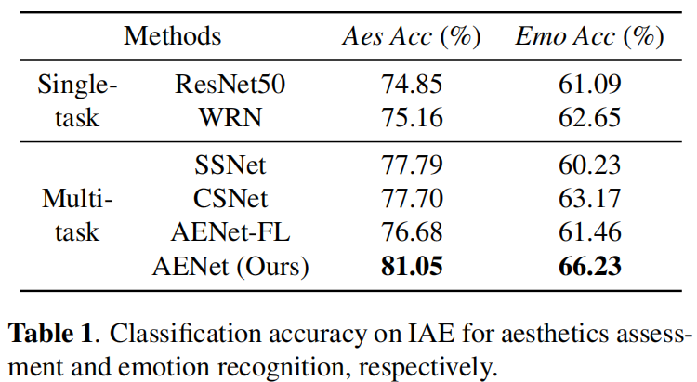
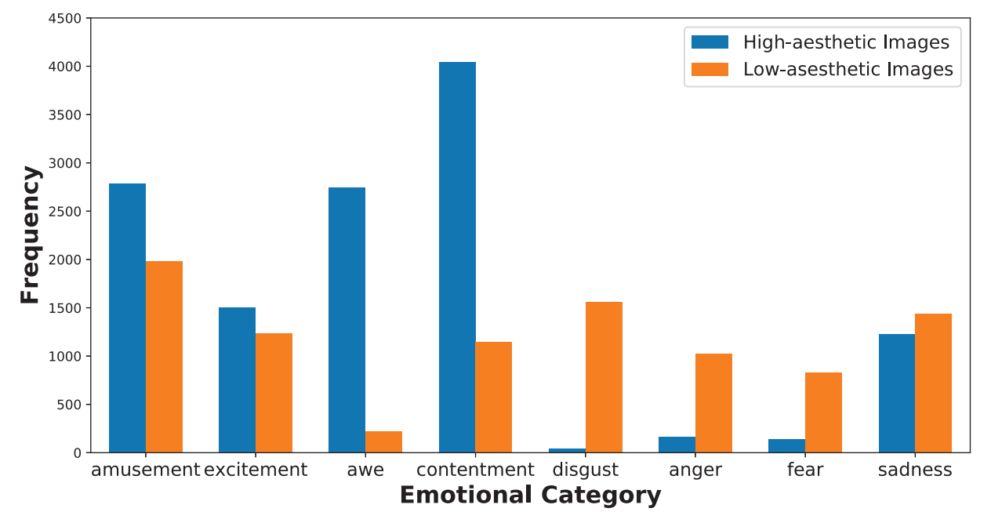
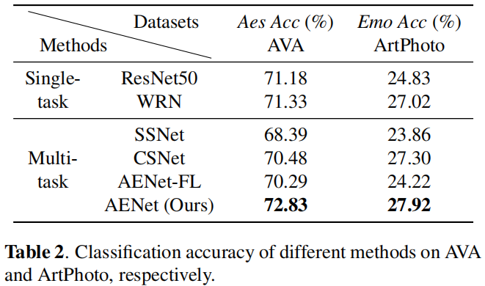
Towards Unified Aesthetics and Emotion Prediction in Images
Jun Yu¹, Chaoran Cui², Leilei Geng², Yuling Ma¹, Yilong Yin¹
¹ Shandong University, ² Shandong University of Finance and Economics
Introduction
AENet
We collect a large-scale set of images that are associated with both aesthetic and emotional labels (IAE).
We present a novel deep neural network architecture (AENet) for multi-task learning on aesthetics assessment and emotion recognition, and this network explicitly separates the features related to each single task and the features shared between tasks.
Overall Architecture
AENet is composed of three streams:
Aesthetic stream ($𝓐\text{−}\text{stream}$) extracts the information that is unique to the task of aesthetics assessment.
Emotional stream ($𝓔\text{−}\text{stream}$) extracts the emotion-related information for emotion recognition.
Shared stream ($𝓢\text{−}\text{stream}$) extracts the features that are shared across aesthetics assessment and emotion recognition.
Experimental Results
IAE dataset
IAE is a large-scale dataset containing 22,086 images divided into eight emotion categories and two aesthetic categories. This new dataset can be downloaded from this link: https://github.com/junfish/IEA-dataset.
Fusion Layer
Fusion layer is designed to combine the knowledge of $𝓢\text{−}\text{stream}$ and that of $𝓐\text{−}\text{stream}$ or $𝓔\text{−}\text{stream}$.

