Slide 1
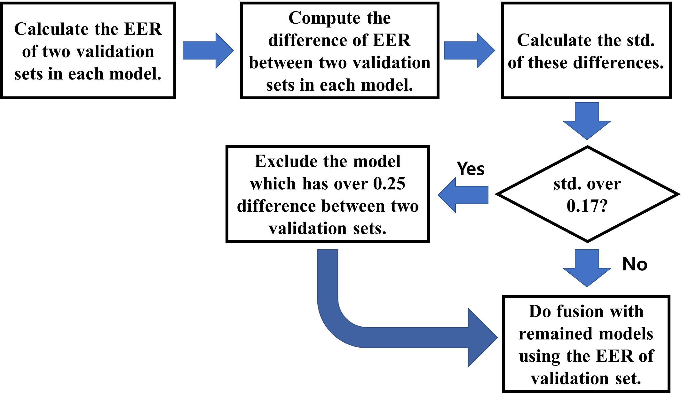
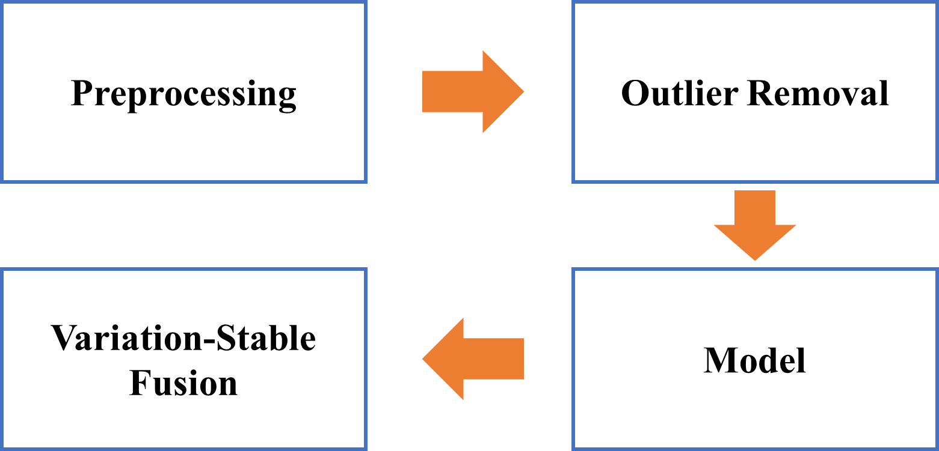
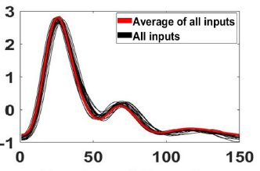
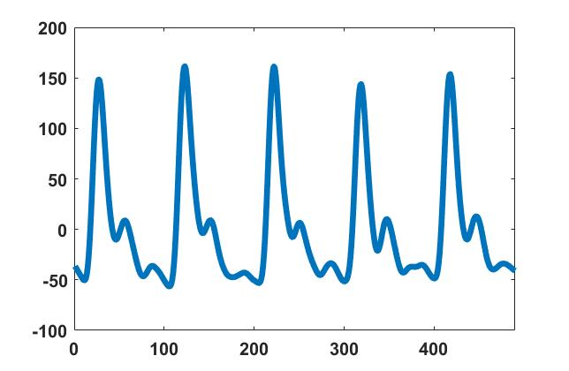
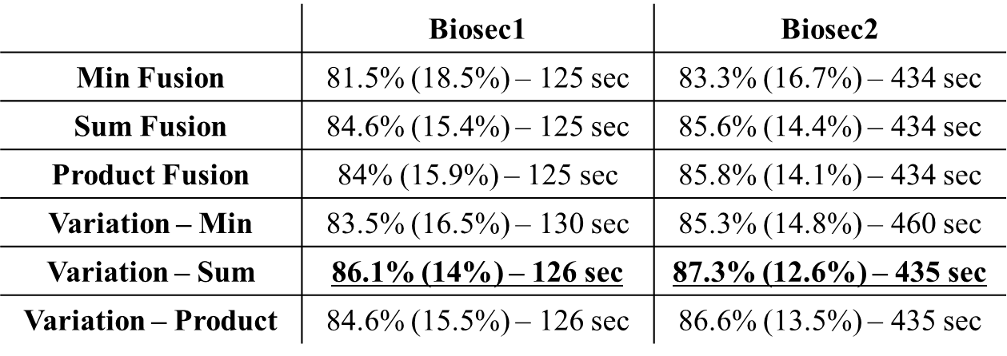
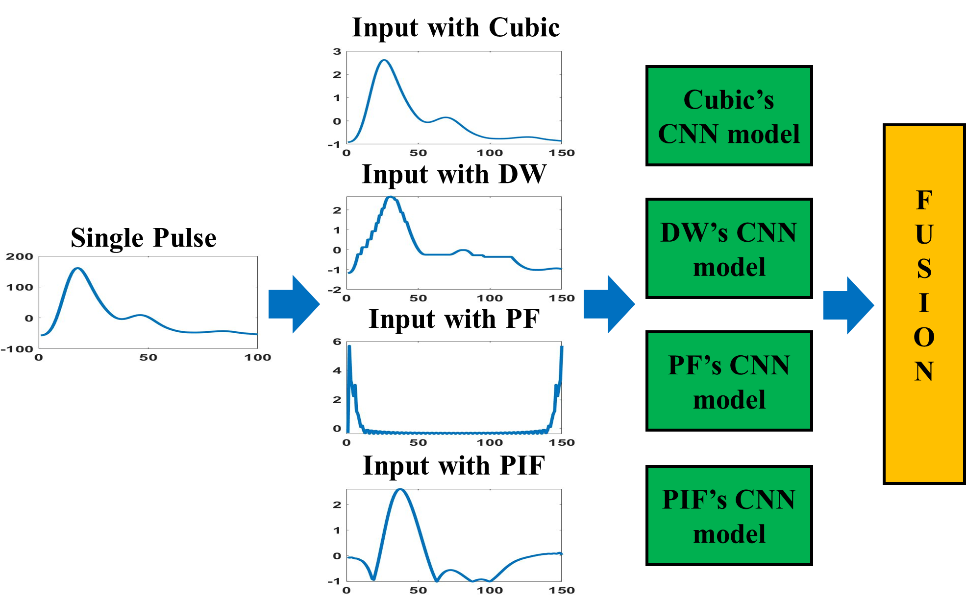
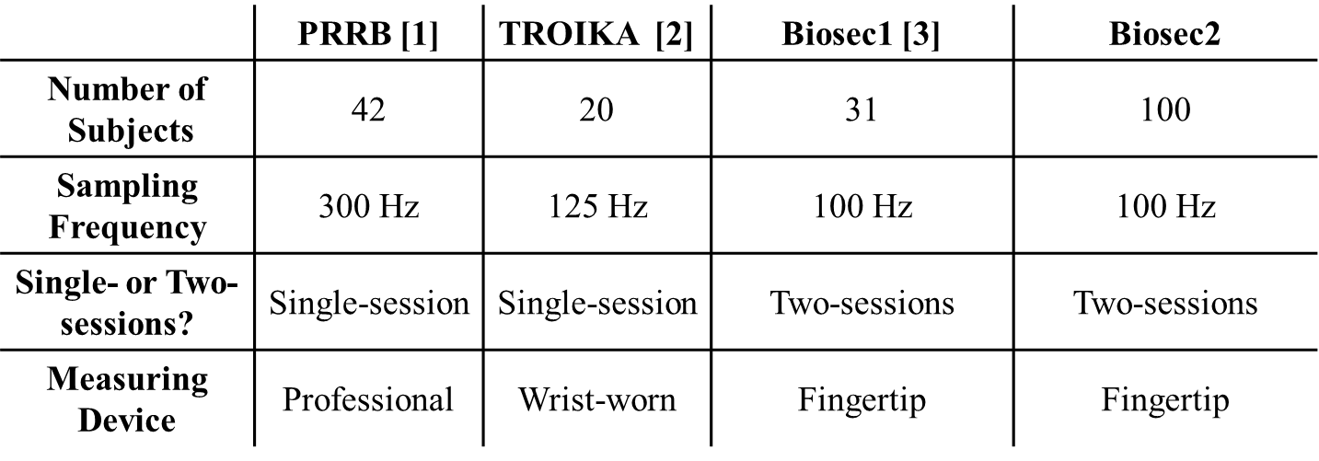
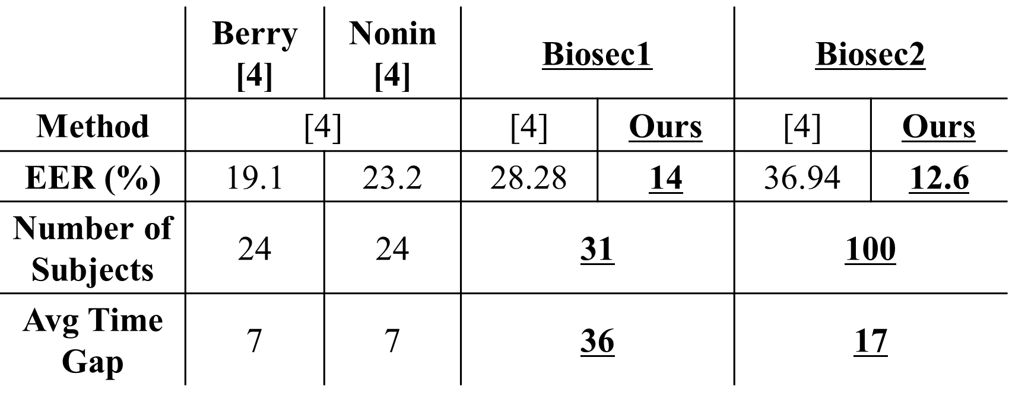
Paper ID: 2918
Variation-Stable Fusion for PPG-based Biometric System
Dae Yon Hwang, Bilal Taha, Dimitrios Hatzinakos
Access to Code: github.com/eoduself/Code-for-VARIATION-STABLE-FUSION-FOR-PPG-BASED-BIOMETRIC-SYSTEM-ICASSP2021-
Access to Collected PPG database: Email to daeyon.hwang@mail.utoronto.ca
Introduction
Algorithms
We considered three well-known score fusions which are min, sum and product fusion. Variation-stable fusion is useful because it can be extended to any other score fusion methods. From Table 2, it is obvious that variation-stable approach always improves the performance, especially when combined with min fusion. Thus, by integrating the variation-stable fusion method into the system, the performance is boosted while ensuring the robustness of the system across different time instances. Also, we can see that variation-stable approach does not require substantial extra training time. Table 3 shows the two-sessions’ performances with our proposed system and other approaches. We considered their approaches and compared to ours, we got low performances which are 28.28% and 36.94% avg EER in Biosec1 and Biosec2. Thus, our proposed system outperforms other state-of-art works with more subjects and longer time gap, meaning our system has a high potentiality to be applied in real world.
Nowadays, the significant increase of the number of devices and platforms connected to the Internet enables the users to transfer data easily. This results in the security threats from cyber-attacks and raises several privacy issues. Biometric systems, including the PPG signal, can be employed as a confirmation to the individual’s identity because of better accessibility and uniqueness. However, the major challenge with PPG is to ensure time stability because it can be easily changed by usual activities. To solve this issue, we propose a variation-stable fusion to boost the performance and robustness of system. The great advantage of this fusion is it can be extended to other biometrics and other areas.
Figure 2. Flow of Algorithm
Figure 6. The process of variation-stable approach
Figure 3. Preprocessing Steps
We propose the developed variation-stable fusion method. When we consider each input independently, each verification system gives a limited performance. This is because of different preference of inputs in each subject. Even if conventional fusions are useful, we want to improve more. After investigation, we found that there are some CNN models which have significant change of EER between close and far validation set. These models usually provide low performance and thus, it would be better to exclude those models before doing fusion. Variation-stable fusion helps to distinguish these models.
What is PPG?
The PPG signal is a method to detect the change in blood volume from heart activity. It possesses universality and uniqueness which are important to build the secure user verification system. Moreover, the PPG can be collected from low-cost sensor with good accessibility. For example, Apple watch and Fitband use the PPG to show the number of heartbeat and manage stress.
Conclusions
Figure 4. Outlier Removal
This work focuses on a variation-stable fusion to improve the robustness and accuracy in PPG verification system. This fusion can be easily extended to other areas and other conventional fusion approaches. Our developed system attains eminent results which outperform other state-of-art works. This demonstrates its potentiality to be used in real world application.
Outlier removal is applied to save computational time and find the most representative data in each subject. To do so, we generate the average shape of the input signals and compare it with each signal individually using the Euclidean distance. After finishing the outlier removal, we have three different types of data: 1) Train / Test set, 2) Close validation set, 3) Far validation set.
Results
Table 2. Performances in Two-sessions. Denoted as follows: Accuracy (EER) – training time
Bibliography
Walter Karlen, S. Raman, J. M. Ansermino, and G. A. Dumont, “Multiparameter respiratory rate estimation from the photoplethysmogram,” IEEE Transactions on Biomedical Engineering, vol. 60, no. 7, pp. 1946–1953, July 2013.
Z. Zhang, Z. Pi, and B. Liu, “Troika: A general framework for heart rate monitoring using wrist-type photoplethysmographic signals during intensive physical exercise,” IEEE Transactions on Biomedical Engineering, vol. 62, no. 2, pp. 522–531, Feb 2015.
U. Yadav, S. N. Abbas, and D. Hatzinakos, “Evaluation of ppg biometrics for authentication in different states,” in 2018 International Conference on Biometrics (ICB), Feb 2018, pp. 277–282.
Jorge Sancho, A´ lvaro Alesanco, and Jose´ Garc´ıa, “Biometric authentication using the PPG: A long-term feasibility study,” Sensors, vol. 18, no. 5, pp. 1525, May 2018.
Figure 1. Sample PPG signal
Table 1. Databases
Table 3. Comparison between ours and others
Figure 5. The procedure of fusion method. Starting from single pulse, each input is used to train CNN independently and we do score fusion

