Slide 1
AVERAGE PERFORMANCE OF ADAPTIVE STREAMING
Yuriy Reznik Brightcove, Inc.
Data Compression Conference
March 2021

Slide 2
Outline
Introduction
Modern era of streaming
Key challenges
Related work
Average performance of streaming
Understanding of main effects
Models (codec, content, client, appearance/quality)
Formulae for average performance of streaming system
Related optimization problems
Simulation results
Conclusions

Slide 3
Modern Era of Streaming
Key characteristics
Videos are delivered to multiple devices:
PCs / Laptops
Mobiles
Tablets
Connected TVs, etc.
Videos can be embedded in web-pages or projected full screen
Delivery is done by HTTP-based adaptive streaming protocols such as HLS or DASH
Stream adaptation logic resides in clients and can be influenced by multiple factors:
network performance (observed bandwidth)
player window size
device decode capabilities, etc.

Slide 4
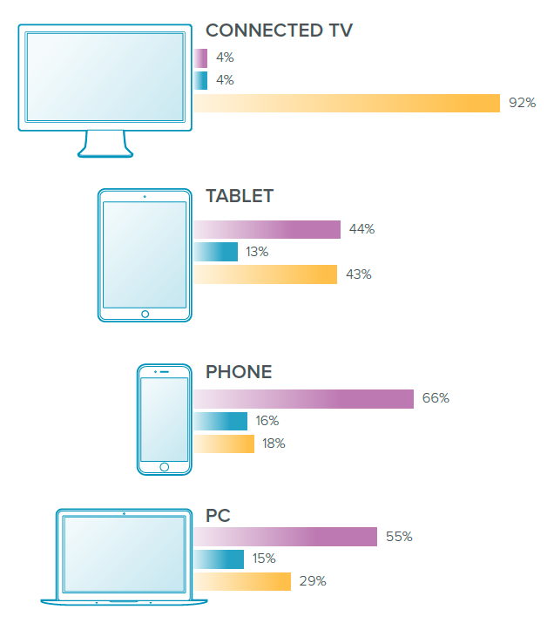
ABR Streaming System
Assumed architecture
Video encoded in HLS and/or DASH streams
Encoding profiles are custom generated for each input video & delivery context
Same streams can be pulled by different devices
Caching and delivery is managed by CDN
CDN
Origin server
Stream 1
360p, 600k
Contribution link
Mezzanine
Encoder
Stream 2
480p, 1200k
…
ABR encoding ladder generator
Stream n
1080p, 4200k
Analytics system

Slide 5
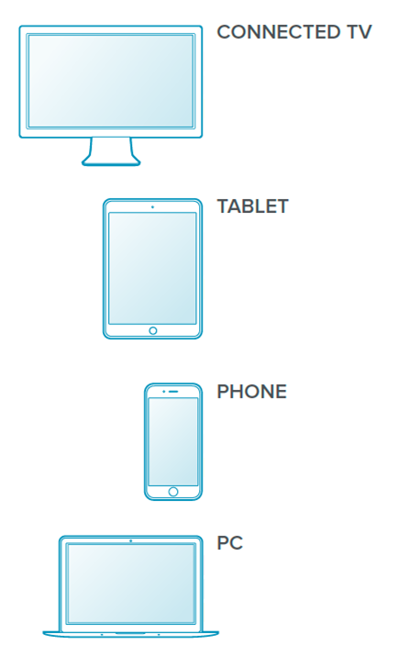
Challenges
Diversity of device capabilities and parameters
Different device capabilities: codecs, DRMs and formats support
Different device form factors, user positions & viewing preferences
Different networks connecting devices
Additional effects
Perception of video on different devices is different
Different devices may pull different subsets of streams
Distribution of content usage across different devices may be different
Key questions:
How to model differences in perceived quality on different devices?
How to model components of this system (networks, clients, etc.)?
How to characterize performance of the entire system?
How to optimize it?
?
?
?
?
?

Slide 6
Related work
Reviews of early results
D. Wu, et al, “Streaming video over the internet: approaches and directions,” IEEE Trans. CSVT, 11 (3), 2001
G. J. Conklin, et al, “Video coding for streaming media delivery on the internet,” IEEE Trans. CSVT, 11 (3), 2001
B. Girod, et al, “Advances in channel-adaptive video streaming,” Wireless Comm. and Mobile Comp., 2 (6), 2002
ABR selection algorithms
C. Zhou, et al, "A control-theoretic approach to rate adaptation for dynamic HTTP streaming," in Proc. VICIP, Aug. 2012
S. Hesse, “Design of scheduling and rate-adaptation algorithms for adaptive HTTP streaming,” Proc. SPIE 8856, 2013
K. Spiteri, et al, “BOLA: Near-Optimal Bitrate Adaptation for Online Videos,” IEEE/ACM Trans. Netw. 28 (4), 2020
ABR ladder optimization techniques
A. Aaron, et al, “Per-Title Encode Optimization,” Netflix tech blog, Dec. 2015
Y. Reznik, et al, "Optimal design of encoding profiles for ABR streaming," Proc. Packet Video Workshop, June 2018
C. Chen, et al, “Optimized Transcoding for Large Scale Adaptive Streaming Using Playback Statistics,” Proc. ICIP, Oct. 2018
Y. Reznik, et al, "Optimal Design of Multi-codec Profiles for ABR Streaming," Proc. ICME, Shanghai, July 2019
Y. Reznik, et al, "Optimizing Mass-Scale Multiscreen Video Delivery," SMPTE Motion Imaging Journal, Apr. 2020
Y. Reznik, et al, "Perceptually optimized ABR ladder generation for Web streaming," Electronic Imaging, Jan. 2021

Slide 7
Perceived Video Quality on Different Devices

Slide 8
Angular Metrics
Video reproduction chain Main parameters involved
Encoded video:
Scaled:
Displayed:
Perceived:
Relevant for human perception
viewing angle $φ$ ➔ angular span of video frame, as visible on screen
angular resolution $u$ ➔ inverse of angular span of 2 pixels (length of smallest "cycle") in encoded video
$$H$$
Parameters | Meaning | Unit
$W, H$ | encoded video width, height | pixels
$W_{p}, H_{p}$ | display/player width, height | pixels
$d$ | viewing distance | inches
$ρ$ | display pixel density | dots per inch
$φ=2\arctan\left(\frac{ W_{p} }{2dρ}\right)$ | viewing angle | degrees
$φ_{c}=2\arctan\left(\frac{W_{p}/W}{dρ}\right)$ | angle to 2 pixels (1 cycle) | degrees
$u=\frac{1}{φ_{c}}$ | angular resolution of video | cycles per degree (cpd)
$$W$$
$$H_{p}$$
$$W_{p}$$
$$φ$$
$$d$$
Note: Another way to describe angular resolution is to say that it is a Nyquist frequency of video, expressed in angular units, reflecting projection the screen.

Slide 9
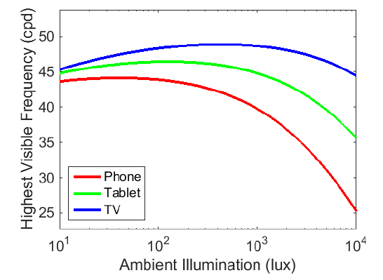
Differences in Viewing Setups
Viewing setup parameters
Angular metrics
Observations
Viewing angles and angular resolutions are very different on different devices!
With high-resolution content and small form-factor devices, angular resolutions may exceed maximum resolutions visible by human eye!
$$L_{displ}$$
Device | Viewing distance | Display size | Brightness | Ambient | Background
TV | 2-6H, med=3H | 32-80", med=50" | 400 nits | 50-200 lux | 10-30% reflective
PC / laptop | 12-30", med=24" | 13-36", med=20" | 200 nits | 100-500 lux | Varies
Tablet | 10-22", med=18" | 7-12", med=9" | 200-400 nits | 50-500 lux | Varies
Phone | 7.5-22", med=14" | 4-6", med=5.5" | 100-300 nits | 10-10000 lux | Varies
$$H_{p}$$
$$I_{amb}$$
$$W_{p}$$
$$d$$
$$φ$$
Device | Viewing angle | Angular resolutions when rendering video full screen |  |  |  |  | Max. visible resolution*
 |  | 360p | 540p | 720p | 1080p | 4k
TV | 33.0 degrees | 9.4 cpd | 14.3 cpd | 18.9 cpd | 28.3 cpd | 56.5 cpd | 48.3 cpd
PC/Laptop | 40+ degrees | 7.7 cpd | 11.5 cpd | 15.4 cpd | 23.1 cpd | 46.1 cpd | 46.2 cpd
Tablet | 24.6 degrees | 12.8 cpd | 19.2 cpd | 25.6 cpd | 38.4 cpd | 76.9 cpd | 46.2 cpd
Phone | 18.2 degrees | 17.9 cpd | 26.9 cpd | 35.9 cpd | 53.8 cpd | 107.6 cpd | 44.1 cpd
(*) L. Kerofsky, R. Vanam and Y. Reznik, "Adapting Objective Video Quality Metrics to Ambient Lighting," QOMEX 2015.

Slide 10
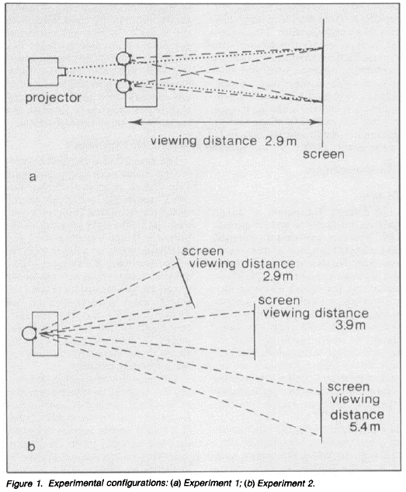
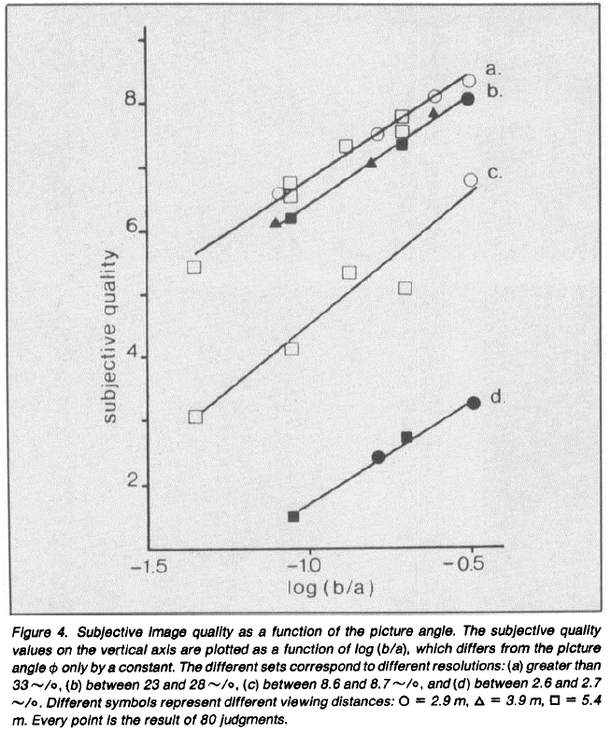
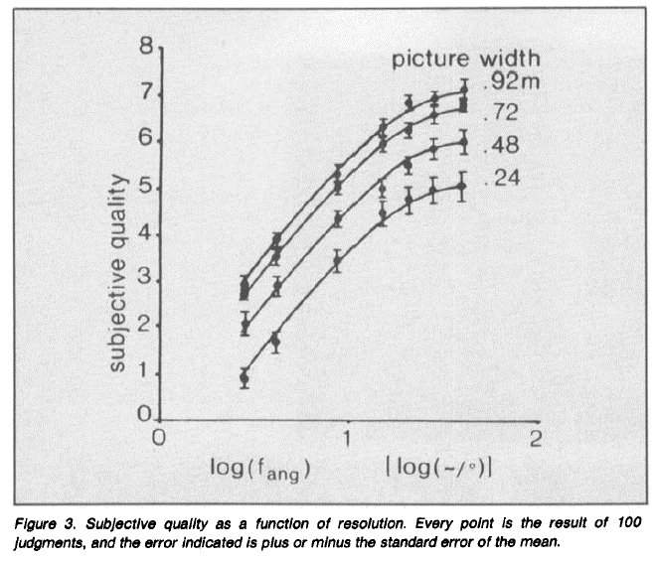
Perceived Quality
Westerink & Roufs experiments (1989)*
Controlled environment, 20 subjects, 5 images, 0-10 categorical scale
Varied: viewing distance, resolution, and picture size
Observed phenomena:
Perceived quality grows approximately as logarithm of viewing angle ($φ$)
Perceived quality also grows with angular resolution ($u$), but saturates at around 25-40 cycles/degree
Model describing these effects*
$Q_{WR}\left(φ,u\right)=3.6\log\left(φ\right)+2.9+4.6\log\left(u\right)+2.7\log{{\left(u\right)}^{2}}−1.7{\log\left(u\right)}^{3}$
(*) J. Westerink and J. Roufs, "Subjective image quality as a function of viewing distance resolution and picture size," SMPTE Journal, vol. 98, 1989, pp. 113-19.
(**) P. G. J. Barten, "Effect of picture size and definition on perceived image quality," IEEE Trans. Electron. Devices, vol. 36, no. 9, pp. 1865-1869, Sept. 1989.

Slide 11
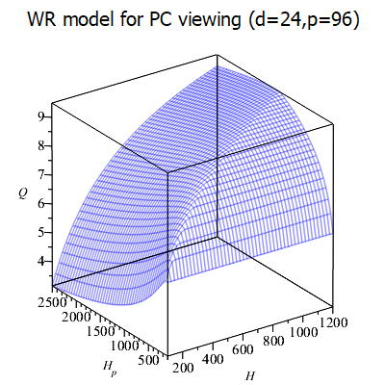
Scaling and Perceived Quality
Westerink-Roufs model
$$Q_{WR}\left(H, H_{p}\right)=Q_{WR}\left({2\arctan\left(\frac{ H_{p}⋅DAR}{2dρ}\right),\left(2\arctan\left(\frac{H_{p}}{\min\left(H,H_{p}\right)dρ}\right)\right)}^{−1} \right)$$
$H$ – video height, $H_{p}$ – player height, $DAR=W_{p}/H_{p}$
$d$ – viewing distance, $ρ$ – pixel density, $Q_{WR}\left(φ,u\right)$ – original WR model
Effects of scaling:
1:1 rendering on PCs is near-optimal
Slight upscaling improves quality. Especially for low-res videos
Downscaling limits quality
Large factor upscaling makes quality worse

Slide 12
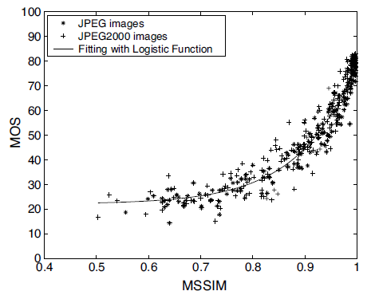
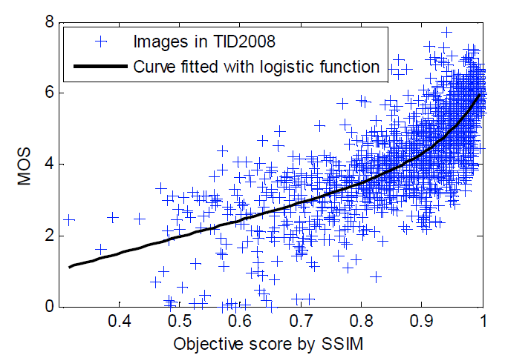
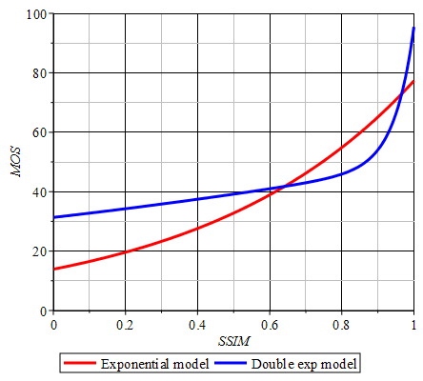
Codec Noise and Perceived Quality
For SSIM* metric this relationship is well studied
Common SSIM to MOS mapping functions
(*) Z. Wang, A. Bovik, H. Sheikh, E. Simoncelli, "Image quality assessment: from error visibility to structural similarity". IEEE Transactions on Image Processing 13 (4) (2004).
L. Zhang, L. Zhang, X. Mou, D. Zhang, "FSIM: a feature similarity index for image quality assessment", IEEE Trans Image Process. 20 (8) (2011)
U. Engelke, M. Kusuma, H-J. Zepernick, M. Caldera, "Reduced-reference metric design for objective perceptual quality assessment in wireless imaging". Signal Processing - Image Communication, 24 (7) (2009).

Slide 13
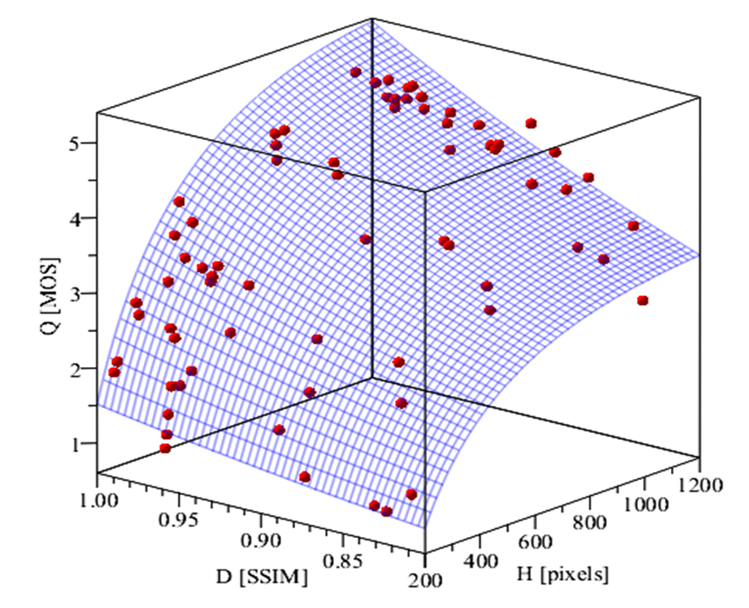
Parametric Quality Model
Simple combined model
$$Q_{Σ}\left(H,H_{p},D\right)=α\left(β+ Q_{WR}\left(H,H_{p}\right)\right)e^{γD}$$
$H$ – encoded video height, $H_{p}$ – player height [pixels]
$D$ – codec noise [SSIM], measured at encoded video resolution
$Q_{WR}\left(H,H_{p}\right)$– Westerink-Roufs model, assuming $d, ρ$ as specific to the device
$α, β, γ$ – calibration parameters
Accuracy w.r.t. Netflix dataset*
Using parameters: $α=\text{0}\text{.}\text{1075}$, $β=−4.859$, $γ=\text{2}\text{.}\text{424467}$
Also assuming $φ=33 \left[°\right]$ to match MOS test conditions used in this set
The resulting RMSE ~ 0.329 on 1-5 MOS scale.
Why such model is needed?
To predict quality when video is played by different devices or players with different window sizes
Same video on different devices / players sizes will look different!
There is no such thing as single ”universal” quality value!
Model vs MOS scores in Netflix dataset*
(*) Z. Li, A. Aaron, et al., Toward A Practical Perceptual Video Quality Metric, June 2016. https://netflixtechblog.com/toward-a-practical-perceptual-video-quality-metric-653f208b9652

Slide 14
Compression Performance

Slide 15
Distortion-Rate Model
"Empirical" SSIM-rate model
$$D\left(H,R\right)={\left(1+{\left(\frac{R}{αH^{β}}\right)}^{−γ} \right)}^{−\frac{1}{ γ}}$$
H – resolution at which video is encoded
R – bitrate at which video is encoded
$α, β, γ$ – model parameters
Fitting process
Run several "probe" encodings, covering typical / expected operating range: $\left(H_{i},R_{i}\right)∈\left[H_{min} ,H_{max} \right]×\left[R_{min} ,R_{max} \right]$,
Compute SSIM values at all points
Find parameters $α, β, γ$ providing best fit
Example applications
x264 encoder used with CRF=16,...,36
Main profile, Level 4, 2sec GOPs
Resolutions: H=[270,360,432,…,1080]
3 sequences
Models for 3 video sequences
Sequence | $$α$$ | $$β$$ | $$γ$$ | $$\text{RMSE}$$
"Easy" | $$\text{0}\text{.}\text{7844}\text{e}\text{−}\text{3}$$ | $$\text{1}\text{.}\text{2281}$$ | $$\text{0}\text{.}\text{7463}$$ | $$\text{0}\text{.}\text{3404}\text{e}\text{−}\text{2}$$
"Medium" | $$\text{0}\text{.}\text{8278}\text{e}\text{−}\text{2}$$ | $$\text{1}\text{.}\text{3217}$$ | $$\text{0}\text{.}\text{9593}$$ | $$\text{0}\text{.}\text{2792}\text{e}\text{−}\text{2}$$
"Complex" | $$\text{0}\text{.}\text{07316}$$ | $$\text{1}\text{.}\text{0957}$$ | $$\text{1}\text{.}\text{0336}$$ | $$\text{0}\text{.}\text{1153}\text{e}\text{−}\text{2}$$

Slide 16
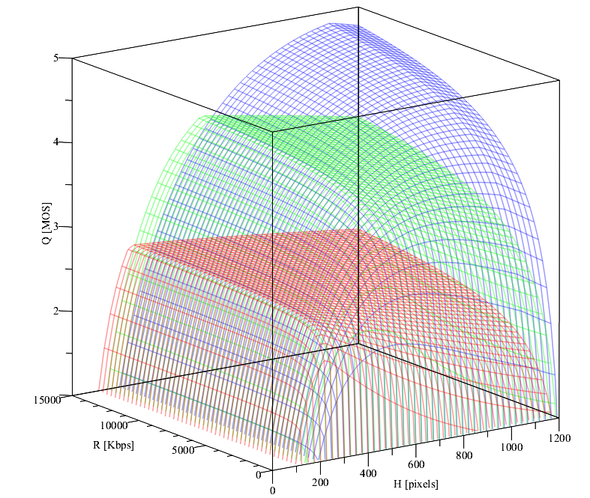
Quality-Rate Model
Translation in quality domain
$$Q\left(H,H_{p},R\right)=Q_{Σ}\left(H,H_{p},D(H,R)\right)$$
Example: "Complex" sequence, x264, PC screen:
Dimensions
$Q$ – predicted quality [MOS]
$R$ – bitrate at which video is encoded
$H$ – resolution at which video is encoded
$H_{p}$ – resolution at which video is displayed
$d,ρ$ – device-specific parameters
Notes
This model is specific for a given:
content, codec, and
parameters of user device
With different player sizes we see that shapes of $Q(H,R)$ surfaces are changing significantly
there is no "tight nesting" of them
All parameters in this model are important!
1080p player
540p player
270p player

Slide 17
Behavior of Streaming Clients

Slide 18
Example Playback Statistics
US Open event, June 13, 2019
Observations
Player sizes apparently impact selection of the streams! This happens not only with web players, but also with mobile apps.
Bandwidth-adaptation is no longer the only dimension of the problem!
Encoding ladder used
Stream | Profile | Resolution | Framerate | Bitrate
1 | Baseline | 480x270 | 23.976 | 450k
2 | Baseline | 640x360 | 23.976 | 800k
3 | Main | 768x432 | 23.976 | 1000k
4 | Main | 1024x576 | 23.976 | 1500k
5 | Main | 1280x720 | 23.976 | 2100k
Usage of top bitrate rendition does not increase even when bandwidth is no longer a limit !!!

Slide 19
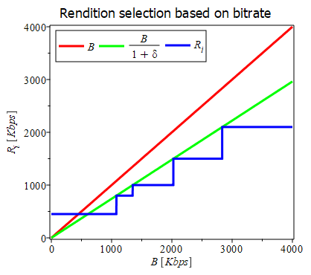
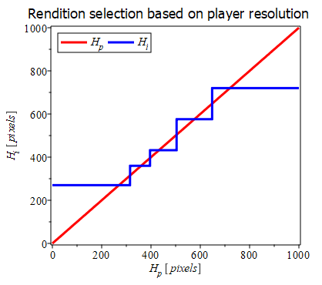
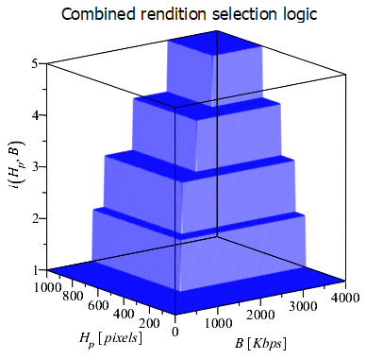
Building a Client Model
Adaptation to bandwidth
$$i_{B}\left(B\right)=\left[\begin{matrix}1 & \text{if} & B<T_{1}^{B} \\ i & \text{if} & T_{i}^{B}≤B<T_{i+1}^{B}, i\text{=}2,..,n\text{−}2, \\ n & \text{if} & B≥T_{n−1}^{B} \end{matrix}\right.$$
where:
$B$ – network bandwidth
$i_{B}$ – index of selected rendition
$R_{1}<…<R_{n}$ – ladder bitrates
$T_{i}^{B}={(1+δ)R}_{i+1}$ – thresholds
$δ≥0$ – client-specific constant
Adaptation to player size
$$i_{H}\left(H_{p}\right)=\left[\begin{matrix}1 & \text{if} & H_{p}<T_{1}^{H} \\ i & \text{if} & T_{i}^{H}≤H_{p}<T_{i+1}^{H}, i\text{=}2,..,n\text{−}2, \\ n & \text{if} & H_{p}≥T_{n−1}^{H} \end{matrix}\right.$$
where:
$H_{p}$ – player height
$i_{H}$ – index of selected rendition
$H_{1}<…<H_{n}$ – ladder resolutions
$T_{i}^{H}={αH_{i}+(1−α)H}_{i+1}$ – thresholds
$α∈[0,1]$ – client-specific constant
Combined model
$i\left(B,H_{p}\right)=\min\left\{i_{B}\left(B\right),i_{H}\left(H_{p}\right)\right\}$
where:
$i_{B}$ – selection based on bitrate
$i_{H}$ – selection based on player size
assumed order:
$R_{1}<…<R_{n}$ and $H_{1}<…<H_{n}$

Slide 20
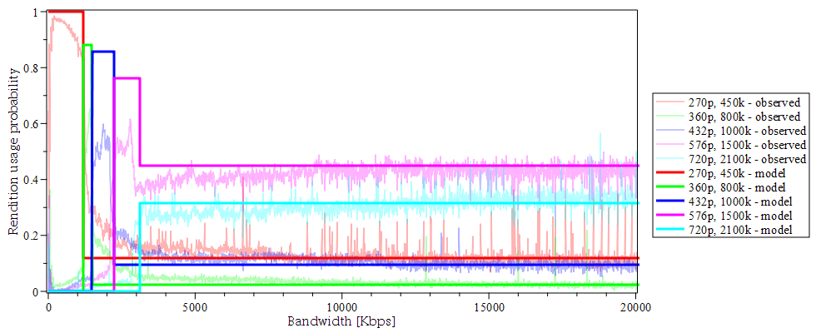
Client Model vs Real World
Usage probability of i-th rendition
$$p\left(i | B\right)=\sum_{H_{p}:i\left(B,H_{p}\right)=i}{p\left(H_{p}\right)}$$
Model-computed vs reported data
Best fit achieved with:
$α≈0.88$
$δ≈0.49$
$RMSE≈ 0.05$
Notes
The model works reasonably well. Explains behavior in high-bandwidth regime.
With different devices/clients/web-pages, client model parameters $α$, $δ$, as well as distributions $p\left(H_{p}\right)$ maybe different
Some clients may only adapt to bandwidth. They can be modeled as $i\left(B,H_{p}\right)=i_{B}(B)$.
$B$ – network bandwidth
$H_{p}$ – player size
$i\left(B,H_{p}\right)$ – client model
$p\left(H_{p}\right)$ – distribution of player sizes

Slide 21
Average Performance of Streaming Systems

Slide 22
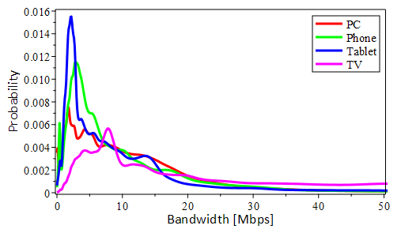
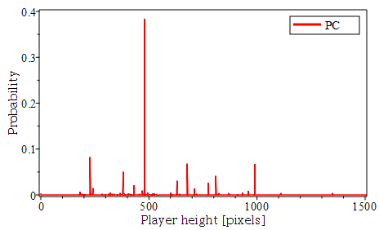
Input Distributions
Devices
We will assume that delivery is done to a set of devices $Ω$, and that relative consumption of content by these devices can be modeled by a discrete random variable $ω∈Ω$, with probability mass function $p(ω)$
Display and client model parameters ($d,ρ,α,δ$) will be specific to each device. We will use sub-index $ω$ to denote this. E.g. $d_{ω}, ρ_{ω}$, etc.
Networks
Network bandwidth $B$ will be treated as a continuous random variable, defined over $[0,∞)$, and with probability density function $q\left(B\right)$
Network density specific to a particular device will be denoted by $q_{ω}\left(B\right)$
Player sizes
Video player size $H_{p }$will also be treated as a discrete random variable, producing values from a set $ℋ_{p}$, with probability mass function $r\left(H_{p}\right)$
Player size distribution specific to a particular device will be denoted by $r_{ω}\left(H_{p}\right)$
Examples
Device distribution
Network distributions
Player size distribution

Slide 23
Average Performance Parameters
Average bitrate
$$\overline{R}\left({H_{1},…,H_{n},R}_{1},..,R_{n}\right)=\int_{0}^{∞}{q\left(B\right)}\sum_{H_{p}}{r\left(H_{p}\right)}R_{i\left(B,H_{p}\right)}dB$$
Average resolution
$$\overline{H}\left({H_{1},…,H_{n},R}_{1},..,R_{n}\right)=\int_{0}^{∞}{q\left(B\right)}\sum_{H_{p}}{r\left(H_{p}\right)}H_{i\left(B,H_{p}\right)}dB$$
Average distortion
$$\overline{D}\left({H_{1},…,H_{n},R}_{1},..,R_{n}\right)=\int_{0}^{∞}{q\left(B\right)}\sum_{H_{p}}{r\left(H_{p}\right)}D\left(H_{i\left(B,H_{p}\right)}, R_{i\left(B,H_{p}\right)}\right)dB$$
Average quality
$$\overline{Q}\left({H_{1},…,H_{n},R}_{1},..,R_{n}\right)=\int_{0}^{∞}{q\left(B\right)}\sum_{H_{p}}{r\left(H_{p}\right)}Q\left(H_{i\left(B,H_{p}\right)},H_{p},R_{i\left(B,H_{p}\right)}\right)dB$$
Notations
$H_{1},…,H_{n}$ – ladder resolutions
$R_{1},..,R_{n}$ – ladder bitrates
$B$ – network bandwidth
$H_{p}$ – player size
$i\left(B,H_{p}\right)$ – index of rendition selected
$q\left(B\right)$ – network bandwidth distribution
$r\left(H_{p}\right)$ – distribution of player sizes
$D\left(H, R\right)$ – distortion-rate model
$Q\left(H,H_{p},R\right)$ – quality-rate model, specific to a given codec, content, and user device
Parameter that is averaged
Averaging over bandwidth B
Averaging over player sizes Hp
Client model selecting rendition based on B, Hp

Slide 24
Average Performance for Multiscreen
Average bitrate
$$\overline{R}\left({H_{1},…,H_{n},R}_{1},..,R_{n}\right)=\sum_{ω}{p\left(ω\right)}\int_{0}^{∞}{q_{ω}\left(B\right)}\sum_{H_{p}}{r_{ω}\left(H_{p}\right)}R_{i_{ω}\left(B,H_{p}\right)}dB$$
Average resolution
$$\overline{H}\left({H_{1},…,H_{n},R}_{1},..,R_{n}\right)=\sum_{ω∈Ω}{p\left(ω\right)}\int_{0}^{∞}{q_{ω}\left(B\right)}\sum_{H_{p}}{r_{ω}\left(H_{p}\right)}H_{i_{ω}\left(B,H_{p}\right)}dB$$
Average distortion
$$\overline{D}\left({H_{1},…,H_{n},R}_{1},..,R_{n}\right)=\sum_{ω∈Ω}{p\left(ω\right)}\int_{0}^{∞}{q_{ω}\left(B\right)}\sum_{H_{p}}{r_{ω}\left(H_{p}\right)}D\left(H_{i_{ω}\left(B,H_{p}\right)}, R_{i_{ω}\left(B,H_{p}\right)}\right)dB$$
Average quality
$$\overline{Q}\left({H_{1},…,H_{n},R}_{1},..,R_{n}\right)=\sum_{ω}{p\left(ω\right)}\int_{0}^{∞}{q_{ω}\left(B\right)}\sum_{H_{p}}{r_{ω}\left(H_{p}\right)}Q_{ω}\left(H_{i_{ω}\left(B,H_{p}\right)},H_{p},R_{i_{ω}\left(B,H_{p}\right)}\right)dB$$
Marked red:
summation over devices $ω$
usage probability of each device
$p(ω)$
elements depended on a device:
$i_{ω}\left(B,H_{p}\right)$ – client model
$q_{ω}\left(B\right)$ – network pdf
$r_{ω}\left(H_{p}\right)$ – player size pmf
$Q_{ω}\left(H,H_{p},R\right)$ – quality rate model
Parameter that is averaged
Averaging over devices $ω$
Averaging over bandwidth B
Averaging over player sizes Hp
Client model selecting rendition based on $ω$,$B, H_{p}$

Slide 25
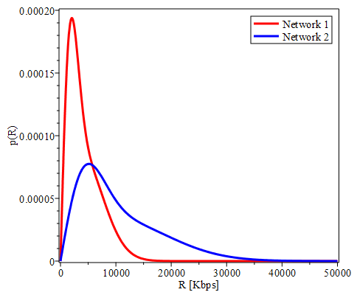
Examples
System configurations
ABR ladder:
Content:
Networks:
Devices / Players:
Average performance
Observations
Complex content gets encoded & delivered at lower quality
Network 2 allows more bits to be pulled and quality to increase
Web players deliver much lower average resolution and consume fewer bits compared to full-screen/1080p players
Network | Player | Content | $$\overline{H}$$ | $$\overline{D}$$ | $$\overline{Q}$$ | $$\overline{R}$$
Network 1 | 1080p player | Easy | 647.8 | 0.9910 | 4.075 | 1846.5
 |  | Medium | 647.8 | 0.9718 | 3.891 | 1846.5
 |  | Complex | 647.8 | 0.9585 | 3.774 | 1846.5
 | Web player | Easy | 465.2 | 0.9903 | 3.563 | 1151.8
 |  | Medium | 465.2 | 0.9701 | 3.395 | 1151.8
 |  | Complex | 465.2 | 0.9522 | 3.258 | 1151.8
Network 2 | 1080p player | Easy | 706.3 | 0.9912 | 4.343 | 2076.5
 |  | Medium | 706.3 | 0.9724 | 4.150 | 2076.5
 |  | Complex | 706.3 | 0.9606 | 4.034 | 2076.5
 | Web player | Easy | 486.5 | 0.9904 | 3.653 | 1232.6
 |  | Medium | 486.5 | 0.9704 | 3.482 | 1232.6
 |  | Complex | 486.5 | 0.9532 | 3.347 | 1232.6
# | Codec | Profile | Resolution | Framerate | Bitrate
1 | H.264 | Baseline | 480x270 | 23.976 | 450k
2 | H.264 | Baseline | 640x360 | 23.976 | 800k
3 | H.264 | Main | 768x432 | 23.976 | 1000k
4 | H.264 | Main | 1024x576 | 23.976 | 1500k
5 | H.264 | Main | 1280x720 | 23.976 | 2100k
Sequence | $$α$$ | $$β$$ | $$γ$$
"Easy" | 0.7844e-3 | 1.2281 | 0.7463
"Medium" | 0.8278e-2 | 1.3217 | 0.9593
"Complex" | 0.07316 | 1.0957 | 1.0336
$$D\left(H,R\right)={\left(1+{\left(\frac{R}{αH^{β}}\right)}^{−γ} \right)}^{\frac{−1}{ γ}}$$
Network | $$α$$ | $$σ_{1}$$ | $$σ_{2}$$
"Network 1" | 0.4287 | 1802.2 | 4499.28
"Network 2" | 0.4287 | 4505.5 | 11248.2
$\overline{Q}$ = average quality [MOS]
$\overline{R}$ = average bitrate [Kbps]
$\overline{H}$ = average resolution [lines]
$\overline{D}$ = average distortion [SSIM]
$q\left(B\right)=α f\left(B,σ_{1}\right)+\left(1−α\right) f\left(B,σ_{2}\right)$,
$$f\left(x,σ\right)=\frac{x}{σ^{2}}e^{−\frac{x^{2}}{2σ^{2}}}$$
Player | Player sizes $𝓗_{p}^{ }$ | Player size probabilities $q\left(H_{p}\right)$
"1080p player" | {1080} | {1.0}
"Web player" | {228, 240, 380, 430, 480, 630, 678, 710, 774, 810, 990} | {0.103188906, 0.017734224, 0.062664264, 0.026945508, 0.480776451, 0.038259368, 0.083865235, 0.018247353, 0.033203174, 0.051450527, 0.08366499}
Other model parameters: $d\text{=}24$ [in], $ρ\text{=}96$ [dpi], $α\text{=}0.88$, $δ\text{=}0.49$

Slide 26
System Optimizations

Slide 27
Optimal Encoding Ladders
Maximum-quality ladder
Given parameters needed for computation of $\overline{Q}\left({H_{1},…,H_{n},R}_{1},..,R_{n}\right)$, find ${\hat{R}}_{1},…,{\hat{R}}_{n}$ and${ \hat{H}}_{1},…,{\hat{H}}_{n}$ such that:
$$\overline{Q}\left({\hat{H}}_{1},…,{\hat{H}}_{n},{\hat{R}}_{1}…,{\hat{R}}_{n}\right)=\max_{\begin{aligned}R_{min}≤R_{1}<…{<R}_{n}^{}≤R_{max} \\ H_{min}≤H_{1}<…<H_{n}≤H_{max} \\ R_{1}≤R_{1,max}, H_{1}≤H_{1,max}\end{aligned}}{\overline{Q}\left(H_{1},…,H_{n},{ R}_{1},…,R_{n}\right)} (∗)$$
The simplest problem that can be posed.
Maximum-quality ladder with capped average bitrate
Given all parameters needed for computation of $\overline{Q}\left({H_{1},…,H_{n},R}_{1},..,R_{n}\right)$, find ${\hat{R}}_{1},…,{\hat{R}}_{n}$ and${ \hat{H}}_{1},…,{\hat{H}}_{n}$ such that:
$$\overline{Q}\left({\hat{H}}_{1},…,{\hat{H}}_{n},{\hat{R}}_{1}…,{\hat{R}}_{n}\right)=\max_{\begin{aligned}R_{min}≤R_{1}<…{<R}_{n}^{}≤R_{max} \\ H_{min}≤H_{1}≤…≤H_{n}≤H_{max} \\ R_{1}≤R_{1,max}, H_{1}≤H_{1,max} \\ \overline{R}\left({\hat{H}}_{1},…,{\hat{H}}_{n},{\hat{R}}_{1}…,{\hat{R}}_{n}\right)≤{\overline{R}}_{max}\end{aligned}}{\overline{Q}\left(H_{1},…,H_{n},{ R}_{1},…,R_{n}\right)}$$
Minimum bitrate ladder with guaranteed minimum average quality
Given all parameters needed for computation of $\overline{Q}\left({H_{1},…,H_{n},R}_{1},..,R_{n}\right)$, find ${\hat{R}}_{1},…,{\hat{R}}_{n}$ and${ \hat{H}}_{1},…,{\hat{H}}_{n}$ such that:
$$\overline{R}\left({\hat{H}}_{1},…,{\hat{H}}_{n},{\hat{R}}_{1}…,{\hat{R}}_{n}\right)=\min_{\begin{aligned}R_{min}≤R_{1}<…{<R}_{n}^{}≤R_{max} \\ H_{min}≤H_{1}≤…≤H_{n}≤H_{max} \\ R_{1}≤R_{1,max}, H_{1}≤H_{1,max} \\ \overline{Q}\left({\hat{H}}_{1},…,{\hat{H}}_{n},{\hat{R}}_{1}…,{\hat{R}}_{n}\right)≥{\overline{Q}}_{min}\end{aligned}}{\overline{R}\left(H_{1},…,H_{n},{ R}_{1},…,R_{n}\right)}$$
More complete problem. Solution of (*) may be needed first, to set a meaningful limit for ${\overline{Q}}_{min}$.

Slide 28
Examples of Optimal Ladders
Maximum quality ladders
Observations
Compared to a fixed ladder considered earlier, quality values are now up by 0.1..0.88 MOS!
Optimal profiles are very different for different content: complex content receives more bits
Optimal profiles are also very different for different networks: more bits are used with better networks
Optimal profiles are also very different for different devices/players: for web-players lower resolutions and higher SSIMs are used as opposed to profiles generated for 1080p/full-screen players
Network | Player | Content | Rendition 1 | Rendition 2 | Rendition 3 | Rendition 4 | Rendition 5 | $$\overline{H}$$ | $$\overline{D}$$ | $$\overline{Q}$$ | $$\overline{R}$$
Network 1 | 1080p player | Easy | 854x480 167k | 1024x576 173k | 1280x720 277k | 1600x900 607k | 1920x1080 1557k | 1043.7 | 0.9819 | 4.955 | 1388.4
 |  | Medium | 854x480 180k | 1024x576 410k | 1280x720 769k | 1600x900 1384k | 1920x1080 2804k | 975.4 | 0.9534 | 4.512 | 2130.5
 |  | Complex | 854x480 180k | 1024x576 480k | 1280x720 899k | 1600x900 1619k | 1920x1080 3155k | 954.4 | 0.9392 | 4.337 | 2288.0
 | Web player | Easy | 512x288 180k | 768x432 365k | 854x480 935k | 1280x720 973k | 1600x900 1557k | 537.7 | 0.9850 | 3.719 | 1094.5
 |  | Medium | 480x270 180k | 768x432 632k | 854x480 1497k | 1280x720 1619k | 1600x900 2697k | 515.9 | 0.9617 | 3.473 | 1262.3
 |  | Complex | 480x270 180k | 768x432 739k | 854x480 1684k | 1280x720 1970k | 1600x900 3155k | 506.1 | 0.9420 | 3.316 | 1407.7
Network 2 | 1080p player | Easy | 854x480 180k | 1024x576 203k | 1280x720 410k | 1600x900 1052k | 1920x1080 3033k | 1057.8 | 0.9892 | 5.000 | 2811.0
 |  | Medium | 854x480 180k | 1024x576 540k | 1280x720 1138k | 1600x900 2305k | 1920x1080 5050k | 1019.8 | 0.9747 | 4.830 | 4264.4
 |  | Complex | 854x480 180k | 1024x576 607k | 1280x720 1280k | 1600x900 2493k | 1920x1080 5050k | 1017.3 | 0.9670 | 4.741 | 4292.1
 | Web player | Easy | 480x270 180k | 768x432 657k | 854x480 1895k | 1280x720 1970k | 1920x1080 2697k | 545.9 | 0.9898 | 3.781 | 1608.6
 |  | Medium | 480x270 180k | 768x432 1052k | 854x480 2804k | 1280x720 2917k | 1600x900 4856k | 530.0 | 0.9741 | 3.630 | 2421.0
 |  | Complex | 384x216 180k | 768x432 1183k | 854x480 3155k | 1280x720 3281k | 1600x900 5050k | 519.1 | 0.9638 | 3.531 | 2635.8
Generated under constraints: $R_{min}\text{=}100,{R_{max}\text{=}5050,H_{min}\text{=}180,{H_{max}\text{=}1080, R}_{1,max}, R}_{1,max}\text{=}180,H_{1,max}\text{=}480, n=5$
$\overline{Q}$ = average quality [MOS]
$\overline{R}$ = average bitrate [Kbps]
$\overline{H}$ = average resolution [lines]
$\overline{D}$ = average distortion [SSIM]

Slide 29
Importance of Right Targeting
Optimal ladders for full-screen players, but played by web players
Optimal ladders for web-players, played by web players
Observations
Mistargeting has severe consequences: we see a drop of 0.15..0.93 MOS when we switch players!!
Web players need high-quality low-res renditions, but in profiles for full screen players they are either missing or encoded at poor quality, as preference is given to resolution.
Network | Player | Content | Rendition 1 | Rendition 2 | Rendition 3 | Rendition 4 | Rendition 5 | $$\overline{H}$$ | $$\overline{D}$$ | $$\overline{Q}$$ | $$\overline{R}$$
Network 1 | 1080p player | Easy | 854x480 167k | 1024x576 173k | 1280x720 277k | 1600x900 607k | 1920x1080 1557k | 584.4 | 0.9630 | 3.569 | 306.3
 |  | Medium | 854x480 180k | 1024x576 410k | 1280x720 769k | 1600x900 1384k | 1920x1080 2804k | 576.4 | 0.8737 | 2.915 | 485.6
 |  | Complex | 854x480 180k | 1024x576 480k | 1280x720 899k | 1600x900 1619k | 1920x1080 3155k | 574.1 | 0.8028 | 2.513 | 523.4
Network 2 | 1080p player | Easy | 854x480 180k | 1024x576 203k | 1280x720 410k | 1600x900 1052k | 1920x1080 3033k | 585.9 | 0.9670 | 3.609 | 476.4
 |  | Medium | 854x480 180k | 1024x576 540k | 1280x720 1138k | 1600x900 2305k | 1920x1080 5050k | 581.8 | 0.8804 | 2.989 | 768.5
 |  | Complex | 854x480 180k | 1024x576 607k | 1280x720 1280k | 1600x900 2493k | 1920x1080 5050k | 581.4 | 0.8115 | 2.603 | 800.5
Network | Player | Content | Rendition 1 | Rendition 2 | Rendition 3 | Rendition 4 | Rendition 5 | $$\overline{H}$$ | $$\overline{D}$$ | $$\overline{Q}$$ | $$\overline{R}$$
Network1 | Web player | Easy | 512x288 180k | 768x432 365k | 854x480 935k | 1280x720 973k | 1600x900 1557k | 537.7 | 0.9850 | 3.719 | 1094.5
 |  | Medium | 480x270 180k | 768x432 632k | 854x480 1497k | 1280x720 1619k | 1600x900 2697k | 515.9 | 0.9617 | 3.473 | 1262.3
 |  | Complex | 480x270 180k | 768x432 739k | 854x480 1684k | 1280x720 1970k | 1600x900 3155k | 506.1 | 0.9420 | 3.316 | 1407.7
Network2 | Web player | Easy | 480x270 180k | 768x432 657k | 854x480 1895k | 1280x720 1970k | 1920x1080 2697k | 545.9 | 0.9898 | 3.781 | 1608.6
 |  | Medium | 480x270 180k | 768x432 1052k | 854x480 2804k | 1280x720 2917k | 1600x900 4856k | 530.0 | 0.9741 | 3.630 | 2421.0
 |  | Complex | 384x216 180k | 768x432 1183k | 854x480 3155k | 1280x720 3281k | 1600x900 5050k | 519.1 | 0.9638 | 3.531 | 2635.8
$\overline{Q}$ = average quality [MOS]
$\overline{R}$ = average bitrate [Kbps]
$\overline{H}$ = average resolution [lines]
$\overline{D}$ = average distortion [SSIM]

Slide 30
How Many Streams are Needed?
Optimal ladders for n=2..5
Notes
Number of streams needed clearly depends on content. E.g. "Easy" content needs only 4 or even 3 streams in this case. Quality saturates with more. "Medium" and "Complex" content need more.
Generally, more streams allow better network utilization, and better quality. But return is diminishing.
In practice, a threshold on relative quality increase can be used to limit the ladder.
Limits on "granularity" of switches can also be used to decide how many streams are sufficient.
Network | Player | Content | n | Rendition 1 | Rendition 2 | Rendition 3 | Rendition 4 | Rendition 5 | $$\overline{H}$$ | $$\overline{D}$$ | $$\overline{Q}$$ | $$\overline{R}$$
Network 1 | 1080p player | Easy | 2 | 854x480 180k | 1920x1080 899k |  |  |  | 1043.1 | 0.9754 | 4.843 | 854.8
 |  |  | 3 | 854x480 180k | 1600x900 427k | 1920x1080 1440k |  |  | 1047.7 | 0.9805 | 4.942 | 1288.9
 |  |  | 4 | 854x480 180k | 1280x720 228k | 1600x900 584k | 1920x1080 1557k |  | 1044.2 | 0.9817 | 4.954 | 1385.1
 |  |  | 5 | 854x480 167k | 1024x576 173k | 1280x720 277k | 1600x900 607k | 1920x1080 1557k | 1043.7 | 0.9819 | 4.955 | 1388.4
 |  | Medium | 2 | 854x480 180k | 1920x1080 1440k |  |  |  | 992.6 | 0.9227 | 4.186 | 1256.4
 |  |  | 3 | 854x480 180k | 1600x900 865k | 1920x1080 2305k |  |  | 1000.3 | 0.9416 | 4.431 | 1819.8
 |  |  | 4 | 854x480 180k | 1280x720 584k | 1600x900 1280k | 1920x1080 2697k |  | 983.4 | 0.9501 | 4.496 | 2061.6
 |  |  | 5 | 854x480 180k | 1024x576 410k | 1280x720 769k | 1600x900 1384k | 1920x1080 2804k | 975.4 | 0.9534 | 4.512 | 2130.5
 |  | Complex | 2 | 854x480 180k | 1920x1080 1557k |  |  |  | 980.0 | 0.8911 | 3.911 | 1327.4
 |  |  | 3 | 854x480 180k | 1600x900 973k | 1920x1080 2493k |  |  | 987.9 | 0.9199 | 4.217 | 1911.5
 |  |  | 4 | 854x480 180k | 1280x720 657k | 1600x900 1440k | 1920x1080 2917k |  | 969.9 | 0.9327 | 4.310 | 2164.6
 |  |  | 5 | 854x480 180k | 1024x576 480k | 1280x720 899k | 1600x900 1619k | 1920x1080 3155k | 954.4 | 0.9392 | 4.337 | 2288.0
$\overline{Q}$ = average quality [MOS]
$\overline{R}$ = average bitrate [Kbps]
$\overline{H}$ = average resolution [lines]
$\overline{D}$ = average distortion [SSIM]

Slide 31
Extensions and Concluding Remarks

Slide 32
Other Optimization Problems
Many possible extensions and other problems can be proposed
Finding optimal parameters $(α, δ)$ for client adaptation model, and then improving client logic
Using worst-case instead of average case, or combinations of worst-case and average case metrics in definition of the problem
Taking into account effects of multiple streams on CDN cache miss probability and factoring it in the optimization problem
Adding time domain to all models, and capturing buffering and delay as additional dimensions of quality
etc., etc.…
Plenty of opportunities for subsequent research...

Slide 33
THANK
YOU

