Slide 1
U-Phylogeny: Undirected Provenance Graph Construction in the Wild
2017 IEEE International Conference on Image Processing
Aparna Bharati¹, Daniel Moreira¹, Allan Pinto^{1,2}, Joel Brogan¹,
Kevin Bowyer¹, Patrick Flynn¹, Walter Scheirer¹, and Anderson Rocha^{1,2}
¹Department of Computer Science and Engineering, Univ. of Notre dame, IN, U.S.A
²Institute of Computing, Univ. of Campinas, SP, Brazil

Slide 2
What?
Introduction Proposed Method Datasets and Evaluation Measure Experimental Results Conclusions
What is image phylogeny analysis?
Obtaining a full corpus of media relating to an image in question (Nodes)
Tracing the specific modifications that have taken place within those images over time (Edges)
Classifying the nature of each edge (e.g. what type of modification took place?)

Slide 3
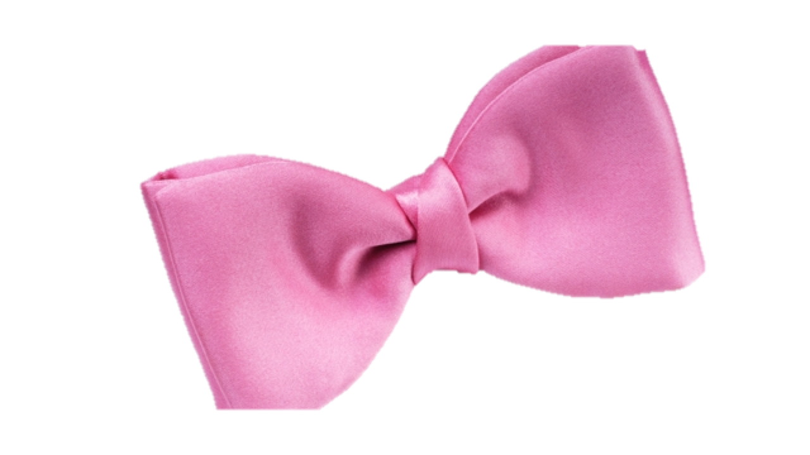
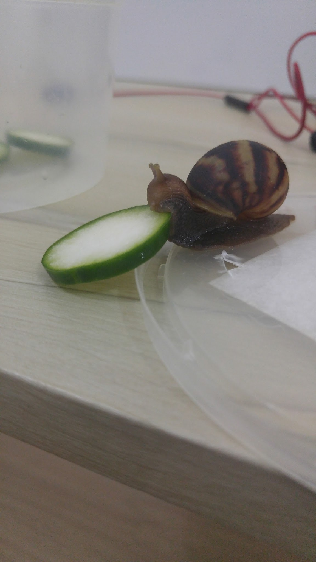
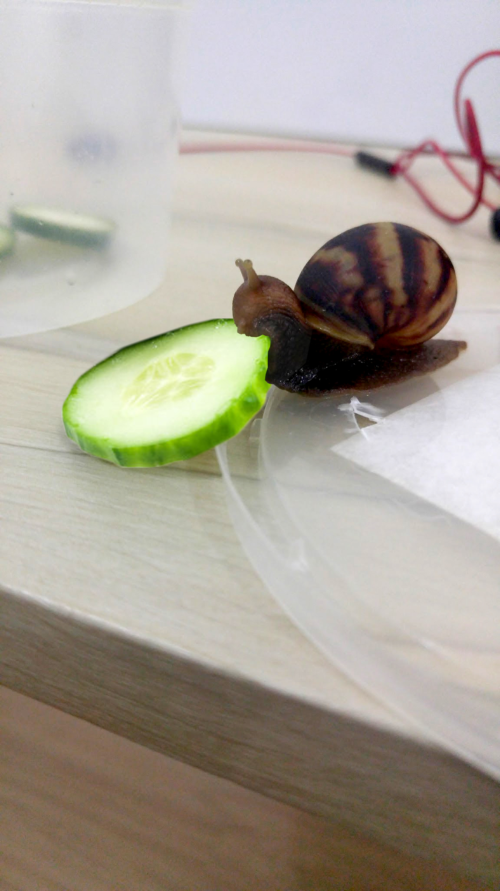
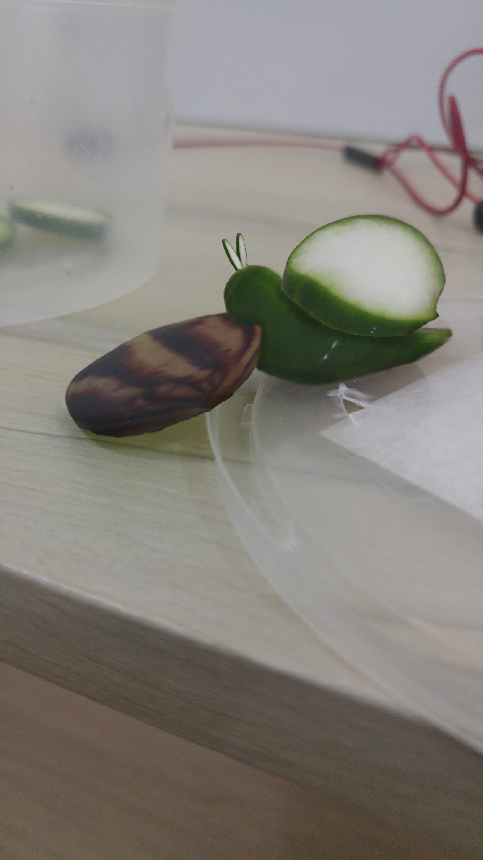
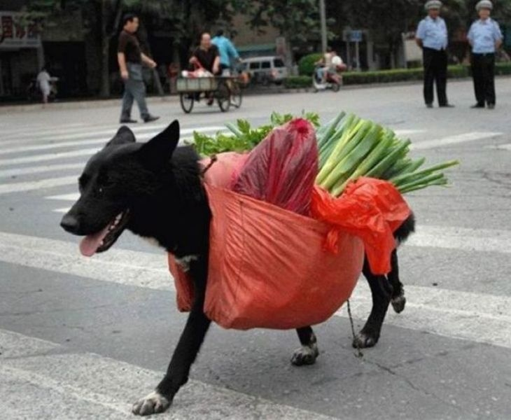
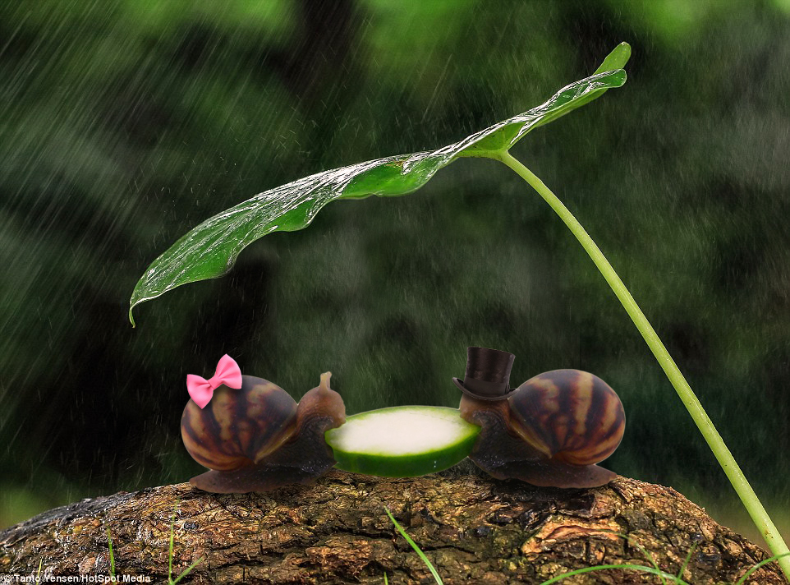
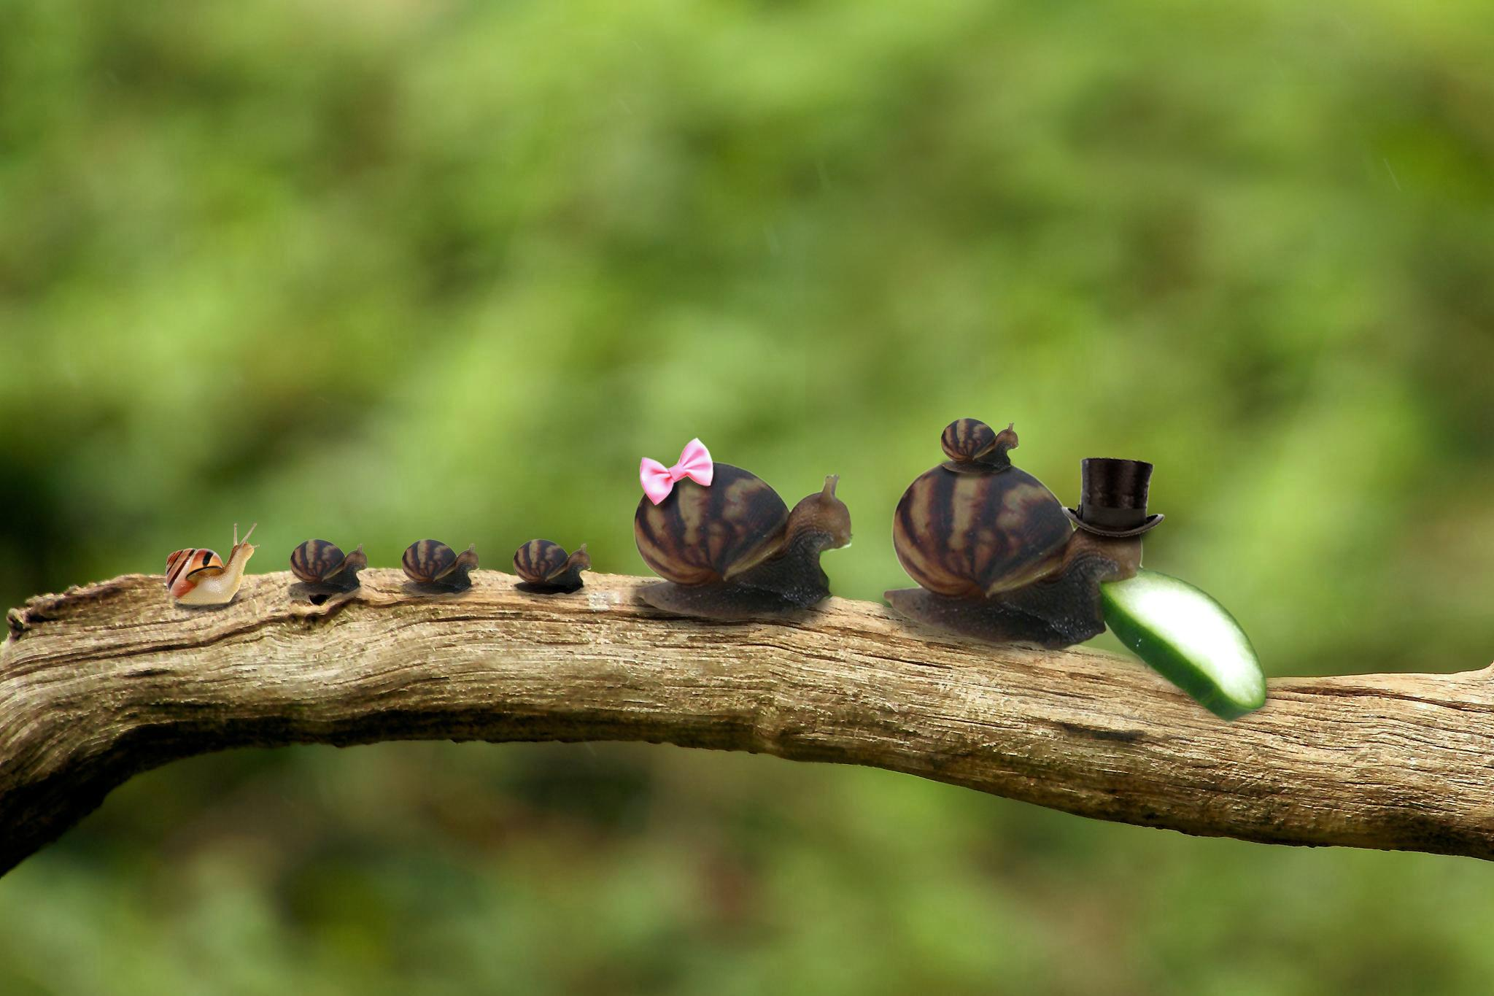
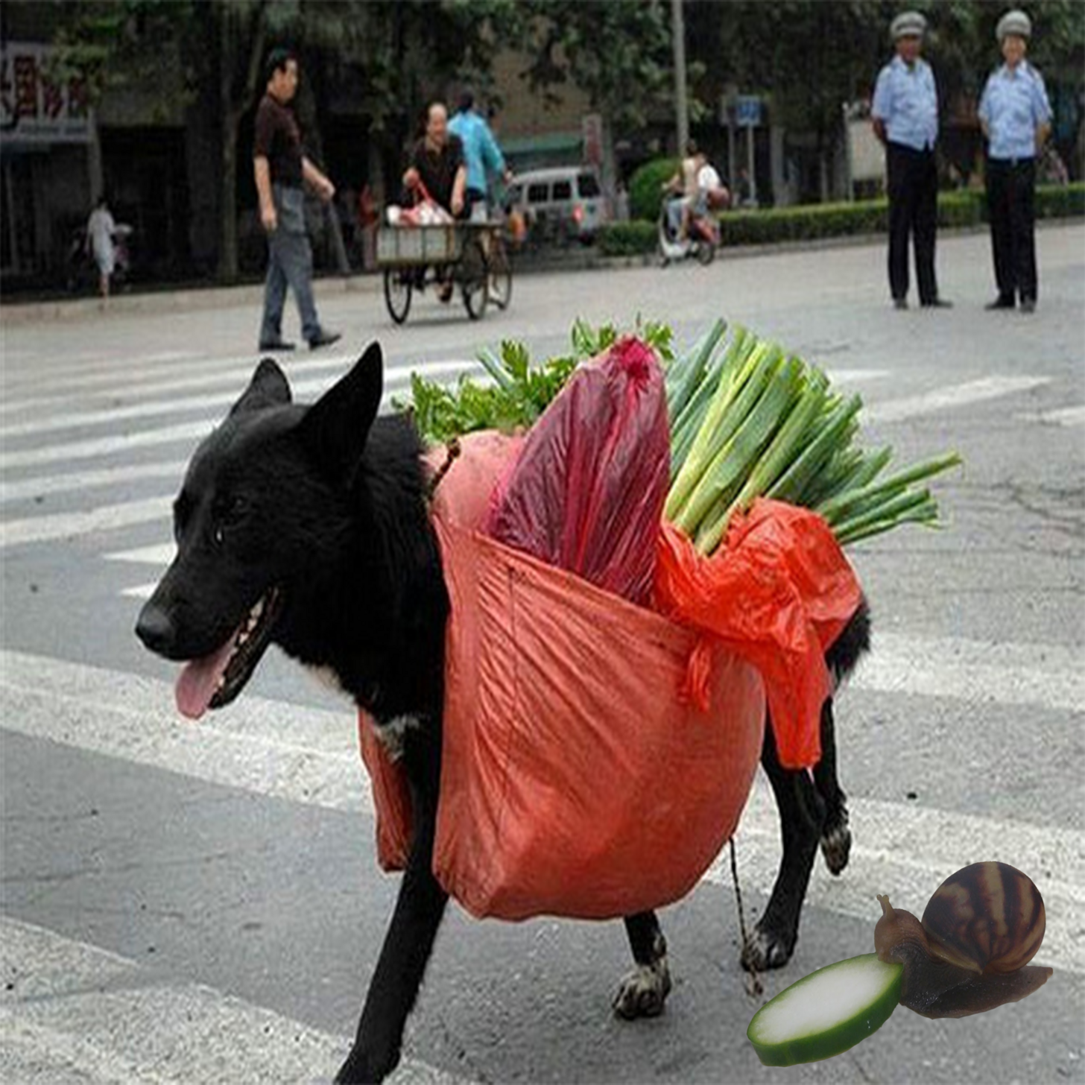
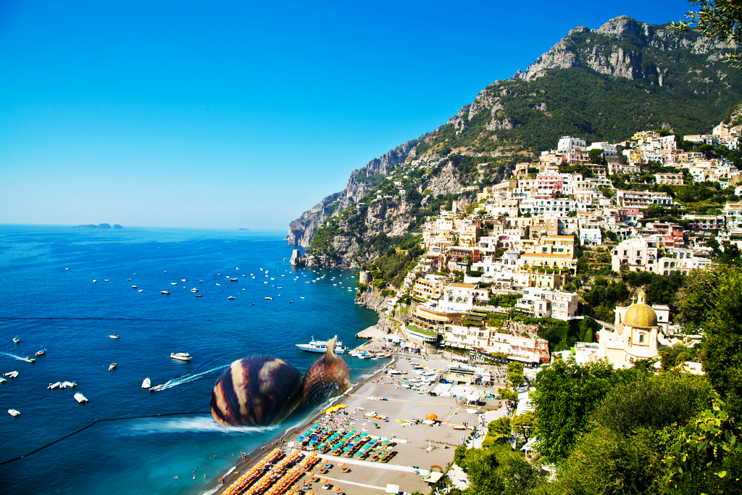
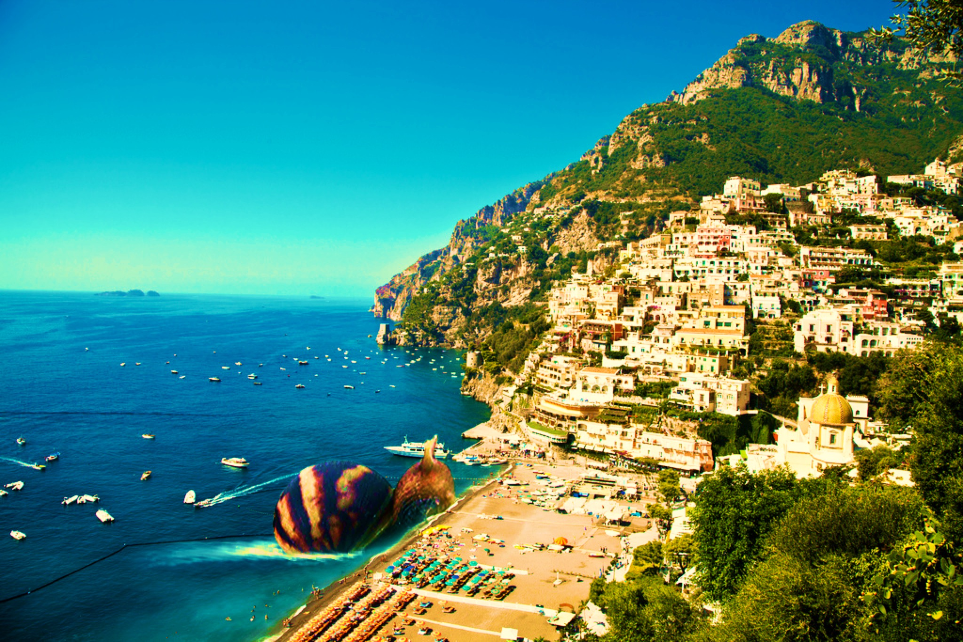
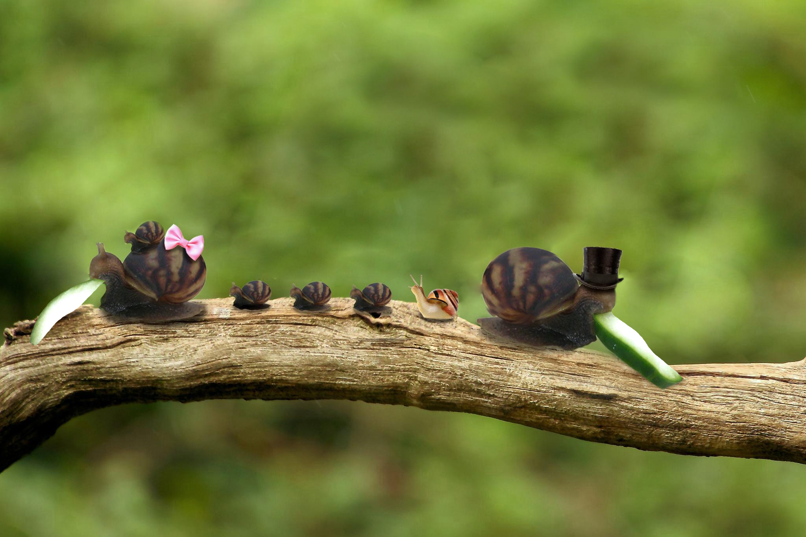
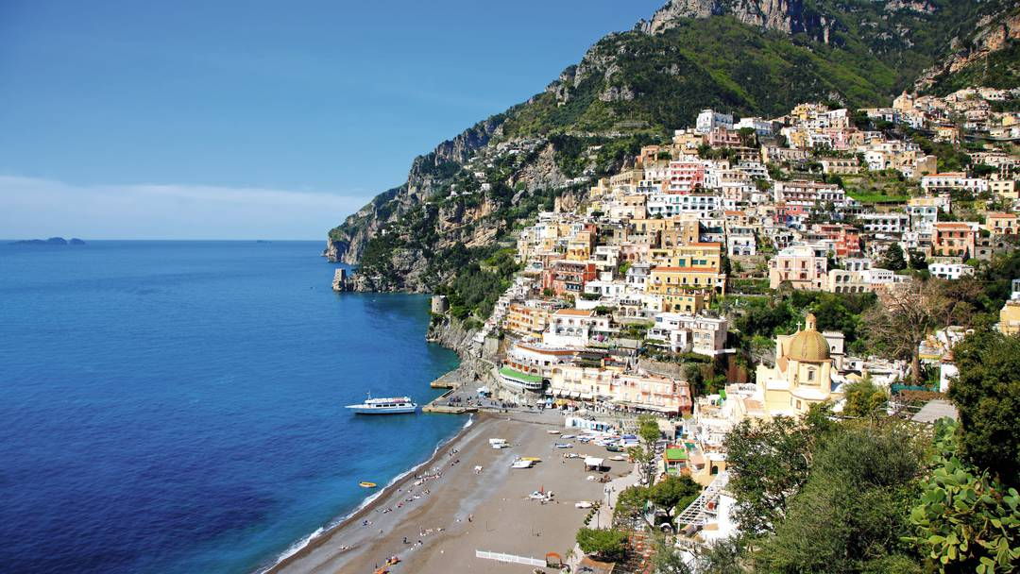
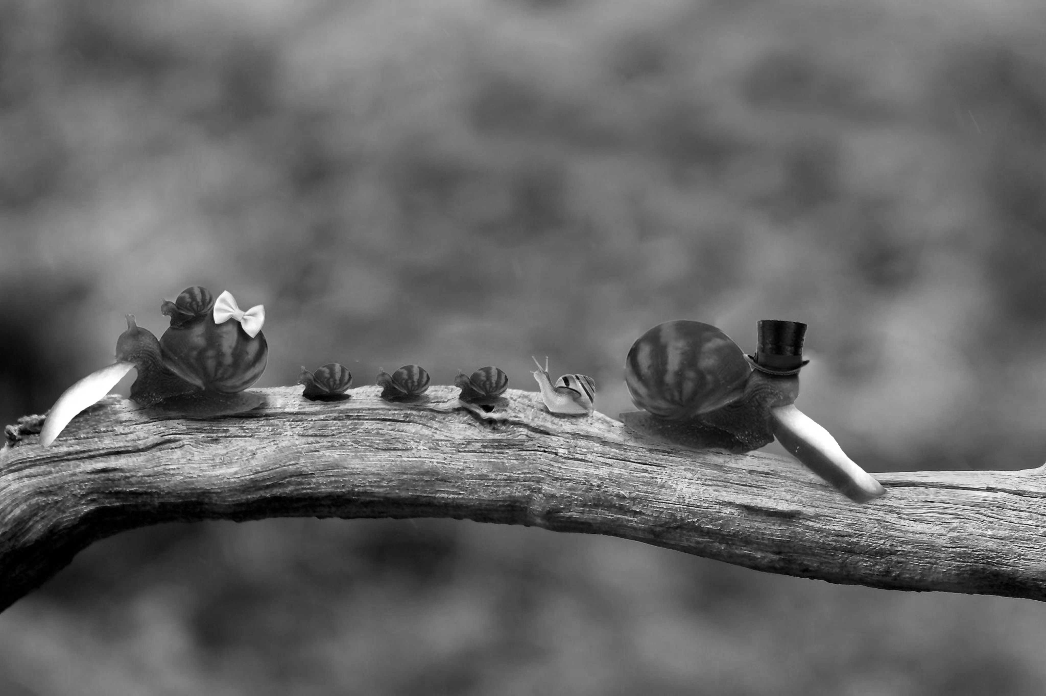
“Snail eating Cucumber”
Introduction Proposed Method Datasets and Evaluation Measure Experimental Results Conclusions
https://www.reddit.com/r/photoshopbattles/comments/55hp46/psbattle_a_snail_eating_a_slice_of_cucumber/

Slide 4
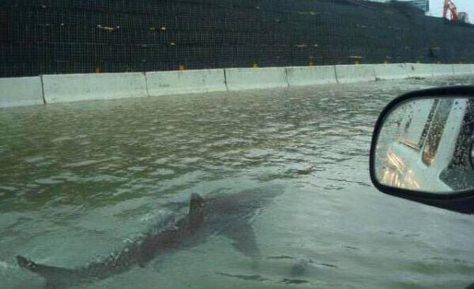
Why?
Introduction Proposed Method Datasets and Evaluation Measure Experimental Results Conclusions
Ease of Accessibility
Iterative image download/re-upload leads to the presence of copies of the same media
Where did the original come from?
Prevalence of photo manipulation in popular culture
“Post Truth” society
Propaganda

Slide 5
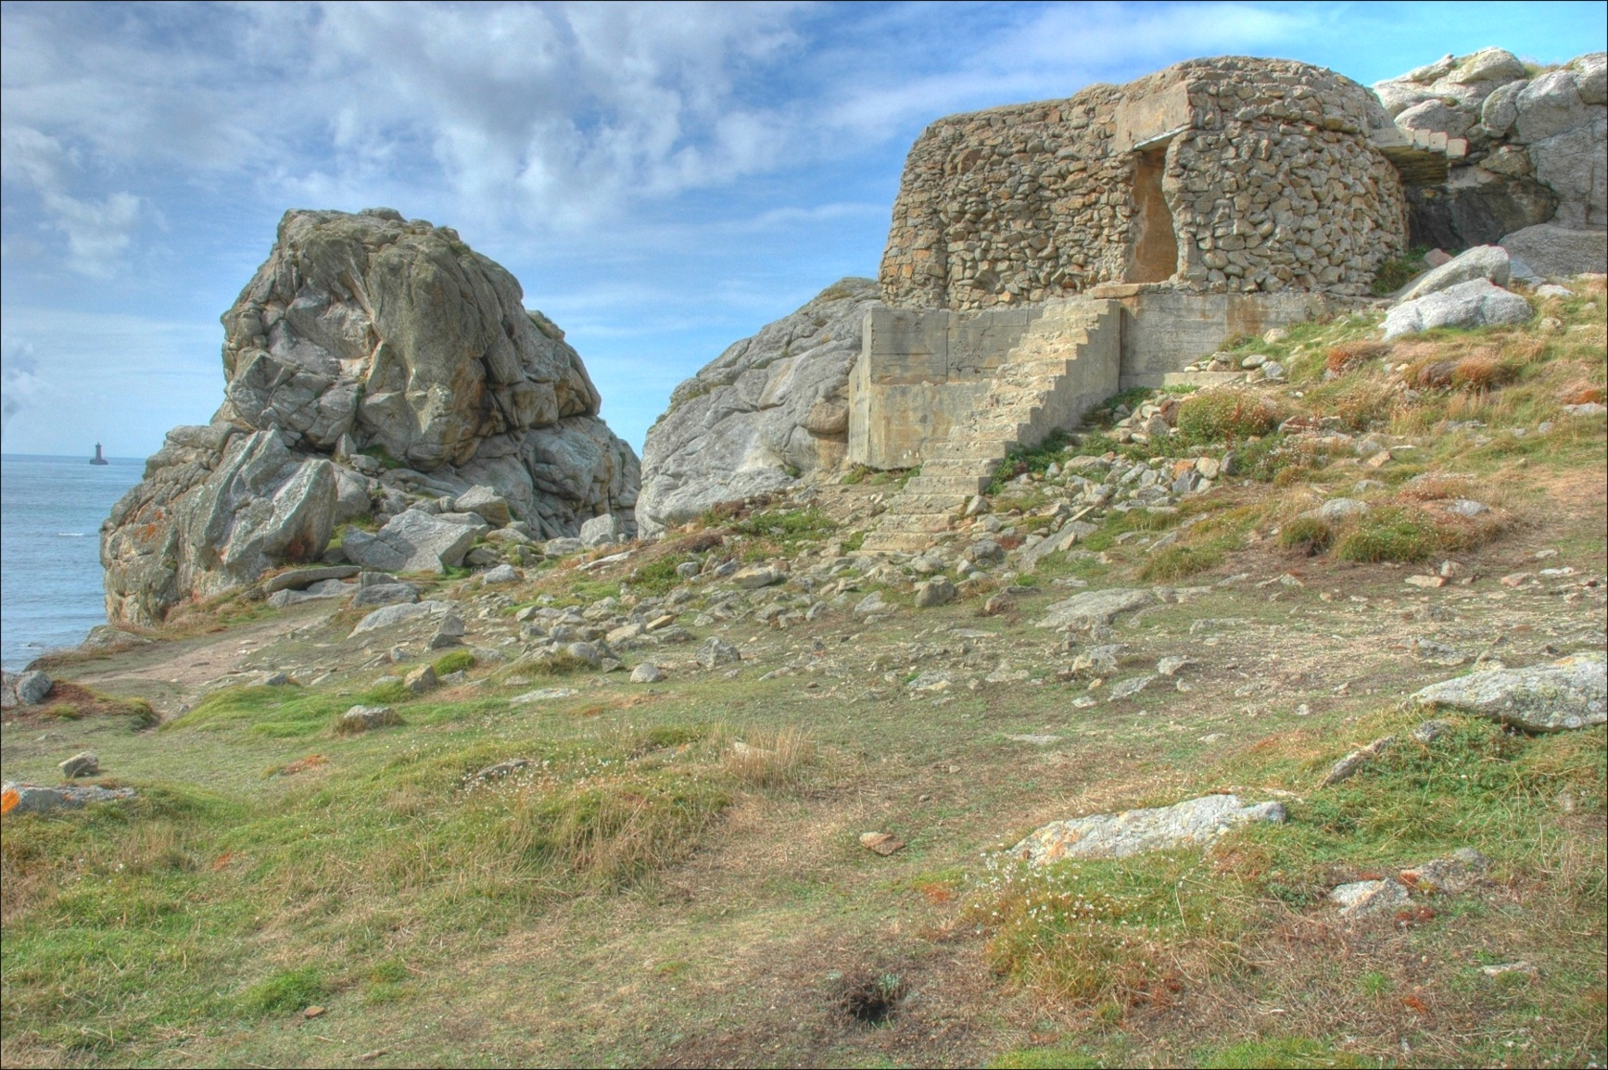
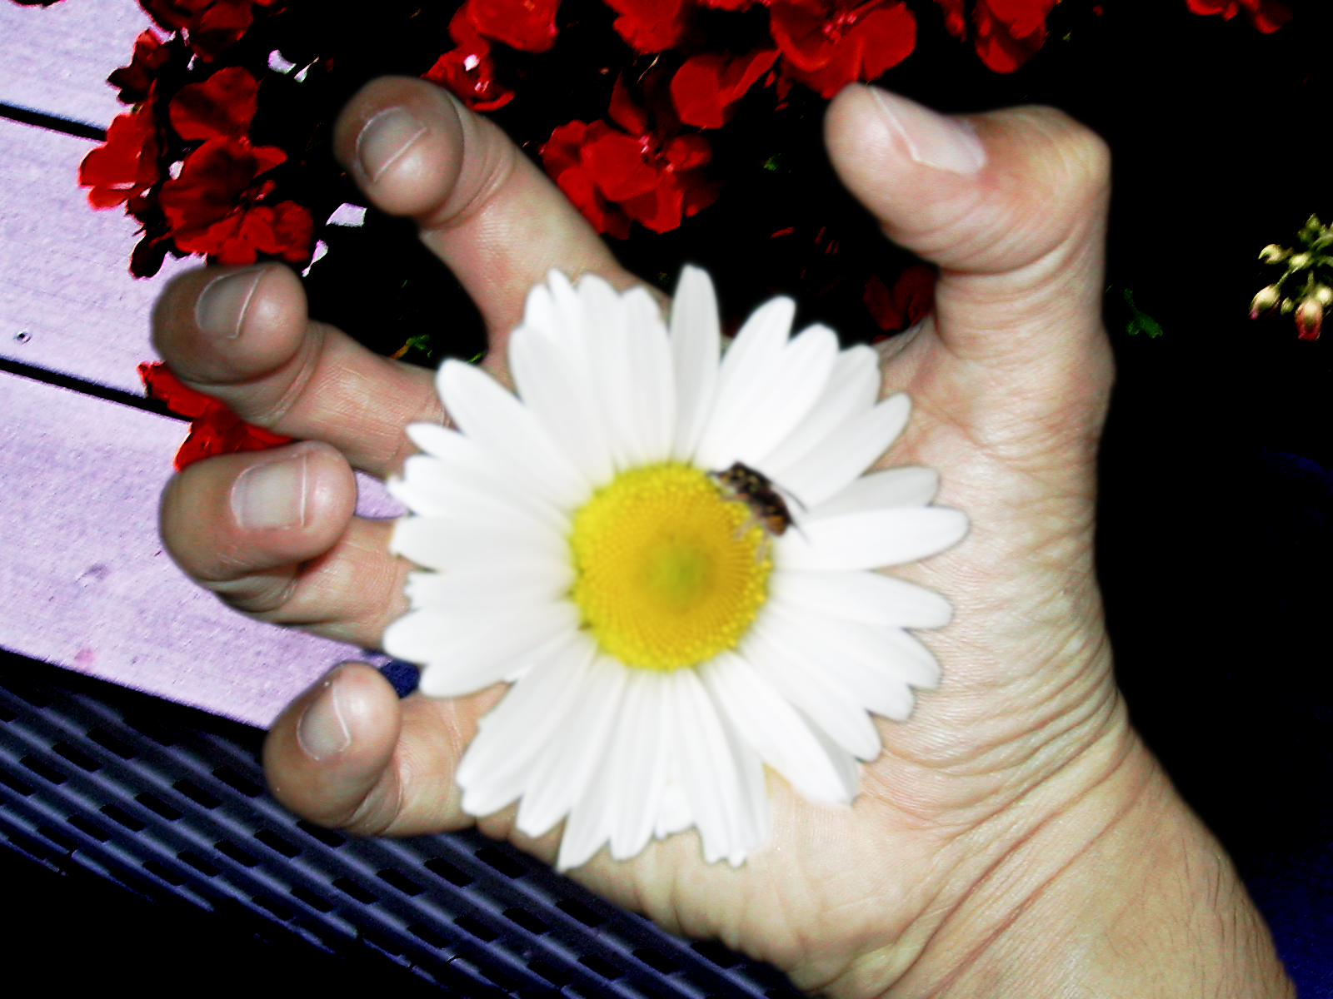
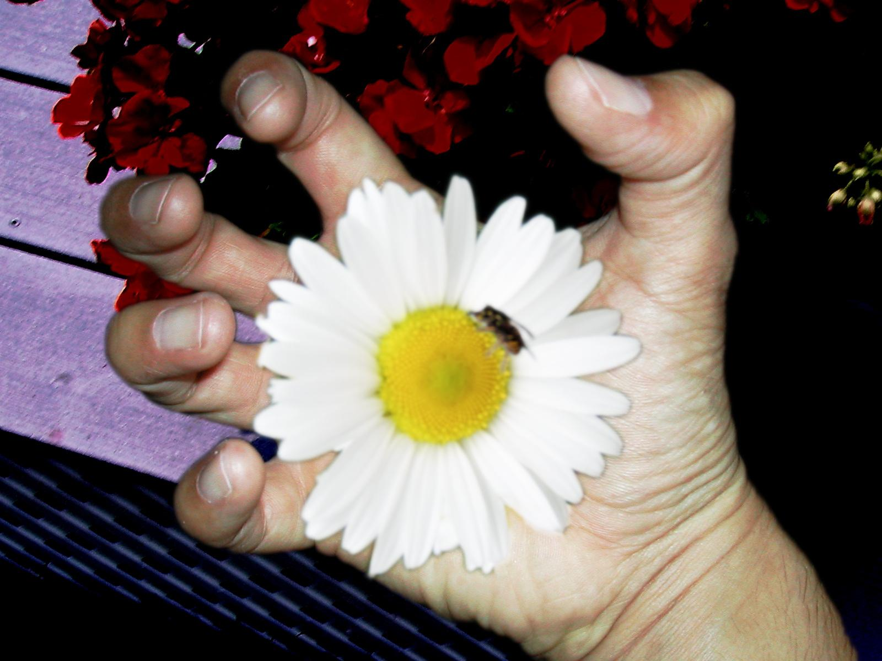
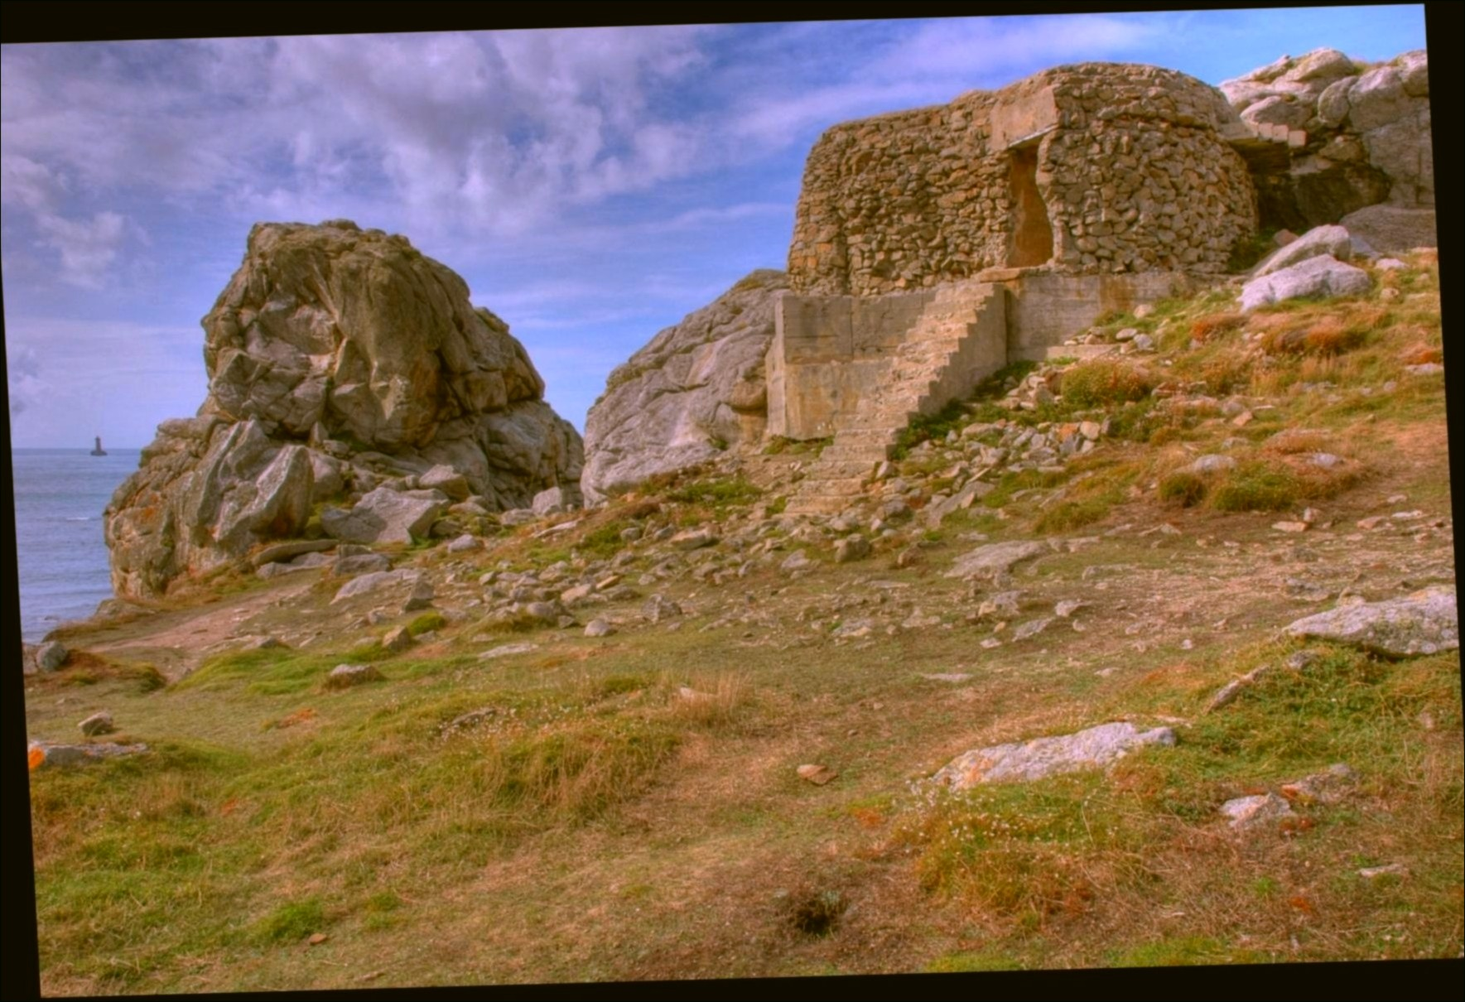
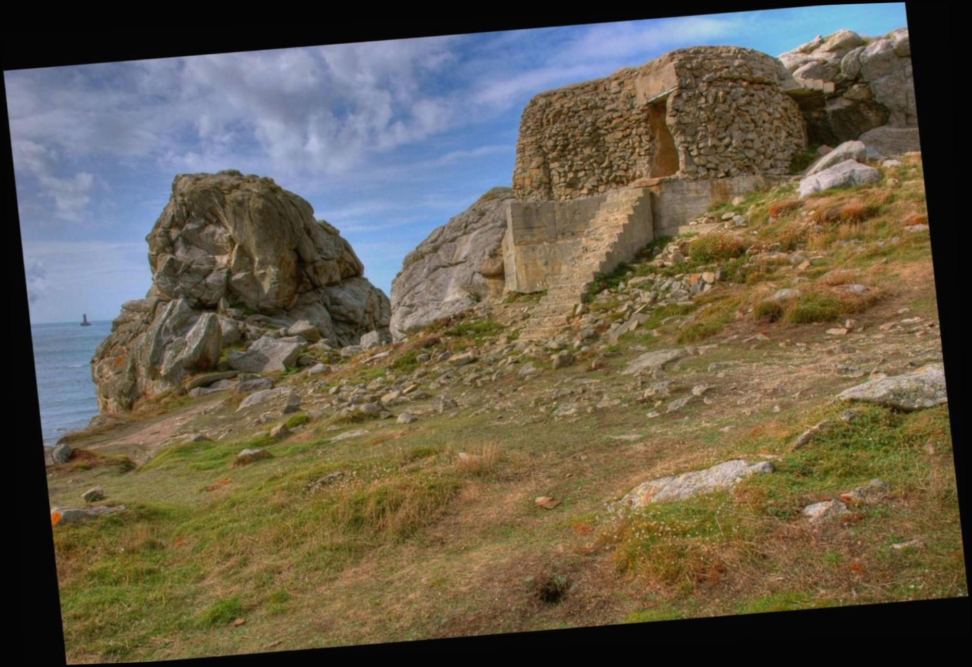
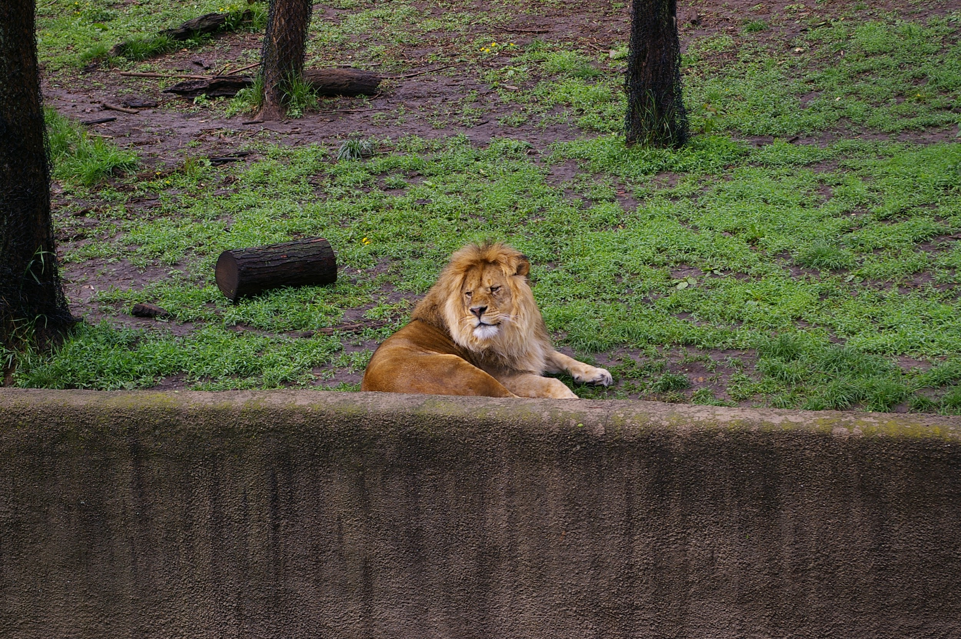
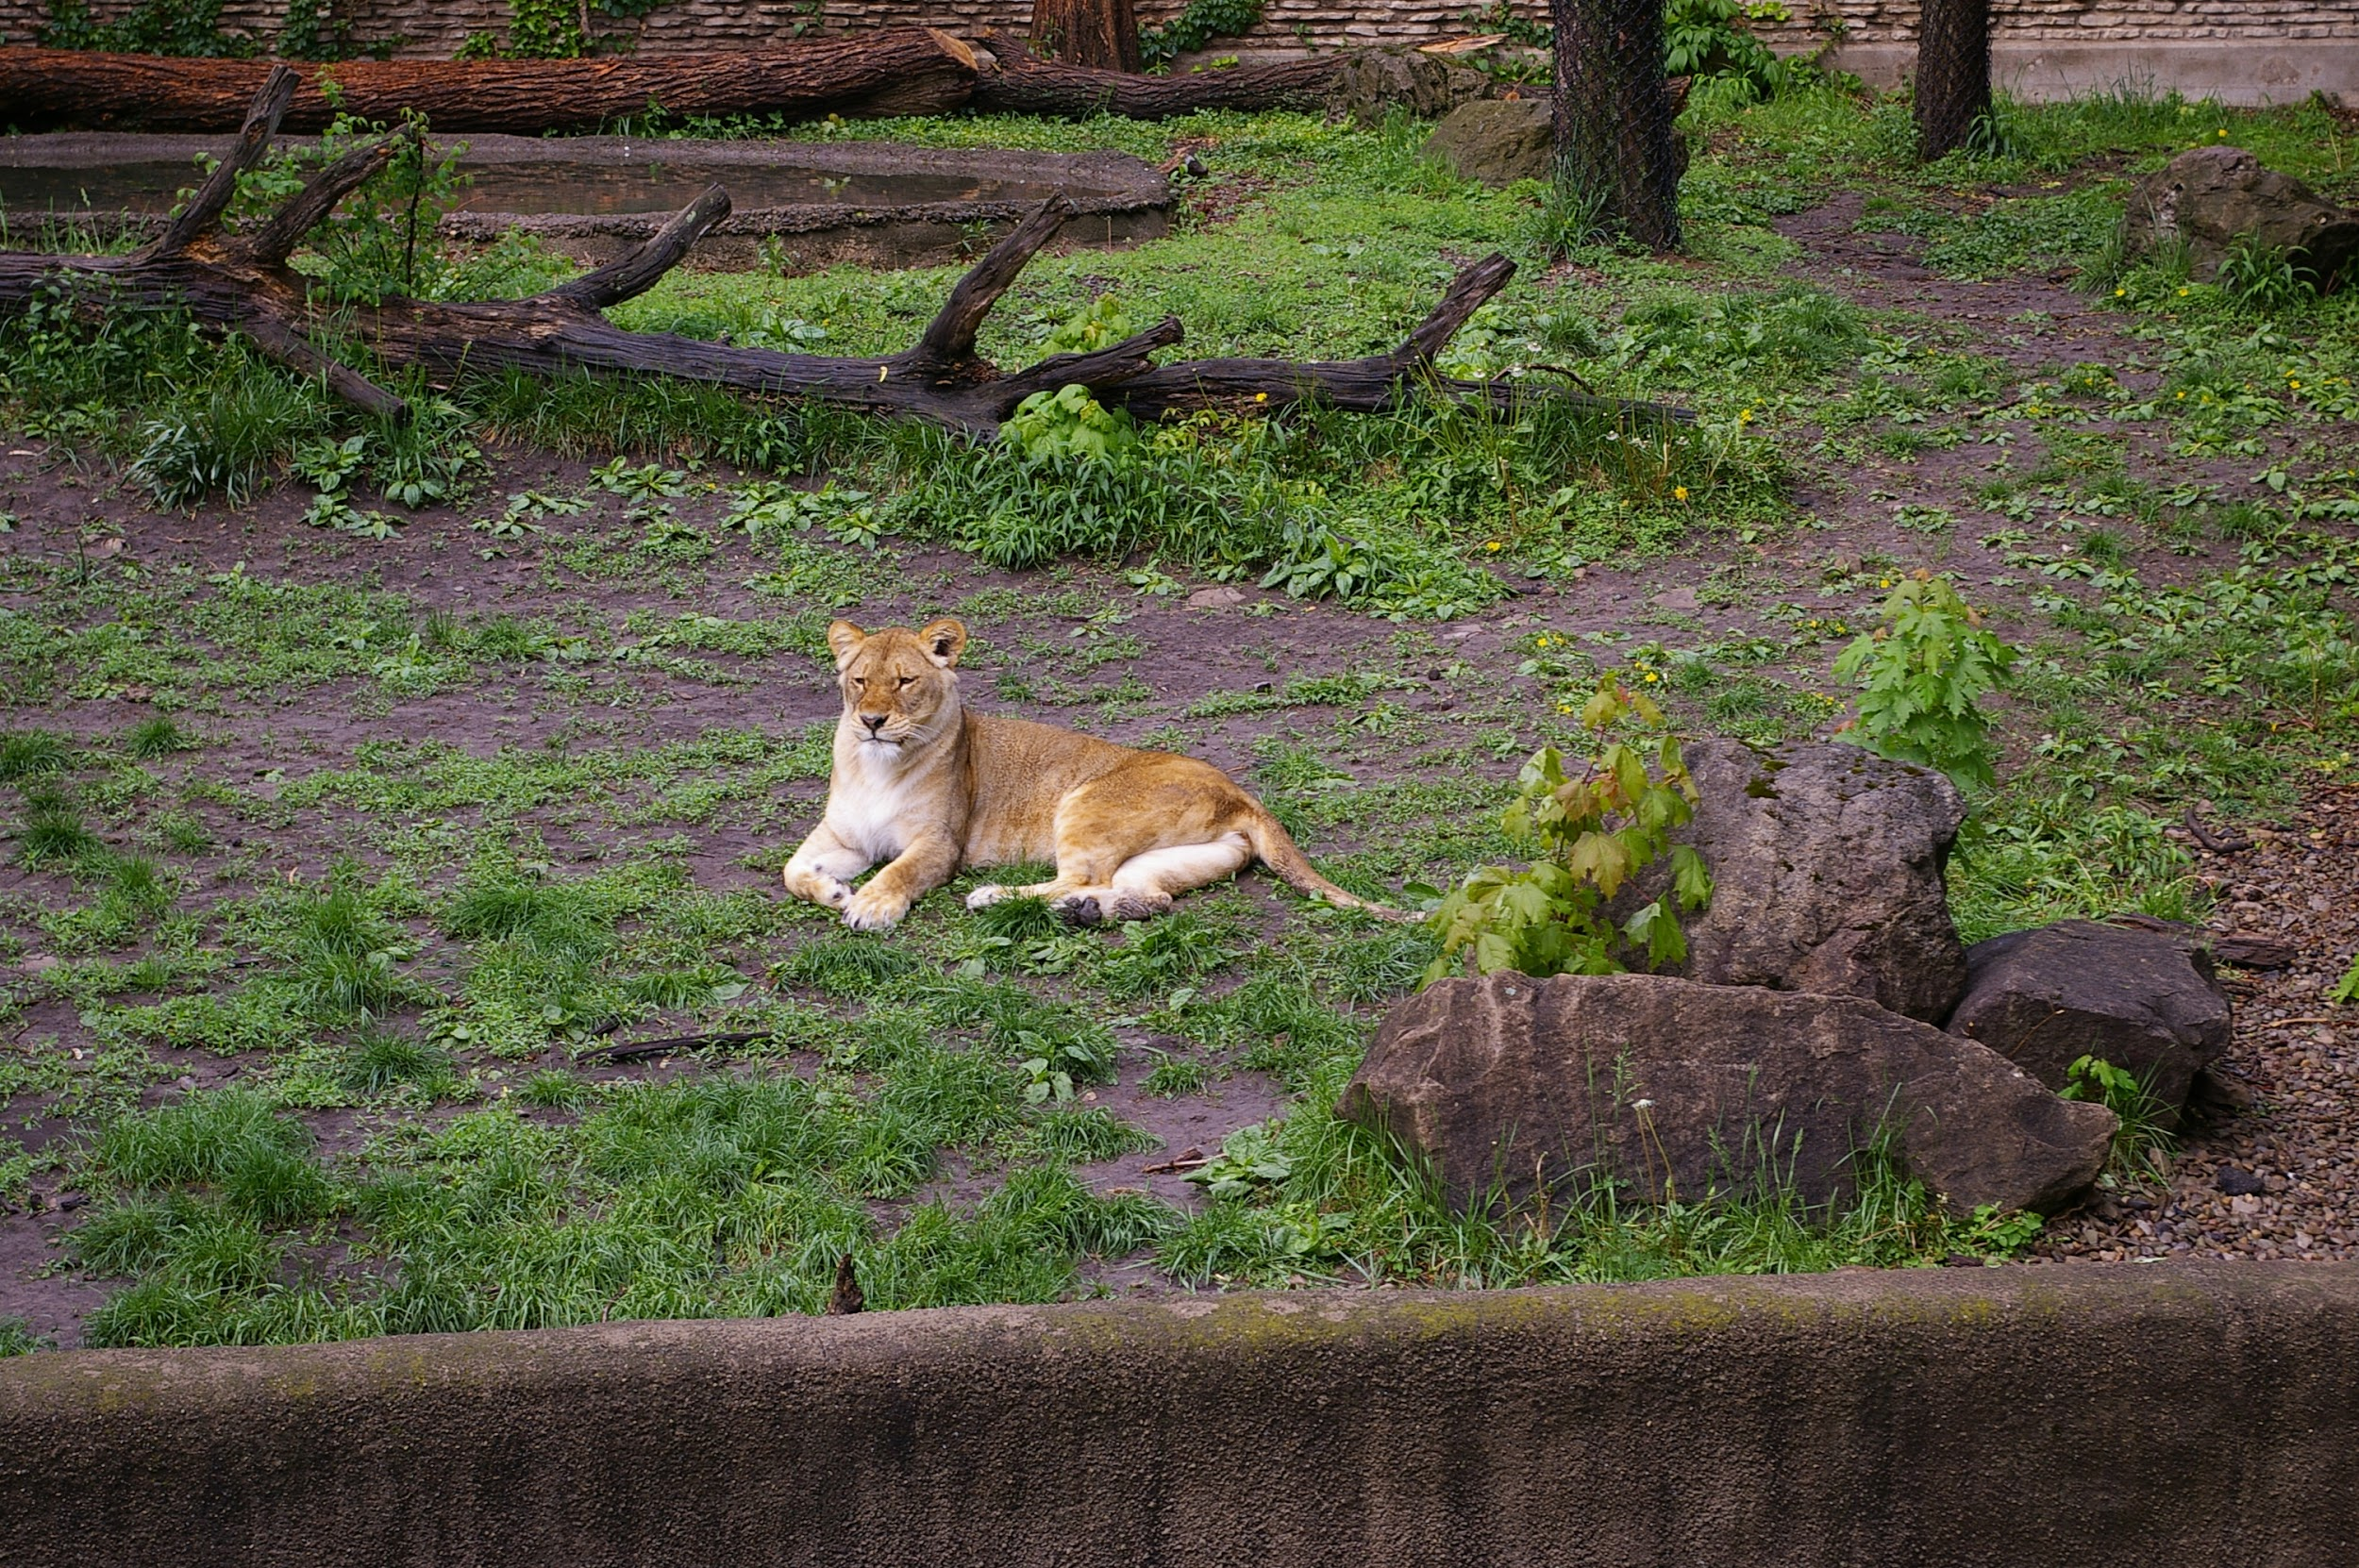
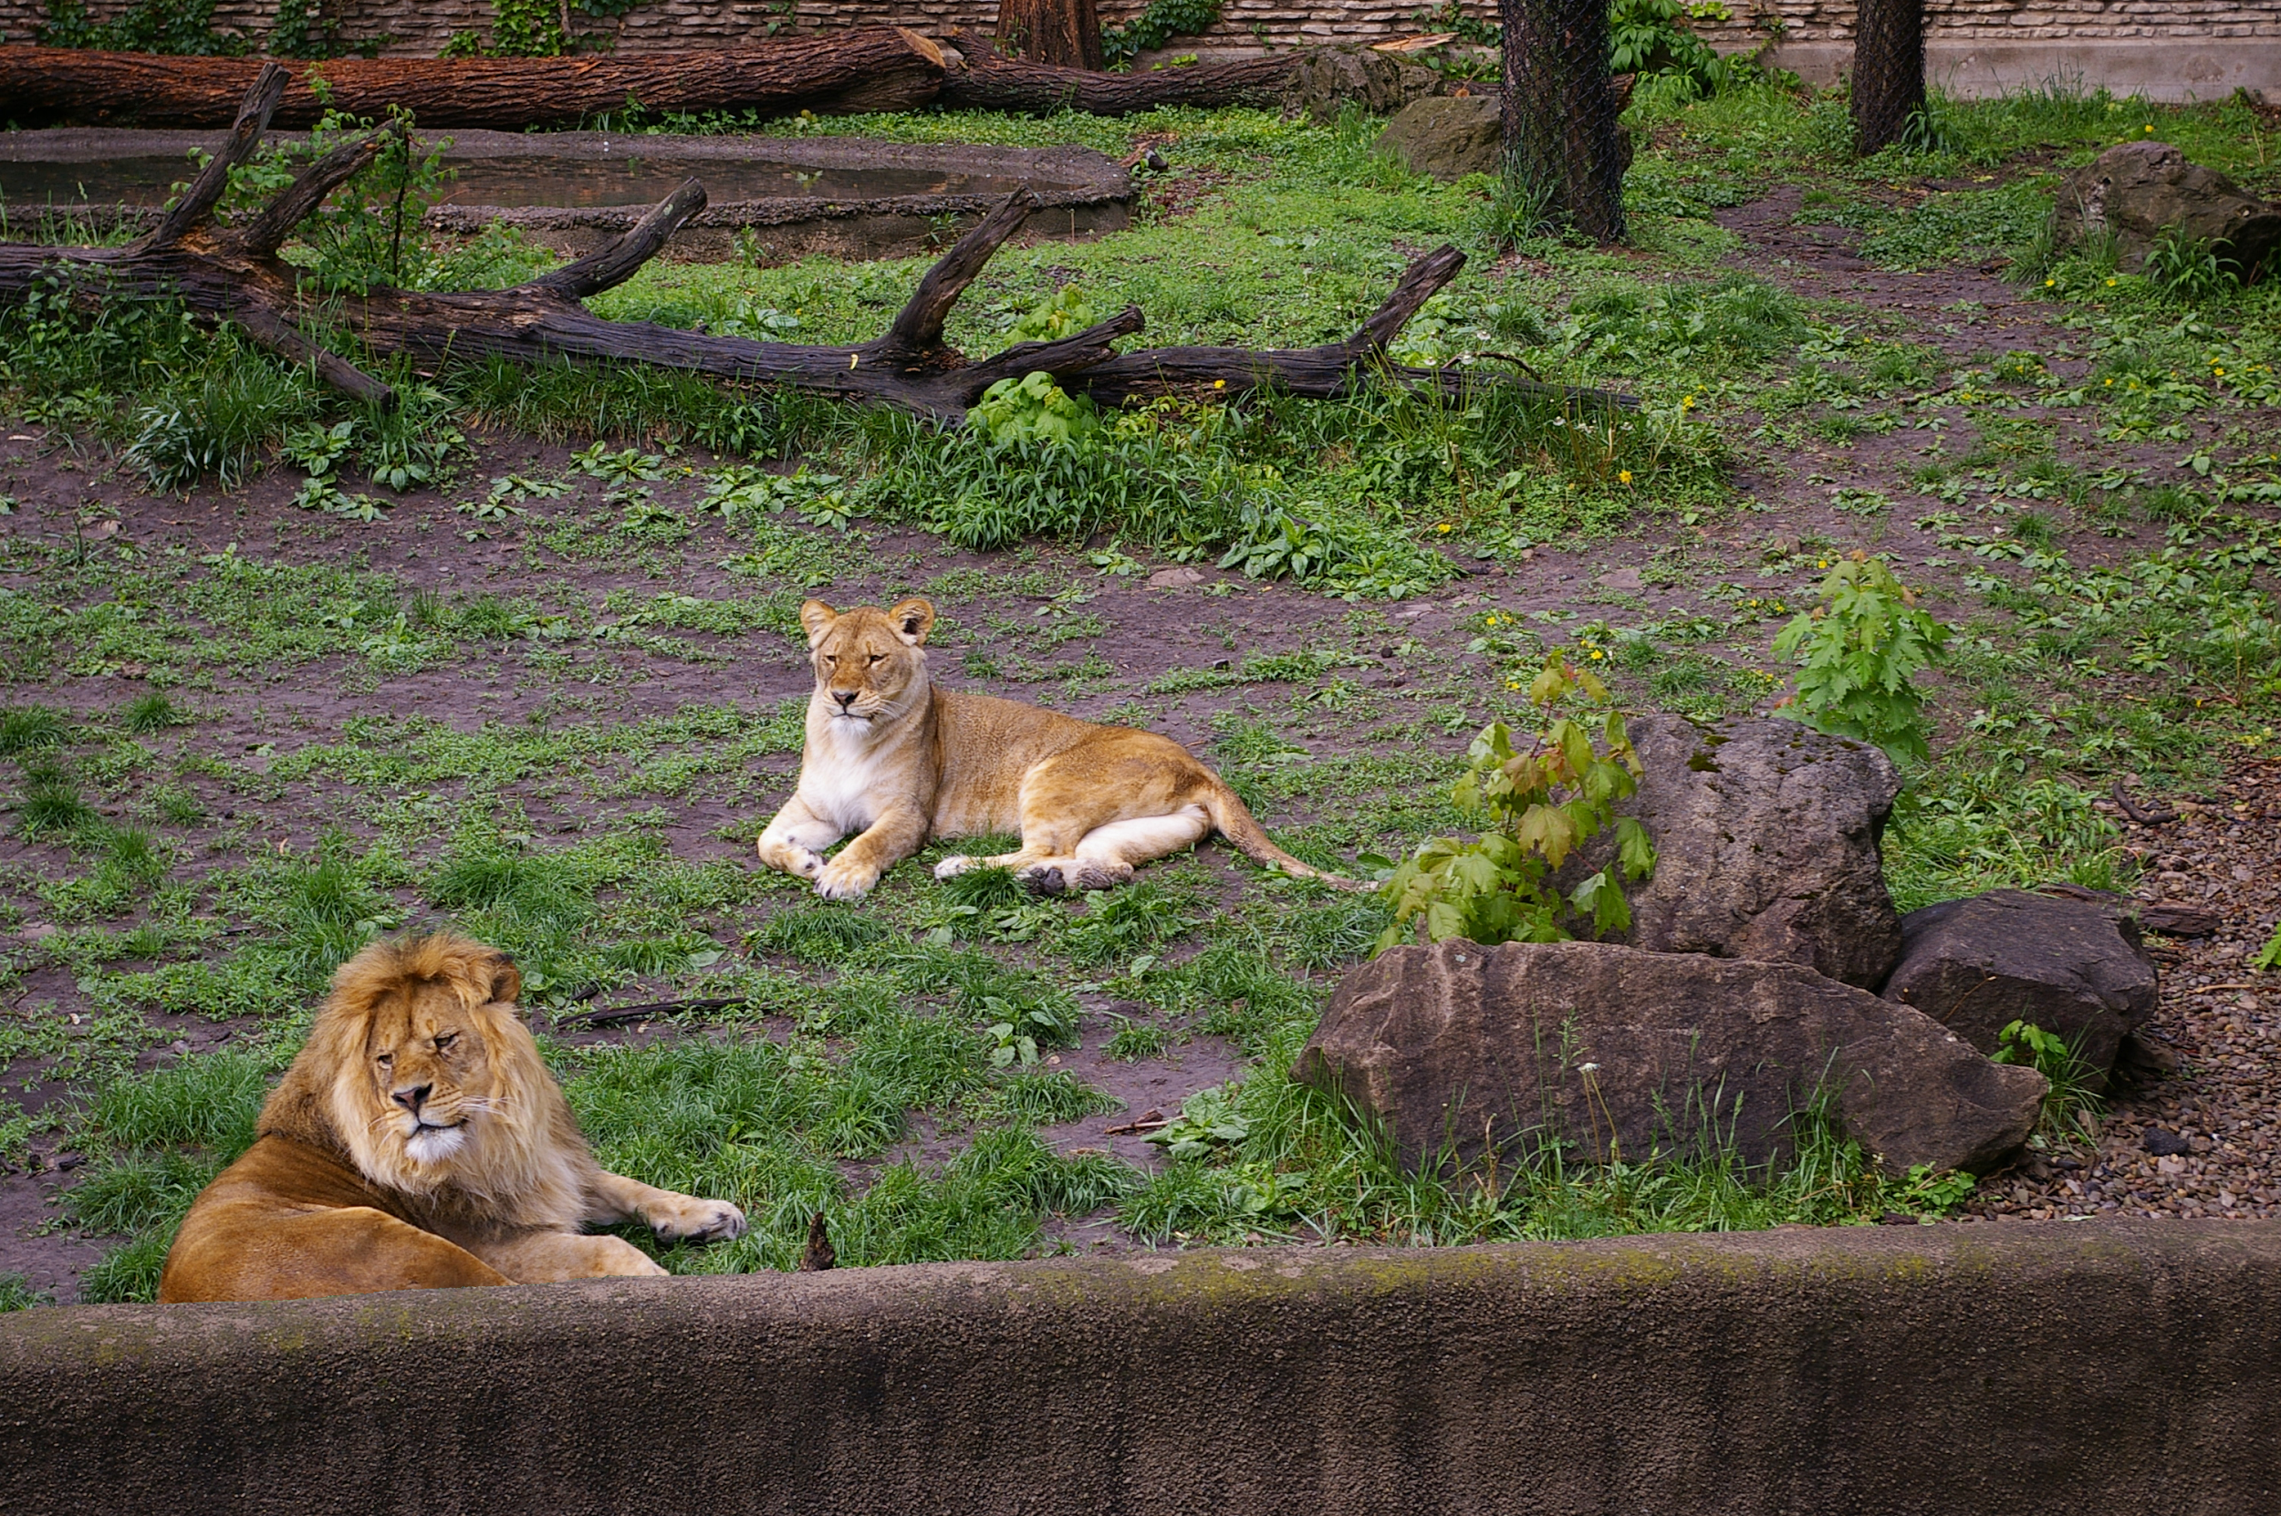
Terminology
Introduction Proposed Method Datasets and Evaluation Measure Experimental Results Conclusions
Near-Duplicate Images
Donor Image
Host Image
Image Phylogeny
Composite Image
Multiple Parenting
Semantically Similar Images

Slide 6
“Snail eating Cucumber”
Introduction Proposed Method Datasets and Evaluation Measure Experimental Results Conclusions
https://www.reddit.com/r/photoshopbattles/comments/55hp46/psbattle_a_snail_eating_a_slice_of_cucumber/

Slide 7
Previous Work
Introduction Proposed Method Datasets and Evaluation Measure Experimental Results Conclusions
Multimedia Phylogeny
Introduced by Dias et. al[1] for near-duplicate images
Extended for multiple trees and SSIs[2]
Multiple Parenting Phylogeny (MPP) by Oliveira et. al[3]
Considers composition scenarios
Considers composition scenarios
Two main steps:
Computation of dissimilarity matrix
Spanning tree algorithm to calculate optimally connected component
Z. Dias, A. Rocha, & S. Goldenstein, “First steps toward image phylogeny,” WIFS, 2010.
Z. Dias, S. Goldenstein, & A. Rocha, “Toward image phylogeny forests: Automatically recovering semantically similar image relationships,” FSI, 2013.
A. de Oliveira, P. Ferrara, A. De Rosa, A. Piva, M. Barni, S. Goldenstein, Z. Dias, & A. Rocha, “Multiple parenting phylogeny relationships in digital images,” TIFS, 2016.

Slide 8
Limitations of Previous Work
Introduction Proposed Method Datasets and Evaluation Measure Experimental Results Conclusions
No Multi-composite scenarios
Only works in constrained environments
Not ideal for fully “in-the-wild” systems
Not much exploration of dissimilarity measures and computations
Are the numerical values robust?
Not invariant to may transformations
Some work relies on JPEG artifacting (not universal!)

Slide 9
Advantages of proposed algorithm
Introduction Proposed Method Datasets and Evaluation Measure Experimental Results Conclusions
Generalized Method to work with more than 2 donors
Improved representation of associated media content
Generalized to graphs, instead of trees
Works with any image format
Uses established graph metrics for evaluation
Proves more efficient for complex scenarios
Needed when the collected corpus becomes very large

Slide 10
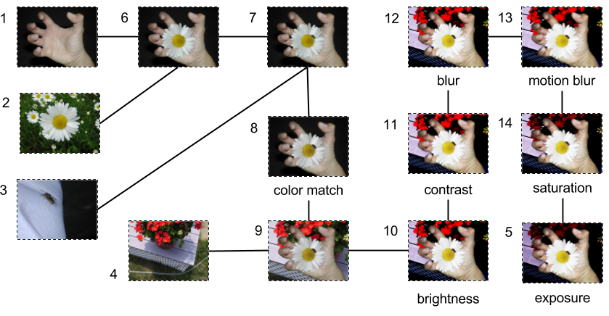
U-Phylogeny
Introduction Proposed Method Datasets and Evaluation Measure Experimental Results Conclusions
U-Phylogeny: A new, generalized method for provenance graph construction based on image content
Extended U-Phylogeny: Improves accuracy using additional steps from previously existing literature

Slide 11
The Pipeline
Introduction Proposed Method Datasets and Evaluation Measure Experimental Results Conclusions
Detection and description of points of interest (SURF)
Keypoint Matching
Match Filtering
L2 Distance
Geometrically Consistent Matching (GCM)
Dissimilarity computation
Number of GCM’s c. Mean Squared Error (MSE) (extended u-phy)
Distance of GCM’s d. Mutual Information (MI) (extended u-phy)
Matrix
5. Kruskal’s MST Algorithm
Graph

Slide 12
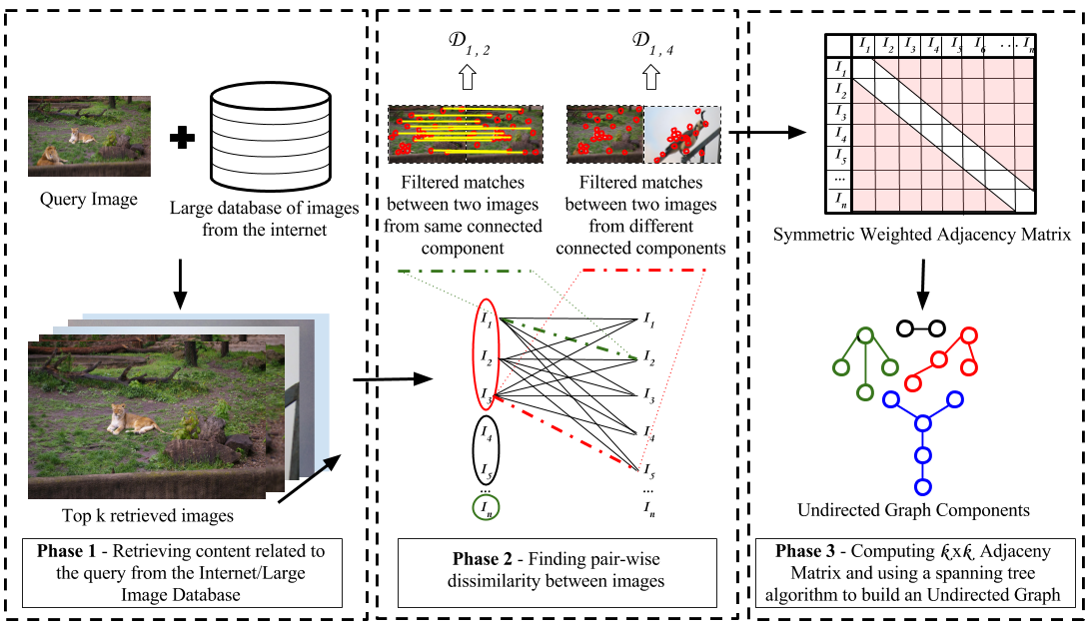
The Pipeline
Introduction Proposed Method Datasets and Evaluation Measure Experimental Results Conclusions

Slide 13
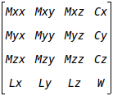
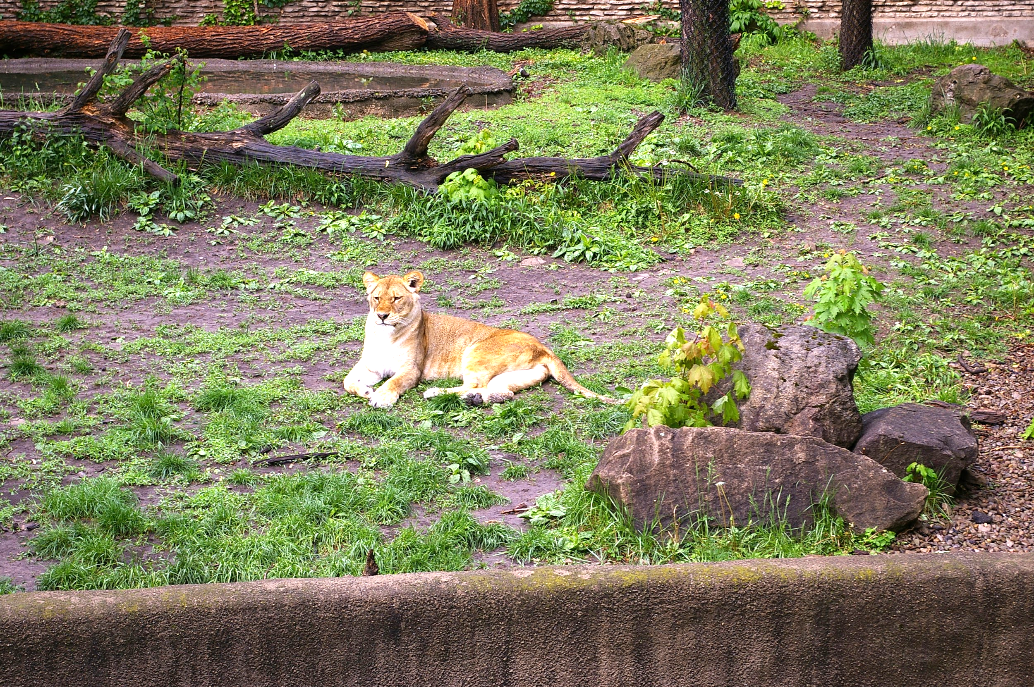
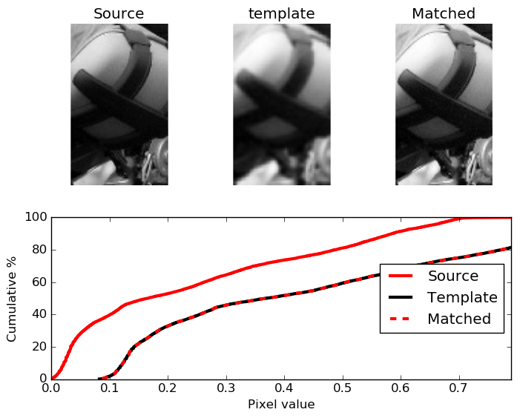
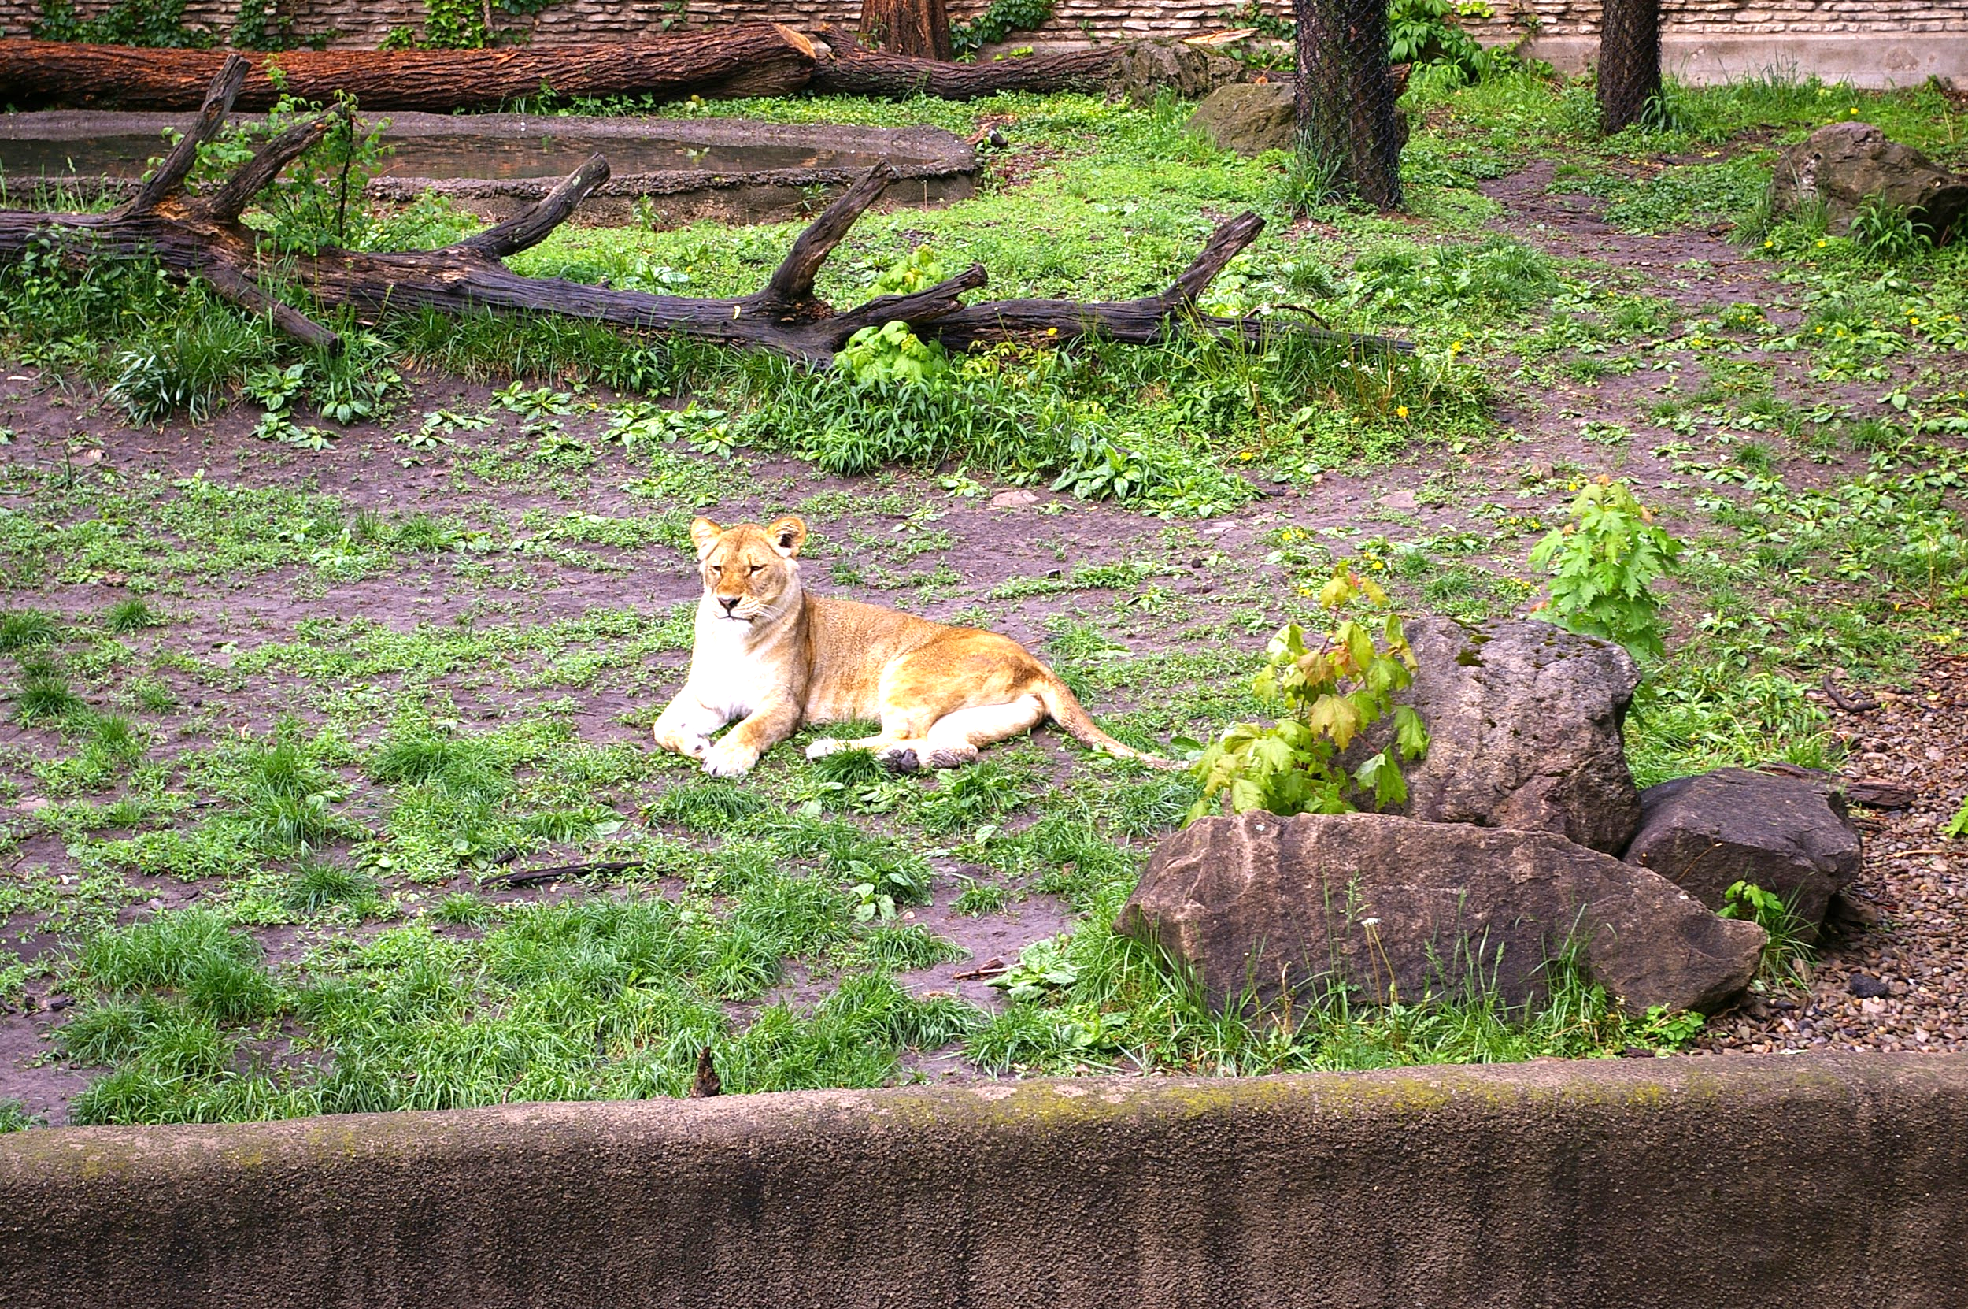
Extended U-Phylogeny
Introduction Proposed Method Datasets and Evaluation Measure Experimental Results Conclusions
Convex-hull based ROI extraction
ROI 1
ROI 2
Compute dissimilarity
Color correction of ROIs

Slide 14
Datasets Used
Introduction Proposed Method Datasets and Evaluation Measure Experimental Results Conclusions
NC2017-DEV2 Dataset provided by the National Institute of Standards and Technology (NIST)
59 queries and 10446 gallery images
59 provenance cases with 750 images in total
Average graph order = 12.7, Range - [3, 82]
Small (<=12 nodes) Medium (13-20 nodes) Large (>20 nodes)

Slide 15
Evaluation Metrics
Introduction Proposed Method Datasets and Evaluation Measure Experimental Results Conclusions
Existing metrics not applicable
Adopting web graph metrics
Precision (nodes) = | nodes(Gʹ) ∩ nodes(G) | |nodes(Gʹ)|
Recall (nodes) = | nodes(Gʹ) ∩ nodes(G) | |nodes(G)|
VEO(G,Gʹ) = | nodes(Gʹ) ∩ nodes(G) | + | edges(Gʹ) ∩ edges(G) | |nodes(Gʹ)|+|nodes(G)|+|edges(Gʹ)|+|edges(G)|

Slide 16
Experimental Setup
Introduction Proposed Method Datasets and Evaluation Measure Experimental Results Conclusions
Without Distractor Images
“Oracle”
A correct corpus is provided for each particular case
All images in corpus are related
Uses all cases from the dataset
Small, Medium, Large – based on the graph order
With Distractor Images
“In the wild”
Simulates retrieving images from an imperfect filtering source
Uses the small cases with (25-n) distractors

Slide 17
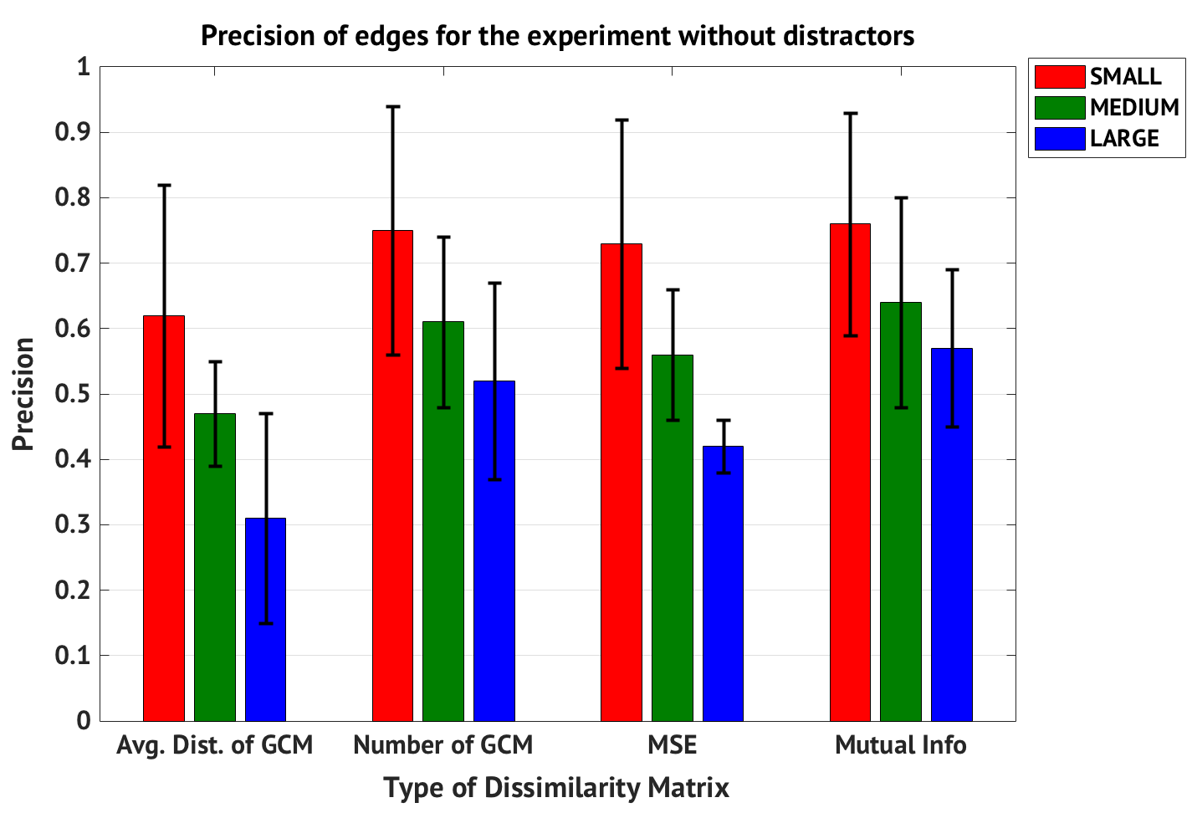
Oracle Scenarios
Introduction Proposed Method Datasets and Evaluation Measure Experimental Results Conclusions
* Node evaluation N\A

Slide 18
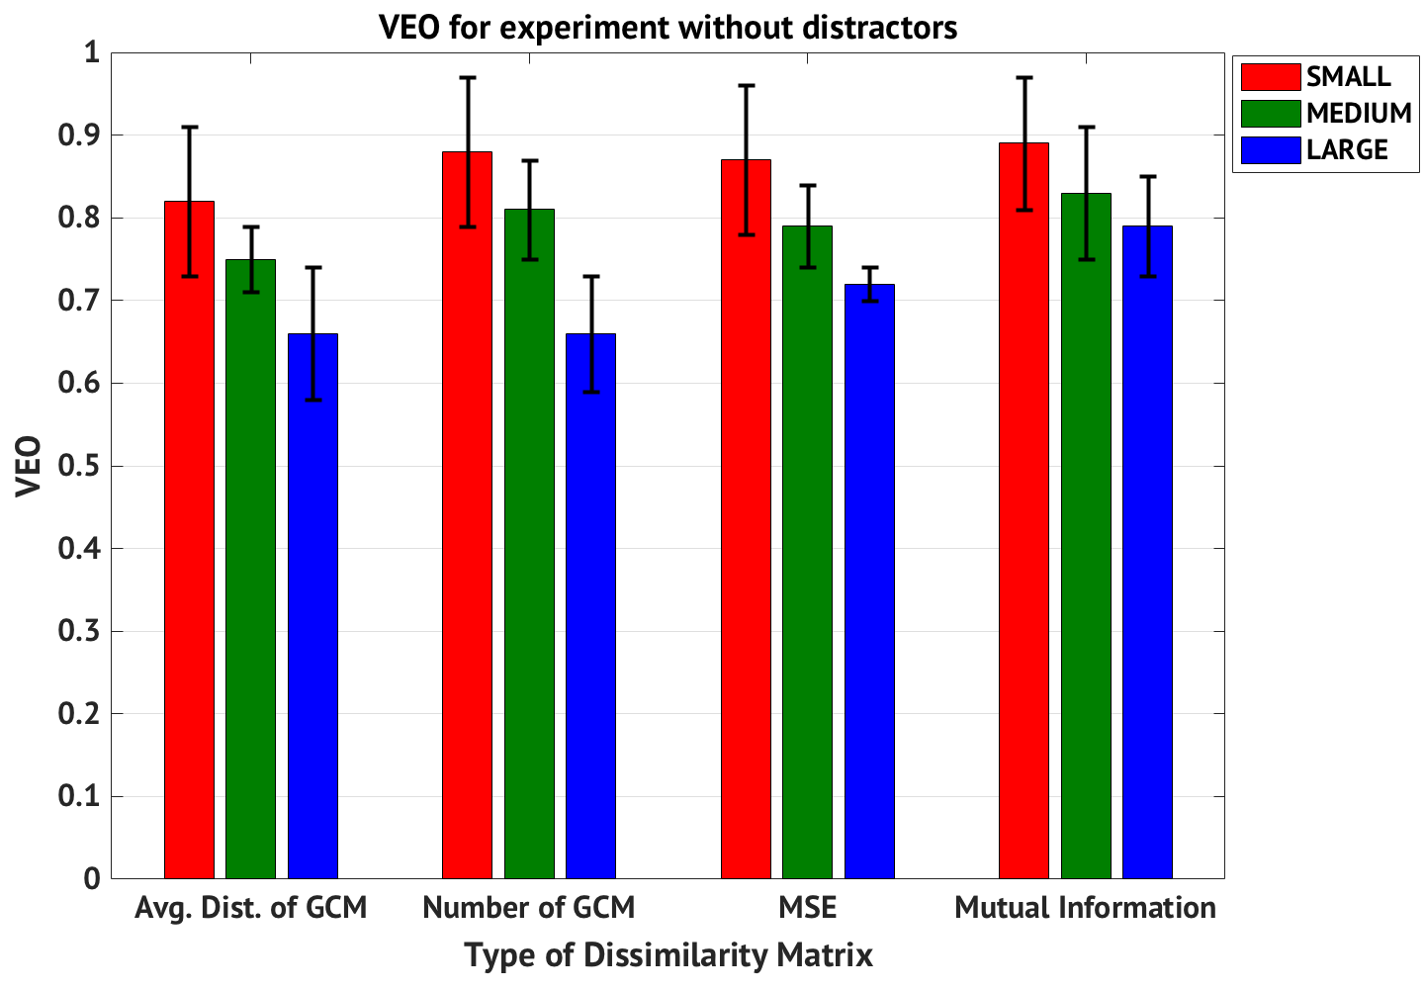
Oracle Scenarios
Introduction Proposed Method Datasets and Evaluation Measure Experimental Results Conclusions

Slide 19
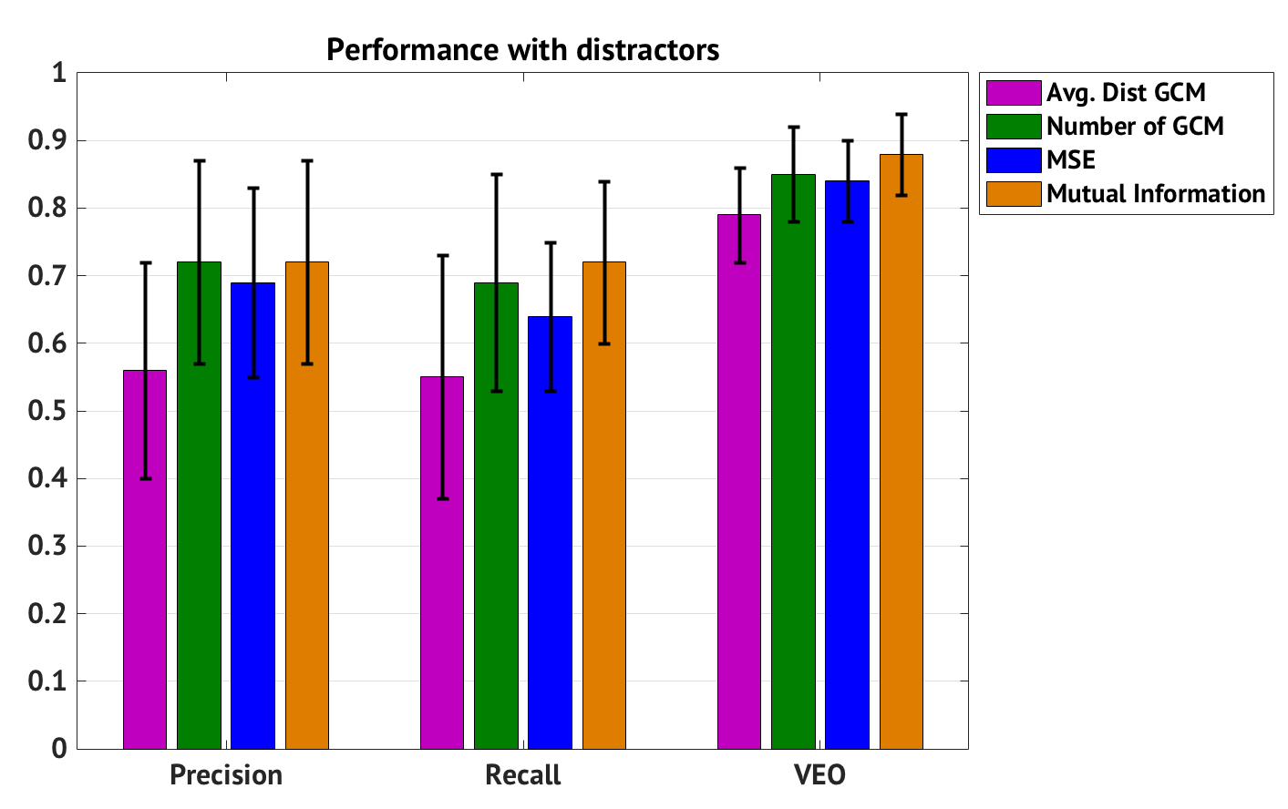
In the wild scenarios
Introduction Proposed Method Datasets and Evaluation Measure Experimental Results Conclusions
Precision_{nodes}= Recall_{nodes}= 1.00∓0.00
Precision_{nodes}= Recall_{nodes}= 0.98∓0.05

Slide 20
Conclusions
Introduction Proposed Method Datasets and Evaluation Measure Experimental Results Conclusions
Effectiveness decreases with the size and complexity of graphs irrespective of dissimilarity calculation method
Extended U-Phylogeny performs better on average
Reduced efficiency (2x execution time¹)
Mutual information works better than MSE
U-Phylogeny is robust to presence of disctractors
Maintains VEO of ~88%
¹On an Intel(R) i7-5930K CPU 3.50GHz with 64GB of RAM, U-phylogeny takes 3.8s to compare two images while the extended version takes 6.7s

Slide 21
Acknowledgements
Introduction Proposed Method Datasets and Evaluation Measure Experimental Results Conclusions

