Slide 1
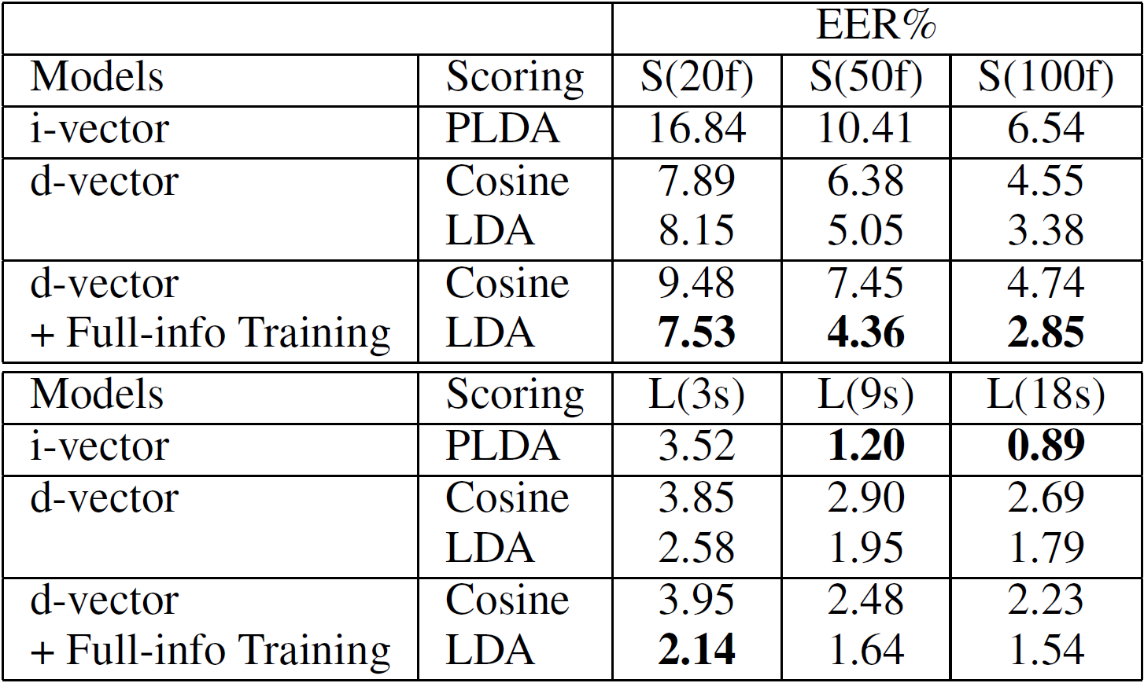
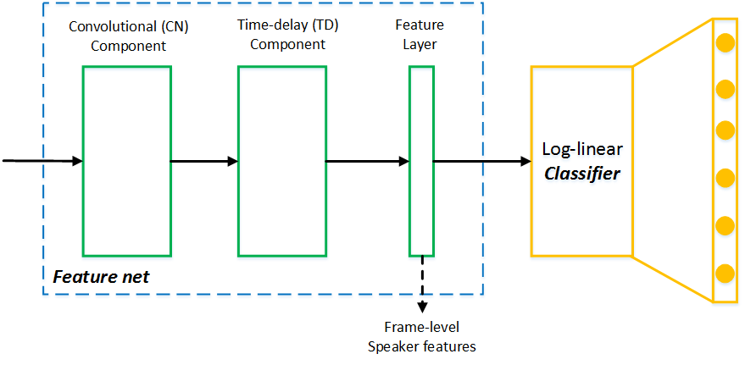
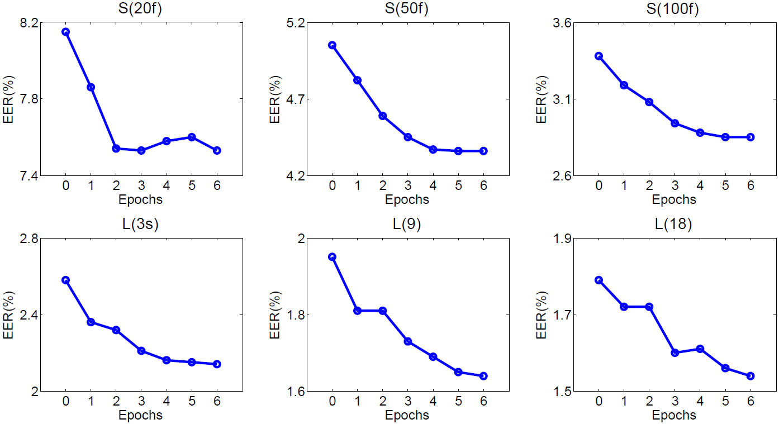
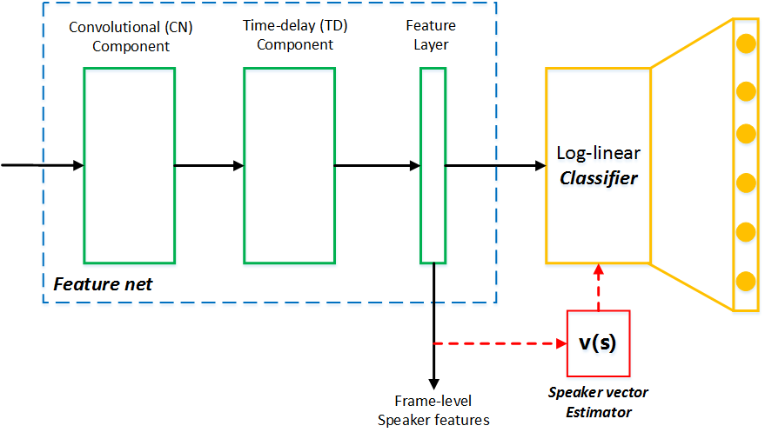
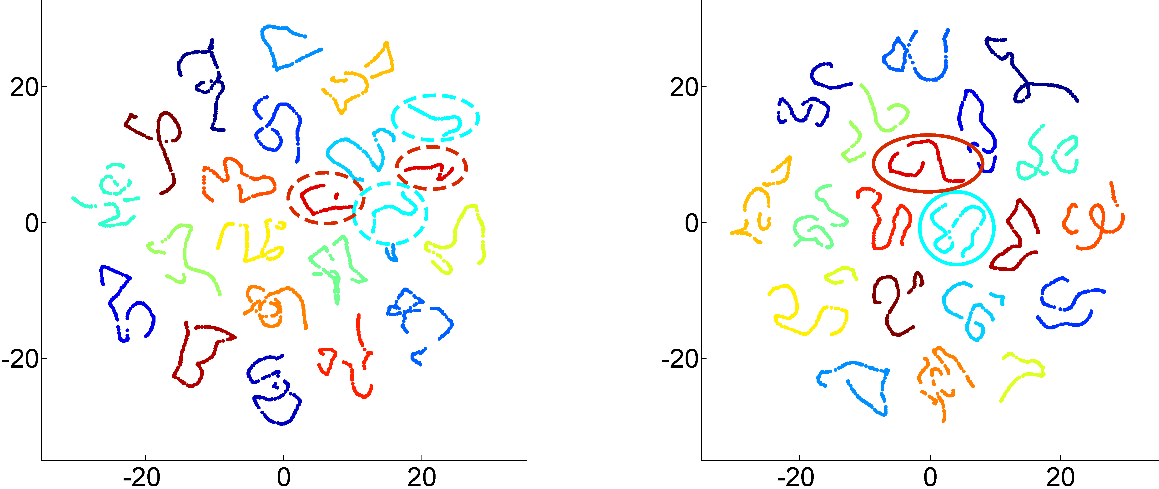
Full-info Training for Deep Speaker Feature Learning
Lantian Li, Zhiyuan Tang, Dong Wang, Thomas Fang Zheng
Center for Speech and Language Technologies (CSLT), RIIT, Tsinghua University, China
http://cslt.riit.tsinghua.edu.cn
Introduction
Full-info training
Experiments
Basic CT-DNN model
Feature net
Convolutional component
Time-delay component
Group-size p-norm
Classifier
Discriminate among speakers
Deep speaker features
Last hidden layer
Potential problems
Model training
No within-speaker constraints
Feature extraction
‘Information leak’
Idea
Discard parametric classifier
Use speaker features as classifier
Solution
(1) speaker vector
(2) softmax function
(3) cross entropy
Implementation
Fisher database (5,000 / 1,000)
Iterative training
Visualization by t-SNE

