Slide 1
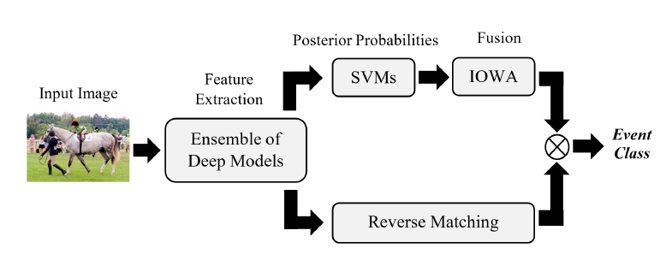
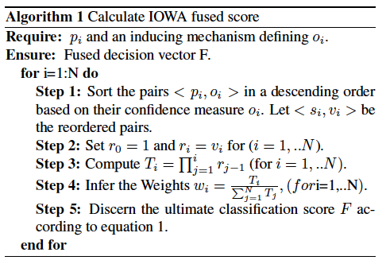
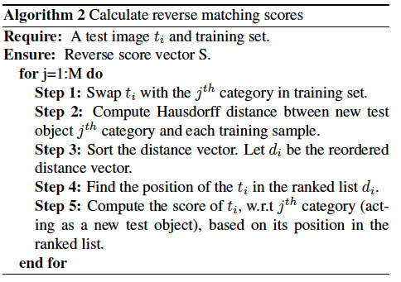
A Pool of Deep Models for Event Recognition
K. Ahmad, M. L. Mekhalfi, N. Conci, G. Boato, F. Melgani and F G. B. De Natale
Multimedia Signal Processing and Understanding Lab, DISI, University of Trento, Italy
Abstract
Overall Scheme
Experimental Results
This paper proposes a novel two-stage framework for event recognition in still images. First, for a generic event image, we extract deep features obtained via different pre-trained models, and feed them into an ensemble of classifiers, whose posterior classification probabilities are thereafter fused by means of an order induced scheme, which penalizes the yielded scores according to their confidence in classifying the image at hand, and then averages them. Second, we combine the fusion results with a reverse matching paradigm in order to draw the final output of our proposed pipeline. We evaluate our approach on three challenging datasets and we show that better results can be attained, outperforming the SoA in this area.
Network | Avg. Acc.
VggNet ImageNet Features | 45.78%
VggNet Places Features | 43.46%
GoogleNet ImageNet Features | 39.83%
GoogleNet Places Features | 39.71%
AlexNet ImageNet Features | 42.78%
AlexNet Places Features | 40.05
Method | Avg. Acc.
Baseline Method | 39.70%
Deep Channel Fusion | 42.40%
SoA1 | 44.06%
SoA2 | 53.00%
Our Approach | 59.49%
Motivation and Approach
Table. 1: Classification results with individual models.
Table. 4: Comparison with SoA on WIDER
Most of the existing approaches tend to fuse the object-level and scene-level information assigning them equal contributions.
This is sub-optimal, as event-related images show significantly diverse sets of chromatic and spatial contexts, often characterized by large inter-class and low intra-class similarities.
According to this, we assume that weights should be allocated to each model based on its capacity in representing specific pieces of information and features that are characteristic of the underlying event/image.
Network | Avg. Acc.
VggNet (O+S) | 54.22%
GoogleNet (O+S) | 49.28%
ALexNet (O+S) | 51.00%
GoogleNet (O) + AlexNet (O) | 52.00%
VggNet (O) + AlexNet (O) | 53.37%
VggNet (O) + GoogleNet (O) | 53.80%
VggNet (S) + AlexNet (S) | 52.93%
VggNet (O+S) + AlexNet (O+S) | 56.86%
VggNet (O+S) + GoogleNet (O+S) | 57.02%
VggNet (O+S) + AlexNet (O+S) + GoogleNe (O+S) | 58.05%
VggNet (O+S) + AlexNet (O+S) + GoogleNe (O+S) + Reverse Matching | 59.49%
Method | Avg. Acc.
Baseline Method | 73.40%
CNN places | 94.00%
GoogleNet GAP | 95.00%
Transferring object and Scene | 98.80%
Our Approach | 99.02%
Induced Ordered Weighted Averaging (IOWA)
Reverse Matching Strategy
Table. 5: Comparison with SoA on UIUC Sports Dataset
The main contributions of this work can be summarized as follows:
A novel fusion scheme, inspired by the concept of Induced Ordered Weighted Averaging operators¹
The application of a reverse matching concept, which has been proven to be useful in other computer vision domains² .
A thorough investigation of the performances of different CNN architectures, applied to object-level and scene-level level information
Method | Avg. Acc. on Subset 1 | Avg. Acc. On Subset 2
AlexNet pre-trained on USED Dataset | 70.03% | 65.96
Spatial Paramid | 72.00% | 79.92
Our Approach | 79.13% | 87.02%
Table. 2: Classification results of different combination with IOWA
Table. 3: A comparison against state of the art on USED dataset
Methodology
Conclusions
The proposed approach builds upon 5 processing steps:
Feature Extraction: using 3 deep models: AlexNet, Google Net and VggNet with 16 layers.
Classification: SVM-based classification
Fusion of Deep Models: IOWA-based late fusion.
Reverse Matching: based on the approach proposed in [2] .
Final Score Computation: based on the simple multiplication of the results of phase 4 and phase 3.
Datasets and Experimental Setup
Selected References
Datasets: For the experimental validation of the proposed approach we use 3 different datasets including:
WIDER
USED
UIUC Sports Dataset
Experimental setup: we conducted the following 3 experiments:
Experiment 1: investigate the performance of individual models pre-trained on ImageNet and Places datasets.
Experiment 2: assess the performance of IOWA-fused models on the same and on different architectures.
Experiment 3: include the Reverse matching strategy in the framework to raise the classification rates.
We have proposed a novel framework for event recognition in single still pictures. Experimental results demonstrate that:
Fusion of different deep models from the same as well as different architectures outperforms the individual models.
IOWA-based fusion succeeds in giving more importance to the models with higher confidence in a learning-free fashion.
As proven in other computer vision domains, reverse matching can boost event recognition performances.
R. R Yager and D. P Filev, “Induced ordered weighted averaging operators,” IEEE Transactions on Systems, Man, and Cybernetics, Part B (Cybernetics) , vol. 29, no. 2, pp. 141–150, 1999.
Q. Leng, R. Hu, C. Liang, Y. Wang, and J. Chen, “Bidirectional ranking for person re-identification,” in IEEE ICME , 2013, pp. 1–6.

