Slide 1
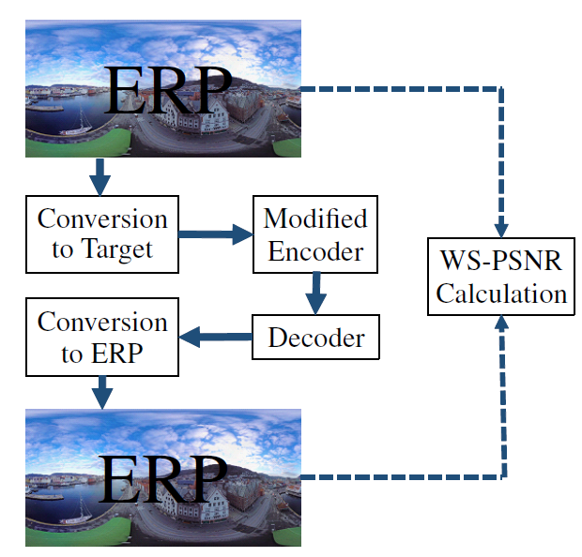
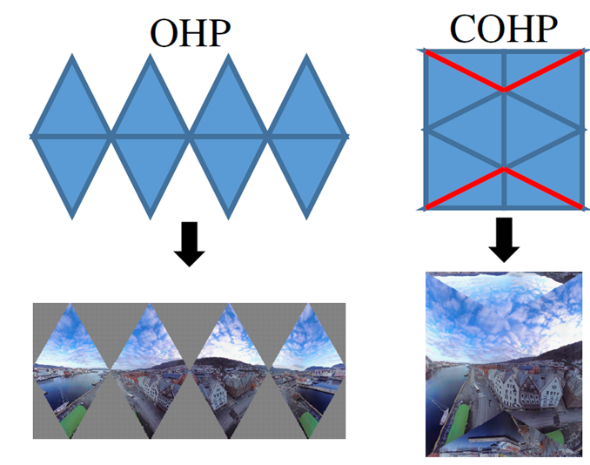
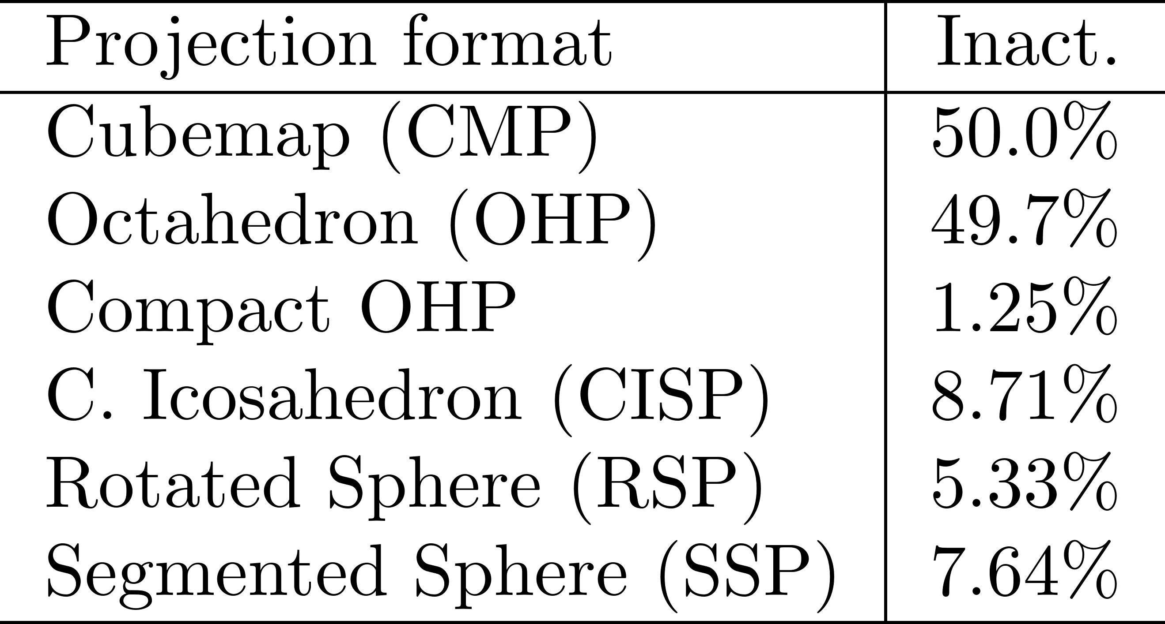
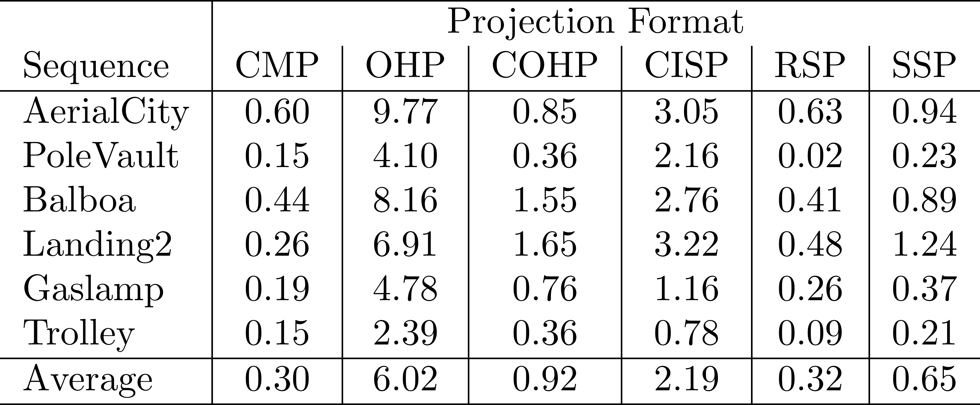
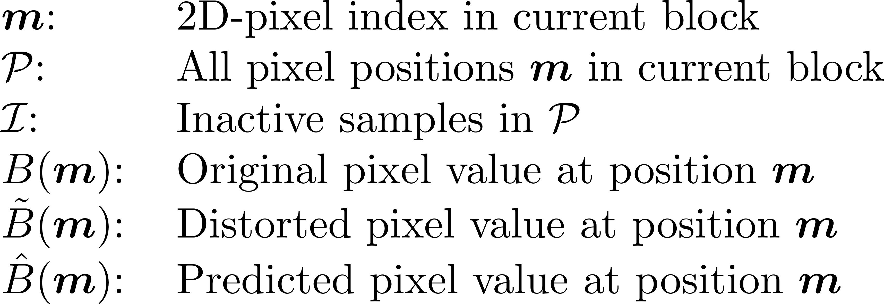
EFFICIENT CODING OF 360° VIDEOS EXPLOITING INACTIVE REGIONS IN PROJECTION FORMATS
C. J. Herglotz¹, M. Jamali¹, S. Coulombe¹, C. Vazquez¹, A. Vakili²
¹École de technologie supérieure (ÉTS), ²Summit Tech Multimedia, Montréal, Canada
2. Inactive Regions
4. Evaluation
1. Introduction
Example: Octahedron packing (OHP) and compact OHP (COHP)
Modern 360° video enables the deployment of immersive live video streaming applications.
The classic equirectangular projection (ERP) format is disadvantageous for video compression because of a high pixel density at the poles.
New projection formats circumvent this effect by projecting to multiple faces.
Packing faces into 2D videos introduces inactive regions, i.e. regions without useful information.
In standard rate-distortion optimization (RDO), these regions are also coded in an optimal RD-sense.
Projection with 360Lib-7.0
Encoder: HM-16.20, randomaccess
WS-PSNR calculation in ERP-domain
6 sequences
Inactive region share (4K):
5. Results
6. Visual Results
BD-rate savings [%] with respect to HM-16.20
3. Proposed Algorithm
Decoded sequences after conventional (top) and proposed (bottom) encoding for all tested formats (HM encoder).
Idea: Perform pure rate-optimization in inactive regions
Distortion Calculation
Residual Calculation
SAO Calculation
Do not consider inactive pixels for SAO-statistics
Conventional
7. Conclusion
Current compression method for inactive regions is not optimal.
Encoders can be modified to allow RD-optimal compression.
Depending on the projection format and frame packing, on our test set, an average of 0.3% to up to 6% of rate can be saved at a constant objective quality.
Method applicable for all sequences containing inactive or irrelevant regions.
Proposed

