Slide 1
Data Compression Conference
MacSR: Macroblock-aware Lightweight Video
Super-Resolution
Presenter: Rui He
Southern University of Science and Technology

Slide 2
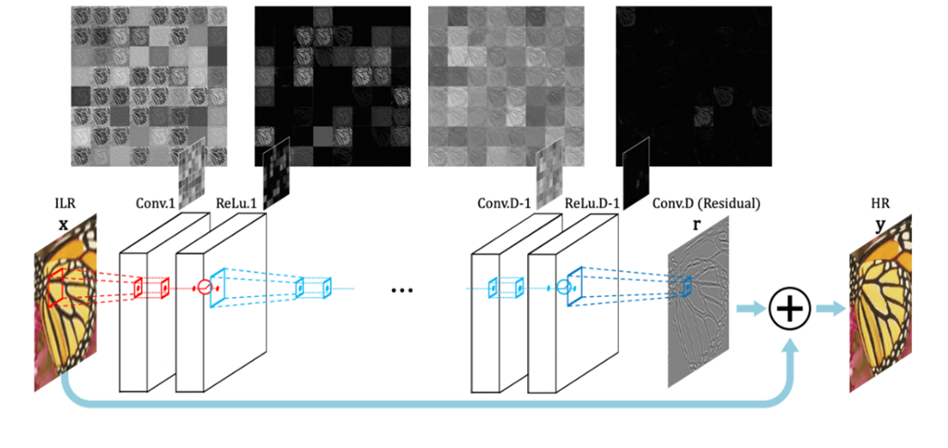
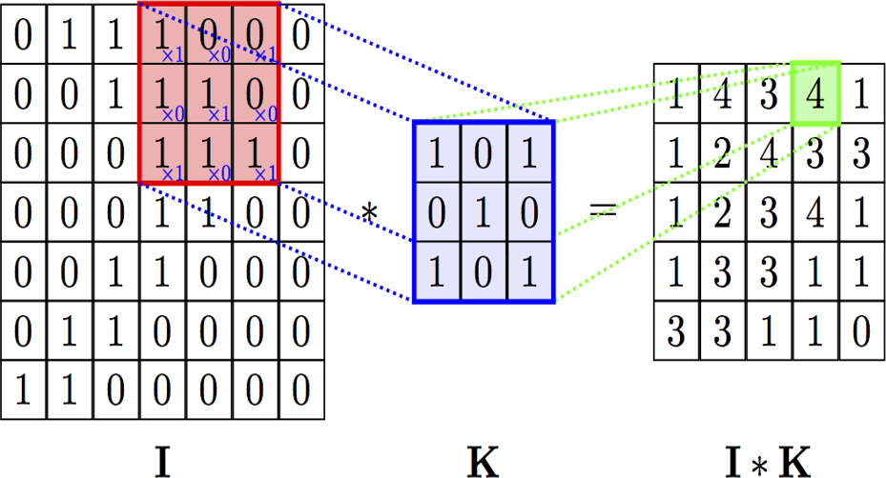
Background:CNN-based Super-resolution
CNN-based Super-resolution (SR) is the state-of-the-art vision algorithm.
Fig 1 :Structure of SRCNN
Fig 2 :Time-consuming Convolution Operation
CNN-based SR effectively improves video quality, but the algorithm is computationally intensive.
processing 1 frame costs 100ms
30fps*100ms=3s >>1s
Fig 3 :Energy-sensitive Mobile Devices

Slide 3
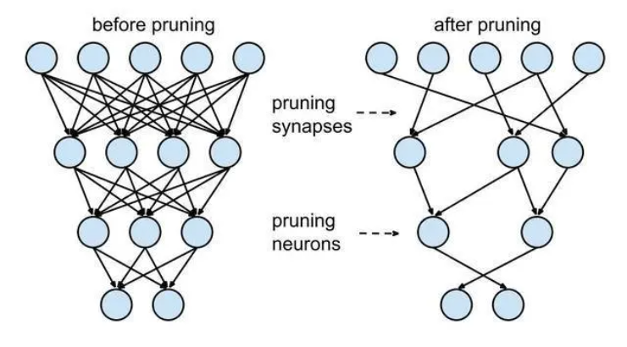
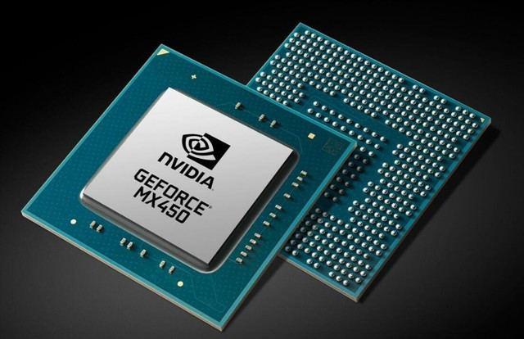
Background:Optimizing CNN Workloads
Lightweight Model
Reduce the number of parameters
Reduce floating point operations
Minimize video quality loss
Fig 4 :Pruning CNN
Hardware Optimization
Specially designed hardware accelerator
GPU support
Fig 5 :GPU Parallel Computing

Slide 4
Background:Optimizing CNN Workloads
Lightweight Model
Reduce the number of parameters
Reduce floating point operations
Minimize video quality loss
Drawback:
The video frame has time correlation
Per frame SR generates computational redundancy
Hardware Optimization
Specially designed hardware accelerator
GPU support

Slide 5
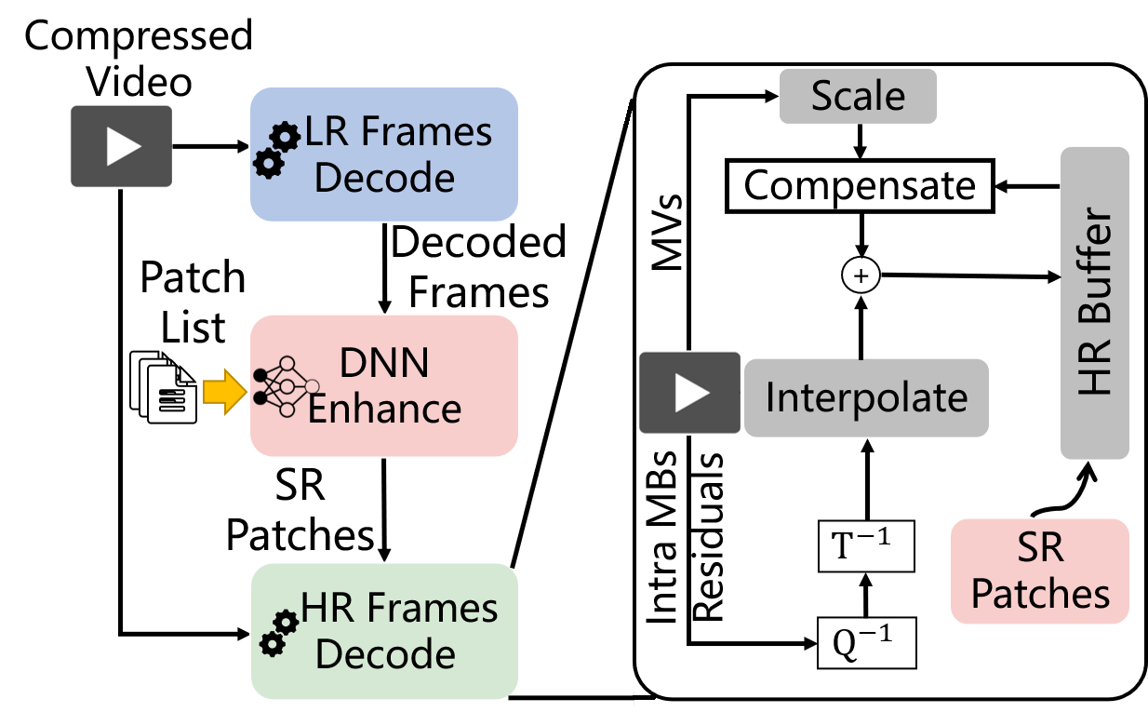
MacSR Design
Different from other schemes:
Image block-based SR
Lightweight SR and decoding scheme in client side
Offline pre-analysis for image blocks in server side
Goal:
Reduce the SR calculation overhead of the terminal
Patch lists select the image blocks to be super-resolved
Time redundancy in calculation
Fig 6:SR-integrated Decoder

Slide 6
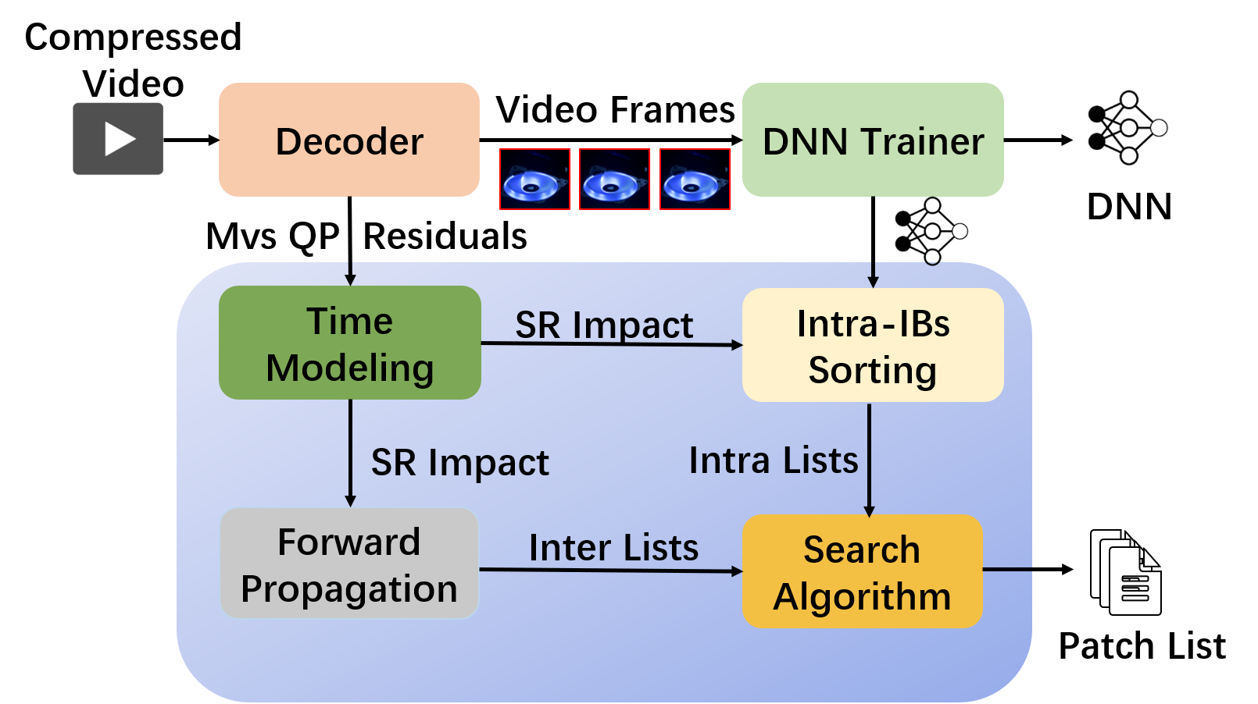
MacSR Design
Different from other schemes:
Image block-based SR
Lightweight SR and decoding scheme in client side
Offline pre-analysis for image blocks in server side
Tasks:
Generate patch list
Train SR DNN for on-demand video
How to generate patch lists:
Use decoded information
Fig 7:Offline Pre-analysis in Server Side

Slide 7
MacSR Design
How to generate patch lists?
Use decoded information
Two image blocks :
Intra image block ; Inter image blcok
Time modeling
Forward propagation
Intra image block sorting
Search Algorithm
Obtain the importance estimation of each image block
Select inter image blocks with different threshold
Sort intra image blocks
Decide final image blocks combination
Fig 7:Offline Pre-analysis in Server Side

Slide 8
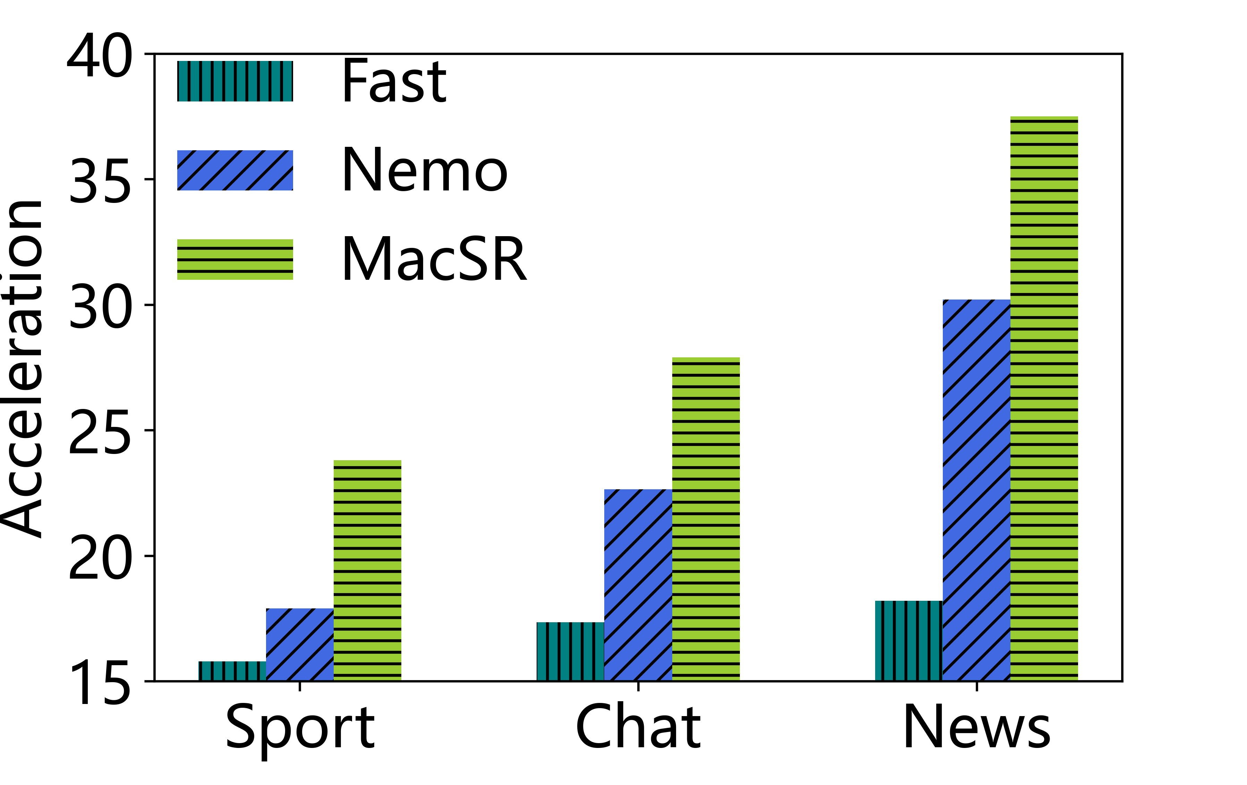
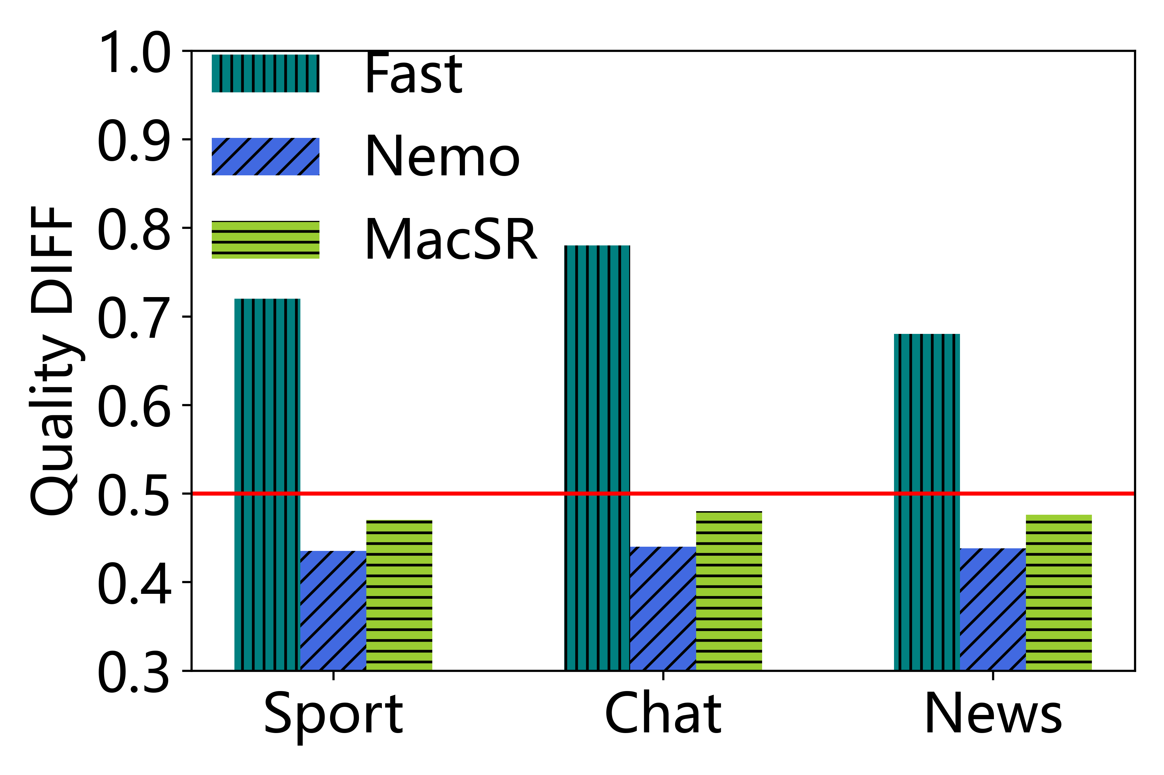
Experimental Result
use less time than previous work
Quality_{allblockSR}-Quality_{blockSR}<0.5dB
Fig 9: Acceleration
Fig 10: Quality

Slide 9
Conclusion
We propose MacSR, a lightweight SR scheme with the assistance of MB information. MacSR
determines the patch lists that meet the quality requirements with minimal SR areas
on the server side. The client can use patch lists to achieve selective SR, thus effectively saving computing resources. Our scheme reduces computing cost by up to 32% compared to previous work.
Future Work:
More accurate measurement on terminal equipment
Optimization combined with ABR algorithm

Slide 10
THANKS!

