Slide 1
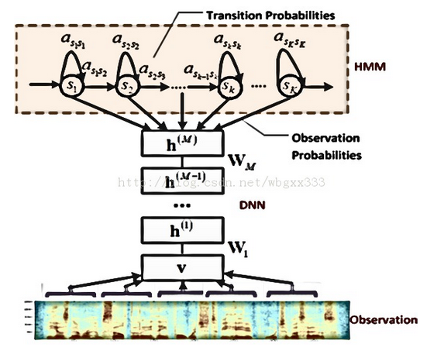
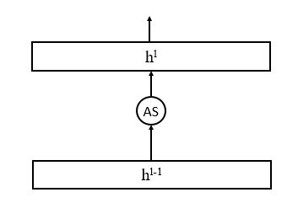
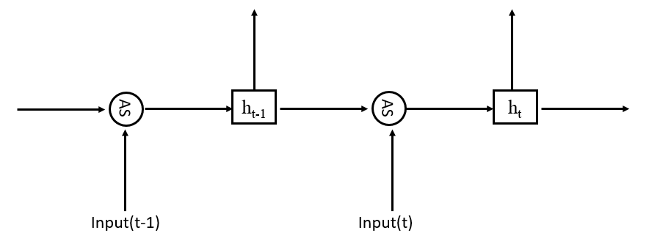
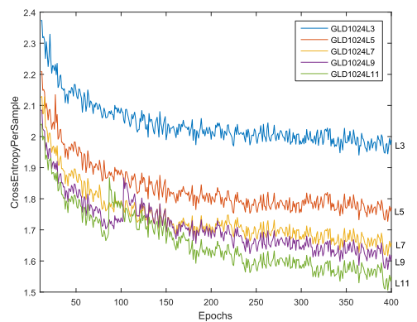
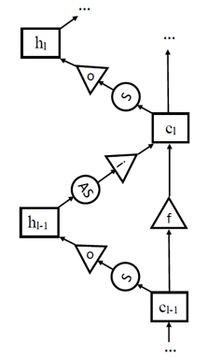
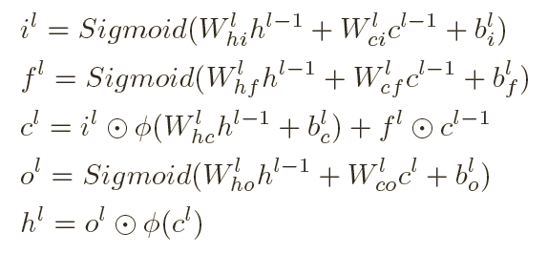
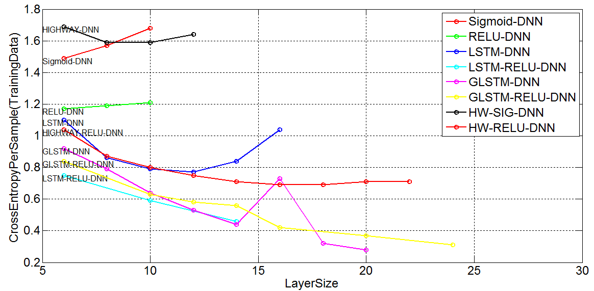
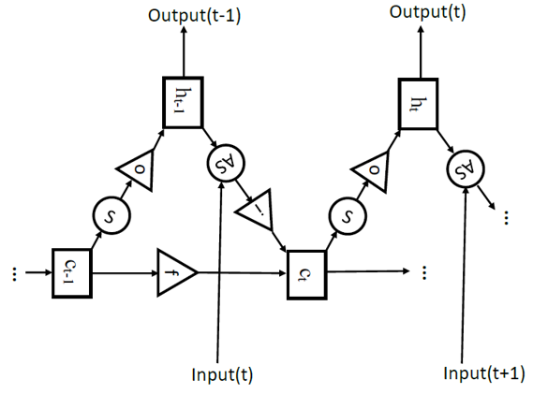
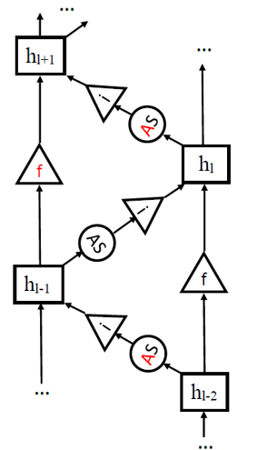
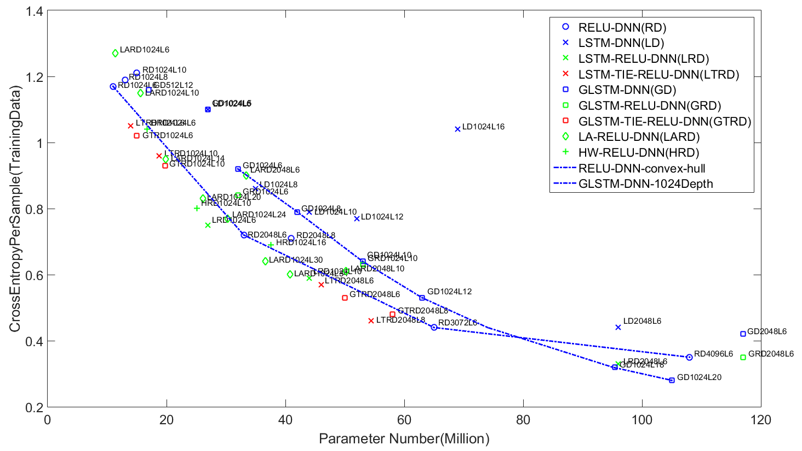
EXPLOITING LSTM STRUCTURE IN DEEP NEURAL NETWORKS FOR SPEECH RECOGNITION
Tianxing He, Jasha Droppo SpeechLab Shanghai Jiao Tong University, Microsoft Research Redmond cloudygooseg@gmail.com, jdroppo@microsoft.com
Overview
The CD-DNN-HMM Framework
Experiments
Motivation: DNN training suffers from the vanishing gradient problem, and training deep models has been difficult.
Approach: Borrow the famous LSTM structure from RNN and use it along depth.
Experiments and Discussion: The LSTM enables deeper NN to be trained, and got 8.2% relative word error rate reduction on the swb2000 data set.
The same “vanishing gradient” problem also exists for DNN.
AMI
Switchboard
80h for training, 9.7h for dev, 9.1h for test
Close-talking IHM set
40-dimensional MFCC, with CMN
DNN Input: 1080 Output:5000
MBSize:256, each epoch:24h, no momentum, L2:1e-6
309h(SWBD1) + 1700h(Fisher), hub5’00(1831 utterances for testing)
40-dimensional MFCC, with CMN
DNN Input: 920 Output:9000
MBSize:1024forG1, 4096forG4, each epoch:24h, momentum:0.9, L2:1e-6
Techniques: 1-bit 4GPU
Model | CE(CV) | CE(TR) | WER
Sigmid-DNN 2048L6 | 2.04 | 1.46 | 31.4
Highway-DNN 2048L10 | 2.04 | 1.4 | 31.8
RELU-DNN 2048L6 | 2.49 | 1.25 | Over-fit
LSTM-DNN 2048L3 | 2.34 | 1.28 | Over-fit
A Review of LSTM-RNN
Model | Parameter Number | WER
Sigmid-DNN 2048L7 | 45M | 15.69
RELU-DNN 2048L7 | 45M | 16.29
LSTM-DNN 2048L7 | 121M | 14.39(-8.2%)
GLSTM-DNN 2048L11 | 230M | 15.02(-4.2%)
RNN uses simple affine transformation to utilize history information for current time representation.
Formulations of (G)LSTM-DNN
The LSTM-DNN over-fits even with 3 layers.
LSTM-DNN borrows the LSTM structure and uses it along depth.
 | No dropout |  | With dropout
Model | CE(CV) | CE(TR) | CE(CV) | CE(TR) | WER
RELU-DNN 2048L6 | 2.36 | 1.1 | 2.05 | 1.4 | 30.8
GLSTM-Tanh-DNN 1024L8 | 2.15 | 1.1 | 1.96 | 1.3 | 30.3
LSTM-Tanh-DNN 2048L6 | 2.09 | 1.04 | 1.99 | 1.28 | 31.11
Decoding results.
Dropout can be used to alleviate this problem.
Scaling behavior on training data oriented exp.
LSTM-DNN
LSTM-RNN introduces a cell memory structure and various gates to capture long-term dependency.
Scaling behavior.
Conclusions
GLSTM-DNN
LSTM-DNN enables the training of deeper models.
However, it costs large number of parameters.
Sequence-discriminative training maybe used to further improve utilize the modeling power.
LSTM-RNN

