Slide 1
Video Compression with Arbitrary Rescaling Network
Mengxi Guo, Shijie Zhao*, Hao Jiang, Junlin Li and Li Zhang
{guomengxi.qoelab, zhaoshijie.0526, jianghao, lijunlin.li, lizhang.idm}@bytedance.com

Slide 2
BACKGROUND
Down sample
&
Transcode
1080P
Up
720P
540P
HTTP Server with video content with different qualities
Network
with variable Bandwidth
Heterogeneous Devices
Requesting the right
QoS and QoE

Slide 3
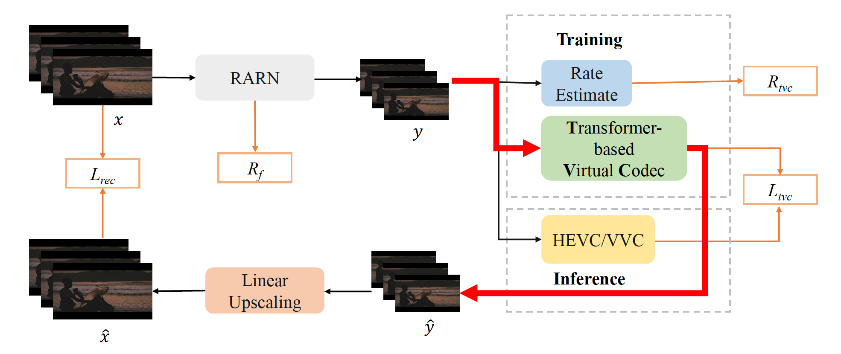
PROPOSED METHODS

Slide 4
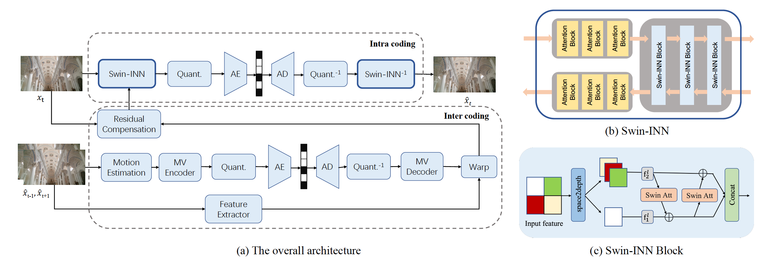
PROPOSED METHODS
Rate-guided arbitrary rescaling network
(RARN)
Transformer
Based
Virtual codec
(TVC)

Slide 5
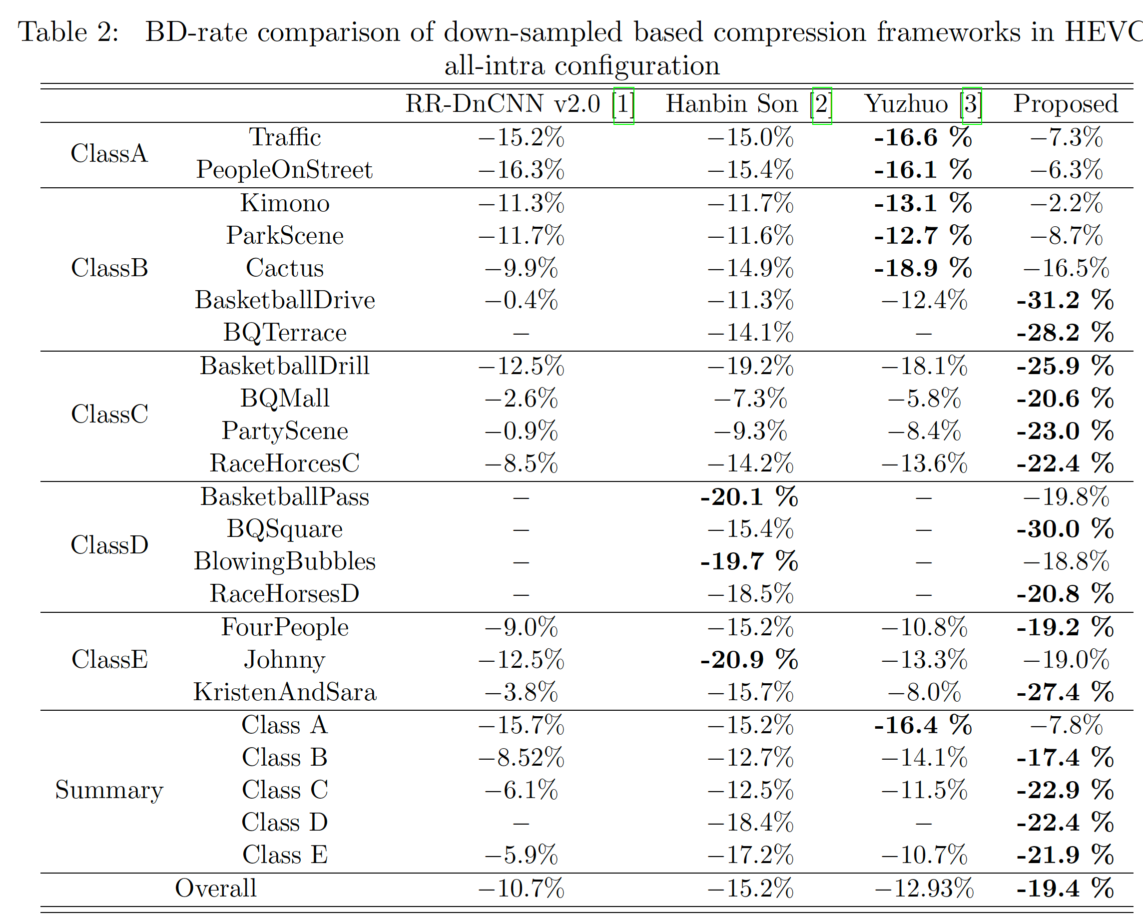
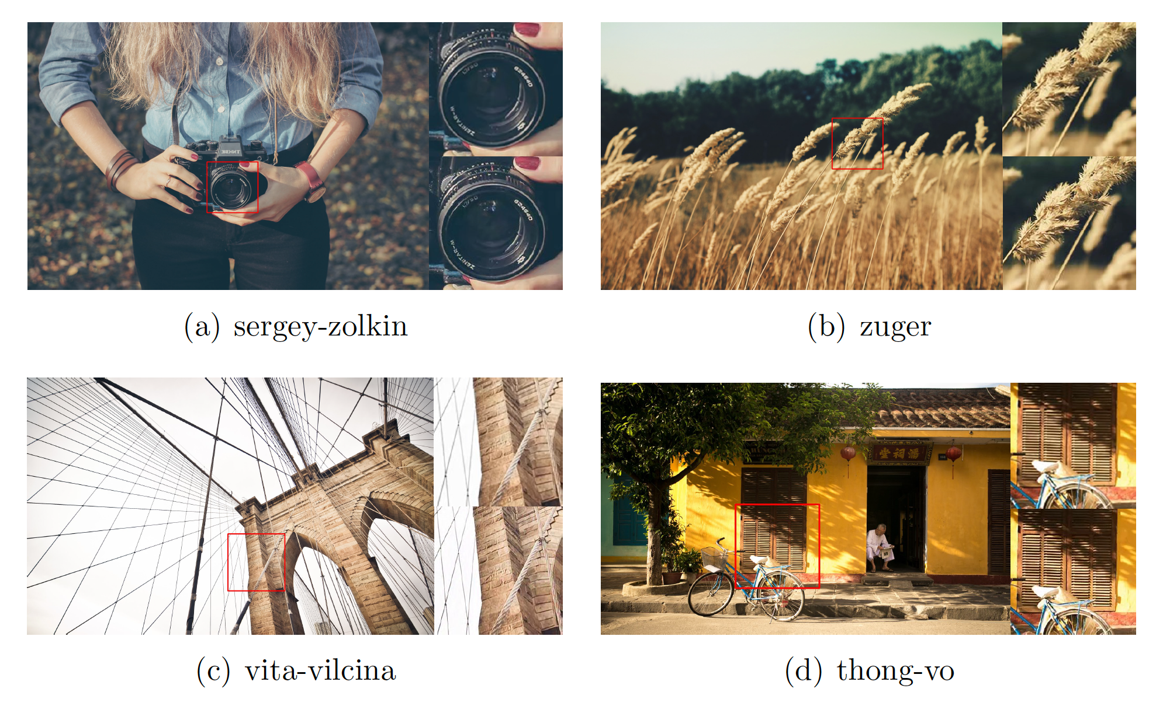
RESULTS

Slide 6
THANKS

