Slide 1
ContextHOI: Contextual Human Object Interaction Understanding From Pre-Trained Large Language Model
Jianjun Gao, Kim-Hui Yap, Kejun Wu, Duc Tri Phan, Kratika Garg, Boon Siew Han

Slide 2
Introduction
Motivation
Existing HOI solutions still suffer from detecting unseen interaction categories and limited zero-shot learning ability.
Current zero-shot learning methods have limitations in understanding context information and comprehensive reasoning.
Objective
To overcome these limitations, we propose ContextHOI to enhance contextual comprehension and zero-shot reasoning ability.

Slide 3
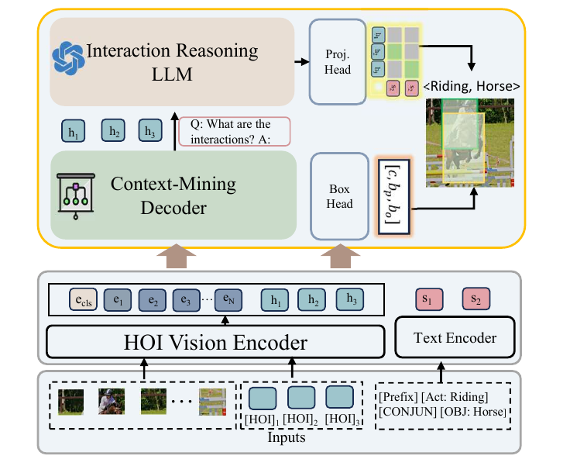
ConetextHOI
Following THID [1], the HOI vision encoder and text encoder are first used to encode image patches with initial HOI tokens and text ground truth into the image, HOI, and text embeddings.
After that, the context-mining decoder is proposed to extract context information for HOI embeddings.
Subsequently, the interaction reasoning LLM is proposed to enhance zero-shot reasoning ability in HOI embeddings.

Slide 4
ConetextHOI
The similarities between final HOI embeddings after projection head and text embeddings are calculated for interaction learning.
Apart from that, a box head is proposed to localize humans and objects from image embeddings and HOI embeddings from the HOI vision encoder.

Slide 5
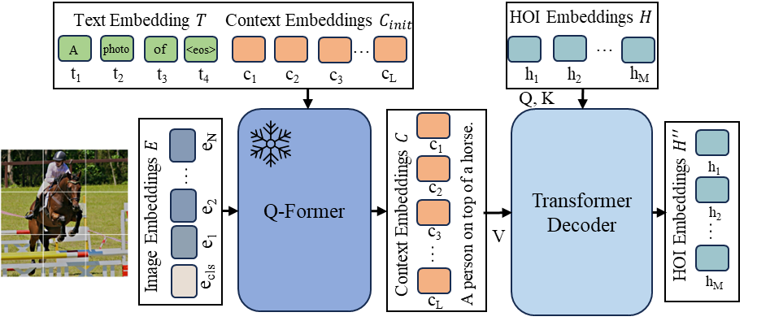
Context Mining Decoder
The Q-former [2] is first utilized to generate linguistic context embedding from visual features.
A transformer decoder is proposed to transfer the context information to HOI embeddings.

Slide 6
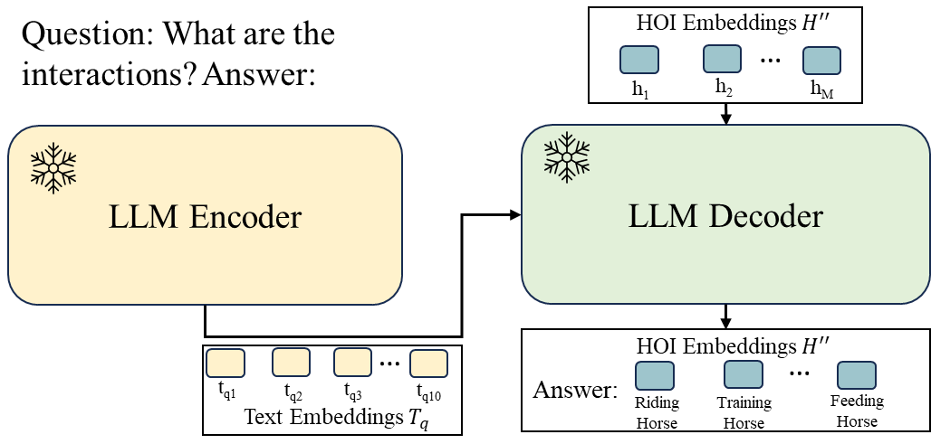
Interaction Reasoning LLM
Inspired by the demonstrated zero-shot learning abilities of LLMs, we propose an interaction reasoning LLM by leveraging Flan-T5 [3].
We provide a question for LLM and let it answer the question according to HOI embeddings.

Slide 7
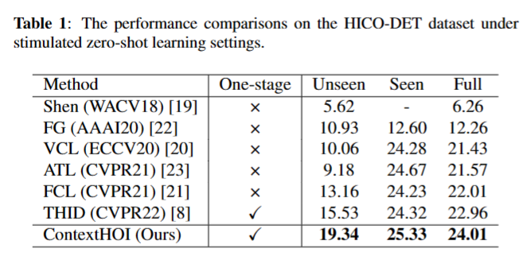
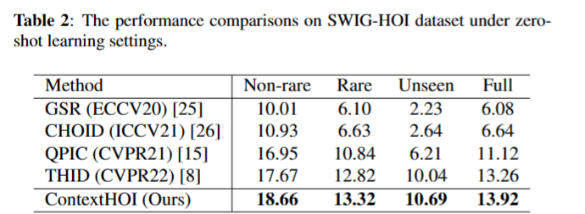
Benchmark Results
We perform benchmark evaluation on two benchmark datasets compared with multiple state-of-the-art methods on HICO-DET and SWIG datasets.
The comparisons show that our proposed context HOI outperforms existing state-of-the-art zero-shot learning methods.

Slide 8
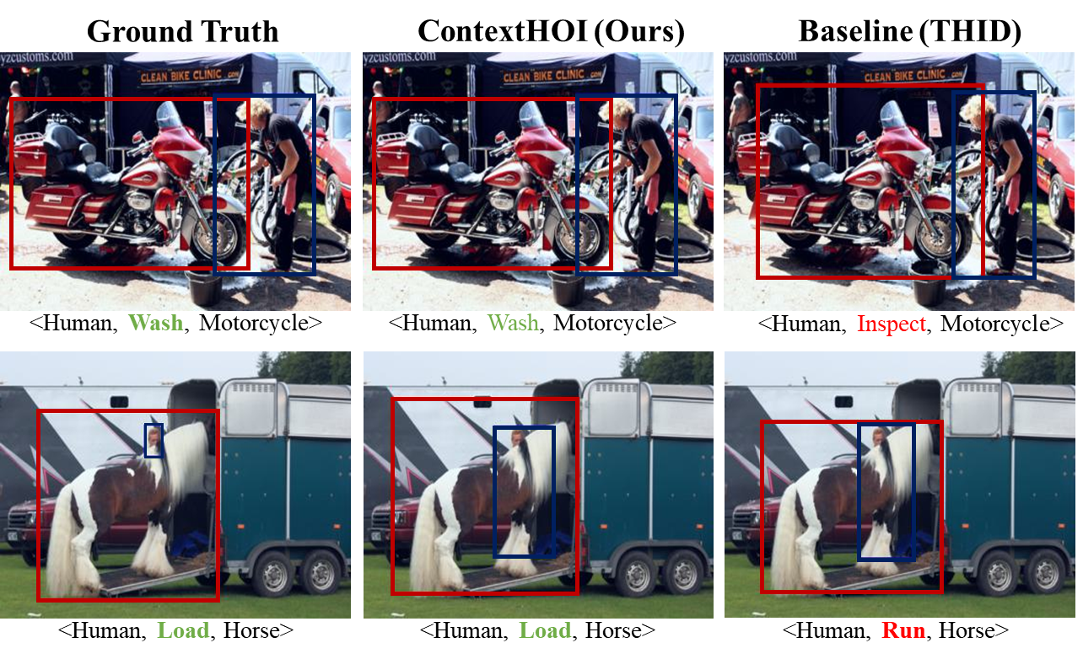
Visualization

Slide 9
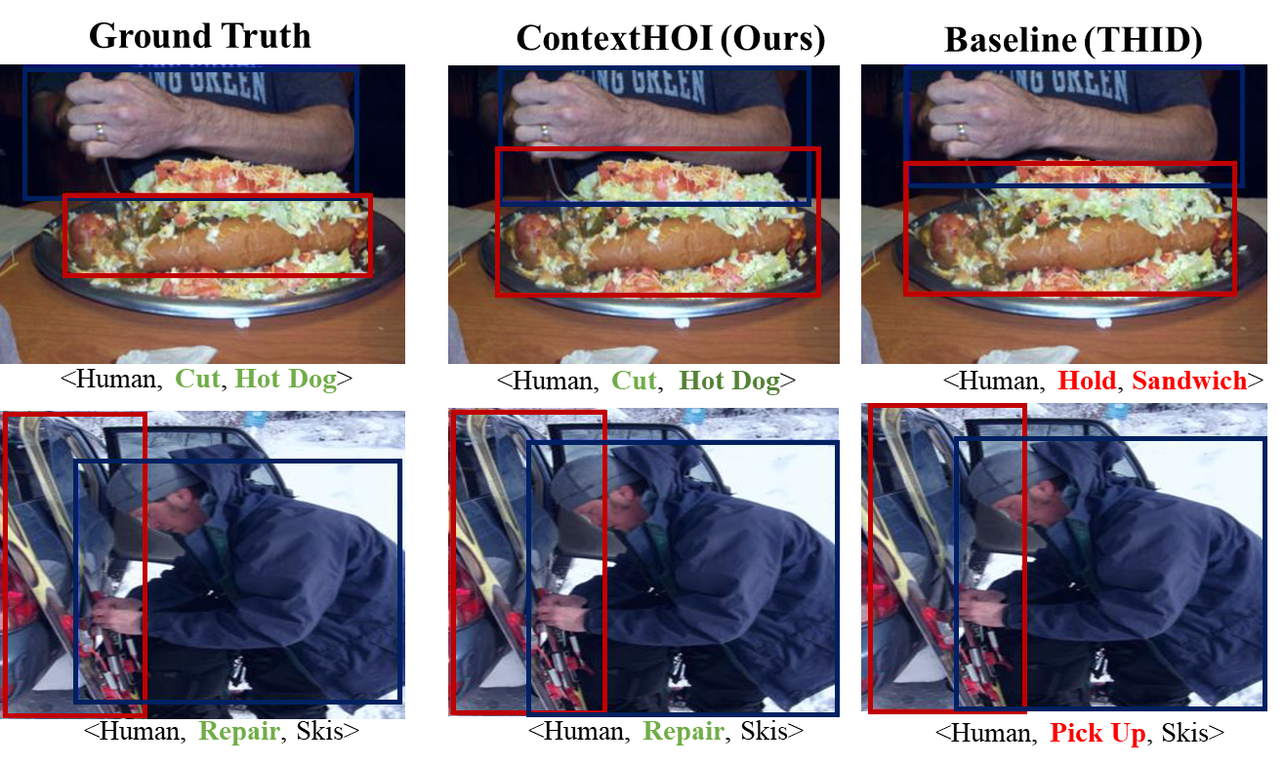
Visualization

Slide 10
References
[1] Wang, Suchen, et al. "Learning transferable human-object interaction detector with natural language supervision." Proceedings of the IEEE/CVF Conference on Computer Vision and Pattern Recognition. 2022.
[2] Li, Junnan, et al. "Blip-2: Bootstrapping language-image pre-training with frozen image encoders and large language models." International conference on machine learning. PMLR, 2023.
[3] Chung, Hyung Won, et al. "Scaling instruction-finetuned language models." arXiv preprint arXiv:2210.11416 (2022).

Slide 11
Thank you.

