Slide 1
Jointly Training of Binary 3D CNN Features for Action
Yangang Cai, Peiyin Xing, Zhenyu Wang and Ronggang Wang
caiyangang@pku.edu.cn
IEEE DCC 2022
Notes:
I'm Cai Yangang, the speaker of this article

Slide 2
ABSTRACT
To address the huge data collection problem in the traditional cloud-centered action recognition, the “front-cloud” collaborative processing framework has been well studied, where the feature is extracted on the front-end devices firstly and then transmitted to the cloud server for further analysis. In this framework, the feature quantization is crucial to reduce the representing bits of feature, subsequently influencing the compression, transmission and storage. Most existing methods often train the 3D CNN model firstly, and then extract features and perform quantization on the features. These methods ignore the influence of the quantization and may lead the accuracy loss. To handle this challenge, this paper omits the standalone quantization and aims to learn the binary feature directly. To achieve this goal, a novel quantization and inverse-quantization layers are introduced to 3D CNN, and train the quantization feature with the action recognition task jointly, and a quantization loss is designed to minimize the information loss of the quantization. In addition, an iterative optimization algorithm is proposed to overcome the learning difficulty caused by the nondifferentiability of the quantization. Experimental results on ResNet-50 and InceptionV1 show that the jointly trained logarithmic quantization represents the features by only 1 bit without recognition accuracy loss.

Slide 3
Proposed Method
An iterative optimization algorithm is proposed to learn the whole network approximately. The framework is shown in Fig. (1).
Jointly training and inference framework: we add a binary quantization and inverse quantization layer into the classic 3D CNN architecture. The quantized feature and recognition accuracy are jointly trained.

Slide 4
Proposed Method
Main contributions
A novel quantization-recognition jointly training method is proposed for the 3D CNN based action recognition.
A quantization loss is designed to minimize the information loss of quantization, and an iterative optimization learning algorithm is introduced to optimize the network approximately.
Experimental results show that the proposed method represents the 3D CNN features with only 1 bit without accuracy loss via the proposed jointly training framework.

Slide 5
Proposed Method
The input of the quantization layer is the raw feature produced by the backbone, and the output is the quantized feature. Specifically, the forward of the quantization layer is calculated as Eq. (1):
where V represents the element value set of the feature, k is the quantization bit, and Qk is the quantized value.

Slide 6
Proposed Method
Then, the inverse quantization layer is introduced to perform inverse quantization to the quantized feature. The inverse quantization layer is calculated as Eq. (2)

Slide 7
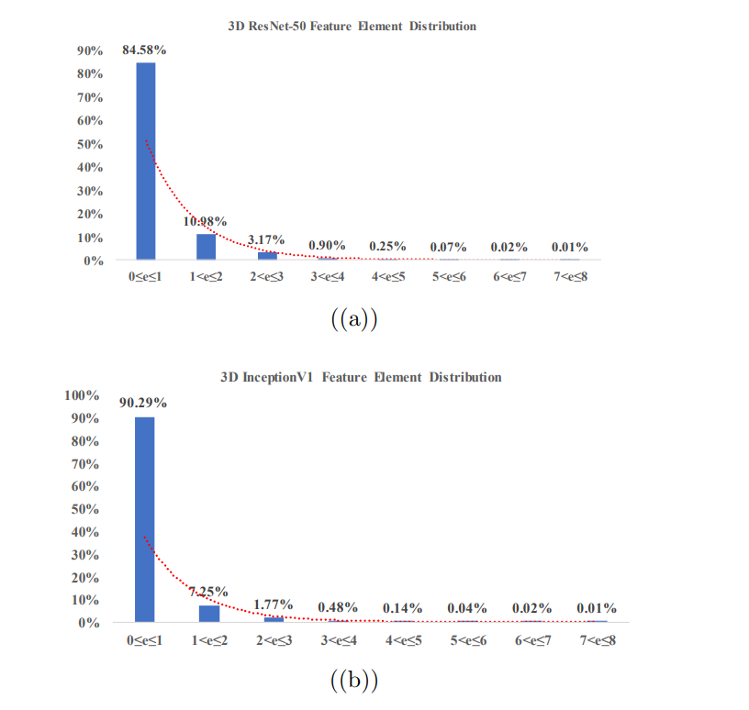
Proposed Method
The reason that we use logarithmic quantization is that the feature elements are concentrated between 0 and 1, showing as an exponential distribution, as shown in Fig. (2).

Slide 8
Proposed Method
Finally, two losses are employed for the joint training: (1) the cross-entropy loss which is used to the action recognition task, and (2) the quantization loss which encourages to minimize the difference between the raw feature and the quantized feature. Overall, the quantization goal is formulated as:

Slide 9
Simulation Results
Evaluations of the Proposed Method
We integrate the logarithmic quantization and inverse quantization into the network training. As a comparison, we test to quantize the original features with min-max quantization, clip min-max quantization, logarithmic quantization , and deep quantization directly. We also integrate min-max quantization into the network training.
The accuracy loss is shown in Eq. (15) and Eq. (16), where top1 ′ and top5 ′ represent the recognition accuracy on reconstructed features and top1 and top5 represent the recognition accuracy on raw features.

Slide 10
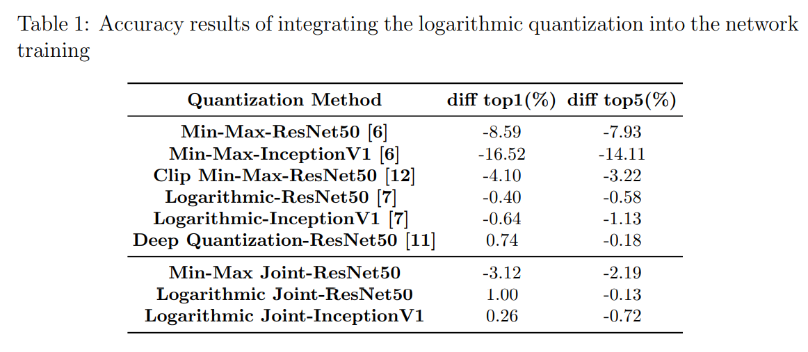
Simulation Results
The accuracy result is shown in Tab. 1. As shown in the table, integrating the quantization and inverse quantization into the network and adding the quantization loss into the total loss will obtain better accuracy against quantizing the features directly. Integrating min-max quantization into the network will lead to 3.12% top1 accuracy loss while integrating logarithmic quantization will get the 1% top1 accuracy increase.

Slide 11
Thank you!

