Slide 1
Data Compression Conference (DCC), 2021.
A Viewport-adaptive Rate Control Approach for Omnidirectional Video Coding
Yichen Guo, Mai Xu, Li Yang, Rui Ding
Beihang University, Beijing, China
{16711024, maixu, 13021041, dingrui1017}@buaa.edu.cn
Notes:
Hello everyone. It’s a great honor to present our work here. My name is Guo Yichen, I’m a graduate student from Beihang University. The paper I will present today is titled A Viewport-adaptive Rate Control Approach for Omnidirectional Video Coding.

Slide 2
Outline
01
Background
02
Related works
03
Motivation
04
Method
05
Results
Notes:
My presentation is divided into five parts.

Slide 3
01
Background
Virtural reality applications have gradually been popular in people’s daily life.
immersive
interactive
High resolution
High bandwidth
Notes:
First, I’ll introduce the background of Omnidirectional video coding, which is short for ODV coding. With the rapid development of virtual reality applications, ODVs have gradually come into people's daily life. They can provide immersive and interactive viewing experience, but also require extremely high resolutions and high transmition bandwidth.

Slide 4
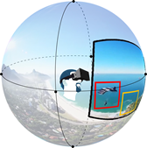
01
Background
The traditional video coding standards waste a huge amount of bits in representing and encoding a whole ODV frame.
Dierent from 2D videos, ODVs are normally watched through a head-mounted display (HMD), resulting that only the scene inside the viewport is visible.
Necessary to improve the coding efficiency of ODVs by considering the visible viewports.
Notes:
However, the traditional video coding standards waste a huge amount of bits in representing and encoding a whole ODV frame.
Different from 2D videos, ODVs are normally watched through a head-mounted display, resulting that only the scene inside the viewport is visible. Therefore, there is a desirable demand on improving the coding efficiency of ODVs by considering the visible viewports.

Slide 5
02
Related works
ODV coding
Spatial distortion optimization.
Liu et al.^{[1]} proposed a novel RC approach for ODV coding, which optimizes S-PSNR with sphere-based mean square error (S-MSE) as signal distortion.
Li et al.^{[2]} proposed assigning bits in the CTUs according to the weight map of WS-PSNR.
Li et al.^{[3]} maintained both representation and encoding in the spherical domain, such that the signal distortion by the sphere-to-plane projection can be reduced.
Drawback:
Neglect of perceptual quality of subjects, which are determined by their viewports.
Notes:
In recent years, a great amount of works have emerged for ODV coding. Next, I will review the existing ODV coding approaches in three categories.
The first is spatial distortion optimization. It’s known that ERP format can introduce severe spatial distortion. So most of them try to modify the R-λ scheme for bit allocation according to the weight maps of projection-friendly PSNR.
But they do not consider the perceptual quality of subjects, which are determined by their viewports.

Slide 6
02
Related works
ODV coding
Perceptual quality promotion.
Sitzmann et al. ^{[4]} subjectively validated the effectiveness of saliency-based sampling scheme on ODVs, in which the saliency map is generated by ground-truth head movement data.
Luz et al. ^{[5]} proposed a saliency-based encoding solution and a relevant perceptual quality metric, both of which are driven by their saliency prediction model.
Liu et al. ^{[6]} proposed determining bit allocation of ODV coding by optimizing perceptual distortion upon the front-center-bias of human attention.
Drawback:
Neglect of that only the viewports (~12.5% of a whole ODV frame) of ODVs can be viewed by subjects.
Notes:
The second is perceptual quality promotion. They try to combine saliency information into encoding procedure such as sampling scheme and bit allocation.
But they also ignore that only the viewport regions of ODVs can be viewed by subjects.

Slide 7
02
Related works
ODV coding
Viewport adaptation.
Nasrabadi et al. ^{[7]} proposed using layered encoding approach, in which the base layer covers the whole frame and the enhancement layers only refer to viewports detected by the HMD.
Kuzyakov et al. ^{[8]} proposed encoding ODVs with a pyramid geometry. The base of the pyramid is the full resolution viewport, while the sides of the pyramid gradually decrease in quality for other regions.
Drawback:
There are more than one potential viewport for different subjects.
Notes:
The third is viewport adaptiation. They allocate more bit to viewport regions by layered encoding or pyramid projection.
Unfortunately, these approaches are all on-line coding, requiring the subsequent viewport of each subject, and they cannot be applied to offline ODV coding, as there are more than one potential viewport for different subjects.

Slide 8
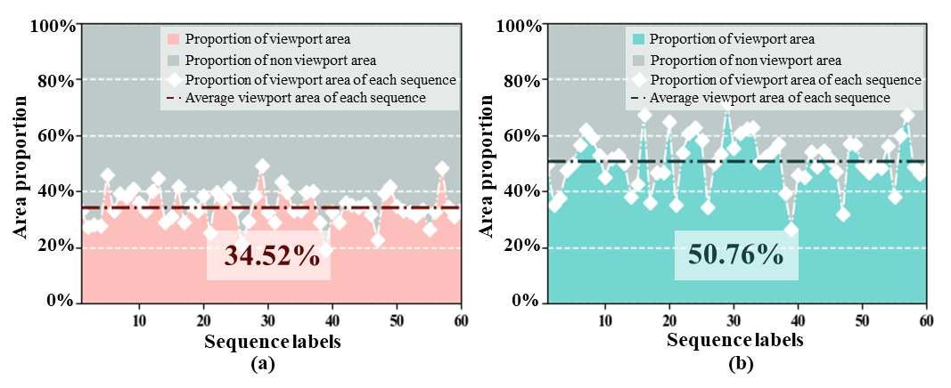
03
Motivation
Human behavior analysis
(a) Average percentage of viewport regions over all subjects for each ODV sequence.
(b) Average percentage of viewport regions over all the frames for each ODV sequence.
Subjects tend to keep head movement in a small range relative to the whole 360° scene.
There exists a large amount of perceptual redundancy in each ODV frame.
Necessary to propose the offline viewport-adaptive RC approach for ODVs to simultaneously save bit-rates and improve the subjective quality.
Notes:
Next is the motivation part. We analyze the human behavior of ODV viewing.
And we found that Subjects tend to keep head movement in a small range relative to the whole spherical scene. Further, there exists a large amount of perceptual redundancy in each ODV frame.
This motivates us to propose the offline viewport-adaptive rate control approach for ODVs to simultaneously save bit-rates and improve the subjective quality.

Slide 9
04
Method
Brief framework of the proposed viewport-adaptive RC approach.
Stage I: The viewport candidates are predicted with importance weights.
Stage II: The viewport saliency is detected for each viewport candidate.
Stage III: The viewport-adaptive block traversal and bit allocation are developed for subjective quality based ODV coding.
Notes:
Our approach is composed of three stages.
For stage I, the viewport candidates are predicted with importance weights.
For stage II, the viewport saliency is detected for each viewport candidate.
For stage III, the viewport-adaptive block traversal and bit allocation are developed for subjective quality based ODV coding.

Slide 10
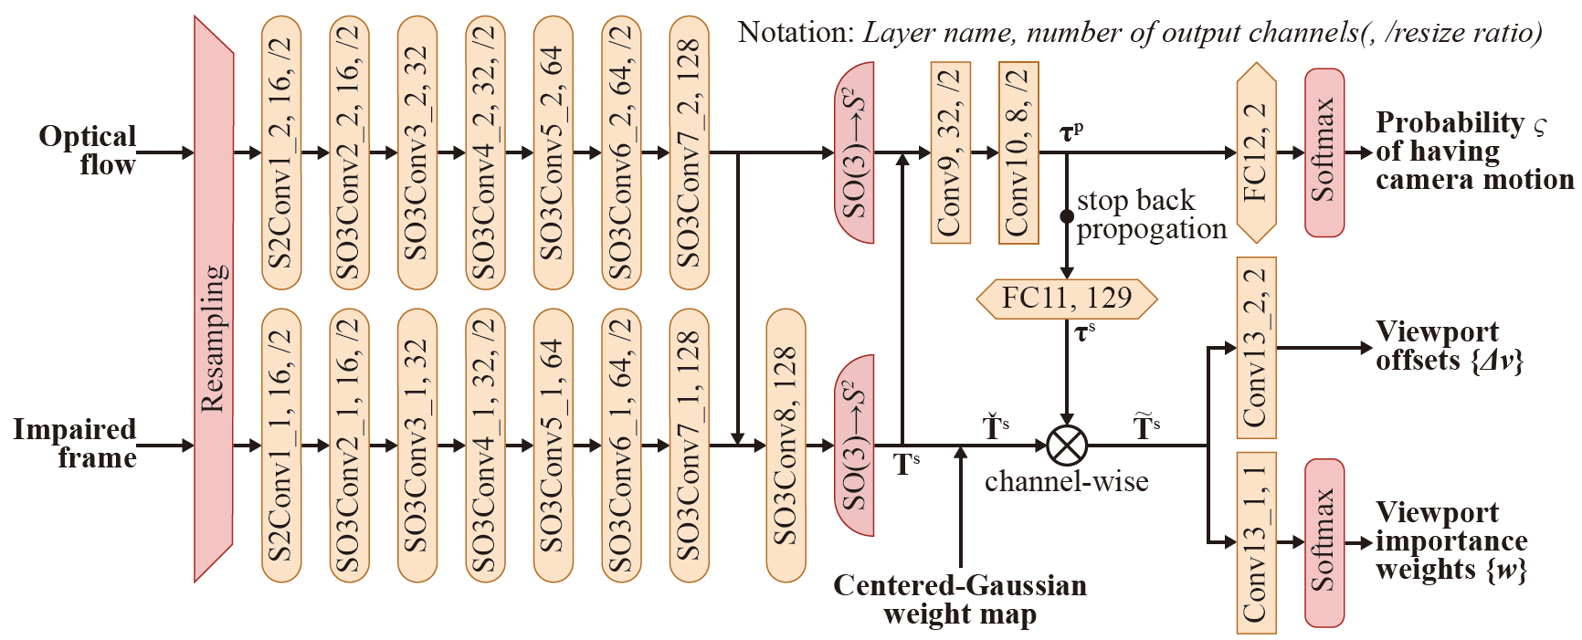
04
Method
Stage Ⅰ: Viewport candidate prediction
Brief framework of the proposed viewport-adaptive RC approach.
For stage Ⅰ, we adopt our previous work^{[9]} of the viewport proposal network (VP-Net) for predicting viewport candidates on ODVs.
Notes:
In stage I,

Slide 11
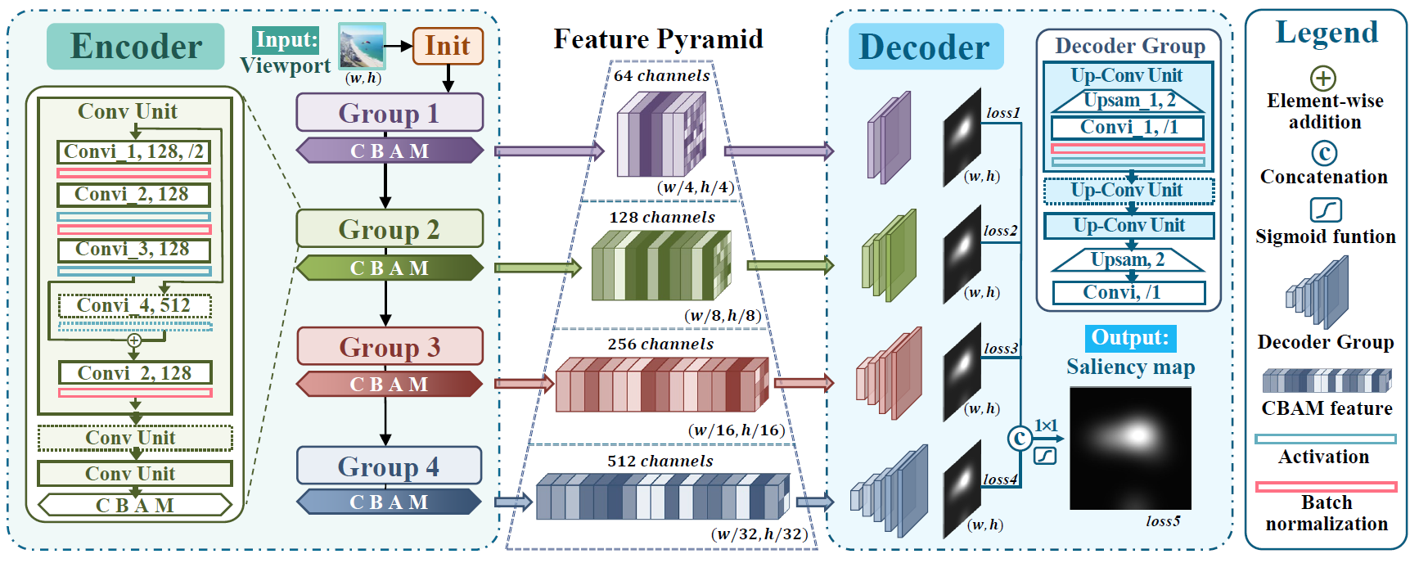
04
Method
Stage Ⅱ: Viewport saliency detection
The architecture of viewport saliency detection
In this stage, we develop a novel fully convolutional network (FCN) for viewport saliency detection.
Notes:
In stage Ⅱ, we develop a novel fully convolutional network (FCN) for viewport saliency detection.

Slide 12
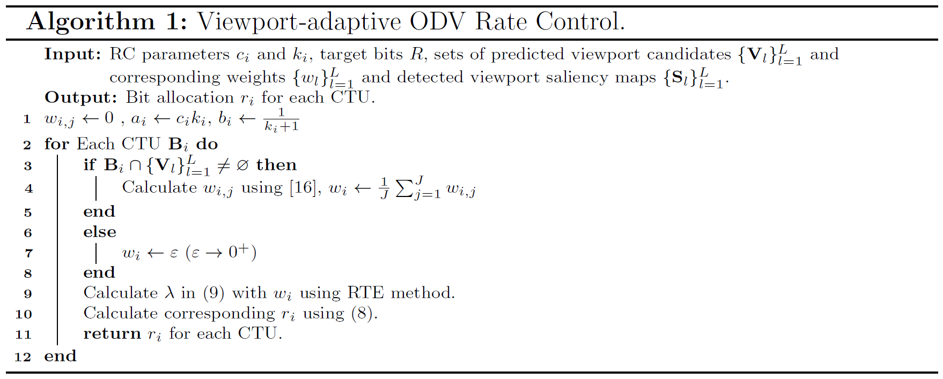
04
Method
Stage Ⅲ: Viewport-adaptive rate control
In this stage, we introduce our viewport-adaptive rate contral approach, which includes viewport-adaptive CTU traversal and bit allocation.
Notes:
In stage Ⅲ,

Slide 13
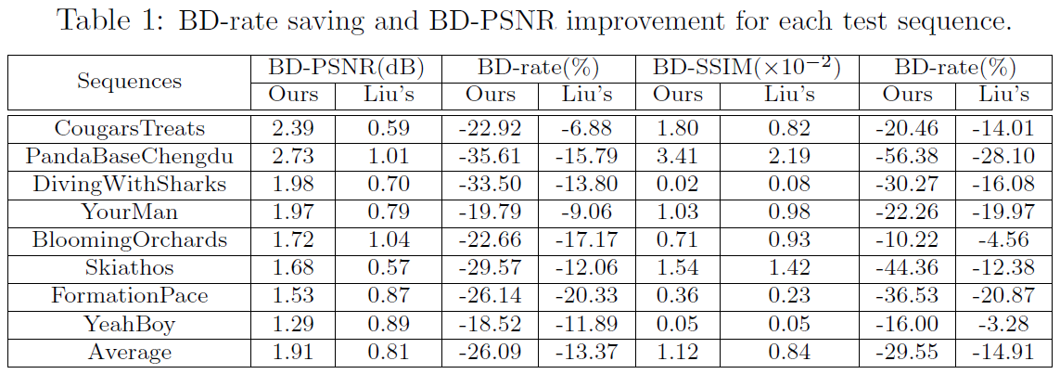
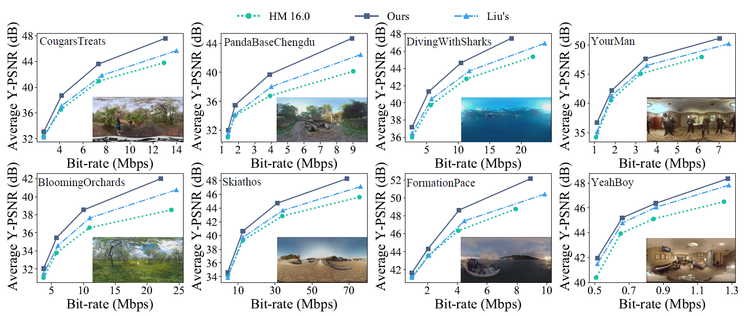
05
Results
Results of ODV coding
Compared with:
HM 16.0
Liu’s
Objective results:
Metrics:
BD-PSNR
BD-SSIM
BD-rate
Test sequences:
AVS standard test sequence
Notes:
Here is the experiment results. We compare with standard HM 16.0 and Liu’s approach. Note that the PSNR and SSIM are weighted by ground truth of head movement. The test sequence is AVS standard test sequence. As can be seen, our approach can better RD performance.

Slide 14
05
Results
Results of ODV coding
Subjective results:
Results of saliency detection
Notes:
Here is the subjective results, our approach can significantly make higher fidelity in salient regions.
Also, the performance of viewport saliency prediction is better than all the state-of-the-art approaches.

Slide 15
Reference
[1] Yufan Liu, Li Yang, Mai Xu, and Zulin Wang, “Rate control schemes for panoramic video coding”, Journal of Visual Communication and Image Representation, 2018.
[2] BiJia Li, Li Song, Rong Xie, and WenJun Zhang, “Weight-based bit allocation scheme for vr videos in hevc”, in IEEE VCIP, 2017.
[3] Yiming Li, Jizheng Xu, and Zhenzhong Chen, “Spherical domain rate-distortion optimization for omnidirectional video coding”, IEEE TCSVT, 2018.
[4] Vincent Sitzmann, Ana Serrano, Amy Pavel, Maneesh Agrawala, Diego Gutierrez, Belen Masia, and Gordon Wetzstein, “Saliency in vr: How do people explore virtual environments?”, IEEE transactions on visualization and computer graphics, 2018.
[5] Guilherme Luz, Jo~ao Ascenso, Catarina Brites, and Fernando Pereira, “Saliency-driven omnidirectional imaging adaptive coding: Modeling and assessment”, in MMSP, 2017.
[6] Yufan Liu, Li Yang, Mai Xu, and Zulin Wang, “Rate control schemes for panoramic video coding”, Journal of Visual Communication and Image Representation, 2018.
[7] Afshin TaghaviNasrabadi, Anahita Mahzari, Joseph D Beshay, and Ravi Prakash, “Adaptive 360-degree video streaming using layered video coding”, in IEEE VR, 2017.
[8] E. Kuzyakov and D. Pio., “Next-generation video encoding techniques for 360 video and vr. [online]”, 2016.
[9] Mai Xu, Lai Jiang, Chen Li, Zulin Wang, and Xiaoming Tao, “Viewport-based cnn: A multi-task approach for assessing 360° video quality”, IEEE TPAMI, 2020.
Notes:
Here is the reference.

Slide 16
Thanks for listensing
Contact
E-mail: 16711024@buaa.edu.cn (Yichen Guo)
Notes:
This is the presentation of our work, thanks for your listening.

