Slide 1
General Speech Restoration Using Two-stage Generative Adversarial Networks
- ICASSP 2024 Speech Signal Improvement Challenge
Qinwen Hu^{1,2}, Tianyi Tan^{1,2}, Ming Tang³, Yuxiang Hu², Changbao Zhu², Jing Lu^{1,2}
¹ Key Laboratory of Modern Acoustics, Nanjing University, Nanjing 210093, China
² NJU-Horizon Intelligent Audio Lab, Horizon Robotics, Beijing 100094, China
³ State Grid Jiangsu Electric Power Co. Ltd, Nanjing 210024, China

Slide 2
General Speech Restoration Using Two-stage Generative Adversarial Networks
- ICASSP 2024 SIG Challenge
Contents
1. Introduction
2. Method description
2.1 Two-stage generative adversarial networks
2.2 Dataset simulation
3. Experimental results and discussions

Slide 3
1. Introduction
General Speech Restoration Using Two-stage Generative Adversarial Networks
- ICASSP 2024 SIG Challenge
Principal challenges of ICASSP 2024 Speech Signal Improvement Challenge (SIG-Challenge)
A broad spectrum of distortion types, each with distinct acoustic features
→ integrating speech priors with generative methods.
Increased computational complexity associated with full-band processing, also requiring the model to handle more intricate spectral features.
A potential conflict between the goals of improving perceptual speech signal quality & minimizing the distortion introduced to speech information.
eg. ASR as the downstream task.
Predictive models | Generative models
(1) Hard to solve ill-posed problems; (2) Hard to find learnable patterns on different distortions. | Able to learn speech priors
Nicolae-Catalin Ristea, et al, “ICASSP 2024 Speech Signal Improvement Challenge.”

Slide 4
1. Introduction
General Speech Restoration Using Two-stage Generative Adversarial Networks
- ICASSP 2024 SIG Challenge
Track1
Track2
Our submission tied for third place with another team in Track 1, and tied for fourth place with four other teams in Track 2.
Nicolae-Catalin Ristea, et al, “ICASSP 2024 Speech Signal Improvement Challenge.”

Slide 5
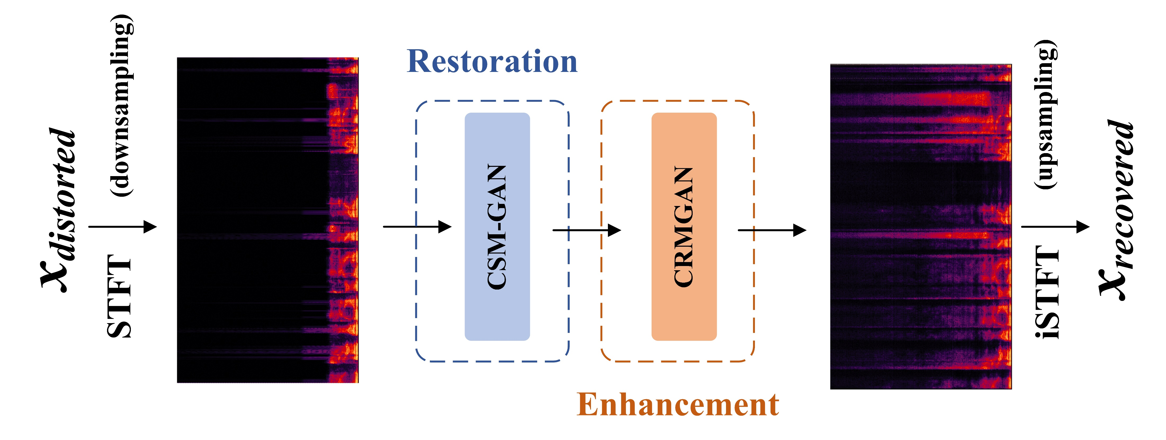
1. Introduction
General Speech Restoration Using Two-stage Generative Adversarial Networks
- ICASSP 2024 SIG Challenge
Overview of the submitted system
Our system employs a 2-stage processing approach, utilizing two sub-modules.
Restoration module: restore the distorted speech.
Enhancement module: enhance its quality by mitigating residual noises.
Both modules are trained with adversarial losses to better exploit the latent key information within the distorted speech.
Fig: The schematic diagram of the proposed system.
 | Model size | RTF*
Track 1 | 7.6 M | 0.47
Track 2 | 9.9 M | 0.62
Processing strategies for different tracks:
For Track1 (real-time): 48 kHz → 24 kHz → process → 48 kHz.
For Track 2 (non-real-time): we process the signal within the full-band range.
Table: The computational complexity of our entries.
* The real-time factors are tested on an Inter core i5 quadcore CPU clocked at 2.4 GHz with a single thread.

Slide 6
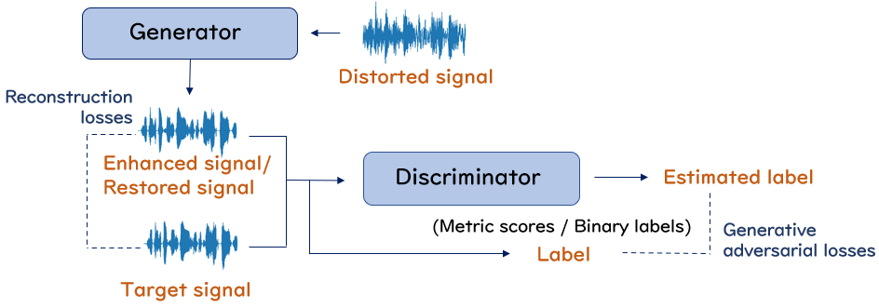
2. Method description
General Speech Restoration Using Two-stage Generative Adversarial Networks
- ICASSP 2024 SIG Challenge
2.1 Two-stage generative adversarial networks (2stageGAN)
Fig: The architecture of our GAN models used in both Stage-1 and Stage-2.
The generator of the restoration module
Track1(24 kHz): partition the spectrum into 2 subbands.
Track2(48 kHz): partition the spectrum into 3 subbands.
→ Concatenate them in the channel dimension.
Training losses
Regression losses
LSGAN losses with
Multi-resolution discriminators
Multi-band discriminators
Multi-period discriminators
Fig: The diagram of the generator of CSM-GAN.
Feature loss not utilized.

Slide 7
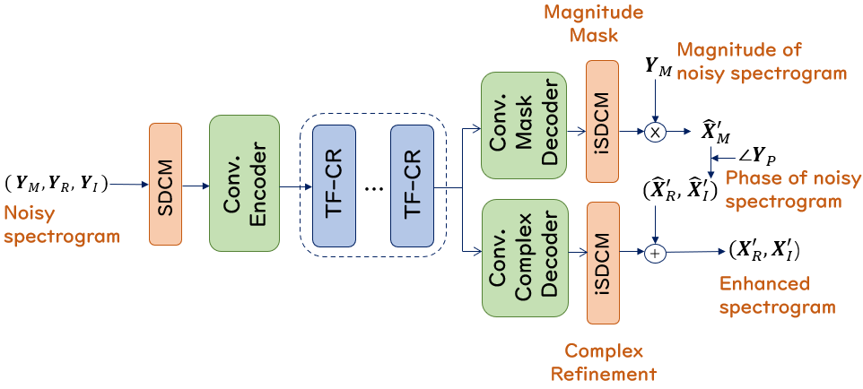
2. Method description
General Speech Restoration Using Two-stage Generative Adversarial Networks
- ICASSP 2024 SIG Challenge
2.1 Two-stage generative adversarial networks
The generator of the enhancement module
SDCM*: Spectral dimension compression mapping module.
TF-CR: Time-frequency convolutional-recurrent networks.
Input and output are both power-compressed spectrograms.
Fig: The diagram of the generator of CRMGAN.
Training losses
STFT configurations:
Regression losses: multi-resolution spectrum losses.
Metric-GAN loss with a single PESQ discriminator.
20 ms window length and FFT length
10 ms hop length
* Hu, Qinwen, et al. "Learnable spectral dimension compression mapping for full-band speech enhancement." JASA Express Letters 3.2 (2023).

Slide 8
2. Method description
General Speech Restoration Using Two-stage Generative Adversarial Networks
- ICASSP 2024 SIG Challenge
2.2 Dataset simulation
Clean speech dataset:
The DNS Challenge training dataset and our private speech dataset, including English, Chinese, French, German, Italian and Russian.
Far-field and bone-conduction distortions are real-recorded, other types of distortion are all simulated.
Total size: 500 hours.
 | Environment | Equipment | Transmission & post-processing
Restoration module | Far-field, Bone-conduction | Equalization, Front-end, Clipping, Rectifications, Anti-AGC | Resampling, Codec, Package-loss concealment
Enhancement module | Noises, Reverberations | - | -
Table: The distortion types in each training set for the modules of the two stages.

Slide 9
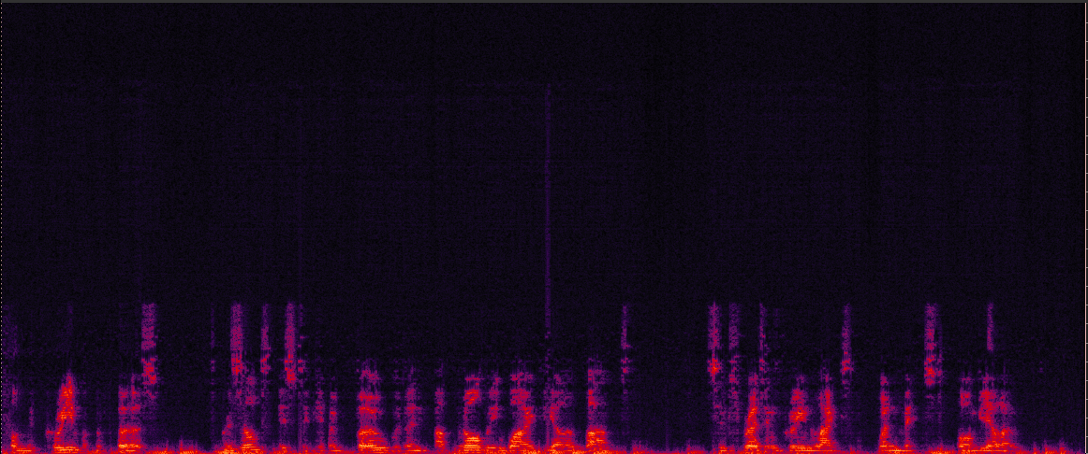
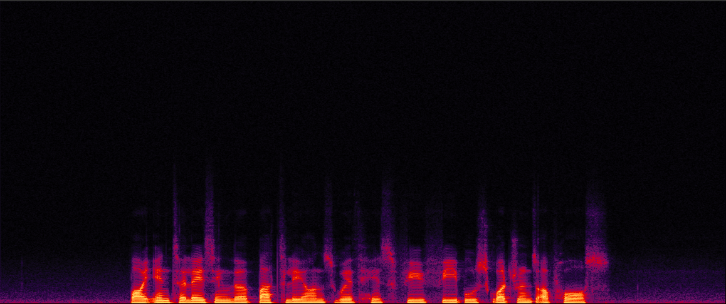
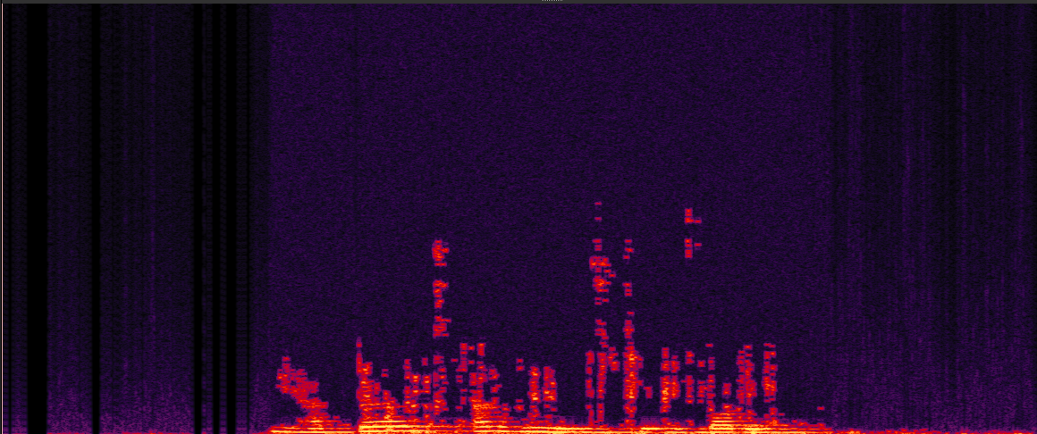
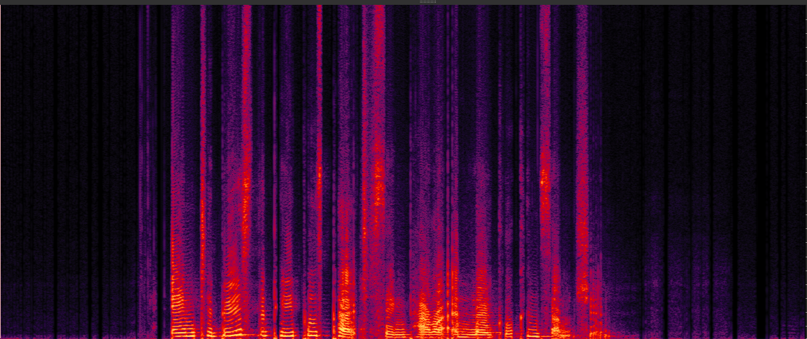
2. Method description
General Speech Restoration Using Two-stage Generative Adversarial Networks
- ICASSP 2024 SIG Challenge
2.2 Dataset simulation
Samples
Front-end, Codec (Opus)
Equalization, Codec (Ogg)
Front-end, Codec (Mp3)
Rectification
Fig: Samples of the simulated training data.
We aim to simulate a broad range of distortions, trying to achieve coverage of those present in the test set.
We avoid simulating distorted signals that are excessively damaged, as learning from such samples poses significant challenges for the model.

Slide 10
3. Experimental results and discussions
General Speech Restoration Using Two-stage Generative Adversarial Networks
- ICASSP 2024 SIG Challenge
Samples from the SIG-2 blind set.
Clip 1
Clip 2
Clip 3
Clip 4
Distorted
2stageGAN-Track1
(24kHz, real-time)
2stageGAN-Track2
(48kHz, non-real-time)
Full-band model: brighter tone, more sibilants and fricatives.

Slide 11
3. Experimental results and discussions
General Speech Restoration Using Two-stage Generative Adversarial Networks
- ICASSP 2024 SIG Challenge
The evaluation on SIG-2 blind test set.
Methods | MOS |  |  |  |  |  |  | WAcc | Score
 | COL | DISC | LOUD | NOISE | REVERB | SIG | OVRL
Noisy | 3.34 | 3.70 | 3.78 | 3.21 | 3.40 | 3.05 | 2.58 | 0.827 | 0.651
2stageGAN-Track1 | 3.52 | 3.74 | 4.02 | 4.10 | 3.65 | 3.29 | 2.94 | 0.795 | 0.681
2stageGAN-Track2 | 3.48 | 3.74 | 3.98 | 3.97 | 3.64 | 3.26 | 2.91 | 0.778 | 0.671
Winner-Track1 | 4.08 | 3.89 | 4.34 | 4.29 | 4.27 | 3.83 | 3.49 | 0.782 | 0.748
Table: The ITUT P.804 subjective evaluations and ASR results on the SIG-2 blind set.
Facts
Discussions
Our submitted models in both tracks show improvement in the speech quality across all metrics, but not for WAcc.
Incorporating a generative method in the end-to-end models we use generally enhances perceptual speech quality.
Misleading interference is introduced to the semantic information.
The model in Track 1 outscores the model in Track 2 across the board.
The super-wide band model can focus more on the low band, and avoid producing unnatural high-band artefacts.
Human perceptual evaluations are possibly more sensitive to the unnaturalness of high-band artifacts.
The performance gap, compared to the winner, particularly lies in MOS-COL and MOS-REVERB.
The limitation of super-wide band processing of Track1 model & not leveraging enough speech prior .

Slide 12
Thanks for your attention!

