Slide 1
Fast Personalized Text-to-Image Generation with Attention Injection
Authors: Yuxuan Zhang¹, Yiren Song¹, Jinpeng Yu²,
Han Pan¹, Zhongliang Jing¹
{ zyx153, songyiren, hanpan, zljing } @sjtu.edu.cn, yujp1@shanghaitech.edu.cn
¹ Shanghai Jiao Tong University, ² ShanghaiTech University
2024.04

Slide 2
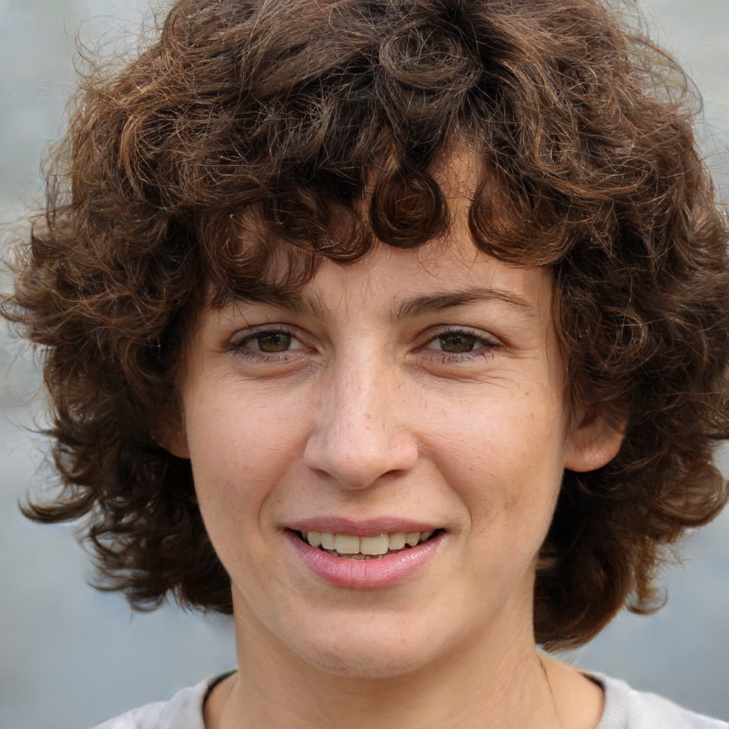
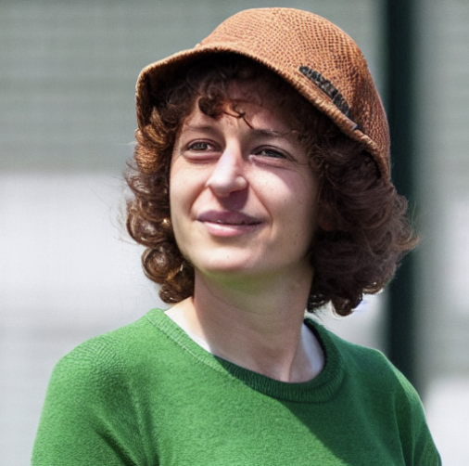
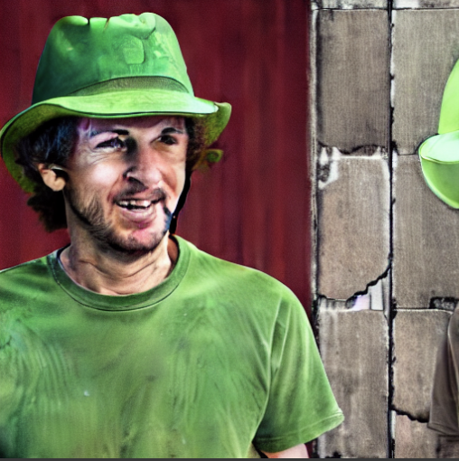
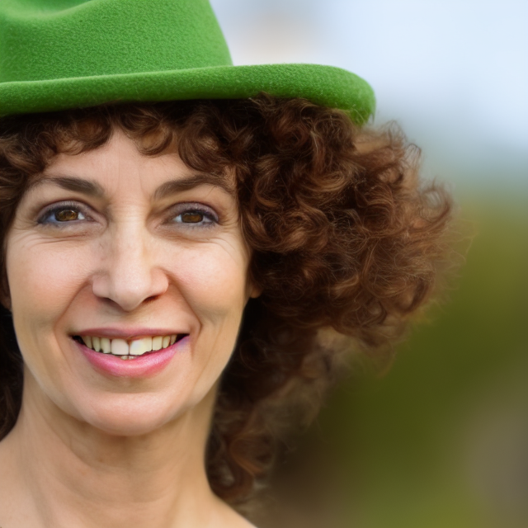
Introduction
Previous methods:
Ours:
long time to finetune
does not require fine-tuning for each concept
Identity image
poor text-image
consistency
better text-image
consistency
bad quality
better quality
DreamBooth
Textual inversion
Ours(seed1)
Ours(seed2)
prompt: A photo of woman wearing a green hat
prompt: A photo of woman wearing a green hat
Notes:
Given a conceptual image and a textual prompt for generating images, the goal of personalized image generation is to inject the identity information of the concept in the reference image into the generated high-quality image. The generated image should conform to the textual description while also adhering to the basic characteristics of the concept. For instance, in the case of a cat, the generated image of the cat's actions and position should correspond to the textual description, and the generated cat should possess the basic characteristics of the reference cat, such as the same breed and fur color.
Previous work on personalized image generation has mainly relied on inversion methods to reverse the concept into a text embedding or to save the concept in the parameters of the generated model through fine-tuning. For example, Textual inversion optimizes a newly added text embedding, Dreambooth fine-tunes the text-to-image pre-trained model to fit a style or concept. Other works have improved upon these methods. However, these methods face a trade-off between text-image consistency and identity consistency. Due to the ease of overfitting the generated model to the training data with text embeddings or fine-tuning, these methods often lose text-image consistency and fail to generate images that conform to the textual description, requiring various training strategies to prevent overfitting.
Upon reflection of these works, training a text embedding or finetuning the whole diffusion models are difficult and not ideal tasks. Do we really need to train a new text embedding to bind the selected concept? We define the rough description of the concept we want to customize as a rough description. If given a rough description, such as "a woman wearing a green hat," where "woman" represents the rough category of the concept, can we directly use this rough category to represent the identity we want to invert and inject into the generated image that conforms to the rough prompt, without training a new text embedding to interact with other textual prompts? Based on this idea, we carefully studied the related work on image-to-image translation, most of which use diffusion attention layers to perform image-to-image editing. P2P and Nulltext Inversion operate cross-attention maps to replace and reweight the subject of the image while maintaining the layout of the reference image. Pix2Pix-Zero finds the text editing direction and uses an optimization method to constrain the cross-attention map to edit the image and replace the concept. These methods provide us with a new approach, perhaps directly using the rough category of text to represent the identity we need to customize and replacing the original concept with the user-provided concept during the generation process.
We use a dual-UNet structure and propose two attention injection manipulations called masked self-attention injection and cross-attention direct detail injection, which are used to generate personalized images. As illustrated in Fig, these two attention manipulations maintain the original synthesis abilities of the pre-trained text-to-image model that improve the text-image consistency and the generated image's quality while also assuring identity consistency between the concept and the generated image.

Slide 3
Method
Notes:
Our method is based on a pre-trained text-to-image diffusion model, with the overall framework shown in Fig. Given a reference image and a textual prompt, our method replaces the original concept during the generation process. Our method uses DDIM inversion to encode the reference image to obtain a series of latent noise features. Then, a noise is randomly sampled and this random noise as well as the previously obtained noise latents from the reference image are input into the dual U-Net structure. During each step of denoising the random noise, both masked self-attention injection and cross-attention direct detail injection are used to generate personalized images.
As for Masked Self-attention injection, We concatenate the key and value features of self-attention from Ref-Unet and Gen-Unet along the spatial dimension, which not only retains the original Unet's ability to generate images from prompt but also injects the identity information from the Ref-Unet into the Gen-Unet. Additionally, we use a cross-attention map to filter and enhance the self-attention's key and value features from Ref-Unet.
While Cross-attention direct detail injection is to directly predict the cross-attention key and value features in the Gen-Unet using an encoder and then concatenate them with the cross-attention key and value features. During training, we train a concept encoder to reconstruct every image in the dataset of a specific domain. During inference, we simply input reference images into the concept encoder and concatenate the output embedding with the cross-attention key and value features from the original text encoder.
The pre-trained text-to-image model we used is Stable Diffusion V1-5. During training, our encoder is trained on FFHQ and AFHQ for 100k iterations on four A100s with a batch size of 2 and a learning rate of 1e-5.

Slide 4
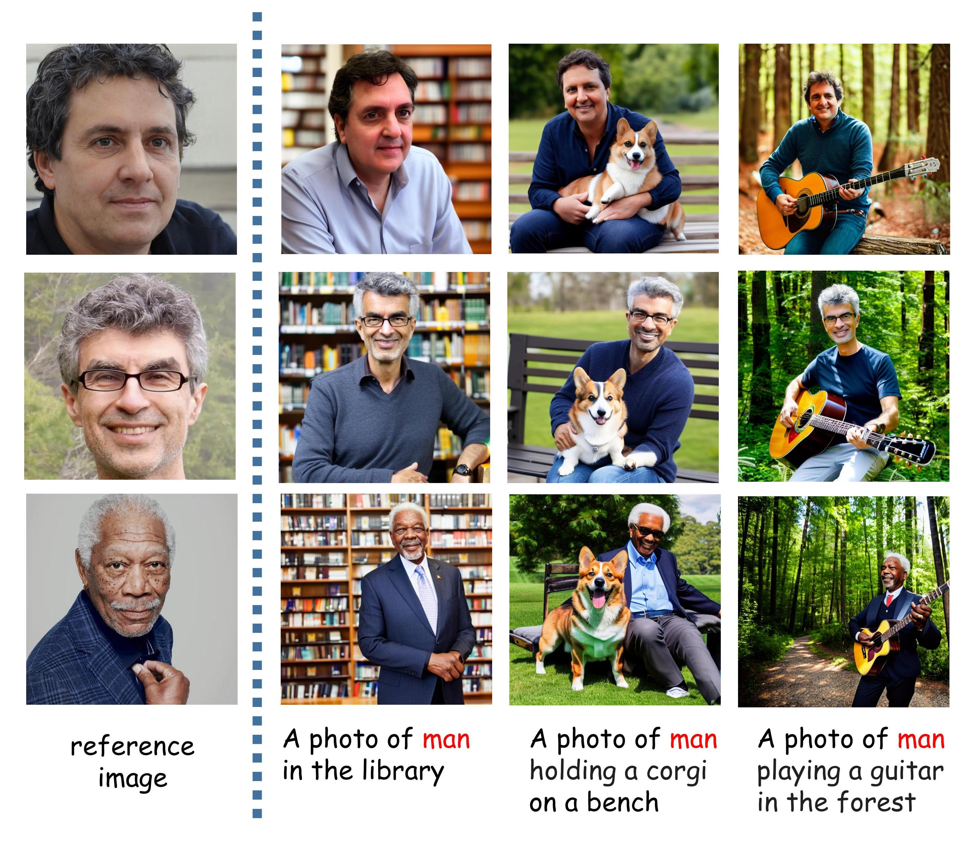
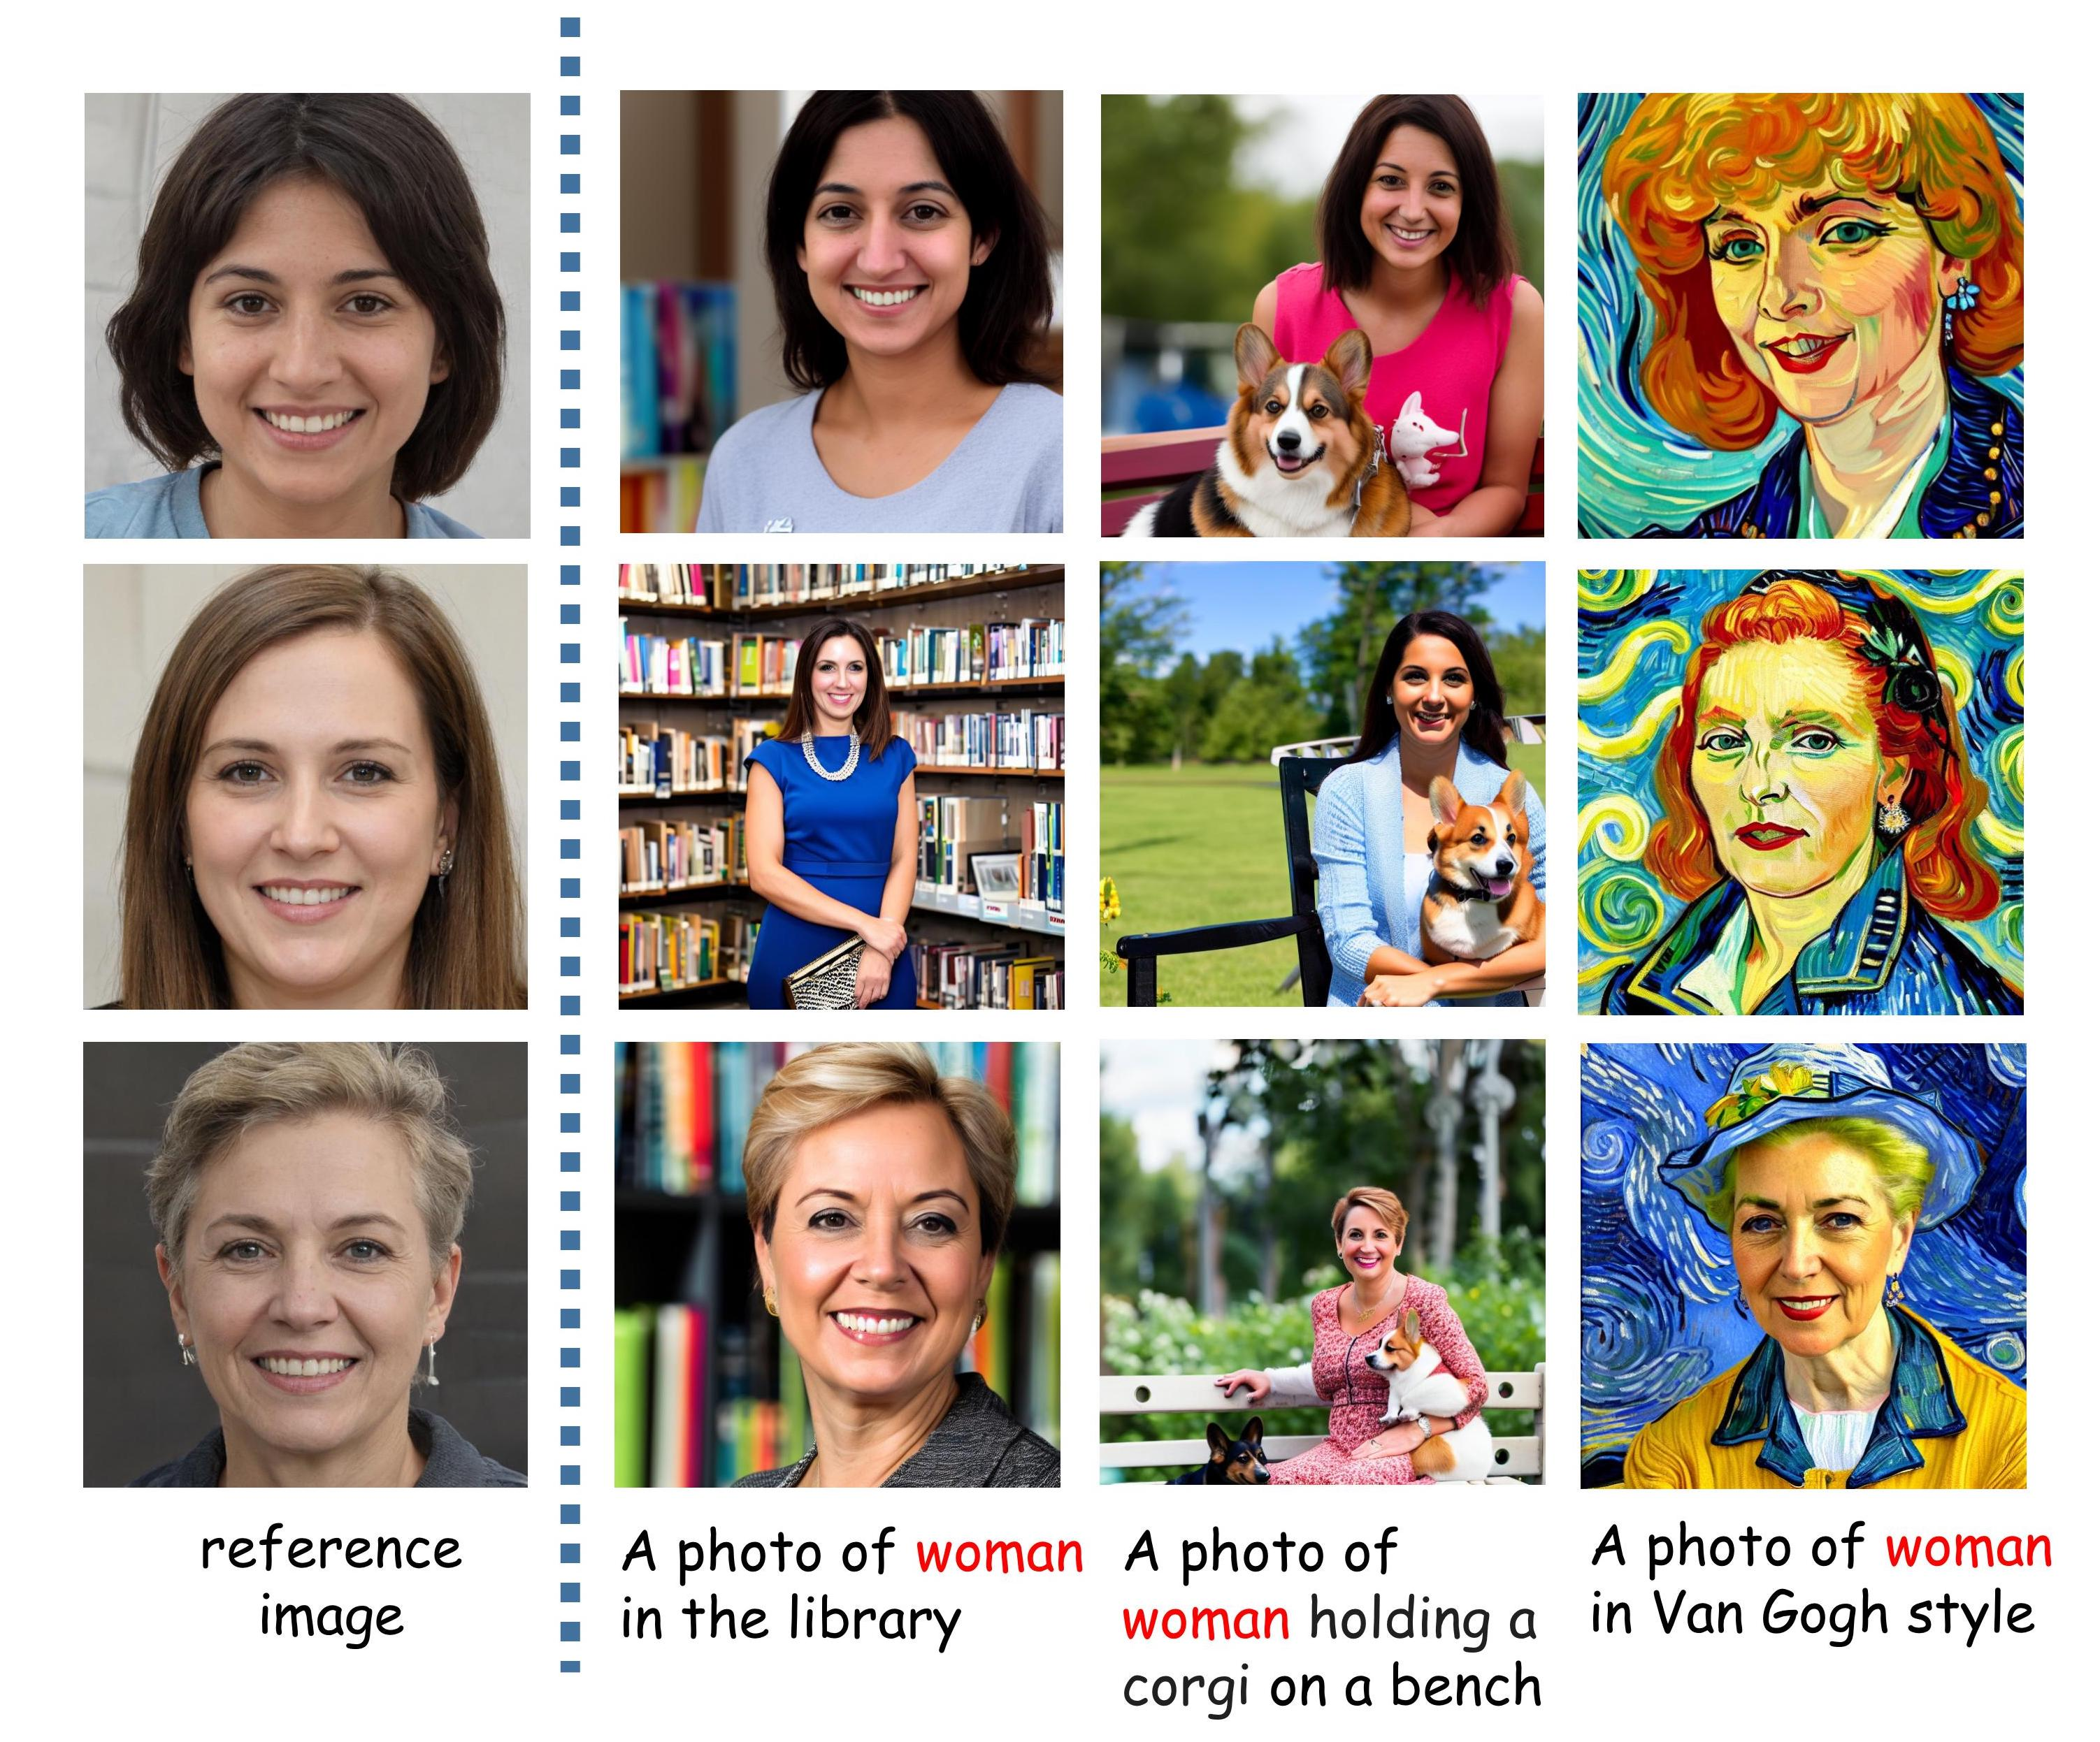
Experimental results
Notes:
This page demonstrating our results on different domain concept, including face domain/ cat and dog domain. Ours method not only acheives great text-image alignment, but also keeps high quality of generated images.

Slide 5
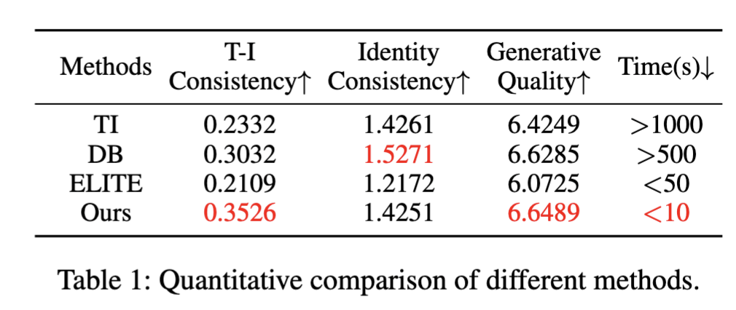
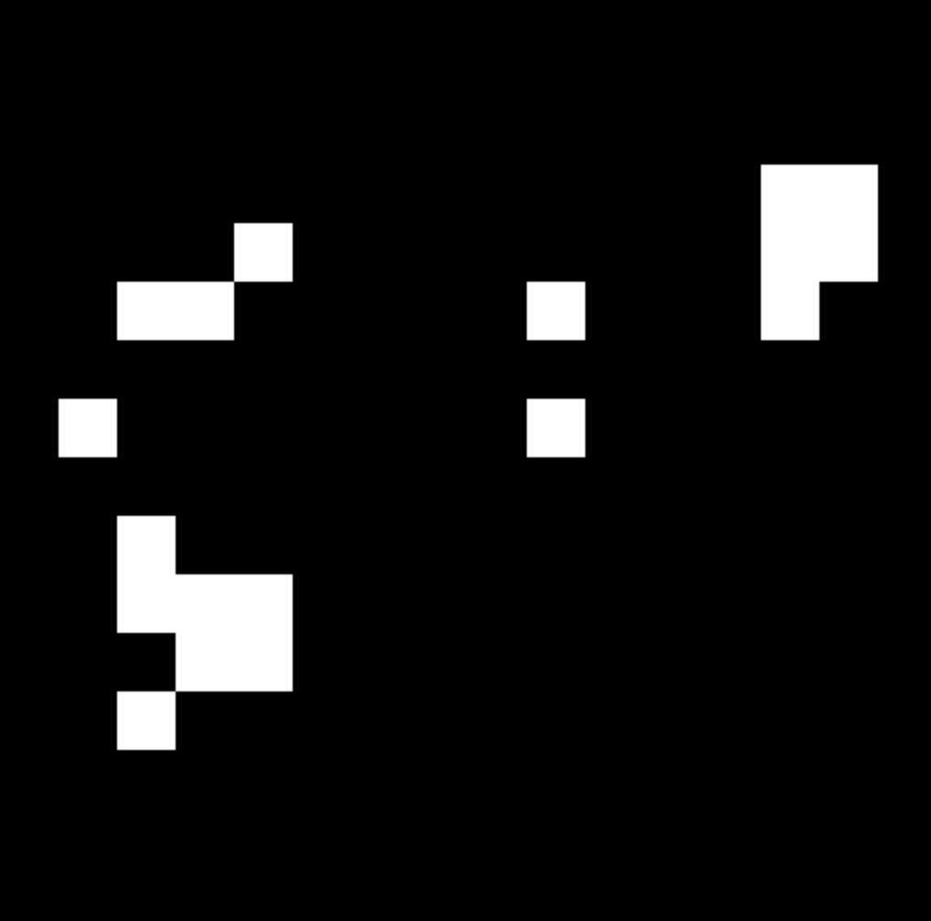
Experimental results
Comparison
from t_{T} to t₀
reference image
t₅₀
t₄₀
t₃₀
t₂₀
t₁₀
Notes:
For comparison, the metrices we used including 4 terms. The first is Text-Image Consistency: We use CLIPScore to calculate the consistency between the generated image and the text prompts. the second is Identity Consistency:Take the face domain as an example. To measure identity consistency, we use a face detector to detect faces in both the generated images and the reference images. Then we extract embeddings from each detected face using an off-the-shelf method and calculate the average embedding cosine distance for each pair of faces. the third is Generative Quality: We score the mean aesthetics of the generated images using an aesthetic predictor to measure the generative quality. the last is Time: Since time directly affects our actual application, we also take the time cost as a comparison indicator.
The visual comparison results for personalized face generation can be seen in the Fig. Generally, TI tends to produce blurred backgrounds or even images that fail to match the description text, which also is a problem occasionally encountered in ELITE's results. DB's identity consistency when generating a big face is fairly good, although, as shown in the second column, it falls short in maintaining identity consistency when generating smaller faces. Our method shows the best performance in generative quality and maintaining consistency between the image and text while maintaining identity consistency.
The quantitative comparison with other methods is shown in Table 1. Our method is close to DB in identity consistency, and it achieves the best in text-image consistency. Since our method does not require fine-tuning or training for any concept, our speed advantage is significant compared to other algorithms. Furthermore, the aesthetic score of the images we generate leads these algorithms.
We also visualize the different mask we get from different denoise stages. the mask obtained in the early stage of denoise is more faithful to the true position in the image of the concept. Therefore, we use the union of the masks of the first two steps in order to obtain a more reasonable mask.
Better T-I consistency, generative quality, and high identity consistency prove that our method does not destroy the original text-to-image generative power of the diffusion model and makes a better text-image consistency and generative quality than the methods above while maintaining identity consistency.

Slide 6
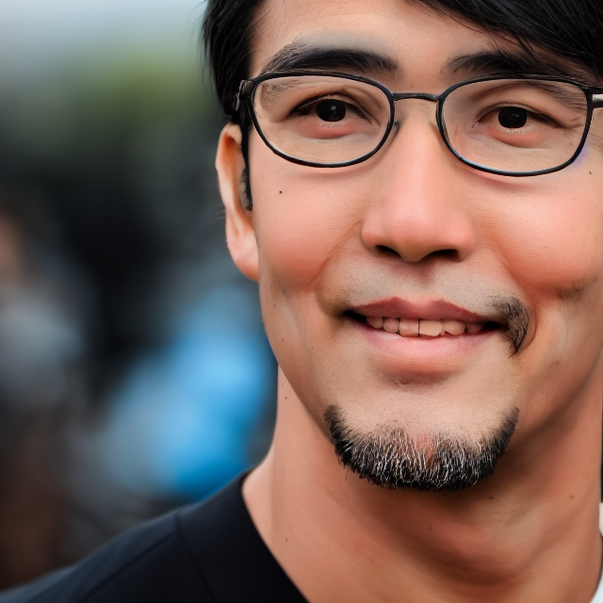
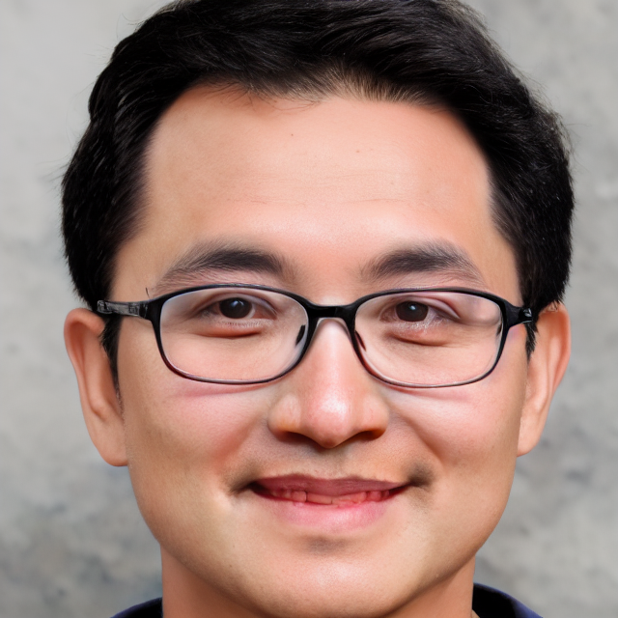
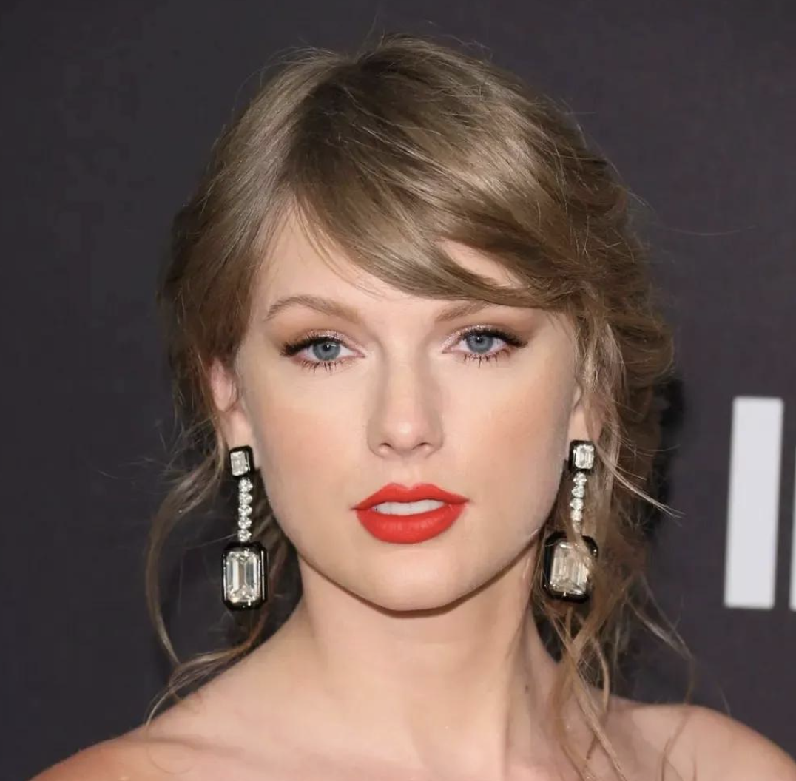
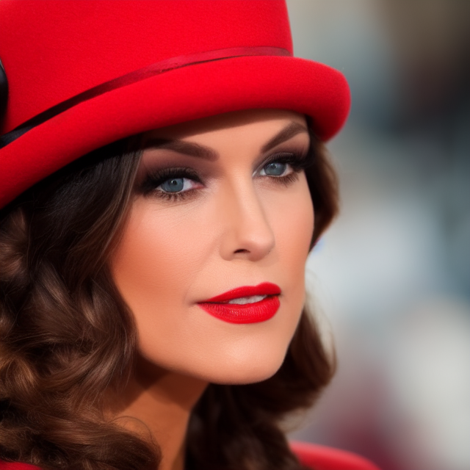
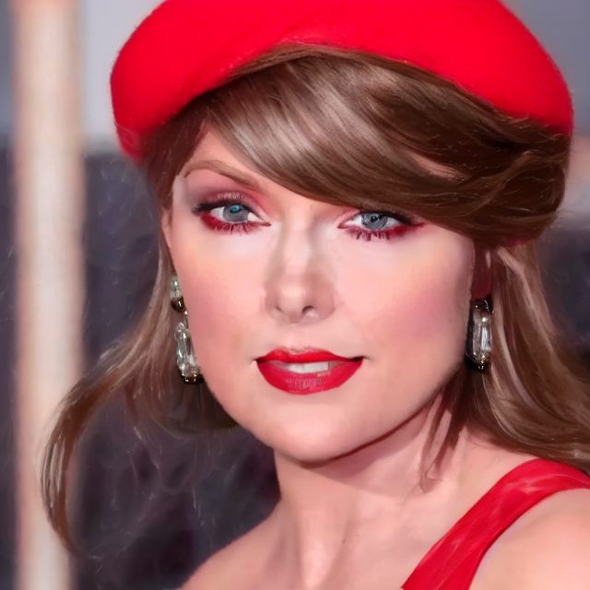
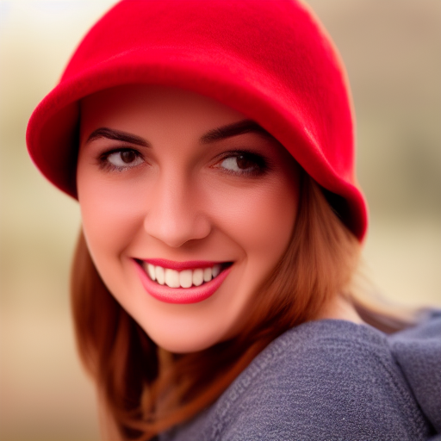
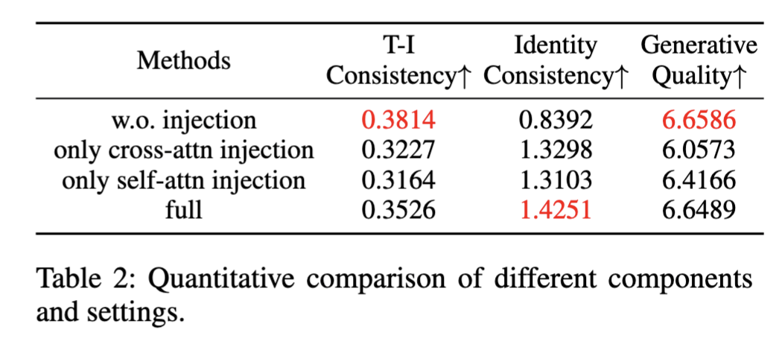
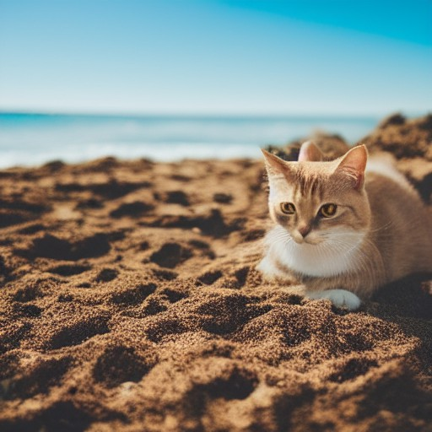
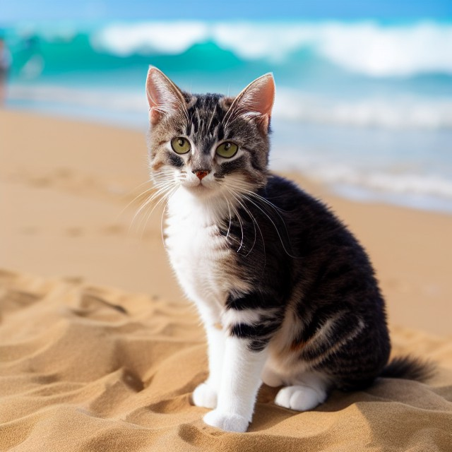
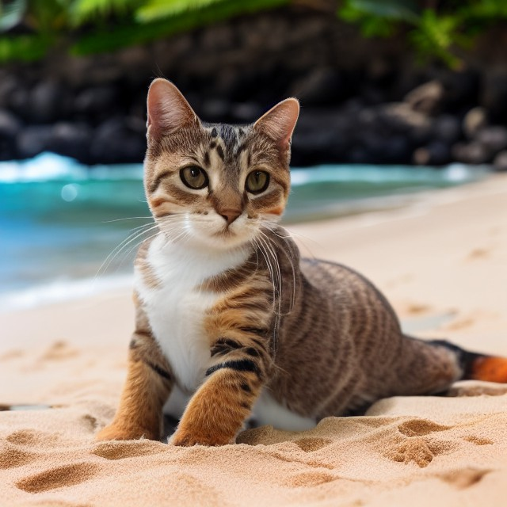
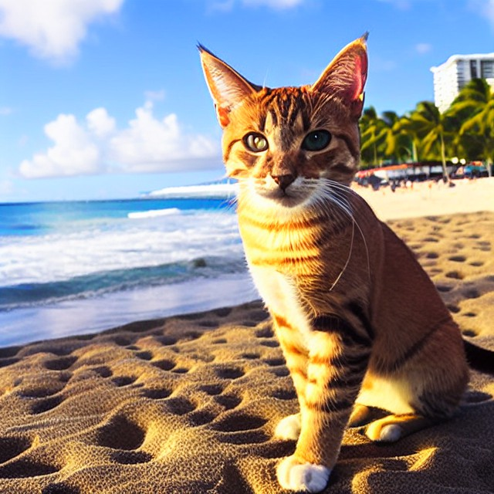
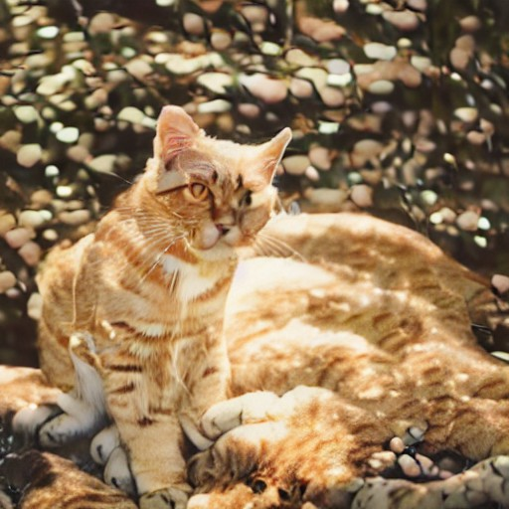
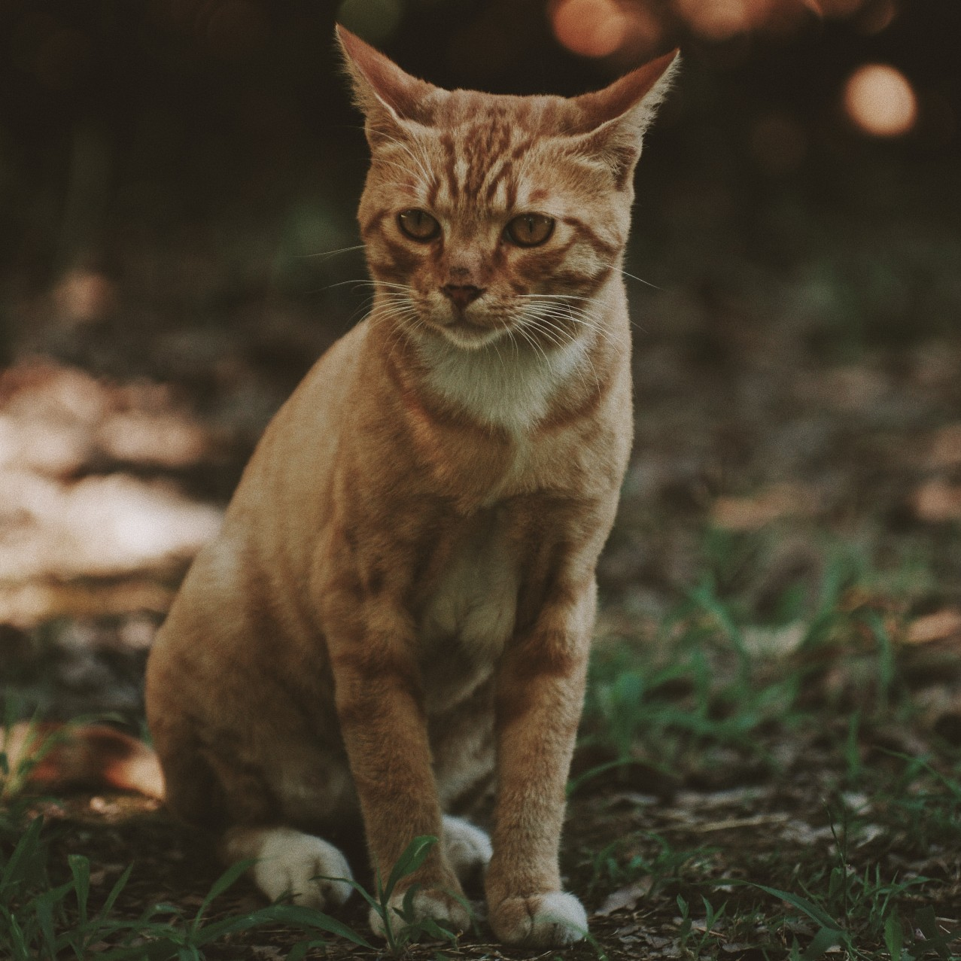
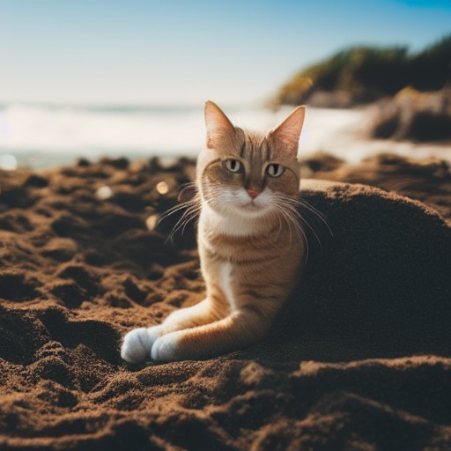
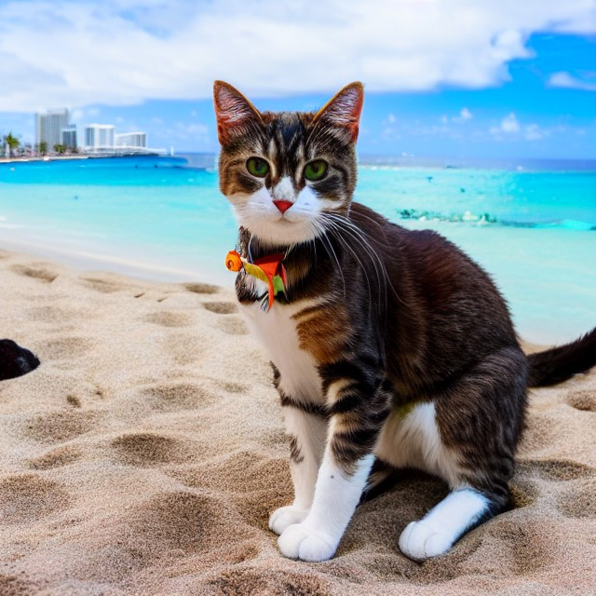
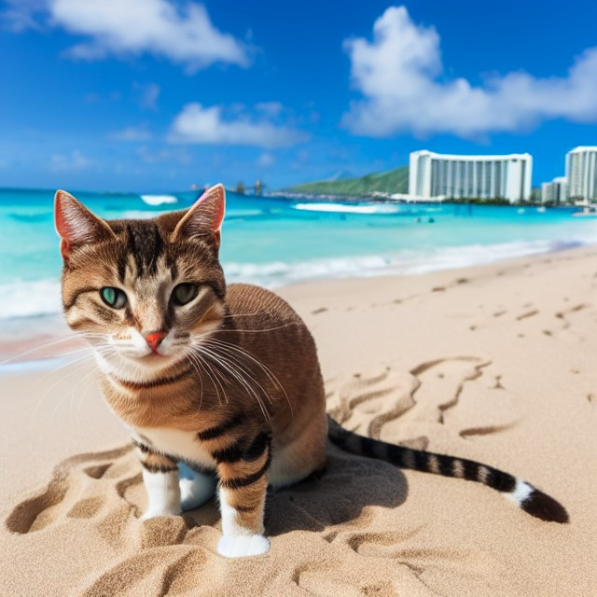
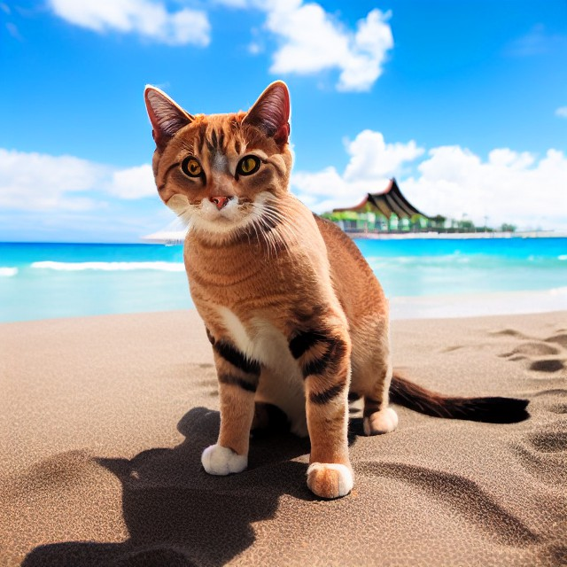
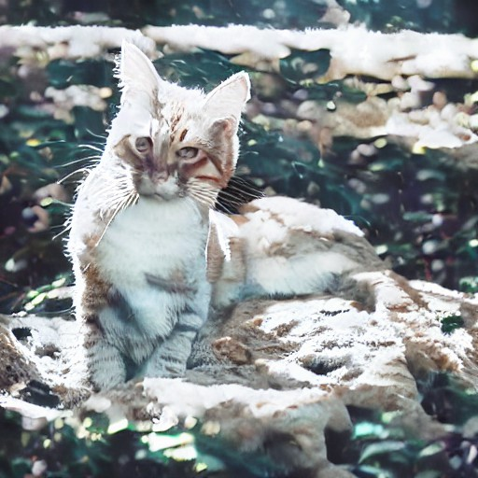
Experimental results
Ablation
prompt: A photo of man, big face, close up
prompt: A photo of woman wearing a red hat
w.o. injection
reference image
W_{C} =0.9
W_{C} =1.0
W_{C} =1.1
W_{C} =1.2
W_{C} =1.3
reference image
w.o. injection
only self-attn injection
only cross-attn injection
full
(W_{S}=1.2)
prompt: A photo of cat on the beach
reference image
W_{s} =1
W_{s} =0.8
W_{s} =1.0
W_{s} =1.2
W_{s} =1.4
w.o. mask (W_{c}=1.2)
w. mask (W_{c}=1.2)
Notes:
We conduct a thorough ablation study across various components and settings. As shown in right Fig, when only self-attention injection or cross-attention injection, the generated image has a closer resemblance to the reference image but lacks facial details. The full injections have more faithful identity preservation. The left Fig demonstrates that without a mask, each images generated with self-attention injection result in black mudflats that match the color tone of the reference image instead of smooth sandy beaches. Additionally, a larger $W_S$ value produces a more similar identity, but exceeding a certain threshold leads to image deterioration. The Fig in the next row demonstrates that increasing the value of $W_C$ can heighten the level of identity consistency. Too small will generate an image that is not similar to the reference image, and too large will also cause image distortion.
The quantitative comparison of different components and settings is shown in Table 2. When all components work together, the best identity consistency is achieved. Furthermore, the text-image consistency and aesthetic scores of our method are nearly equivalent to those of the original SD without any attention injection.

Slide 7
More results
Genelizable to customized models:
Notes:
Our method demonstrated proficient performance not only on SDV1-5 but also showed high identity consistency with other pre-trained text-to-image models. AnythingV4.5 and Chilloutmix, both were fine-tuned based on SDV1-5. We conducted experiments on these two models using the same experimental parameters as employed with SDV1-5. As depicted in Fig, our method can be adaptable to different models.

Slide 8
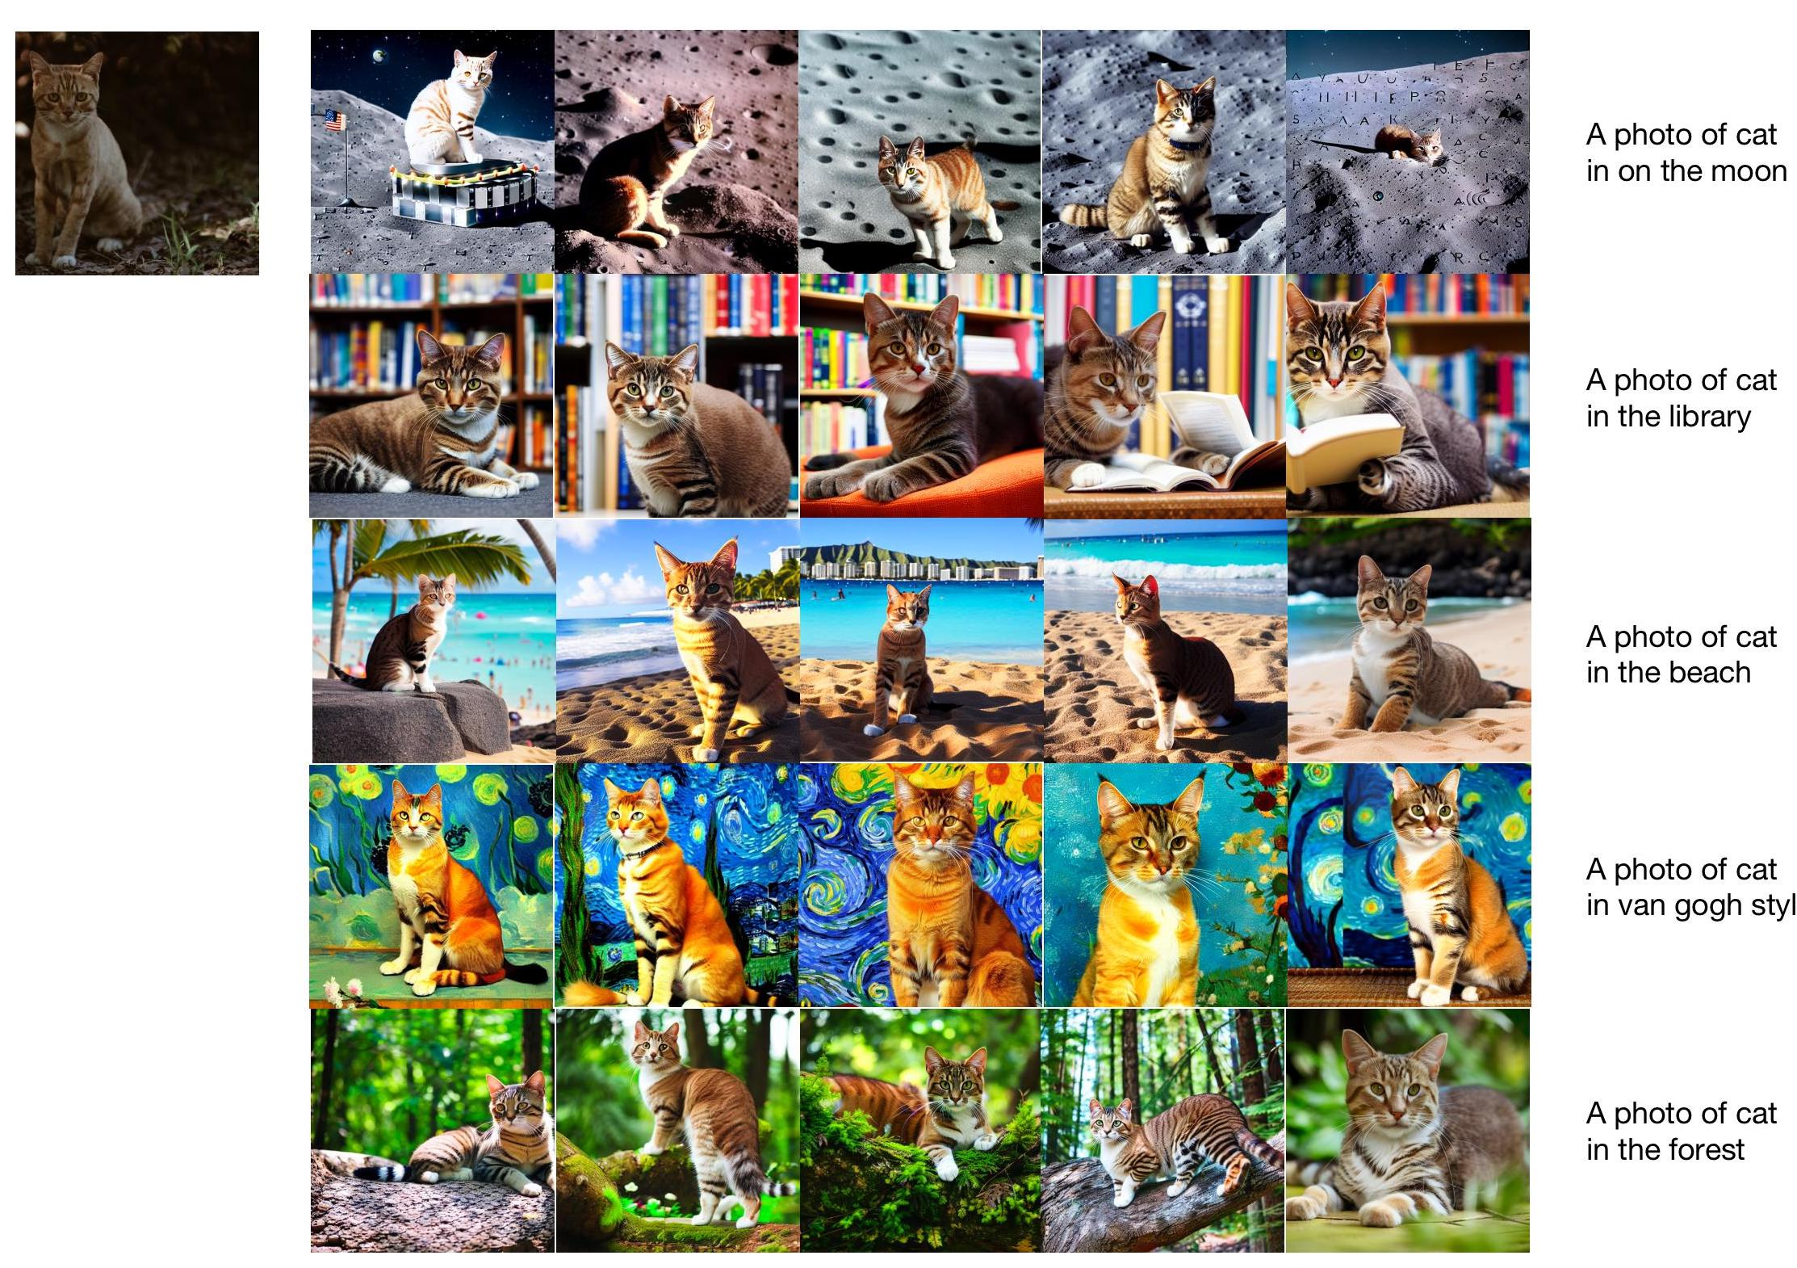
More results
T2i Results on cat domain:
Notes:
We show more T2i Results on cat domain

Slide 9
More results
T2i Results on cat domain:

Slide 10
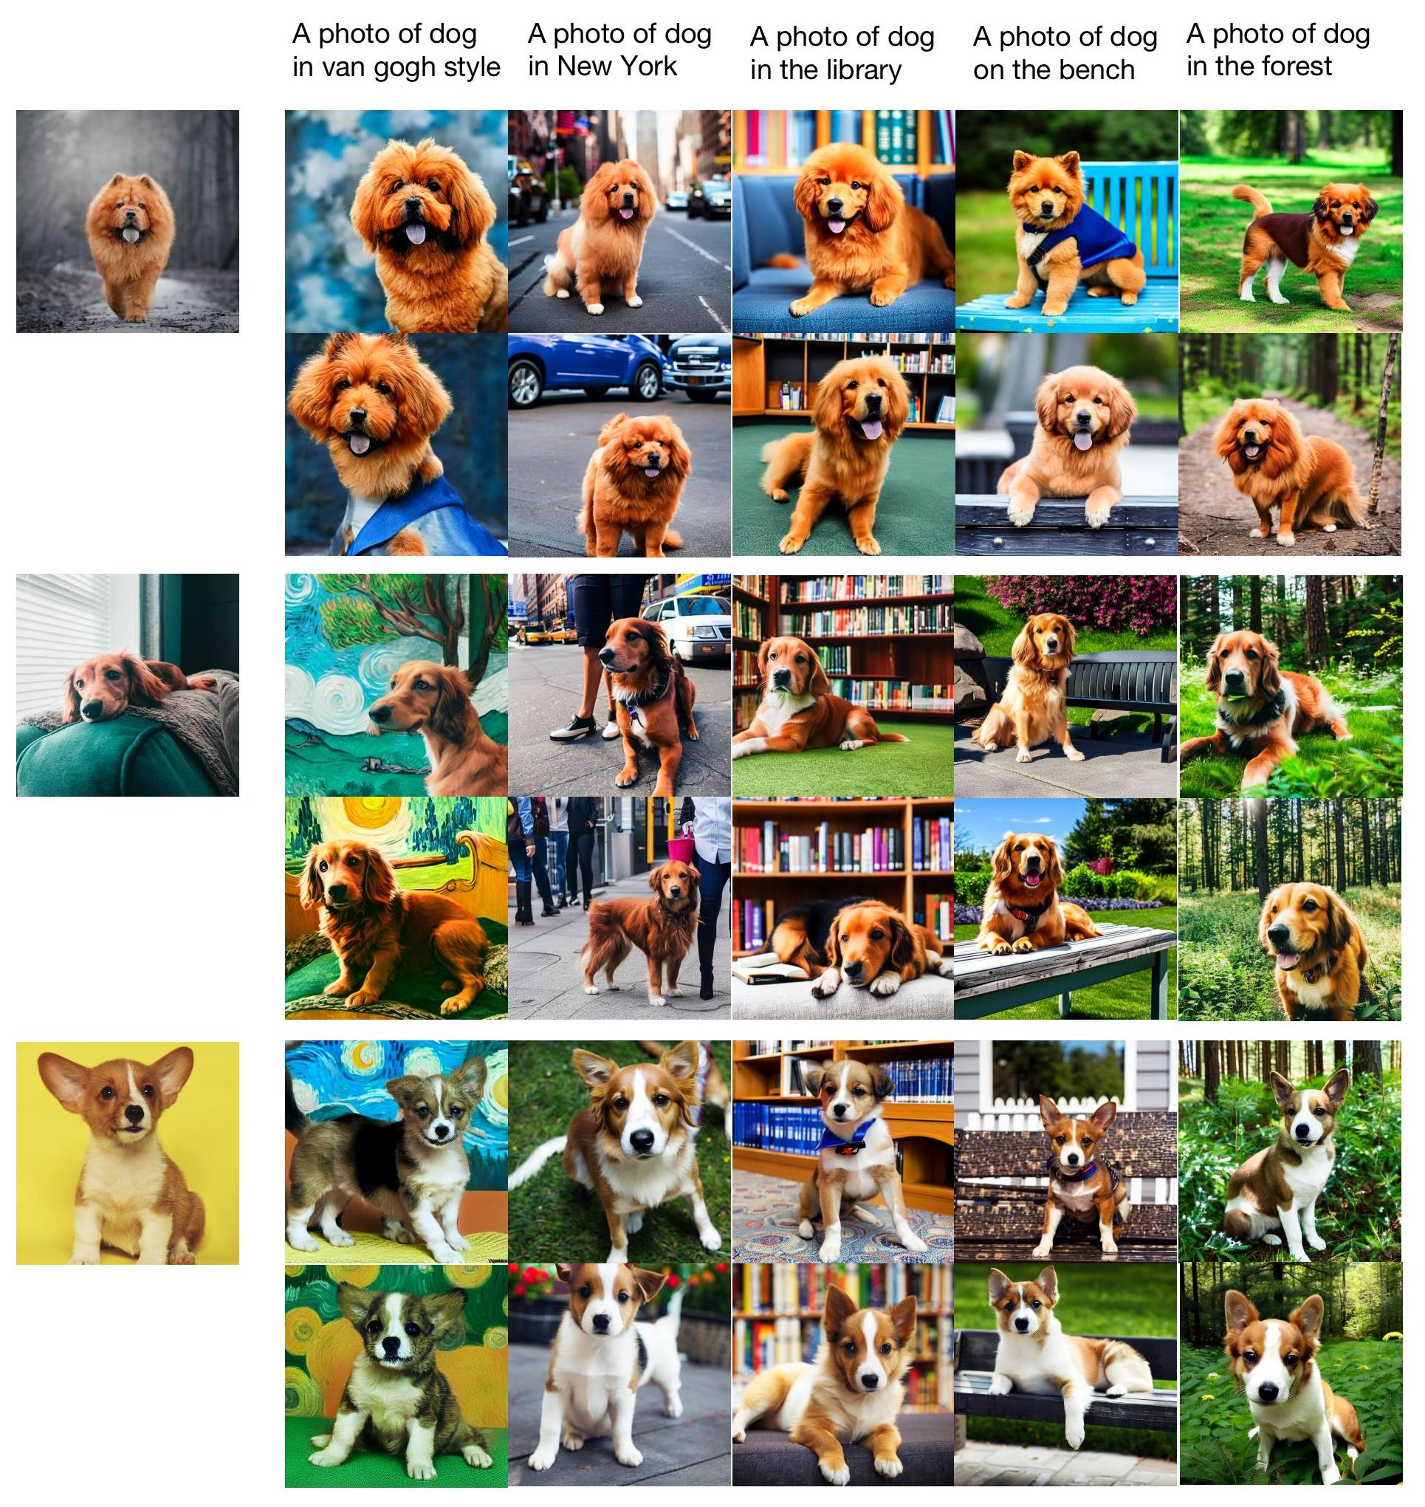
More results
T2i Results on dog domain:
Notes:
We show more T2i Results on dog domain

Slide 11
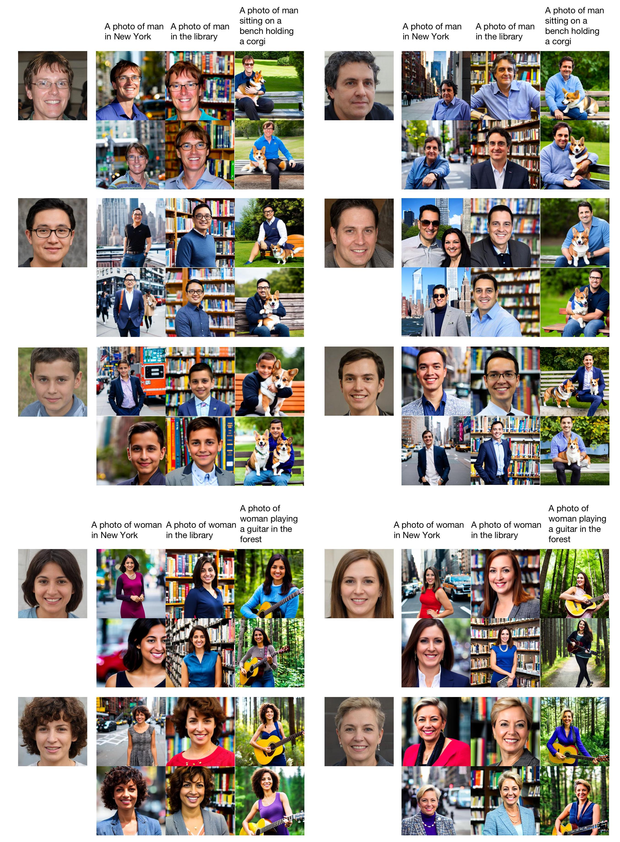
More results
T2i Results on human domain:
Notes:
We show more T2i Results on human domain

Slide 12
More results
T2i Results on human domain:

Slide 13
Conclusion
We propose a new method for personalized image generation that takes a novel approach to improving textual-image consistency while maintaining identity consistency, without the need for fine-tuning or training for each individual concept.
We innovated to use two dual-unet structures and a domain-specific concept encoder to inject the concept during generation through self-attention and cross-attention layers.
Extensive experiments demonstrate that our method can generate images that are both identity-consistent and text-image consistent. This fast and highly text-image consistent method advances the development of personalized image generation and makes identity injection applications more flexible.

Slide 14
THANKS FOR WATCHING

