Slide 1
SiamCLIM: Text-Based Pedestrian Search via Multi-modal Siamese Contrastive Learning

Slide 2
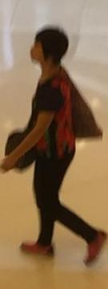
Introduction:TBPS
TBPS(text-based pedestrian search):
Retrieves target persons from an image gallery through descriptive text queries.
"This walking woman has short dark hair, black pants and a black and red floral print shirt with pink shoes. She is also carrying a large bag."
Target Person
Descriptive Text Query
Notes:
TBPS, a technology that retrieves target persons from an image gallery through descriptive text queries. This technology has the potential to revolutionize surveillance, making it more efficient and effective, and increasing crime clearance rates.

Slide 3
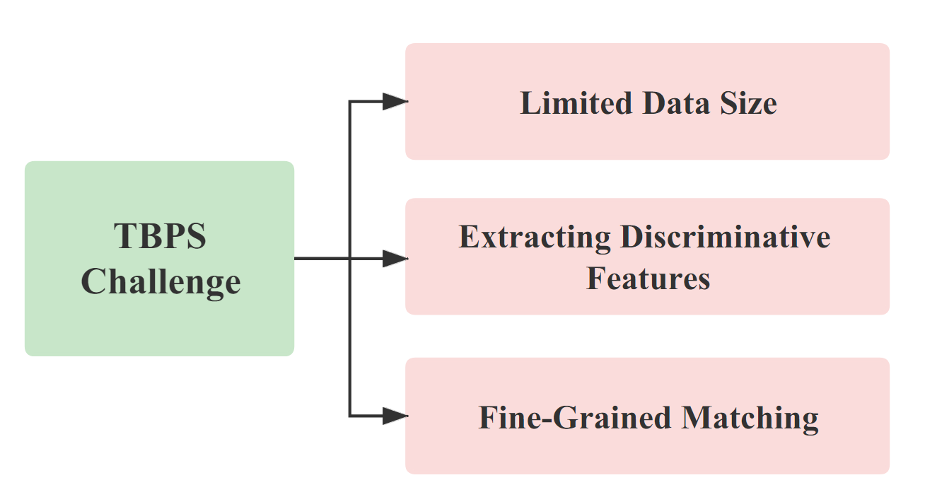
Motivation
Notes:
Despite significant progress in this field, previous works about TBPS have struggled to efficiently extract discriminative features from multi-modal data. One of the major challenges is the efficient extraction of discriminative features from multi-modal data (i.e., images and text descriptions). This process involves understanding the relationship between the text descriptions and the corresponding images, which is a complex task due to the inherent differences between these two types of data.
Another is about Fine-Grained Matching: TBPS requires fine-grained matching between text descriptions and images. This means that the system must be able to distinguish between very similar images based on subtle differences described in the text. Current models such as CLIP provide only coarse-grained descriptions, which are not sufficient for this task.
Also, Most TBPS models are trained using pedestrian data only, which makes it has the limitation of data size.

Slide 4
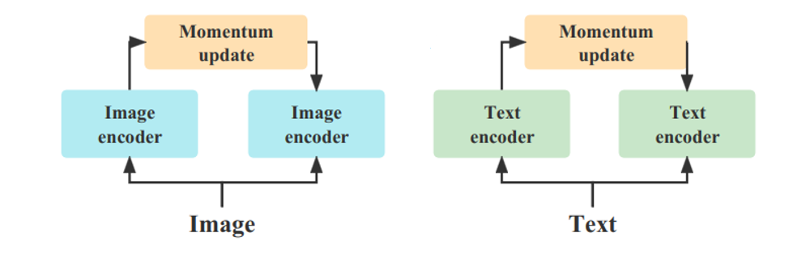
Contribution
Previous Model： 4 Encoders
Our Model：2 Encoders
Notes:
To overcome these limitations, we drew inspiration from the SimSiam architecture, a simpler model that proved good representations can be learned. We proposed the SiamCLIM, which maps images and texts into one shared vector space, and conducts contrastive learning. This simplified the contrastive learning pattern and allowed us to learn more information.
The SiamCLIM addresses the problem of cross-modal fine-grained text-to-image by implementing a deep bilateral projection that interacts with textual descriptions and target-person images. It uses a siamese network structure to capture the relationship between text and image, which significantly enhances the performance of TBPS.
In previous studies, traditional contrastive learning models are mostly implemented with two encoders for each modality. Therefore, in a cross-modal scenario , four encoders should be deployed (Fig.1), which results in a complex model structure and higher computational costs. In our work of SiamCLIM, we leverage the SimSiam architecture and enable cross-modal contrastive learning with only two encoders (Fig.2). We demonstrate that our method reduces the computational complexity, which brings higher model efficiency with more reliable search accuracy.

Slide 5
Model Structure
The projection and prediction heads are identical for both image and text as they share the same parameters, where no gradient for the text branch
Notes:
Our model performs contrastive learning and downstream tasks learning in an end-to-end manner. The projection head and prediction heads are identical for both image and text as they share the same parameters.
In our model, image, and text data are separately processed by a ResNet and a BiGRU. The ResNet backbone is the vanilla version that is pre-trained on CLIP，Projectors with projection MLP head are added after both the image and text encoder to form and maintain more information from the former encoded features for a better contrastive learning outcome. For symmetric loss calculation, a prediction MLP head is used as a predictor to process information from the projector. where no gradient for the text branch. Plus, although two projectors are implemented in coding, they can be regarded as the same projector since they share the same parameters. Therefore, the projector only do parameter update according to one branch at a time.

Slide 6
Total Loss
Symmetric Loss
Alignment Loss
Classification Loss
Notes:
the align loss and identity loss for matching text and images for downstream tasks, and the symmetric loss for the improvement of contrastive learning.
symmetric loss computation aims at mapping text and images with the same ID to a shared space, thereby enabling the learning of sophisticated representations within the encoder.
The alignment loss considers both relative and absolute distances between positive and negative pairs.
The identity classification loss is adopted here to assist the learning of instance discriminative features.

Slide 7
Results
Notes:
In terms of text to image, our model outperforms the current state-of-the-art CM-MoCo by 11.55%, 11.02% and 7.76% in terms of top-1, top-5 and top-10, respectively. It is also worth noting that It is worth noting that our model exceeds the baseline in both Resnet50 and 101 versions. In other words, our proposed multi-modal contrast learning framework is able to learn more discriminative features.

Slide 8
Ablation study
The tested model is SiamCLIM with ResNet-101. Our experiments have shown the Siamese architecture provides the most significant improvement of 7.89%
Notes:
Further experiments are done to validate our method. The results demonstrate the synchronous training of downstream tasks and contrastive learning (row 2) can provide significant improvement compared to the counterpart that trained downstream task only without siamese structure. Also, it is shown that by adding batch normalization layer in the projection head and prediction head can further improve the model performance.The ablation study compares how the siamese architecture, symmetric loss, and batch normalization affect the model performance.

