Slide 1
ICASSP 2022

Slide 2
LEARNING TO FUSE HETEROGENEOUS FEATURES FOR LOW-LIGHT IMAGE ENHANCEMENT
Zhenyu Tang, Long Ma, Xiaoke Shang, Xin Fan
Dalian University of Technology
Email: sxk-1212@zju.edu.cn

Slide 3
Motivation
Existing issues in related works
Severe color distortion
Large noise and inadequate texture
We propose a framework considering semantic features along with the great denoise effect

Slide 4
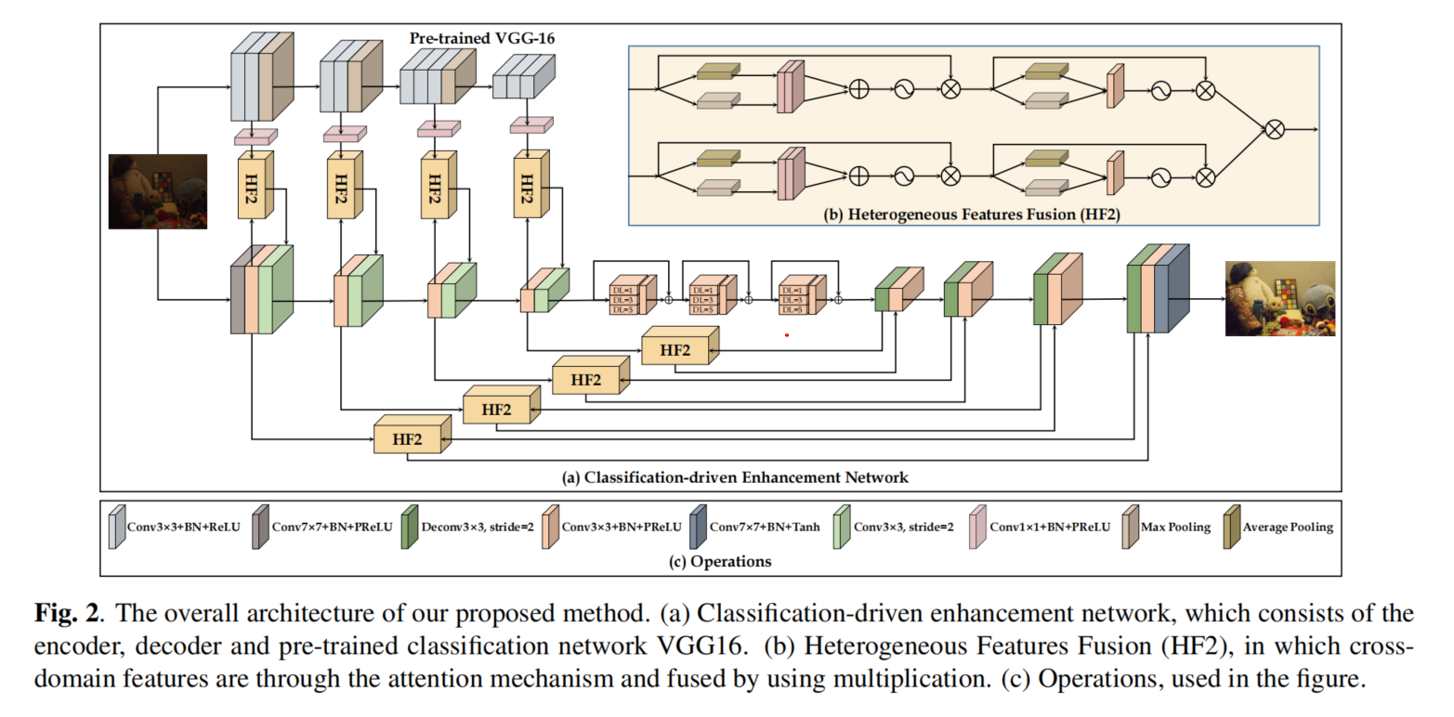
The Overall Framework

Slide 5
Heterogeneous Features Fusion Operation:
Loss Function :

Slide 6
Comparison with State-of-the-arts

Slide 7
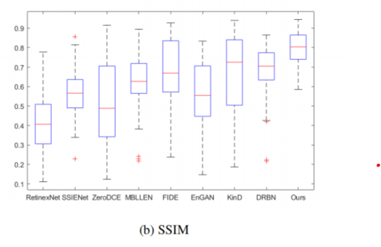
Comparison with State-of-the-arts

Slide 8
Comparison with State-of-the-arts

Slide 9
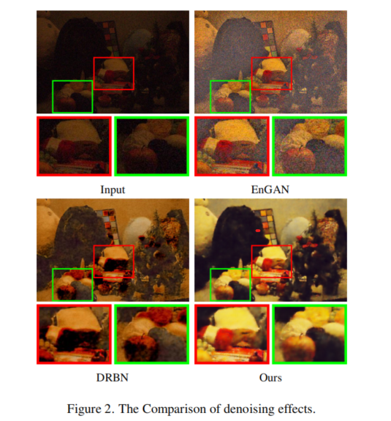
Comparison with State-of-the-arts

Slide 10
Ablation Study

Slide 11
Ablation Study

Slide 12
谢 谢 观 看 THANK YOU

