Slide 1
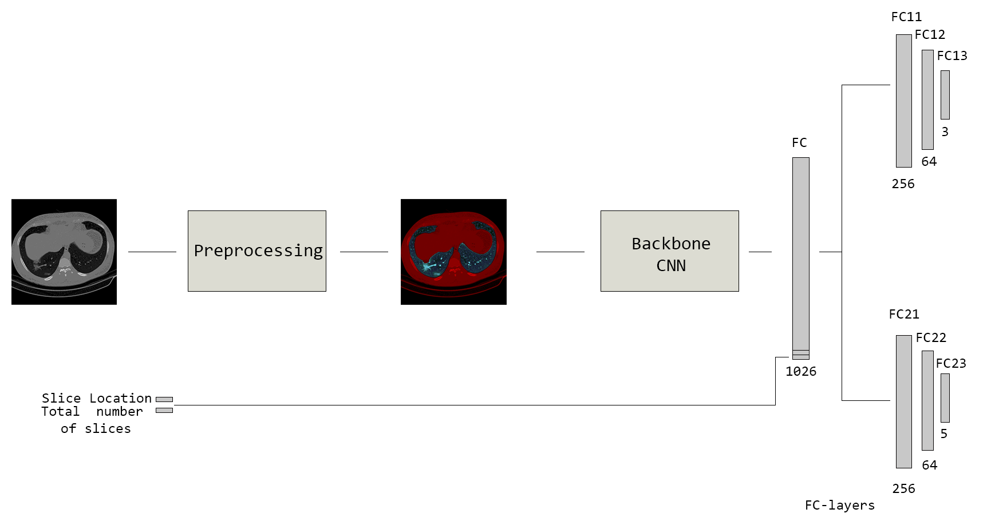
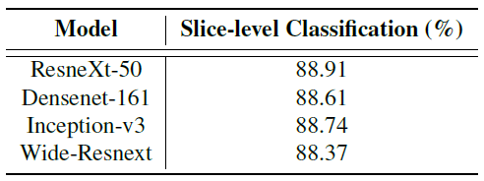
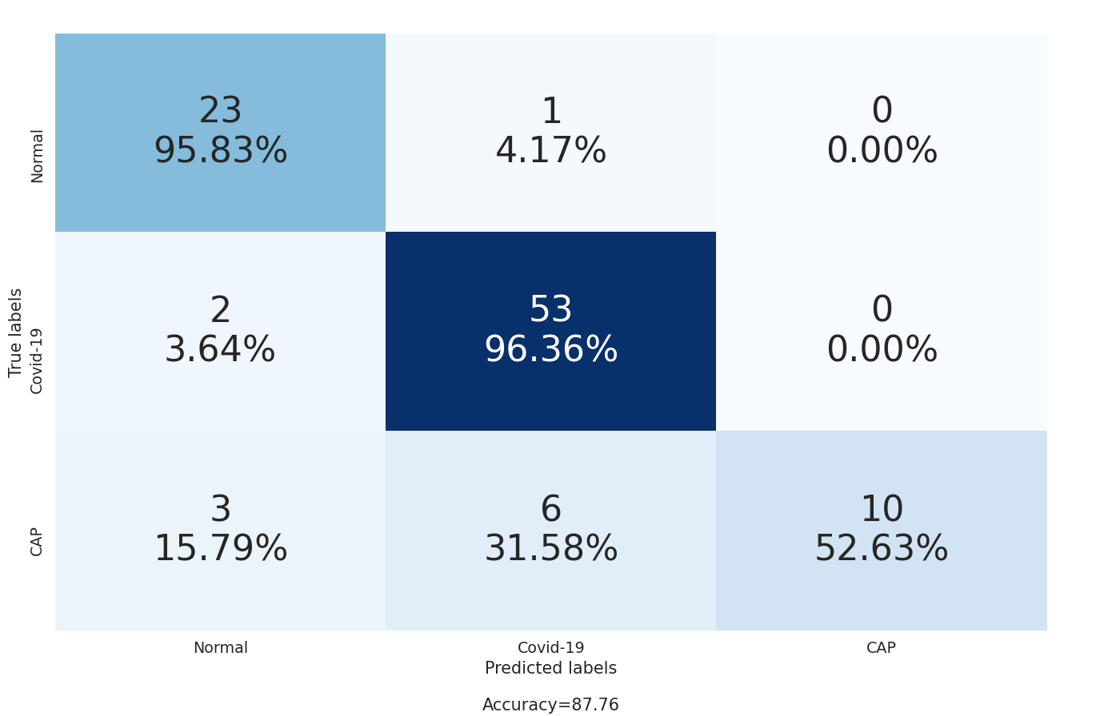
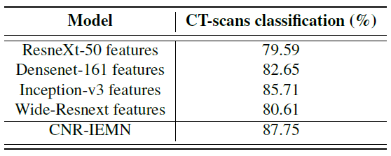
Paper ID: 5690
Monday, June 7th, 2021
CNR-IEMN: A DEEP LEARNING BASED APPROACH
TO RECOGNISE COVID-19 FROM CT-SCAN
Fares Bougourzi, Riccardo Contino, Cosimo Distante and Abdelmalik Taleb-Ahmed
Introduction:
Contributions:
Covid-19 is a respiratory infection caused by the virus named SARS-CoV-2 belonging to the coronavirus family. The virus mainly affects the respiratory tract.
The first stage, to prevent the spreading of this disease is the recognition and confinement of the infected persons. Different recognition methods have proved their efficiency including RT-PCR, X-ray scans and CT-scans.
For the recognition of Covid-19 infection from the X-ray scans and CT-scans, the Artificial Intelligence (AI) systems can provide an alternative solution for the automatic diagnosis of Covid-19 infections and differentiate them from other Lung diseases.
We propose to segment the lung nodules of the slice, then we stack the original slice channel with the segmented channels to have RGB like image.
With the use of Multi-task strategy and data augmentation for Covid-19 and Cap slices, we trained four CNN architectures (ResneXt-50, Densenet-161, Inception-V3 and Wide-Resnet) for Slice-level classification.
For Patient-Level CT-scans classification, we propose to divide the CT-scan slices into groups, then calculate the percentage of each class within each group using all trained CNN models for the Slice-Level classification. At the end, we combined all grouping percentages from all trained CNN architectures then feed them into XG-boost classifier to recognize the CT-scan category.
Our Proposed Approach:
The overall structure of our approach is summarized in Figure 1. In summary, our approach consists of two stages:
1st stage : Slice-level Classification
The objectify of this stage is to classify the slices into one of the three classes (Normal, Covid-19 and Cap).
First: we propose to stack the gray image, the segmented lung nodules image and the multiplication of the gray-scale image with the binary lung nodules mask.
Secondly, we used the stacked three channels images to train four backbone CNN architectures for slice level classification. The trained CNN architectures are ResneXt-50, Densenet-161, Inception-V3 and Wide-Resnet. In Figure 2 we shows an example of the training of Backbone CNN with Multi-Tasks learning scheme.
Figure 1: General structure of our proposed approach
2nd stage : Patient-Level Classification
We predicted the slices label for the whole CT-scan using trained CNN architectures.
Since the number of slices of the CT-scans varies from one CT-scan to another, we propose to divide the slices into 20 equal groups. For each group, we calculate the slice prediction percentage of each class.
Finally, we concatenated the percentages of all CT-scan groups which creates the feature vector. Then we feed this feature vector into XG-boost classifier to predict the class of the CT-scan.
Figure 2: Training scheme of the CNN architectures for slice classification
Experimental Results:
Results on Validation Data:
Slice-level Results:
From Table 1, we notice that the architectures achieved close result on classifying the slices with slightly better performance by ResneXt-50 architecture.
2. Patient-level Results:
Table 2 summarizes the obtained results of each individual CNN percentage features and their combination. We notice that Inception-v3 features achieved the best performance compared with the other architectures features. From other hand, the combination of the four models features achieved the best performance.
From the confusion matrix in Figure 4, we notice that our approach achieved high accuracy in the recognition of Normal and Covid-19 CT-scans.
Table 1 : Validation Slice-level classification results
Table 2: Validation Patient-level classification results
Figure 3 : The Confusion Matrix of the validation data CT-scan classification.
Results on Testing Data of challenge :
The testing data of SPGC on COVID-19 challenge consists of three sets. The testing data labels are not known for all of the challenge participants. Our approach achieved the fifth place on SPGC on COVID-19 challenge. In should be noted that our approach achieved the best sensitivity of Covid-19 recognition. In more details, our approach achieved 81.11% as overall accuracy and 91.43%, 45.0% and 91.43% sensitivities for Covid-19, Cap and Normal, respectively.
Conclusions:
Perspective:
Our approach achieved promising results in both validation and testing data especially for the recognition of Normal and covid-19 infection.
For the validation data, our approach achieved 87.75% as overall accuracy and 96.36%, 52.63% and 95.83% sensitivities for Covid-19, Cap and Normal, respectively.
For the testing data, our approach achieved the fifth place on SPGC challenge and the first place for Covid-19 sensitivity.
To improve our approach performance, specially for the Cap class, we suggest to use more Cap CT-scans for the Slice-Level and Patient-level classification.
Notes:
Clement:
Figure 1: remove ref to L&T. add dimensions. Give details on each type of sensor? (or ref to Clément’s presentation)
Figure 2: add name of each zone
Figure 3:
Add Caltech logo.
C: to modify title.
Caltech, Eram, BMGF, + Vodafone Wireless Innovation Project,
Sara:
Echelle
Référence
Zone explicite (ok)
Légendes carte xbee (ok)
Titre meme bloc (mecanique / electronique) (ok)
Logos: Fondation, caltech, vodafone, eram , iemn, uphf, cnrs?

