Slide 1
Medical image retrieval based on deep hashing
Author : Longquan Yan, Wei Shi*,
Reporter: Longquan Yan
NingXia University

Slide 2
01 Introduction
CONTENTS
02 Method
03 Results
04 Conclusion

Slide 3
Part 1
Introduction

Slide 4
1.1 Background- Image Retrieval
Methods | The traditional algorithm | LSH
Advantages | easy to implement and strong real-time | Can perform effective hash mapping | Effectively improve retrieval performance
disadvantages | Incomplete feature extraction and low retrieval accuracy | Need to generate a longer hash code

Slide 5
1.2 Objective
The primary aims of this study : In order to improve the medical image retrieval performance, This paper proposes a deep hash network model based on attention mechanism for medical image retrieval. It combines the advantages of the attention mechanism and deep hashing. The model first adds the attention mechanism module to the convolutional neural network used to extract image feature information, then inputs the extracted image feature vector into the hash layer to obtain the hash code corresponding to the image.

Slide 6
Part 2
Method

Slide 7
2.method
Firstly, in order to enhance the feature extraction and learning ability of the network model, we add SENet visual attention mechanism into each residual module of the backbone network ResNet50 used for feature extraction. Then the extracted high-dimensional semantic features are added to the Cauchy hash module to generate a compact, centralized hash code, and then complete medical image retrieval.
PPT模板下载：www.1ppt.com/moban/ 行业PPT模板：www.1ppt.com/hangye/
节日PPT模板：www.1ppt.com/jieri/ PPT素材下载：www.1ppt.com/sucai/
PPT背景图片：www.1ppt.com/beijing/ PPT图表下载：www.1ppt.com/tubiao/
优秀PPT下载：www.1ppt.com/xiazai/ PPT教程： www.1ppt.com/powerpoint/
Word教程： www.1ppt.com/word/ Excel教程：www.1ppt.com/excel/
资料下载：www.1ppt.com/ziliao/ PPT课件下载：www.1ppt.com/kejian/
范文下载：www.1ppt.com/fanwen/ 试卷下载：www.1ppt.com/shiti/
教案下载：www.1ppt.com/jiaoan/
字体下载：www.1ppt.com/ziti/

Slide 8
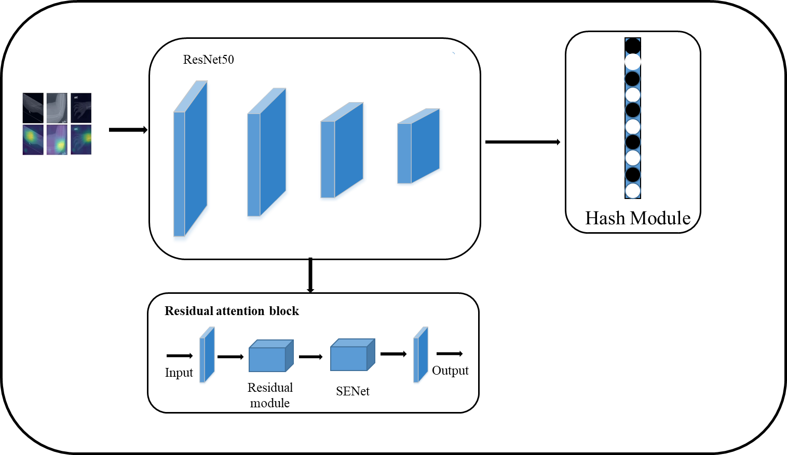
2.method
Framework of the proposed method
PPT模板下载：www.1ppt.com/moban/ 行业PPT模板：www.1ppt.com/hangye/
节日PPT模板：www.1ppt.com/jieri/ PPT素材下载：www.1ppt.com/sucai/
PPT背景图片：www.1ppt.com/beijing/ PPT图表下载：www.1ppt.com/tubiao/
优秀PPT下载：www.1ppt.com/xiazai/ PPT教程： www.1ppt.com/powerpoint/
Word教程： www.1ppt.com/word/ Excel教程：www.1ppt.com/excel/
资料下载：www.1ppt.com/ziliao/ PPT课件下载：www.1ppt.com/kejian/
范文下载：www.1ppt.com/fanwen/ 试卷下载：www.1ppt.com/shiti/
教案下载：www.1ppt.com/jiaoan/
字体下载：www.1ppt.com/ziti/

Slide 9
2.method
ResNet50 is selected for image feature extraction in this paper, and ResNet50 is divided into 5 stages. The structure of Stage 0 is relatively simple, which can be regarded as the preprocessing of INPUT. The last 4 stages are composed of Bottleneck and have similar structures. Stage 1 contains 3 Bottlenecks, and the remaining 3 stages include 4, 6, and 3 Bottlenecks respectively. Each different Bottleneck contains three convolution kernels, plus the convolutional layer and the last layer at the beginning of the network model, which the fully connected layer constitutes a network structure diagram of a total of 50 layers, as shown in Figure for the ResNet50 network structure diagram.
Fig. 2 Mean hash map
PPT模板下载：www.1ppt.com/moban/ 行业PPT模板：www.1ppt.com/hangye/
节日PPT模板：www.1ppt.com/jieri/ PPT素材下载：www.1ppt.com/sucai/
PPT背景图片：www.1ppt.com/beijing/ PPT图表下载：www.1ppt.com/tubiao/
优秀PPT下载：www.1ppt.com/xiazai/ PPT教程： www.1ppt.com/powerpoint/
Word教程： www.1ppt.com/word/ Excel教程：www.1ppt.com/excel/
资料下载：www.1ppt.com/ziliao/ PPT课件下载：www.1ppt.com/kejian/
范文下载：www.1ppt.com/fanwen/ 试卷下载：www.1ppt.com/shiti/
教案下载：www.1ppt.com/jiaoan/
字体下载：www.1ppt.com/ziti/

Slide 10
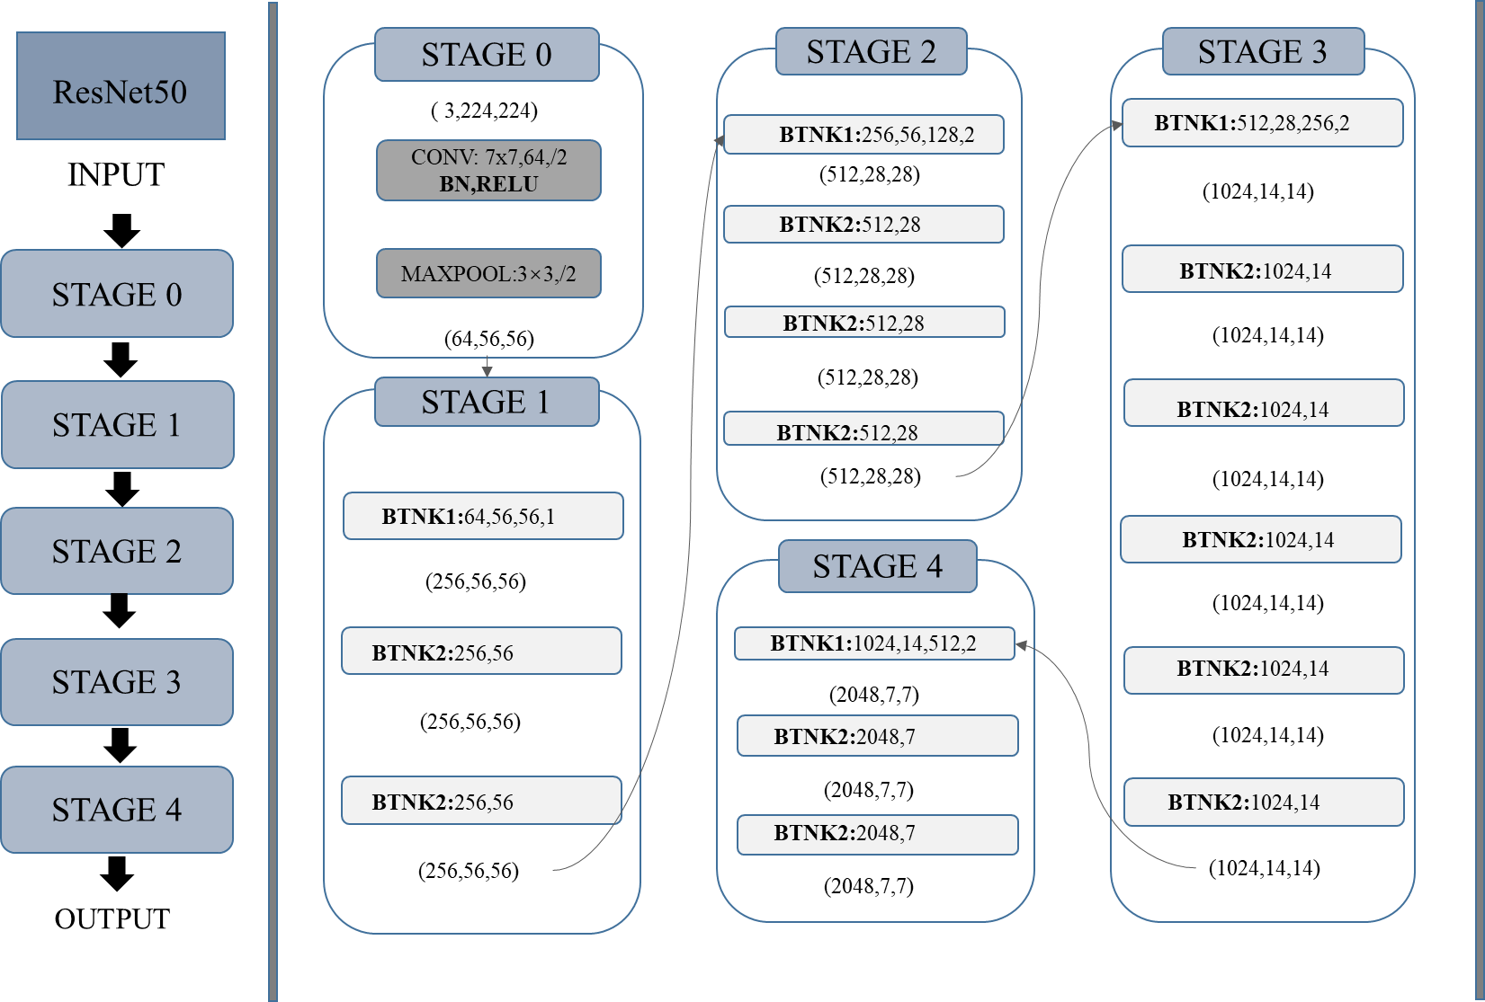
2.method
ResNet50 network structure diagram
PPT模板下载：www.1ppt.com/moban/ 行业PPT模板：www.1ppt.com/hangye/
节日PPT模板：www.1ppt.com/jieri/ PPT素材下载：www.1ppt.com/sucai/
PPT背景图片：www.1ppt.com/beijing/ PPT图表下载：www.1ppt.com/tubiao/
优秀PPT下载：www.1ppt.com/xiazai/ PPT教程： www.1ppt.com/powerpoint/
Word教程： www.1ppt.com/word/ Excel教程：www.1ppt.com/excel/
资料下载：www.1ppt.com/ziliao/ PPT课件下载：www.1ppt.com/kejian/
范文下载：www.1ppt.com/fanwen/ 试卷下载：www.1ppt.com/shiti/
教案下载：www.1ppt.com/jiaoan/
字体下载：www.1ppt.com/ziti/

Slide 11
2.method
This paper introduces the SE algorithm into each residual module of the residual network ResNet50, uses the network to implement dynamic feature recalibration, There by improving the performance of the network, and successfully applies the soft attention mechanism to the typical deep network. Embed the SE module into the new residual module as shown in the Figure .
PPT模板下载：www.1ppt.com/moban/ 行业PPT模板：www.1ppt.com/hangye/
节日PPT模板：www.1ppt.com/jieri/ PPT素材下载：www.1ppt.com/sucai/
PPT背景图片：www.1ppt.com/beijing/ PPT图表下载：www.1ppt.com/tubiao/
优秀PPT下载：www.1ppt.com/xiazai/ PPT教程： www.1ppt.com/powerpoint/
Word教程： www.1ppt.com/word/ Excel教程：www.1ppt.com/excel/
资料下载：www.1ppt.com/ziliao/ PPT课件下载：www.1ppt.com/kejian/
范文下载：www.1ppt.com/fanwen/ 试卷下载：www.1ppt.com/shiti/
教案下载：www.1ppt.com/jiaoan/
字体下载：www.1ppt.com/ziti/

Slide 12
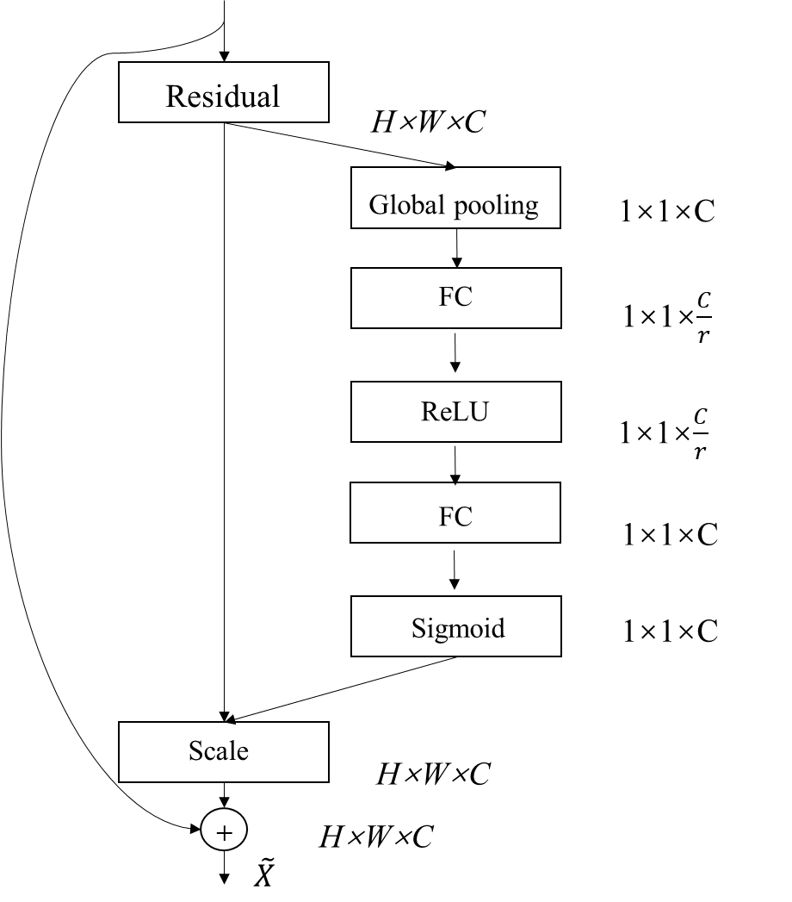
2.method
PPT模板下载：www.1ppt.com/moban/ 行业PPT模板：www.1ppt.com/hangye/
节日PPT模板：www.1ppt.com/jieri/ PPT素材下载：www.1ppt.com/sucai/
PPT背景图片：www.1ppt.com/beijing/ PPT图表下载：www.1ppt.com/tubiao/
优秀PPT下载：www.1ppt.com/xiazai/ PPT教程： www.1ppt.com/powerpoint/
Word教程： www.1ppt.com/word/ Excel教程：www.1ppt.com/excel/
资料下载：www.1ppt.com/ziliao/ PPT课件下载：www.1ppt.com/kejian/
范文下载：www.1ppt.com/fanwen/ 试卷下载：www.1ppt.com/shiti/
教案下载：www.1ppt.com/jiaoan/
字体下载：www.1ppt.com/ziti/

Slide 13
2.method
After the residual neural network is added to the attention module, it can identify the key features of the image, map the image into a focused feature vector, and then map the feature vector into a binary code after passing through the image hash module. The method in this paper replaces the last fully connected layer of ResNet50 with a hash layer, and maps the high dimensional image feature expression extracted by the network into binary codes through the hash module. Through the function to quantify the eigenvectors.
PPT模板下载：www.1ppt.com/moban/ 行业PPT模板：www.1ppt.com/hangye/
节日PPT模板：www.1ppt.com/jieri/ PPT素材下载：www.1ppt.com/sucai/
PPT背景图片：www.1ppt.com/beijing/ PPT图表下载：www.1ppt.com/tubiao/
优秀PPT下载：www.1ppt.com/xiazai/ PPT教程： www.1ppt.com/powerpoint/
Word教程： www.1ppt.com/word/ Excel教程：www.1ppt.com/excel/
资料下载：www.1ppt.com/ziliao/ PPT课件下载：www.1ppt.com/kejian/
范文下载：www.1ppt.com/fanwen/ 试卷下载：www.1ppt.com/shiti/
教案下载：www.1ppt.com/jiaoan/
字体下载：www.1ppt.com/ziti/

Slide 14
Part 3
Results

Slide 15
3 Experiment
Through a large number of experiments in this paper, the method is reliable, can be used for medical image retrieval, this method compared with other existing hash algorithm to improve the retrieval performance to some extent.
PPT模板下载：www.1ppt.com/moban/ 行业PPT模板：www.1ppt.com/hangye/
节日PPT模板：www.1ppt.com/jieri/ PPT素材下载：www.1ppt.com/sucai/
PPT背景图片：www.1ppt.com/beijing/ PPT图表下载：www.1ppt.com/tubiao/
优秀PPT下载：www.1ppt.com/xiazai/ PPT教程： www.1ppt.com/powerpoint/
Word教程： www.1ppt.com/word/ Excel教程：www.1ppt.com/excel/
资料下载：www.1ppt.com/ziliao/ PPT课件下载：www.1ppt.com/kejian/
范文下载：www.1ppt.com/fanwen/ 试卷下载：www.1ppt.com/shiti/
教案下载：www.1ppt.com/jiaoan/
字体下载：www.1ppt.com/ziti/

Slide 16
3 Experiment
NUS-WIDE
The mean Average Precision scores of different hashing algorithms
Methods | NUS-WIDE
 | 12-bit | 24-bit | 36-bit | 48-bit
My Method | 0.816 | 0.828 | 0.833 | 0.846
SSDH | 0.783 | 0.788 | 0.791 | 0.794
PQN | 0.803 | 0.818 | 0.822 | 0.824
SUBIC | 0.652 | 0.783 | 0.792 | 0.796
BGAN | 0.675 | 0.69 | 0.714 | 0.728
LEBV | 0.588 | 0.592 | 0.599 | 0.598
WDH | 0.453 | 0.473 | 0.492 | 0.504
CNNH | 0.432 | 0.436 | 0.445 | 0.433
KSH | 0.433 | 0.459 | 0.466 | 0.469
LSH | 0.333 | 0.339 | 0.345 | 0.347
PPT模板下载：www.1ppt.com/moban/ 行业PPT模板：www.1ppt.com/hangye/
节日PPT模板：www.1ppt.com/jieri/ PPT素材下载：www.1ppt.com/sucai/
PPT背景图片：www.1ppt.com/beijing/ PPT图表下载：www.1ppt.com/tubiao/
优秀PPT下载：www.1ppt.com/xiazai/ PPT教程： www.1ppt.com/powerpoint/
Word教程： www.1ppt.com/word/ Excel教程：www.1ppt.com/excel/
资料下载：www.1ppt.com/ziliao/ PPT课件下载：www.1ppt.com/kejian/
范文下载：www.1ppt.com/fanwen/ 试卷下载：www.1ppt.com/shiti/
教案下载：www.1ppt.com/jiaoan/
字体下载：www.1ppt.com/ziti/

Slide 17
3 Experiment
MURA datasets
The mean Average Precision scores of different hashing algorithms
Methods | Precision | Recall | MAP@20
My Method | 0.956 | 0.893 | 0.980
SSDH | 0.835 | 0.803 | 0.906
BGAN | 0.789 | 0.768 | 0.889
CNNH | 0.751 | 0.721 | 0.803
PPT模板下载：www.1ppt.com/moban/ 行业PPT模板：www.1ppt.com/hangye/
节日PPT模板：www.1ppt.com/jieri/ PPT素材下载：www.1ppt.com/sucai/
PPT背景图片：www.1ppt.com/beijing/ PPT图表下载：www.1ppt.com/tubiao/
优秀PPT下载：www.1ppt.com/xiazai/ PPT教程： www.1ppt.com/powerpoint/
Word教程： www.1ppt.com/word/ Excel教程：www.1ppt.com/excel/
资料下载：www.1ppt.com/ziliao/ PPT课件下载：www.1ppt.com/kejian/
范文下载：www.1ppt.com/fanwen/ 试卷下载：www.1ppt.com/shiti/
教案下载：www.1ppt.com/jiaoan/
字体下载：www.1ppt.com/ziti/

Slide 18
Part 4
Conclusion

Slide 19
Conclusion
This paper proposes a deep hash network model for medical image retrieval.
In order to improve the detection effect of medical image and make up for the limitation of insufficient feature extraction of traditional hash algorithm, the SENet visual attention mechanism is added into each residual module of ResNet50, the backbone network used for feature extraction, to enhance the feature extraction effect.
Then the extracted semantic features are added to the Cauchy hash module to generate compact and concentrated hash codes. A large number of experiments verify that the proposed method is reliable and can be used for medical image retrieval.

Slide 20
THANK YOU
FOR WATCHING
PRESENTED BY Longquan Yan

