Slide 1
Formal Template
Pepper Robotic Platform for Museum Assistance Application
Authors:
Alessandro Francesco
Allegra Dario
Santoro Corrado
Stanco Filippo
Notes:
Software for a robotic museum guide which aim is to accomplish functions such as interact with visitors, guiding them in the museum explaining and showing information about the museum works.

Slide 2
Presentation Outline IEEE 2018
Introduction to Humanoid Robots
Pepper Robot
CUMA - Cultural hUManoid Assistant
Software Architecture
Software Implementation
Experimental Results
Future Works
Notes:
Before to start and focus to the project I will present the outline of this paper.
We will start talking about humanoid robots, and then we will present the robot used for this project, the architecture, the implementation of the modules of the system, and the evaluation of the application developed.

Slide 3
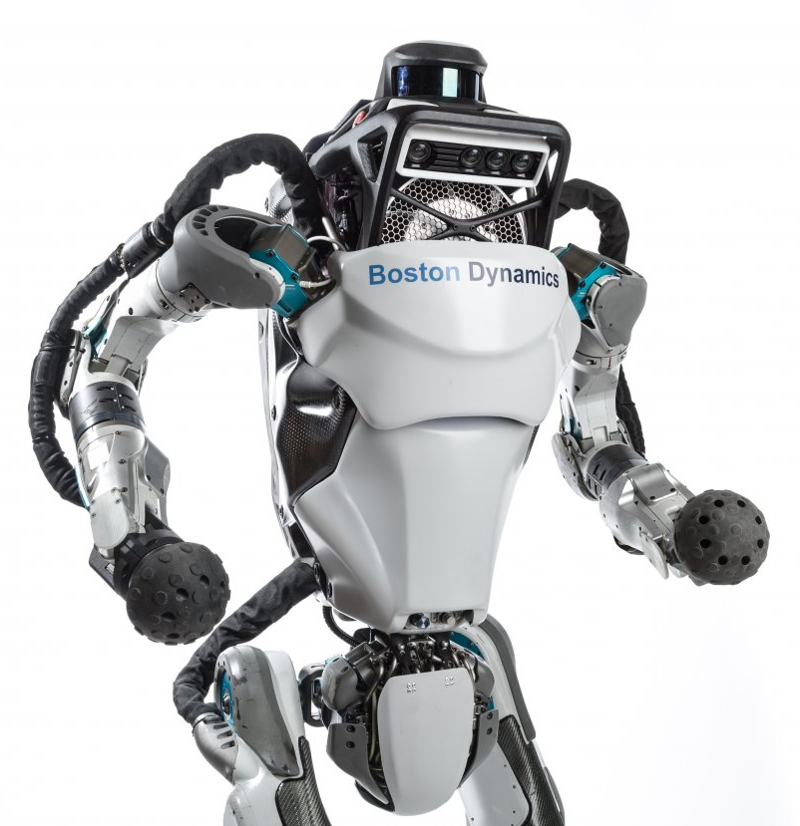
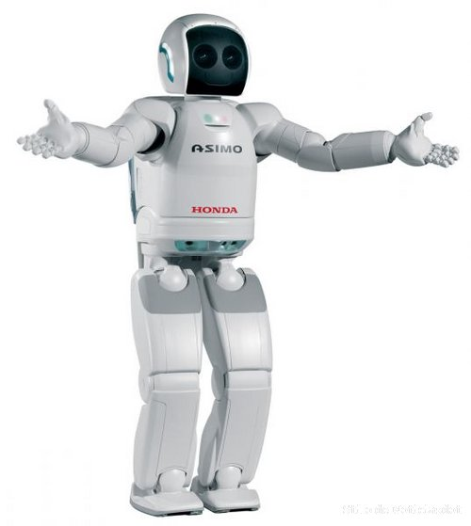
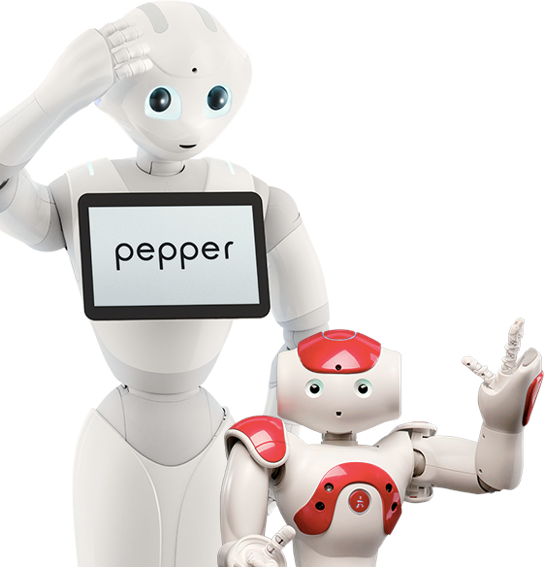
Humanoid Robot IEEE 2018
Humans are brilliant, beautiful, compassionate, and capable of love. Why shouldn't we aspire to make robots humanlike in these ways?
(a) Atlas
(b) Asimo
(c) Pepper, Nao
Fig. 1: Humanoid Robots
Notes:
What are humanoid robots? Humanoid robots are robot with a human body shape.
They are used in several areas, but they recently are developed especially to perform human tasks like personal assistance.
For instance they could be used to take care of elderly and sick people or children with some kind of disorder.

Slide 4
Pepper Robot IEEE 2018
Which robot could we use for this kind of application?
(a) Pepper as Shop Assistant
(c) Pepper as a Steward
Fig. 2: Pepper
Notes:
The first choice that we had to made for our project was which robot to use. What we needed was a humanoid robot capable of interact with people, and move autonomously around an environment.
We choose the humanoid Pepper which is capable of recognize faces, speak, hear, move, and capable of recognizing the principal human emotions and adapting his behavior to the mood of his interlocutor.
It is also equipped with a tablet particularly useful to show resources and information.
We decided to choose this robot because it is particularly suitable for this kind of project thanks to his multi-modal user interface.

Slide 5
CUMA – Cultural hUManoid Assistant IEEE 2018
Robotic museum guide developed to accomplish the following tasks:
to welcome museum visitors
to schedule the path and the tour to accompany visitors along the itinerary
to provide information about the various museum works
to answer to questions concerning museum items
to gather a feedback from visitors about the service offered
Notes:
In this slide we can see the tasks that our Robotic museum guide is capable of accomplish.
For instance he is able:
to welcome museum visitors when they arrive in the museum
to schedule the path and the tour to accompany visitors along the itinerary
to provide information about the various museum works
to answer to questions concerning museum items
to gather a feedback from visitors about the service offered

Slide 6
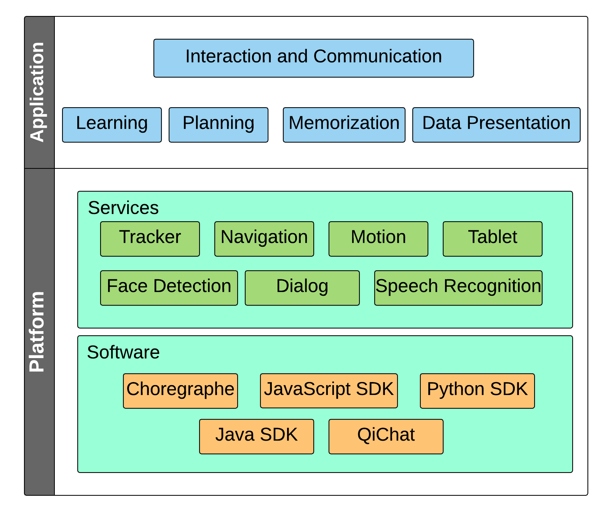
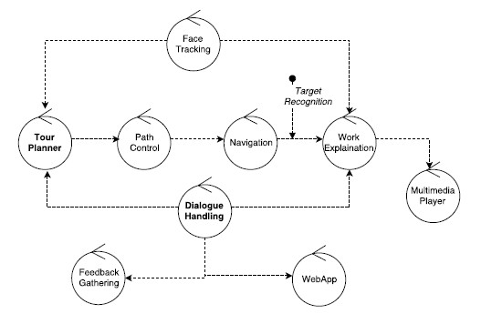
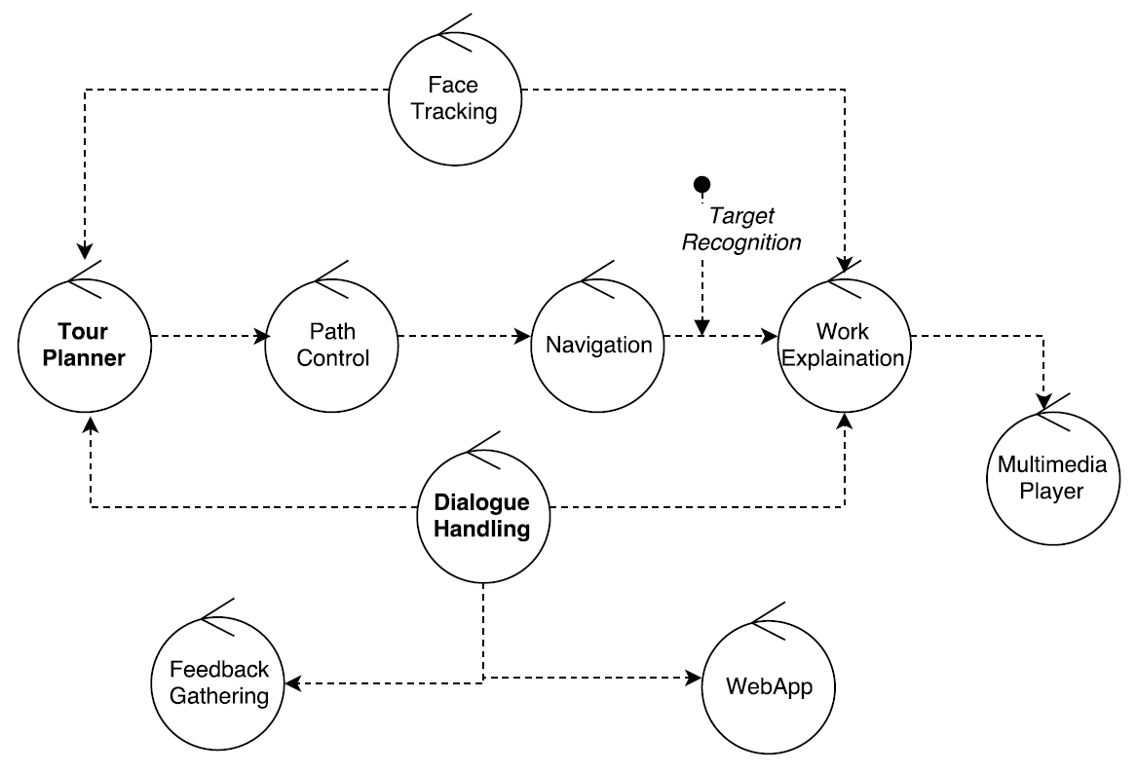
CUMA – Software Architecture IEEE 2018
(a) System Architecture
(b) Application Architecture
Fig.3 CUMA Architecture
Notes:
Once we choose the robot and the task that he have to manage, we designed the architecture of the system which is made of a set of behaviors.
In the architecture showed in the right figure, each circle corresponds to a specific behavior while arrows represent a dependence between two different behavior that interact exchanging data.
One of the behavior is the Tour Planner which makes Pepper able to determine the specific tour to follow.
It performs a planning process by selecting the order of the set of museum items to be visited.
The path tour can be selected using a pre-configured tour loaded or also using other modules of the system. For instance Pepper could recognize the emotions of the visitors such as fatigue, boredom or happiness and re-plan the tour accordingly.
After the path is chosen, the process continue to the Navigation module that allows the robot to move along the different works museum and then, once a work is approached, the robot start the work explanation using the multimedia player.
Two other main behavior of the architecture are the Dialogue Handling, which runs in parallel with the others behavior and that has the aim to managing the speech-based dialogue with visitors, and the Face Recognition that with the use of cameras can perform tasks like counting number of people in the group, guessing the age and the gender of people, or guessing their mood, or direct the robot body toward a visitors that has asked a question.

Slide 7
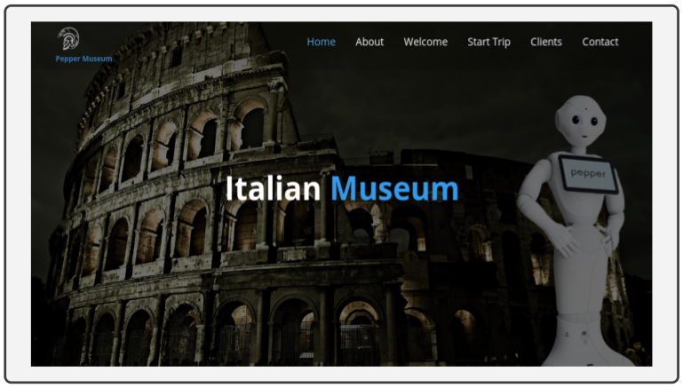
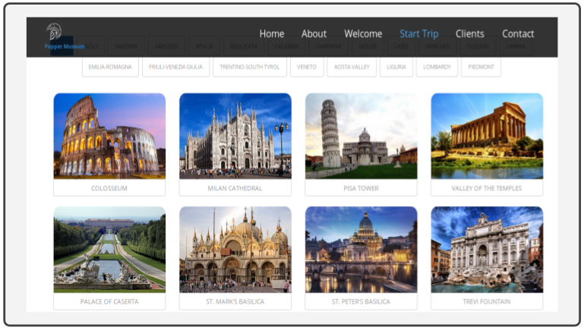
CUMA – Software Implementation IEEE 2018
Web Application: Communication interface of the multi-modal system
(a) Web Application Home
(b) Web Application Demo
Fig 4: Web Application
Notes:
Now that we have presented the architecture of the system we can (go through) focus on the implementation of the modules.
The first communication interface that we are going to see is the one web based.
This module has the task of showing information and speech-image-video description about the works of the museum.
The Web Apllication is written in HTML and JavaScript and runs directly on the Tablet.
As we can see in the video of this slide, users can interact with it using the touch-based navigation or with natural language giving specific commands to the robot.

Slide 8
CUMA – Software Implementation IEEE 2018
Speech Recognition: module for the voice recognition and speech synthesis. Integrated with a “Gesture Module” that allows the robot to talk in an expressive way.
Robot Activities | Sentences
Move | Follow me
Stop Move | Stop tracking
Start the museum presentation | Start Session
Show a presentation of the work <x> | Show work <x>
Work Explanation | <Question about the work x>
(a) Sentences of the voice command system
(b) Speech Recogniton Demo
Fig. 5: Speech Recognition System
Notes:
Speech recognition is an important asset for a robot that increase his ability to interact with human beings and above all using their most natural form of communication.
With this module we build a VOICE COMMANDS System based to manage different task using sentence commands.
Table (a) show some of the sentences/dialogues that we used.
This module make use of the QiChat Framework, a multilanguage system that categorize topics through lists of “rules”.
Gesture
The Speech Recognition module is integrated with a “Gesture Module” which contains a large library of flexible and fluid movement .
The ALAnimatedSpeech module allows to make the robot talk in an expressive way.
Gestures are one of the important parts of the Natural Language.
You can create more lively speech by annotating the text yourself with some instructions or by adding personal or predefinited animations for some words with ALSpeakingMovement.

Slide 9
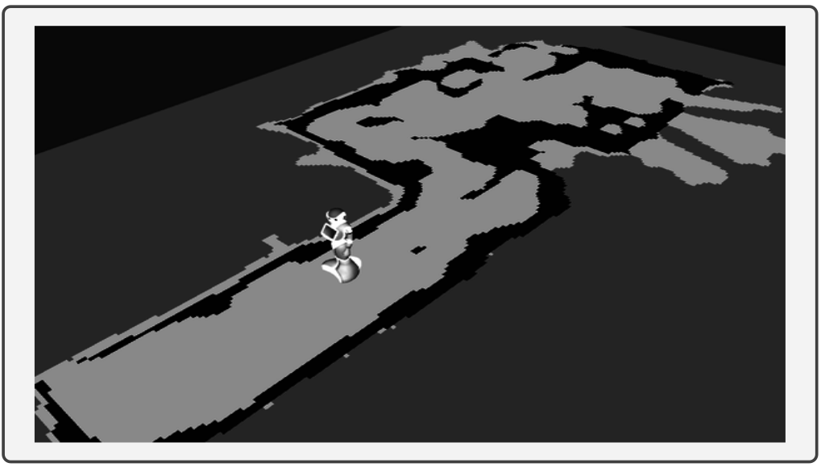
CUMA – Software Implementation IEEE 2018
Tracking: module for the navigation using Face Tracking and Landmarks
(a) SLAM Process
(b) Tracking Demo
Figura 6: Tracking System
Notes:
Module for the navigation using Face Tracking and Landmarks.
The movement of the robot is performed using both a map of the environment and some specific landmarks that allows Pepper to find its position in the museum. Landmarks are also used to identify museum items.
Once the target landmark is detected and the work is approached, the execution of the Work Explanation behavior is triggered; Pepper starts reciting the description of the work and showing multimedia contents on the tablet PC, activity that is performed by the Multimedia Player behavior.
SLAM: With the use of some of his sensors such as 3D camera, laser and sonar Pepper is able to:
Explore autonomously an unknown environment;
Build a map of this environment;
Localize himself and navigate inside this map.
The map can be retrieved as a 2D image.
Collision Avoidance: The robot is also capable to detect and avoid obstacles in its move direction.

Slide 10
CUMA – Experimental Results IEEE 2018
Qualitative test of the modules:
Computer Vision: emotion/age/gender recognition
Speech Recognition: natural language interaction
Tracking: collision avoidance system
Usability tests using Pepper in a public place to find out system problems and limitations
Notes:
To evaluate the system developed we designed a test-plan.
For instance, one of the test that we made was to build a vocabulary of sentences and verify, using the Speech Recognition and the Speech-to-Text module, how many words Pepper was able to recognize.
We also got an opportunity to test our system in a public place (MERI Conference) that gave us a huge opportunity to verify the usability of our system and also learn people’s opinion about.
It was also helpful to find-out our system problems and limitations.
Results-Evaluation
Through the testing we have found that the SR is not only sensitive to noise, but also sensitive to voice tone changes. We have also found that complex sentences are not always recognized.

Slide 11
CUMA – Future Works IEEE 2018
Integration of the Speech Recognition with a cloud based speech-to-text service (e.g. Google, IBM, Microsoft Speech to Text API)
Integration of the Speech Recognition with an Artificial Intelligence engine such as IBM Watson in order to manage the dialogue interaction
Add an Augmented Reality module to make Pepper able to improve user educational experience
Notes:
To solve this problem and other limits we are planning to improve the system developed:
Integration of the SR with a cloud-based speech-to-text service
Integration of the SR with an AI engine such as IBM Watson, in order to manage the dialogue interaction with the use of NLP (natural language processing) and deep learning.
To use an Augmented Reality module to improve the user experience or to monitor and preserve the state of the museum works.

Slide 12
Formal Template
Thank you for your attention!
Contact:
francescosancono91@yahoo.it

