Slide 1
#1375
Deep Object Detection with
Example Attribute Based Prediction Modulation
Zhihao Wu^{1,2}
Chengliang Liu^{1,2}
Chao Huang^{1,2,3}
Jie Wen^{1,2}
Yong Xu*^{1,2,3}
¹Bio-Computing Research Center, Harbin Institute of Technology, Shenzhen
²Shenzhen Key Laboratory of Visual Object Detection and Recognition
³Peng Cheng Laboratory

Slide 2
Outline
Introduction
Method
Experiments
Conclusion

Slide 3
Motivation
Deep object detectors face the gradient contribution imbalance during training:
One-stage detectors suffer from the background/foreground imbalance.
Detectors face the outliers/inliers imbalance.
Anchor-based detectors suffer from the imbalance caused by severe shape variations of examples. (We are the first to observe such imbalance.)

Slide 4
Solution
We ascribe these imbalance problems to the imbalance in example attributes, and further propose example attribute based prediction modulation (EAPM):
The attribute is defined by the prediction and the corresponding ground truth.
A novel modulating factor is introduced to adjust the prediction error according to the attribute.
The new prediction and the corresponding ground truth are taken as inputs of loss functions.

Slide 5
Understanding
Similar to loss function redesigning, the nature behind our strategy is to reformulate the gradients of examples according to their attributes, thereby adjusting their contribution on the global gradients. However, we do not need to design new gradients but only use the original ones by changing errors.
gradient
new
original
error

Slide 6
Outline
Introduction
Method
Experiments
Conclusion

Slide 7
EAPM
is designed to guide the training of detectors, where and denote the classification result and the ground truth, t and t* represent the regression result and the ground truth.
First, are introduced to denote specific attributes of examples in classification and regression, respectively.
Next, are designed to adjust the prediction error. The predictions are updated as: .
Finally, the loss function is recalculated by inputting the new predictions and the targets:
So, the gradients are reformulated as well.

Slide 8
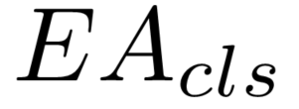
EAPM with Focal Loss
We apply EAPM with focal loss in the classification training of one-stage detectors. Focal loss is defined as:
To apply EAPM, we first introduce as to define example difficulty. It equals to the absolute value of probability prediction error. Thus a larger Dif denotes that the example is harder.
Then, we define . After that, we can calculate the new prediction.

Slide 9
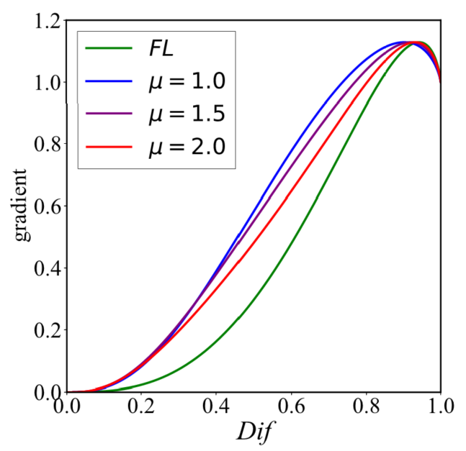
EAPM with Focal Loss
(a) When examples are easy or very hard, the gradients are nearly unaffected while the ones of other examples increase. (b) The tunable parameter μ smoothly adjusts the rate at which examples are up-weighted. Intuitively, EAPM with focal loss increases the gradients of all examples except for easy and very hard ones. This in turn reduces the importance of background examples and outliers.

Slide 10
EAPM with Balanced L1 Loss
We apply EAPM with balanced L1 Loss in the regression training of anchor-based detectors. Balanced L1 Loss is defined as:
where d = t – t*. We first introduce Gap-over-Sum (GoS) as EA_{reg} to define the shape variation degree.
Then we define . After that, we can calculate the new prediction.

Slide 11
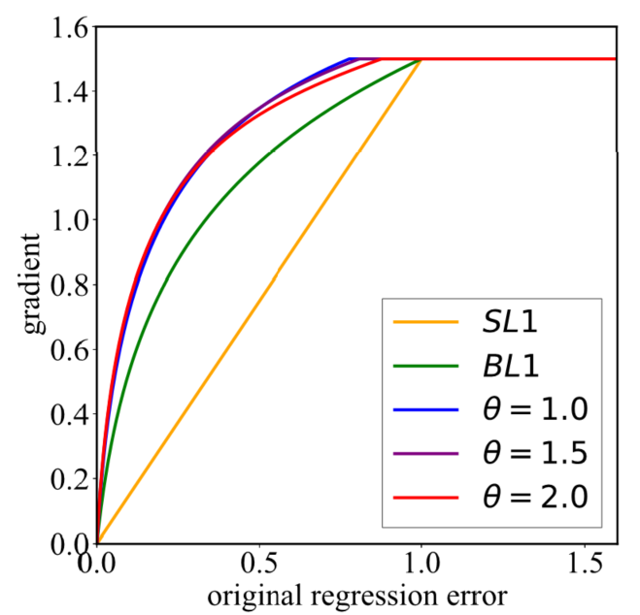
EAPM with Balanced L1 Loss
Compared with smooth L1 loss, balanced L1 loss increases the gradients of inliers to increase their importance. With EAPM, the gradients of inliers with large shape variations are up-weighted. And the tunable parameter θ determines the increasing rate of their gradients.

Slide 12
Outline
Introduction
Method
Experiments
Conclusion

Slide 13
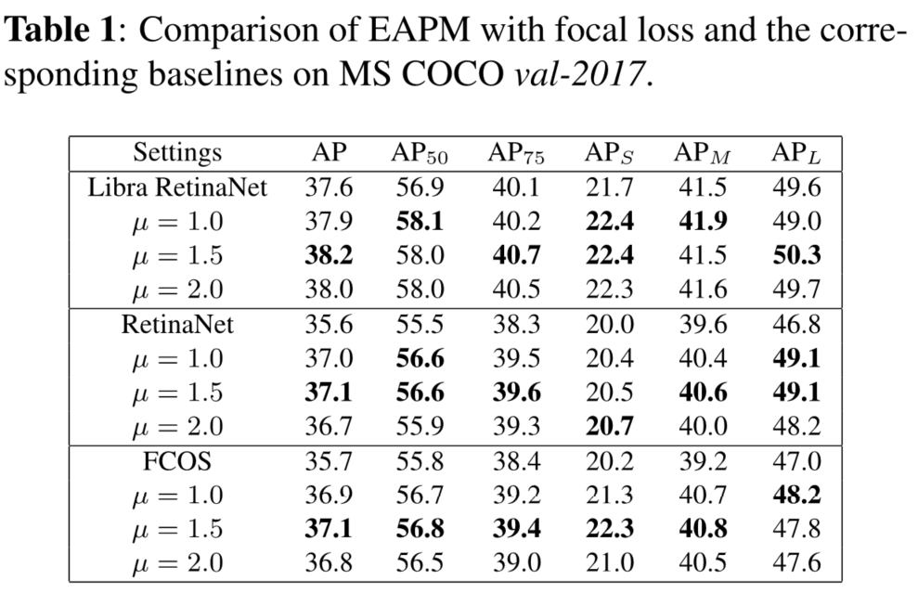
EAPM with Focal Loss

Slide 14
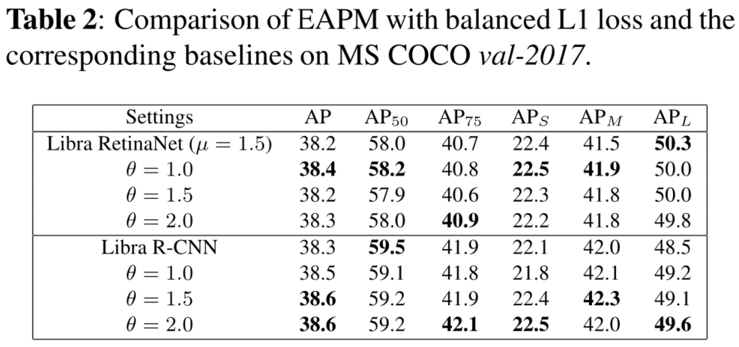
EAPM with Balanced L1 Loss

Slide 15
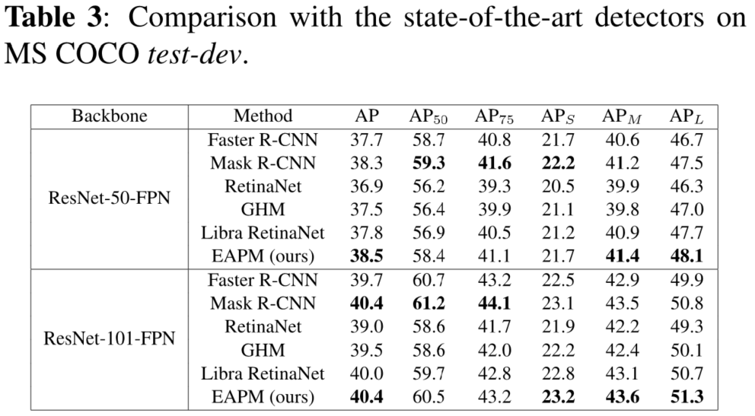
Main Results

Slide 16
Outline
Introduction
Method
Experiments
Conclusion

Slide 17
Conclusion
In this work, we focus on the gradient contribution imbalance in the training of deep object detectors and ascribe this imbalance to the example attribute imbalance. Furthermore, we propose EAPM, a strategy in cooperation with loss functions to simultaneously solve such imbalance in classification and box regression. Extensive experiments show that EAPM is very applicable for both one-stage detectors and two-stage detectors using various backbones. The detectors using EAPM can easily achieve the state-of-the-art performance.

