Slide 1
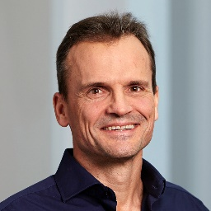
Digraph Signal Processing with Generalized Boundary Conditions IEEE Trans. Signal Proc. Vol. 69, pp. 1422-1437, 2021
Bastian Seifert Markus Püschel
Department of Computer Science
IEEE ICASSP 2022
Notes:
In this talk on the ICASSP 2022 I present our paper
"Digraph Signal Processing with Generalized Boundary Conditions"
which appeared in the IEEE Transactions on Signal Processing and is co-authored by Markus Püschel and me.

Slide 2
Graph Signal Processing...
Concept | Undirected Graphs | Directed Graphs (Digraphs)
Shift/Variation operator | ✓ (Adjacency or Laplacian) Symmetric | ✓ (Adjacency or Laplacian) Not symmetric
Convolution | ✓ | ✓
Fourier Basis/Transform (eigendecomposition) | ✓ | ✗ Does not exist in general
Orthogonality | ✓ | ✗ (In general no)
Digraph Example:
No eigendecomposition/Fourier basis
Only one eigenvalue (Jordan Block)
Notes:
So, Graph Signal Processing is now a widely accepted and used field, partially due to the nice properties it shares with classical signal processing, like one has a shift operator, which yields convolution, one obtains a Fourier basis and transform via eigendecomposition of the shift and the transform is then even orthogonal, as the shift matrices are symmetric. So everything nice and cool!
But this is only the case for undirected graphs, for directed graphs things are not so nice anymore. While there exist notions of shift operator, they are not symmetric anymore, which in turn gives the problem that the graph Fourier transform does not exist in general anymore as a general matrix might not be diagonalizable. And even when it is, the Fourier transform does not need to be orthogonal anymore.
As example consider the path graph, modeling finite discrete time. The shift operators here have only one eigenvalue and can not be further decomposed, as the eigenvalues belong to one large Jordan block.
So this means that Graph Signal Processing with directed graphs is problematic.

Slide 3
Digraph Signal Processing is an Open Problem Graph Signal Processing: Overview, Challenges, and Applications, Ortega et al., Proc. IEEE, vol. 106(5), pp. 808–828, 2018
Jordan-Normal-Form + Tricks:
Fourier transform via optimization:
Approximate diagonalization:
Complex-valued Shift:
Subset of diagonalizable filters:
Notes:
And indeed Digraph Signal Processing is an open problem, as stated for example in the overview paper on Graph Signal Processing by Ortega and co-authors.
Also a short look into the literature shows that there are various approaches to obtain a well-defined notion of Fourier transform for digraphs, ranging from computational tricks to stabilize the computation of the Jordan Normal form, over Graph Fourier bases which do not diagonalize the shift but are obtained via optimization of measures like the spectral dispersion, to just considering the subset of diagonalizable filters of all graph filters.

Slide 4
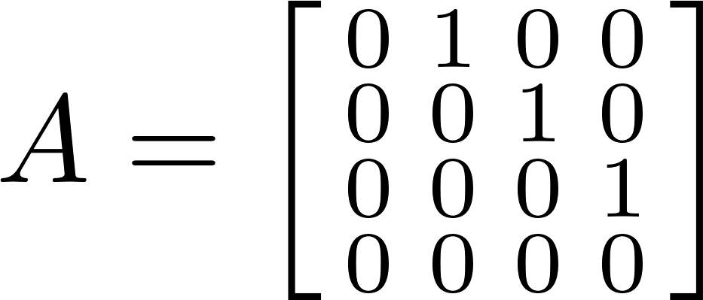
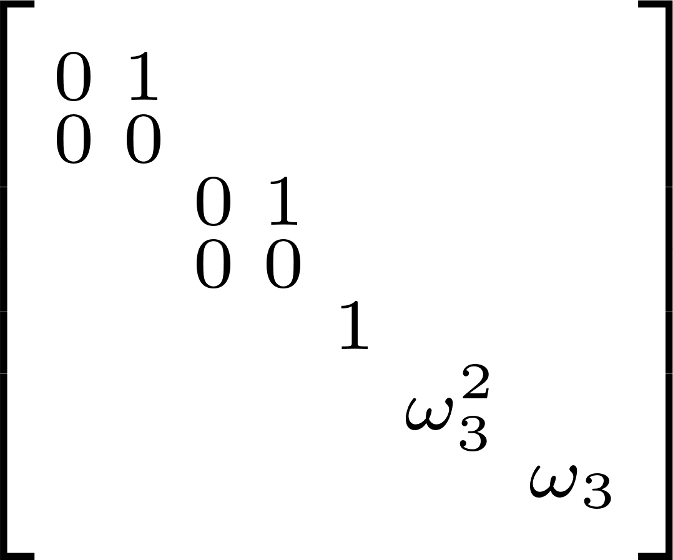
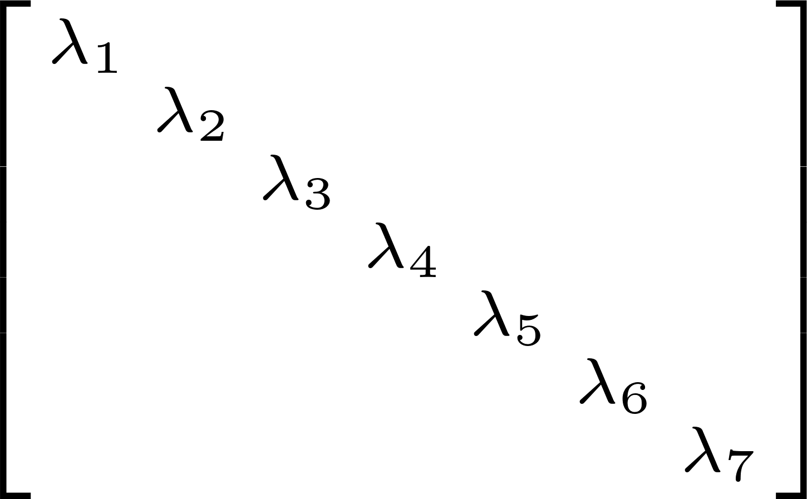
Our Key Idea: Boundary Conditions
Classical Signal Processing
Digraph for finite discrete time
Can we do this for other digraphs?
This is done even when the signal is not periodic!
Goal: Add small number of edges to obtain Fourier basis of eigenvectors
Notes:
Our approach to the problem of Digraph Fourier Transform is very different from the previous ones, as our motivation is quite different leading to a vastly different route and solution.
Consider classical signal processing. Finite discrete time is associated with the directed path graph. However, as we have seen in the intro, this digraph is not diagonalizable at all. Also, this is not what is used in classical signal processing. Indeed, in classical signal processing one considers periodically extended signals, which can be modelled by adding an edge from the last to the first vertex – the periodic boundary condition.
Now the resulting graph is indeed diagonalizable and by the classical discrete Fourier transform. So adding a boundary condition in form of a edge makes the digraph diagonalizable.
Here I also want to stress that this is done, even when the signal is not periodic!
The question we now ask is: Can we do this for other digraphs? For example consider this graph, whose adjacency matrix has a Jordan Form with two Jordan blocks of size 2.
If we add these two edges here, the new adjacency matrix now has simple eigenvalues and hence an eigendecomposition.
Our goal is now to find a small numbers of edges to add to a digraph to obtain a Fourier basis of eigenvectors.

Slide 5
Edges to Destroy Jordan Blocks
Tool: Perturbation Theory
Our work: Specialize to Adjacency/Laplacian matrices
Corollay: Adding an edge is enough to destroy the largest Jordan block to a choosen eigenvalue.
Q: How to find these edges?
Jordan-Normal-Form
Notes:
To do this, we import the mighty tool Perturbation Theory. Especially, we make use of one theorem, which was proofed simultaneously by Savchenko and by Moro and Dopico, which describes the change of the Jordan structure of a matrix under the addition of a matrix of low rank.
This fits to our setting, as a new edge corresponds to adding a matrix with one entry only, that is a matrix of rank one.
Our corollary of this theorem is a specialization to adjacency and Laplacian matrices and states that we can indeed take such a matrix to destroy the Jordan block. However the question how to find these edges remains.
This question we also answered by specializing above theorem and it is given in terms of a spectral condition, by a sum of left and right multiplications of the matrix with the edge to the eigenvectors of the Jordan blocks to an eigenvalue.
That is, if this condition is fullfilled, then in the perturbed adjacency matrix, corresponding to the graph with an added edge, the largest Jordan block to the eigenvalue is destroyed.

Slide 6
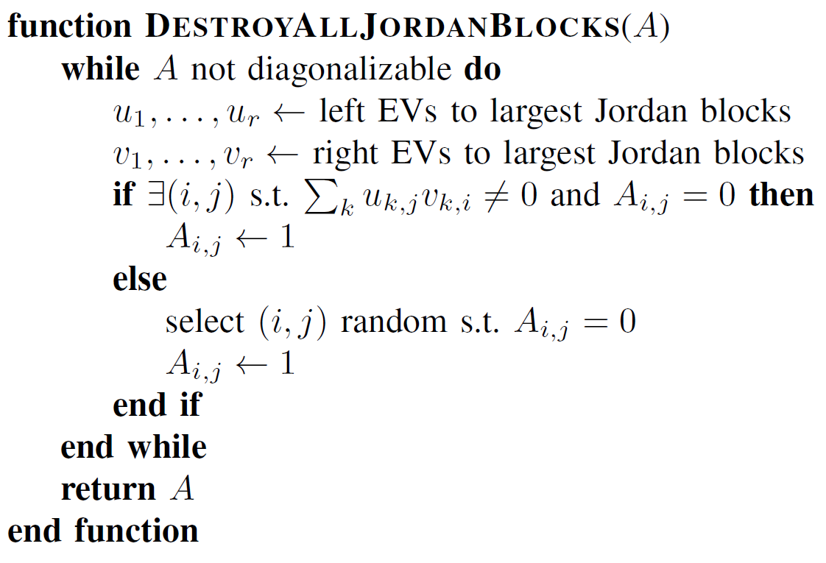
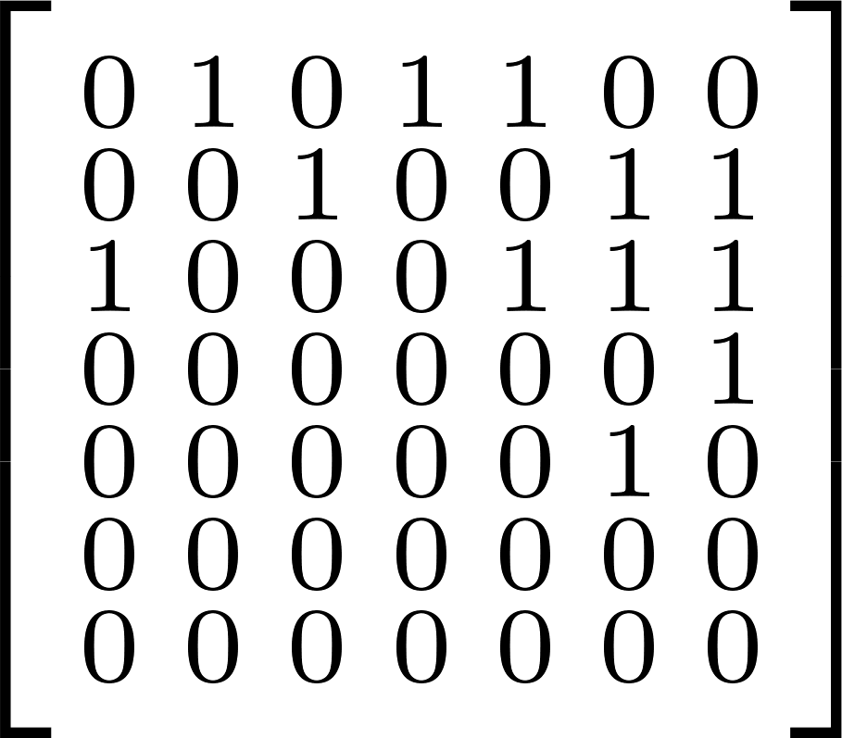
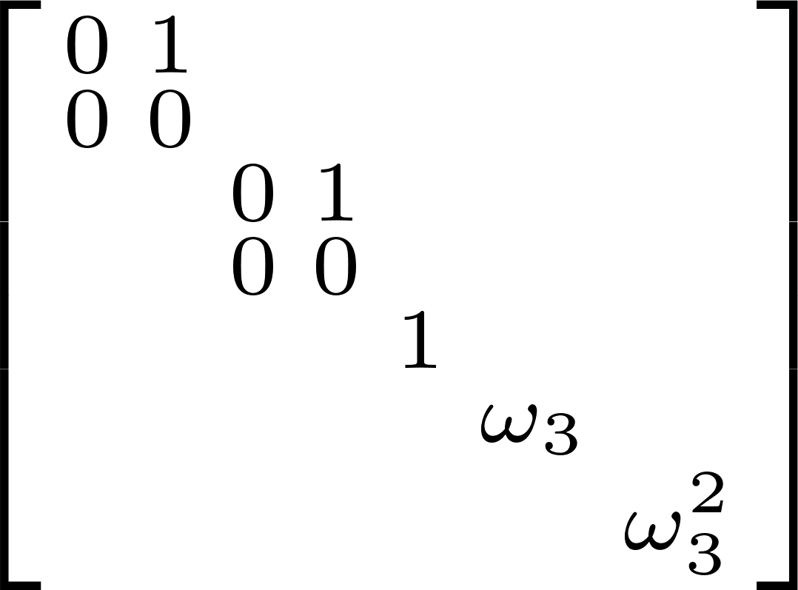
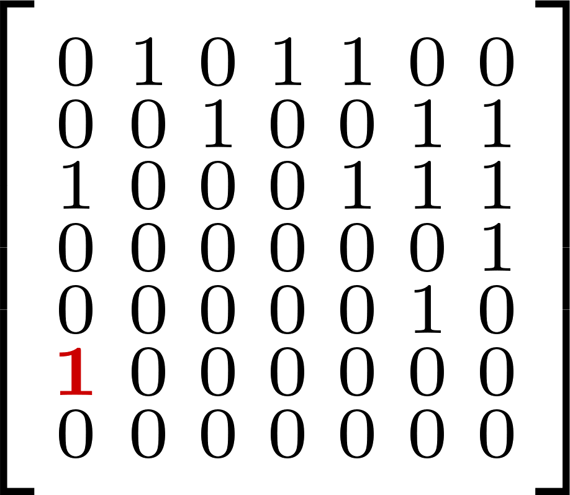
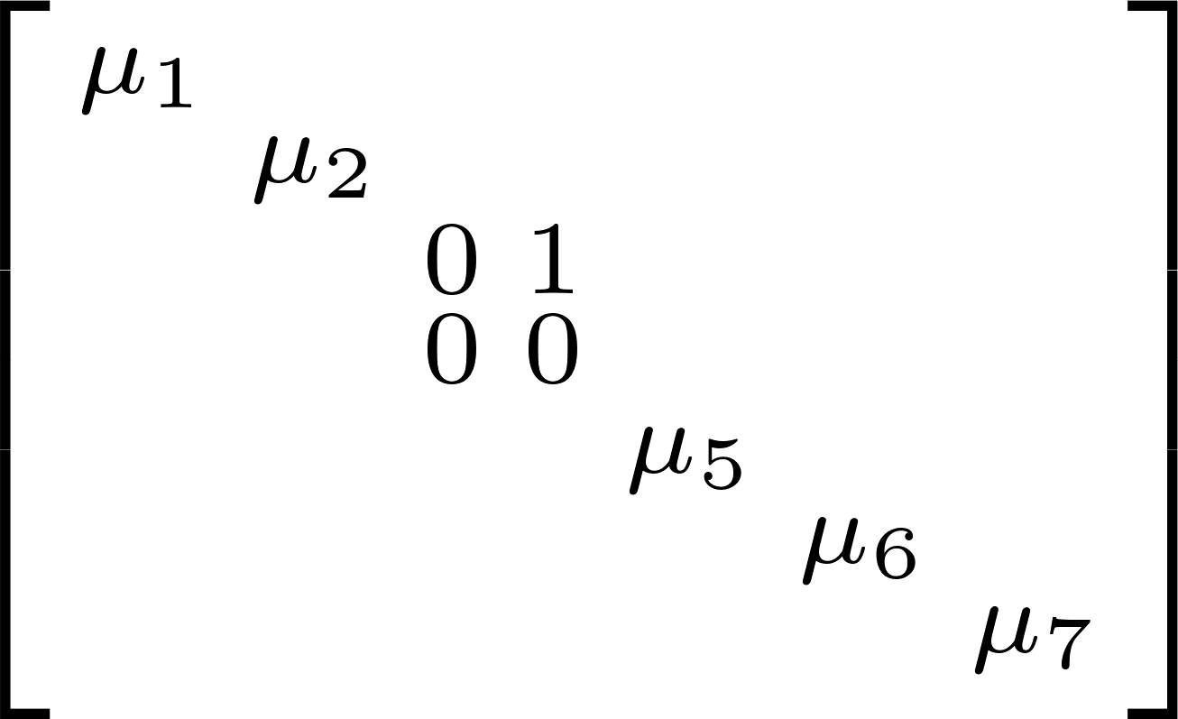
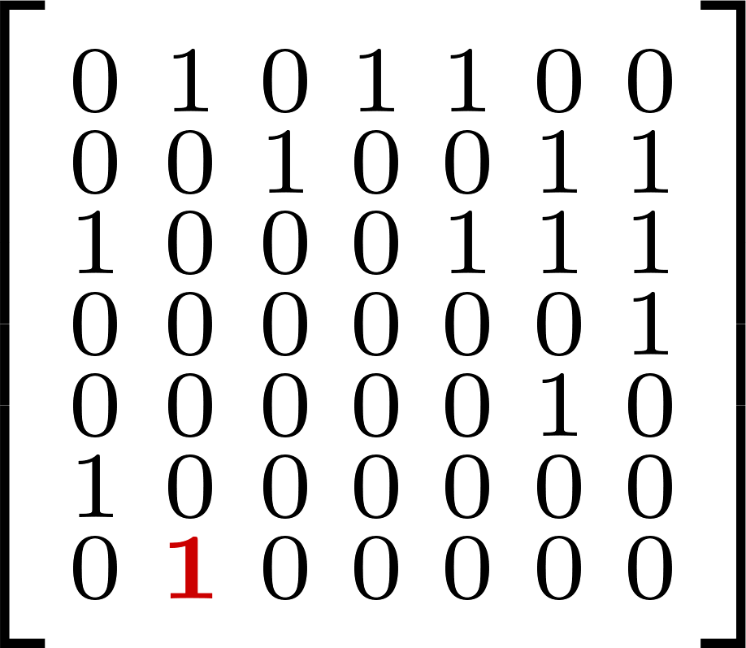
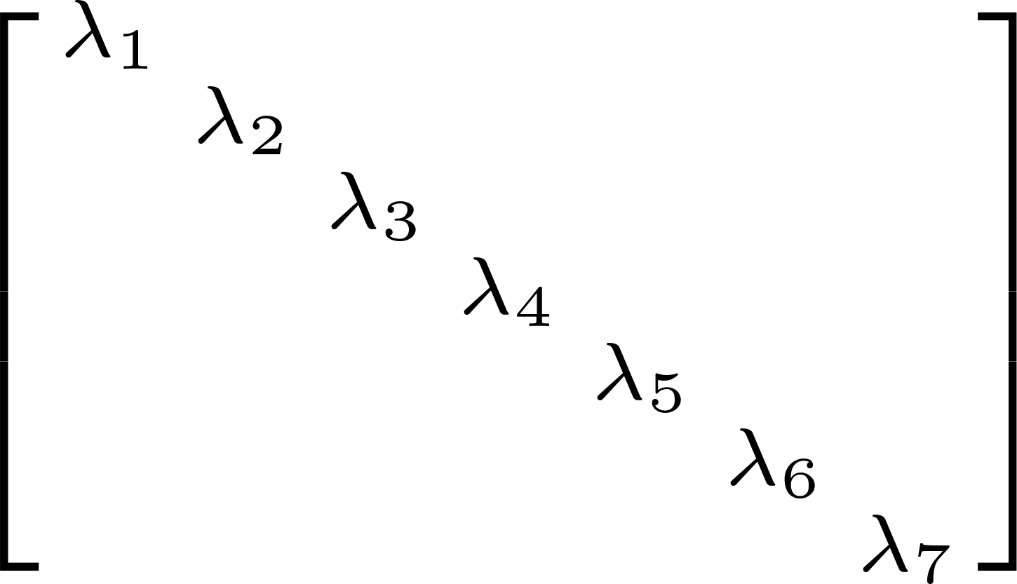
The Algorithm
Numerical Implementation:
Needs some tricks, see paper/poster
Faster, Inexact Implementation:
Eigenvalue 0 appears often, use that
Notes:
Our theorem gives us a way to add one edge to destroy one Jordan block. In reality however, there might be several Jordan blocks. So we iteratively destroy the Jordan blocks, until the adjacency matrix is diagonalizable. Note that we needed some tricks to implement a numerical version of this algorithm and that we found a faster but less exact version of the algorithm by leveraging the observation that the eigenvalue zero appears frequently.
So to see how this algorithm works, we consider our running example, which has two Jordan blocks. To destroy the first one, our condition gives use four possibilities and we choose to add the edge 6 to 1. As one can see, the first Jordan block gets destroyed by this edge, but the second remains.
Checking the condition again, we now have less possibilities to destroy the second block. We decide to add the edge 7 to 2, resulting in a diagonalizable digraph.

Slide 7
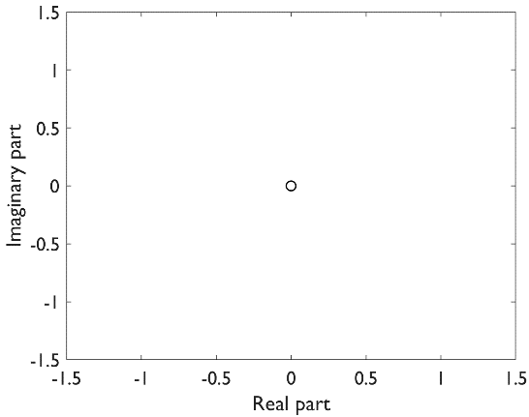
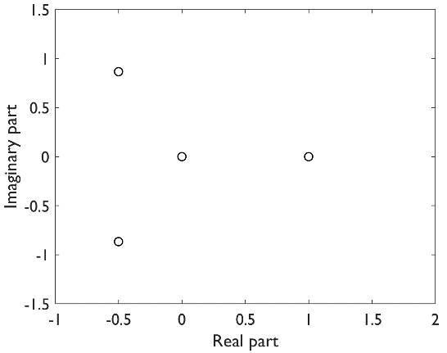
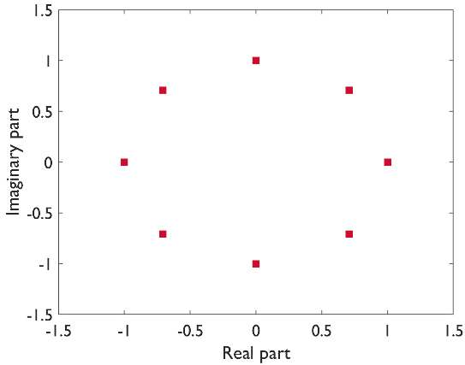
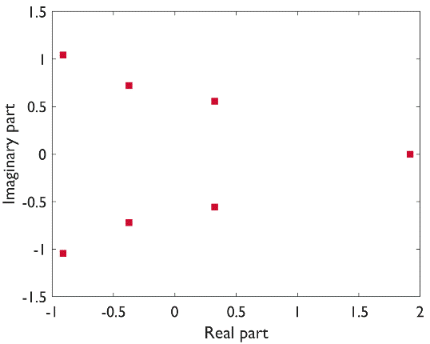
Behaviour of Eigenvalues? (Spectrum)
Finite Discrete Time
Spectrum
Spectrum
with periodic extension
Notes:
An interesting question is, what happens to the eigenvalues, that is the spectrum, under these edge adding algorithm.
First, we consider the classical finite, discrete time setting. The directed path graph has as only eigenvalue the eigenvalue zero with multiplicity eight. Adding the periodic boundary condition splits the eigenvalue zero to – in this case – eight simple eigenvalues all lying on a circle, corresponding to the classical frequencies or spectral values.
Now for our running example, we have three simple eigenvalues and the eigenvalue zero with multiplicity four.
Adding the two edges from our algorithm now splits up the eigenvalue zero to two circles (corresponding to the two Jordan blocks) but also moves the other eigenvalues a tiny bit. So the behaviour is similar to the one from classical signal processing, hence makes sense.

Slide 8
Generally Applicable & Fast
Random digraphs with different properties, 500 nodes & ~5000 edges
Medium number of edges added: 27
Median runtime: 6 seconds
Notes:
To show that our algorithm is generally applicable and fast, we used different random models and generated one hundred digraphs for each model, each with 500 nodes and approximately 5000 edges.
Our results show, that the algorithm in each case adds only a small number of edges, even in the worst case it only added 1 % additional edges and required only half a minute, while typically it runs very fast.

Slide 9
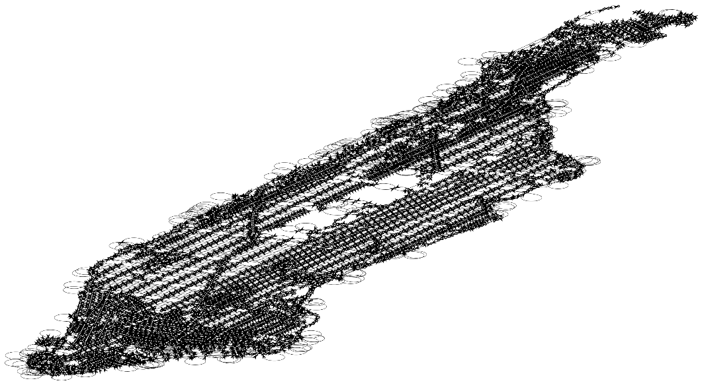
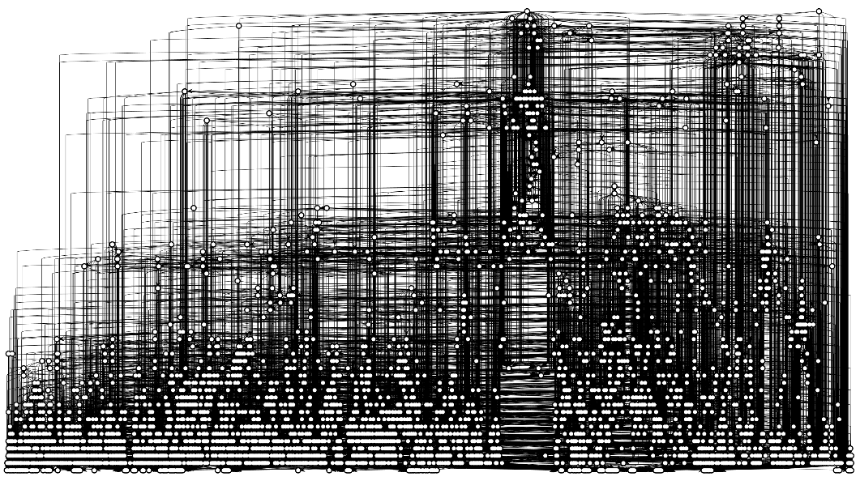
Scalable
Manhattan Taxi Graph
Li & Moura, ECAI, 2020
5464 nodes & 11568 edges
Runtime: 19 hours,
243 edges added
Runtime (inexact algo): 5 min,
772 edges added
Citation Graph
https://snap.stanford.edu/data/cit-HepPh.html
4989 nodes & 17840 edges
Runtime (inexact algo): 31.5 min,
1911 edges added
Notes:
Also the inexact algorithm, which leverages the presence of the eigenvalue zero, is scalable to very large graphs.
Our first large Graph is the Manhattan Taxi Graph from Li & Moura consisting of five and a half thousand nodes and 11 thousand edges.
While the normal, exact algorithm required 19 hours and added 243 edges, the inexact algorithm ran in only 5 minutes, but added thrice as many edges.
Another interesting, large graph is the the Citation graph obtained from arxive papers citing each other. It consists of 5000 nodes with 18 thousand edges and is almost acyclic, which means that the eigenvalue zero is almost the only eigenvalue. We only ran the fast inexact algorithm, which added 2000 edges within half an hour.

Slide 10
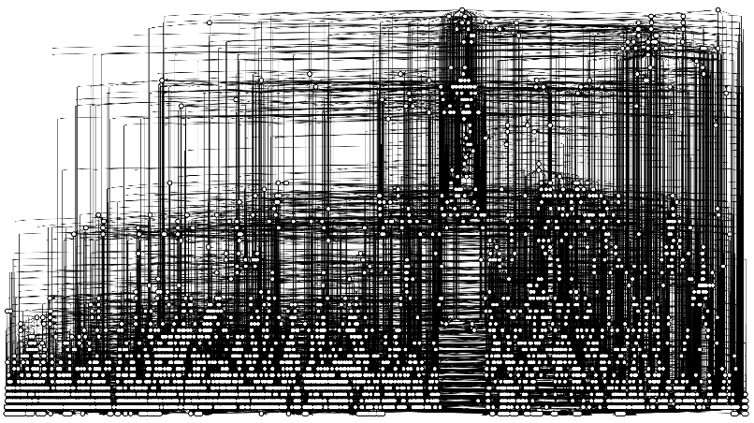
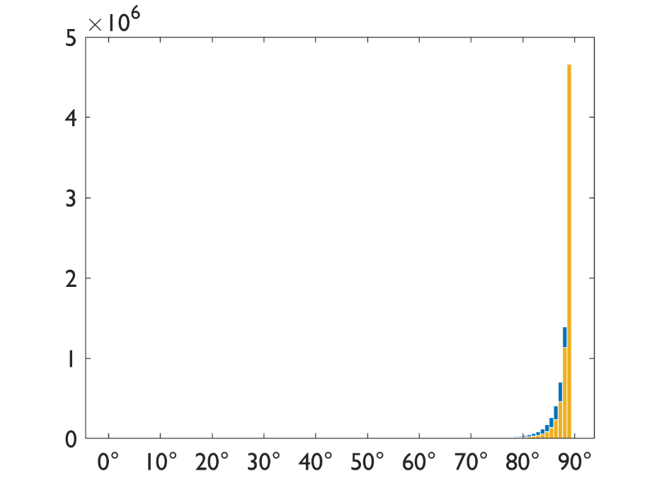
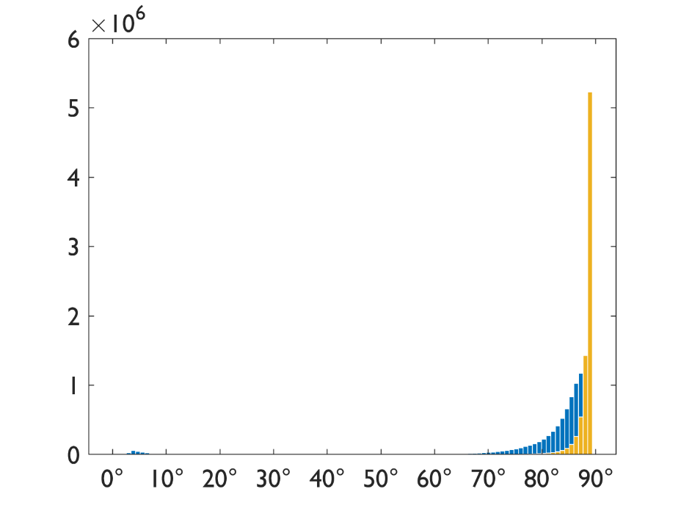
Fourier bases found are almost orthogonal
Histograms of pairwise angles between basis vectors
Notes:
Also the obtained Fourier basis is almost orthogonal. We show this by showing histograms of the pairwise angles between basis vectors. An orthogonal matrix would have all angles being 90 degrees. The basis vectors we obtain are almost as good, where we have only few vectors with none orthogonality. Note that a directed graph can only be diagonalized by an orthogonal matrix if it is regular, i.e., if all vertices have the same in and out degree.

Slide 11
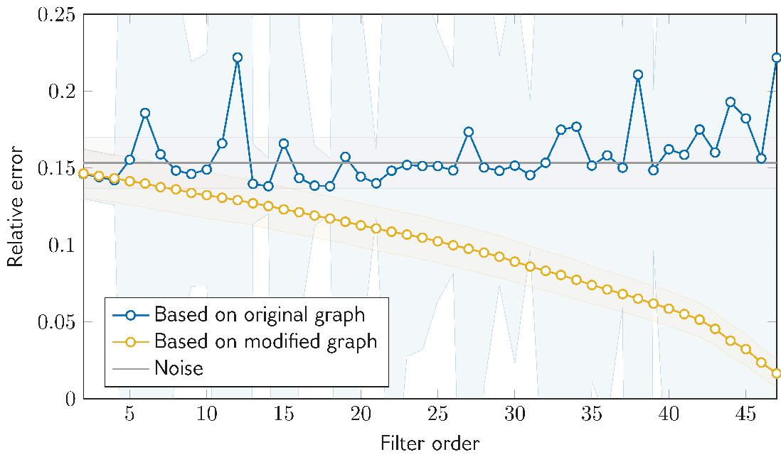
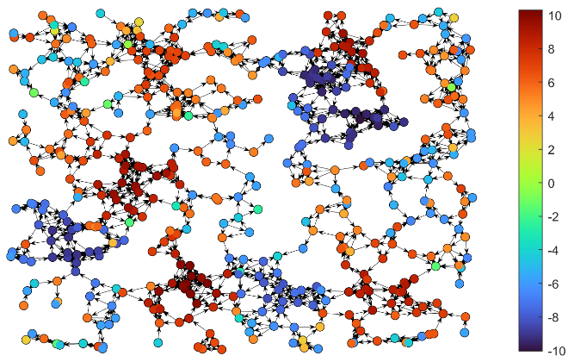
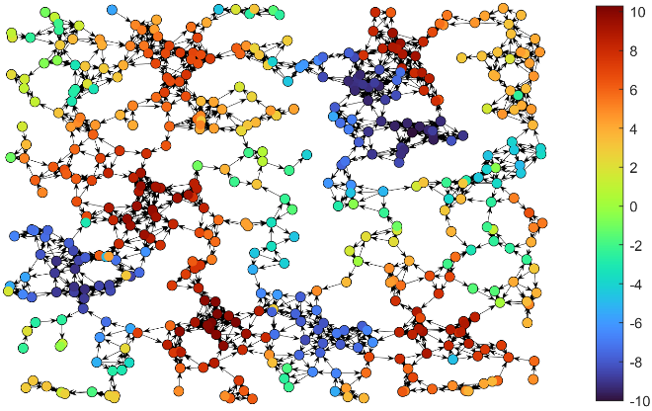
Applications
Enable Wiener Filter based on Gavili & Zhang, IEEE Trans. Signal Proc., 2017
Requires Fourier Basis
Upcoming Paper
Denoising
Notes:
Finally, this basis is also useful for applications, as we showed in our paper by enabling a graph Wiener filter which requires a Fourier basis on digraphs.
And in an upcoming paper with Vedran Mihal, we showed that our Fourier basis is very well-suited for denoising with unrolling networks.

Slide 12
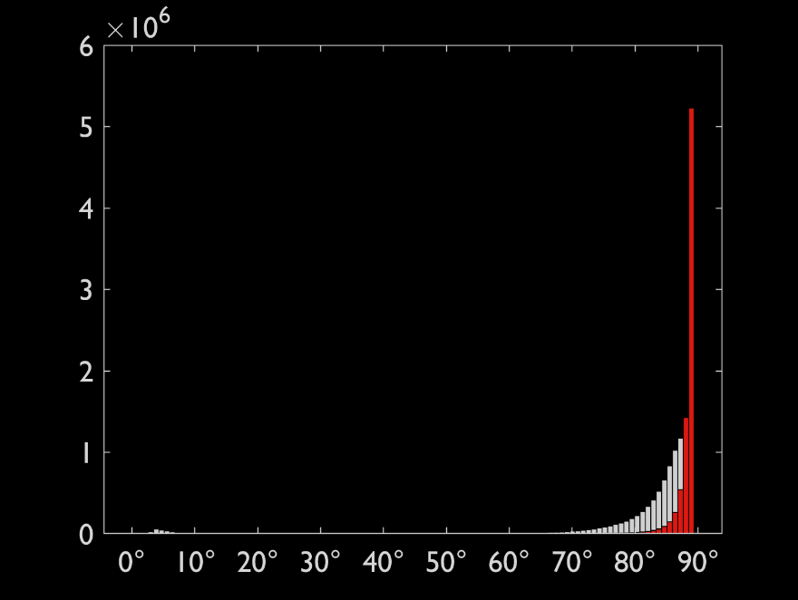
Fourier Bases for Digraphs by Adding Edges to the Graph
Classical discrete finite time signal processing
Generalized boundaries
Eigendecomposition exists
Eigendecomposition exists
Generally applicable & scalable
Fourier bases found are almost orthogonal
Notes:
To wrap up: This talks was about a method on how to obtain Fourier bases for digraphs by adding edges to a graph.
It was motivated by classical discrete finite time signal processing, where we interpreted the classical periodic boundary condition as an additional edge, going from the last to the first vertex.
This we generalized to arbitrary digraphs, leveraging perturbation theory and derived an algorithm, which makes any digraph diagonalizable.
This algorithm is generally applicable, fast and scalable.
Also, the obtained Fourier bases are almost orthogonal, a desirable property.
If you have any questions, I would love to see you at the poster session!

