Slide 1
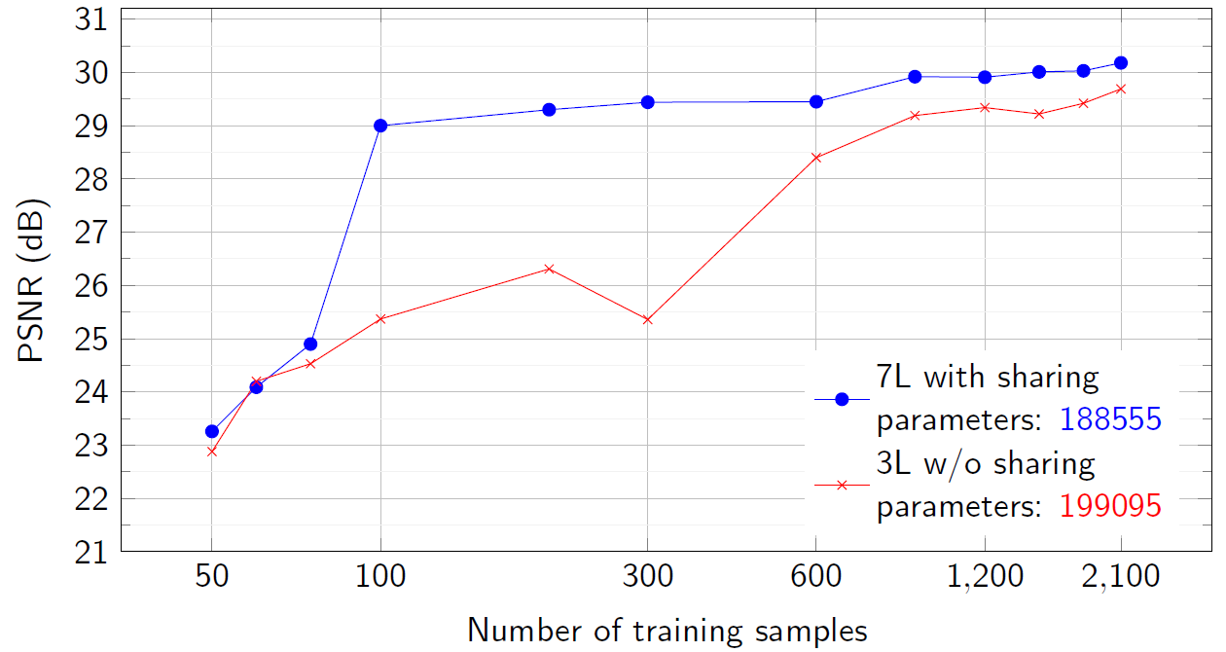
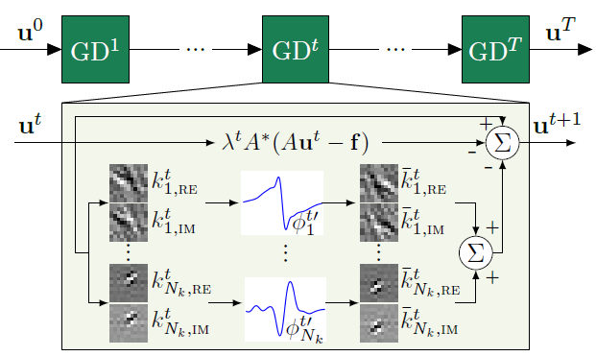
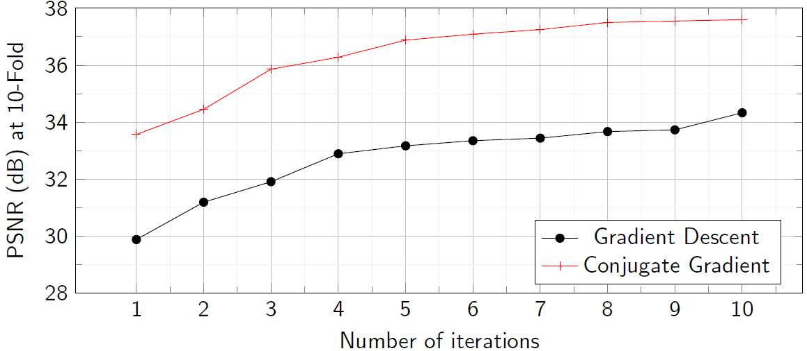
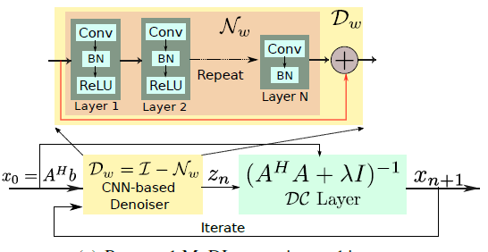
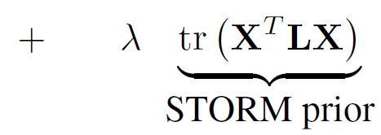
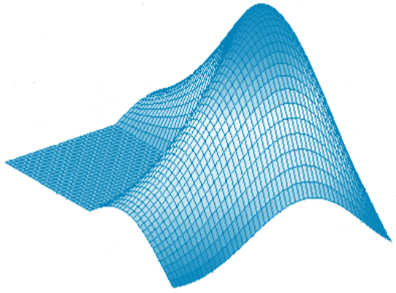
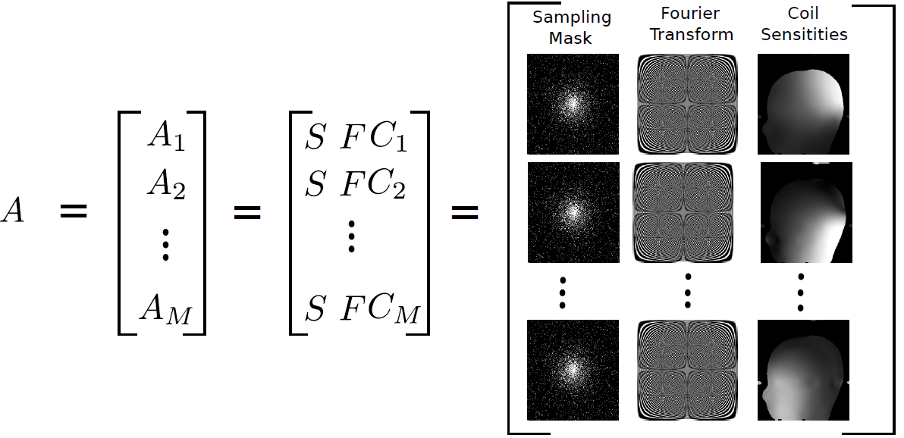
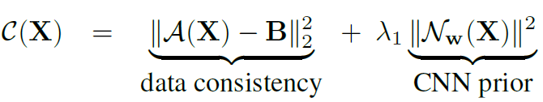
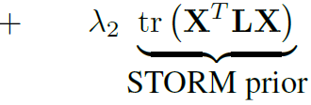
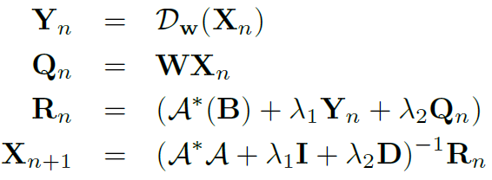
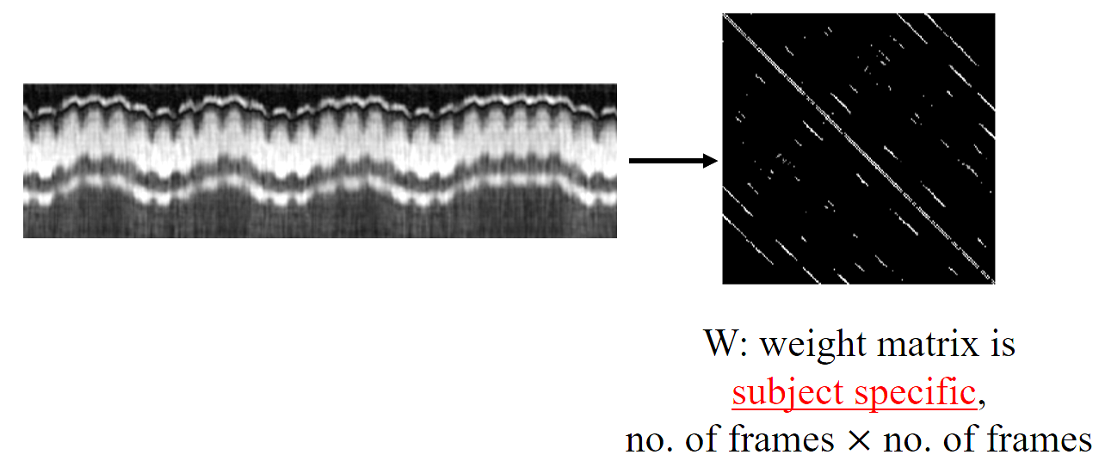
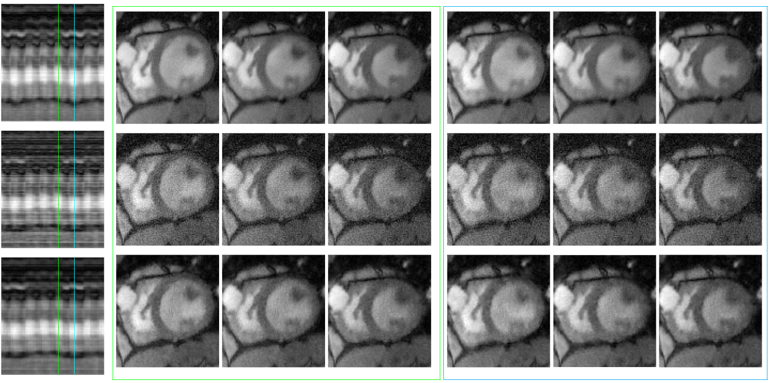
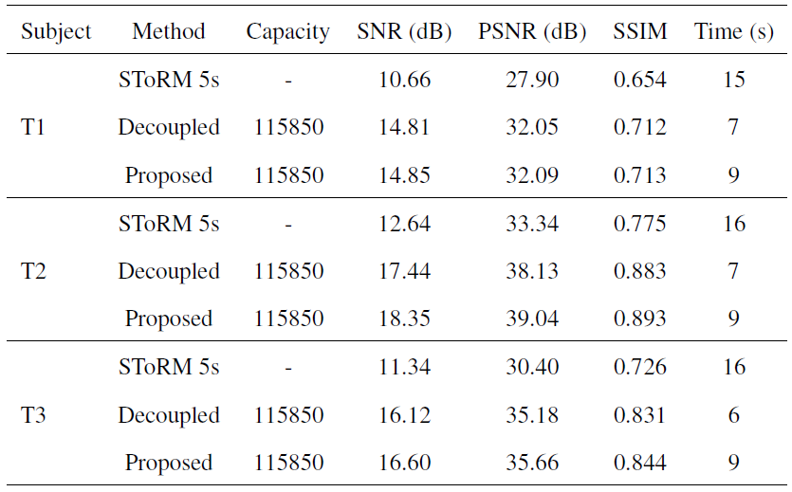
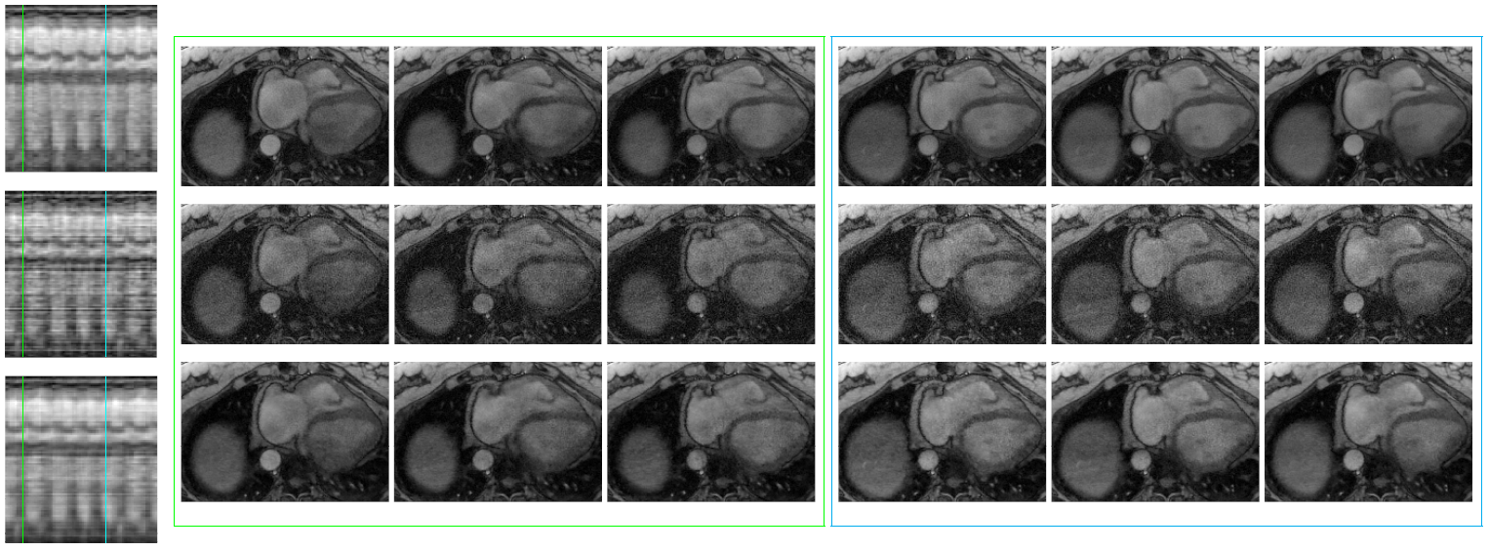
MODEL BASED DEEP LEARNING IN FREE BREATHING, UNGATED, CARDIAC MRI RECOVERY
Sampurna Biswas, Hemant Aggarwal, Sunrita Poddar & Mathews Jacob; University of Iowa
Contact: sampurna-biswas@uiowa.edu
Inverse problems in MRI are ill posed:
due to undersampling
Model based deep learning: MoDL
Related work -I
MoDL: can be trained with
less training data
Related work -II
MoDL: CG within network,
improved performance
CNN : learns the noise
Model based solution
A captures physics/ “model”
Regularizer needed
‘learnable’
Clean data
Image of 0s
Generative adversarial networks, Mardani et al, 17
CNN:
Alternating minimization, subproblems:
Noise
Noise
Learning based recovery: , learned CNN
CG:
local redundancies
Captures acquisition
Learns local features
Cascade networks, Schlemper et al. 17
Variational networks, Hammernik
et al. 17
may not be data consistent!!
Unrolling
Different networks at each iteration: not consistent with model based framework
NO weight sharing = increase complexity of networks at each iteration
Large network = needs more training data
Many gradient descent steps
Large network on unrolling
GPU memory constraints
Conjugate Gradient has faster convergence than GD
needs fewer alternating steps
Aggarwal et al., MoDL, arXiv, Nov ‘17,
Qin et al., CRNN, arXiv, ‘18
Goal: accelerated free breathing, ungated cardiac MR
MoDL-SToRM
Current methods | Proposed (MoDL-SToRM)
Static; Breath-held or gated | free breathing, ungated
acceleration of 11x | realistic FB accelerations
Cartesian. random trajectory mostly | Radial, golden angle
Most assume single coil acquisition | exploits multiple coils
Most forward operators with analytical inverse | forward operators with non-analytical inverse
Mostly, no weight sharing along the iterations | enforces weight sharing
Mostly, no subject specific priors | Can include scan specific priors!
Local priors only | Non-local priors!
State of the art in free breathing, ungated cardiac MR
Model based recovery with SToRM
Model based reconstruction : SToRM (SmooThness Regularization on Manifolds)
SToRM
5 s
Images in similar phases
dissimilar phases
45 s/long
SToRM +DL
$A_{i}$ : time varying lines + fixed radial navigators
Multi-coil time varying Fourier sampler
5 s/short
Real time recon
SToRM prior:
W: weight matrix is
subject specific,
computed using navigators
#frames $×$ #frames
Implicit “soft” binning: weighting images based on their cardiac & respiratory phases
Long scan time !
Need: $W_{45s}→W_{5s}$
Poddar et al., SToRM, TMI 2016
MRI forward model : not invertible analytically
Integrating MoDL with SToRM: shorter scan time
Proposed iterative model
Training: with alternating minimization
Input:
ZF recon from
5s acquisition
W
Target:
SToRM recon from
45s acquisition
3D batch of
512 x 512 x 7
(limited by GPU)
global information!
512 x 512 x 91
$λ_{1}, λ_{2} :$trainable
CG iterations in DC block
Not invertible analytically
Storm: subject dependent,
non-local redundancies
CNN: local, spatio-temporal
redundancies
DC captures sampling
& coil sensitivities
Training details
Reconstruction at different cardiac & respiratory phases
Error images & time profiles
Conclusion
Dataset
Sampling : 6 golden angle + 4 uniform radial navigators
Time : 900 frames ~ 45s; Size: 512x512x900
Trained on 4 subjects ; Tested on 3
Network
3 layer (64-64-2), 1st 2 layers, 3x3 last, capacity:1e6, shallow
Adam on squared error loss
N = 3 repetitions
Test time: 5.2s/N to reconstruct 512x512x91 (5s);
real time recovery!
1) SToRM 45s
2) SToRM 5s
Denoising on SToRM 5s
3) 3 L CNN
4) Proposed 5s
MoDL-SToRM
SToRM 45s
Limited training data
Shallow recurrent network
Parallel-MRI forward model integrated with a CNN !
DC + CNN/local + scan specific /non-local constraints
Prospective data with multi-coil acquisition
SToRM 5s
SToRM 5s
CNN
Proposed 5s
Respiratory phase 1
SToRM
5 s
45 s/long
SToRM +DL
5 s/short
Real time recon
desirable reconstruction from accelerated acquisition
in real time
Future: navigator-less acquisition!
Cardiac phase 1

